Slide 1
doc.: IEEE 802.15-22-0389-02-06ma
Project: IEEE P802.15 Working Group for Wireless Personal Area Networks (WPANs) Submission Title: [Overview of IG-DEP, SG6a, TG6a, and TG15.6ma for Revision of IEEE802.15.6-2012 Wireless BAN with Enhanced Dependability]
Date Submitted: [16 May 2023]
Source: [Ryuji Kohno, Takumi Kobayashi] [1;Yokohama National University(YNU), 2;YRP International Alliance Instiitute(YRP-IAI)]
Address [1; 79-5 Tokiwadai, Hodogaya-ku, Yokohama, Japan 240-8501
2; YRP1 Blg., 3-4 HikarinoOka, Yokosuka-City, Kanagawa, Japan 239-0847 ] Voice:[1; +81-90-5408-0611], FAX: [+81-45-383-5528],
Email:[1: kohno@ynu.ac.jp, kobayashi-takumi-ch@ynu.ac.jp, 2:kohno@yrp-iai.jp, kobayashi-takumi@yrp- iai.jp]
Abstract: [This document summarizes IG-DEP, SG15.6a , TG6a, and TG6ma activity for revision amendment of IEEE802.15.6 - 2012 Medical Body Area Network(BAN) corresponding to increasing for enhanced dependability in wireless sensing and controlling human and car bodies for medical healthcare and automotive uses. After quick overview of IEEE802.15.6 -2012, necessity of the amendment is described in such critical use cases that various types of interference such as intra BAN interference in multiple overlaid BANs, interference among BAN and other PANs in some overlaid frequency band etc. Extension of BAN from human body for medical healthcare to car body for automotive uses and their combination are discussed as a common standard.]
Purpose: [information]
Notice: This document has been prepared to assist the IEEE P802.15. It is offered as a basis for discussion and is not binding on the contributing individual(s) or organization(s). The material in this document is subject to change in form and content after further study. The contributor(s) reserve(s) the right to add, amend or withdraw material contained herein.
Release: The contributor acknowledges and accepts that this contribution becomes the property of IEEE and may be made publicly available by P802.15.
Slide 1
Ryuji Kohno, Takumi Kobayashi(YNU/YRP-IAI)

Slide 2
May 2023
doc.: IEEE 802.15-22-0389-02-06ma
Overview of IG-DEP, SG6a, TG6a and TG15.6ma for Revision of IEEE 802.15.6-2012 Wireless BAN with Enhanced Dependability
Ryuji Kohno, Takumi Kobayashi Yokohama National University, Japan(YNU)
YRP International Alliance Institute, Japan(YRP-IAI)
Slide 2
Ryuji Kohno, Takumi Kobayashi(YNU/YRP-IAI)

Slide 3
Agenda
May 2023
Demand for WBAN for Emergent Medical Healthcare Use and Huge Market of Automotive Use
Short Review of WBAN Standard IEEE802.15.6-2012
Necessity and Uniqueness for Amendment of BAN with Enhanced Dependability
Channel and Environment Models for Focused Use Cases for Revision of std 15.6-2012 for Human and Vehicle BANs with Enhanced Dependability TG16.6ma
Requirement for Revision of 15.6 MAC for Human and Vehicle BANs with Enhanced Dependability TG16.6ma
Available Technologies in PHY and MAC Layers for the Focused Use Cases for Revision of std 15.6-2012 for Human and Vehicle BANs with Enhanced Dependability TG16.6ma
Timeline of TG6ma
Submission
3
Ryuji Kohno, Takumi Kobayashi(YNU/YRP-IAI)

Slide 4
doc.: IEEE 802.15-22-0389-02-06ma
1. Demand for WBAN for Emergent Medical Healthcare Use and Huge Market of Automotive Use
Slide 4

Slide 5




doc.: IEEE 802.15-22-0389-02-06ma
1.1 Demand of BAN for Medical Uses
Emergent Problems over the world：
  1-4% of total population in a world may be suffered by COVID-19, that is a global pandemic.
  Clinic are overloaded and many business are damaged seriously.
COVID-19 Pandemic Population Ageing
Challenging but Feasible Solutions:
  Provide Remote Vital Sensing and Therapy Using ICT and AI
➔ Prevent Epidemic and Maintain Safe and Efficient Diagnosis
Promote Global Business of Medical ICT and Data Science
C. Approach:
R&D of Enable Technologies for Pandemic and Daily QoL
Promote International Standard of Wireless Body Network（BAN) and Integrated Platform of BAN/5G/AI for Global Marketing
Regulatory Compliance of Medical Devices & Services to Ensure Safety, Reliability, Security, i.e. Dependability by Regulatory Science
Slide 5

Slide 6
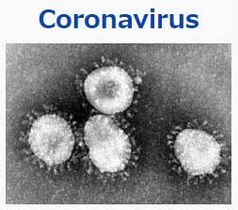

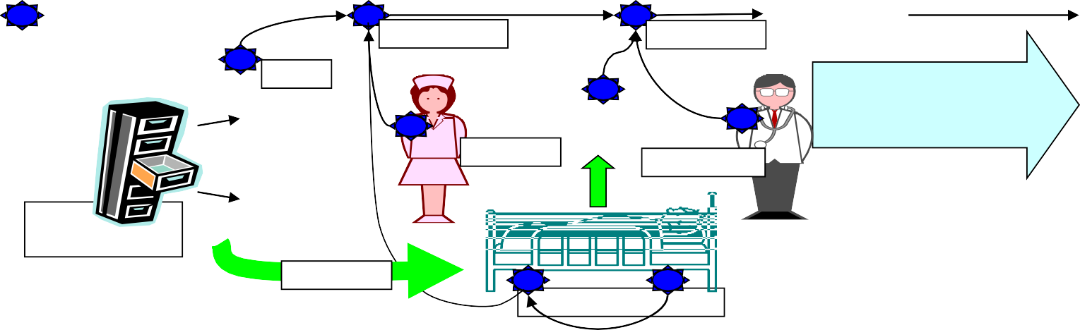
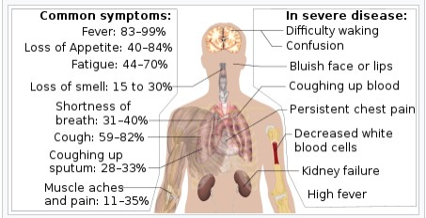
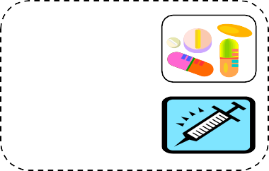

1.2 Medical Inspection and Treatment by BAN
Medical Healthcare Using BAN can perform remote real-time medical diagnosis and therapy
To prevent pandemic against COVID-19 and medical care incident etc. in daily life.
> Remote sensing vital sign and monitoring symptoms
> Evidence based medicine for clinical and nursing actions
•To support safe and efficient medical care for clinical staffs and patients etc.
> Online diagnosis, PCR and other inspection
> Protect clinical staffs and care givers with network
Server on Medical S
WBAN can apply for
ervices
Senso
^{⇒sensor} Recognition Recognition ^{Gate}
^{nodes} _{Details} Medical data _{Aut}
of
^{Nursing} Treatment
Stock information
Medication
Condition of patients
^{r node} Electronic medical card way
omatic recording medical treatments
and nursing
• Patients’ condition monitoring
•Warning information _{• Medical}
•Medical information
preventing pandemic and supporting daily care by remote sensing and therapy in digital healthcare.
information
Symptoms of COVID-19
6
Slide 6

Slide 7
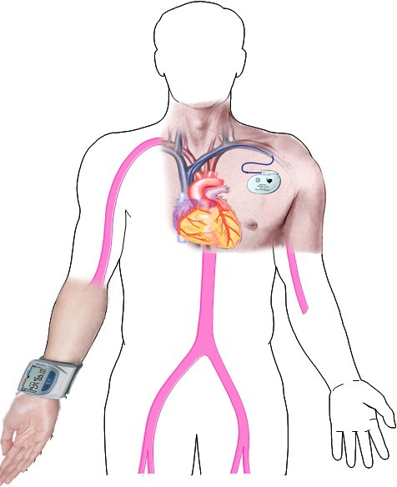
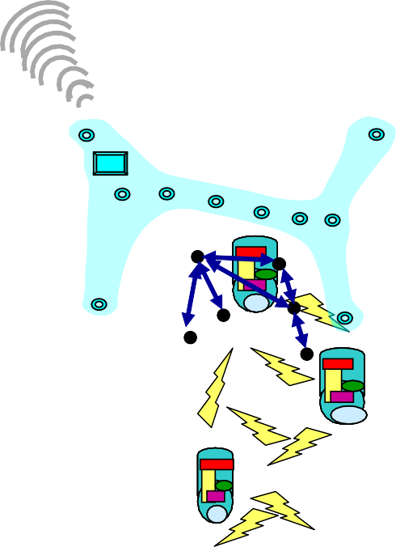






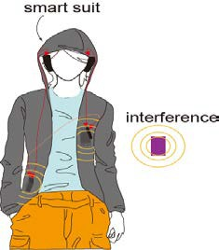
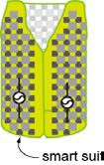


1.3 Wireless BAN: Body Area Network
May 2023
Wearable BAN
Tele-metering or sensing
vital signs with various sensors
ECG EEG SPO2
Blood Pressure Heartbeat
Body temperature Glocuse level
Medical images(X-ray, MRI) and video
Implant BAN
Tele-control of Medical Equipment and Devices
Pace Maker with ICD
etc.
Wireless Capsule Endoscope
Novel Concept Intelligent Network of Vital
Sensors, eHR, Medical Robots etc.
Submission
7

Slide 8

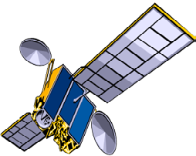
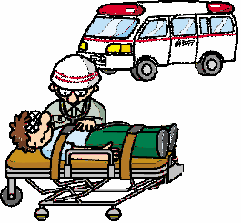
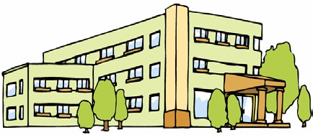




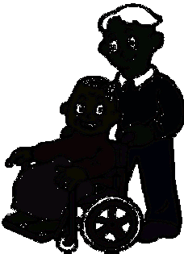

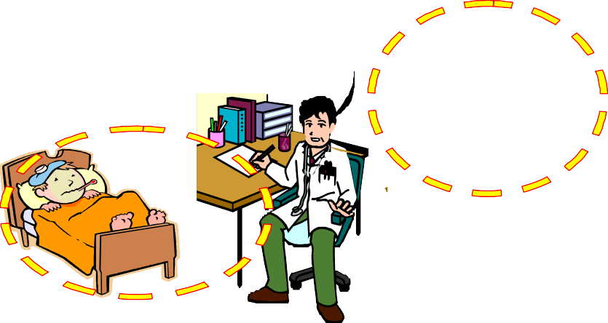








1.4 BAN- Use Cases for Remote Medical Services
doc.: IEEE 802.15-22-0389-02-06ma
Medical support
for developing countries
Satellite Link
Medical Data Server for Data Mining with Machine Learning
Satellite Networks
BAN
Moble
Big Data
Station
Network Cloud
Internet
Data mining
BAN
VSAT
Cellular Network
Medical Center and General Hospitals
8
BAN
切替
BAN
Slide 8

Slide 9
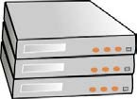










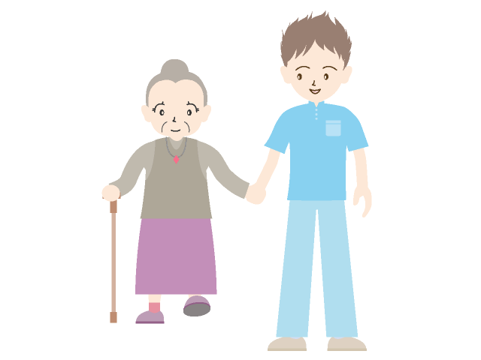
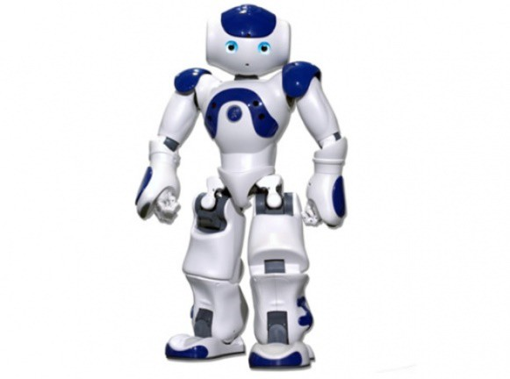
1.5 BAN-base Universal Platform with Network Cloud, Data Mining Server for Medical Healthcare
doc.: IEEE 802.15-22-0389-02-06ma
Data mining or Analysis
like Watson
Data storage server; DBMS
Network cloud (5G. 6G)
Hospital, Rehabilitation center, or Clinicians
Gateway
Body Area Network (BAN)
Coordinator
Node
Node
Node
physical assistant and surgery robots
Therapist, Nurses, Care givers
Elderly people
lide 9

Slide 10
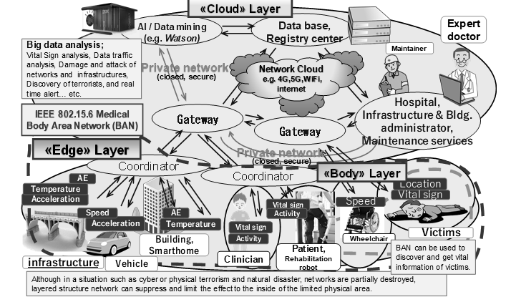
1.6 Universal Platform Based on BAN, Cloud Network, and AI Data Server for General Social Infrastructure beyond Medical Services
May 2023
Submission
10
Ryuji Kohno, Takumi Kobayashi(YNU/YRP-IAI)

Slide 11
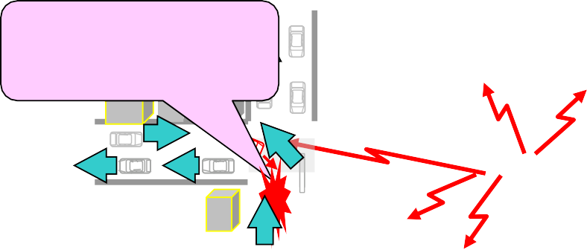
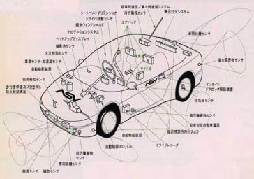
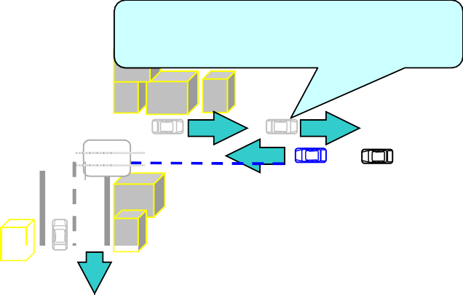
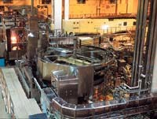


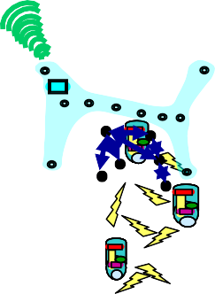

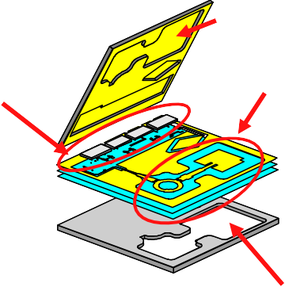






doc.: IEEE 802.15-22-0389-02-06ma
1.7 Extension of Use Cases of BAN beyond Medical Healthcare
Collision Avoidance
Collision Avoidance and safe driving by inter-vehicle networks
Using inter-vehicle and
roadside networks
Inter-module wireless Networks
A車
Road to car networks
Inter-vehicle networks
Car LAN & Wireless Harness
Car Navigation & Collision Avoidance Radar
Factory Automation (FA)
Dependable Wireless Networks for Transportation
Dependable Wireless Sensing & Controlling for Manufacturing (CIM)
Silicon Bsee
Wearable BAN
Tele-metering vital data
EEG. ECG,
Blad Pressure Temperatute MRI images
Implant BAN
Tele-controlling implant devices
UWB can solve
MMIC
(Flip Chip)
On Chip Antenna and Wireless Network in chio
such a problem
Etc.
Pacemaker with IAD
that radio interferes
a human body and
medical equipments
Silicon Base
Multi-layer BCB
Dependable Network among vital sensors, actuators, robots
Capsule Endoscope
Micor Machine Fablication
Dependable Wireless System Clock in Micro Circuit & Network in Devices
Dependable BAN for Medical Healthcare
Submission Slide 11
Ryuji Kohno, Takumi Kobayashi(YNU/YRP-IAI)

Slide 12
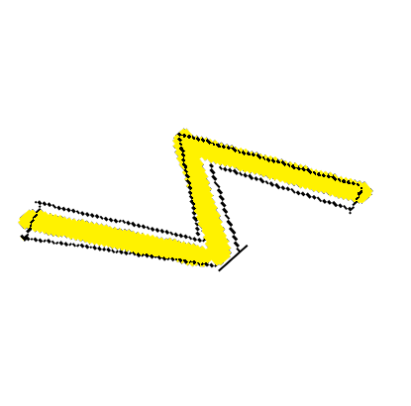
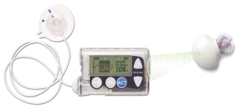

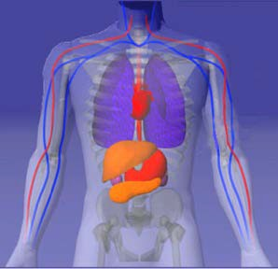




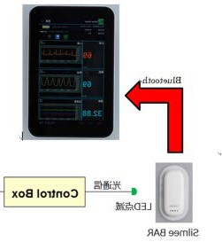
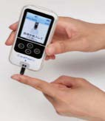

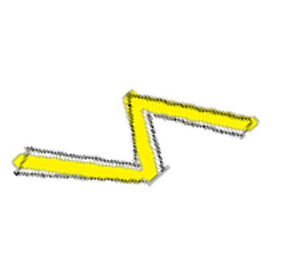







doc.: IEEE 802.15-22-0389-02-06ma
Automatic Remote Sensing Glucose and Controlling Insulin Pump for Diabetes Patients Using Wireless BAN
Clinician
Insulin Pump
Patient
controller Pump
Wireless channe^{W}l ^{ith}
sensor
Blood-sugar level (Glucose) HbA1c
Wireless Feedback Sensing and Controlling Loop for Diabetes Patients
Controller
u[k]
u^ [k]
Human Model of Glucose vs Insulin
r[k]
+
Bd 1/S
y[k]
K
+
-
+
Wireless channel
Ad
^
x[k]
x[k]
Feedback Delay Loop Model with Motion Equation
Submission

Slide 13
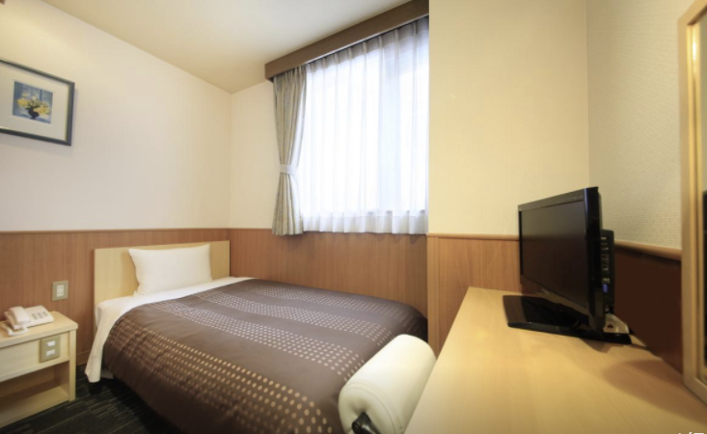
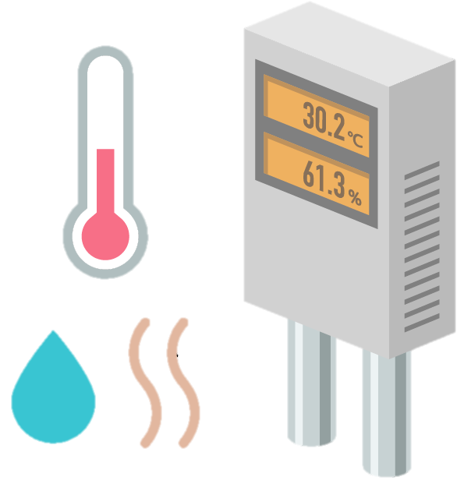
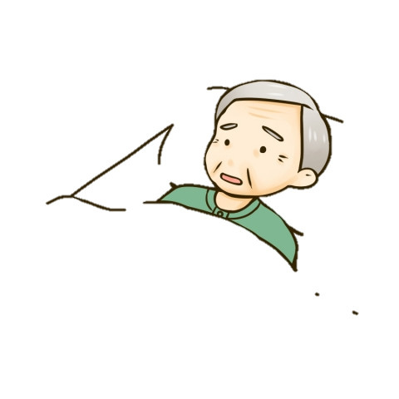
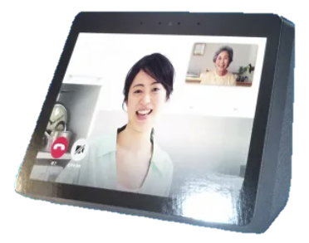

BAN Platform Use Cases in Remote Treatment for COVID-19 Patients under Quarantine at Home
Family
Data Collection and Analysis
Analyzed results for health condition
Cloud Remote Monitoring Service
Environmental Data
BAN Coordinator
Without Clinical Staffs, health condition of COVID-19 patents can be monitoring and rescue them immediately.
Integrated Data
Data Input
Remote Therapy and mental care keeping distance
Vital Sensors for SpO2, ECG, Temperature etc.
Display
Smart Phone, Tablet,
Camera, Display. Microphone,
Speaker
Command for care of patients
Analyzed results
Real-time remote monitoring and care
Remote Maintenance of COVID-19 Patients at Home Using Platform of Integrated Vital Sensors/Wireless BAN/5G Cloud/AI Analysis
Dialog
Medical Care Center and
Government Control Center
13
Ryuji Kohno’s Properties, Confidential
Notes:
ｲﾗｽﾄ
https://illust8.com/contents/6134
http://tech-pic.com/materials/13/24/307
http://mangatop.info/sozai/senior/3822/
https://illustimage.com/?id=2001
https://free-designer.net/archive/entry30752.html

Slide 14




doc.: IEEE 802.15-22-0389-02-06ma
1.8 Demand of BAN for Automotive Uses
Increasing Demands in a world：
  New business promotion by applying wireless ICT to vehicle by huge alliance between automotive and telecom industries such as smart key, wireless harness
  Autonomous car driving and safety controlling of elderly drivers by ICT and data science
Smart Vehiles EV and HV
Challenging but Feasible Solutions:
  Provide Remote Sensing and Controlling Using ICT and AI
➔ Prevent Traffic Accidents , Jam and Co2 Emission
Promote a New Global Business of Automotive , ICT, and Electronics
C. Approach:
R&D of Enable Technologies for Smart Vehicle and City
Promote International Standard of Wireless Body Network（BAN) and Integrated Platform of BAN/5G/AI for Global Marketing for both Medical and Automotive uses
Regulatory Compliance of Devices & Services to Ensure Safety, Reliability, Security,
i.e. Dependability by Regulatory Science
Submission

Slide 15


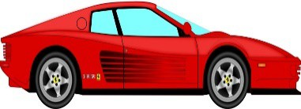



doc.: IEEE 802.15-22-0389-02-06ma
1.9 Use of BAN for Autonomous Car Driving
Driver or AI
For Autonomous Driving
Own Car
controller
Axel/Brake
Wireless channel
Car Running Ahead
Radar
For Collision Avoidance and Inter- Vehicle Communication
Wireless Feedback Sensing and Controlling Loop for Autonomous Driving
Controller
u[k]
u^ [k]
Car Axel/Brake Model and Radar System
r[k]
+
Bd 1/S
y[k]
K
+
-
+
Wireless channel
Ad
^
x[k]
x[k]
Feedback Delay Loop Model with Motion Equation
Submission

Slide 16




1.10 Remote Localization and Rescue of Missing Victims Using Wireless Dependable BAN of Things/M2M
For Remote Controlling UAVs
UAVs/Drones
Rescue Team
controller
Navigation
Wireless channel
Missing Victims
Localization
By Using GNSS and Localization
of UAVs/Drones
Wireless Feedback Sensing and Controlling Loop for Rescue of Victims
UAVs/Drones Model and Localizing
Controller
u[k]
u^ [k]
System
r[k]
+
Bd 1/S
y[k]
K
+
-
+
Wireless channel
Ad
^
x[k]
x[k]
Feedback Delay Loop Model with Motion Equation
Submission

Slide 17
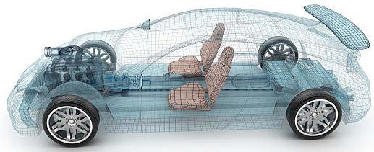
doc.: IEEE 802.15-21-0022-0389-02-06ma
1.11 Body Area Network(BAN) of Vehicle Body
Motivation to extend human BAN(HBAN) to VBAN is to promote much dependable services by interaction between HBAN and VBAN.
Use case of Vehicle Body Area Network(VBAN) for Engine Room
Engine diagnostic sensor and controller
Air pressure sensor, wheel health sensor and controller
Transmission monitoring sensor and controller
Use case of Vehicle Body Area Network(VBAN) for Cabin Room
Cabin environment sensor (temperature, brightness, humidity etc.)
Sheet sensor, health care sensors for driver
Sheet sensor, health care sensors for passenger
4
2
5
1
3
6
https://media.istockphoto.com/photos/transparent-car-design-wire-model3d-illustration-my-own-car- design-picture-id594040008?k=6&m=594040008&s=612x612&w=0&h=XE8LiBjpM51aB4pH2CFt6- MT6IvALRPnlxPcac0RXhg=
Submission
16
Ryuji Kohno, Takumi Kobayashi(YNU/YRP-IAI)

Slide 18
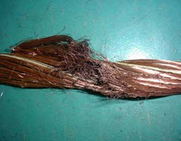
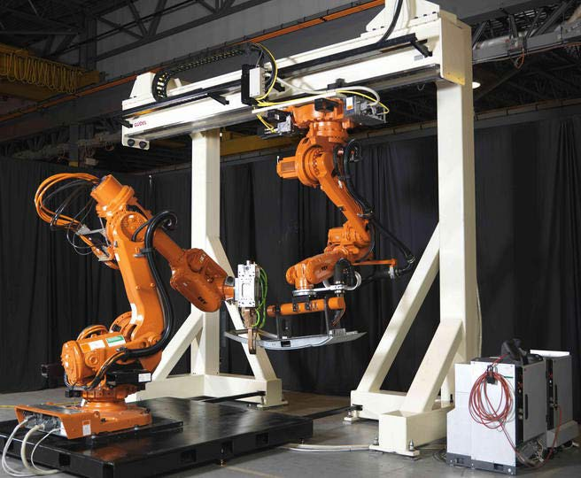
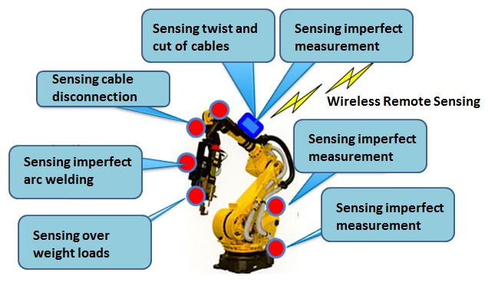
doc.: IEEE 802.15-22-0389-02-06ma
1.12 Use case in Factory Manufacturing Line; Detection of Twist and Cut of Cables
In order to improve QoS of controlling robots in factory lines, real-time sensing and controlling with permissible feedback control loop must be important requirement
Prediction and Real-time Detection of twist and cut in signal and power cables

Slide 19
doc.: IEEE 802.15-22-0389-02-06ma
2. Short Review of WBAN Standard IEEE802.15.6-2012

Slide 20
2.1 Standard of Medical Wireless Body Area Network(BAN);IEEE802.15.6
IEEE802
IEEE802.11
Wireless LAN
IEEE802.15
Wireless PAN
IEEE802.16
Wireless MAN
802.15.1
Bluetooth
802.15.2
Coexistence between WPAN and WLAN
802.15.3
PHY for High Rate WPAN
802.15.4
PHY for Low Rate WPAN
802.15.5
WPAN
Mesh Network
802.15.6
Wireless Medical BAN
2012.2 Standard was Completed
802.15.3a
Alternative PHY of 15.3
802.15.3b
Maintenance of 15.3
802.15.3c
PHY in Millimeter wave band
802.15.4a
Low rate UWB PAN Alternative PHY of 15.4
802.15.4b
Revision & Modification of 15.4 MAC
802.15.4c
Chinese WPAN
802.15.4d
Japanese WPAN
2007.3
Standard Completed
Submission
19

Slide 21
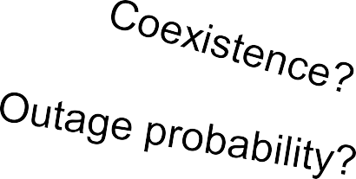
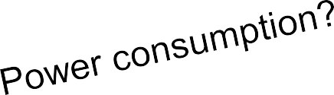

2.2 Top View of IEEE Std 802.15.6
IEEE 802.15.6
Narrow band PHY on-body & in-body
UWB PHY
on-body
HBC PHY
on-body
Common MAC
（for all PHY）
Modulation: GMSK
•& DPSK
TX range: ~3m
Modulation:IR-UWB & FM-UWB
Frequency Selective
• 10-50MHz
125kbps- 2Mbps
Beacon-base- TDMA
Group Superframe
Priority support
Non-beacon mode
TX range: ~3m
Bands: MICS,WMTS,ISM • Band: UWB band
Data rate: ~ some Mbps
Data rate: ~10Mbps
UWB: Ultra-wideband
HBC: Human body communication

Slide 22
doc.: IEEE 802.15-22-0389-02-06ma
2.3 User Priority Mapping
Priority level | Traffic designation | Data type
7 | Emergency or medical event report | Data
6 | High priority medical data or network control | Data or management
5 | Medical data or network control | Data or management
4 | Voice | Data
3 | Video | Data
2 | Excellent effort | Data
1 | Best effort | Data
0 | Background | Data

Slide 23
2.4 Three Channel Access Modes
Channel access mode | Time reference-based (superframe structure) | Beacon | Notes
I | Yes | Yes | Coordinator sends beacon in each superframe except for inactive superframes.
II | Yes | No | Coordinator establishes time reference but doesn’t send beacon.
III | No | No | There is not time reference.

Slide 24
2.5 Time-referenced Superframe w/ Beacon
Clock and position of each access phase
May obtain contended allocation for highest priority
B
B2
EAP1
RAP1
MAP
EAP2 RAP2
MAP
CAP
One superframe
EAP: exclusive access phase RAP: random access phase MAP: managed access phase CAP: contention access phase

Slide 25
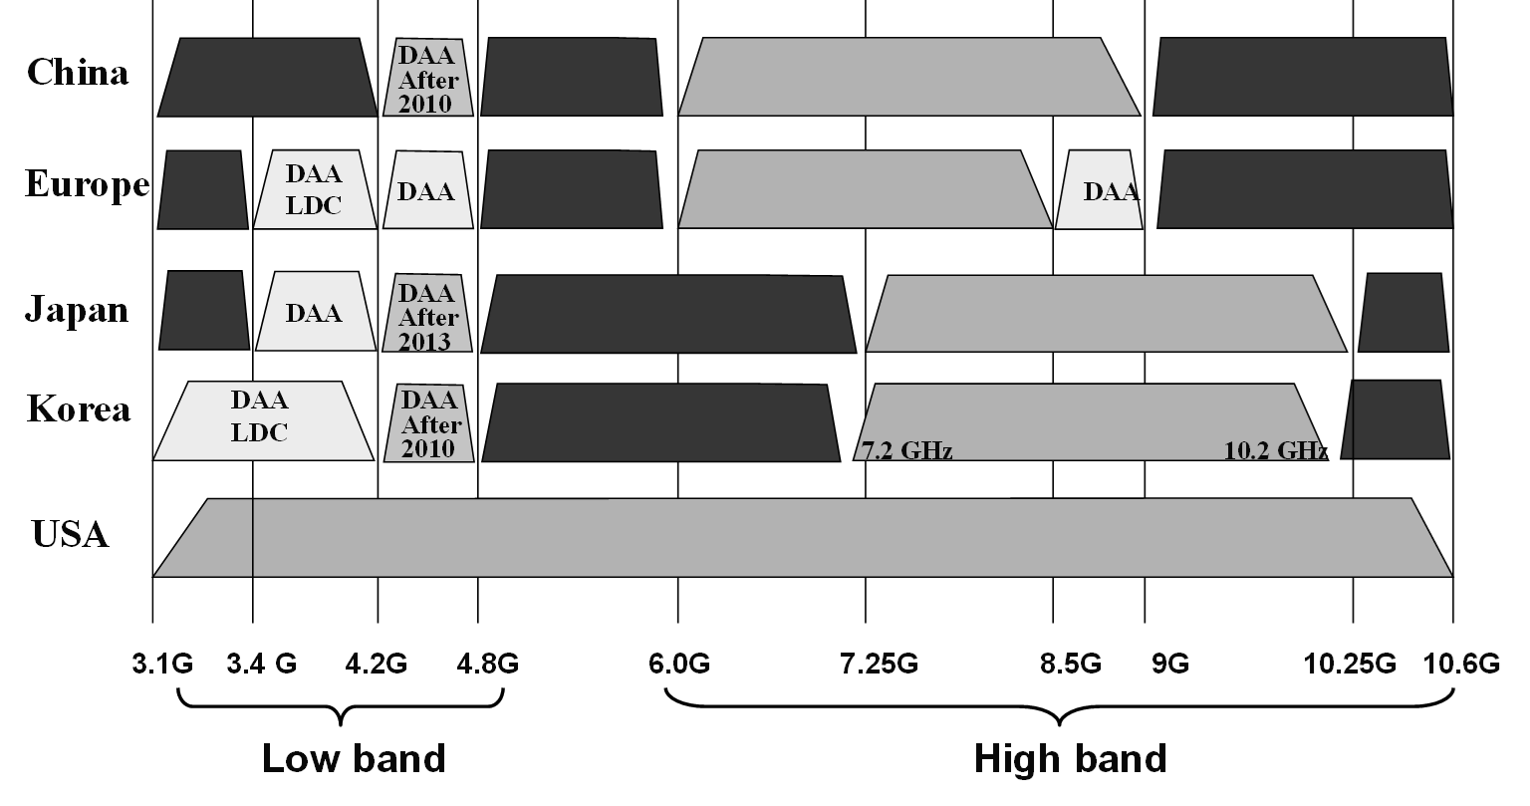
2.6 Worldwide UWB Regulations in 2012
doc.: IEEE 802.15-22-0389-02-06ma

Slide 26
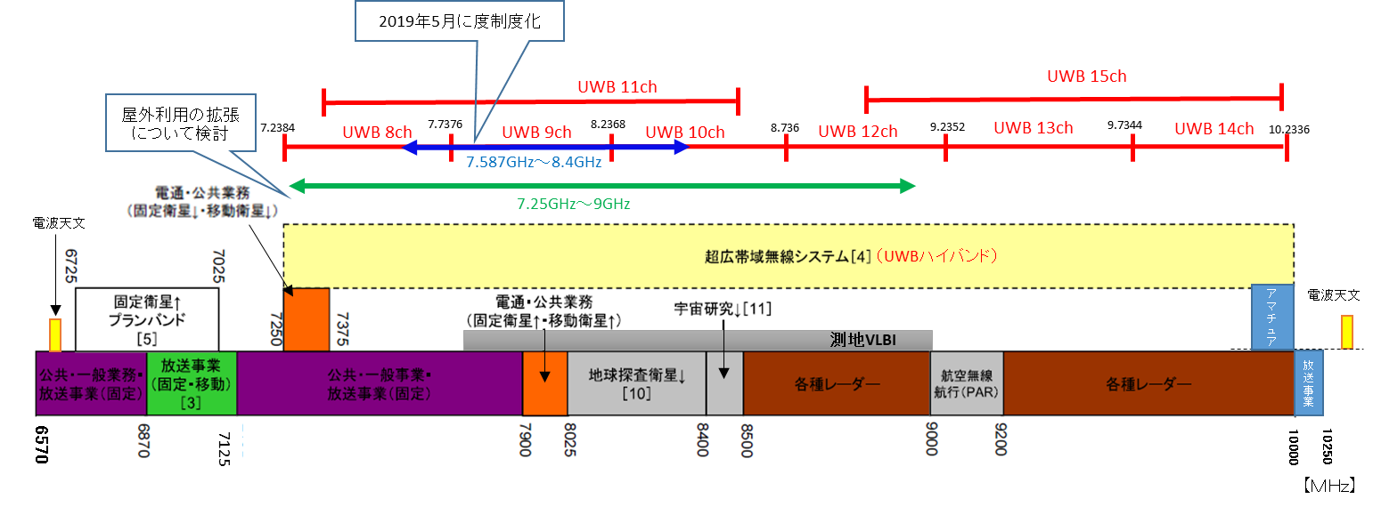
2.7 Radio Outdoor Uses in the Frequency Band 7.25-9.00GHz (January 2021)
Red lines indicate channels defined by IEEE802.15.4a.
Although Ch 9 in 7.587-8.4GHz Blue line was allowed for outdoor use in May 2019, MIC has started investigation to allow wider band 7.25-9.00 GHz Green line wand it is expected to allow it for outdoor use in January 2021
Permitted Outdoor Band in May 2019
Expected Permitted Outdoor Band in Jan. 2021
RAS
Public uses (Fixed & Mobile Satellites
UWB High Band Systems
Planed Band for Fixed Satellites
Public uses (Fixed & Mobile Satellites
Space Research
Radio Amatur e
RAS
Geolocation VLBI
Public/Civi l Uses
Fixed Broadcast
Fixed & Mobile Broadca st
Public/Civil Uses Fixed Broadcast
EESS
Various Radars
Various Radars
Boardcast
Airplane s
(PAR)

Slide 27
2.8 Summary of IEEE802.15.6-2012
A standard, IEEE Std 802.15.6TM was completed and published in Feb. 2012. In which, specifications of three PHY and common MAC are defined to support various medical and non-medical consumer applications.
Commercial products of BAN have been sold as an enable technology supporting personal healthcare as a consumer electronics but not much approved for medical equipment.
In PHY, ultra-wide band(UWB) is applied for high QoS use case but radio regulation for UWB results in restricting use cases.
In MAC, hybrid contention base and free protocol can perform flexible delay and throughput for variable QoS levels of packets but its implementation complexity is too high for its complete protocol.

Slide 28
doc.: IEEE 802.15-22-0389-02-06ma
3. Necessity and Uniqueness for Amendment of BAN with Enhanced Dependability

Slide 29
3.1 Necessity for Enhanced Dependability in 15.6 BAN
In case of coexistence of multiple BANs
  Current existing standard IEEE802.15.6 has not been designed to manage contention and interference among overlaid BANs. The more BAN uses in dense area, the more contention and inference cause performance degradation.
  Amendment of PHY and MAC for resolving these problems in coexistence of BANs is necessary.
In case of coexistence with other radios
  For enhanced dependability, UWB PHY of BAN should be updated to avoid performance degradation due to interference with coexisting other narrow band and UWB networks in overlapped frequency band.
In case of feedback sensing and controlling loop
  Remote medical diagnosis with vital sensing and therapy and control actuators and robotics need more dependable and efficient protocol.
Usability and Implementation Complexity
  Interoperability with other radio networks, more flexible network topology,
  Transparency with other standards such as ETSI SmartBAN
  Capability of ranging and positioning in UWB is required for mobility and security.

Slide 30
3.2 Technical Challenges for Enhanced Dependability
First of all, we should recognize that any technology in PHY and MAC cannot guarantee full dependability in every use case.
However, we can design a new standard which can guarantee a certain level of enhanced dependability in a specific defined use case.
As an analogy of informed consent in medical doctor to a patient, a manufacturer of a dependable wireless network can describe such a specific defined use case that the manufacture can guarantee a defined level of dependability showing necessary cost and remained uncertainty. This is an honest manner and much better than no guarantee for any use case.
Therefore, an expecting standard describes a specific use case in which worst performance can be guaranteed enough high while most of exiting standards have been designed with average performance base.
Technical requirement for the specific use case can be guaranteed.
Submission

Slide 31
3.3 Uniqueness different from existing standards (1/2)
MAC protocol for around packets and recursive access for feedback loop in remote sensing and controlling;
Level of dependability can be defined with showing necessary cost and remained uncertainty. This is an honest manner and much better than no guarantee for any use case.
Worst performance can be guaranteed enough high while most of exiting standards have been designed with average performance base.
Others

Slide 32
3.3 Uniqueness different from existing standards (2/2)
PHY technologies to satisfy technical requirement for enhanced dependability in the focused use cases
  In feedback loop for remote monitoring sensors or radars and feedback controlling actuators, real-time cognition of varying condition on site and adaptive reconfiguration in relatively messy, small, and dense areas are requested to guarantee worst performance with permissible delay and errors.
  Within a permissible limited feedback delay, propagation paths connecting between nodes and coordinator should be found to keep connectivity by diversity, channel switching etc. .
  For such a dynamic environment and QoS requirement changing situation, sophisticated PHY technologies are requested to guarantee minimum requirement of performance.

Slide 33
3.4 Focused Issues in Amendment of std 15.6 BAN with Enhanced Dependability
MAC Protocol in case of coexistence of multiple BANs
  Amendment of MAC for resolving these problems in coexistence of BANs is necessary.
  Specified MAC protocol for feedback sensing and control loop between coordinator and nodes.
PHY Interference Mitigation In case of coexistence with other radios
  For enhanced dependability, UWB PHY of BAN should be updated to avoid performance degradation due to interference with coexisting other narrow band and UWB networks in overlapped frequency band.
Usability and Implementation Complexity
  Interoperability with narrow band and UWB PHY
  more flexible network topology,
  Transparency with other standards such as ETSI SmartBAN
Ranging and Positioning Capability of UWB-BAN
  Mobile nodes and coordinator of BAN need ranging and positioning of UWB-BAN

Slide 34
doc.: IEEE 802.15-22-0389-01-06ma
4. Channel and Environment Models for Focused Use Cases for Revision of std 15.6-2012 for Human and Vehicle BANs with Enhanced Dependability TG16.6ma

Slide 35
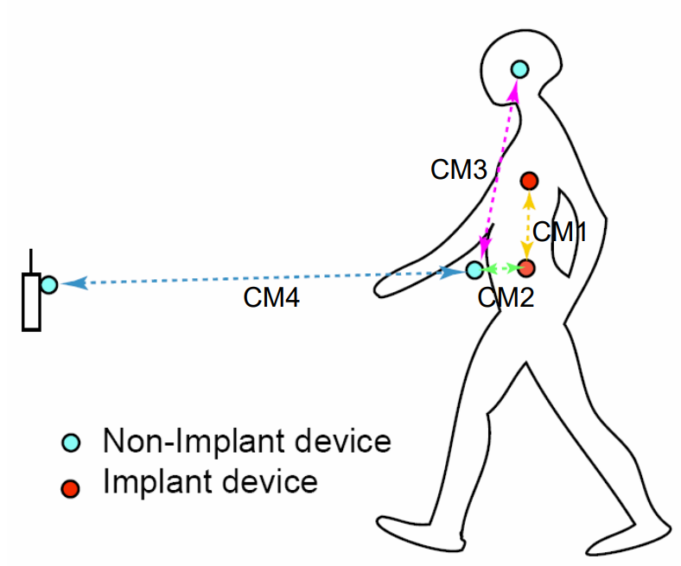
4.1 Channel models and scenarios in IEEE802.15.6ma
Scenario | Description | Frequency Band | Channel Model
S2 | Implant to Body Surface | 402-405 MHz, | CM2
S2.1 | Implant (upper body) to Body Surface | 3.1-10.6 GHz UWB | CM2.1
S2.2 | Implant (head) to Body Surface | 3.1-10.6 GHz UWB | CM2.2
S3 | Implant to External | 402-405 MHz, 3.1-10.6 GHz UWB | CM2
S4 | Body Surface to Body Surface (LOS) | 400, 600, 900 MHz 2.4, 3.1-10.6 GHz | CM3
S4.1 | Body Surface to Body Surface (LOS) | 3.1-10.6 GHz CM4.1 | CM4.1
S5 | Body Surface to Body Surface (NLOS) | 400, 600, 900 MHz 2.4, 3.1-10.6 GHz | CM3
S6 | Body Surface to External (LOS) | 900 MHz 2.4, 3.1-10.6 GHz | CM4
S6.1 | Body Surface (head) to External (LOS) | 3.1-10.6 GHz | CM6.1
S7 | Body Surface to External (NLOS) | 900 MHz 2.4, 3.1-10.6 GHz | CM4
Path loss (Mandatory)
Optional;
  Fading ( Small scale/ large scale)
  Shadowing
  Power delay profile
Specific use cases
Implant to Body Surface for BCI
Implant to External for BCI
Body surface to body surface for BCI
Body Surface to External for BCI
Implant to body surface for capsule endoscopy

Slide 36
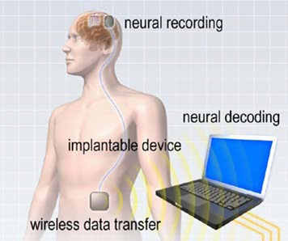
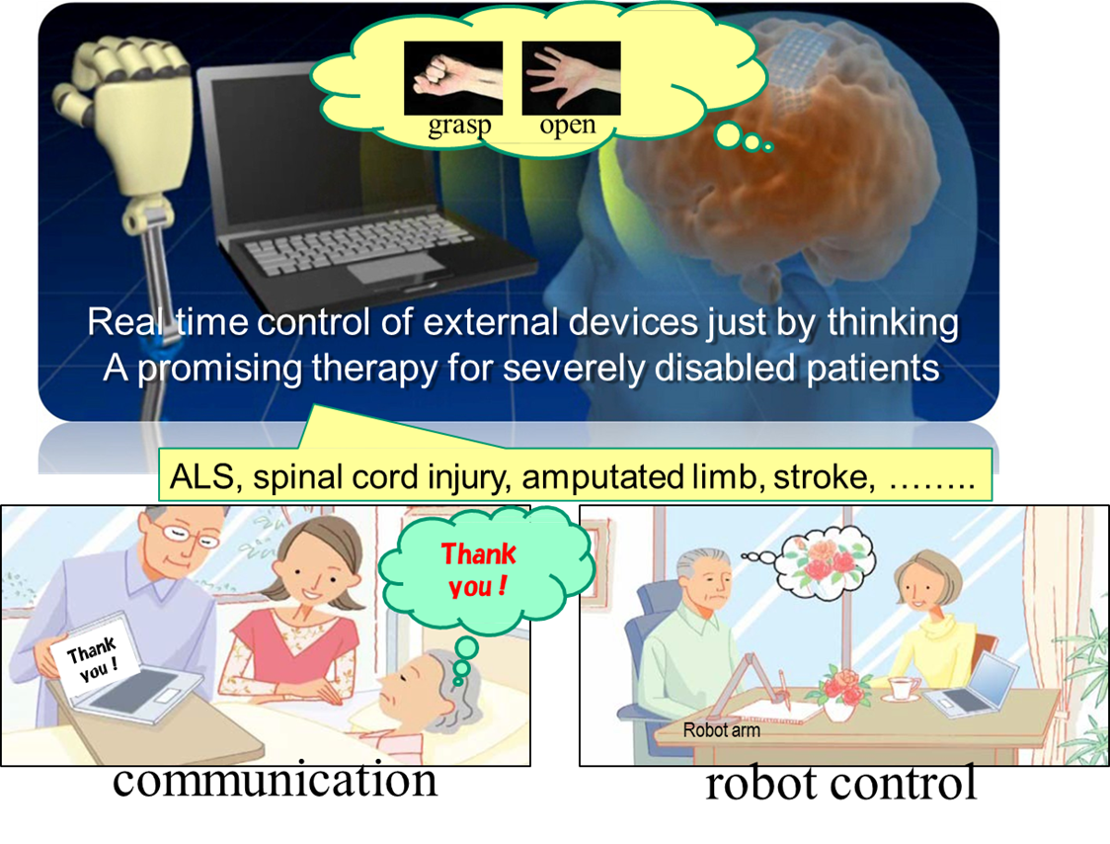
4.2 Brain-Machine-Interface(BMI): Wireless Body Area Network (BAN) with AI Machine-Learning and User-Interface
Brain-Computer-Interface(BCI) and Brain-Machine-Interface(BMI) for Clinical Support to Disability and More General Use Cases Including for Entertainment, e-Game, and Heavy Industries.
Brain-Computer-Interface(BCI) for Understanding Human Contention and Machine Control.

Slide 37
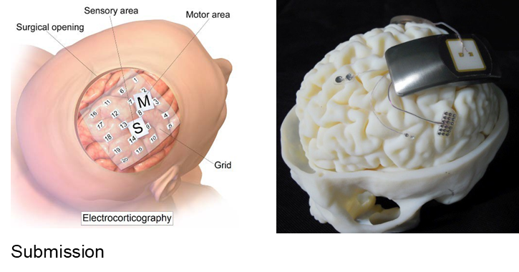
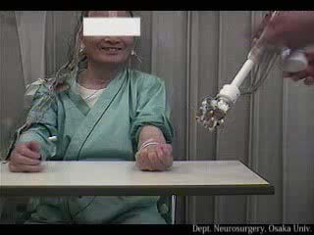
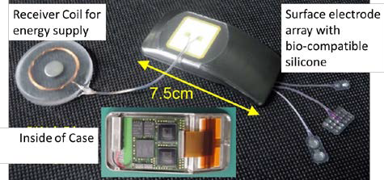
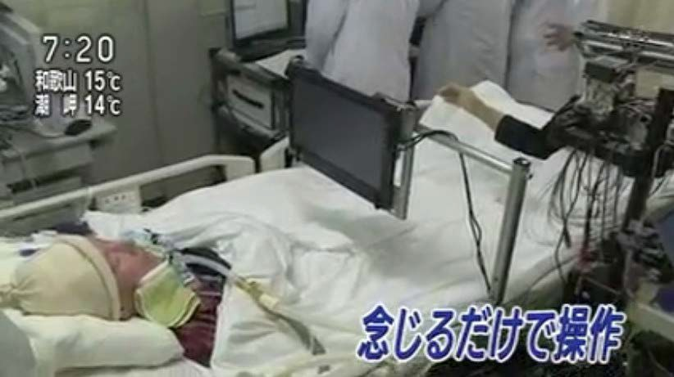
4.2 BMI with Wireless BAN with AI Machine-Learning and User-Interface
Brain-Machine-Interface(BMI) systems for Clinical Support to Disability such as autonomous robot hand control and communication assistance.
ECoG（Electrocorticogram) detected with implanted thousands of electrodes is transmitted in wireless by BAN with high capacity and dependability.

Slide 38
4.2 Channel models and scenarios in use case of BMI and BCI
Specific use cases
Implant to Body Surface for BCI
Implant to External for BCI
Body surface to body surface for BCI
Body Surface to External for BCI
Implant to body surface for capsule endoscopy
We will define what is BCI and BMI.
Wired connection
Body Surface to Body Surface for BCI
electrode
Future
Future
Arm
Implant to Body Surface for BCI
Body Surface to External on-body surface for BCI
Implant to External for BCI

Slide 39
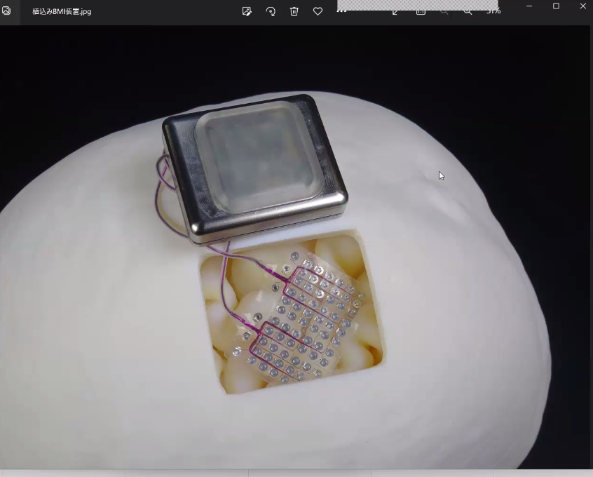

Slide 40
4.3 Channel models and scenarios for capsule endoscopy
Specific use cases
Implant(head) to on-body for BCI
Implant to External for BCI
Body surface to body surface for BCI
Body Surface to External for BCI
Implant to body surface for capsule endoscopy
Transceiver on body surface
Gastrointestinal tract
capsule endoscopy
Implant to Body Surface for Capsule Endoscopy

Slide 41

4.4 Channel and Environmental models of VBAN
S11: On-vehicle to on-vehicle (LOS)
S13: On-vehicle to external (LOS)
S12: On-vehicle to on-vehicle (NLOS)
S9: In-vehicle to On-vehicle
S10: In vehicle to External
S8: In-vehicle to In-vehicle (sedan)
S14: On-vehicle to external (NLOS)

Slide 42



4.4 Use Case of Coexisting Multiple HBAN and VBAN
Geometrical configuration
Nodes and coordinator are in cabin room
Original channel models, common channel model to IEEE 802.15.4a and IEEE802.15.6-2012
VBAN Coordinator
HBAN Coordinator
Noise source
coordinator
Use case
Entertainment for passengers
  Nodes are in cabin room / coordinator is in cabin room.
scenario |  | Sedan/RV / SUV with engine | Sedan/RV / SUV without engine | Bus | Cargo / pickup | Special purpose
8.1vv | VBAN coordinator and VBAN coordinator | Case 3.1a |  | Case 3.1a | Same as 3.1a | ---
8.1vh | VBAN coordinator and HBAN coordinator | Case 3.1b |  |  |  | ---

Slide 43

4.4 Channel models and scenarios in IEEE802.15.6ma
S11: On-vehicle to on-vehicle (LOS)
S13: On-vehicle to external (LOS)
S12: On-vehicle to on-vehicle (NLOS)
S9: In-vehicle to On-vehicle
S10: In vehicle to External
S8: In-vehicle to In-vehicle (sedan)
S14: On-vehicle to external (NLOS)

Slide 44
4.5 Classification of Channel and Environment Models for Human and Vehicle Body Area Networks (HBAN&VBAN)
Channel model
※Covered by
IEEE 802.15.6-2012
HBAN model
In-body (Implant)
※
On-body
※
Channel model
With environment
Around body
Outdoor
※Around means;
Desk, WiFi AP in the room etc.
Indoor
※
Home
Implanted BCI model
Office
※
On skull BCI model
Medical (e.g. Hospital)
※
capsule endoscopy
※not covered in 2012
VBAN model
In-vehicle
Engine compartment
Note:
HBAN-model:
-Environment with co-existing systems is not considered.
VBAN model:
Key-less entry system
Localization in-body, on-body
Most dominant model should be defined and separatory defined as Mandatory and Optional.
Cabin
Through Engine compartment and cabin
On-vehicle
Roof
Around vehicle
Side Right/Left/Front/back
Bottom
Static vehicle
Moving vehicle

Slide 45
doc.: IEEE 802.15-22-0389-02-06ma
5. Requirement for Revision of 15.6 MAC for Human and Vehicle BANs with Enhanced Dependability TG16.6ma

Slide 46


5.1 Interference among BANs or BAN and other systems
There would be cases where BANs or BAN and other networks are spatially collapsed.
  Case 1: BANs, using same frequency bands
Case 2: BAN and PAN, using same frequency bands

Slide 47

5.2 Interference among BANs or BAN and other systems
Case 3: BAN and other piconets such as cellular network or Wi-Fi, some part of their frequency bands are overlapped.
Case 4: Case 1 to 3 combined
The concept of 802.1 MAC Bridge can be extended to enhance dependability.
The coordinator can manage interference or packet collision among same or different BANs (VBAN and/or HBAN), PANs, and other piconets.

Slide 48

5.3 Two-hop star topology extension
Star topology + one hop (current std.)
  Since there is no Line-of-Sight link between back and front of a human body, as well as a vehicular body
Star topology + multiple hops (may be introduced in the amendment)
TSN concept may be applicable.
  Frame Replication and Elimination (802.1CB)
    When the amendment introduces using more than 2 relay nodes simultaneously.
  Link Control (802.1Qca)
Note: The relaying described in this slide operates on MAC layer, though corresponding 802.1 Stds define routing in the network layer.

Slide 49
5.4 TSN Possibility in WBAN 15.6ma
802.15.6 has BAN coordinator (hub) which can perform MAC bridge which connects two separate networks as 802.1 TSN(Time Sensitive Network).
A coordinator connects to nodes in its own network.
  Not only same nodes operate on the same PHY, but also different PHYs.
The revision may enable a coordinator to connect to other coordinators, to avoid interference and enhance dependability.
  Unlike wired network, wireless network shares same medium and collision occurs which plays significant role in dependability.

Slide 50
5.4 Possible bridging in 802.15.6ma
BAN
(wireless)
WLAN
(wireless)
LAN
(wired)
Talker
Bridge
Bridge
Bridge
BAN
Node
BAN
Coordinator
Access Point
Switch / Router
BAN
Node
Server /
Nurse station
Talker
Vital sign monitor
Listener
Listener
BAN coordinator may relay frames to outer network as a MAC Bridge.

Slide 51
5.5 Coordinator to Coordinator Bridging
Talker
BAN
WLAN
BAN
Node
LAN
Listener
Talker
Server,
Nurse station,
etc.
Wi-Fi Access Point
(or Cellular Base Station)
BAN
Node
BAN
Coordinator
As a MAC Bridge,
BAN coordinator may relay frames to outer network.
Those frames can be from other BAN coordinator.
BAN
Node
Talker
BAN
Coordinator
BAN
BAN
Node
BAN
Node
Talker
Talker

Slide 52
5.6 TSN equipment to infrastructure

Slide 53
5.7 TSN in the 15.6ma protocol stack

Slide 54
5.7 TSN switch
15.6ma should focus on the MAC layer
Fortunately, there is no conflict with 802.1 MAC addresses.

Slide 55
doc.: IEEE 802.15-22-0389-02-06ma
6. Available Technologies in PHY and MAC Layers for the Focused Use Cases for Revision of std 15.6-2012 for Human and Vehicle BANs with Enhanced Dependability TG16.6ma

Slide 56
doc.: IEEE 802.15-22-0389-02-06ma
6.1 Intra and Inter System Interference among BAN and Other PANs
Inter-user interference
Inter-system interference
Interference from the other wreless system using overlapped frequency band. ⇒ Unknown
IR-UWB uses the same pulse as all users signal in the same standard.
Other users signal and/or the other network signal would be interference.
＊ 802.11a (wi-fi) （5GHz） overlaps
UWB-WBAN
IEEE 802.15.6
user B
Other UWB system.
e.g. IEEE 802.15.4a
user ？
user C
interference
user ？
interference
User A wants to connect to“B”.
user ？

Slide 57
6.2 Approach for Intra and Inter System Interference among BAN and Other PANs
Sparate and Recognize each interference from different source.
* Apply suitable interference mitigation method according to source of interference.
Using both of Spatial and Temporal signal processing.
Inter-user interference
“IUI” in this presentation
Recognize and demodulate
Pulse shape multiple access Multi-user detection
known
Interference from a system using the same pulse
Inter-system interference
“ISI” in this presentation
unknown
Remove
Interference canceller
Interference from a system using overlapped frequency

Slide 58

doc.: IEEE 802.15-22-0389-02-06ma
6.3 Time Domain Interference Mitigation
OMF； orthogonal matched filter
consists a matched filter （MF₁） and MF Group（MFG）
Tap coefficients of MF₁ are the same as sequence of desired signal.
Coefficients of MF₁ and each MF_{k} that constituting MFG are orthogonal.
Desired signal does not through MF_{2～K-1} because orthogonality.
→only interference can through.
MFG makes replica of interference signal by lenear combination with weight vector w of linear combiner; LC.
Subtract interference replica from the output of MF₁ .
Principle of OMF
OMF can remove interference without any pre-knowledge of interference.

Slide 59




6.4 Space Domain Interference Mitigation
TDL-AA；Tapped delay line array antenna
Array antenna by using multiple antenna elements and tapped delay line.
Each antenna branch has coefficients.
Transfer function of this antenna has parameters of signal incoming angle;θ and frequency; ω.
⇒has characteristics of both of spatial and time domain.
（Tapped delay line array antenna）
Principle of TDL-AA
TDL-AA can work as interference canceller on both of time and space domains

Slide 60





May 2023
doc.: IEEE 802.15-22-0389-02-06ma
6.5 Interference Mitigation among Other Radios
2.4GHz
5.2GHz
Frequency（Hz) Time（sec）
(a) Time Waveform of Pulse (right figure) and its Frequency Spectrum with notches in 2.4 and 5.2GHz for WLAN (left figure)
∝ 1
τ _{m}
ω₀
Frequency（Hz)
Time（sec）
(b) Time Waveform of Pulse (right figure) and its Frequency Spectrum satisfying spectrum mask (left figure)
Ref. R.Kohno, H.Zhang, H.Nagasaka, "Ultra Wideband impulse radio using free-verse pulse waveform shaping , Soft-Spectrum adaptation, and local sine template receiving," doc.: IEEE
802.15-03/097r1, March 3, 2003.
Slide 38
Ryuji Kohno’(, Takumi Kobayashi (YNU/YRP-IAI)

Slide 61
6.6 Integrated Terminal to Avoid Mutual Interference in case of overlaid coexisting BAN and other Radios such as UWB-BAN and 4G/5G
May 2023
Cellular Base Station
(Primary BS)
BAN Node (Secondary User)
Cellular Terminal (Primary User)
Integrated Terminal
= (Cellular Terminal + BAN Coordinator)
= (Primary User + Secondary BS)
M. Kim, T. Kobayashi, C.Sugimoto, R Kohno, ”Transmission Power Control of UWB -WBAN for Avoidance of Interference to Cellular Networks Using Integrated Terminal for Both Networks,” International Journal of Computer Science and Telecommunications, ISSN
2047-3338 (Online) , Vol. 11, Issue 02, pp.8-15, March 2020

Slide 62


May 2023
doc.: IEEE 802.15-22-0389-02-06ma
6.7 Contention among Overlaid BANs
Interference problem in the case where multiple BANs overlap (specifically, situations where people with BAN approaching)
Issue
Because the schedule adjustment between the coordinators has not been done
Solution
Negotiation between coordinators, scheduling between different BANs, to prevent deterioration due to inter-BAN interference
Desired Packet
Interfering Packet
Desired Packet
Interfering Packet
What is interference at the MAC layer
Node 1
Node 1
Sensor nodes within the communication range try to transmit packets at the same timing, causing collisions, making it impossible to communicate correctly
Coordinator 1
Coordinator 2
Coordinator 1
Coordinator 2
Node 2
BAN1 BAN2
In case of no negotiation of Coordinators of overlapped BANs, contention happens among packets from nodes of f the BANs
Node
2
BAN1 BAN2
In case of negotiation of Coordinators of overlapped BANs, contention can be resolved
Ref. R.Kohno, S.Ogawa, “MAC Protocol with Interference Mitigation Using Negotiation among Coordinators in Multiple Wireless Body Area Networks (BANs),” IEEE802.15 doc.#15-19-0119-00- 0dep-ig-dep, Vancouver, Canada, March 12, 2019
Submission
Slide 62
Ryuji Kohno’(, Takumi Kobayashi (YNU/YRP-IAI)

Slide 63
doc.: IEEE 802.15-22-0389-02-06ma
7. Timeline of TG15.6ma

Slide 64
Definition of Coexistence Environment Levels
Coexistence Level | Coexisting system(s) |  |  |  |  | Category
Level | 802.15.6ma | 802.15.6-2012 | Non-UWB (ex. Wi-Fi / Unlicensed / 3GPP) | 802.15 UWB (ex. 802.15.4) | Non-802.15 UWB (ex. ETSI SmartBAN) | Category
0 | - | - | - | - | - | Single BAN
1 (1a) | ✓ | - | - | - | - | Multiple 15.6 BANs
2 (1b) | ✓ | ✓ | - | - | -
3 | ✓ | - | ✓ | - | - | Non-UWB
4 (2a) | ✓ | - | - | ✓ | - | Multiple UWB systems
5 (2b) | ✓ | - | - | - | ✓
6 (2c) | ✓ | - | - | ✓ | ✓
7 | ✓ | ✓ | ✓ | ✓ | ✓ | Final Boss
The coexistence level has been redefied to 8 levels, which can be represented by 3 bits and would be suitable to include in PHY or MAC headers.

Slide 65
Progress Report(1/5)
IEEE 802.15.6-2012 Std |  |  | IEEE 802.15.6ma revision | Status | Notes
Contents | Page |  | Contents
1. Overview | 1 |  | 1. Overview | TBD | Changes target for the May meeting. The text requires revision to reflect the new changes.
1.1 Scope | 1 |  | 1.1 Scope | TBD | Changes target for the May meeting. The text requires revision to reflect the new changes.
1.2 Purpose | 1 |  | 1.2 Purpose | TBD | Changes target for the May meeting. The text requires revision to reflect the new changes.
2. Normative references | 2 |  | 2. Normative references | Done | No new change.
3. Definitions, acronyms, and abbreviations | 2 |  | 3. Definitions, acronyms, and abbreviations
3.1 Definitions | 2 |  | 3.1 Definitions | TBD | The text requires revision to reflect the new changes. We need to finish all new changes to add new Definitions, Terms, Acronyms
3.2 Special terms | 7 |  | 3.2 Special terms | TBD | The text requires revision to reflect the new changes. We need to finish all new changes to add new Definitions, Terms, Acronyms
3.3 Acronyms and abbreviations | 7 |  | 3.3 Acronyms and abbreviations | TBD | The text requires revision to reflect the new changes. We need to finish all new changes to add new Definitions, Terms, Acronyms
4. General framework elements | 10 |  | 4. General framework elements
4.1 General | 10 |  | 4.1 General | Done | No new change.
4.2 Network topology | 10 |  | 4.2 Network topology | 70% | C2C topology: 70% The text requires revision to reflect the new changes: 30%
4.3 Reference model | 11 |  | 4.3 Reference model | Done | No new change.
4.4 Time base | 12 |  | 4.4 Time base | TBD | The text requires revision to reflect the new changes.
4.5 MAC and security state diagrams | 12 |  | 4.5 MAC and security state diagrams | Done | No new change.
4.6 Security paradigm | 15 |  | 4.6 Security paradigm | Done | No new change.

Slide 66
Progress Report(2/5)
IEEE 802.15.6-2012 Std |  |  | IEEE 802.15.6ma revision |  | Status | Notes
5. MAC frame formats | 16 |  | 5. MAC frame formats
5.1 Conventions | 16 |  | 5.1 Conventions | TBD | The text requires revision to reflect the new changes.
5.2 General format | 17 |  | 5.2 General format | TBD | The text requires revision to reflect the new changes.
5.3 Management type frames | 27 |  | 5.3 Management type frames | TBD | The text requires revision to reflect the new changes.
5.4 Control type frames | 55 |  | 5.4 Control type frames | TBD | The text requires revision to reflect the new changes.
5.5 Data type frames | 60 |  | 5.5 Data type frames | TBD | The text requires revision to reflect the new changes.
5.6 MAC/PHY Capability fields | 61 |  | 5.6 MAC/PHY Capability fields | TBD | The text requires revision to reflect the new changes.
5.7 Information elements | 65 |  | 5.7 Information elements | TBD | The text requires revision to reflect the new changes.
6. MAC functions | 77 |  | 6. MAC functions |  | It may take some time rewetting with the new MAC proposal. Propose to insert the new MAC functionality and push down (renumber) the rest of clauses when applicable.
6.1 General | 77 |  | 6.1 General | TBD | The text requires revision to reflect the new changes.
6.2 Frame processing | 78 |  | 6.2 Frame processing | TBD | The text requires revision to reflect the new changes.
6.3 Access classification and division | 88 |  | 6.3 Access classification and division | TBD | The text requires revision to reflect the new changes.
6.4 BAN creation/operation and node connection/disconnection | 90 |  | 6.4 BAN creation/operation and node connection/disconnection | TBD | The text requires revision to reflect the new changes.
6.5 Random access | 92 |  | 6.5 Random access | TBD | The text requires revision to reflect the new changes.
6.6 Improvised access and unscheduled access | 98 |  | 6.6 Improvised access and unscheduled access | TBD | The text requires revision to reflect the new changes.
6.7 Scheduled access and scheduled-polling access | 107 |  | 6.7 Scheduled access and scheduled-polling access | TBD | The text requires revision to reflect the new changes.
6.8 Access continuation, termination, and timeout | 110 |  | 6.8 Access continuation, termination, and timeout | TBD | The text requires revision to reflect the new changes.
6.9 MICS band communication | 116 |  | 6.9 MICS band communication | TBD | The text requires revision to reflect the new changes.
6.10 Two-hop star topology extension | 121 |  | 6.10 Two-hop star topology extension | TBD | The text requires revision to reflect the new changes.
6.11 Clock synchronization and guard time provisioning | 132 |  | 6.11 Clock synchronization and guard time provisioning | TBD | The text requires revision to reflect the new changes.
6.12 Power management | 140 |  | 6.12 Power management | TBD | The text requires revision to reflect the new changes.
6.13 Coexistence and interference mitigation | 142 |  | 6.13 Coexistence and interference mitigation | TBD | The text requires revision to reflect the new changes.
6.14 MAC/PHY capability handling/interaction and Application Specific IE usage | 147 |  | 6.14 MAC/PHY capability handling/interaction and Application Specific IE usage | TBD | The text requires revision to reflect the new changes.
6.15 MAC sublayer parameters | 148 |  | 6.15 MAC sublayer parameters | TBD | The text requires revision to reflect the new changes.

Slide 67
Progress Report(3/5)
5
IEEE 802.15.6-2012 Std |  |  | IEEE 802.15.6ma revision |  | Status | Notes
7. Security services | 151 |  | 7. Security services | Done | No new change.
7.1 Security association and disassociation | 151 |  | 7.1 Security association and disassociation | Done | No new change.
7.2 PTK creation and GTK distribution | 163 |  | 7.2 PTK creation and GTK distribution | Done | No new change.
7.3 Message security | 165 |  | 7.3 Message security | Done | No new change.
7.4 Optional cipher functions | 172 |  | 7.4 Optional cipher functions | Done | No new change.
8. Narrowband PHY specification | 172 |  | 8. Narrowband PHY specification | Done | No new change.
8.1 Data-rate-dependent parameters | 173 |  | 8.1 Data-rate-dependent parameters | Done | No new change.
8.2 PLCP preamble | 176 |  | 8.2 PLCP preamble | Done | No new change.
8.3 PLCP header | 178 |  | 8.3 PLCP header | Done | No new change.
8.4 PSDU | 181 |  | 8.4 PSDU | Done | No new change.
8.5 Constellation mapping | 185 |  | 8.5 Constellation mapping | Done | No new change.
8.6 General requirements | 187 |  | 8.6 General requirements | Done | No new change.
8.7 PHY layer timing | 188 |  | 8.7 PHY layer timing | Done | No new change.
8.8 Transmitter specifications | 190 |  | 8.8 Transmitter specifications | Done | No new change.
8.9 Receiver specifications | 194 |  | 8.9 Receiver specifications | Done | No new change.

Slide 68
Progress Report(4/5)
IEEE 802.15.6-2012 Std |  |  | IEEE 802.15.6ma revision |  | Status | Notes
9. Ultra wideband PHY specification | 196 |  | 9. Ultra wideband PHY specification | Done | The text requires revision to reflect the new changes.
9.1 Definition of hubs and devices | 196 |  | 9.1 Definition of hubs and devices | TBD | Changes target for the May meeting. The text requires revision to reflect the new changes.
9.2 Modes of operation | 197 |  | 9.2 Modes of operation | TBD | Changes target for the May meeting. The text requires revision to reflect the new changes.
9.3 Rules for use of modes and options | 197 |  | 9.3 Rules for use of modes and options | TBD | Changes target for the May meeting. The text requires revision to reflect the new changes.
9.4 Pulse shape option | 198 |  | 9.4 Pulse shape option | TBD | Changes target for the May meeting. The text requires revision to reflect the new changes.
9.5 UWB PHY frame format | 198 |  | 9.5 UWB PHY frame format | Done
9.6 PSDU construction | 198 |  | 9.6 PSDU construction | TBD | The text requires revision to reflect the new changes.
9.7 PHR construction | 201 |  | 9.7 PHR construction | TBD | The text requires revision to reflect the new changes.
9.8 Synchronization header | 204 |  | 9.8 Synchronization header | TBD | The text requires revision to reflect the new changes.
9.9 IR-UWB symbol structure | 206 |  | 9.9 IR-UWB symbol structure | TBD | The text requires revision to reflect the new changes.
9.10 UWB modulations | 209 |  | 9.10 UWB modulations | TBD | The text requires revision to reflect the new changes. 9.10.1 & 9.10.2 Deprecate?
9.11 IR-UWB PSDU timing parameters | 215 |  | 9.11 IR-UWB PSDU timing parameters | TBD | The text requires revision to reflect the new changes.
9.12 Operating frequency bands | 217 |  | 9.12 Operating frequency bands | TBD | The text requires revision to reflect the new changes.
9.13 Transmit spectral mask | 218 |  | 9.13 Transmit spectral mask | TBD | The text requires revision to reflect the new changes.
9.14 IR-UWB pulse shapes | 219 |  | 9.14 IR-UWB pulse shapes | TBD | Move to an Annex The text requires revision to reflect the new changes.
9.15 Type II hybrid ARQ mechanism | 224 |  | 9.15 Type II hybrid ARQ mechanism | TBD | Deprecate? The text requires revision to reflect the new changes.
9.16 FM-UWB | 228 |  | 9.16 FM-UWB | TBD | Deprecate? The text requires revision to reflect the new changes.
9.17 General UWB PHY requirements | 231 |  | 9.17 General UWB PHY requirements | TBD | The text requires revision to reflect the new changes.
9.18 General radio specifications | 232 |  | 9.18 General radio specifications | TBD | The text requires revision to reflect the new changes.

Slide 69
Progress Report(5/5)
IEEE 802.15.6-2012 Std |  |  | IEEE 802.15.6ma revision |  | Status | Notes
10. Human body communications PHY specification | 235 |  | 10. Human body communications PHY specification | TBD | Deprecate? Under consideration to be removed
10.1 General | 235 |  | 10.1 General | TBD | Deprecate? Under consideration to be removed
10.2 HBC packet structure | 235 |  | 10.2 HBC packet structure | TBD | Deprecate? Under consideration to be removed
10.3 HBC transmitter | 236 |  | 10.3 HBC transmitter | TBD | Deprecate? Under consideration to be removed
10.4 PLCP Preamble | 237 |  | 10.4 PLCP Preamble | TBD | Deprecate? Under consideration to be removed
10.5 Start frame delimiter and rate indicator | 239 |  | 10.5 Start frame delimiter and rate indicator | TBD | Deprecate? Under consideration to be removed
10.6 PHY Header | 242 |  | 10.6 PHY Header | TBD | Deprecate? Under consideration to be removed
10.7 PSDU | 244 |  | 10.7 PSDU | TBD | Deprecate? Under consideration to be removed
10.8 Transmitter specifications | 247 |  | 10.8 Transmitter specifications | TBD | Deprecate? Under consideration to be removed
10.9 Receiver specifications | 248 |  | 10.9 Receiver specifications | TBD | Deprecate? Under consideration to be removed
10.10 General requirements | 248 |  | 10.10 General requirements | TBD | Deprecate? Under consideration to be removed
10.11 PHY layer timing | 249 |  | 10.11 PHY layer timing | TBD | Deprecate? Under consideration to be removed
Annex A (informative) Bibliography | 250 |  | Annex A (informative) Bibliography | TBD | The text requires revision to reflect the new changes.
Annex B (informative) Coexistence applicability guide | 251 |  | Annex B (informative) Coexistence applicability guide | TBD | The text requires revision to reflect the new changes.
Annex C (informative) Ultra wideband | 252 |  | Annex C (informative) Ultra wideband | TBD | The text requires revision to reflect the new changes.
Annex D (informative) Features of human body communication | 256 |  | Annex D (informative) Features of human body communication | TBD | Under consideration to be removed

Slide 70
TG 6ma Timeline
Tech Req Doc(TRD) July 2022
TRD,CMD
Call Proposals Sept 2022
Presentation of proposalsNov2022 Jan.2023
Harmonization of Proposals
Mar 2023
^{Std Draft V0}
May 2023
Finish integration of technical proposals. Draft v1
July2023
WG pre-ballot
Sept 2023
Comments and resolution for pre-ballot.
Nov 2023
WG letter ballot (LB)
Jan. 2024
Revcom Approve
Jul 2024
SB recirculation
May 2024
RevcomSubmission
June 2024
SB recirculation if required
Jun 2024
EC approval to SB, SB submission
Mar 2024
Notes: SASB/RevCom scheduled for 2024 a guess

Slide 71
Timeline details.
Topic | Deadline | Notes
Technical Requirements Document (TRD). Channel Model Document (CMD). Call for Proposals. | Sept. 2022 | TRD describes the technical requirements baseline for the evaluation of proposals. The CMD contains the channel models for different use cases targeted by the Std. Announcement of call for proposals.
Due day for proposals | March 10th, 2023 | Postponed from January 2023
Presentation of proposals | Nov. 2022, January, March 2023 | Start of discussions for harmonization of proposals.
Harmonization of Proposals | March 2023 | Agreements on key technologies.
Std Draft v.0 | May 2023 | Mostly editorial revisions and start integrating text of agreed proposals.
Std Draft v. 1 | July 2023 | Finish integration of technical proposals.
Std Draft v. 1 recirculation | August 2023 | TG approval
WG pre-ballot | September 2023 | WG pre-ballot submission.
Comments and resolution for pre-ballot. | November 2023 | Finish resolutions to pre-ballot comments and recirculation.
WG letter ballot (LB) | January 2024 | LB submission
LB recirculation | January 2024 | Comment-resolutions to LB recirculation
Conditional approval for Sponsor Ballot (SB) | January 2024 | Seek conditional approval
Final LB recirculation. EC approval | March 2024 | Just before the March meeting.
EC approval to SB | March 2024
SB submission | March 2024
SB recirculation | May 2024 | Resolutions to SB.
Conditional/unconditional approval to RevCom | May 2024 | Submission to SASB agenda
SB recirculation if required | June 2024
RevCom submission | June 2024 | RevCom approval
Note: the deadlines are subject to change.

Slide 72
7. Concluding Remark
May 2023
Corresponding request from ETSI smart BAN and smart M2M, IG-DEP and its successive SG15.6a have discussed to focus on internal car network for IoT/M2M connections that is focused on BAN for human and car bodies.
As revision of IEEE802.15.6, MAC for multiple BANs can be guaranteed to
satisfy permissible delay or back-off time and throughput of high QoS packets for human and vehicle BANs while maintaining average performance.
As revision of IEEE802.15.6, PHY for UWB radios should be revised for updated UWB regulation. In particular, coexistence among different UWB
radios of IEEE802.15 such as 15.4a, 15.4f, 15.4z can be supported. For instance, during CCA, types or features of these UWB radios can be analyzed to control
access of packets from each radio.
To include new use cases with enhanced dependability such as the 2nd Generation of ECoG for Brain-Machine-Interface(BMI), technical requirement has been updated to cover higher data rate and more units of ECoG sensors .
We focus on revision of IEEE802.15.6 for enhanced dependability in PHY and MAC, call for proposals satisfying TRD and establish IEEE802.15.6ma.
If you have any question and comment, you are welcome to discussion in TG15.6ma and send content contributions to
Ryuji Kohno <kohno@ynu.ac.jp> and Takumi Kobayashi <Kobayashi-takumi- ch@ynu.ac.jp>
Slide 72

Slide 73
Contacts and Conference call
May 2023
Chair; Ryuji Kohno, YNU/YRP-IAI
kohno@ynu.ac.jp, kohno@yrp-iai.jp
Vice-Chair; Marco Hernandez, YRP-IAI/CWC
Marco.Hernandez@ieee.org
3. Secretary; Takumi Kobayashi, YNU/TCU
kobayashi-takumi-ch@ynu.ac.jp
Daisuke Anzai, NIT
anzai@nitech.ac.jp
Technical Editor; Minsoo Kim, YRP-IAI
minsoo@minsookim.com
Slide 73

Slide 74
Thank You !
Any Questions ?
Slide 74

