Slide 1
Project: IEEE P802.15 Working Group for Wireless Specialty Networks (WSN)
Submission Title: [Status on Downlink TDOA (DL-TDOA) Location Service Proposals in 802.15]
Date Submitted: [12th July 2022]
Source: [Zhenzhen Ye and Yongsen Ma] Company [Red Point Positioning], [Sven Zeisberg] Company [Zigpos], [Jean-Marie Andre] Company [ST microelectronics], Pablo Corbalán Pelegrín [NXP]
Re: Call for contributions to TG15.4ab
Abstract: Presentation, UWB in 802.15, DL-TDOA
Purpose: Present technical content for consideration by the group
Notice: This document has been prepared to assist the IEEE P802.15. It is offered as a basis for discussion and is not binding on the contributing individual(s) or organization(s). The material in this document is subject to change in form and content after further study. The contributor(s) reserve(s) the right to add, amend or withdraw material contained herein.
Release: The contributor acknowledges and accepts that this contribution becomes the property of IEEE and may be made publicly available by P802.15.

Slide 2
PAR Objective | Proposed Solution (how addressed)
Safeguards so that the high throughput data use cases will not cause significant disruption to low duty-cycle ranging use cases
Interference mitigation techniques to support higher density and higher traffic use cases | The proposed method for DL-TDOA scheduling is used to reduce interference between participating anchors. DL-TDOA supports a high density of tags without increasing interference potential.
Other coexistence improvement
Backward compatibility with enhanced ranging capable devices (ERDEVs) | The proposed MAC enhancements are compatible with legacy ERDEVs; All required information is conveyed using IEs in existing MAC frame formats harmlessly ignored by non-participating legacy devices.
Improved link budget and/or reduced air-time
Additional channels and operating frequencies
Improvements to accuracy / precision / reliability and interoperability for high-integrity ranging | The new feature will provide enhanced reliability in some high density use cases.
Reduced complexity and power consumption
Hybrid operation with narrowband signaling to assist UWB | Option allowed to offload network discovery and device management to NB channels
Enhanced native discovery and connection setup mechanisms
Sensing capabilities to support presence detection and environment mapping
Low-power low-latency streaming
Higher data-rate streaming allowing at least 50 Mbit/s of throughput
Support for peer-to-peer, peer-to-multi-peer, and station-to-infrastructure protocols | The proposed superframe structure, transmission scheme and messages are to support downlink TDOA location service.
Infrastructure synchronization mechanisms | Proposed IE(s) supports synchronization for downlink TDOA network infrastructure

Slide 3
Recap: Existing Work
Two types of system designs for providing DL-TDOA location service in IEEE 802.15.4ab
Another DL-TDOA design from an external industrial alliance (FiRa)
Commonality – ranging block/ranging round concept has been used in all designs

Slide 4
What has been discussed or worked on
Examination of detailed design in each existing work
Exploration of a high-level structure to merge different designs

Slide 5
Using a superframe to unify different location service designs

Slide 6
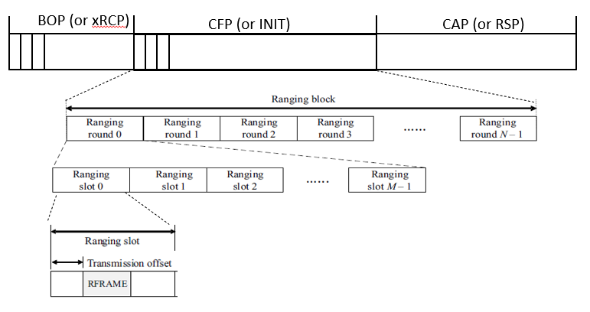
A Superframe Structure
Three periods in a superframe structure – BOP, CFP and CAP
Period duration is configurable: for example, the duration of BOP or CAP could be zero
The BOP and CAP periods provide capability for in-band discovery and UWB service setup
Superframes repeat over time: period durations could be modified over time
The CFP period follows 802.15.4z ranging block structure
N ranging rounds in a block
M ranging slots in a ranging round
One frame (message) per ranging slot
With optional BOP and CAP, different configurations (N, M), the superframe structure can support DL-TDOA schemes from [1-8] or FiRa
superframe

Slide 7
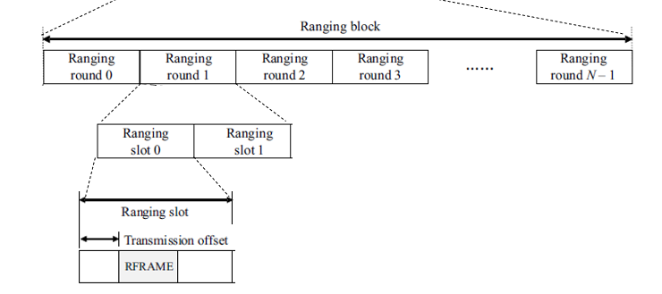
Superframe Structure for Supporting [2-4]
M=2: each ranging round in the CFP has two slots - for anchor pairs
BOP
CFP (ranging block)
CAP
Ranging round for an anchor pair

Slide 8
Superframe Structure for Supporting [5-8]
The superframe structure becomes a single ranging block
BOP = 0
Several ranging rounds per block
Each ranging round contains many-2-many merged RCM/INIT slots, optional INIT only slots (BPS), and merged INIT/RSP for DL-TDOA + a period for other ranging schemes
CAP = 0: CAP functionality is in a dedicated CAP part of a ranging round
Ranging round
xRMC/INIT/(RSP) slots
opt.INIT(BPS) slots
INIT/RSP
RSP/(INIT) (CAP/scheduled)
many-2-many anchor ranging frames for DL-TDoA

Slide 9
Superframe Structure for Supporting FiRa Scheme
M>=2: each ranging round has more than one slots - for anchor clusters
Either SS-TWR-like or DS-TWR-like ranging (as defined in FiRa) can be supported in each ranging round
BOP and CAP are optional
RCM (per round) may be merged with the ranging (initiation) message
To support clusters with different sizes, ranging block/round in 802.15.4z might be extended according to [12]
BOP (optional)
CFP (ranging block)
CAP (optional)
ranging round for an anchor cluster

Slide 10
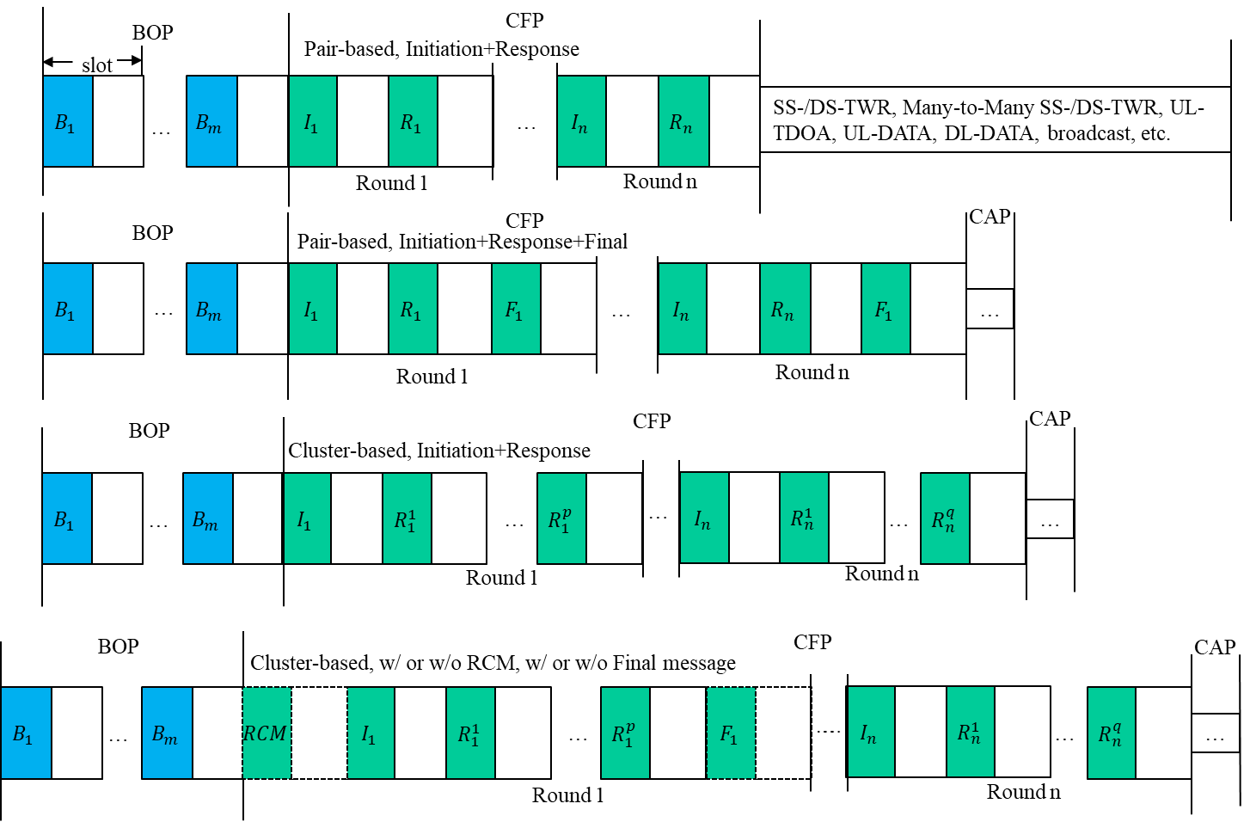
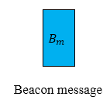
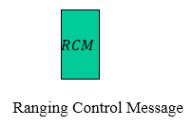
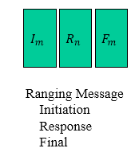
Superframe Structure for Other Examples
The 802.15.4z ranging block and its extension (e.g., [12]) can be fit into CFP period to support various ranging modes – see 4z examples

Slide 11
Conclusion
The described superframe structure is flexible to be configured for different existing designs
The (optional) BOP and CAP periods provide capability for in-band discovery/setup, control, data communication, etc.
Next Steps
Toolbox to support different designs in this superframe structure
IEs for different designs
IB/OOB consideration

Slide 12
References
Zhenzhen Ye, Yongsen Ma (Redpoint), Jean-Marie André (ST microelectronics), Sven Zeisberg (HTW): Converging Downlink TDOA (DL-TDOA) Location Service Proposals in 802.15, 2022-05-18, IEEE 802.15 TG4ab
Zhenzhen Ye (Redpoint): Reverse TDOA Applications and Technical Characteristics. IEEE 15-21-0223-00-04ab, 2021-04-27, IEEE 802.15 TG4ab
Zhenzhen Ye (Redpoint): Downlink TDOA (DL-TDOA) Location Service in 802.15. IEEE 15-21-0488-00-04ab, 2021-09-15, IEEE 802.15 TG4ab
Yongsen Ma, Zhenzhen Ye (Redpoint): Beacon and Ranging Frames to Support Downlink TDOA (DL-TDOA) Location Service in 802.15. IEEE 15-21-0616-01-04ab, 2021-11-16, IEEE 802.15 TG4ab
Sven Zeisberg, Jean-Marie André: 802.15.4z upgrade requirements for larger industrial scenarios. IEEE 15-21-0066-00-04ab, 2021-01-20, IEEE 802.15 SG4ab
Jean-Marie André, Sven Zeisberg: DL-TDOA positioning TDMA scheme. IEEE 15-21-0530-00-04ab, 2021-10-19, IEEE 802.15 TG4ab
Jean-Marie André (ST microelectronics), Sven Zeisberg (HTW), Vincent van der Locht (SynchronicIT), Frank Stephan (ZIGPOS), Andreas Schumacher (TRUMPF): TDMA scheme enabling industrial DL-TDoA and UL-TDoA scenarios. IEEE 15-22-0077-00-04ab, 2022-01-2, IEEE 802.15 TG4ab
Jean-Marie André (ST microelectronics), Sven Zeisberg (HTW), Vincent van der Locht (SynchronicIT), Frank Stephan (ZIGPOS), Andreas Schumacher (TRUMPF): Information Elements for efficient DL-TDoA. IEEE 15-22-0113-00-04ab, 2022-02, IEEE 802.15 TG4ab
J.S. Hammerschmidt, Ersen Ekrem, Eren Sasoglu, Xiliang Luo (Apple): Narrowband assisted multi-millisecond UWB. IEEE 15-21-0409-00-04ab, 2021-07, IEEE 802.15 TG4ab
Ersen Ekrem, et al., NBA-UWB Technical Framework Proposal. IEEE-15-22-xxxx-00-004ab, 2022-03, IEEE 802.15 TG4ab
Billy Verso, et al. (Qorvo), Multi-millisecond Ranging, IEEE-15-22-0205-00-04ab, 2022-03, IEEE 802.15 TG4ab
Youngwan So, Mingyu Lee, Taeyoung Ha, Karthik Srinivasa Gopalan, Aniruddh Rao Kabbinale, Ankur Bansal, Clint Chaplin (Samsung), Flexible Block Structure, 2022-07-12, IEEE 802.15 TG4ab

