Slide 1
Project: IEEE P802.15 Working Group for Wireless Personal Area Networks (WPANs)
Submission Title: [More on Supercomplementary Zero-sum Cross-correlation (SZC) Code Blocks]
Date Submitted: [10 July 2022]
Source: [Igor Dotlic and Michael McLaughlin] Company [Qorvo]
Address [Adelaide Chambers, Peter Street, Dublin 8, Ireland]
E-Mail:[igor(dot)dotlic(at)qorvo(dot)com]
Re: [Study Group 4ab: UWB Next Generation.]
Abstract: [The document introduces supercomplementary zero-sum cross-correlation (SZC) code blocks and describes their properties and benefits for usage as a deterministic STS field.]
Purpose: [To promote usage of SZC code blocks in IEEE 802.15.4ab standard.]
Notice: This document has been prepared to assist the IEEE P802.15. It is offered as a basis for discussion and is not binding on the contributing individual(s) or organization(s). The material in this document is subject to change in form and content after further study. The contributor(s) reserve(s) the right to add, amend or withdraw material contained herein.
Release: The contributor acknowledges and accepts that this contribution becomes the property of IEEE and may be made publicly available by P802.15.
Notes:
Jul 12, 2010
Page 1

Slide 2
More on Supercomplementary Zero-sum Cross-correlation (SZC) Code Blocks

Slide 3
Clarifying General Considerations
SHR/STS channel estimation signal processor considered:
Removes Carrier Frequency Offset (CFO) after correlation and before accumulation on per-symbol basis.
Minimizes power consumption and area.
Full-duplex is considered in mono-static scenarios, whereas half-duplex is considered in bi/multi-static scenarios.
SZC code blocks video-clipping resilience is beneficial in the presence of a strong direct path.
SZC code blocks CFO resilience is beneficial in bi/multi-static scenarios.
Symbol/Channel/Correlator lengths considered are close to those already in 15.4z – 512 ns or 1024 ns.
No need to worry about channel being longer than one symbol.
Channel estimation can be done as for the current STS field with minimal adjustments.
Duration of the SZC code block field is planned to be multiples of 32 µs and 64 µs, like the current STS field.
Need for a SHR/pilot preceding the SZC code block depends on Tx and Rx being synchronized in timing and CFO.

Slide 4
Multiple Access Interference Mitigation
Multiple access interference resilience is achieved in two ways:
Scrambling.
Aperiodic nature of SZC code blocks.
Interfering transmitter and victim receiver are not synchronized.
Zero shift between the two is no more significant than any other.

Slide 5
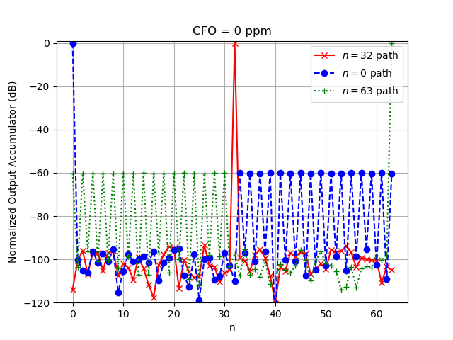
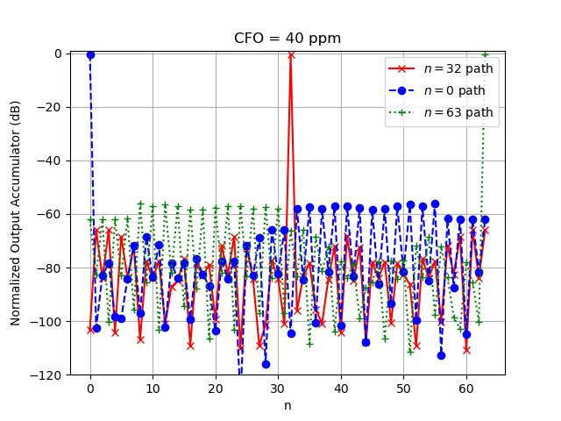
Results for CH9, Spreading Factor $L=4$ and Symbol Duration of $N=64$ (512 ns Symbol / PRF=125 MHz)
Single Block ($32 μs$)

Slide 6
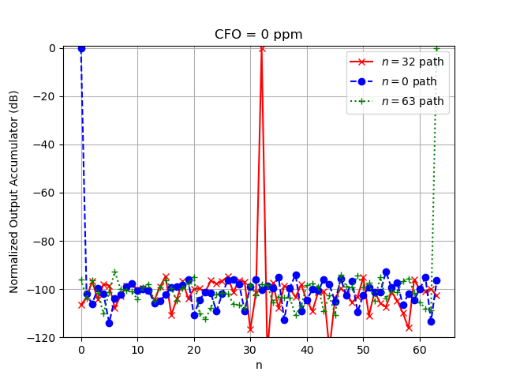
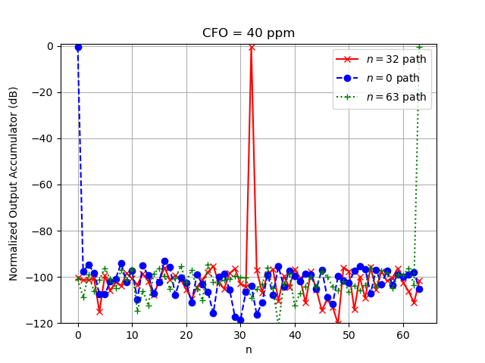
Results for CH9, Spreading Factor $L=4$ and Symbol Duration of $N=64$ (512 ns Symbol / PRF=125 MHz)
Two Blocks ($64 μs$)

