Slide 1

IEEE 802.15 Working Group for Wireless Specialty Networks (WSN)
802 Technical Plenary Presentation
---802.15 Alignment w/802.1---
July 11, 2022

Slide 2
802.15 WG Org. Chart

Slide 3
802.15 WG Standards Pipeline

Slide 4
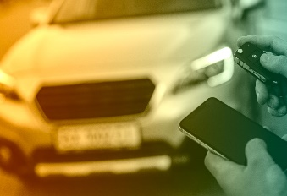







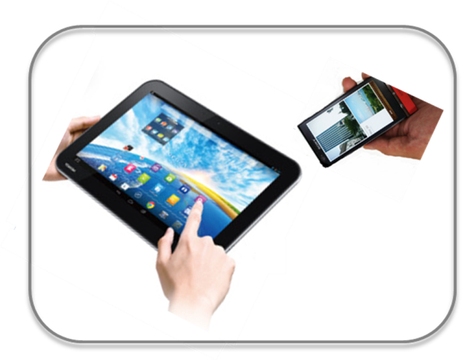








Wireless Specialty Networks (WSN)
Locating and Tracking
Automotive
Ultra-low Power Sensors
FAN/MAN/RAN
Industrial Networks
Multi-media networks
Medical
Critical Infrastructure Networks
Optical
Communications
Consumer Devices

Slide 5
802.15 - The most popular wireless standards you don’t notice
Invisible applications and visible applications in which you don’t think about the wireless communication
  Wireless sensor networks in industrial and consumer markets
  Smart utility and smart city networks
  Internet of so many different things
  Critical Infrastructure Monitoring
  Positive Train Control
  Medical devices
  Game controller and remote control devices
  Precise location services for tracking assets, objects, people and other stuff
  Secure entry for vehicles and buildings
  Multi-media content transfer/distribution
  And many, many more!

Slide 6
802.15 Compatibility w/802.1
The Basic questions:
What features make sense on 802.15 wireless medium(s)?
What are the barriers to 802.15 using 802.1 features?
What are considered “essential to be called 802.1 compliant”?
Looking for answers:
Which features make sense for which standards?
Continue mapping what we think we know to what we know

Slide 7
802.1 Features to 802.15 Mapping
Std | Relevant? | Issues? | Bridging | Dynamic Addressing | EPD | QoS | TSN
15.3 | Yes | ? | Done | Not yet | Done | Yes | Not yet
15.4 (V2 MAC Frame Type) | Maybe | Yes | Bridging-like | Maybe | Yes (15.9) | Not yet | Not yet
15.4 (V1 MAC Frame Type) | No | -- | -- | -- | -- | -- | --
15.6 | Yes | Yes | Maybe | TBD | Yes | Yes | Yes
15.7 | ? | -- | -- | -- | -- | -- | --
15.8 | No | -- | -- | -- | -- | -- | --
15.13 | Yes | Yes | Yes, but no 4-addr | Not yet | Yes | Priority,but not in MPDU | Planned
15.14/15 | TBD | -- | -- | -- | -- | -- | --
15.16t | TBD | -- | -- | -- | -- | -- | --

Slide 8
Thank You

