Slide 1
Project: IEEE P802.15 Working Group for Wireless Personal Area Networks (WPANs)
Submission Title: Challenges in Middle-Range Wireless Communications using the 300GHz-Band
Date Submitted: July 14, 2022
Source: Tetsuya Kawanishi, Kazuhiko Tamesue, Toshio Sato, Takuro Sato, Waseda University
3-4-1, Okubo, Shinjuku-ku, Tokyo 169-8555, Japan
Voice: +81 3 5286 3386, E-Mail: kawanishi@waseda.jp
Iwao Hosako, National Institute of Information and Communications Technology (NICT)
4-2-1, Nukui-Kitamachi, Koganei, Tokyo 184-8795, Japan
E-Mail: hosako@nict.go.jp
Re: n/a
Abstract: Overviews of middle-range 300GHz transmission using MIMO is provided.
Purpose: Informing SC THz on key technologies for 300GHz transmission based on MIMO for discussion in future THz standardization
Notice: This document has been prepared to assist the IEEE P802.15. It is offered as a basis for discussion and is not binding on the contributing individual(s) or organization(s). The material in this document is subject to change in form and content after further study. The contributor(s) reserve(s) the right to add, amend or withdraw material contained herein.
Release: The contributor acknowledges and accepts that this contribution becomes the property of IEEE and may be made publicly available by P802.15.

Slide 2
Challenges in Middle-Range Wireless Communications using the 300GHz-Band
Tetsuya Kawanishi, Kazuhiko Tamesue, Toshio Sato,
Takuro Sato and Iwao Hosako
Waseda University, Japan
National Institute of Information and Communications Technology (NICT), Japan

Slide 3
Outline of this contribution
Use-cases of middle-range WPAN
Link budget for middle-range 300 GHz wireless communication
Feasibility study by simulation for path loss and delay of both applications
Antenna, RF technologies for this project

Slide 4

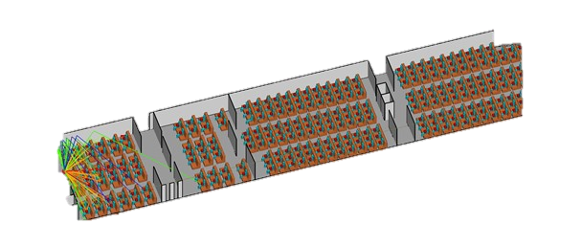

Applications for middle-range WPAN
High speed wireless communication for personalized 8K videos
Medium-range communication to cover stadium or aircraft cabin
300GHz
20Gbps 100 users
300GHz
20Gbps 100 users
70m
70m
Use case 1:
Stadium
Personalized video services
8K video stream
Use case 2:
Aircraft cabin
In-flight video services
8K video stream
Tetsuya Kawanishi, Waseda Univ., et al

Slide 5
A channel plan example
300GHz-band can provide high-speed transmission and multi-channel capability.
Each channel offers effective bit rate 20 Gbps with 2.16 GHz bandwidth
and can handle 100 compressed streams of HEVC/H.265 8K video (200 Mbps).
Total transmission capacity can be 240 Gbps by using 12 channels.
Frequency (GHz)

Slide 6

Link budget for middle-range WPAN
Link budget for 100m distance communication is estimated
High EIRP (43 dBm) is achieved by hybrid beam-forming
EIRP 43dBm
23dBi
Tx Antenna
20dBm
Tx Power
Throughput 20Gbps
CP-OFDM w/ 64-QAM subcarrier
0dBm
Path loss
-122dB
Bandwidth 2.16GHz
CNR=23.8dB
Rx Level
-57dBm
Atmospheric loss
23dBi
-80.8dBm
-1.0dB
Rx Antenna
thermal noise
Access
Point
Terminal
Distance d=100m
(Target 70m + margin 30m)

Slide 7
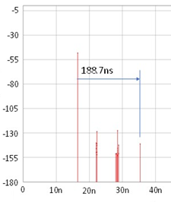
Feasibility study using simulation
Propagation analysis for the stadium using the ray tracing method
- Place 5 blocks of 16x10 sheets and a metal roof at 20 m height to simulate the stadium
- Path loss is estimated as 91 dB at 50 m and 124 dB at 70 m that is close to the value in link budget
- The impulse response at the 50m receiving point is 188.7 nsec
Metal roof (20 m in height)
Response
time
Tx
50m
Power (dBm)
Rx3
Path loss 91dB
-91dB
loss
33m
Rx2
18m
Rx1
Rx1
Rx2
16x10 seats
16x10 seats
16x10 seats
16x10 seats
16x10 seats
Rx3
Configuration of simulation (stadium)
Time of arrival (sec)

Slide 8
System Design for middle-range WPAN
Target
  - Throughput 20 Gbps per channel
  - Spectral efficiency 10 bps/Hz
  - Bandwidth 2.16 GHz per channel
  - Distance 70 m
Key Specification
  - 3x3 MIMO
  - CP-OFDM 64-QAM subcarriers and LDPC (1440, 1344)
  256-QAM subcarriers and LDPC (1440, 1056)
3x3MIMO
Transmitter
Receiver
RHCP
ANT
RHCP
ANT
IP data
LHCP
ANT
LHCP
ANT
IP data
QSFP+
I/F
QSFP+
I/F
LP
ANT
LP
ANT
PHY
orthogonal channel
and multipath
PHY
RHCP Right-handed circular polarization
LHCP Left-handed circular polarization
LP Linearly polarized wave

Slide 9
Antenna, RF technologies
High power amplifier
-Parallel 16 InP HEMTs to realize 20 dBm
High gain patch array antenna using the low loss dielectric substrate
- Right/Left Circular Polarized 8x8 Elements Antenna Array
- Broad axial-ratio by 2-times sequential connection method

Slide 10
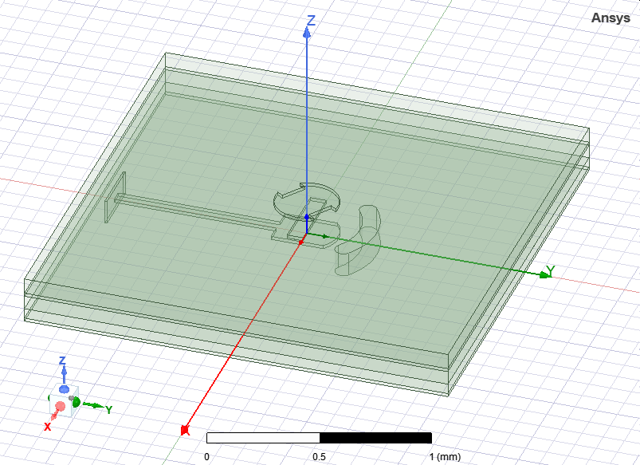
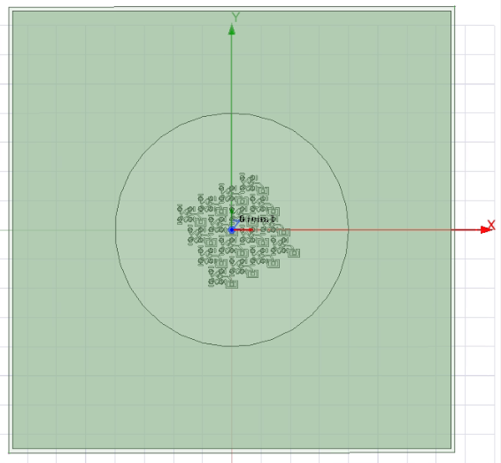
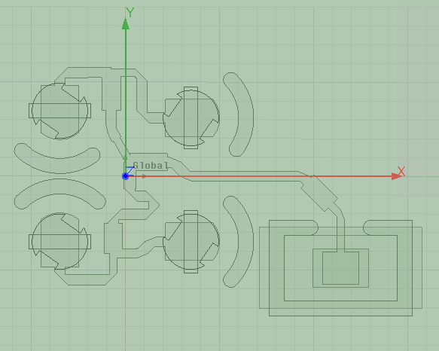
8x8 Elements Antenna Array
RHCP element
Distance between elements 0.65λ
2-times sequential
sequential pair 1
sequential pair 2

Slide 11
Summary and Discussion
Research on 300GHz medium-range wireless transmission is underway.
The transmission speed is targeted at effective bit rate 20 Gbps to deliver HEVC/H.265 8K compressed video to 100 streams.
The target communication distance was set at 70 m for the stadium and the aircraft cabin. Feasibility is confirmed through link budget design and simulation.
System design and Key technologies including RF amplifier and Antenna are introduced.

