Slide 1
Project: IEEE P802.15 Working Group for Wireless Specialty Networks (WSN)
Submission Title: Wireless Next Generation Meeting Slides
Date Submitted: 10 July 2022
Source: Benjamin A. Rolfe (Blind Creek Associates)
Contact:
Voice: <deprecated>, E-Mail: ben.rolfe @ ieee.org
Re: Wireless Next Generation Standing Committee
Abstract: Agenda and Meeting Slides for the July 2022 WNG meeting
Purpose: Stimulate thoughts for the next round of innovations and for other purposes
Notice: This document has been prepared to assist the IEEE P802.15. It is offered as a basis for discussion and is not binding on the contributing individual(s) or organization(s). The material in this document is subject to change in form and content after further study. The contributor(s) reserve(s) the right to add, amend or withdraw material contained herein.
Release: The contributor acknowledges and accepts that this contribution becomes the property of IEEE and may be made publicly available by P802.15.
Notes:
Jul 12, 2010
Page 1

Slide 2
July 2022 802 Plenary
Mixed-mode
Session

Slide 3
Mixed-mode
Please remember to enter your attendance in IMAT
In-room: you must use the microphone
On-line: you must use the chat to que
Reminder:
This is a non-PAR activity
All the rules of conduct apply https://grouper.ieee.org/groups/802/sapolicies.shtml

Slide 4
Registration for 802 LMSC Plenaries and 802 Wireless Interims
This 802.15 meeting (WNG) is part of an IEEE 802 LMSC Plenary or IEEE 802 Wireless Interim session
You must pay the registration fee in order to attend
If you do not intend to register for this session you must leave this meeting and, if you have logged attendance on IMAT, email the appropriate WG chair or vice chairs to have your attendance cancelled

Slide 5
Agenda May 2022
Agenda Item |  |  | Duration | Start Time
1. | Start |  | 0:00 | 11:25
2. | Opening and reminders | Chair | 0:00 | 11:25
3. | Automobiles and Wireless Connectivity | Powell, TBD | 0:40 | 11:25
4. | Low power options for BAN | Khono, Nabki | 0:20 | 12:05
5. | Any other Business (Reminders and anouncements) |  | 0:05 | 12:25
6. | Adjourn |  | 0:00 | 12:30

Slide 6
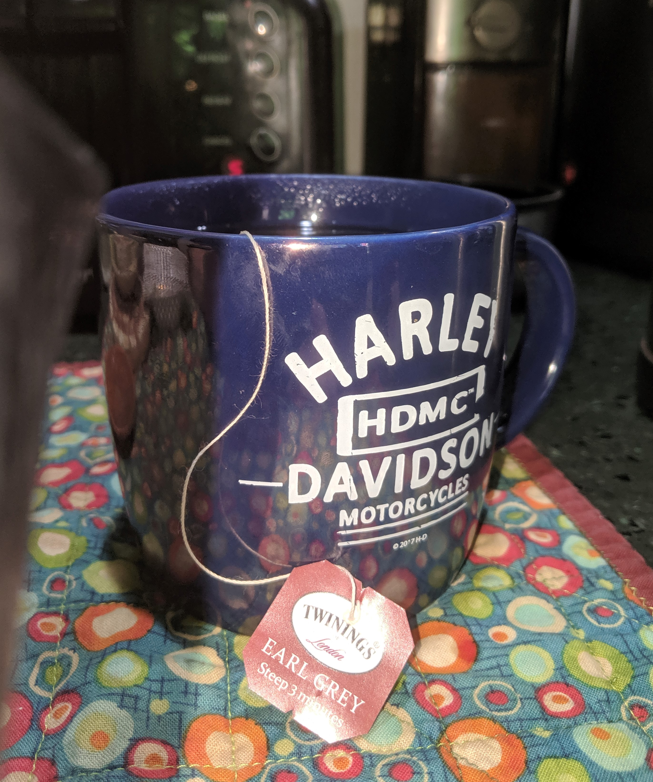
The usual question
What do you propose the Working Group do next?

Slide 7
Reminders and Announcements
Register if you haven’t already!
Call for Contributions for WNG September 2022: Provide your request to the WNG chair

Slide 8
Meeting Adjourned Thanks
Something Shiny to look at while mingling

