Slide 1
Project: IEEE P802.15 Working Group for Wireless Specialty Networks (WSN)
Submission Title: TG4ab May 2022 Meeting Slides
Date Submitted: July 10, 2022
Source: Benjamin A. Rolfe (Blind Creek Associates)
Contact:
Voice: +1 408 395 7207, E-Mail: ben.rolfe @ ieee.org
Re: Task Group 4ab: UWB Next Generation for 802.15.4
Abstract: Plenary Session Slides
Purpose: Continue to progress the project
Notice: This document has been prepared to assist the IEEE P802.15. It is offered as a basis for discussion and is not binding on the contributing individual(s) or organization(s). The material in this document is subject to change in form and content after further study. The contributor(s) reserve(s) the right to add, amend or withdraw material contained herein.
Release: The contributor acknowledges and accepts that this contribution becomes the property of IEEE and may be made publicly available by P802.15.
Notes:
Jul 12, 2010
Page 1

Slide 2

Mixed Mode Plenary
July 2022
Task Group 15.4ab
Next Generation UWB Amendment
First Time for an 802 Plenary!
Live and on-line!

Slide 3
Hybrid Meeting Note (Plea)
The TG leadership strongly requests that if you are in the room, please do not join the Webex
If you do join the Webex from inside the meeting room you MUST assure that you join without audio or disable your device audio completely
Failure to comply with these requests will disrupt the meeting and consume time better spent on technical discussions
Thank you very much!

Slide 4

Task Group 15.4ab
Next Generation UWB Amendment
Objective: enhancements to 802.15.4 Ultra Wideband (UWB) physical layers (PHYs) medium access control (MAC) and associated ranging techniques while retaining backward compatibility with enhanced ranging capable devices (ERDEVs).

Slide 5
5.2.b Scope of the project (As approved):
This amendment enhances the Ultra Wideband (UWB) physical layers (PHYs) medium access control (MAC), and associated ranging techniques while retaining backward compatibility with enhanced ranging capable devices (ERDEVs).
Areas of enhancement include:
  additional coding, preamble and modulation schemes to additional coding, preamble and modulation schemes to support improved link budget and/or reduced air-time relative to IEEE Std 802.15.4 UWB;
  additional channels and operating frequencies;
  interference mitigation techniques to support greater device density and higher traffic use cases relative to the IEEE Std 802.15.4 UWB;
  improvements to accuracy, precision and reliability and interoperability for high-integrity ranging; schemes to reduce complexity and power consumption;
  definitions for tightly coupled hybrid operation with narrowband signaling to assist UWB;
  enhanced native discovery and connection setup mechanisms;
  sensing capabilities to support presence detection and environment mapping;
  and mechanisms supporting low-power low-latency streaming as well as high data-rate streaming allowing at least 50 Mb/s of throughput.
Support for peer-to-peer, peer-to-multi-peer, and station-to-infrastructure protocols are in scope, as are infrastructure synchronization mechanisms. This amendment includes safeguards so that the high throughput data use cases do not cause significant disruption to low duty-cycle ranging use cases.
https://development.standards.ieee.org/myproject-web/app#viewpar/9081

Slide 6
Task Group Organization
Chair: Benjamin Rolfe (BCA)¹
Vice Chair: Clint Powell (Meta)
Vice Chair: Clint Chaplin (SRA)
Vice Chair and Recording Secretary: David Xun Yang (Huawei)
Lead Technical Editor: Billy Verso (Qorvo)
  Thank you to all the volunteers!
¹ Affiliation Details here: https://mentor.ieee.org/802-ec/dcn/22/ec-22-0061-00-00EC-rolfe-affiliations-by-802-activity.pdf

Slide 7
Registration for 802 LMSC Plenaries and 802 Wireless Interims
This 802.15 meeting is part of a IEEE 802 Wireless Interim session
You must pay the registration fee in order to attend virtually or in person
If you have not already done so please register:
  https://cvent.me/N3z9og
  If you do not intend to register for this session you must leave this meeting and, if you have logged attendance on IMAT, email the appropriate WG chair or vice chairs to have your attendance cancelled

Slide 8
Deadbeat Consequences
(Deadbeat: in default of paying registration fee for a prior mtg.)
No participation credit will be granted for said session.
Any participation credit acquired before said session toward membership in any IEEE 802 LMSC group is revoked.
Membership in any IEEE 802 LMSC group is terminated.
No participation credit will be granted for attendance at any subsequent IEEE 802 LMSC session until the individual has complied with the registration requirements for all previously attended IEEE 802 LMSC sessions by the start of said subsequent session.

Slide 9
Task Group Rules
Discussion: Everyone present is welcome
Straw polls: Everyone present may vote
Formal motions: WG voters
  To make, second and vote
Patent policy for PAR activities applies
All the usual rules of conduct
Please identify yourself on first contact with name and affiliation

Slide 10
IEEE-SA Patent, Copyright, and Participation Policies
See: https://grouper.ieee.org/groups/802/sapolicies.shtml
IEEE-SA Patent Slides for Standards Development Meetings (.pdf)
https://development.standards.ieee.org/myproject/Public/mytools/mob/slideset.pdf
IEEE-SA Standards Board Patent Committee (PatCom) home page
https://standards.ieee.org/content/ieee-standards/en/about/sasb/patcom/index.html
IEEE-SA Participation Policy meeting slide set - individual method (.pdf)
https://standards.ieee.org/content/dam/ieee-standards/standards/web/documents/other/Participant-Behavior-Individual-Method.pdf
Working Group Copyright Materials
https://standards.ieee.org/ipr/copyright-materials.html
https://standards.ieee.org/content/dam/ieee-standards/standards/web/documents/other/ieee-sa-copyright-policy-2019.pdf

Slide 11
IEEE 802 Ground Rules
Respect … give it, get it
NO product pitches
NO corporate pitches
NO prices
NO restrictive notices – (no confidentially notices in email)
Presentations must be openly available

Slide 12
July Agenda
https://mentor.ieee.org/802.15/documents?is_dcn=328&is_group=04ab
15.4ab
 | TG4ab Meeting slots
Joint
 | Joint meetings with TG4ab

Slide 13
Agenda
Motion to approve agenda contained in document 15-22-0328r4
Moved by Clint Chaplin (SRA)
Second by Clint Powell (Meta)
Discussion:

Slide 14
Approval of Minutes
Motion to approve May interim session minutes, document # 15-22-0326-00 and interim conference call minutes in document 15-22-00368-00.
Moved by: David Xun Yang (Huawei)
Second by: Clint Powell (Meta)
Links:
https://mentor.ieee.org/802.15/dcn/22/15-22-0326-00-04ab-tg4ab-may-interim-mins.docx
https://mentor.ieee.org/802.15/dcn/22/15-22-0368-00-04ab-tg4ab-conf-call-mins-may-to-jul-2022.docx

Slide 15
We have a full agenda!
Sorry Ghost Rider, the Agenda is full…
You are reminded NOW that all the 802 and IEEE rules you heard at the opening plenary apply to every meeting. This is your final reminder!
Meetings will start ON TIME as shown on the schedule – arrive early, finish nesting, get comfortable
We will need to be disciplined to get through everything
Questions and discussions time may be limited: Use the email reflector to continue discussion!
Take advantage of coffee breaks and other ad hoc time as well as the reflector

Slide 16
Mixed Mode Meeting
This is the first 802 plenary in mixed mode, so we’re learning as we go!
Vice chare CC will be running all presentations and ques
All presentations must be posted at least 4 hours prior to your meeting slot reference to the scheduled start time of the meeting
Posting sooner is ok
Que protocol:
  In-room: Line up at the microphone
  Virtual: use chat
  1 question or comment per que slot; requeue as needed
  Keep (question+answer) to 2 minutes, comments later
  For more in-depth discussion use the reflector.

Slide 17
Time Management
We will need to stay within the allocated time to get through everything
If less than the allocated time is used in a time slot, we’ll start the next time slot (accumulate any unused time to the end of the meeting)
Accumulated time will be used to continue discussion

Slide 18
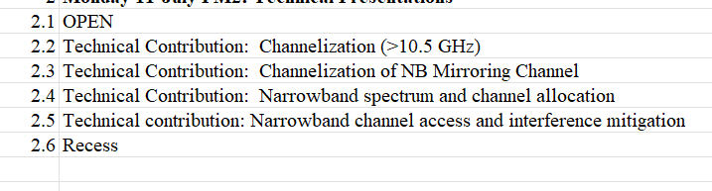
Time reference definitions
Session: The 802 Plenary (everything this week)
Meeting: one of our meeting slots
Time slot: one of the time slots allocated in the TG4ab agenda
Meeting
Time Slot
15.4ab
 | TG4ab Meeting slots
Joint
 | Joint meetings with TG4ab

Slide 19
Session Objectives
Hear technical contributions and develop technical content
Converge PHY proposals
Be ready to commence text submissions
Remember how to talk while in the same room!

Slide 20

Next Steps

Slide 21
Project Schedule (working baseline)
Proposed project schedule | Nov-21 | Dec-21 | Jan-22 | Feb-22 | Mar-22 | Apr-22 | May-22 | Jun-22 | Jul-22 | Aug-22 | Sep-22 | Oct-22 | Nov-22 | Dec-22 | Jan-23 | Feb-23 | Mar-23 | Apr-23 | May-23 | Jun-23 | Jul-23 | Aug-23 | Sep-23 | Oct-23 | Nov-23 | Dec-23 | Jan-24 | Feb-24 | Mar-24 | Apr-24 | May-24 | Jun-24 | Jul-24 | Aug-24 | Sep-24 | Oct-24 | Nov-24
Call for proposals
Hear and evaluate proposals
Cut-off for new proposals, PHY
Cut-off for new proposals, MAC
Integrate poposals/contributions into TFD
Develop draft from TFD
Draft 0
TG draft review and revision
Working group pre-ballot review
Pre-ballot review and comment resolution
First letter ballot |  |  |  |  |  |  |  |  |  |  |  |  |  |  |  |  | LB
LB Comment Resolution
WG Recirculatoin |  |  |  |  |  |  |  |  |  |  |  |  |  |  |  |  |  |  |  |  | LB-R
Comment resolution, 1st recirc
Conditional approval for SA ballot
WG Recirculatoin |  |  |  |  |  |  |  |  |  |  |  |  |  |  |  |  |  |  |  |  |  |  | LB-R
Comment resolution, 2nd recirc and final recirc
First SA ballot |  |  |  |  |  |  |  |  |  |  |  |  |  |  |  |  |  |  |  |  |  |  |  |  | SA
Comment resolution, first SA ballot
SA Resirculation |  |  |  |  |  |  |  |  |  |  |  |  |  |  |  |  |  |  |  |  |  |  |  |  |  |  |  | SA-R
Comment resolution, SA recirculation
SA Resirculation |  |  |  |  |  |  |  |  |  |  |  |  |  |  |  |  |  |  |  |  |  |  |  |  |  |  |  |  |  |  | SA-R
Comment resolution, 2nd SA recirc
Conditional or unconditional approval to RevCom |  |  |  |  |  |  |  |  |  |  |  |  |  |  |  |  |  |  |  |  |  |  |  |  |  |  |  |  | ?? |  |  |  | ??
Optional 3rd SA recirc if needed |  |  |  |  |  |  |  |  |  |  |  |  |  |  |  |  |  |  |  |  |  |  |  |  |  |  |  |  |  |  |  |  | SA-R
RevCom meets |  |  |  |  |  |  |  |  |  |  |  |  |  |  |  |  |  |  |  |  |  |  |  |  |  |  |  |  |  |  |  |  |  | ` |  |  |  | `
You are Here >
Notes: SASB/RevCom schdule for 2024 a guess

Slide 22
Schedule Major Milestones
Near Term Working Milestones
Call for proposals | November 2021
Cut-off for new features (high level feature set), PHY | May 2022
Cut-off for new features (high level feature set), MAC | July 2022
Draft 0 | September 2022
TG draft review and revision complete | November 2022
Working group pre-ballot review complete | January 2022 (before meeting)
First letter ballot | March 2023 (following meeting)
…

Slide 23
Telecon Schedule
July '22
S | M | T | W | T | F | S
 |  |  |  |  | 1 | 2
3 | 4 | 5 | 6 | 7 | 8 | 9
10 | 11 | 12 | 13 | 14 | 15 | 16
17 | 18 | 19 | 20 | 21 | 22 | 23
24 | 25 | 26 | 27 | 28 | 29 | 30
31
Aug '22
S | M | T | W | T | F | S
 | 1 | 2 | 3 | 4 | 5 | 6
7 | 8 | 9 | 10 | 11 | 12 | 13
14 | 15 | 16 | 17 | 18 | 19 | 20
21 | 22 | 23 | 24 | 25 | 26 | 27
28 | 29 | 30 | 31
You are Here
Sept '22
S | M | T | W | T | F | S
 |  |  |  | 1 | 2 | 3
4 | 5 | 6 | 7 | 8 | 9 | 10
11 | 12 | 13 | 14 | 15 | 16 | 17
18 | 19 | 20 | 21 | 22 | 23 | 24
25 | 26 | 27 | 28 | 29 | 30
Plenary

Slide 24
Interim TC planning
Call frequency and phase:
Weekly commencing July 26th
Call Objectives:
Support drafting effort
Review and revise baseline text contributions
Methodology
Using email reflector for discussion
Via email reflector and ad hoc collaboration develop merged and refined features
Use telecons to review and revise

Slide 25
Preparing text for baseline
Begin submitting and reviewing baseline text on first weekly telecon
Submissions for each topic by September interim
To assist the TE we need to converge and merge contributions as much as possible
Collaboration is the most efficient way to converge
Will use formal selection (voting) as needed
Will ask TG to formally approve contributions for inclusion in draft baseline

Slide 26

Technical Contributions

Slide 27
Technical Presentations This Week
Req Order | Requester | Preferences | Assigned | Topic/Title
1 | Libra | 14-July AM1 | Thursday AM1 | A Wake Up Radio Scheme for UWB.
2 | Huan-Bang | Any AM | Tuesday AM1 | To be announced
3 | Fred and Moh | Any | Monday PM2 | Non-coherent reception
4 | Fred and Moh | Any | Monday PM2 | Channel access demo
5 | Zhenzhen, et al | Any | Tuesday AM1 | DL-TDoA
6 | Jarek Niewczas | Any | Monday PM1 | To be announced
7 | Boris, David | Any | Thursday AM1 | Follow up on secure ranging
8 | Carlos | Tuesday | Tuesday AM1 | LDPC
9 | Shang-Te Yang | PT friendly and before the 802.11 WNG | Tuesday PM2 | UWB Interference Considerations
10 | Xiliang Luo et al | Any | Wednesday PM2 | Preamble sequence convergence
11 | Xiliang Luo | Any | Thursday AM2 | More details on MMS
12 | Xiliang Luo | Later in the week | Thursday AM2 | update on the NB-UWB technical framework
13 | Claudio Anliker | In person so any | Thursday AM1 | Secuirty aspects, analysis of distance boudning proposals
14 | Alexander Krebs |  | Monday PM2 | Narrowband spectrum and channel allocation
15 | Alexander Krebs |  | Monday PM2 | Narrowband channel access and interference mitigation
16 | Alexander Krebs |  | Thursday AM2 | Narrowband advertising and session discovery
17 | Mingyu LEE | Monday PM2 (30 min) | Monday PM1 | Channelization of NB Mirroring Channel
18 | YoungWans So, Mingyu LEE | Tuesday PM2 (30 min) | Tuesday PM2 | Enhancement of Ranging Block Structure
19 | Taeyoung Ha | Tuesday PM2 (30 min) | Tuesday PM2 | Text Proposal for NB Mirroring Channel
20 | YoungWans So, Mingyu LEE | Tuesday PM2 (30 min) | Tuesday PM2 | Text Proposal for Multiple Transmissions in A Ranging Slot
21 | Vinod Kristem | Might be able to sqeeze int o Xiliang's slot; PT friendly | Monday PM2 | Higher data rate and symbol structure
22 | Kangjin Yoon |  | Monday PM1 | HRP PHY Inter frame spacing
23 | Claudio da Silva |  | Monday PM2 | channelization (>10.5 GHz)
24 | Porria Pakrooh, Bin Tian | Tuesday PM2 | Tuesday PM2 | Preamble Sequence Study
25 | Porria Pakrooh, Bin Tian |  | Deferred to later | Updates on sensing TFD
26 | Rani Keren | 15 to 20 minutes | Thursday AM1 | Selecting number of fragments in MMS
27 | Chenchen Liu | 30 min | Wednesday PM2 | Considerations on sequences in 4ab
28 | Bin Qian | 15-20 minutes | Thursday PM1 | NB considerations for NBA-MMS
29 | Wei Lin | 15 minutes | Thursday PM1 | Preliminary Discussion on Possible LDPC Codes for 15.4ab
30 | Xiaohui Peng | 15 minutes | Thursday PM1 | UWB sensing pulse shape
31 | Aniruddh Rao Kabbinale |  | Thursday AM2 | co-scheduling ranging and sensing

Slide 28
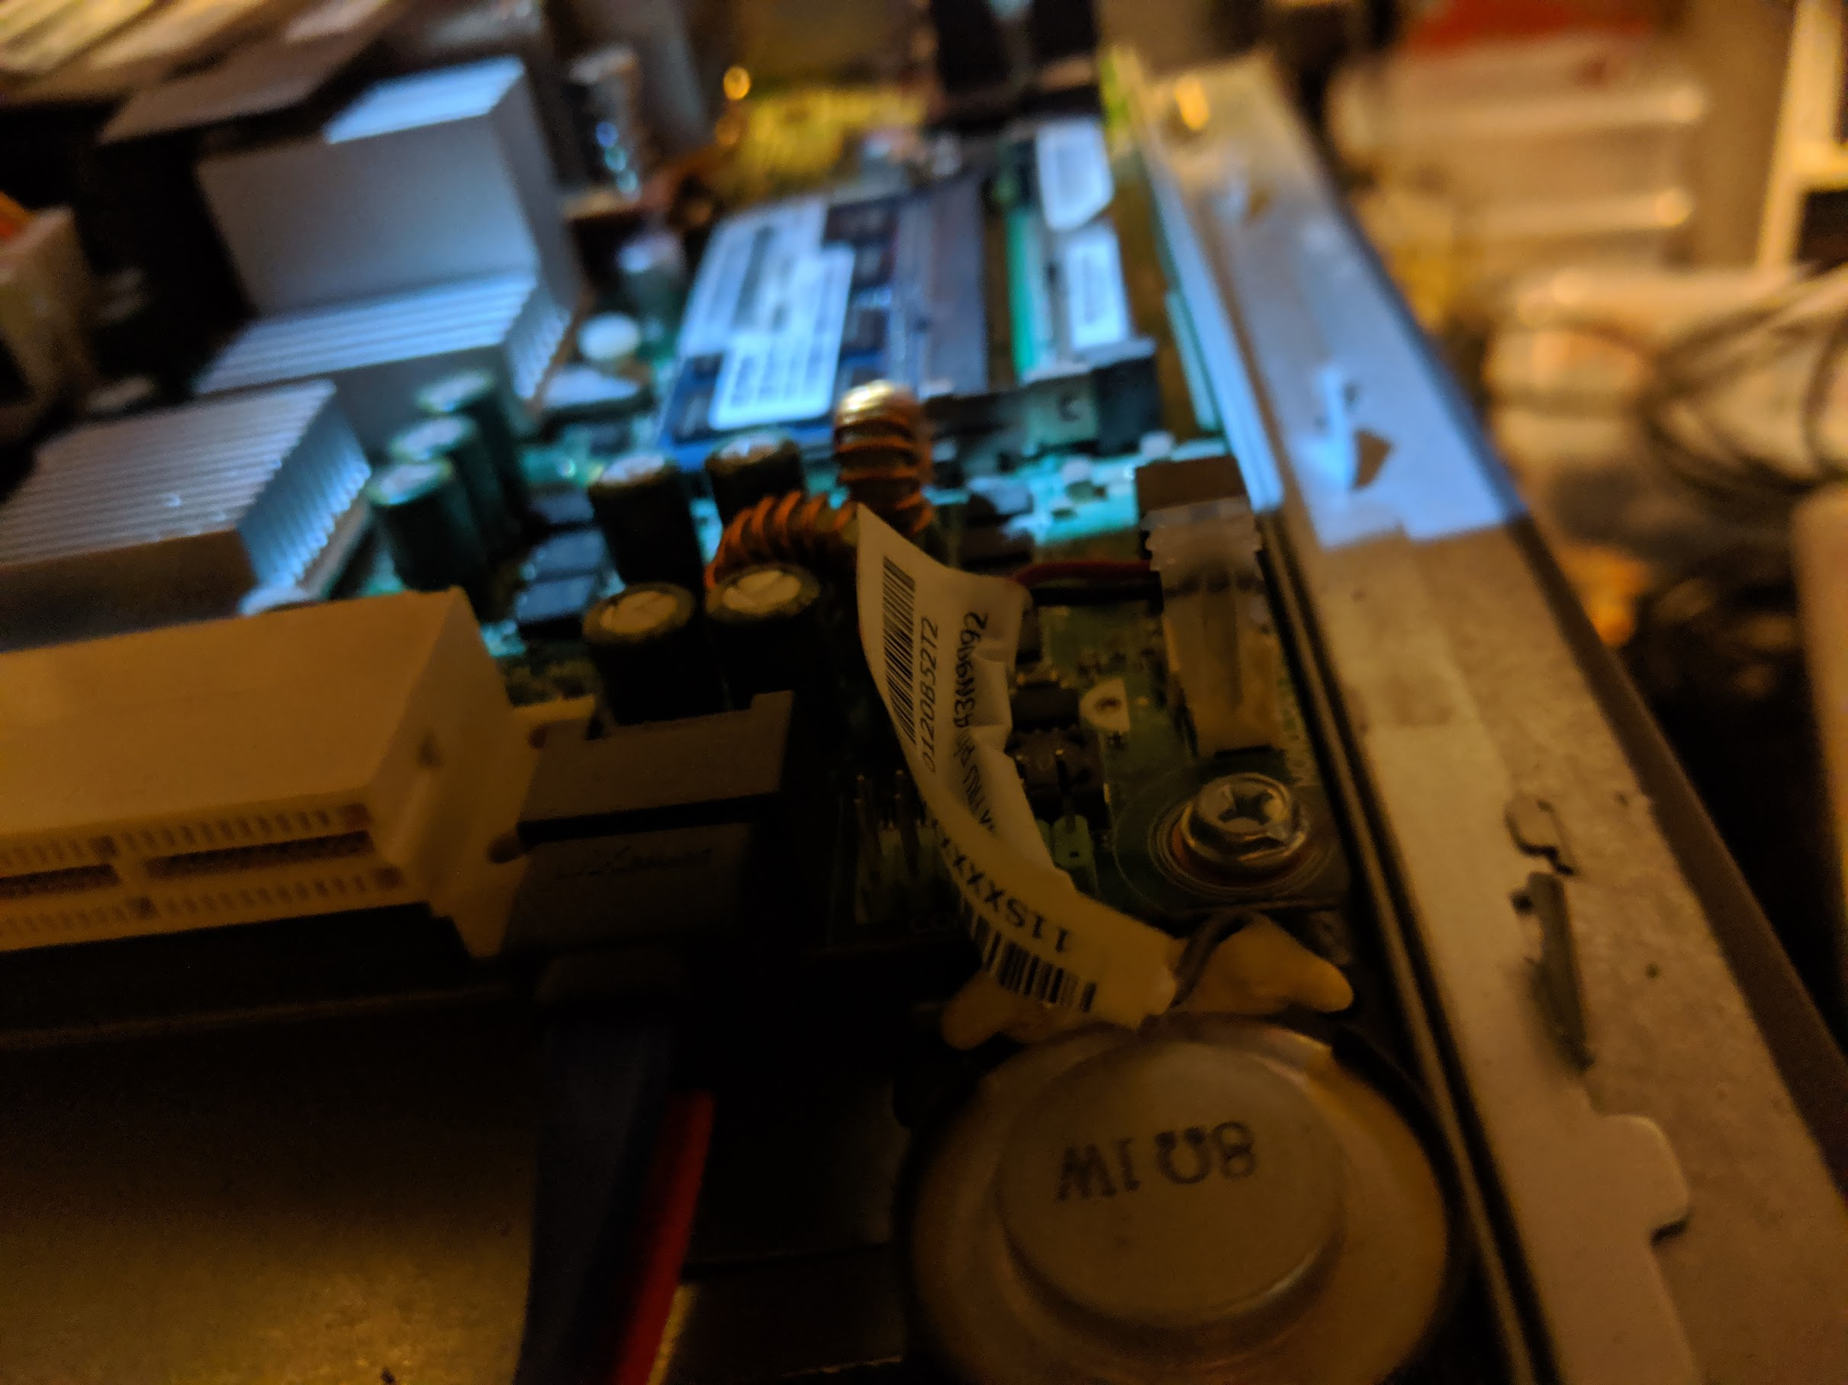
Task Group Closing

Slide 29
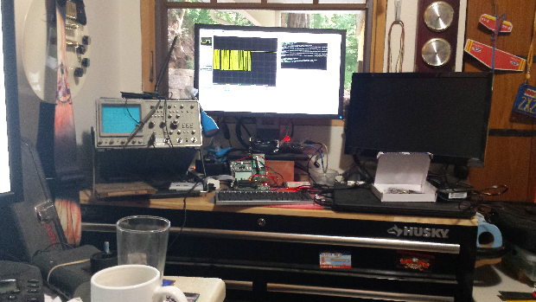
Other Business

Slide 30
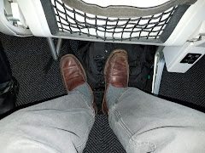
Adjourned
Thanks

