Slide 1
Project: IEEE P802.15 Working Group for Wireless Personal Area Networks (WPANs)
Submission Title: [Narrowband Channel Access and Interference Mitigation for NBA-MMS-UWB]
Date Submitted: [6 July, 2022]
Source: [Alexander Krebs, Yong Liu, Lochan Verma, Jinjing Jiang, SK Yong (Apple)]
Re: [Input to the Working Group]
Abstract: [This documents presents proposed methods for signaling of coordinated NB access between NBA-MMS-UWB initiator and responder, frequency diversity achieving methods in coexistence with 802.11 radio, and proposal of LBT access methods for regulatory compliance.]
Purpose: []
Notice: This document has been prepared to assist the IEEE P802.15. It is offered as a basis for discussion and is not binding on the contributing individual(s) or organization(s). The material in this document is subject to change in form and content after further study. The contributor(s) reserve(s) the right to add, amend or withdraw material contained herein.
Release: The contributor acknowledges and accepts that this contribution becomes the property of IEEE and may be made publicly available by P802.15.

Slide 2
PAR Objective | Proposed Solution (how addressed)
Safeguards so that the high throughput data use cases will not cause significant disruption to low duty-cycle ranging use cases
Interference mitigation techniques to support higher density and higher traffic use cases | PRNG randomized channel access, Wi-Fi aware channel switching mechanism
Other coexistence improvement | CCA-ED based LBT channel access
Backward compatibility with enhanced ranging capable devices (ERDEVs)
Improved link budget and/or reduced air-time
Additional channels and operating frequencies
Improvements to accuracy / precision / reliability and interoperability for high-integrity ranging
Reduced complexity and power consumption
Hybrid operation with narrowband signaling to assist UWB | This describes the NB part
Enhanced native discovery and connection setup mechanisms
Sensing capabilities to support presence detection and environment mapping
Low-power low-latency streaming
Higher data-rate streaming allowing at least 50 Mbit/s of throughput
Support for peer-to-peer, peer-to-multi-peer, and station-to-infrastructure protocols
Infrastructure synchronization mechanisms

Slide 3
NB Channel MAC Signaling
250 NB channels in aggregated UNII-3+5 with 2.5 MHz adjacent channel spacing [1]
Enumeration of macNbaUwbChannelAllowList[] configurations
  macNbaUwbChannelAllowList[][0] = [5,…,47,63,…,248] as default, sets 1-255 tbd.
  macNbaUwbChannelAllowListUpdate() method for adding/removing channels wrt. to known interference characteristics prior, or during NBA-MMS-UWB session lifetime
  Definition of both bitmask and TLV based encoded message formats are reasonable
Example application: coordination of internal 802.11 and 802.15.4 radio

Slide 4
NB Channel Switching 1/5
Channel switching sequence for 4z block based access via AES-128-CTR [2], with synchronized key/nonce configuration among RAN participants
AES based switching achieves white noise a-like frequency diversity over set of macNbaUwbChannelAllowList[]
  reuses secure ranging dynamic STS generator implementation from 4z
  can be operated in combination with 4z block based “round hopping”
Basic PRNG operation mode:
NbaUwbChannelSelected[idx] = macNbaUwbChannelAllowList[AES128CTR(key,nonce,ctr=idx) % L]
where L=len(macNbaUwbChannelAllowList[]) and idx=ranging block index

Slide 5
NB Channel Switching 2/5
Wifi 11bgn,ac,ax is OFDM block structured, adjacent NB channel interference is not i.i.d., purely random access is suboptimal
AES output can be non-i.i.d. biased to optimize coexistence
Biased PRNG operation mode:
  Example method 1: Update macNbaUwbChannelAllowList[] to temporarily exclude overlapping 802.11 channels (e.g. B=20 MHz) from previous NB channel selection

Slide 6
NB Channel Switching 3/5
Example method 2
  Rotate macNbaUwbChannelAllowList[] by L/2 when successively selected NB channels are within the same 802.11 channel
  NB channel access candidates
    c1[idx] = macNbaUwbChannelAllowList[AES128CTR(key,nonce,ctr=idx) % L]
    c2[idx] = macNbaUwbChannelAllowList[(AES128CTR(key,nonce,ctr=idx) + L/2) % L]
  Guard bandwidth switching test (e.g., B=20MHz)
    If |c1[idx] - NbaUwbChannelSelected[idx-1]| * 2.5 MHz < B
      NbaUwbChannelSelected[idx] = c1[idx]
    Else
      NbaUwbChannelSelected[idx] = c2[idx]

Slide 7



NB Channel Switching 4/5
Example: macNbaUwbChannelAllowList[] = [1,…, 50]
c1 (selected)
c1 (not selected)
c2 (selected)

Slide 8
NB Channel Switching 5/5
Resulting non-i.i.d. channel statistics

Slide 9
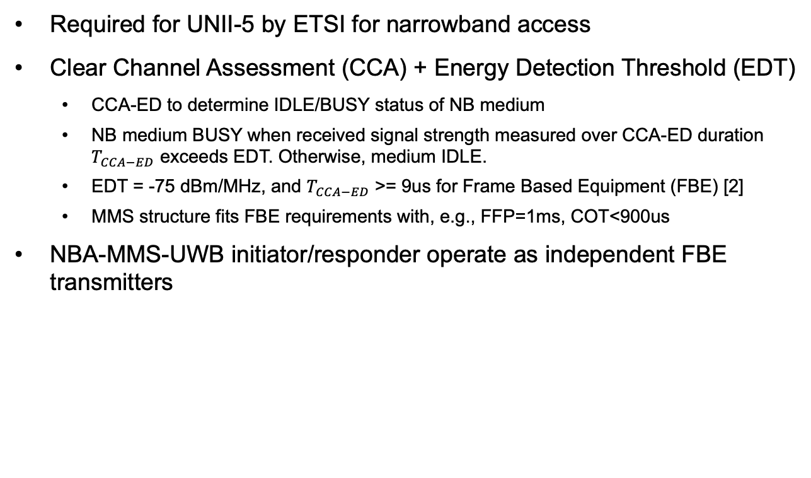
NB Access: CCA-EDT LBT 1/3
Required for UNII-5 by ETSI for narrowband access
Clear Channel Assessment (CCA) + Energy Detection Threshold (EDT)
  CCA-ED to determine IDLE/BUSY status of NB medium
  NB medium BUSY when received signal strength measured over CCA-ED duration $T_{CCA−ED}$ exceeds EDT. Otherwise, medium IDLE.
  EDT = -75 dBm/MHz, and $T_{CCA−ED}$ >= 9us for Frame Based Equipment (FBE) [2]
  MMS structure fits FBE requirements with, e.g., FFP=1ms, COT<900us
NBA-MMS-UWB initiator/responder operate as independent FBE transmitters

Slide 10
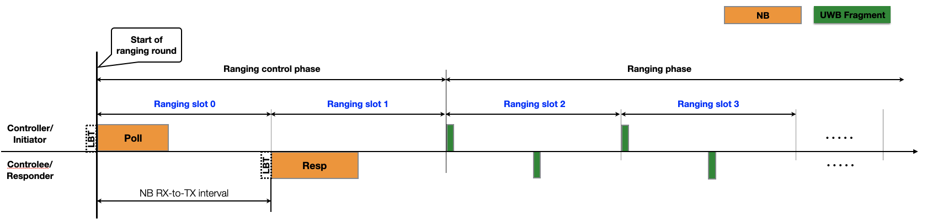
NB Access: CCA-EDT LBT 2/3
Ranging control phase NB access is required for UWB-MMS
  CCA-ED busy state of NB channel at either Poll or Response NB packets leads to loss of synchronization for ranging phase
  UWB fragments will not be transmitted, if either NB Poll/Resp slots are CCA-ED busy
No in-block retry of transmission, NBA-MMS-UWB will commence in next ranging block

Slide 11
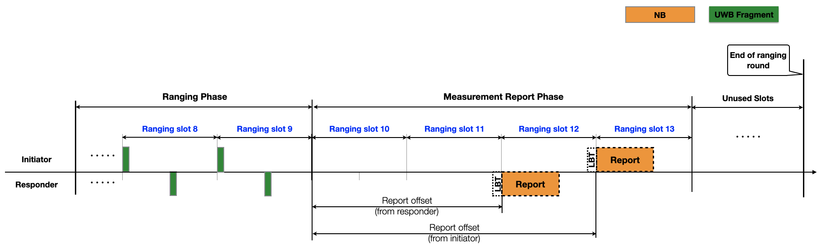
NB Access: CCA-EDT LBT 3/3
Ranging report phase NB access is not required for UWB-MMS tx
CCA-ED busy state of NB channel at Report NB packets does not affect ranging phase
In-block retransmissions could be considered to increase reliability

Slide 12
Summary
We propose adding indexed lists of commonly used NB channels macNbaUwbChannelAllowList[] and macNbaUwbChannelAllowListUpdate() methods to enable efficient coordination of a mutually agreed set of NB channels for NBA-MMS-UWB between initiator and responder.
We propose AES-128-CTR as the baseline PRNG to obtain frequency diversity by switching NB channels between NBA-MMS-UWB blocks, and biasing of the output to obtain non-repeating NB channel access in the same 802.11 channel.
We propose CCA-ED LBT channel access as a low complexity solution to comply with regularity requirements for UNII-5, and definition of a common ruleset for skipping transmission of UWB fragments in case of CCA busy state of NB during ranging control phase.

Slide 13
References
[1] Krebs et al., “Narrowband channel allocation”, 15-22-0339-00-004ab.
[2] ETSI EN 302 867 Draft 1, April 2022.
[3] SP 800-38A Recommendation for Block Cipher Modes of Operation: Methods and Techniques”, Dec 2001.

