Slide 1
Project: IEEE P802.15 Working Group for Wireless Personal Area Networks (WPANs)
Submission Title: [TG15.6ma(Revision of IEEE802.15.6-2012) Opening Information for July 2022]
Date Submitted: [5th July 2022]
Source: [Ryuji Kohno] [1;Yokohama National University(YNU), 2;YRP International Alliance Institute(YRP-IAI)]
Address [1; 79-5 Tokiwadai, Hodogaya-ku, Yokohama, 240-8501 Japan
2; YRP1 Blg., 3-4 HikarinoOka, Yokosuka-City, Kanagawa, 239-0847 Japan]
Voice:[1; +81-90-5408-0611], FAX: [+81-45-383-5528],
Email:[1: kohno@ynu.ac.jp, 2: kohno@yrp-iai.jp] Re: []
Abstract: [This document contains opening information and meeting agenda for the TG15.6ma, that is a task group of Revision of IEEE802.15.6-2012, meeting in July 2022.]
Purpose: [information]
Notice: This document has been prepared to assist the IEEE P802.15. It is offered as a basis for discussion and is not binding on the contributing individual(s) or organization(s). The material in this document is subject to change in form and content after further study. The contributor(s) reserve(s) the right to add, amend or withdraw material contained herein.
Release: The contributor acknowledges and accepts that this contribution becomes the property of IEEE and may be made publicly available by P802.15.

Slide 2
IEEE 802.15 TG15.6ma
(Revision of IEEE802.15.6-2012)
Opening Information
In Personal and Virtual Hybrid Plenary Session
July 12th, 2022
Ryuji Kohno
Yokohama National University(YNU),
YRP International Alliance Institute(YRP-IAI)

Slide 3
Agenda
Opening Session
  Attendance Check
  Administrative Items
  Call for Patents
  Session Schedule of This and Next Weeks
  Review minutes and approve minutes from last virtual meeting in May 2022. Doc.# 15-22-0301-00-06a
  Current Meeting Agenda Doc.# 15-22-0338-00-06ma

Slide 4
Attendance
https://imat.ieee.org
Register
Indicate attendance
Please sign attendance sheet

Slide 5
Administrative Items
Required notices
  Affiliation FAQ - http://standards.ieee.org/faqs/affiliationFAQ.html
  Anti-Trust FAQ - http://standards.ieee.org/resources/antitrust-guidelines.pdf
  Ethics - http://www.ieee.org/portal/cms_docs/about/CoE_poster.pdf
Chair and Secretary
  Chair is Ryuji Kohno(YNU/YRP-IAI)
  Vice Chair is Marco Hernandez(YRP-IAI/CWC)
  Secretary is Takumi Kobayashi(YNU/TCU)
  Technical Editors are Minsoo Kim(YRP-IAI) and
  Marco Hernandez(YRP-IAI/CWC)

Slide 6
Participants, Patents, and Duty to Inform
All participants in this meeting have certain obligations under the IEEE-SA Patent Policy.
  Participants [Note: Quoted text excerpted from IEEE-SA Standards Board Bylaws subclause 6.2]:
    “Shall inform the IEEE (or cause the IEEE to be informed)” of the identity of each “holder of any potential Essential Patent Claims of which they are personally aware” if the claims are owned or controlled by the participant or the entity the participant is from, employed by, or otherwise represents
      “Personal awareness” means that the participant “is personally aware that the holder may have a potential Essential Patent Claim,” even if the participant is not personally aware of the specific patents or patent claims
    “Should inform the IEEE (or cause the IEEE to be informed)” of the identity of “any other holders of such potential Essential Patent Claims” (that is, third parties that are not affiliated with the participant, with the participant’s employer, or with anyone else that the participant is from or otherwise represents)
  The above does not apply if the patent claim is already the subject of an Accepted Letter of Assurance that applies to the proposed standard(s) under consideration by this group
  Early identification of holders of potential Essential Patent Claims is strongly encouraged
  No duty to perform a patent search

Slide 7
Patent Related Links
  All participants should be familiar with their obligations under the IEEE-SA Policies & Procedures for standards development.
  Patent Policy is stated in these sources:
  IEEE-SA Standards Board Bylaws (http://standards.ieee.org/develop/policies/bylaws/sect6-7.html#6)
  IEEE-SA Standards Board Operations Manual (http://standards.ieee.org/develop/policies/opman/sect6.html#6.3)
Material about the patent policy is available at
http://standards.ieee.org/about/sasb/patcom/materials.html
If you have questions, contact the IEEE-SA Standards Board Patent Committee Administrator at patcom@ieee.org or visit http://standards.ieee.org/about/sasb/patcom/index.html
This slide set is available at https://development.standards.ieee.org/myproject/Public/mytools/mob/slideset.ppt

Slide 8
Call for Potentially Essential Patents
If anyone in this meeting is personally aware of the holder of any patent claims that are potentially essential to implementation of the proposed standard(s) under consideration by this group and that are not already the subject of an Accepted Letter of Assurance:
  Either speak up now or
  Provide the chair of this group with the identity of the holder(s) of any and all such claims as soon as possible or
  Cause an LOA to be submitted

Slide 9
Other Guidelines for IEEE WG Meetings
All IEEE-SA standards meetings shall be conducted in compliance with all applicable laws, including antitrust and competition laws.
  Don’t discuss the interpretation, validity, or essentiality of patents/patent claims.
  Don’t discuss specific license rates, terms, or conditions.
    Relative costs, including licensing costs of essential patent claims, of different technical approaches may be discussed in standards development meetings.
      Technical considerations remain primary focus
  Don’t discuss or engage in the fixing of product prices, allocation of customers, or division of sales markets.
  Don’t discuss the status or substance of ongoing or threatened litigation.
  Don’t be silent if inappropriate topics are discussed … do formally object.
---------------------------------------------------------------
See IEEE-SA Standards Board Operations Manual, clause 5.3.10 and “Promoting Competition and Innovation: What You Need to Know about the IEEE Standards Association's Antitrust and Competition Policy” for more details.

Slide 10
Instructions for Chairs of
standards development activities
At the beginning of each standards development meeting the chair or a designee is to:
  Show the following slides (or provide them beforehand)
  Advise the standards development group participants that:
  IEEE SA’s copyright policy is described in Clause 7 of the IEEE SA Standards Board Bylaws and Clause 6.1 of the IEEE SA Standards Board Operations Manual;
  Any material submitted during standards development, whether verbal, recorded, or in written form, is a Contribution and shall comply with the IEEE SA Copyright Policy;
  Instruct the Secretary to record in the minutes of the relevant meeting:
  That the foregoing information was provided and that the copyright slides were shown (or provided beforehand).

Slide 11
IEEE SA Copyright Policy
By participating in this activity, you agree to comply with the IEEE Code of Ethics, all applicable laws, and all IEEE policies and procedures including, but not limited to, the IEEE SA Copyright Policy.
  Previously Published material (copyright assertion indicated) shall not be presented/submitted to the Working Group nor incorporated into a Working Group draft unless permission is granted.
  Prior to presentation or submission, you shall notify the Working Group Chair of previously Published material and should assist the Chair in obtaining copyright permission acceptable to IEEE SA.
  For material that is not previously Published, IEEE is automatically granted a license to use any material that is presented or submitted.

Slide 12
IEEE SA Copyright Policy
The IEEE SA Copyright Policy is described in the IEEE SA Standards Board Bylaws and IEEE SA Standards Board Operations Manual
  IEEE SA Copyright Policy, see
  Clause 7 of the IEEE SA Standards Board Bylaws
  https://standards.ieee.org/about/policies/bylaws/sect6-7.html#7
  Clause 6.1 of the IEEE SA Standards Board Operations Manual
  https://standards.ieee.org/about/policies/opman/sect6.html
IEEE SA Copyright Permission
  https://standards.ieee.org/content/dam/ieee-standards/standards/web/documents/other/permissionltrs.zip
IEEE SA Copyright FAQs
  http://standards.ieee.org/faqs/copyrights.html/
IEEE SA Best Practices for IEEE Standards Development
  https://standards.ieee.org/develop/policies/best_practices_for_ieee_standards_development_051215.pdf
Distribution of Draft Standards (see 6.1.3 of the SASB Operations Manual)
  https://standards.ieee.org/about/policies/opman/sect6.html

Slide 13
Registration for the July 802.15 plenary session
This meeting is part of the July IEEE 802 wireless session
You must pay the registration fee in order to attend
If you have not already done so, you can register here or follow the registration link - https://touchpoint.eventsair.com/ieee-802-wireless-interim-session-jan-2022/registration/Site/Register
If you do not intend to register for this session you must leave this meeting and, if you have logged attendance on IMAT, email the 802.15 chair or vice chairs to have your attendance cancelled

Slide 14
Objectives of TG 6a – Enhanced Dependability Body Area Network (ED-BAN)
Objective: Enhancements to the BAN Ultra Wideband (UWB) physical layer (PHY) and media access control (MAC) to support enhanced dependability to a human BAN (HBAN) and adds support for vehicle body area networks (VBAN), a coordinator in a vehicle with devices around the vehicular cabin.
Action:
Complete Channel Model Document(CMD) for revision
Discussion on MAC for enhanced dependability
Complete Technical Requirement Document(TRD)
Feasibility and satisfaction in market of the TRD
Feasibility of TSN of 802.1 in MAC and interference mitigation in PHY and MAC
Joint Meeting with other groups for harmonization to resolve common problems
Next Things to Do：
Complete all documents for call for proposals

Slide 15
Agenda items for the week
TG15.6a meeting call to order
Call for essential patents and policies & procedures reminder
Approve last meeting minutes: TG 15.6a Meeting Minutes for May 2022 doc.#15-22-0301-00-06a
Agenda of TG15.6ma July Meeting doc.#15-22-0338-00-06ma
Review
  IG DEP, SG & TG15.6a Activity for Amendment of IEEE802.15.6 Wireless BAN with Enhanced Dependability
  doc.#15-21-0023-06-0dep
  2. Revision PAR and CSD for IEEE802.15.6ma doc.#15-22-0168-02-06a doc.#15-22-0167-03-06a
  3. Summary of Channel and Environment Model doc.#15-22-0091-01-06a
  Considerations for MAC protocol in IEEE 802.15.6 BAN with Enhanced Dependability doc.#15-22-0186-01-06a
  Interference modeling in the Technical Requirements Document doc.#15-22-0052-00-06a
  Coordinator-to-coordinator communication for Body Area Networks doc.#15-21-0582-02-06a
  Presentation
  Draft Document of MAC with Enhanced Dependability doc.#15-222-0277-01-06a
  MAC proposal for supporting dependable BAN service classes
  MAC Proposal on Interference Avoidance in Coexisting Dependable BANs
  C2C MAC Technical Requirements
  MAC Solution for Coexisting BANs and Other Networks with MAC-Bridge and Integrated Terminal 21-0245-02-06a
  MAC Bridging for Time-Sensitive Networking of 802.15.6ma doc.#15-22-0024-00-06a
  Collaboration with ETSI SmartBAN and propagation characteristics of UWB communication applications including medical implants
  Channel Model for Wearable and Implant BAN in use case of BMI and BCI
  UWB Channel Models Document doc.#15-22-0xxx-00-06ma
Discussion
1. Common Channel Model for Harmonization with TG 15.6a, 4ab, 5.14, and ETSI Smart BAN
:2. Complete Channel Model Document(CMD)
3. Complete TRD of Enhanced Dependable BAN for Revision of IEEE802.15.6-2012
4. Feasible Technologies for Satisfying the Technical Requirement
5. Timeline for next July and September meetings and later

Slide 16
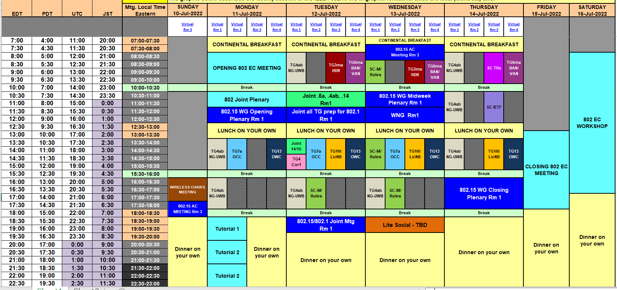
TG15.6ma Plenary Session Schedule for 10-18th, July 2022
TG15.6ma has three own sessions and one joint session such as
Session1: AM1 8:00-10:00 EDT, July 12(TUE), 21:00-23:00 JST
Session2 AM1 8:30-10:00 EDT, July 13(WED), 21:30-23:00 JST
Joint Session TG6a,TG4ab,TG14:AM2 10:30-11:30 July 13(WED EDT, 23:30-24:30 JST
Session3: AM1 9:00-11:00 EDT, July 14(THU), 21:00-23:00 JST

Slide 17
TG15.6ma Plenary Session Schedule for 10-18th July 2022
 | July 11th Monday | July 12th Tuesday | July 13th Wednesday | July 14th Thursday
EDT 8:00AM-10:00AM JST: 9:00-11:00PM |  | AM1 TG15.6ma Session 1 | 8:30-10:00AM1 TG15.6ma Session 2 | AM1 TG15.6ma Session 3
EDT 11:30AM-12:30AM JST:+1day 0:30-1:30AM | IEEE802.15 Opening Plenary |  | AM2 Joint Session TG15.6a, 4ab, &TG14
EDT 4:30PM-15:30PM JST:+1day 5:00-6:00AM |  |  |  | IEEE802.15 Closing Plenary
1. TG 15.6ma Session1,2,3, Tue AM1 (Virtual Room #4)
8:00 AM - 10:00 AM Tue. July 12th,14th 2022 (UTC-04:00) Eastern Time,
8:30 AM - 10:00 AM Tue. July 13th 2022 (UTC-04:00) Eastern Time,
9:00 PM - 11:00PM Tue July 12th,14th 2022 (UTC+9:00) Japan & Korean Time
9:30 PM - 11:00PM Tue July 13th 2022 (UTC+9:00) Japan & Korean Time
https://ieeesa.webex.com/ieeesa/j.php?MTID=m7fadbeaa09b94a2eddcb2fa6535f638d
Meeting number: 2337 002 2352
Password: 80215mtgrm4
Opening and Closing Plenary sessions
Session TG15.6a, 4ab, &TG14 (Virtual Room #1)
EDT 11:30AM-12:30AM July 13th Wednesday
JST:+1day 0:30-1:30AM July 14th Thursday
https://ieeesa.webex.com/ieeesa/j.php?MTID=m6f062ff14eb2736e35dafaf57512b515
Meeting number: 2336 930 3122
Password: 80215mtgrm1

Slide 18
Contacts and Conference call
Chair; Ryuji Kohno, YNU/YRP-IAI
kohno@ynu.ac.jp, kohno@yrp-iai.jp
Vice-Chair; Marco Hernandez, YRP-IAI/CWC
Marco.Hernandez@ieee.org
3. Secretary; Takumi Kobayashi, YNU/TCU
kobayashi-takumi-ch@ynu.ac.jp
Technical Editor; Minsoo Kim, YRP-IAI
minsoo@minsookim.com

Slide 19
Thank you for your attention

Slide 20
Project: IEEE P802.15 Working Group for Wireless Personal Area Networks (WPANs)
Submission Title: [BAN Application for Healthcare under COVID-19
;Field Trial of Detecting Symptom Using Machine Learning in Care Center]
Date Submitted: [12th May 2022]
Source: [Ryuji Kohno] [1;Yokohama National University(YNU), 2;YRP International Alliance Institute(YRP-IAI)]
Address [1; 79-5 Tokiwadai, Hodogaya-ku, Yokohama, 240-8501 Japan
2; YRP1 Blg., 3-4 HikarinoOka, Yokosuka-City, Kanagawa, 239-0847 Japan]
Voice:[1; +81-90-5408-0611], FAX: [+81-45-383-5528],
Email:[1: kohno@ynu.ac.jp, 2: kohno@yrp-iai.jp] Re: []
Re: []
Abstract: [This document contains BAN application for healthcare .]
Purpose: [information]
Notice: This document has been prepared to assist the IEEE P802.15. It is offered as a basis for discussion and is not binding on the contributing individual(s) or organization(s). The material in this document is subject to change in form and content after further study. The contributor(s) reserve(s) the right to add, amend or withdraw material contained herein.
Release: The contributor acknowledges and accepts that this contribution becomes the property of IEEE and may be made publicly available by P802.15.

Slide 21
BAN Application for Healthcare under COVID-19
;Field Trial of Detecting Symptom Using Machine Learning in Care Center
Ryuji Kohno
Yokohama National University(YNU),
YRP International Alliance Institute(YRP-IAI)

Slide 22
Agenda
(1)Overview of this Project
(2)Problems in Care Center under COVID-19
(3)Approach Using BAN and Machine Learning
(4)Feasible Solution
(5)Field Trial in Care Center
(6)Experiment and Evaluation for Applied Machine Learning
(7)Scalability of Learning Models
(8)Concluding Remark
Notes:
本発表の流れを示します。

Slide 23
(1) Overview of this Project
Problems of COVID-19 Pandemic in Care Fields
Infection route Increase
due to infected persons movement
Overload of Care Givers
due to extra works for COVID-19
Increase of Risk for COVID-19
due to Closed Space, Dense and Contact
Demand: Support for infection prophylaxis or prevention using
ICT such as BAN, 5G and AI Based Machine Learning for safe
and sustainable support of care-receivers and care-givers.
Establishing Infection Prevention Support System
Approach of Field Trial of the Support System
Result and Remained Problems of the Field Trial
本報告は、国立研究開発法人情報通信研究機構(NICT)の「ウイルス等感染症対策に資する情報通信技術の研究開発」に関する委託研究の成果を活用
・サービス利用者が受容可能な簡易な仕組みを検討，考察
・異なる事業形態の介護事業者にてコンセプトの実現性を実証実験で確認
・成果と把握した課題を報告
Notes:
日本の高齢者向け介護現場では、COVID-19による以下の課題を抱えています・
・感染症予防対策への対応作業が増えたことで、従来の課題である介護の人手不足に拍車がかかっている。
・自宅から施設への利用者送迎を行う際、利用者に感染者が含まれていると移動時に感染経路が拡大する恐れがある。
・介護時の接触が避けられないなど、施設内では「３つの密（密閉・密集・密接）」状態になってしまうため、感染リスクが増大する。
介護サービスの利用者の多くは、COVID-19感染時の重症化リスクの高い高齢者です。
被介護者とその家族が安全に介護サービスを利用するため、また、介護事業者がサービス利用者に対して安心・安全なサービスを継続して提供するためには、人手の対策コストを極小化しつつ、感染予防を実施する必要があります。
このため、ICTを活用した感染症予防対策支援が必要と考えています。
私たちは、この課題を解決するための感染症予防対策支援システムを検討しています。
取り組みはまだ中途段階ですが、これまでの成果と最新状況を報告します。

Slide 24
(1) Organization of this Project
Fujitsu Co.
Yokohama National University
YRP International Alliance Institute
Shota Watanabe
Yuichi Tsutatani
Yuki Ishiguro
Kumiko Nagashima
Tomomi Nagasaka
Chika Sugimoto
Takumi Kobayashi
〇Ryuji Kohno
This presentation is a part of results in the Project “R&D of ICT for Strategy against COVID-19 Pandemic” sponsored by National Institute of Information and Communication Technology (NICT), Japan.
Notes:
本発表は、国立研究開発法人情報通信研究機構(NICT)の「ウイルス等感染症対策に資する情報通信技術の研究開発」に関する委託研究の成果を活用しています。
この委託研究は、YRP国際連携研究所・横浜国立大学・富士通が連携して行っています。

Slide 25
(2) Problems in Care Center under COVID-19
Problems to be solved for Care Center
Support Using ICT for Preventing Infection
Infection prevention under COVID-19
Safe, stable and sustainable support
Lack of care-givers due to overload
Minimizing cost and load for care-givers
Considering care-receivers’ features and health condition
Elderly people
Less familiar for ICT
Relatively less healthy
Easy and helpful service for both care-receivers and givers
Usability for care-receivers with lack physical and mental strength
Notes:
COVID-19感染拡大により、介護施設の利用控えも増加している中で、介護事業者はサービス利用者に対して安心・安全なサービスを継続して提供する必要があります。
感染症予防対策は必須ですが、そのために従来からの課題である人手不足に拍車がかかることは避けなければなりません。
このため、ICTを活用した感染症予防対策支援が必要と考えています。
ただし、介護施設を利用する被介護者は、高齢でICTに明るくない場合が多く、また体力的に十分でない利用者も多いため、できうる限り簡易な仕組みでかつ、身体的な負荷も考慮した仕組みであることが重要と考えます。
これらの課題に対し、私たちは事業形態の異なる介護事業者からヒアリングするなど、介護サービス利用者の特徴を踏まえたICTサービスの内容・仕組みを検討しています。

Slide 26
(2)Applied Care Centers and Its Current Service for Preventing Infection
Listening Current Action for Infection Prevention in 4 Care Centers
Day Care for rehabilitation with clinical staffs：Center A
Day Service for supporting care-receivers’ daily life such as eating, bath, training at home, and transport between home and center: Center B, C, D
 | Center | Current Services for Preventing Infection
1 | A，B，C，D | Monitoring body temperature in check in
2 | A，B，C，D | Disinfection before and after contact
3 | A，C，D | Monitoring SpO₂※
4 | A | Clinical test support
High risk for infection in Care Center and transportation from home because any current services can be performed after coming to Center
※SpO2 is Blood oxygen saturation and one of risk index for infection of COVID-19
Notes:
私たちは、事業形態の事なる介護護事業者から、計4施設に対して現行の感染症対策とその課題をヒアリングしました。
デイケアとはリハビリを目的としたサービスであり、医師が常勤し、指示を行っています。
デイサービスとは利用者が自宅で自立した日常生活を送る事を支援するサービスで食事、入浴、機能訓練や自宅との送迎などを行います。
いずれも複数のサービス利用者に対してサービスを提供しているため他者との接触機会が多く、コロナ感染時の重症化リスクの高い高齢者がサービス利用者に多い特性から、感染対策が必須な環境です。
これらの施設からヒアリングを行った結果、各施設が共通で実施している対策として1.「入室時の検温の徹底と発熱時のサービスの利用の断り」、2.「介護者と被介護者の接触を避けられないため、都度都度の消毒の徹底」がありました。
これに加えて施設A・C・Dでは3.「Sp02センサーの利用による血中酸素飽和度の監視」を実施し、施設Aでは4.「サービス利用時の体調悪化に対する医療サービスとの連携」を実施していました。
一方で、現行の感染症対策はいずれも「通所後の対策」であり、解決しきれていない課題があることもわかりました。

Slide 27
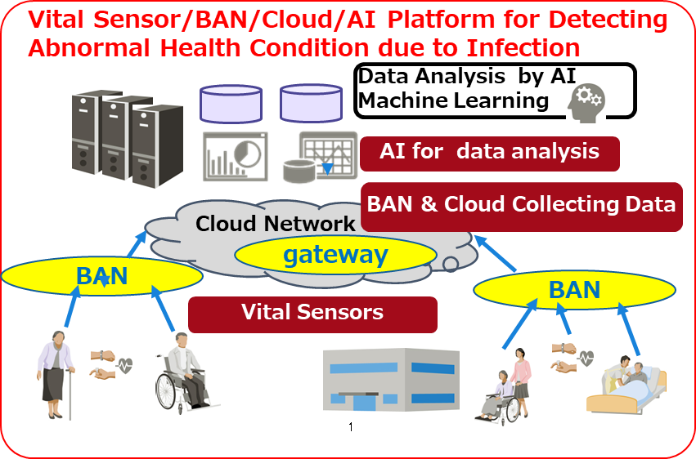
(3) Supporting System for Infection Using Vital Sensor/BAN/Cloud/AI Platform
System to detect abnormal health condition for Infection such as COVID-19 ⇒ Supporting System for Infection Using Integrated Vital sensors, BAN, Cloud, and AI Platform
1．Vital sensors for monitoring vital data of care-receivers
2．BAN and cloud network for collecting and saving vital data
3．AI machine learning for detecting abnormal physical and mental condition from collected vital data

Slide 28


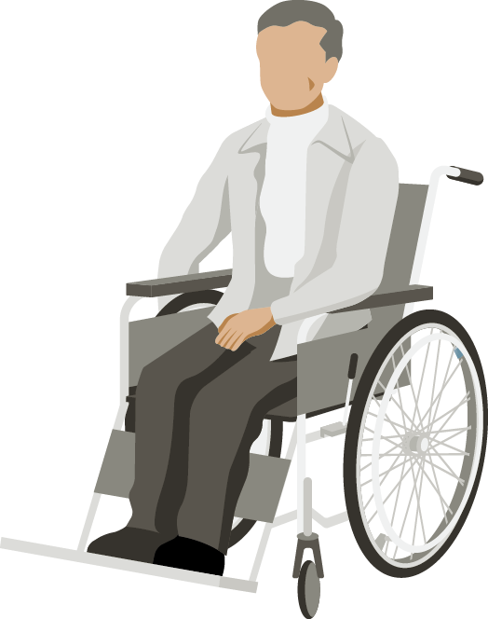

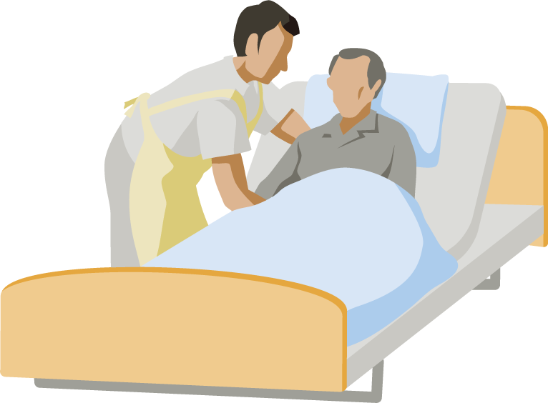
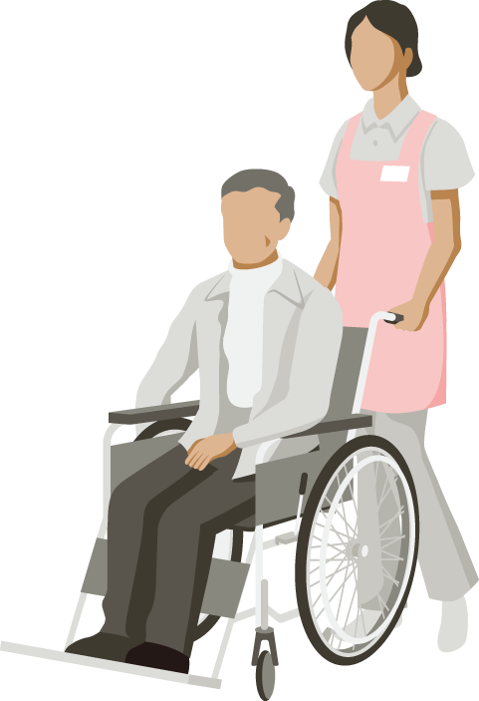

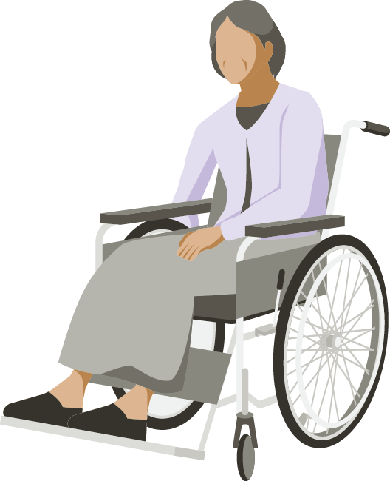






(3) Approach Using BAN and Machine Learning
No increase of care-givers load ⇒
Sophisticated Supporting System for Infection Using ICT and AI
■Risk of Infection in current environment
Support System Using BAN/Cloud/AI Platform
Contact with other care-receivers
AI Analysis
Machine Learning
Contact with Care-Givers
Network
Cloud
Collection in Server
Infection prediction
Carrying care-receivers
by bus
BAN
Vital data
sensing
BAN
BAN
!
Caution to care-receiver for possibility of infection
Vital Data
Home
In Transport
Care Center
Home
Care Center
Notes:
現状、対応しきれていない感染リスクには、以下があります。
・バス送迎利用時など通所前に他の利用者に感染する可能性がある
・介護施設内では、利用者同士、または介護スタッフと被介護者が密集・密着する機会が多く感染リスクが高まる可能性がある
これに対応するには、「通所前」に感染対策を行う必要がありますが、現状の検温・血中酸素飽和度の監視という対応では、以下のリスクに対応しきれません。
・発熱や咳などの症状が出た日の数日前から他の人にうつす可能性がある
・体温やSpO2の値は個人差があり，平常時との差異や時系列的な推移を確認する必要がある
そこで、私たちが検討している感染症対策支援システムでは、サービス利用者の体温・SpO2等のバイタルデータを常時測定・蓄積し、バイタルの異常を検知してCOVID-19感染の可能性がある場合は、介護施設に通知する仕組みを考えています。この仕組みにより、感染の可能性があるサービス利用者には、通所前に介護施設から連絡を入れて通所を控えてもらうなどの対策を取ることができます。
ただし、介護人員不足の現状から、介護施設が日々すべての被介護者のセンサデータを収集・監視・確認することは困難です。このため、バイタルセンサの情報を収集する仕組みは、バイタルセンサに、データの信頼性も含めて有効なBAN、AI技術とを組み合わせ、半自動的に被介護者の体調の不調を検知す方法を検討しています。
これにより、現行の業務負荷を抑えたままで実施できる対策を実現しようと考えています。

Slide 29
(4) Feasible Solution: Selected Technologies
Selected Technologies to Carry out Prospective Services
Vital Sensor: Vital watch “Fitbit Sense” selected considering usability, availability, noninvasive and less load for care-receivers
Remote monitoring: Wireless Body Area Network (BAN) applied for enhanced dependability in transmission according to international standard IEEE802.15.6
Prediction and Detection: Artificial Intelligent (AI) Machine Learning without Teacher data to detect unusual or abnormal physical and mental condition of care-receivers
Notes:
感染症対策支援システムを実現するには、1.「非介護者からバイタル情報を取得するためのバイタルセンサー」、2.「バイタルセンサの情報を収集・蓄積するためのBodyAreaNetwork(BAN)および収集クラウド」、3.「収集したバイタル情報をもとに非介護者の体調・メンタルの変調を検知するAI」が必要です。
私たちは、感染症対策支援システムの実現に向けて実証実験を行うにあたり、以下の技術を採用しました。
高齢の被介護者に対して身体的に負担が少なく、装着・測定が簡単な腕時計型のバイタルウォッチ「Fitbit Sense」をバイタルセンサとして採用しました。
BANはバイタルのデータを扱う関係上、セキュアな通信が求められます。このため、IEEE 802.15.6の標準規格にそった機器を選定しました。
個人差の大きいバイタルデータを扱うにあたり、各個人の正常な状態を学習し、正常な状態から逸脱した状態を検知するアプローチが適していると考えられたため、教師なし学習を採用しました。
それぞれについての選定条件を、詳しく述べます。

Slide 30
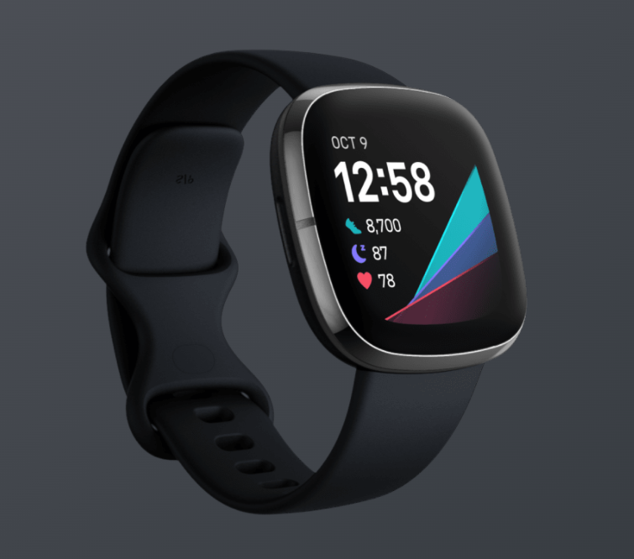
(4) Feasible Solution: Vital Sensor
Condition to select vital sensor
Index for infection of COVID-19 such as temperature, SpO2 etc. can be sensed and monitored.
Easy-wearable, continuous use without recharging battery for 3 days.
■ Fitbit Sense selected
[Feasures]
Wearable wristwatch type of vital sensor
Functionality of On-Wrist Skin Temperature Sensing, Oxygen Saturation (SpO2) Monitoring in sleep as well as usual a heart rate and steps
However, it has not been approved by Japanese authority PMDA as a medical device, so accuracy and sensitivity are not equivalent to approved medical devices.
Easy-detachable wristwatch type and continuous use for more than 6 days without recharge.
https://www.fitbit.com/global/us/products/smartwatches/sense
Notes:
バイタルセンサは、腕時計型のバイタルウォッチから「Fitbit Sense」を採用しました。
Fitbit Senseは心拍数や歩数などの一般的なバイタルウォッチの機能に加えて、睡眠中の皮膚の表面温度や血中酸素ウェルネスなどCOVID-19感染の指標となる情報を測定できます。
さらに、腕時計型で着脱が用意であり、バッテリは6日間以上継続使用可能であることから本実験に適していると考えています。
ただし、日本においては医療機器認定されているバイタルウォッチは存在せず、Fitbit Senseも我が国の認定を受けた医療機器ではありません。
変調が確認できたあとに、より厳密な判断が求められる場合は、医療機器認定されている機器の活用も検討する必要があると考えています。

Slide 31
(4) Feasible Solution: Wireless BAN
Condition to select BAN
Reliability, security, robustness against noise and interference, that is so-called dependability in wireless data transmission according to international standard IEEE802.15.6 and its ongoing its revision 802.15.6a.
■Prototyping with specified for the Sophisticated Supporting System for Infection Using ICT and AI
This is an occasion to apply current ongoing revision of the existing standard IEEE802.15.6 with enhanced dependability; IEEE802.15.6a (6ma) for this supporting sysrem for infection.
Notes:
BANはバイタルのデータを扱う関係上、セキュアな通信が求められます。
このため、医療やヘルスケア分野を中心とする応用を前提に2012年に策定された「IEEE 802.15.6」の標準規格にそった機器を選定する必要があります。
なお、無線通信方式の国際標準規格であるIEEE 802.15.6は、求められる情報パケットの信頼性、緊急性などに応じたQoS(Quality of Service) レベル（0～7レベル）に対応した優先制御が基本仕様として設定されています。
感染症対策支援システムでは、様々なセンサに加えてバイタルウォッチなどの接続が必要であるため、感染症対策支援システムに特化した機器を試作しています。
この試作機器は、利用環境（複数BANや周波数共用する他無線ネットワークの共存、EMC/EMIなどの干渉下でも高信頼）および、人体（医療用）だけでなく車体（自動車用）への拡張のため、現在更新が進められている同標準規格の高信頼化(Enhanced Dependability)更新(amendment/revision) IEEE802.15.6aに反映されています。
なお、本研究開発の事業化のために、標準更新活動と並行して、体温・SpO2などのセンサの複数バイタルデータを組織的に取得できるように設計開発しています。

Slide 32

(4) Feasible Solution: AI Machine Learning
Condition to select AI machine learning
Machine learning without teacher signals is selected to accurately learn normal condition of individual care-receivers and correctly detect their abnormal situation with symptom of COVID-19.
Normal condition of Individual
Modeling abnormal Detection
Data for Normal Condition
Data for Abnormal Condition
Learning without teacher signals
Abnormal Score
Calculation of abnormal score that is differential from normal data
Notes:
AIに利用する機械学習の手法には、教師あり学習・教師なし学習・強化学習などがあります。
感染症対策支援システムでは、人の体調の変化を検知する必要があるため、以下の特性に合った手法を愛用する必要があります。
・基礎疾患の有無なども含め人のバイタル情報は大きな個人差が存在する
・個人がCOVID-19に感染する事は稀であり，症状も様々であるため十分なデータ量でかつ精緻な教師データを確保する事は困難である
・医師のみに許可されている病名などの判定より，個人の体調に変化が生じている事を検知する技術的な根拠を提供する事が重要である
以上の特性から、各個人の正常な状態を学習し、正常な状態から逸脱した状態を検知するアプローチが適していると考えられたため、教師なし学習を採用しています。

Slide 33
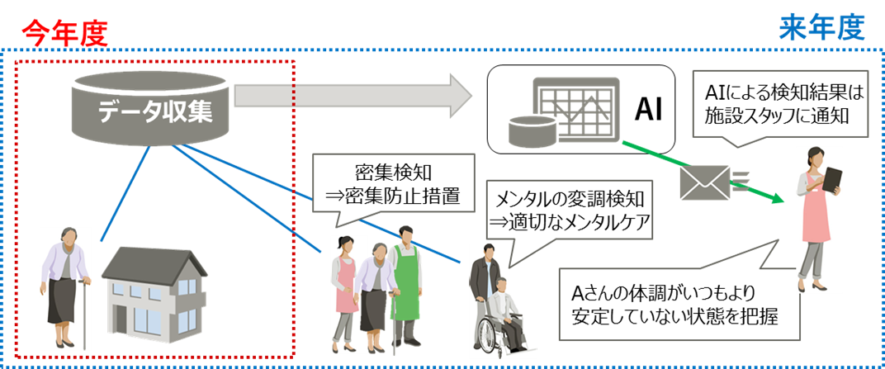
(５) Field Trial
Three Trial Phases of Applying the Supporting System
Phase 1: Data Collection and Apply Machine Learning
Phase 2: Modification of precise data collection and learning algorithm by connecting Fitbit Sense and other medical vital sensors with BAN
Phase 3: Commercial prototyping and filed trial of the Supporting System for Care Center under COVID-19 using modified BAN/Cloud/AI Machine Learning Algorithm
⇒ This presentation
■Phase 3
Data collection
Inform AI detecting results to care-givers
BAN
Medical Devices
Identifying abnormal condition of individual care-receiver
■Phase 1
■Phase 2
Notes:
検討した仕組みを、採用した技術によって実現できるかどうか、富士通社員および介護者、被介護者の協力を得て社会実験を行っています。
この社会実験は3回に分けて実施予定で、現時点では1回目の社会実験が完了し、2回目の実証実験を実施しています。
1回目の社会実験では主にデータの収集と機械学習の試行を実施しました。
2回目はBANとFitbitSense、各種医療機器を接続し、より精緻なデータの取得と機械学習のアルゴリズムの改善を行います。
3回目は1回目、2回目で取得したデータおよび開発した機械学習のアルゴリズムを活用して、介護支援システムのプロトタイプの開発と実証を実施します。
本会では、1回目の社会実験の結果を報告します。
なお、本社会実験は実施母体の倫理審査を経て実施しています。

Slide 34
(５) Field Trial: Phase 1 Result
Participants: 28 persons×2～4months(using Fitbit Sense data and interview sheets)
Major collected vital data: 17 kinds（using Fitbit Sense）
Machine Learning Trial: In case of normal in interview sheet, normal condition data collected.
In case of abnormal in interview sheet, abnormal condition data collected.
No. | Collected Data
1 | Heart beet in stable condition
2 | In case of active motion
3 | In case of sitting
4 | Heart beet
5 | Steps
6 | Calorie
7 | Hight
8 | Distance
9 | On-Wrist Skin Temperature
No. | Collected Data
10 | SpO2 in sleeping
11 | Sleep level
12 | Sleep score
13 | Variance of heart beet in sleeping
14 | Respiration rate in sleeping
15 | Estimated variance of SpO2 in sleeping
16 | Record of sleeping condition
17 | Record of exercise
⇒Show examples
⇒ Show examples
⇒example
34
Notes:
本検証は、28名が参加し、各参加者の2～4か月のFitbit Senseのデータおよび問診票を活用しています。
Fitbit Senseでは、心拍変動や体温、SpO2などのバイタルデータ、歩行やエクササイズなどの記録に加え、睡眠の質に関するデータなど計17種の情報を収集しました。
また、問診票で日々の体調を記録してもらい、機械学習の試行では、問診時に異常がない日を正常時のデータ、問診時に異常がある日を体調不良時のデータとて扱いました。
データの内容について、心拍数、手首温度、SpO2をもとに、次頁で説明します。

Slide 35
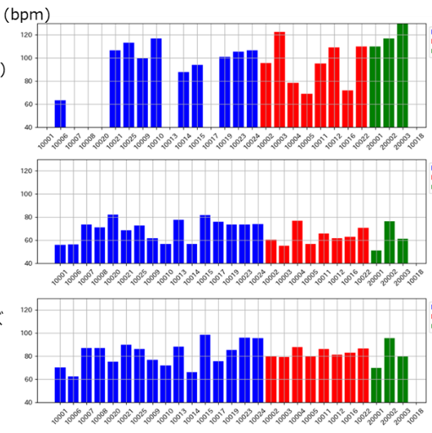
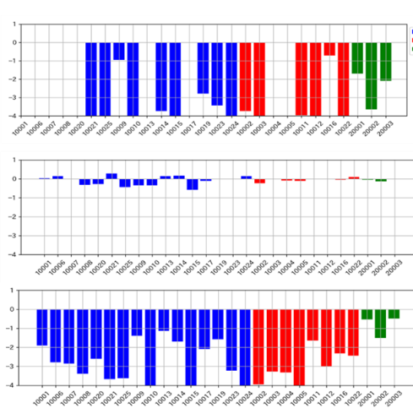
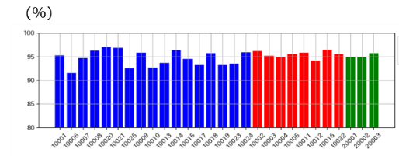
(6)Experiment and Evaluation for Applied Machine Learning
■Respiration rate
■On-Wrist Skin Temperature
■SpO2
In active with exercise
In sleeping
In active without exercise
Care-receivers
Care-givers
Company staffs
・Estimated that trend of data are different in between stable sleeping and active motion.
・Estimated that trend of data are different for individual persons.
⇒ Vital data vary for individual, so it is not easy to detect abnormal
using common threshold
Notes:
エクササイズなどの活動時、睡眠時、エクササイズ以外の活動時の状態ごとの心拍数、手首温度、SpO2の参加者のデータです。
エクササイズなどの活動時、睡眠時、それら以外の状態では、データの傾向が異なることが推察されます。
また、個人ごとにデータの傾向が異なることも推察されます。各個人の状態に応じてバイタルは変化するため、一律の閾値による以上の検出では不十分であると考えます。

Slide 36
(6)Experiment and Evaluation for Applied Machine Learning
Method of making data for machine learning
①Select data for three persons with fever out of 28 participants
②Make labeling data for abnormal body condition by interviewing sheets
  Heavy bad condition with fever
  Light bad condition without fever, headache, lassitude etc.
③Collect data for normal condition for machine learning
  Avoid data in days of heavy and light bad condition
  Avoid data one to three days before and after the day of heavy bad condition
④Confirmation of detecting accuracy of abnormal body condition using cross validation
Notes:
体調不良を検知する機械学習のアルゴリズムとして教師なし学習を利用するために、正常時のデータを定義する必要があります。
今回の社会実験では、学習用データは以下の方法で作成しました。
取得した28名のデータから発熱の体調不良が存在した3名のデータを検証のデータとして抽出します。
問診表のデータから、発熱を伴う場合を重度の体調不良、それ以外の場合を軽度の体調不良としてラベルを付与します。
精緻な正常データを用意するために、学習用の正常データからは、軽度、重度の体調不良が発生した日、重度の体調不良が発生した前日～3日前、翌日～3日後を除外します。
交差検定を利用して体調不良の検知精度を確認します。

Slide 37
(6)Experiment and Evaluation for Applied Machine Learning
Image of cross validation process
Abnormal condition data
Normal condition data
Bad condition data
Both normal and bad condition data
are divided into 10 sets, individually.
1
2
3
4
5
6
7
8
9
10
1
2
3
4
5
6
7
8
9
10
Make 10 different sets for 10 trials
1st Trial
1
2
3
4
5
6
7
8
9
10
1
2nd Trial
2
3
4
5
6
7
8
9
10
1
2
3rd Trial
3
4
5
6
7
8
9
10
1
2
3
・・・
10th Trial
10
1
2
3
4
5
6
7
8
９
10
Learning data
Testing data
Notes:
検知精度の検証のために交差検定を活用しました。交差検定の実施イメージをご説明します。
正常時と体調不良時のデータをそれぞれ10分割し、10分割したデータを組み合わせて10セットのデータセットを作成します。
各データセットのうち学習データのみを学習し、学習モデルを10モデル作成し、各学習モデルを利用して、各データセットの検知対象データを対象に体調不良の検知ができるか検証を行います、

Slide 38
(6)Experiment and Evaluation for Applied Machine Learning
A way of scoring in detecting abnormal condition
The higher score, the higher possibility of abnormal body condition is marked.
０
Score to detecting abnormal condition for 0-1
1
In case that body condition is abnormal when the score is over 0.9,
Less fault alarm in detection while more wrong detection
In case that body condition is abnormal when the score is over 0.1,
Less wrong detection while more fault alarm in detection
Notes:
異常検知では、スコアが高いほど体調不良の可能性が高いと考えます。
どのスコアを閾値として体調不良とみなすかを踏まえて評価する必要があります。

Slide 39
(6)Experiment and Evaluation for Applied Machine Learning
Truth-Positive Rate (TPR) and False-Positive Rate (FPR)
 |  | Truth
 |  | Abnormal | Normal
Detection result | Abnormal | A | B
 | Normal | C | D
B：Wrong detection (False Alarm detection)
A,D：Correct detection
Index value
True Positive Rate (TPR) = A/(A+C)
Index of correctly detecting abnormal body condition with missing the truth
> The higher index value, the better correct detection for normal
False Positive Rate (FPR）= B/(B+D)
Index of incorrectly detecting normal body condition as abnormal condition
> The lower index value, the worse incorrect detection to be abnormal
C：Wrong detection (Miss detection)
Notes:
評価指標としてAUCを利用します。ここではAUCの計算に利用する真陽性率と偽陽性率について、説明します。
真陽性率は、体調不良のデータを漏れずにどの程度検知できたか、偽陽性率は、正常のデータをどの程度誤って体調不良と検知してしまったかを計算します。

Slide 40
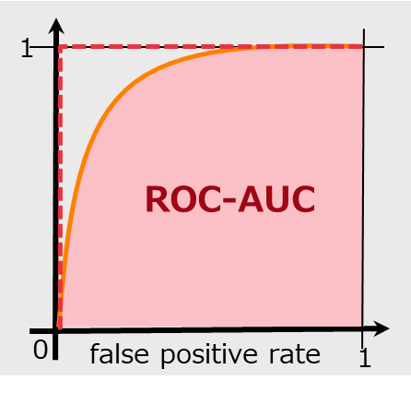
(6) Reference: Machine Learning Trial and Evaluation
ROC curve & ROC-AUC
ROC curve
Figure of Truth-Positive Rate (TPR) versus False-Positive Rate (FPR) according to changing threshold for border of classes of classification model.
true positive rate
ROC-AUC:
colored area under the curve
ROC curve：View graph of TPR vs FPR according to the threshold to decide to be abnormal if the index 0～1 calculated by AI machine learning is higher than the threshold.
ROC-AUC：Area under the ROC curve. AUC range is 0～1. The closer to 1, the higher accuracy can be performed. It is well known that accuracy is dependent upon situation such as sleeping and active moving.
Notes:
検証では、異常の閾値を踏まえて評価するために、ROC曲線とROC曲線から算出したAUCで評価しました。
ROC曲線とはAIの算出した異常スコアに対して、異常スコアがどの値以上であれば異常とみなすかの閾値を変化させた場合の真陽性率、偽陽性率の変化を表現したグラフです。
AUCはROC曲線のグラフ下部の面積で、AUCは0から1までの値をとり、値が1に近いほど精度が良いことを示します。

Slide 41
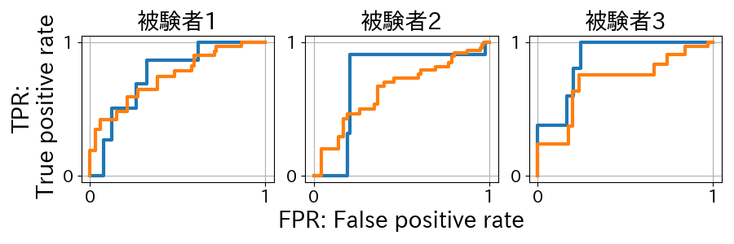
(6)Experiment and Evaluation for Applied Machine Learning
ROC curve for results of detecting abnormal and AUC
Heavy bad condition
Heavy and light bad condition
Care-receiver #1
Care-receiver #2
Care-receiver #3
AUC | Care-receiver #1 | Care-receiver #2 | Care-receiver #3
Heavy band condition | 0.825 | 0.712 | 0.921
All bad condition | 0.753 | 0.665 | 0.672
Since AUC for all cases are over 0.5, it means that abnormal bad condition can be detected.
Notes:
発熱の体調不良があった、被験者3名に関する体調の異常検知結果のROC曲線と、ROC曲線からAUCを計算した結果です。
ROC曲線およびAUC値を確認するとすべての被験者においてAUC：0.5以上であるため、ある程度体調不良が検知できている事がわかります。
重度の体調不良のみを検知の対象とした場合、すべての体調不良を検知対象とした場合より検知精度が良いです。
これは重度の体調不良は発熱や心拍の上昇など分かりやすいデータの変化があったが、軽度の不調はバイタル上の変化に乏しいのが原因であると考えられます。

Slide 42
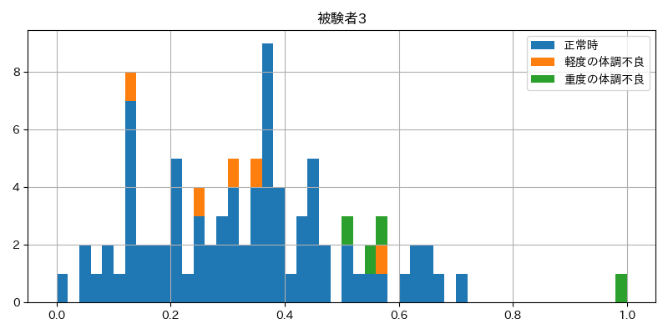
(6)Experiment and Evaluation for Applied Machine Learning
Isolation Forest algorithm is applied for machine learning without teacher data for detecting abnormal condition
detection
Summary of detection result
〇Success of detecting heavy abnormal condition
× Not enough detecting light abnormal condition
→ due to less variance of vital data
× Still some incorrect detection
→ due to sensor accuracy, less data in exercise etc.
No detection
Incorrect detection
Care-receiver #3
Normal condition
Light abnormal condition
Heavy abnormal condition
Normal
Abnormal
Notes:
AIが誤検知した原因を分析します。最も高いAUCである被験者3の各データの異常スコアの分布で確認していきます。
重度の体調不良は推察できていることがわかります。
一方で、青枠の部分のように、正常ではありますが、以上スコアが高いデータ群が存在しています。これらのデータを確認したところ、頻度の少ないエクササイズなどの行動パターンを学習しきれていないケースが多く存在しました。
この傾向は被験者1，2についても同様に存在しており、これらの誤検知は今後のデータ蓄積により削減できる想定です。

Slide 43
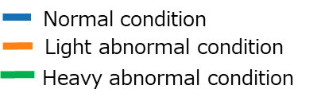
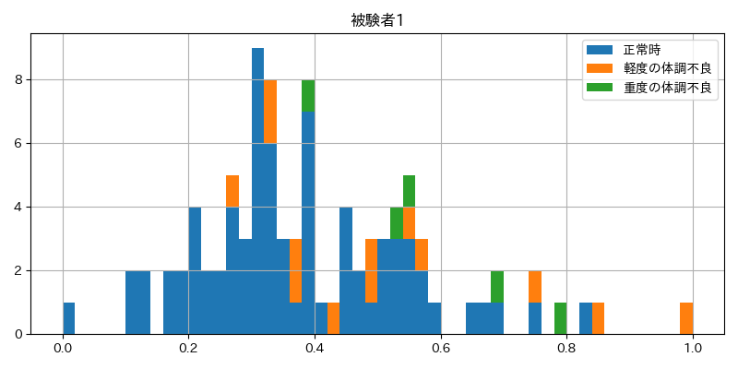
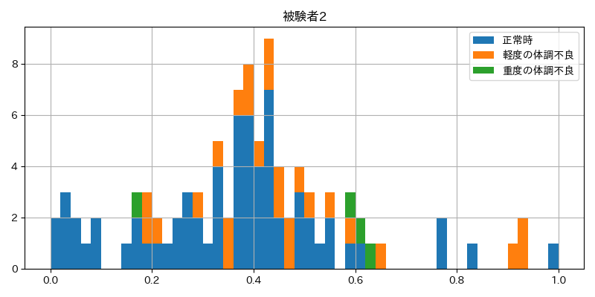
(6)Experiment and Evaluation for Applied Machine Learning
Results of field trial in Phase 1
detection
Care-receiver #1
Care-receiver #2
Care-receiver #3
Normal
Abnormal
Detection of heavy abnormal condition is successful for all care-receivers although there are some remained incorrect detection.
It is approved that an easy wearable vital senser “Fitbit Sense” is useful to detect abnormal body condition.
Notes:
誤検知は多いが3名の被験者とも重度の体調不良を検知することができています。
Fitbit Senseという簡易で身体負荷が低いセンサを活用して被験者の体調不良が検知できる可能性が実証できました。
対象者の人数が少なく、追加の検証は必要ですが実証実験について一定の成果を上げることができたと考えています

Slide 44
（7) Scalability for More General Cases
Scalable Model of Machine Learning
 | Advantage | Drawback
Model of Individual user | Easy learning for individual feature Applicable for data of specified individual Easy making model for similar class of features | Unless enough amount of data are collected, the method cis not applicable
Model of more general class of users | Applicable even if data of a specified user is not collected enough. | Not available for learning feature of specified user Need mass data of users Need to choose proper feature
60 yrs old males
Recipient A
Normal data
Recipient B Normal data
被験者Y
正常データ
…..
Model of detecting abnormal condition
被験者Z
正常データ
Recipient Z
Normal data
Collection of Data for recipients having the same feature
Modelling of 6detecting abnormal condition of 60 yrs old male recipients
Notes:
個人モデルに加えて、汎用性なモデルを作成し、汎用性の確認を実施しました。
個人モデルは、対象者の特徴を学習しやすいというメリットがある一方で、対象者のデータを一定量収集できるまで検知ができないというデメリットがあります。
そこで、60代の男性のように、同じような属性を持つ被験者のデータで検知モデルを作成し、精度を検証します。

Slide 45
(7) Application of General Model in Field Trial
Applied trial of general model in machine learning
Using data of recipients 2 and 3 who have the same gent and age
Adding data of recipient 4 with no abnormal data as a teacher data
Avoiding data of recipient 1 because there is no data similar feature
Pattern | Tearcher data | Detecting recipient
Pattern #1 | Normal condition data of recipient #2 and #4 | Recipient #3
pattern #2 | Normal condition data of recipient #3 and #4 | Recipient #2
Notes:
汎用性なモデルの試行として、性別と年代が同じ被験者２，３のデータを利用します。
また正常時のデータのバリエーション追加のため被験者２，３と、性別と年代が同じであり、異常データがない被験者4のデータを教師データとて加えます。
今回、被験者１は属性の近いデータが存在しないため対象外とします。

Slide 46
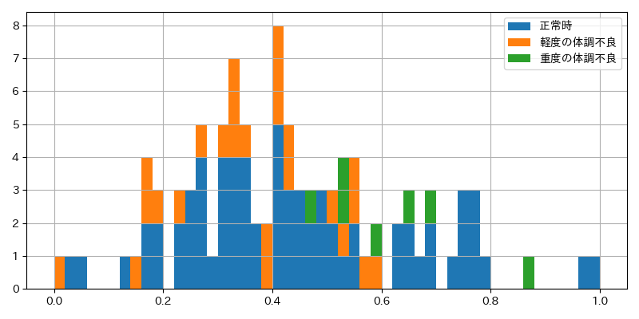
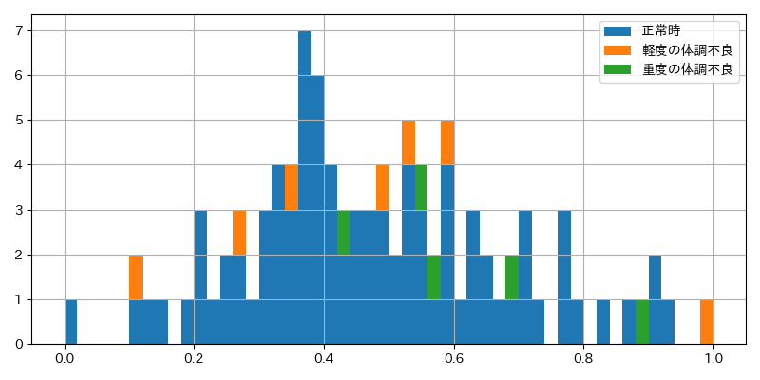
(7) Result of General Model in Field Trial
Results of applied general model in field trial
detection
Recipient #2
Recipient #3
Normal
Abnormal
AUC | Recipient #2 | Recipient #3
Heavy abnormal condition for individual | 0.712 | 0.921
Heavy abnormal condition for genal | 0.805 | 0.734
In case of recipient #2 accuracy of detection is improved but in case of recipient #3 accuracy is degraded, so detection performance may not always be improved using general model.2.
General model may be useful to detect abnormal condition of recipients because AUC is over 0.5.
Need further study for modeling.
Notes:
被験者2,3に関する体調の異常検知結果のROC曲線と、ROC曲線からAUCを計算した結果です。
被験者２は精度が向上したが、被験者３は低下しており、汎用化による精度は必ずしも低下するわけではないことがわかりました。
サンプル数が少なく更なる検証は必須ですが、汎用的なモデルで検証した場合もAUC0.5を超えており、被験者の体調不良が検知できる可能性がある事が確認できました。

Slide 47
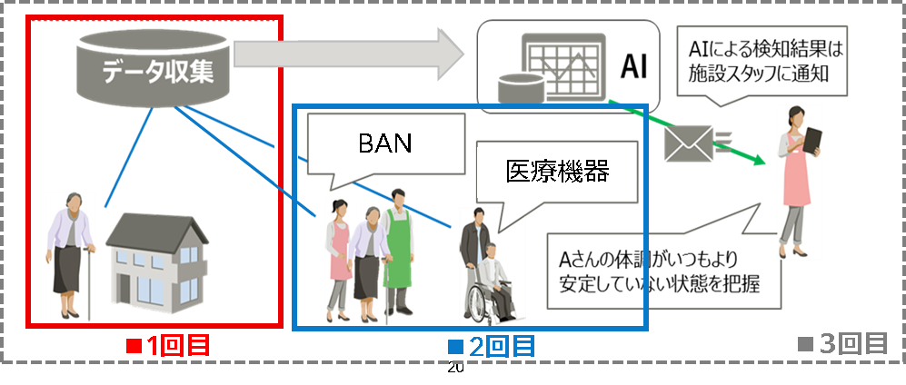
(8) Concluding Remark
We can confirm feasibility of applying Vital Sensor/BAN/AI platform for the developed supporting system to detect infection by field trials.
Further study is needed for improving the system for data collection and detection as well as BAN with selected sensors.
We keep improving the system for below issues.
  Collecting more data for field trial
  Saving high quality data with
  medical vital sensor and BAN
  Improving performance of machine
  learning with teacher data.
Notes:
データの確保や社会実験1回目の結果として、実証実験を行うことで、感染症対策支援システムの実現性が確認できました。
一方で、重度の体調不良は検知できたが軽度の体調不良は検知するに至らなかったなど、検知精度の課題や、データの確保などの課題が存在しています。
今後は、データの取得方法の検討や、教師あり学習の採用による検知精度の向上等、課題の改善に向けた取り組みを継続していく予定です。

Slide 48
Acknowlegement
A part of this research and development project has been supported by National Institute of Information and Communication Technology (NICT), Japan in the program on “ Networking and AI Platform for Supporting Strategies of healthcare in Care Center and home against COVID-19 Pandemic.
On behalf of organizing team of this project, we deeply appreciate for NICT support.

Slide 49
Thank you for your attention

