Slide 1
Ieee802.16t Filtering
DCN 15-22-0322-00-016t
June 14th, 2022

Slide 2
Objective
Show how TX and RX filtering can be applied to the proposed waveform to meet ACLR requirements while maintaining low ISI such that high level QAM can be supported.

Slide 3
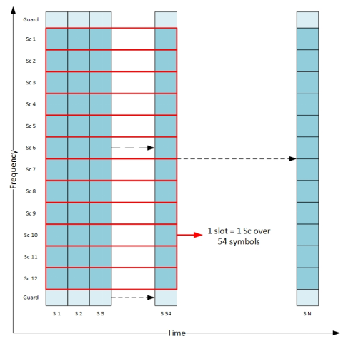
TIME FREQUENCY GRID IN SINGLE CARRIER SYSTEMS

Slide 4
TRANSMIT CHAIN

Slide 5
RECEIVE CHAIN

Slide 6
RAISED COSINE WINDOWING AND IBR FILTERING
The sudden discontinuities that are present across the symbols in the single carrier system result in high frequency harmonics leading to poor adjacent channel leakage ratio.
This can lead to harmful interference to adjacent channels and in order to combat this effect, Raised Cosine windowing technique that smooth the transitions across the symbols are used.
Since the spectrum emission mask (SEM) requirements are more stringent and may not be satisfied by windowing alone, this is followed by IBR filtering to further restrict the out of band emissions.

Slide 7
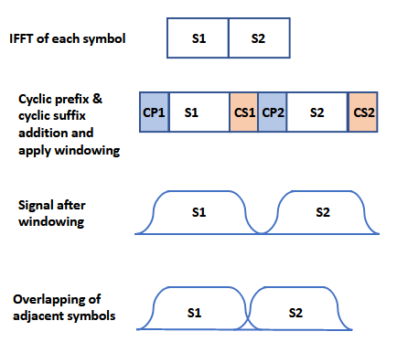
STEPS FOR WINDOWING IN TIME DOMAIN

Slide 8
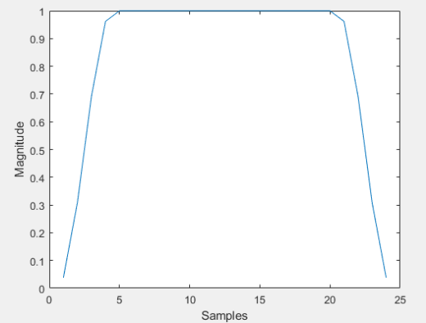
RAISED COSINE WINDOWING
RC Window Generation Code
WINDOW APPLIED ON SAMPLES AFTER CYCLIC PREFIX AND SUFFIX ADDITION

Slide 9
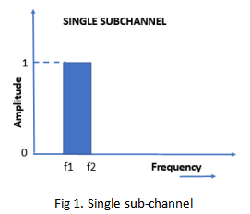
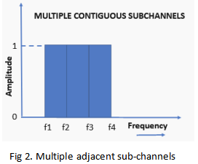
IBR FILTER
In order to design the in-band rejection filter, a brick wall filter in the frequency domain is considered with the passband comprising of the active subchannels.

Slide 10
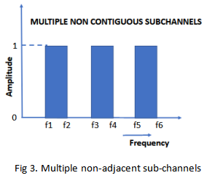
IBR FILTER – Contd.
As shown in the figure, the passband of the filter can be a subchannel (Fig. 1) or subchannels which may be adjacent (Fig. 2) or non-adjacent (Fig. 3).

Slide 11
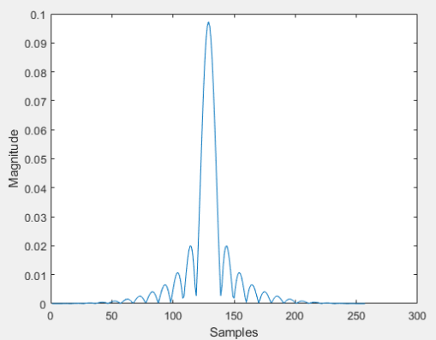
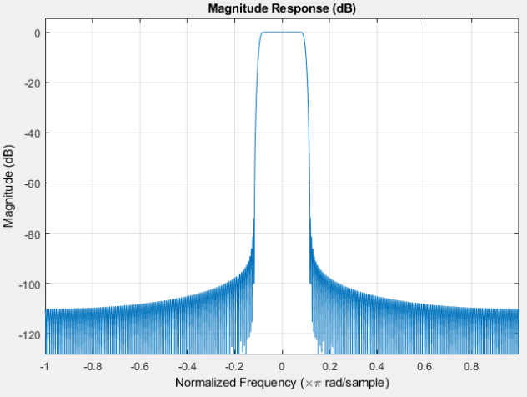
IBR FILTER – Contd.
This is converted to time domain using IFFT to get a truncated sinc function on which windowing is applied to further improve the filter response.
The resultant IBR filter provides reasonably high levels of stop band rejection.
IBR Filter response in time domain
IBR Filter response in frequency domain

Slide 12
PERFORMANCE ANALYSIS
The Tx signal is generated by subchannel mapping, taking IFFT, CP addition, followed by raised cosine windowing and IBR filtering.
At the receiver, followed by noise addition, IBR filtering can be done, followed by FFT and data symbol extraction. The modulation symbols can be further demodulated to recover the bits.
In this document, the results of the following three simulations are summarized.
1) Plotting the Tx signal spectrum after raised cosine windowing and IBR filtering and to check if the FCC Mask D requirements are satisfied.
2) Computing the SNR and EVM for the received symbols.
3) Demodulating the symbols to bits and finding the number of bits in error for different values of SNR.
The results for steps 2 and 3 have been obtained with Tx filtering alone and with both Tx and Rx filtering.
The 256QAM modulation scheme has been considered for the simulations. The number of IBR filter taps is 257.
BER analysis is done without using forward error correction (FEC).

Slide 13
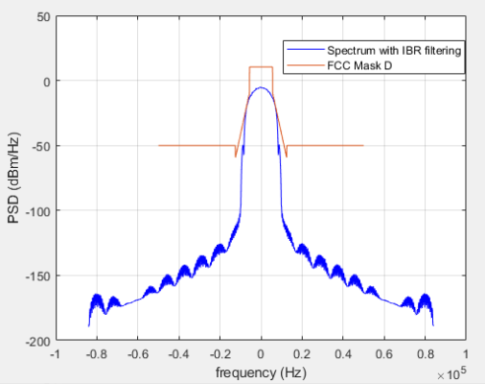
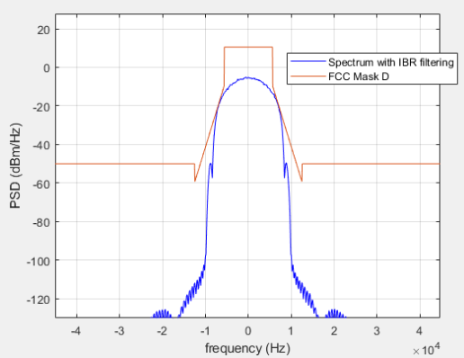
WITH RAISED COSINE WINDOWING, CP 1/4, IBR FILTERING (257 taps), 256QAM no noise
Floating point

Slide 14
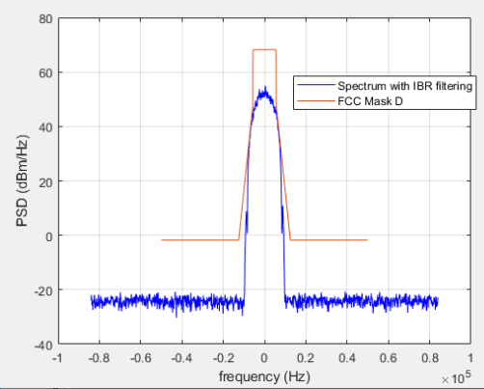
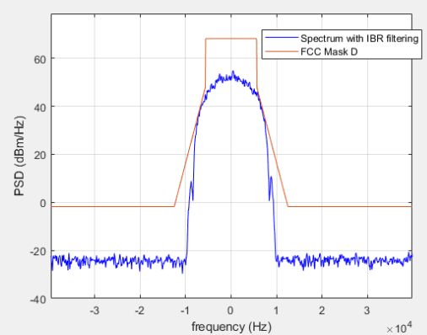
WITH RAISED COSINE WINDOWING, CP 1/4, IBR FILTERING (257 taps), 256QAM no noise
Fixed point : 12 bits Filtered output

Slide 15
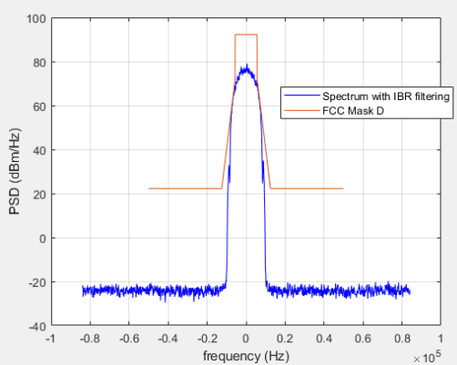
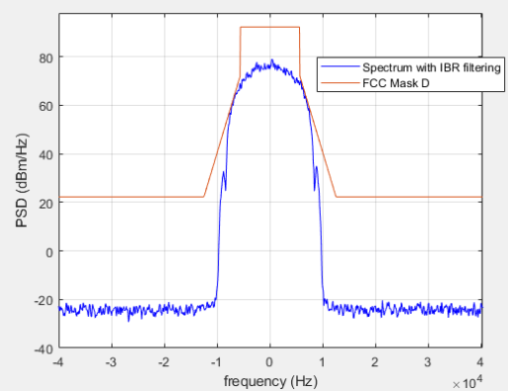
WITH RAISED COSINE WINDOWING, CP 1/4, IBR FILTERING (257 taps), 256QAM no noise
Fixed point : 16 bits Filtered output

Slide 16
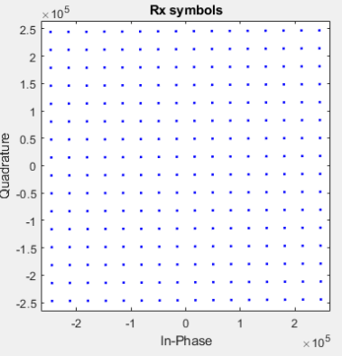
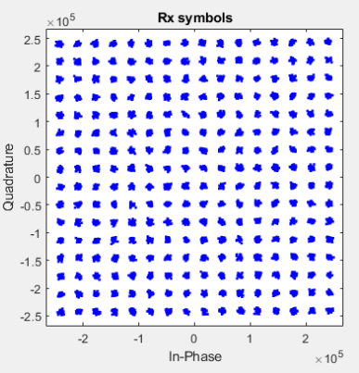
WITH RAISED COSINE WINDOWING, CP 1/4, IBR FILTERING at Tx (257 taps), 256QAM, no noise, 16 bits Filtered output
All subchannels enabled in IBR filter
SNR : 44.27 dB
EVM : 0.61% (-44.27 dB)
One subchannel in IBR filter
SNR : 32.31 dB
EVM : 2.38% (-32.45 dB)

Slide 17
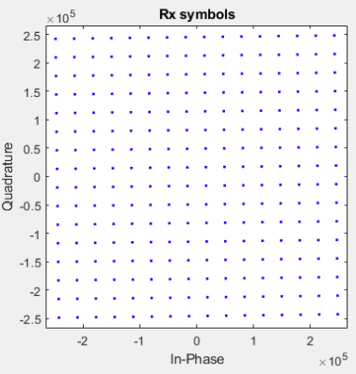
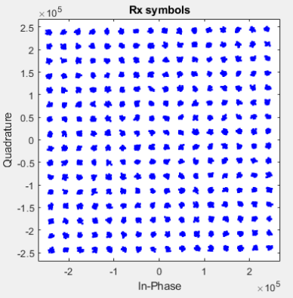
WITH RAISED COSINE WINDOWING, CP 1/4, IBR FILTERING Tx & Rx (257 taps), 256QAM, no noise, 16 bits at filtered output
All subchannels enabled in IBR filter
SNR : 38.25 dB
EVM : 1.22% (-38.25 dB)
One subchannel in IBR filter
SNR : 31.52 dB
EVM : 2.61% (-31.67 dB)

Slide 18
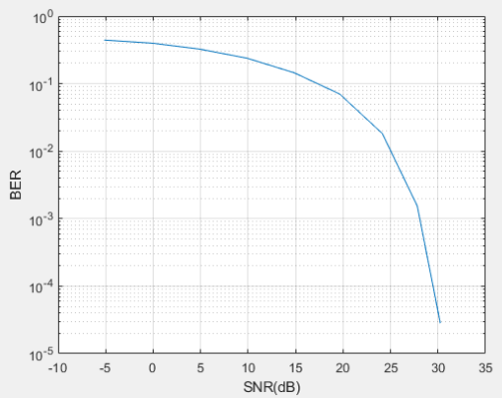
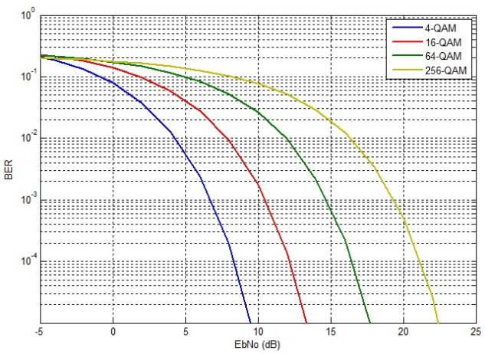
SNR vs BER with RC windowing and Tx IBR filtering for Single subchannel : 256QAM : floating point
SIMULATED
REFERENCE
SNR = Eb/No + 10log10(bits per symbol)
SNR for 10^-4 BER
: 21+10*log10(8) = 30.03 dB
SNR for 10^-4 BER ~ 29.5 dB

Slide 19
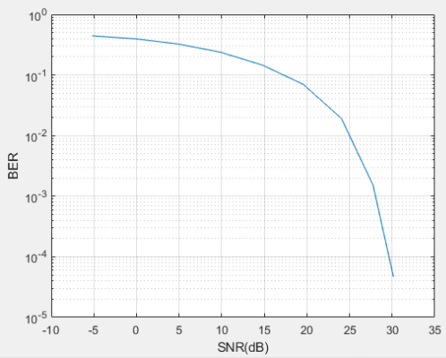
SNR vs BER with RC windowing and Tx IBR filtering for single subchannel : 256QAM : 16 bits fixed point at filtered output
SIMULATED
REFERENCE
SNR = Eb/No + 10log10(bits per symbol)
SNR for 10^-4 BER
: 21+10*log10(8) = 30.03 dB
SNR for 10^-4 BER ~ 29.5 dB

Slide 20
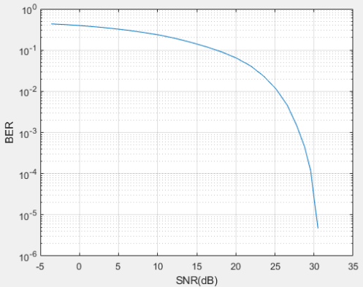
SNR vs BER with RC windowing and IBR filtering at Tx and Rx for single subchannel : 256QAM : 16 bits fixed point at filtered output
SIMULATED
REFERENCE
SNR = Eb/No + 10log10(bits per symbol)
SNR for 10^-4 BER
: 21+10*log10(8) = 30.03 dB
SNR for 10^-4 BER ~ 29.5 dB

Slide 21
CONCLUSIONS
1) The Tx signal spectrum after RC windowing and IBR filtering satisfies the FCC Part 90 Mask D.
2) The minimum SNR and EVM requirements are satisfied for 256QAM.
3) The SNR for 10^(-4) BER matches with that of the reference curve for 256QAM.

Slide 22
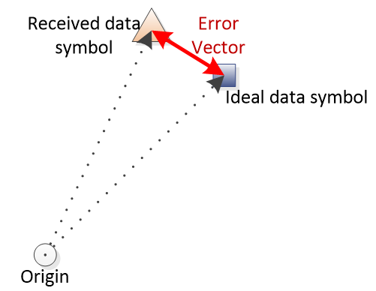
SNR COMPUTATION

Slide 23
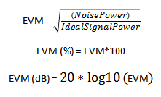
EVM COMPUTATION

Slide 24
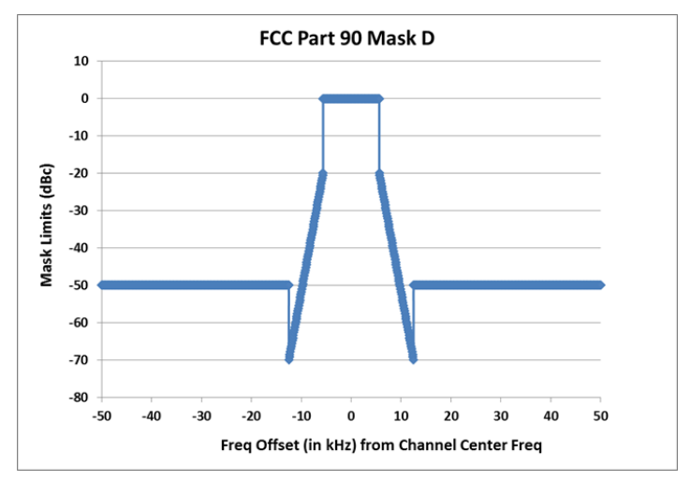
FCC PART 90 MASK D

Slide 25
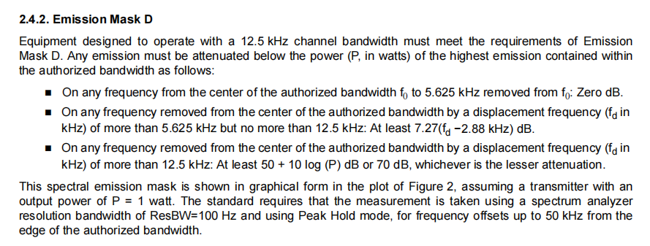
**Extracted from Si446X AND FCC PART 90 COMPLIANCE AT 450–470 MHZ, Silcon labs, AN866

Slide 26
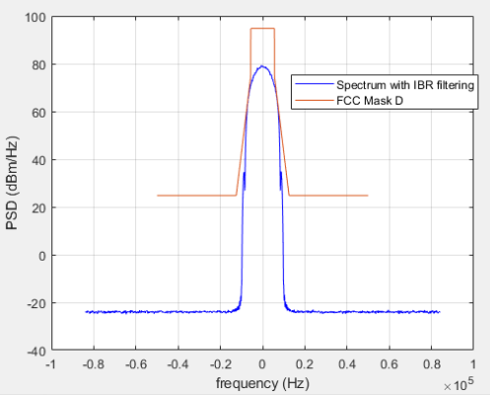
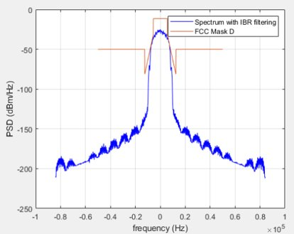
VARIATION OF FCC PART 90 SPECTRAL EMISSION MASK D DEPENDING ON PEAK POWER
As per the third point of the above slide, the FCC Mask can take either of the shapes as shown above depending on the peak power

Slide 27
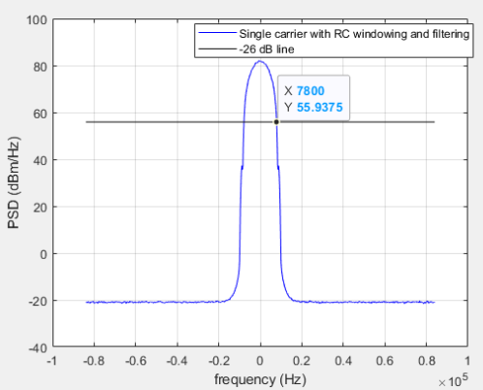
STEPS FOR PLOTTING SIGNAL SPECTRUM WITH FCC PART 90 SPECTRAL EMISSION MASK D
1. The spectrum of the signal is first plotted with 200 Hz resolution bandwidth.
2. Mark the line that is 26 dB below the maximum PSD value at 0 Hz.
3. Obtain the bandwidth corresponding to the 26 dB line which is the emission bandwidth. (eg : from the fig 7.8kHz*2)

Slide 28
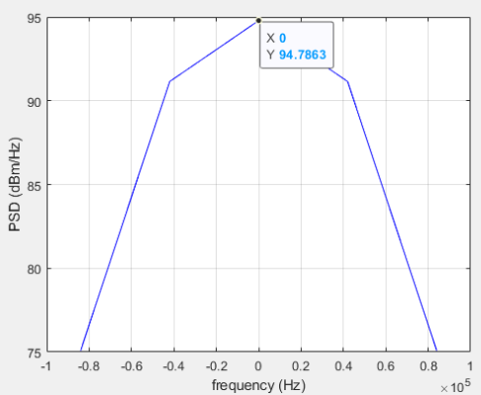
STEPS FOR PLOTTING SIGNAL SPECTRUM WITH FCC PART 90 SPECTRAL EMISSION MASK D
4. Plot the spectrum with three times the emission bandwidth (i.e. 3*7.8*2kHz) obtained in step3.(above fig)
5. The peak value of this PSD plot gives the peak power in dB of the spectrum emission mask.

Slide 29
STEPS FOR PLOTTING SIGNAL SPECTRUM WITH FCC PART 90 SPECTRAL EMISSION MASK D
6. Plot the spectrum again with resolution bandwidth of 100 Hz and plot the mask on top of it.

