Slide 1
Project: IEEE P802.15 Working Group for Wireless Specialty Networks (WSN)
Submission Title: TG 15.4ab Agenda and Meeting Slides
Date Submitted: June 6, 2022
Source: Benjamin A. Rolfe (Blind Creek Associates)
Contact:
Voice: +1 408 395 7207, E-Mail: ben.rolfe @ ieee.org
Re: Task Group 4ab: 802.15.4 UWB Next Generation
Abstract: Teleconference (WebEx) Agenda and Meeting Slides
Purpose: Emulate organization, encourage participation and make further progress
Notice: This document has been prepared to assist the IEEE P802.15. It is offered as a basis for discussion and is not binding on the contributing individual(s) or organization(s). The material in this document is subject to change in form and content after further study. The contributor(s) reserve(s) the right to add, amend or withdraw material contained herein.
Release: The contributor acknowledges and accepts that this contribution becomes the property of IEEE and may be made publicly available by P802.15.
Notes:
Jul 12, 2010
Page 1

Slide 2
Task Group 15.4ab Next Generation UWB Amendment
Teleconference / Virtual Meeting
June 7th, 2022

Slide 3
Task Group Rules
Discussion: Everyone present is welcome
Straw polls: Everyone present may vote
Formal motions: WG voters
To make, second and vote
Patent policy for PAR activities applies
All the usual rules of conduct
Please identify yourself on first contact with name and affiliation

Slide 4
IEEE-SA Patent, Copyright, and Participation Policies
See: https://grouper.ieee.org/groups/802/sapolicies.shtml
IEEE-SA Patent Slides for Standards Development Meetings (.pdf)
https://development.standards.ieee.org/myproject/Public/mytools/mob/slideset.pdf
IEEE-SA Standards Board Patent Committee (PatCom) home page
https://standards.ieee.org/content/ieee-standards/en/about/sasb/patcom/index.html
IEEE-SA Participation Policy meeting slide set - individual method (.pdf)
https://standards.ieee.org/content/dam/ieee-standards/standards/web/documents/other/Participant-Behavior-Individual-Method.pdf
Working Group Copyright Materials
https://standards.ieee.org/ipr/copyright-materials.html
https://standards.ieee.org/content/dam/ieee-standards/standards/web/documents/other/ieee-sa-copyright-policy-2019.pdf

Slide 5
IEEE 802 Ground Rules
Respect … give it, get it
NO product pitches
NO corporate pitches
NO prices
NO restrictive notices – (no confidentially notices in email)
Presentations must be openly available

Slide 6
Proposed Agenda
Opening and meeting preamble
Recap and Reminders
Progressing to drafting
Update the map of 4ab enhancements
Review of grouping
Plans for convergence
Technical discussions
TBD
Next steps
July overview
Any other Business

Slide 7
Recap

Slide 8
5.2.b Scope of the project (As approved):
This amendment enhances the Ultra Wideband (UWB) physical layers (PHYs) medium access control (MAC), and associated ranging techniques while retaining backward compatibility with enhanced ranging capable devices (ERDEVs). Areas of enhancement include:
additional coding, preamble and modulation schemes to additional coding, preamble and modulation schemes to support improved link budget and/or reduced air-time relative to IEEE Std 802.15.4 UWB;
additional channels and operating frequencies;
interference mitigation techniques to support greater device density and higher traffic use cases relative to the IEEE Std 802.15.4 UWB;
improvements to accuracy, precision and reliability and interoperability for high-integrity ranging; schemes to reduce complexity and power consumption;
definitions for tightly coupled hybrid operation with narrowband signaling to assist UWB;
enhanced native discovery and connection setup mechanisms;
sensing capabilities to support presence detection and environment mapping;
and mechanisms supporting low-power low-latency streaming as well as high data-rate streaming allowing at least 50 Mb/s of throughput.
Support for peer-to-peer, peer-to-multi-peer, and station-to-infrastructure protocols are in scope, as are infrastructure synchronization mechanisms. This amendment includes safeguards so that the high throughput data use cases do not cause significant disruption to low duty-cycle ranging use cases.
https://development.standards.ieee.org/myproject-web/app#viewpar/9081

Slide 9
Moving Forward

Slide 10
Alternate Grouping (WIP)
Alternate org:
Sensing
Improved Ranging
Data com Enhancements
Improved lower power options
User Network Separation
Common MAC parts

Slide 11
Volunteer List
So Far (more expected):
Narrow band assist and improved ranging:
Xiliang Lou, Jonathan Segev,
Sensing
Xiaohui Peng, Pooria Pakrooh
MAC scheduling
Kangin Yoon, Kuan Wu
DL-TDoA:
Zhenzhen Ye, Jean-Marie
Channel access MAC and PHY:
Alex Krebs, Frederic Nabki
Data com improvements
Bin Qian, Frederic Nabki, Carlos Aldana

Slide 12
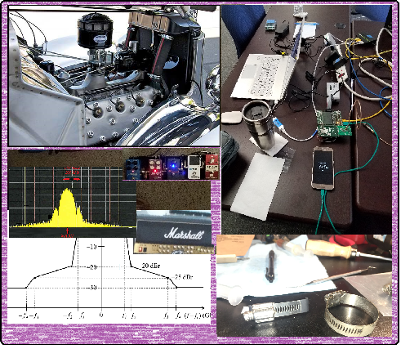
Technical Discussion

Slide 13
Next Steps

Slide 14
July Plenary
Mtg. Local Time | SUNDAY |  | MONDAY |  |  |  | TUESDAY |  |  |  | WEDNESDAY |  |  |  | THURSDAY
Eastern | 10-Jul-2022 |  | 11-Jul-2022 |  |  |  | 12-Jul-2022 |  |  |  | 13-Jul-2022 |  |  |  | 14-Jul-2022
 |  |  | Rm 1 80 CR | Rm 2 45 CR | Rm 3 16 BR | Rm 4 8 BR | Rm 1 80 CR | Rm 2 45 CR | Rm 3 16 BR | Rm 4 8 BR | Rm 1 80 CR | Rm 2 45 CR | Rm 3 16 BR | Rm 4 8 BR | Rm 1 80 CR | Rm 2 45 CR | Rm 3 16 BR | Rm 4 8 BR
07:00-07:30 |  |  | CONTINENTAL BREAKFAST |  |  |  | CONTINENTAL BREAKFAST |  |  |  | CONTINENTAL BREAKFAST |  |  |  | CONTINENTAL BREAKFAST
07:30-08:00 |  |  |  |  |  |  |  |  |  |  | 802.15 AC Meeting
08:00-08:30 |  |  | OPENING 802 EC MEETING |  |  |  | TG4ab | TG13 OWC | TG3ma |  |  |  |  |  | TG4ab | TG13 OWC | SC THz
08:30-09:00 |  |  |  |  |  |  |  |  |  |  | SC-M/ Rules | TG13 OWC | TG3ma
09:00-09:30
09:30-10:00
10:00-10:30 |  |  | Break |  |  |  | Break |  |  |  | Break |  |  |  | Break
10:30-11:00 |  |  | 802 Joint Plenary |  |  |  | Joint .6a, .4ab, .14 Rm1 |  |  |  | 802.15 WG Midweek Rm 1 |  |  |  | TG4ab | SC IETF
11:00-11:30
11:30-12:00 |  |  | 802.15 WG Opening Plenary Rm 1 |  |  |  | Joint all TG prep for 802.1 Rm 1 |  |  |  | WNG Rm1
12:00-12:30
12:30-13:00 |  |  | LUNCH ON YOUR OWN |  |  |  | LUNCH ON YOUR OWN |  |  |  | LUNCH ON YOUR OWN |  |  |  | LUNCH ON YOUR OWN
13:00-13:30
13:30-14:00 |  |  | TG4ab | TG6ma | TG7a OCC |  | Joint 14/15 | TG6ma | TG7a OCC | TG16t | SC-M/ Rules | TG6ma | TG7a OCC | TG16t | TG4ab | TG16t
14:00-14:30
14:30-15:00
15:00-15:30
15:30-16:00 |  |  | Break |  |  |  | Break |  |  |  | Break |  |  |  | Break
16:00-16:30 | WIRELESS CHAIRS MEETING |  | TG4ab | TG13 OWC |  |  | TG4ab | SC-M/ Rules | TG4 Cor1 |  | TG4ab | SC-M/ Rules | TG4 Cor1 |  | 802.15 WG Closing Plenary Rm 1
16:30-17:00
17:00-17:30
17:30-18:00 | 802.15 AC MEETING
18:00-18:30 |  |  | Break |  |  |  | Break |  |  |  | Break |  |  |  | Break
18:30-3:00 |  |  | Tutorials (3) |  |  |  | 802.15/802.1 Joint Mtg Rm 1 |  |  |  | Lite Social - TBD

Slide 15
Telecon Schedule
June '22
S | M | T | W | T | F | S
 |  |  | 1 | 2 | 3 | 4
5 | 6 | 7 | 8 | 9 | 10 | 11
12 | 13 | 14 | 15 | 16 | 17 | 18
19 | 20 | 21 | 22 | 23 | 24 | 25
26 | 27 | 28 | 29 | 30
July '22
S | M | T | W | T | F | S
 |  |  |  |  | 1 | 2
3 | 4 | 5 | 6 | 7 | 8 | 9
10 | 11 | 12 | 13 | 14 | 15 | 16
17 | 18 | 19 | 20 | 21 | 22 | 23
24 | 25 | 26 | 27 | 28 | 29 | 30
31
Plenary

Slide 16
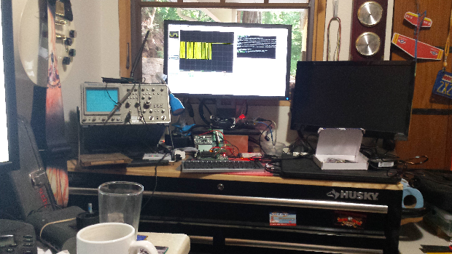
Other Business

Slide 17
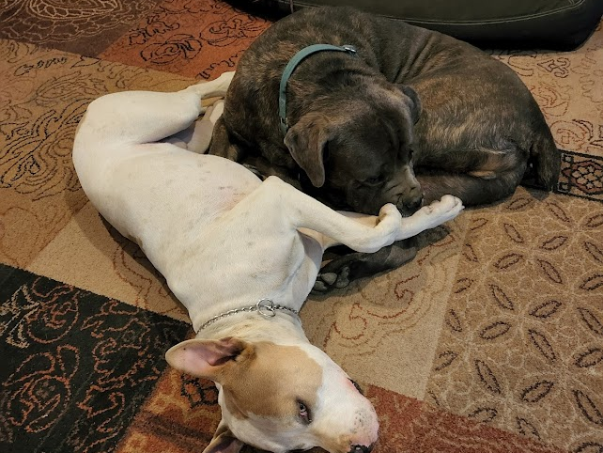
Adjourned Thanks

