Slide 1
Project: IEEE P802.15 Working Group for Wireless Specialty Networks (WSN)
Submission Title: TG4ab May 2022 Closing Report
Date Submitted: May 17, 2022
Source: Benjamin A. Rolfe (Blind Creek Associates)
Contact:
Voice: +1 408 395 7207, E-Mail: ben.rolfe @ ieee.org
Re: Task Group 4ab: UWB Next Generation for 802.15.4
Abstract: Task Group Closing Report, May 2022 Wireless Interim
Purpose: Report on project progress
Notice: This document has been prepared to assist the IEEE P802.15. It is offered as a basis for discussion and is not binding on the contributing individual(s) or organization(s). The material in this document is subject to change in form and content after further study. The contributor(s) reserve(s) the right to add, amend or withdraw material contained herein.
Release: The contributor acknowledges and accepts that this contribution becomes the property of IEEE and may be made publicly available by P802.15.
Notes:
Jul 12, 2010
Page 1

Slide 2
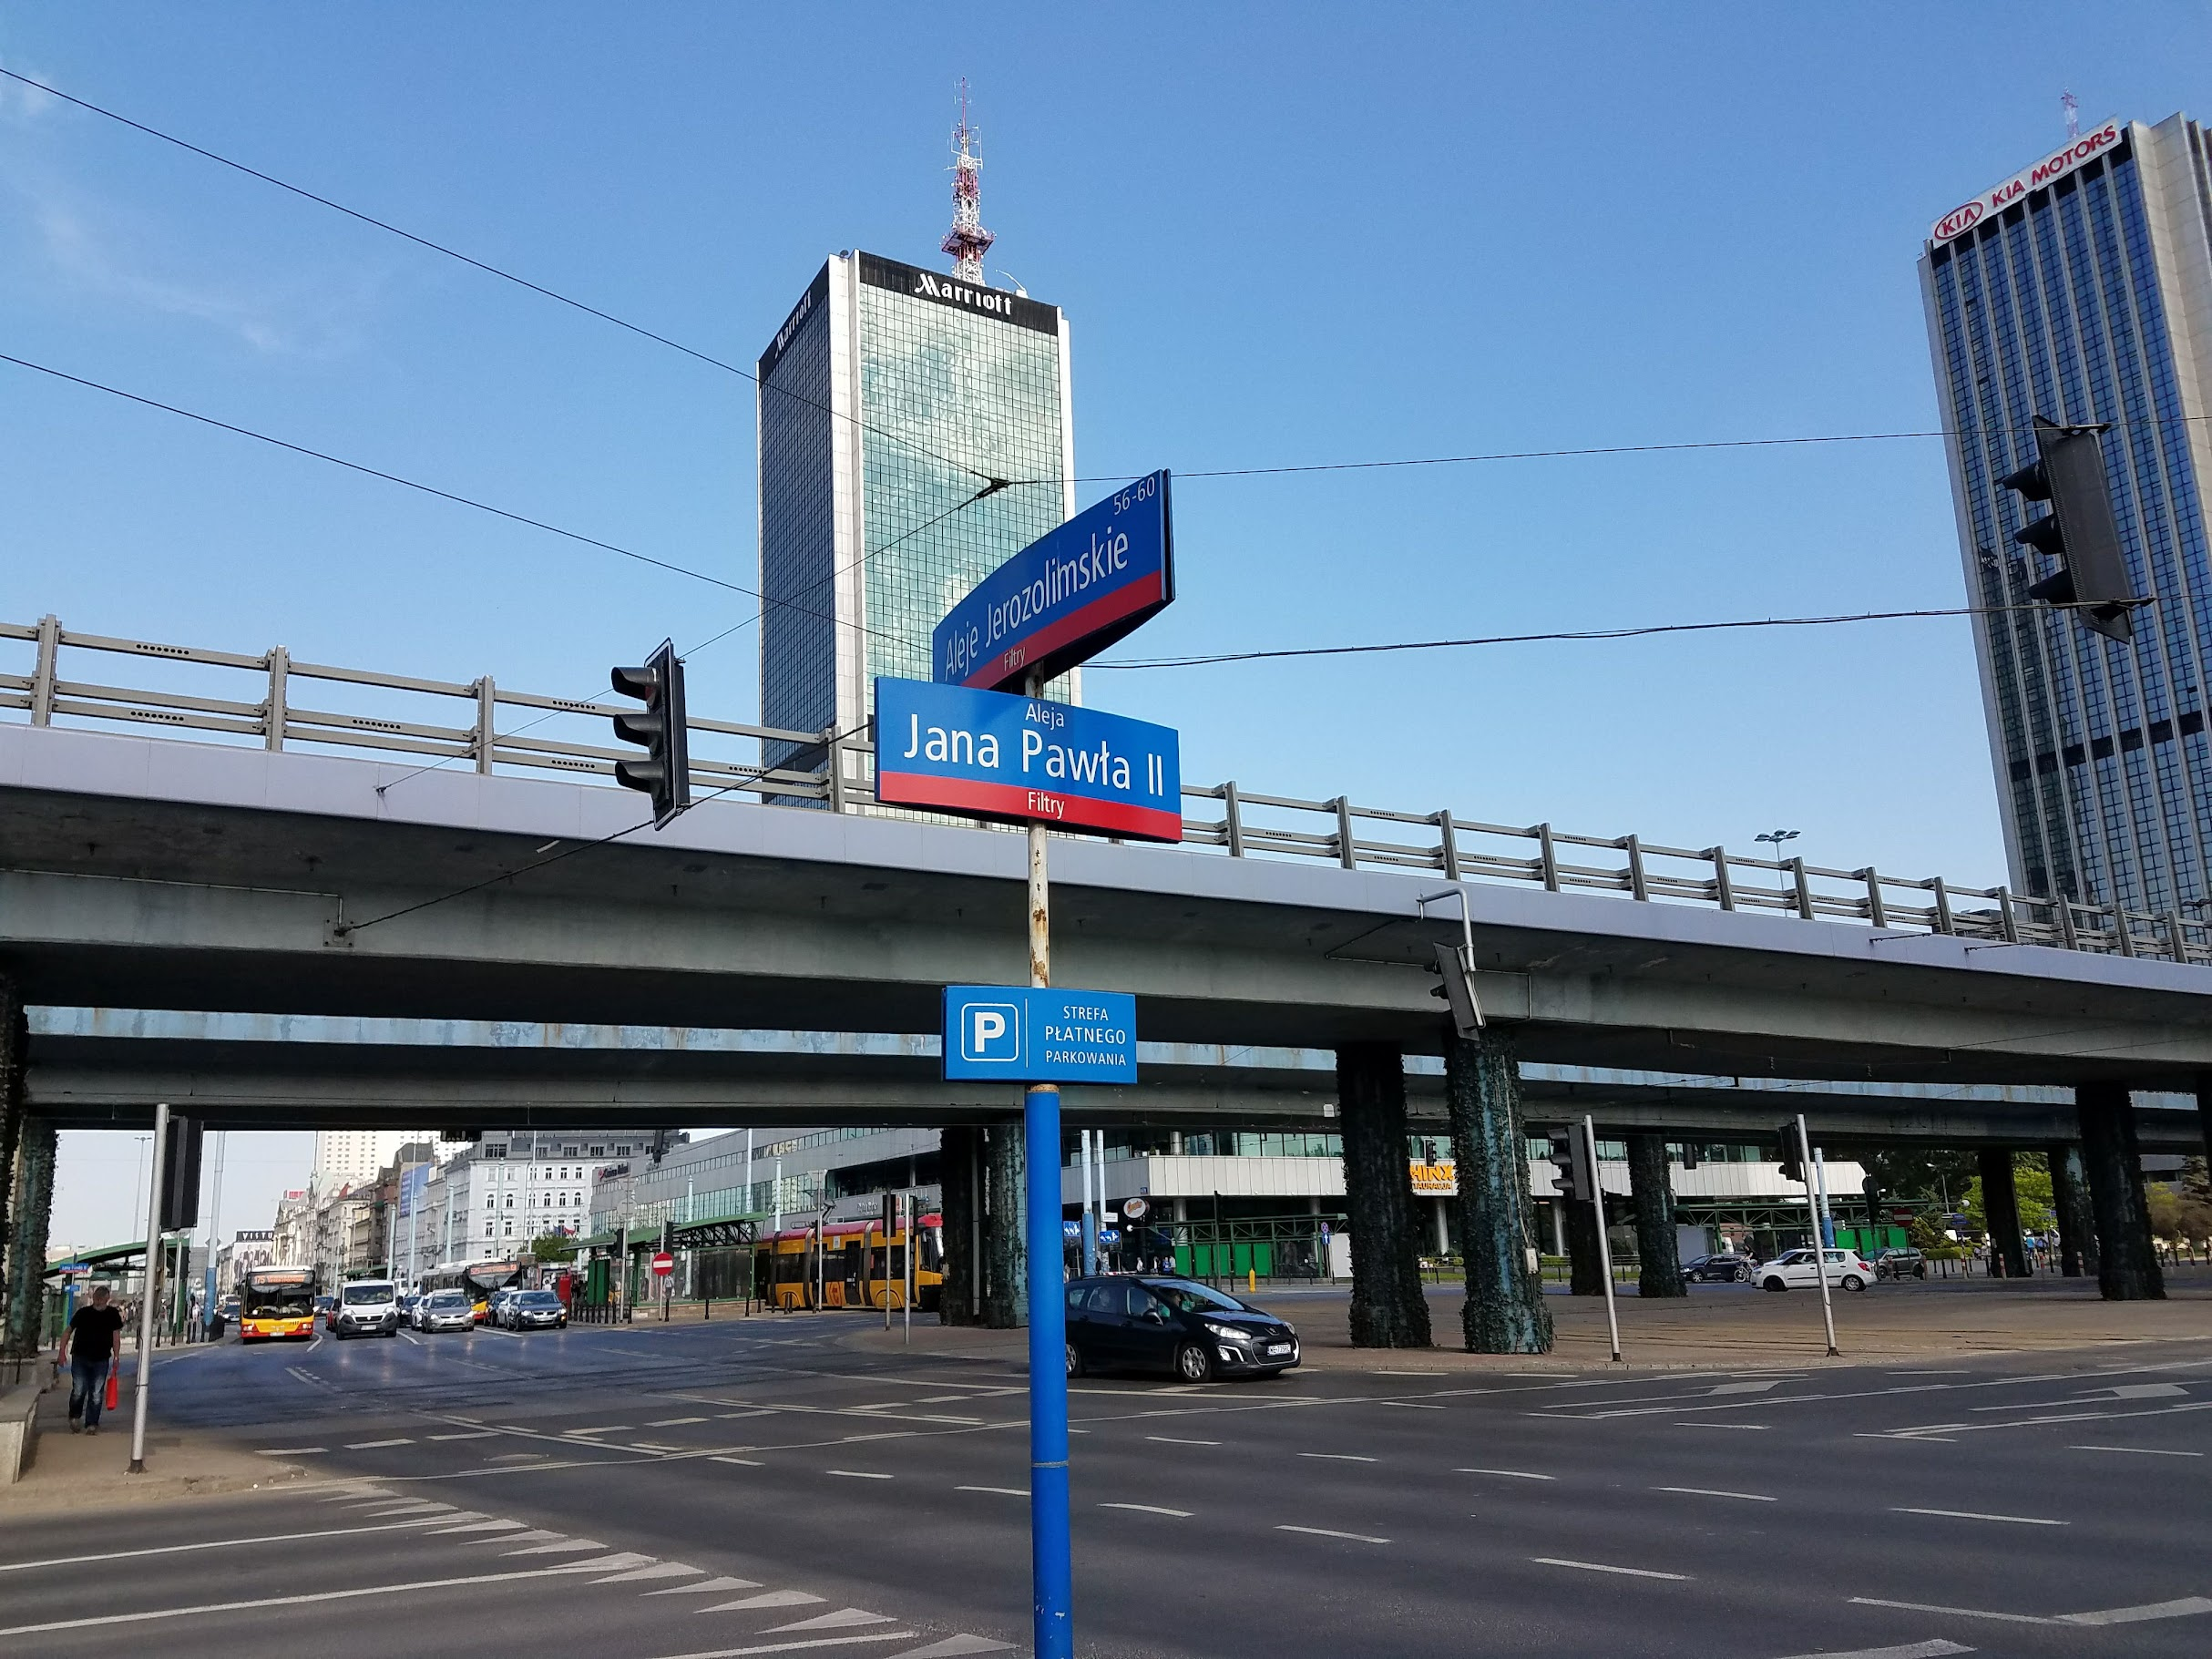
Task Group 15.4ab Virtual Interim May 2022
May 10th through May 17th

Slide 3
Task Group 15.4ab Next Generation UWB Amendment
Objective: enhancements to 802.15.4 Ultra Wideband (UWB) physical layers (PHYs) medium access control (MAC) and associated ranging techniques while retaining backward compatibility with enhanced ranging capable devices (ERDEVs).

Slide 4
5.2.b Scope of the project (As approved):
This amendment enhances the Ultra Wideband (UWB) physical layers (PHYs) medium access control (MAC), and associated ranging techniques while retaining backward compatibility with enhanced ranging capable devices (ERDEVs). Areas of enhancement include:
additional coding, preamble and modulation schemes to additional coding, preamble and modulation schemes to support improved link budget and/or reduced air-time relative to IEEE Std 802.15.4 UWB;
additional channels and operating frequencies;
interference mitigation techniques to support greater device density and higher traffic use cases relative to the IEEE Std 802.15.4 UWB;
improvements to accuracy, precision and reliability and interoperability for high-integrity ranging; schemes to reduce complexity and power consumption;
definitions for tightly coupled hybrid operation with narrowband signaling to assist UWB;
enhanced native discovery and connection setup mechanisms;
sensing capabilities to support presence detection and environment mapping;
and mechanisms supporting low-power low-latency streaming as well as high data-rate streaming allowing at least 50 Mb/s of throughput.
Support for peer-to-peer, peer-to-multi-peer, and station-to-infrastructure protocols are in scope, as are infrastructure synchronization mechanisms. This amendment includes safeguards so that the high throughput data use cases do not cause significant disruption to low duty-cycle ranging use cases.
https://development.standards.ieee.org/myproject-web/app#viewpar/9081

Slide 5
Task Group Organization
Chair: Benjamin Rolfe (BCA)¹
Vice Chair and Recording Secretary: David Xun Yang (Huawei)
Vice Chair: Clint Powell (Meta)
Vice Chair: Clint Chaplin (SRA)
Lead Technical Editor: Billy Verso
Thank you to all the volunteers!
¹ Affiliation Details here: https://mentor.ieee.org/802-ec/dcn/22/ec-22-0061-00-00EC-rolfe-affiliations-by-802-activity.pdf

Slide 6
Session Objectives
Hear technical contributions and develop technical content
Continue collaborations and convergence
Commit to PHY feature set

Slide 7
MAY Agenda
https://mentor.ieee.org/802.15/dcn/22/15-22-0216-11-04ab-tg-agenda-may-2022.xlsx
 |  |  |  | Wednesday | Friday | Tuesday |  | Wednesday |  | Thursday |  | Friday |  | Sunday |  |  | Monday |  | Tuesday |  | Wednesday
EST | PST | UTC | JST | 4-May | 6-May | 10-May |  | 11-May |  | 12-May |  | 13-May |  | 15-May | UTC | JST | 16-May |  | 17-May |  | 18-May
5:00 | 2:00 | 10:00 | 19:00 |  |  |  |  |  |  |  |  |  |  |  | 9:00 | 18:00
6:00 | 3:00 | 11:00 | 20:00 |  |  |  |  |  |  |  |  |  |  |  | 10:00 | 19:00
7:00 | 4:00 | 12:00 | 21:00 |  |  |  |  | TG7a | TG13 | TG7a | TG13 | SC THz | AM0 |  | 11:00 | 20:00 | TG7a | TG13 | TG7a | TG13
8:00 | 5:00 | 13:00 | 22:00 |  |  |  |  |  |  |  |  |  |  |  | 12:00 | 21:00
9:00 | 6:00 | 14:00 | 23:00 |  |  | WG Opening Meeting |  | TG6a | TG3ma | TG6a | TG4ab | TG3ma | Joint 6a/4ab/14 |  | 13:00 | 22:00 | TG3ma | TG4ab | TG6a | TG4ab | WG Closing Meeting
10:00 | 7:00 | 15:00 | 0:00 | 802.15 CAC |  |  |  |  |  |  |  |  |  |  | 14:00 | 23:00
11:00 | 8:00 | 16:00 | 1:00 |  |  | SC Maint |  | Joint 802.15/802.1 |  | SC Maint |  | SC IETF |  |  | 15:00 | 0:00 | SC Maint |  | SC WNG
12:00 | 9:00 | 17:00 | 2:00 |  |  |  |  |  |  |  |  |  |  |  | 16:00 | 1:00
13:00 | 10:00 | 18:00 | 3:00 |  |  | TG16t | Joint 14/15/4ab | TG15 | PM1 | TG4ab (TBC) | PM1 | PM1 | PM1 |  | 17:00 | 2:00 | TG16t | PM1 | TG15 | PM1
14:00 | 11:00 | 19:00 | 4:00 |  |  |  |  |  |  |  |  |  |  |  | 18:00 | 3:00
15:00 | 12:00 | 20:00 | 5:00 |  |  | PM2 | PM2 | TG4cor1 | PM2 | PM2 | PM2 | PM2 | PM2 |  | 19:00 | 4:00 | TG4cor1 | PM2 | PM2 | PM2
16:00 | 13:00 | 21:00 | 6:00 |  |  |  |  |  |  |  |  |  |  |  | 20:00 | 5:00
17:00 | 14:00 | 22:00 | 7:00 |  |  | TG4ab | EV1 | TG4ab | EV1 | TG4ab | EV1 | EV1 | EV1 |  | 21:00 | 6:00 | TG4ab | EV1 | TG4ab | EV1
18:00 | 15:00 | 23:00 | 8:00 |  |  |  |  |  |  |  |  |  |  |  | 22:00 | 7:00
19:00 | 16:00 | 0:00 | 9:00 |  |  | EV2 | EV2 | EV2 | EV2 | EV2 | EV2 | EV2 | EV2 |  | 23:00 | 8:00 | EV2 | EV2 | EV2 | EV2
20:00 | 17:00 | 1:00 | 10:00 |  |  |  |  |  |  |  |  |  |  |  | 0:00 | 9:00
21:00 | 18:00 | 2:00 | 11:00 |  |  |  |  |  |  |  |  |  |  |  | 1:00 | 10:00
22:00 | 19:00 | 3:00 | 12:00 |  |  |  |  |  |  |  |  |  |  |  | 2:00 | 11:00
23:00 | 20:00 | 4:00 | 13:00 |  |  |  |  |  |  |  |  |  |  |  | 3:00 | 12:00
15.4ab
 | TG4ab Meeting slots
Joint
 | Joint meetings with TG4ab

Slide 8
Project Schedule (working baseline)
Proposed project schedule | Nov-21 | Dec-21 | Jan-22 | Feb-22 | Mar-22 | Apr-22 | May-22 | Jun-22 | Jul-22 | Aug-22 | Sep-22 | Oct-22 | Nov-22 | Dec-22 | Jan-23 | Feb-23 | Mar-23 | Apr-23 | May-23 | Jun-23 | Jul-23 | Aug-23 | Sep-23 | Oct-23 | Nov-23 | Dec-23 | Jan-24 | Feb-24 | Mar-24 | Apr-24 | May-24 | Jun-24 | Jul-24 | Aug-24 | Sep-24 | Oct-24 | Nov-24
Call for proposals
Hear and evaluate proposals
Cut-off for new proposals, PHY
Cut-off for new proposals, MAC
Integrate poposals/contributions into TFD
Develop draft from TFD
Draft 0
TG draft review and revision
Working group pre-ballot review
Pre-ballot review and comment resolution
First letter ballot |  |  |  |  |  |  |  |  |  |  |  |  |  |  |  |  | LB
LB Comment Resolution
WG Recirculatoin |  |  |  |  |  |  |  |  |  |  |  |  |  |  |  |  |  |  |  |  | LB-R
Comment resolution, 1st recirc
Conditional approval for SA ballot
WG Recirculatoin |  |  |  |  |  |  |  |  |  |  |  |  |  |  |  |  |  |  |  |  |  |  | LB-R
Comment resolution, 2nd recirc and final recirc
First SA ballot |  |  |  |  |  |  |  |  |  |  |  |  |  |  |  |  |  |  |  |  |  |  |  |  | SA
Comment resolution, first SA ballot
SA Resirculation |  |  |  |  |  |  |  |  |  |  |  |  |  |  |  |  |  |  |  |  |  |  |  |  |  |  |  | SA-R
Comment resolution, SA recirculation
SA Resirculation |  |  |  |  |  |  |  |  |  |  |  |  |  |  |  |  |  |  |  |  |  |  |  |  |  |  |  |  |  |  | SA-R
Comment resolution, 2nd SA recirc
Conditional or unconditional approval to RevCom |  |  |  |  |  |  |  |  |  |  |  |  |  |  |  |  |  |  |  |  |  |  |  |  |  |  |  |  | ?? |  |  |  | ??
Optional 3rd SA recirc if needed |  |  |  |  |  |  |  |  |  |  |  |  |  |  |  |  |  |  |  |  |  |  |  |  |  |  |  |  |  |  |  |  | SA-R
RevCom meets |  |  |  |  |  |  |  |  |  |  |  |  |  |  |  |  |  |  |  |  |  |  |  |  |  |  |  |  |  |  |  |  |  | ` |  |  |  | `
You are Here >
Notes: SASB/RevCom schdule for 2024 a guess

Slide 9
Schedule Major Milestones
Near Term Working Milestones
Call for proposals | November 2021
Cut-off for new features (high level feature set), PHY | May 2022
Cut-off for new features (high level feature set), MAC | July 2022
Draft 0 | September 2022
TG draft review and revision complete | November 2022
Working group pre-ballot review complete | January 2022 (before meeting)
First letter ballot | March 2023 (following meeting)
…
Progress:
We have most of the PHY features identified
Multiple proposals in some areas, with collaborative convergence underway
Some gaps identified to be worked
Plan to continue with weekly teleconferences (Webex)

Slide 10
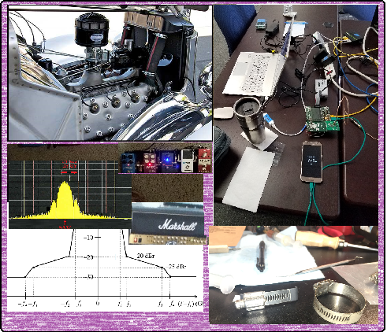
Technical Contributions

Slide 11
Technical Presentations
 | Tuesday 10-May
1.7 | Technical contribution: Review of UWB coex contributions
 | https://mentor.ieee.org/802.15/dcn/22/15-22-0242-00-04ab-review-of-uwb-coex-contributions.pptx
1.8 | Technical contribution: Coding discussion
 | https://mentor.ieee.org/802.15/dcn/22/15-22-0265-01-04ab-discussion-on-advanced-channel-coding-for-15-4ab.pptx
 | Wednesday 11-May
2.3 | Technical contribution: Simultaneous ranging solutions
 | https://mentor.ieee.org/802.15/dcn/22/15-22-0256-00-04ab-simultaneous-ranging-solutions.pptx
2.4 | Technical contribution: CIR feedback scheme for UWB sensing – continue
 | https://mentor.ieee.org/802.15/dcn/22/15-22-0257-00-04ab-cir-feedback-scheme-for-uwb-sensing-continue.pptx
2.5 | Technical contribution: MAC considerations on unified control for UWB sensing and ranging
 | https://mentor.ieee.org/802.15/dcn/22/15-22-0255-00-04ab-mac-considerations-on-unified-control-for-uwb-sensing-and-ranging.pptx

Slide 12
Technical Presentations
 | Thursday 12-May
3.3 | Narrow Band Assist Clear Channel Assessment
 | https://mentor.ieee.org/802.15/dcn/22/15-22-0275-00-04ab-proposal-of-nb-phy-assisted-cca-for-uwb-medium-access.docx
3.4 | Privacy preserving and performance enhancement for UWB sensing
 | https://mentor.ieee.org/802.15/dcn/22/15-22-0248-00-04ab-privacy-preserving-and-performance-enhancement-for-uwb-sensing.pptx
3.4 | Topic to be Announced
 | https://mentor.ieee.org/802.15/dcn/22/15-22-0276-01-04ab-details-of-nb-mirroring-channel.pptx
4.3 | More on higher data rate coding
 | https://mentor.ieee.org/802.15/dcn/22/15-22-0274-00-04ab-high-data-rates-and-coding.pptx
4.4 | NBA-UWB framework proposal update
 | https://mentor.ieee.org/802.15/dcn/22/15-22-0262-01-04ab-nba-uwb-technical-framework-proposal.docx
4.5 | HRP Packet Structure Options for Sensing
 | https://mentor.ieee.org/802.15/dcn/22/15-22-0280-01-04ab-deterministic-sts-for-sensing-applications.pptx
5.3 | Coexistence discussion on NB assisted UWB
 | https://mentor.ieee.org/802.15/dcn/22/15-22-0261-00-04ab-coexistence-discussion-on-nb-assisted-uwb.pptx
5.4 | Discussion on NB assisted UWB message sequence and synchronization
 | https://mentor.ieee.org/802.15/dcn/22/15-22-0266-00-04ab-discussion-on-nb-assisted-uwb-message-sequence-and-synchronization.pptx
5.5 | Channel Access Considerations on Fragmented UWB Format
 | https://mentor.ieee.org/802.15/dcn/22/15-22-0150-02-04ab-channel-access-considerations-on-fragmented-uwb-format.pptx

Slide 13
Technical Presentations
 | Monday 16-May
7.3 | Time Hopping for Fragmented UWB Transmission
 | https://mentor.ieee.org/802.15/dcn/22/15-22-0289-01-04ab-time-hopping-for-fragmented-uwb-transmission-in-mms-uwb-systems.pptx
7.4 | More on wake-up radio (WUR)
 | https://mentor.ieee.org/802.15/dcn/22/15-22-0282-01-04ab-the-advantages-of-uwb-wakeup.pptx
7.5 | Mulit-user interferecne mitigation
 | https://mentor.ieee.org/802.15/dcn/22/15-22-0284-00-04ab-multi-user-interference-mitigation.pptx
8.3 | More on Golay Sequences for preambles
 | https://mentor.ieee.org/802.15/dcn/22/15-22-0243-00-04ab-golay-complementary-sequences-preamble-construction-for-uwb-ranging-beyond-4z-ipatov.pptx
8.4 | Non-coherent option for data communication
 | https://mentor.ieee.org/802.15/dcn/22/15-22-0297-00-04ab-non-coherent-hrp-option-for-data-communication.pdf
8.5 | More on higher data rates
 | https://mentor.ieee.org/802.15/dcn/22/15-22-0296-01-04ab-a-higher-data-rate-proposal-for-uwb.ppt

Slide 14
Technical Presentations
 | Tuesday 17-May
9.3 | More on Sensing
 | https://mentor.ieee.org/802.15/dcn/22/15-22-0291-01-04ab-proposal-of-sensing-framework.docx
9.4 | Summary of interests
 | https://mentor.ieee.org/802.15/dcn/22/15-22-0305-00-04ab-a-summary-of-proposals-and-interests.pptx
9.5 | DL-TDOA convergence
 | https://mentor.ieee.org/802.15/dcn/22/15-22-0298-00-04ab-converging-downlink-tdoa-dl-tdoa-location-service-proposals-in-802-15.pptx
9.6 | Preamble only packet
 | https://mentor.ieee.org/802.15/dcn/22/15-22-0267-01-04ab-preamble-only-packet-for-uwb.pptx
10.3 | Air-time efficiency improvements
 | https://mentor.ieee.org/802.15/dcn/22/15-22-0308-00-04ab-air-time-efficiency-improvements.pptx
10.4 | TG4ab Presentations by TGD Categories
 | https://mentor.ieee.org/802.15/dcn/21/15-21-0638-03-04ab-tg4ab-presentations-by-tgd-categories.xlsx

Slide 15
Next Steps

Slide 16
Convergence
Preferred Method: Collaboration
Have identified major topics to be worked
Have identified areas for collaboration
Collaboration well underway
Plan is to continue and accelerate
Refining the Technical Framework
Will continue to refine topic list and structure on interim calls

Slide 17
Interim TC planning
Call frequency and phase:
Weekly, Tuesday 06:00 PT / 09:00 ET
Commencing 31-May provides 6 calls
Call organization:
Status of collaborations Technical presentations: provide requests for presentation time 24 hours prior
If nothing to report or present call will be cancelled
Topics:
Technical convergence on PHY features proposals
Technical Framework
MAC proposals

Slide 18
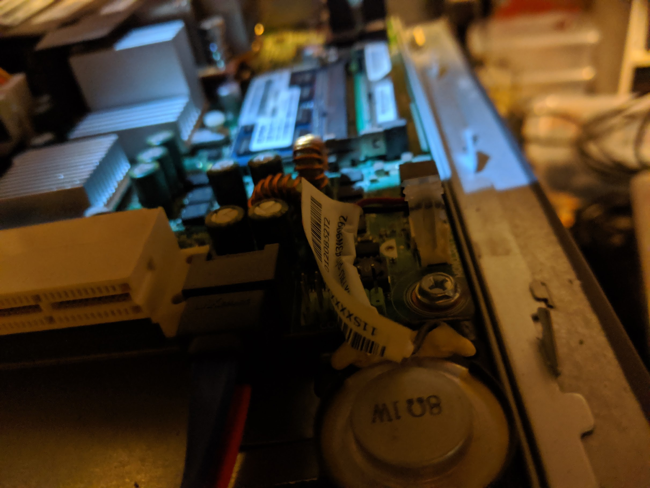
Other stuff

Slide 19
Straw Polls on July Session
Straw poll question: Will you attend the July meeting:
in person?
virtually?
not at all?
Result:
In person: 28 (24 + 4 email responses)
Virtual: 13
Will not attend: 3
Number responding / number present: 61
21 regarded as undecided

Slide 20
Thanks See you in Montreal!

