Slide 1
Project: IEEE P802.15 Working Group for Wireless Personal Area Networks (WPANs)
Submission Title: [Air-Time Efficiency Improvements]
Date Submitted: [17 May, 2022]
Source: [Håkon A. Hjortland, Nikolaj Andersen, Kristian Granhaug, Dries Neirynck, Jan Roar Pleym, Dag T. Wisland] Company [Novelda AS]
E-mail: [haakon.hjortland@novelda.com]
Re: [Working Group input]
Abstract: [Presents pulse burst sensing, where bursts of pulses is transmitted instead of single pulses. Also presents the super packet, which uses the same transmitted energy to provide both communication, ranging, and sensing.]
Purpose: []
Notice: This document has been prepared to assist the IEEE P802.15. It is offered as a basis for discussion and is not binding on the contributing individual(s) or organization(s). The material in this document is subject to change in form and content after further study. The contributor(s) reserve(s) the right to add, amend or withdraw material contained herein.
Release: The contributor acknowledges and accepts that this contribution becomes the property of IEEE and may be made publicly available by P802.15.

Slide 2
PAR Objective | Proposed Solution (how addressed)
Safeguards so that the high throughput data use cases will not cause significant disruption to low duty-cycle ranging use cases
Interference mitigation techniques to support higher density and higher traffic use cases
Other coexistence improvement | Super packet promotes coex across sensing/ranging/comms applications
Backward compatibility with enhanced ranging capable devices (ERDEVs)
Improved link budget and/or reduced air-time | Pulse burst sensing coding scheme reduces air-time for monostatic sensing
Additional channels and operating frequencies
Improvements to accuracy / precision / reliability and interoperability for high-integrity ranging
Reduced complexity and power consumption
Hybrid operation with narrowband signaling to assist UWB
Enhanced native discovery and connection setup mechanisms
Sensing capabilities to support presence detection and environment mapping | PRF considerations for sensing applications
Low-power low-latency streaming
Higher data-rate streaming allowing at least 50 Mbit/s of throughput
Support for peer-to-peer, peer-to-multi-peer, and station-to-infrastructure protocols
Infrastructure synchronization mechanisms

Slide 3
Air-Time Efficiency Improvements
Pulse Burst Sensing
and
Super Packet

Slide 4
Related TG4ab Contributions
15-22-0061-00-04ab-sensing-continued
15-22-0248-00-04ab-privacy-preserving-and-performance-enhancement-for-uwb-sensing
15-22-0280-01-04ab-deterministic-sts-for-sensing-applications
15-22-0083-01-04ab-uwb-sensing-concepts
15-22-0175-00-04ab-sensing-device

Slide 5
Motivation
Want high average transmit power
Needed for e.g. sensing breathing at 5 m distance
Want reduced air-time / duty cycle
Improves coexistence
Reduces power consumption (RX powered up for shorter time)
Want sensing to use the spectrum responsibly

Slide 6
Pulse Burst Sensing
Increased Transmit Power for
Monostatic Sensing

Slide 7
Monostatic Sensing
Full-duplex transceiver
Receive weak reflections while transmitting strong pulses
Challenging to implement
Half-duplex transceiver
Reception will be masked by transmissions
Direction switching must be fast (approx. 1 ns)
Easy to implement
Separate TX and RX antennas
Antennas are usually close to each other, so masking is still an issue
Pulse amplitude is limited by CMOS technology
Note that bistatic sensing does not have these masking issues

Slide 8
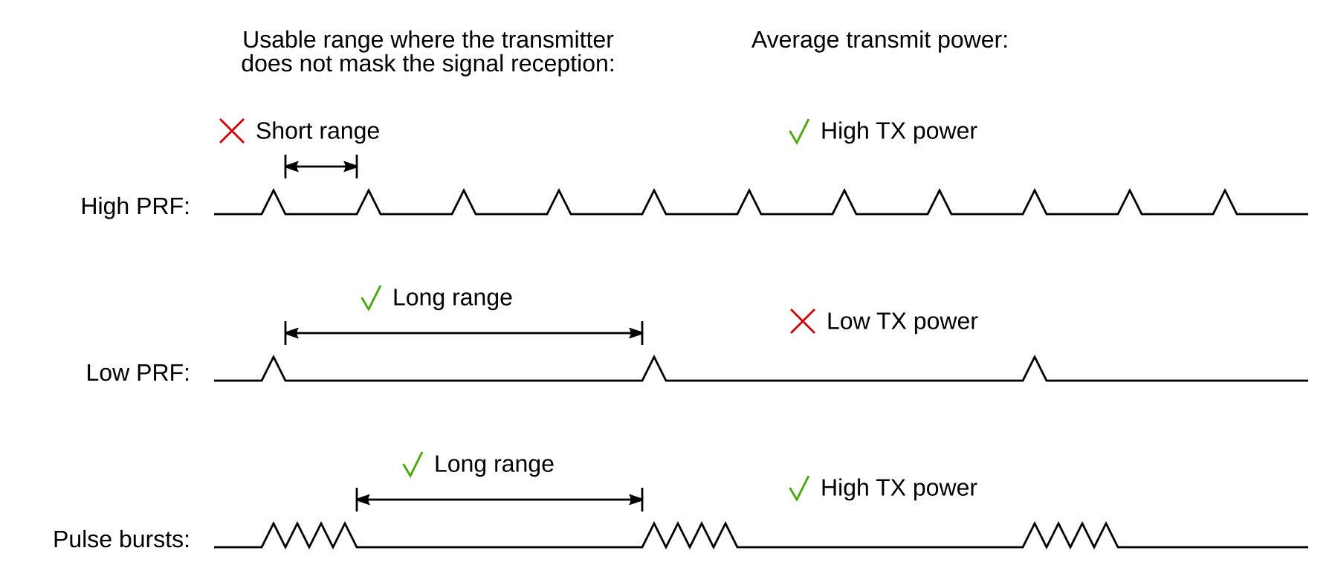
Half-Duplex Monostatic Sensing
Assuming pulse amplitude stays the same (e.g. CMOS limited)

Slide 9
Pulse Bursts
Pulse compression radar
Send a coded pulse burst, receive with matched filter
Single burst
There will be sidelobes
E.g. Barker code [+++++--++-+-+] has autocorrelation [1 0 1 0 1 0 1 0 1 0 1 0 13 0 1 0 1 0 1 0 1 0 1 0 1]
Multiple bursts
A "2D code" that spans both pulses and bursts can reduce the sidelobes

Slide 10
Shifted-Ipatov-Code Pulse Burst Sensing
Send multiple Ipatov sequences at once
Circular-shifted to avoid interference with each other
Pulses separated by a few chip intervals
Add padding to ensure periodic cross-correlation between received signal and template. Can be done in one of three ways:
Pad the transmitted sequences
Pad the cross-correlation template
Will then always integrate some noise-only samples, lowering the SNR
No padding is needed if the resulting artifacts are acceptable
Perfect cross-correlation between transmitted signal and template for range of interest
We have called this "Shifted-Ipatov-Code Pulse Burst Sensing"

Slide 11
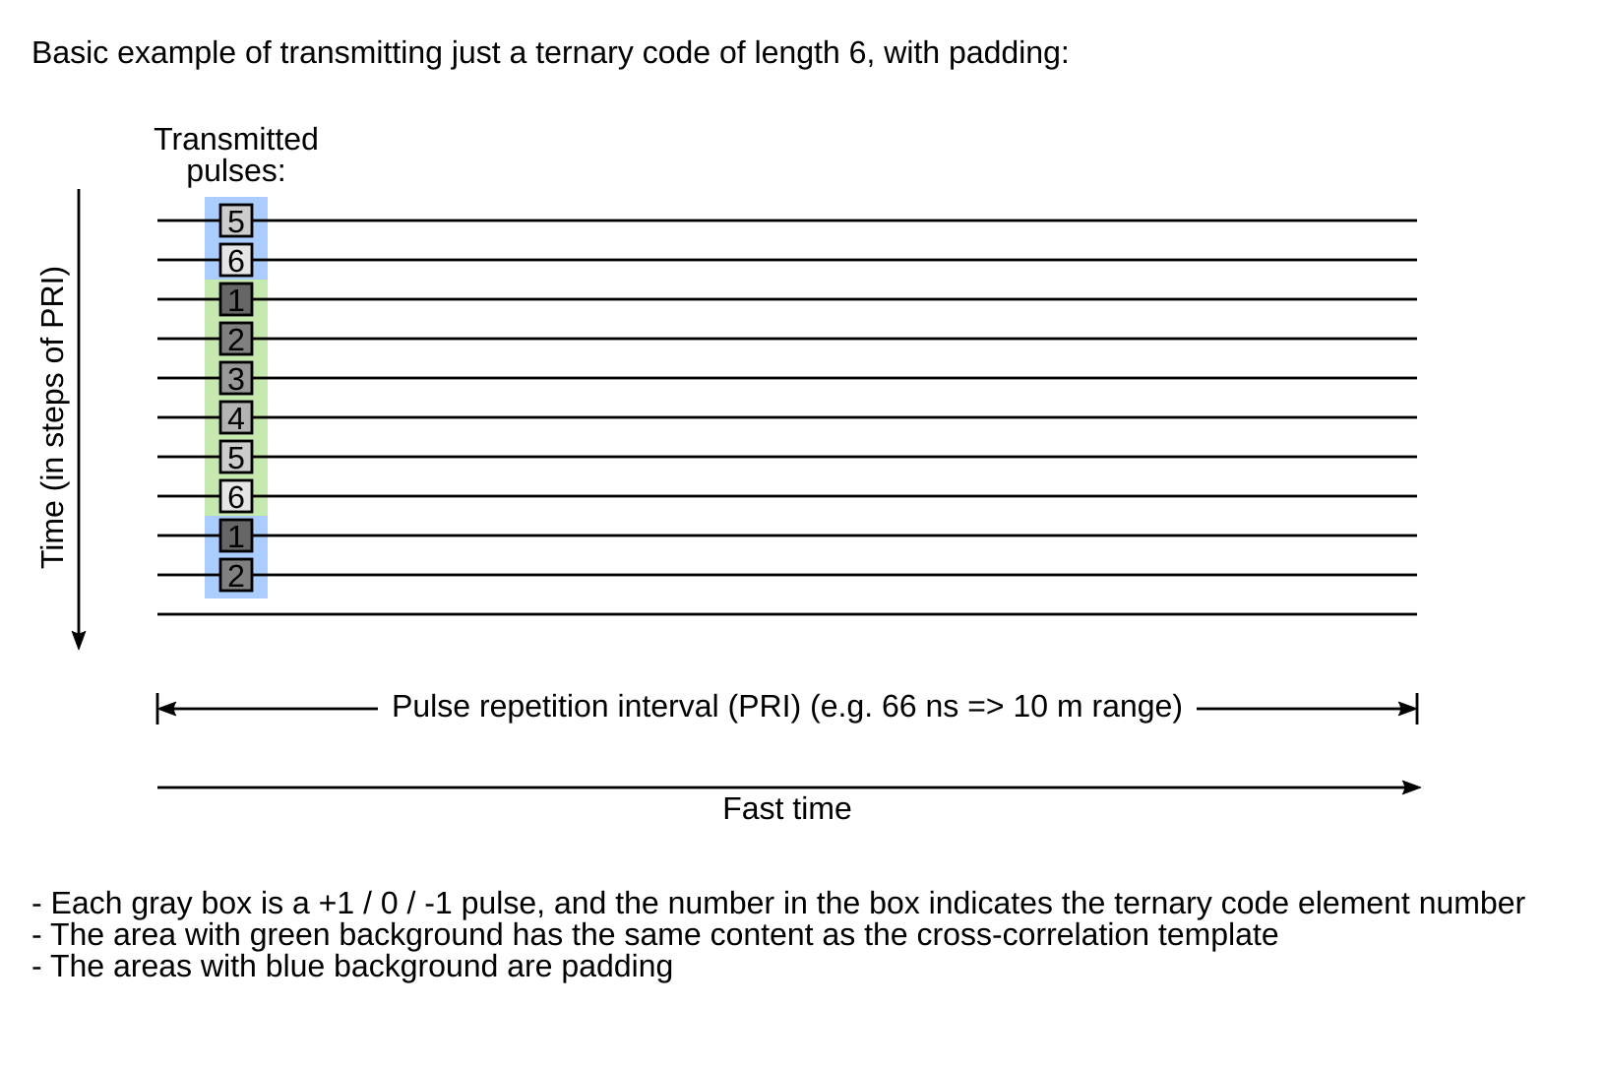

Slide 12
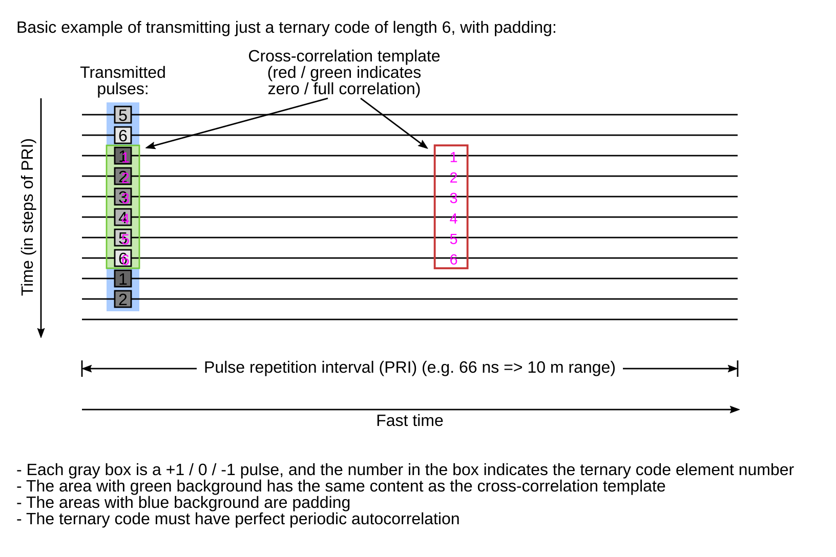

Slide 13
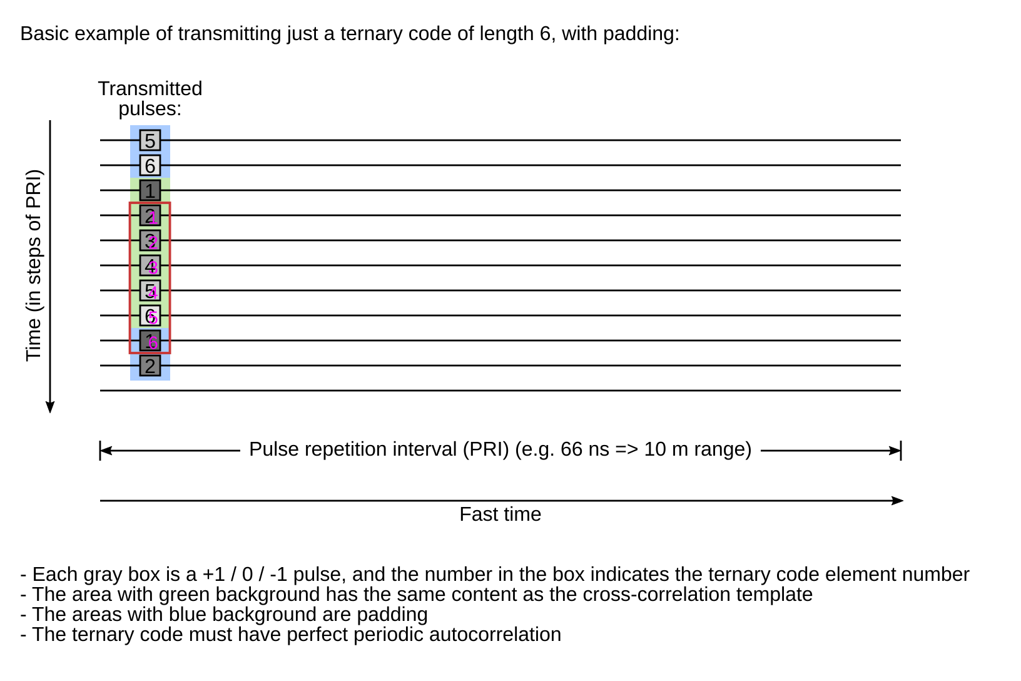

Slide 14
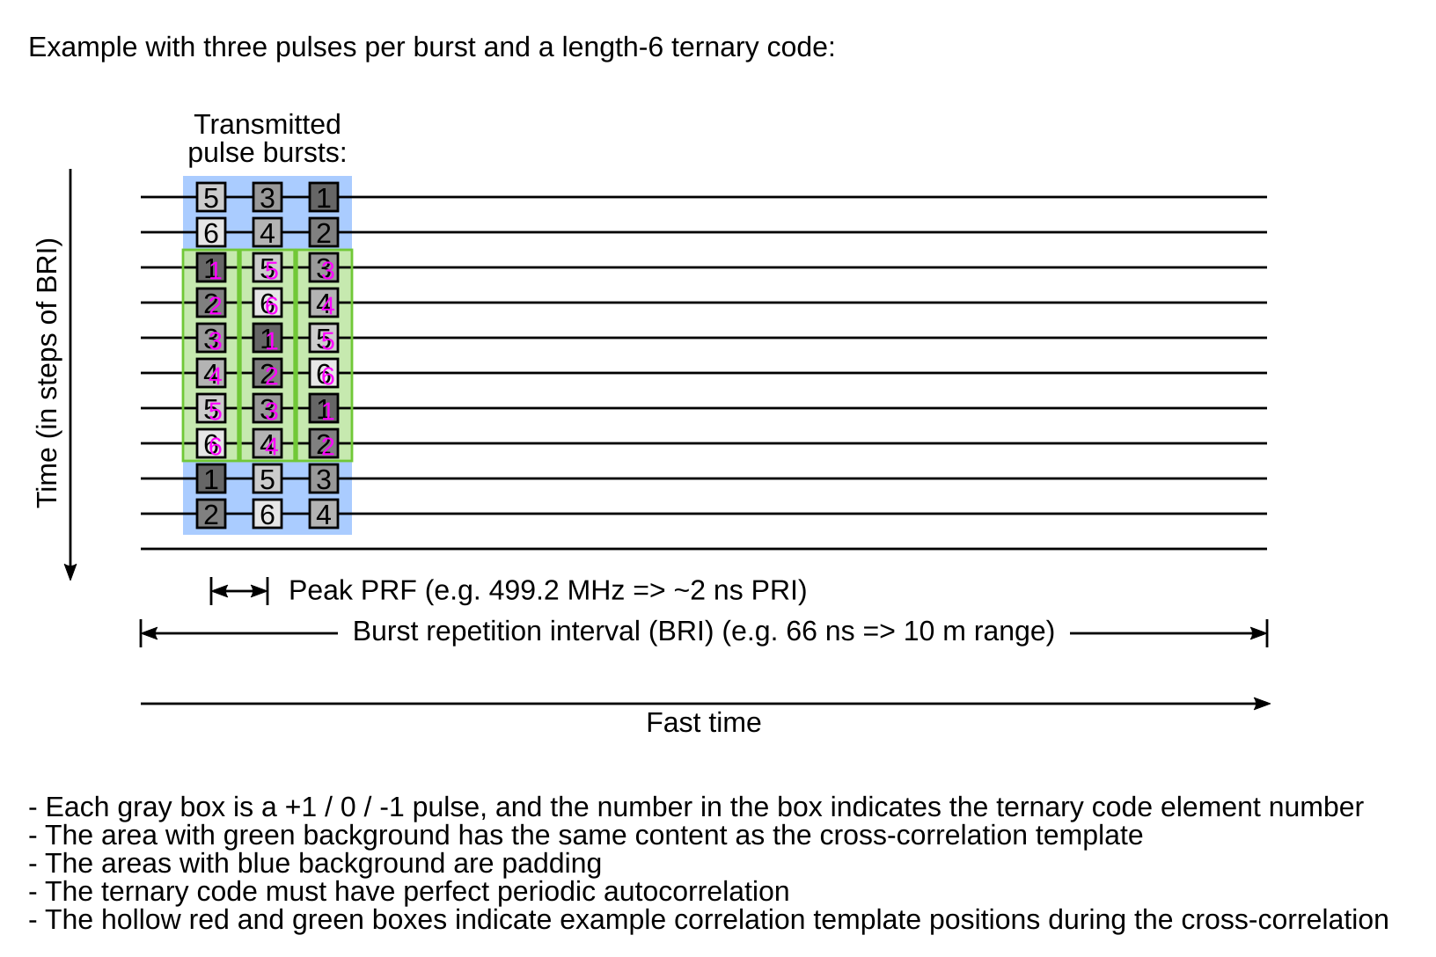

Slide 15
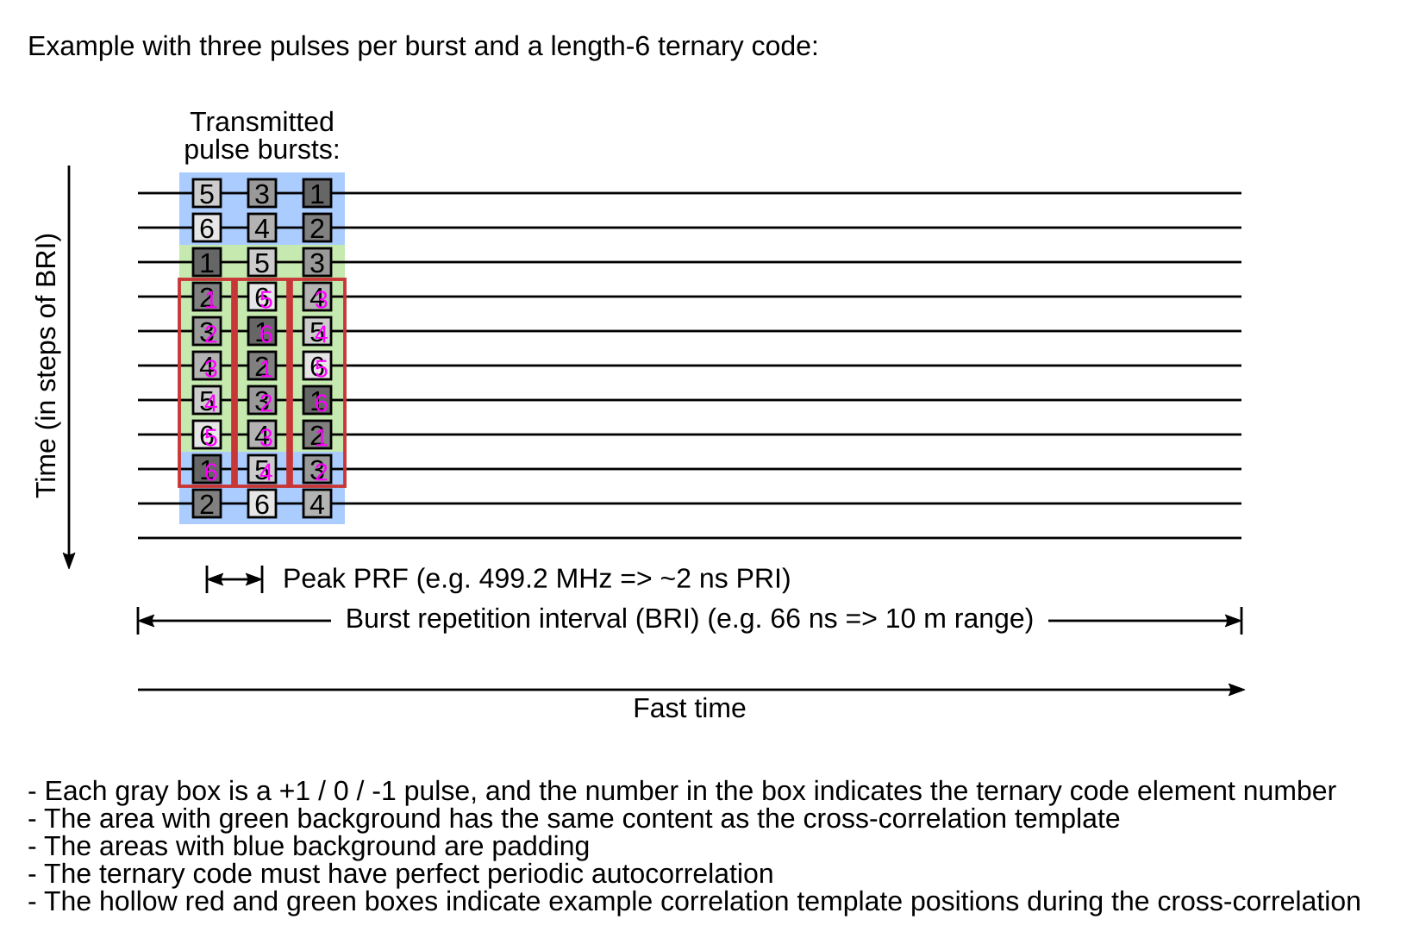

Slide 16
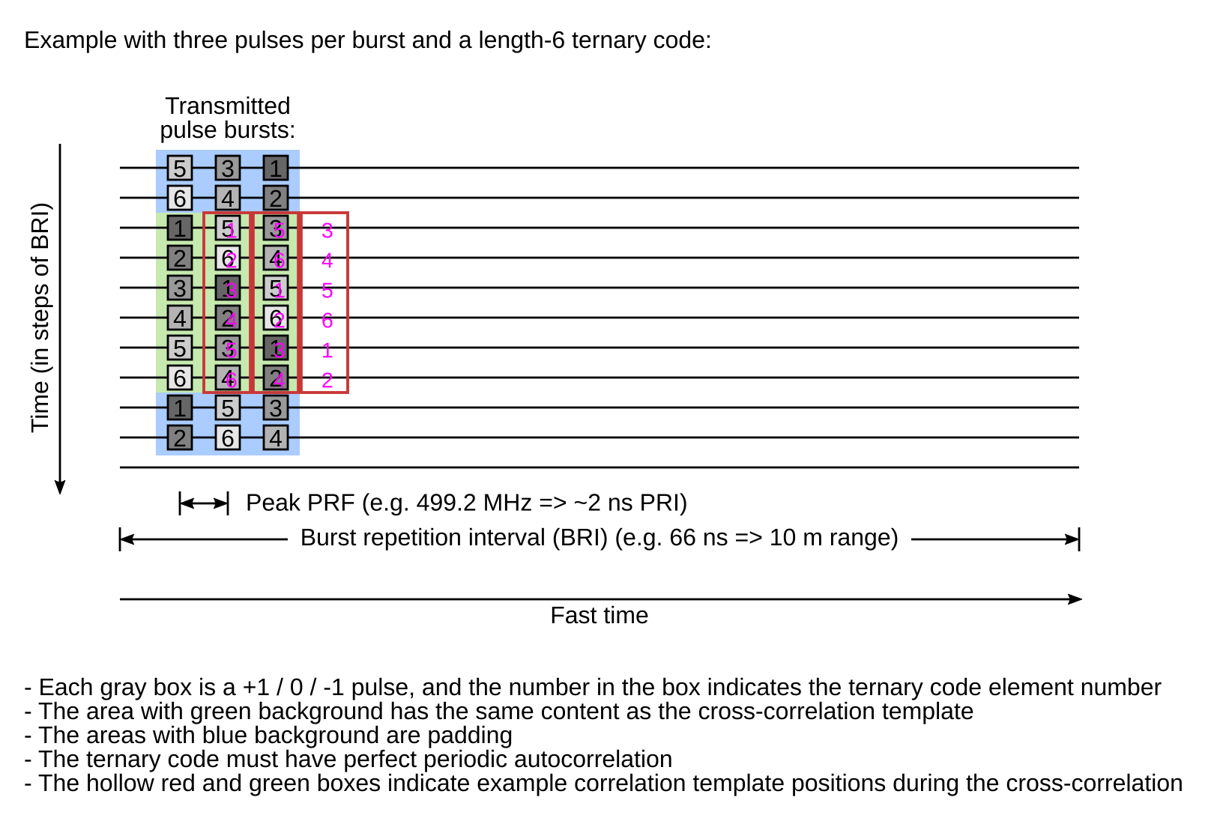

Slide 17
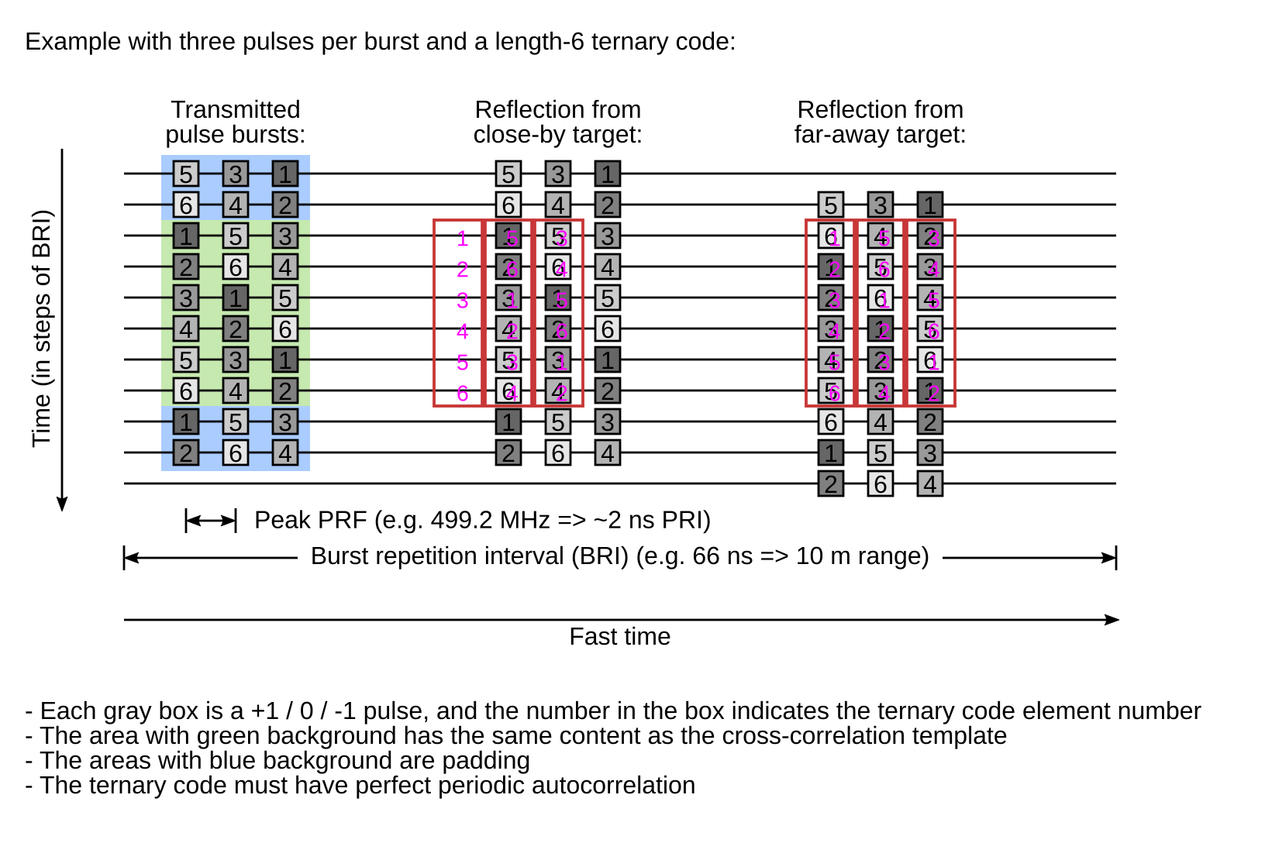

Slide 18
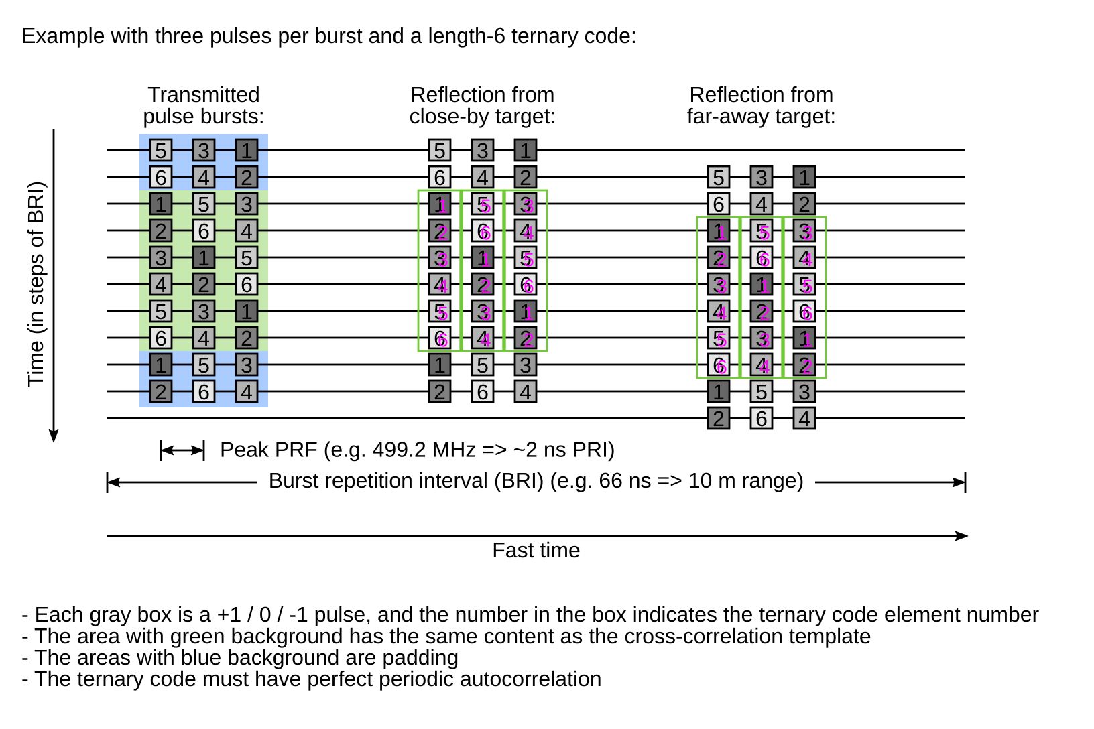

Slide 19
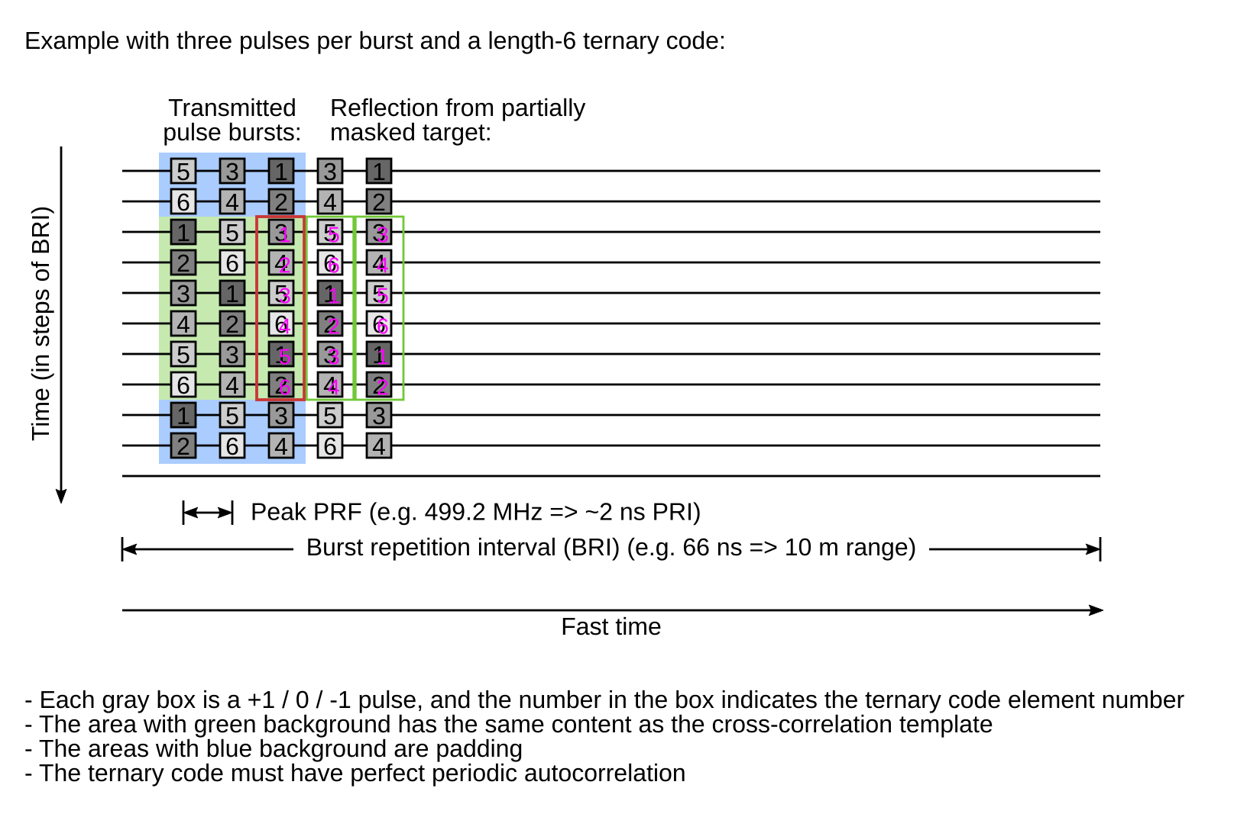

Slide 20
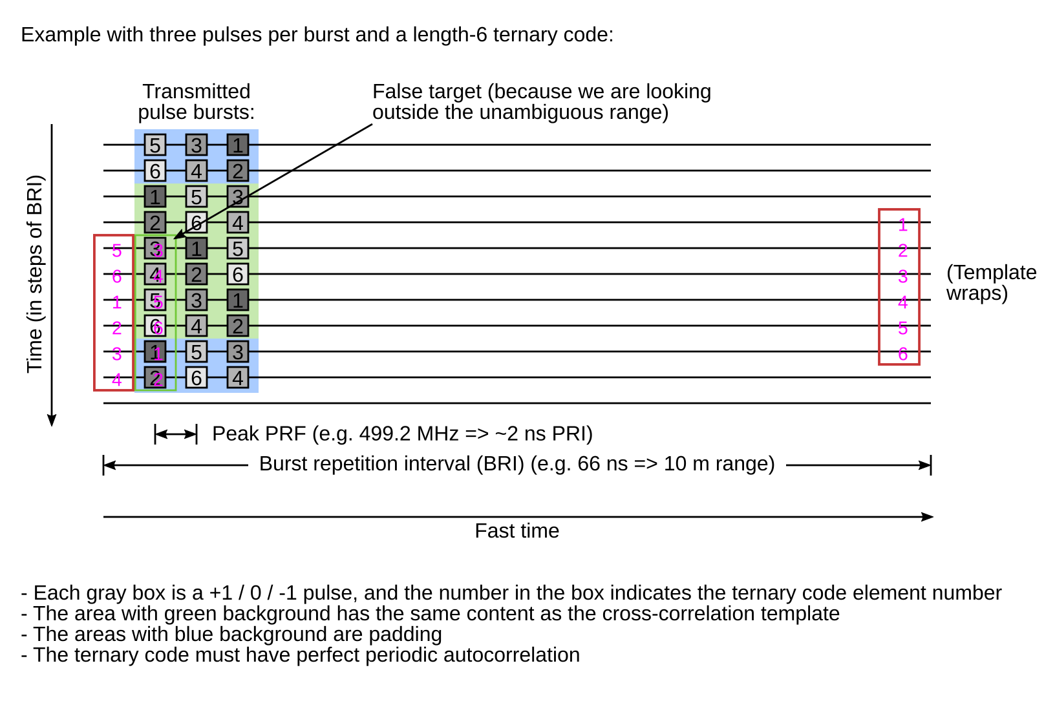

Slide 21
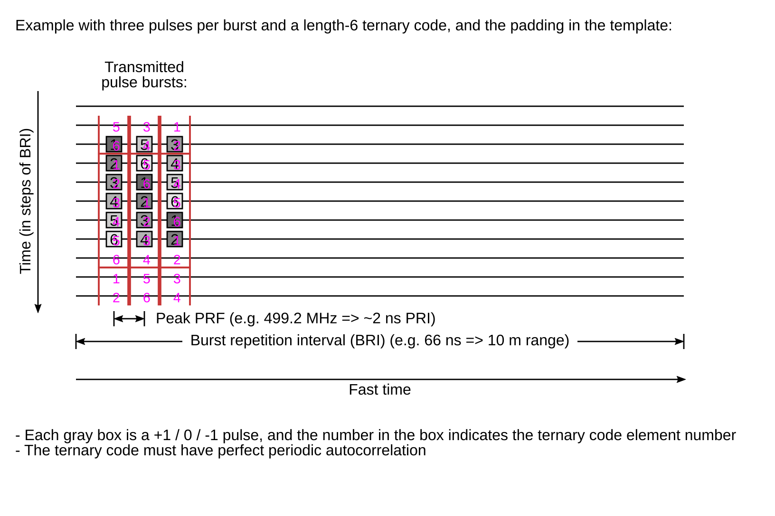

Slide 22
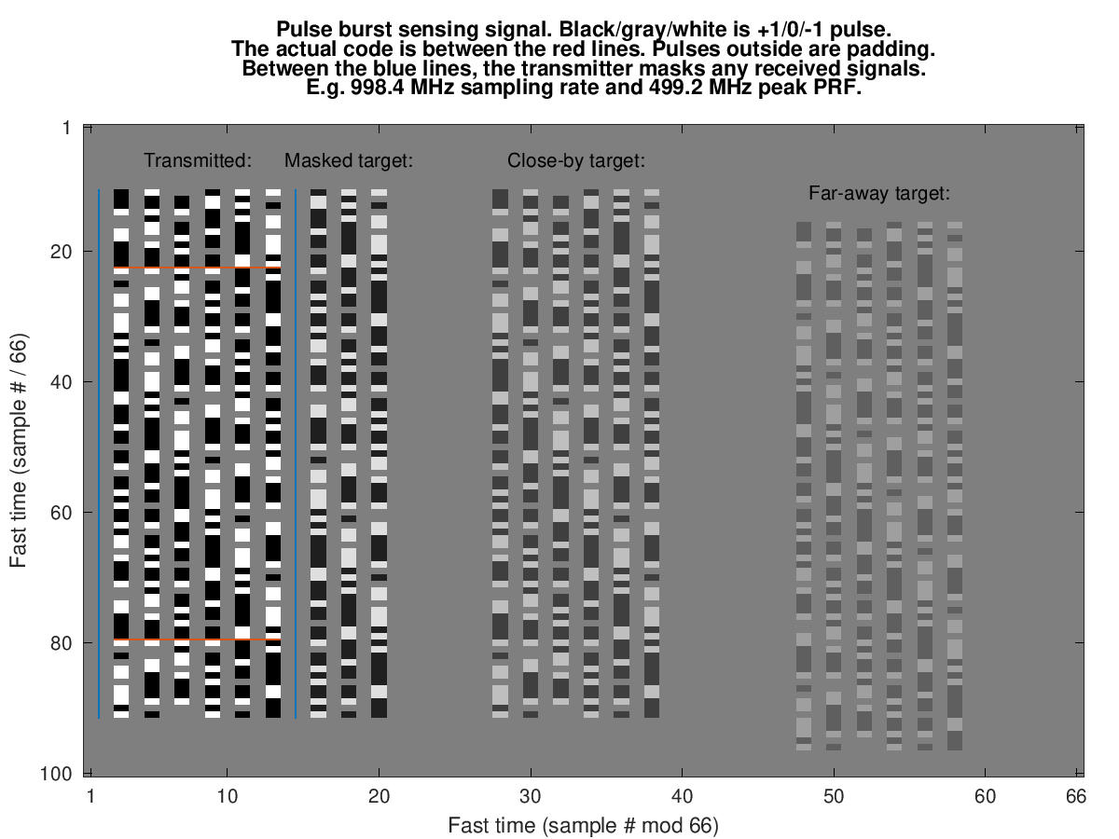
Signals (2D View)

Slide 23
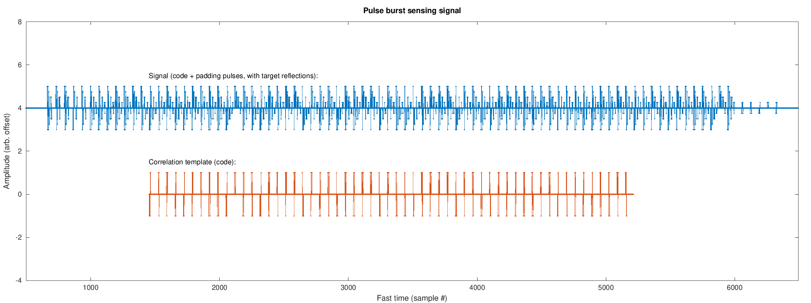
Signals (1D View)

Slide 24
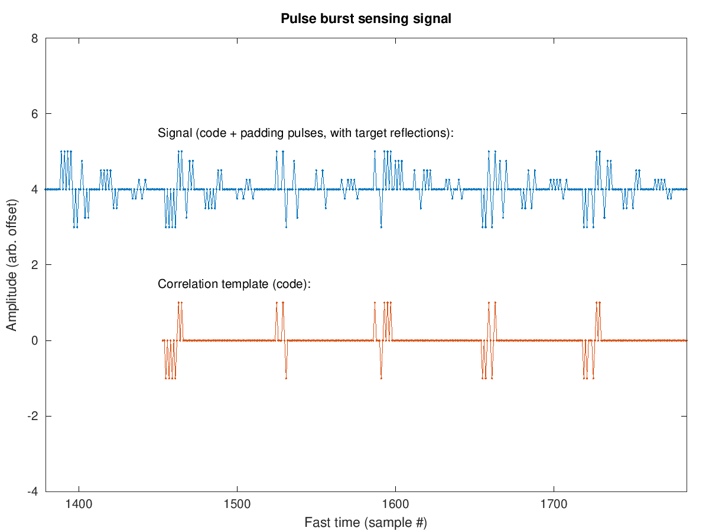
Signals (1D View, Zoomed)

Slide 25
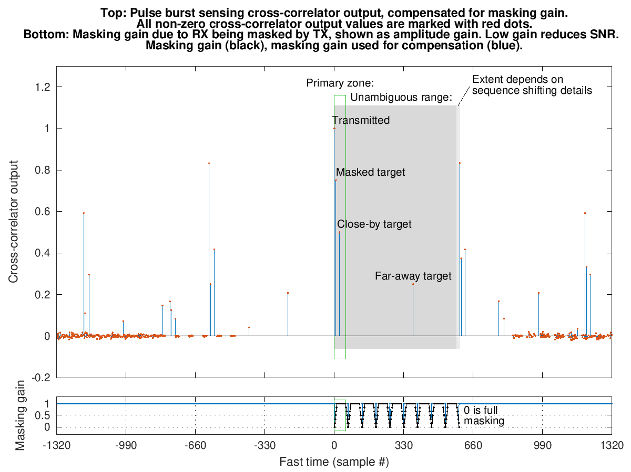
Cross-Correlator Output

Slide 26
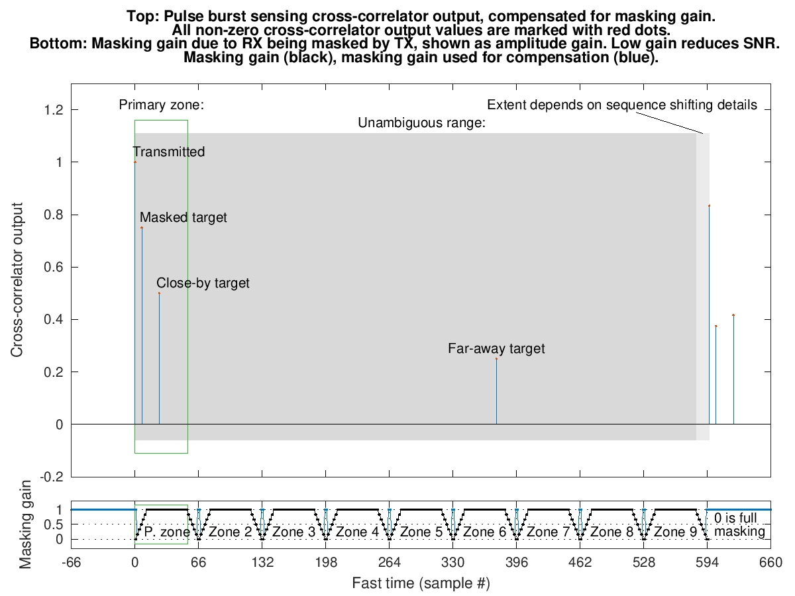
Cross-Correlator Output (Zoomed)

Slide 27
Design Considerations
Long Ipatov codes are beneficial
High density
Longer time before repetition, therefore better spectral properties
50 MHz bin peak power regulations
Maybe it is possible to choose or shift Ipatov sequences such as to avoid e.g. all pulses in a burst being positive
More pulses per burst means a higher ADC dynamic range requirement, since burst reflections could add constructively
Pulse burst sensing reduces air-time and power consumption (RX powered up less) at the expense of complexity and area

Slide 28
System Properties
Best for a range from time zero to about the burst repetition interval ("primary zone"). Beyond this, there will be blind zones.
The long unambiguous range is still beneficial, though, since it prevents far-away targets from becoming ghost pulses
The zones between the blind zones are also usable
Partially masked targets work correctly
The SNR will be lower, but a low SNR for close-by target is not a problem
Parallel transmitters in the device could use non-interfering Ipatov shifts to channelize the TX antennas

Slide 29
Standardization
Monostatic sensing does not necessarily require standardization
By standardizing, bistatic receivers can exploit the monostatic energy
More efficient monostatic sensing will reduce air-time, which improves coexistence
The pulse burst sensing can be an STS-segment replacement

Slide 30
Super Packet
Simultaneous Communication,
Secure Ranging, and Sensing

Slide 31
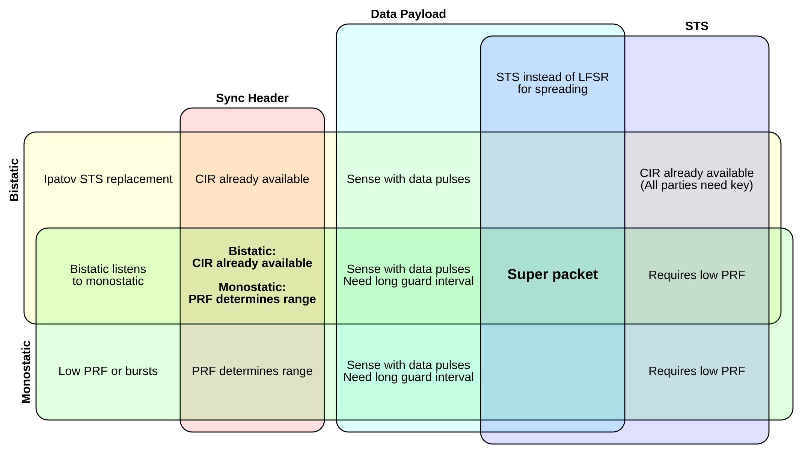
Mode Combinations
Can different modes of operation be combined?
For example, can data packet energy be used to sense the environment?

Slide 32
Super Packet
A PPDU packet structure that provides communication, secure ranging, and monostatic/bistatic sensing all at once
Only small changes to the packet format
Some increase in receiver complexity
Reuses RX frontend power consumption
Reduces air-time and power consumption at the cost of receiver complexity and area
Up to 3x improvement if communication, ranging, and sensing duty cycle needs are aligned
Assuming bistatic sensing already combined with ranging or monostatic sensing
STS key must be shared with all parties, i.e. all parties must be trusted
Can use LFSR instead of STS, i.e. original packet format, for non-secure ranging
Can not share transmitted energy with pulse burst sensing (Ipatov vs. modulated STS)

Slide 33
Example Use Case
A mesh network with always-on ranging, sensing, and CIR exchange
Should make efforts to be a "good citizen"
The increased receiver complexity might be warranted

Slide 34
Super Packet Format
Use preexisting data packet format
Replace LFSR with STS for the spreading
Provides secure ranging
Use long guard intervals or BPRF (hopping)
Prevents blind zones, i.e. range bins that are always masked by the transmitter
Maybe extend the guard intervals beyond the 802.15.4z spec

Slide 35
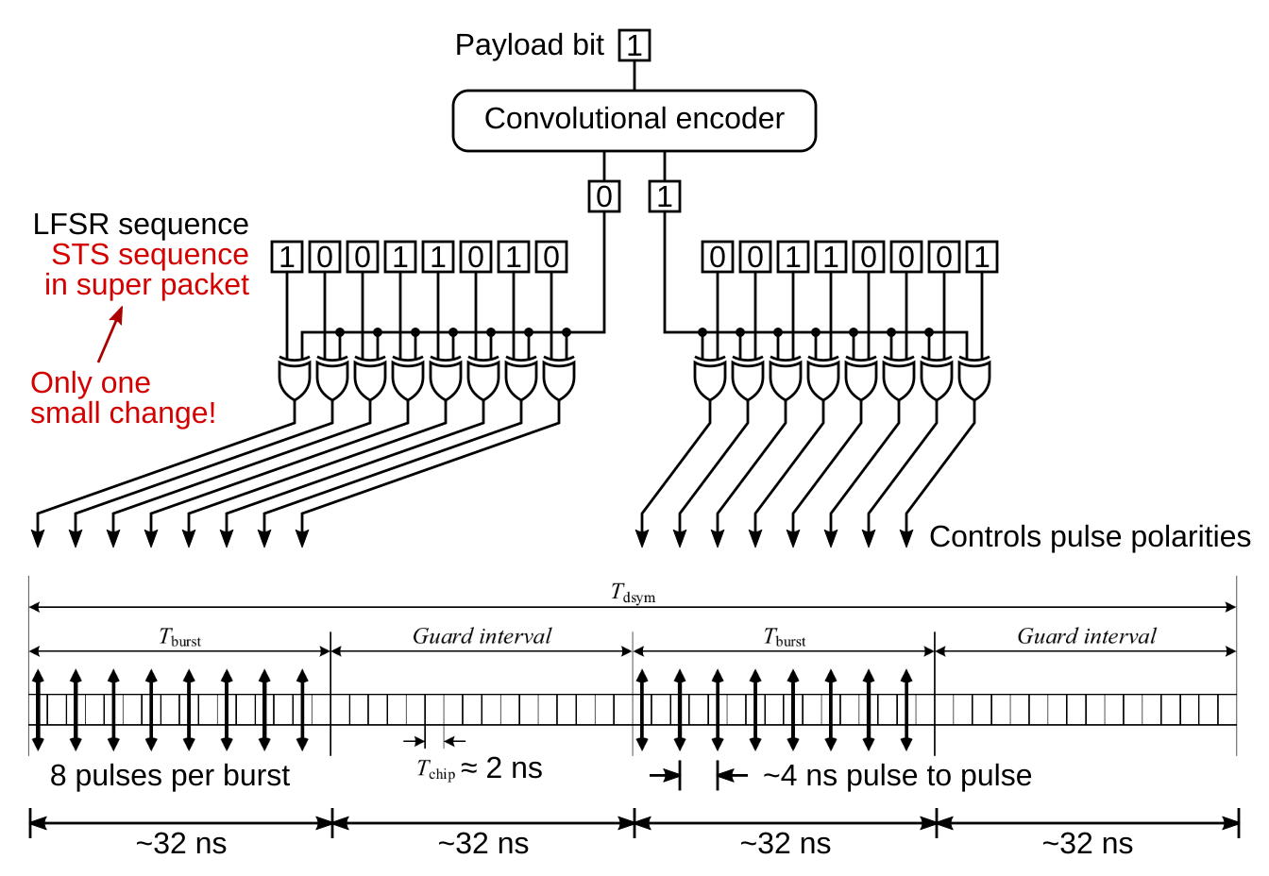
Super Packet Based on 802.15.4z HPRF 124.8 MHz (7.8 Mbit/s)

Slide 36
Data Payload Receiver
As in 802.15.4z, except with STS instead of LFSR for despreading

Slide 37
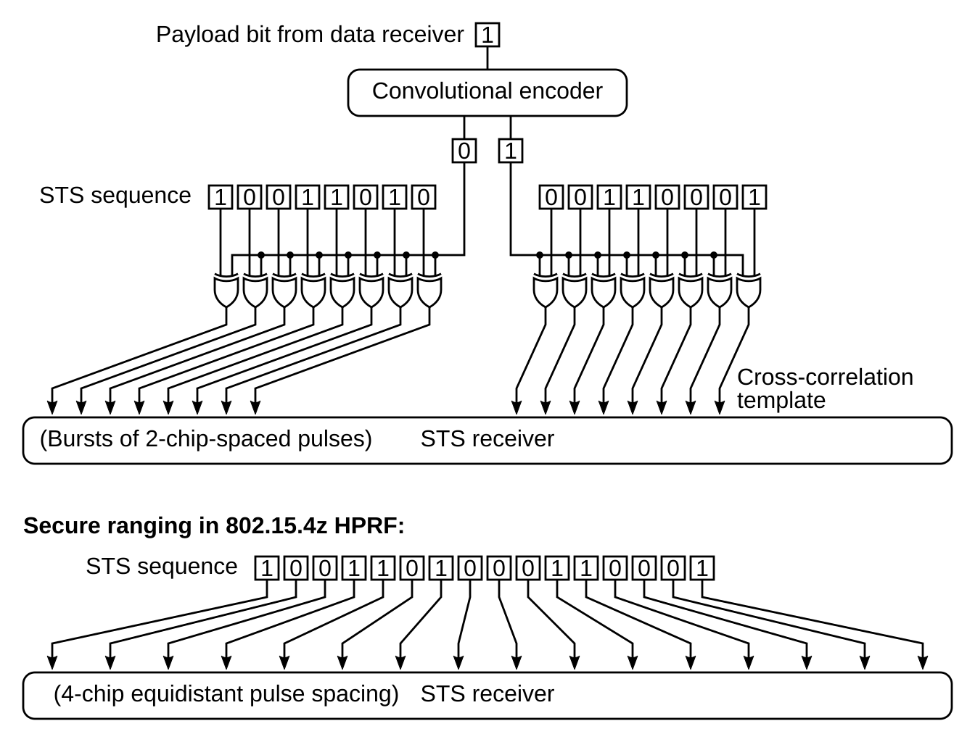
Secure Ranging and Bistatic Sensing Receiver

Slide 38
Ranging Security
Verify data packet integrity cryptographically
Ensures the cross-correlation template for the STS receiver was correct

Slide 39
Monostatic Sensing Receiver
Same as the bistatic receiver (cross-correlate with TX sequence), except:
Long guard intervals are important (32 ns gives 4.8 m sensing range)
Transmitted sequence is readily available
Could base the super packet on BPRF instead of HPRF
Non-periodic burst transmission will prevent blind zones (a given range bin will only some of the time be masked by transmission of a later burst)
More complex receiver due to the non-periodic behavior
The STS provides secure sensing (an attacker outside can not fake presence)
802.15.4z BPRF packet format

Slide 40
Summary
Pulse burst sensing
Sends bursts of pulses instead of single pulses
Increases average TX power. Reduces required air-time.
Has perfect correlation properties
Super packet
Uses the same transmitted energy to provide both communication, ranging, and sensing
Gives up to 3x reduction in required air-time

Slide 41
Thank you!

Slide 42
Backup Slides

Slide 43
Pulse Burst Sensing System Parameters
nominal_sequence_stepping = floor(base_code_length / pulses_per_burst)
padding_unambiguous_range = BRI * (1 + pre_pad_rows) - T_burst_length
Targets further away will cause non-periodic cross-correlation
padding_range_profile_length = BRI * (1 + post_pad_rows) - T_burst_length
Looking beyond this will cause non-periodic cross-correlation
max_snr_region_start = T_burst_length
max_snr_region_end = BRI - T_burst_length
This is the optimal range. Beyond this point, the SNR will vary due to masking.
max_snr_region_length = BRI - 2 * T_burst_length
blind_zone_positions = BRI * k
unambiguous_range >= BRI * minimum_sequence_stepping - T_burst_length
Depends on sequence shifting details
typical_unambiguous_range = BRI * minimum_sequence_stepping

