Slide 1
Project: IEEE P802.15 Working Group for Wireless Specialty Networks (WSN)
Submission Title: Wireless Next Generation Meeting Slides
Date Submitted: 17 May 2022
Source: Benjamin A. Rolfe (Blind Creek Associates)
Contact:
Voice: +1 408 395 7207, E-Mail: ben.rolfe @ ieee.org
Re: Wireless Next Generation Standing Committee
Abstract: Agenda and Meeting Slides for the January 2022 WNG meeting
Purpose: Stimulate thoughts for the next round of innovations and for other purposes
Notice: This document has been prepared to assist the IEEE P802.15. It is offered as a basis for discussion and is not binding on the contributing individual(s) or organization(s). The material in this document is subject to change in form and content after further study. The contributor(s) reserve(s) the right to add, amend or withdraw material contained herein.
Release: The contributor acknowledges and accepts that this contribution becomes the property of IEEE and may be made publicly available by P802.15.
Notes:
Jul 12, 2010
Page 1

Slide 2
May 2022 Wireless Interim
Virtual Session
Meeting will begin at 10 minutes after the hour

Slide 3
Electronic Interim
Please remember to enter your attendance in IMAT
Reminder:
This is a non-PAR activity
All the rules of conduct apply https://grouper.ieee.org/groups/802/sapolicies.shtml

Slide 4
Registration for 802 LMSC Plenaries and 802 Wireless Interims
This 802.15 meeting (WNG) is part of an IEEE 802 LMSC Plenary or IEEE 802 Wireless Interim session
You must pay the registration fee in order to attend
If you have not already done so, you can register here or follow the registration link here Meeting Information
If you do not intend to register for this session you must leave this meeting and, if you have logged attendance on IMAT, email the appropriate WG chair or vice chairs to have your attendance cancelled

Slide 5
Deadbeat Consequences (Deadbeat: in default of paying registration fee for a prior mtg.)
No participation credit will be granted for said session.
Any participation credit acquired before said session toward membership in any IEEE 802 LMSC group is revoked.
Membership in any IEEE 802 LMSC group is terminated.
No participation credit will be granted for attendance at any subsequent IEEE 802 LMSC session until the individual has complied with the registration requirements for all previously attended IEEE 802 LMSC sessions by the start of said subsequent session.

Slide 6
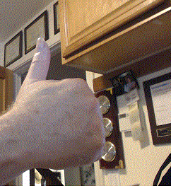
Registration Reminder
Please Register now if you have not already done so!
Register here

Slide 7
Agenda May 2022
Opening and Meeting Reminders
Presentations
PSDO Process
ISO-IEC JC1 SC6 WG1 FAN topic
Future planning
Any other business
Reminders and announcements
Adjourn

Slide 8
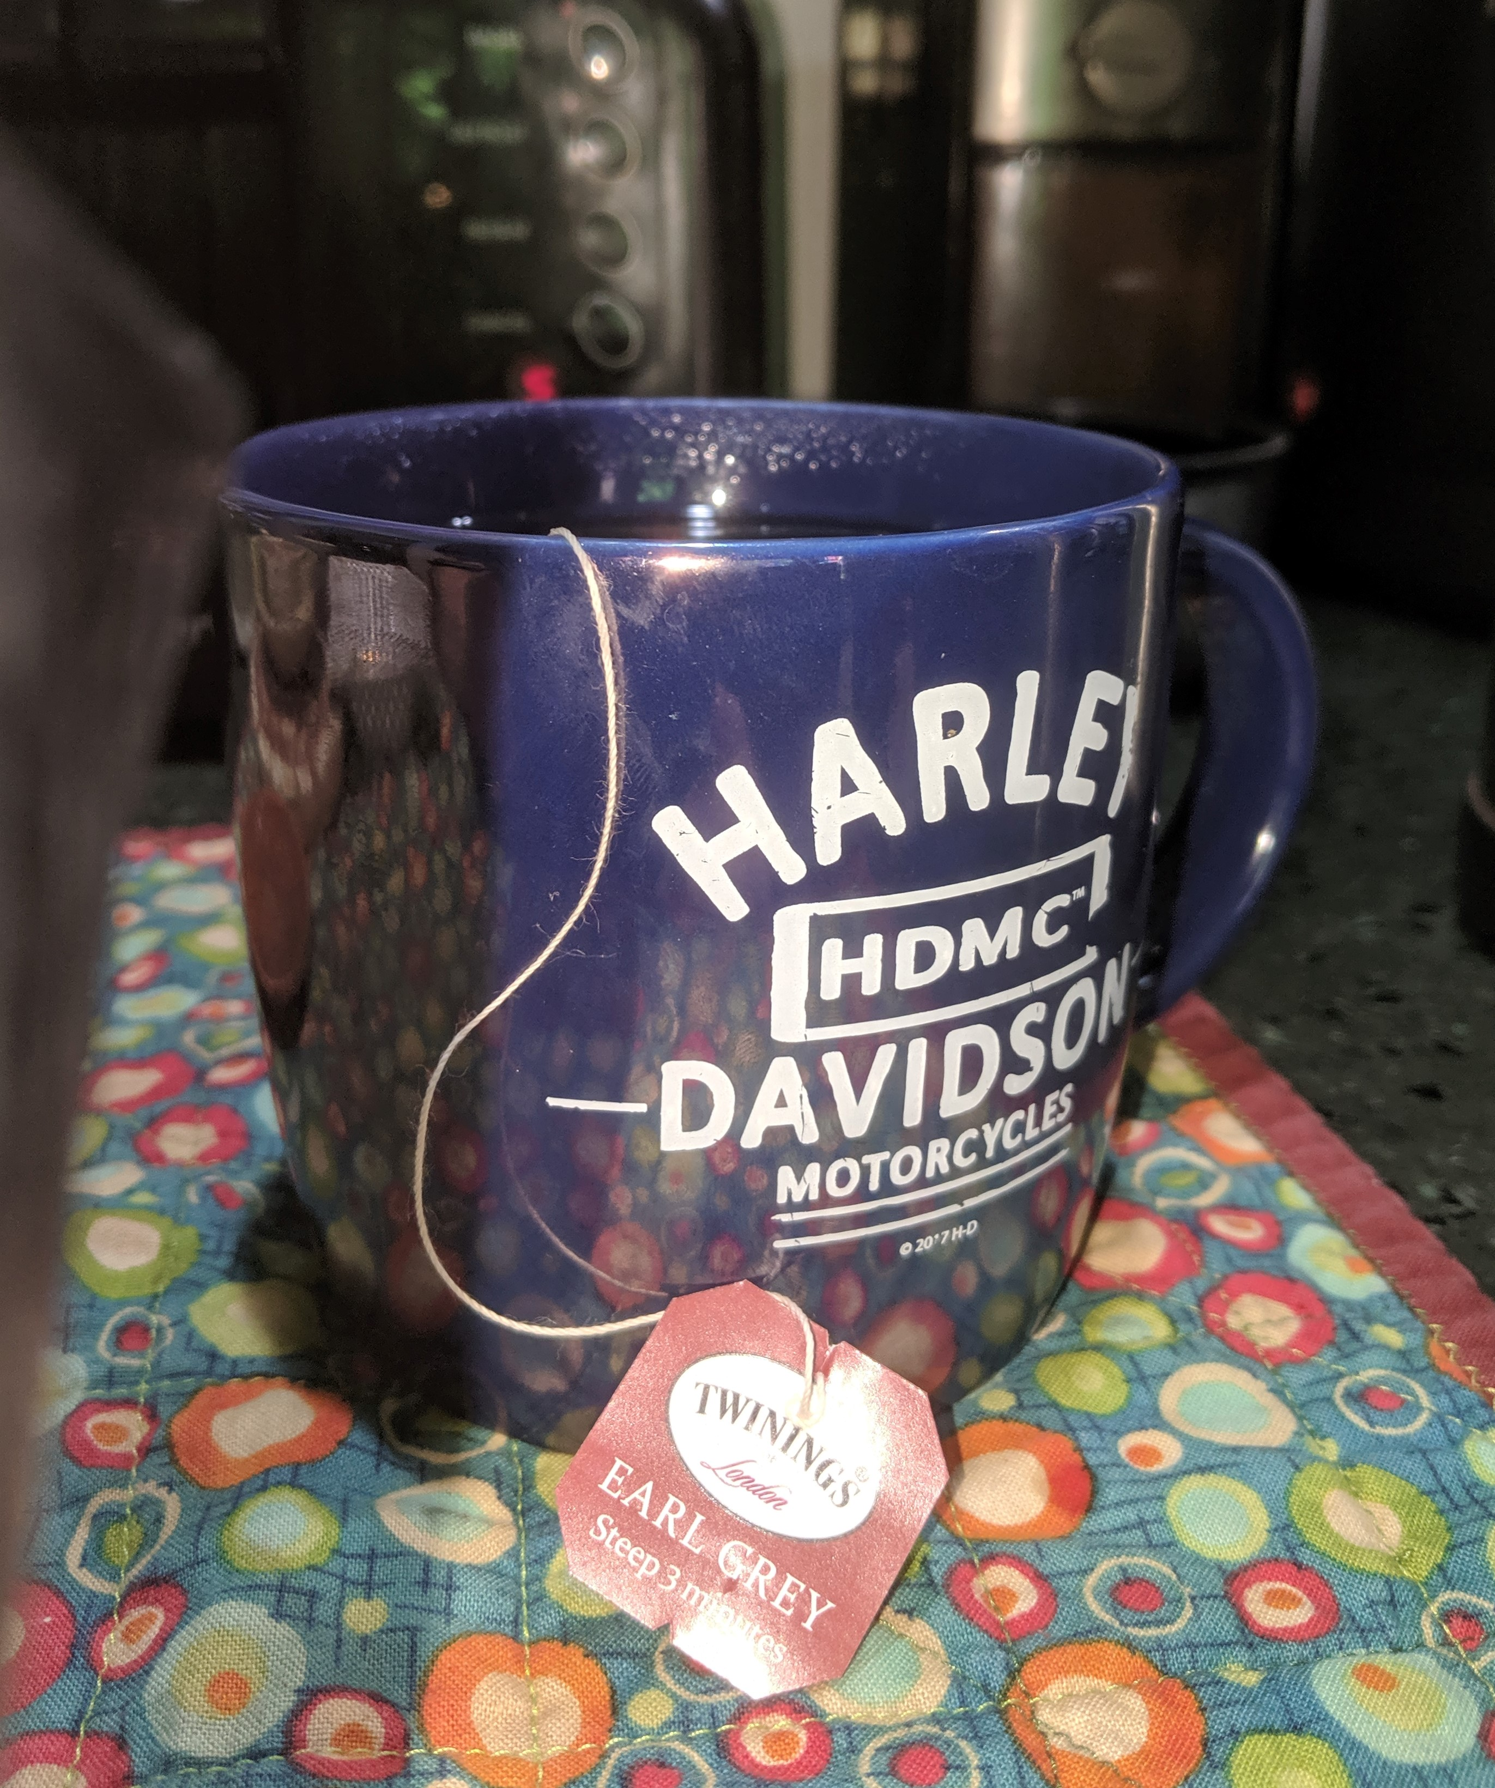
The usual question
What do you propose the Working Group do next?

Slide 9
Reminders and Announcements
Register if you haven’t already!
Registration for the July plenary is open (http://802world.org/plenary/)
Early bird ends May 20
Call for Contributions for WNG July 2022: Provide your request to the WNG chair

Slide 10
Meeting Adjourned Thanks
Something Shiny to look at while mingling

