Slide 1
Project: IEEE P802.15 Working Group for Wireless Specialty Networks (WSN)
Submission Title: [Converging Downlink TDOA (DL-TDOA) Location Service Proposals in 802.15]
Date Submitted: [16th May 2022]
Source: [Zhenzhen Ye and Yongsen Ma] Company [Red Point Positioning], [Sven Zeisberg] Company [Zigpos], [Jean-Marie Andre] Company [ST microelectronics]
Re: Call for contributions to TG15.4ab
Abstract: Presentation, UWB in 802.15, DL-TDOA
Purpose: Present technical content for consideration by the group
Notice: This document has been prepared to assist the IEEE P802.15. It is offered as a basis for discussion and is not binding on the contributing individual(s) or organization(s). The material in this document is subject to change in form and content after further study. The contributor(s) reserve(s) the right to add, amend or withdraw material contained herein.
Release: The contributor acknowledges and accepts that this contribution becomes the property of IEEE and may be made publicly available by P802.15.

Slide 2
PAR Objective | Proposed Solution (how addressed)
Safeguards so that the high throughput data use cases will not cause significant disruption to low duty-cycle ranging use cases
Interference mitigation techniques to support higher density and higher traffic use cases | The proposed method for DL-TDOA scheduling is used to reduce interference between participating anchors. DL-TDOA supports a high density of tags without increasing interference potential.
Other coexistence improvement
Backward compatibility with enhanced ranging capable devices (ERDEVs) | The proposed MAC enhancements are compatible with legacy ERDEVs; All required information is conveyed using IEs in existing MAC frame formats harmlessly ignored by non-participating legacy devices.
Improved link budget and/or reduced air-time
Additional channels and operating frequencies
Improvements to accuracy / precision / reliability and interoperability for high-integrity ranging | The new feature will provide enhanced reliability in some high density use cases.
Reduced complexity and power consumption
Hybrid operation with narrowband signaling to assist UWB | Option allowed to offload network discovery and device management to NB channels
Enhanced native discovery and connection setup mechanisms
Sensing capabilities to support presence detection and environment mapping
Low-power low-latency streaming
Higher data-rate streaming allowing at least 50 Mbit/s of throughput
Support for peer-to-peer, peer-to-multi-peer, and station-to-infrastructure protocols | The proposed superframe structure, transmission scheme and messages are to support downlink TDOA location service.
Infrastructure synchronization mechanisms | Proposed IE(s) supports synchronization for downlink TDOA network infrastructure

Slide 3
Recap: Previous Contributions
Two types of system designs for providing DL-TDOA location service
List of IEEE 802.15.4ab contributions related to DL-TDOA location systems (by 03/2022, ordered by groups of authors:
Zhenzhen Ye (Redpoint): Reverse TDOA Applications and Technical Characteristics. IEEE 15-21-0223-00-04ab, 2021-04-27, IEEE 802.15 TG4ab
Zhenzhen Ye (Redpoint): Downlink TDOA (DL-TDOA) Location Service in 802.15. IEEE 15-21-0488-00-04ab, 2021-09-15, IEEE 802.15 TG4ab
Yongsen Ma, Zhenzhen Ye (Redpoint): Beacon and Ranging Frames to Support Downlink TDOA (DL-TDOA) Location Service in 802.15. IEEE 15-21-0616-01-04ab, 2021-11-16, IEEE 802.15 TG4ab
Sven Zeisberg, Jean-Marie André: 802.15.4z upgrade requirements for larger industrial scenarios. IEEE 15-21-0066-00-04ab, 2021-01-20, IEEE 802.15 SG4ab
Jean-Marie André, Sven Zeisberg: DL-TDOA positioning TDMA scheme. IEEE 15-21-0530-00-04ab, 2021-10-19, IEEE 802.15 TG4ab
Jean-Marie André (ST microelectronics), Sven Zeisberg (HTW), Vincent van der Locht (SynchronicIT), Frank Stephan (ZIGPOS), Andreas Schumacher (TRUMPF): TDMA scheme enabling industrial DL-TDoA and UL-TDoA scenarios. IEEE 15-22-0077-00-04ab, 2022-01-2, IEEE 802.15 TG4ab
Jean-Marie André (ST microelectronics), Sven Zeisberg (HTW), Vincent van der Locht (SynchronicIT), Frank Stephan (ZIGPOS), Andreas Schumacher (TRUMPF): Information Elements for efficient DL-TDoA. IEEE 15-22-0113-00-04ab, 2022-02, IEEE 802.15 TG4ab

Slide 4
Recap: Previous Contributions (Cont’d)
Similarity between two designs
Block-based frame structure by extending/adopting 802.15.4z ranging block structure in multi-node ranging (sec. 6.9.7)
Infrastructure synchronization with signals from a subset of devices
Support of different ranging modes (DL-TDOA, UL-TDOA, etc.) in the proposed block-based frame structure
Difference between two designs
The specific ways of organizing ranging messages to provide TDOA information
Specific IEs defined to support DL-TDOA service
Availability of TDMA scheduled time slots and CAP for UL messages vs. availability of only CAP for UL-messages, TW-messages and in-band data
Next steps
How to extend 802.15.4 toolbox to enable both designs

Slide 5
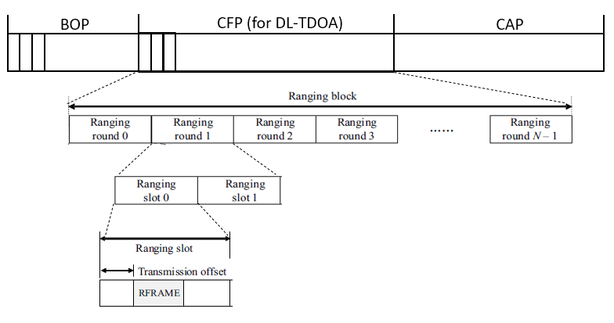
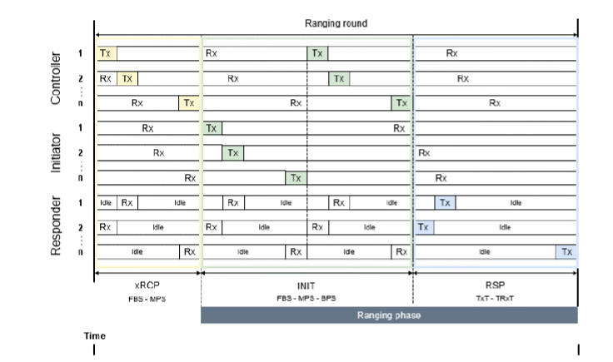
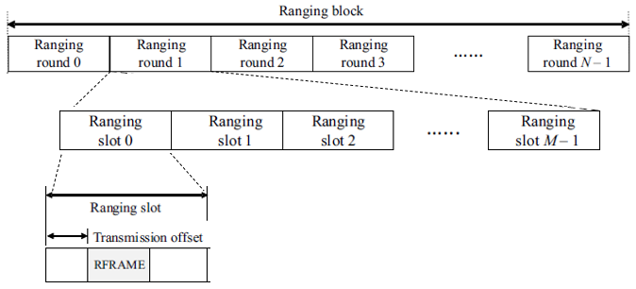
Similarity – Block Structure
M=2: two slots per round (anchor pair)
M>2: anchor cluster
Superframe based structure [2]
BOP: beacons from a subset of anchors for synchronization and superframe info broadcast
CFP: a ranging block structure supporting DL-TDOA messages from anchors grouped into pairs or clusters
CAP: contention period to support other ranging modes (UL-TDOA, TWR, etc.) and in-band data communications. A variety of ranging and data traffic is supported in the same CAP.
Ranging block & round based structure [5-6]
xRCP: control messages from controllers for block/round control, synchronization and DL-TDOA
INIT: 2 sub-phases for first BPS and 2nd MPS/FBS, both for DL-TDOA, in which messages from satellites (anchors) are scheduled
RSP: a contention-free/contention period (mode per round) to support UL-TDOA, scheduled TWR, RToF, TsToF

Slide 6
Similarity – Infrastructure Synchronization
Contributions [2-3]
A mesh network topology
A subset of anchors are selected to transmit beacons which contains timing info
Other anchors in the network use timing info in beacons to handle synchronization
Contributions [5-6]
Satellites (anchors) are in groups and there are several controller per satellite group
All anchors transmit various messages containing timing info
Other satellites use these messages to allow a variety of synchronization schemes

Slide 7
Similarity – Ranging Modes supported
Contributions [2-3]
DL-TDOA: in the CFP, anchors pairs or clusters are scheduled to transmit in corresponding ranging rounds/slots so that a tag can calculate TDOA values from these messages
UL-TDOA, TWR: in the CAP, both anchors and tags are allowed to transmit so either UL-TDOA or TWR are supported
Contributions [5-6]
DL-TDOA: in the xRCP and INIT periods, satellites are scheduled to transmit frames containing time relation info, so that a tag can calculate TDOA; DL-TDOA info is sent equally separated in time within a block at each position
UL-TDOA, scheduled TWR, RToF, TsToF in RSP period together with xRCP and INIT periods, tags are allowed to transmit either in a scheduled round or in a CAP round

Slide 8
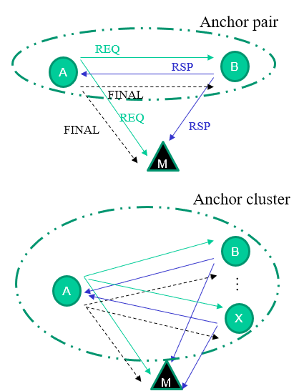
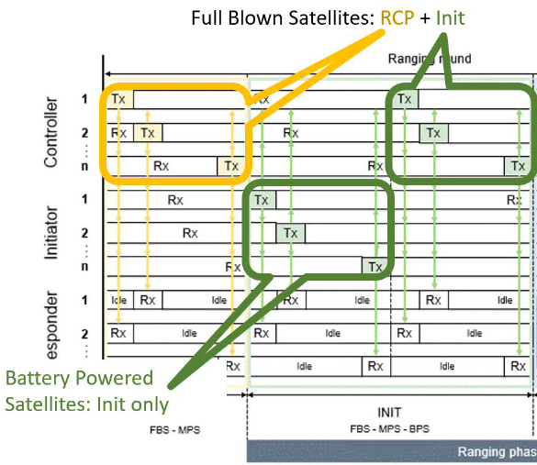
Difference – DL-TDOA derivation
Contributions [2-3]
Anchors are explicitly grouped into pairs or clusters so the TDOA values are generated from these pairs or clusters
Contributions [5-6]
Satellites (controllers and initiators) are not required to be grouped into pairs or clusters, but provide time relation info relative to neighbors
Satellites transmit messages in xRCP and INIT phases in each ranging round, which are integrating multiple ranging methods
A tag (“responder”) may derive TDOA values from several messages if satellites are either well synchronized or time relation info between them has been received

Slide 9
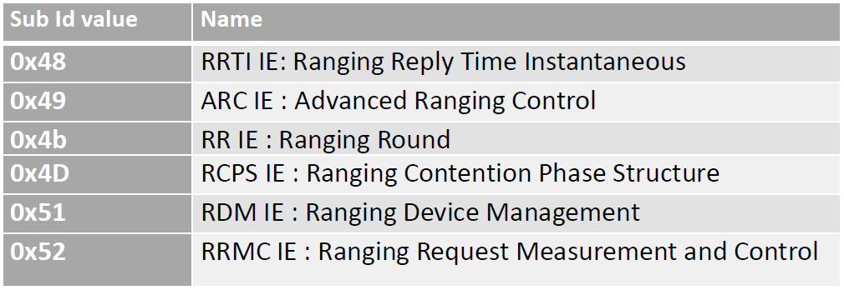
Difference - IEs
Contributions [2-3]
New Header IE and Payload IE for the beacon frame
New Header IE and Payload IE for DL-TDOA ranging frame
Contributions [6-7]
A combination of existing IEs from 4z and a group of complementary new proposed IEs, where all IEs, which are relevant for DL-TDoA tags reception are assumed to become header IEs
Some functional overlap:
Beacon HIE ≈ XRCM IE, RDM IE, ARC IE, XOCM IE?
Ranging PIE ≈ RR IE, RRTI IE, XTxTime IE, XCFO IE, XPos IE?

Slide 10
Next Steps
How to extend the IEEE 15.4 toolbox enabling these two designs?
1. Block structure alignment options:
Example a): try to fit [5-6] into [2-3] approach: BOP = xRCP, CFP = INIT (for DL-TDOA, with flexible ranging slot configuration in a ranging round, # of slots>=1), CAP = RSP
# of slots >=2: the scheme with anchors grouped as pairs or clusters [2-3]
CAP to support scheduling mode as that in RSP
Example b): try to fit [2-3] into [5-6] approach: xRCP are carrying block/round org contents (in case no OOB avail.) as the BOP, the INIT carry several slots for several pairs or cluster anchors and the RSP may be extended to allow anchor Tx as that in CAP
…further discussion and harmonization

Slide 11
Next Steps (Cont’d)
How to extend the IEEE 15.4 toolbox enabling these two designs?
2. IE design considerations
Information in header IE or payload IE section split
A few bigger IEs vs a set of “small” IEs
Possible alignment with concurrent work in other standard forums
OoB and IB Options to support other ongoing TG4ab initiatives [8, 9, 10]
…further discussion and harmonization
3. Conclusion:
a common framework based on extending 15.4(z) supporting both designs seems possible
(further) examples/options need to be discussed and evaluated

Slide 12
References
Zhenzhen Ye (Redpoint): Reverse TDOA Applications and Technical Characteristics. IEEE 15-21-0223-00-04ab, 2021-04-27, IEEE 802.15 TG4ab
Zhenzhen Ye (Redpoint): Downlink TDOA (DL-TDOA) Location Service in 802.15. IEEE 15-21-0488-00-04ab, 2021-09-15, IEEE 802.15 TG4ab
Yongsen Ma, Zhenzhen Ye (Redpoint): Beacon and Ranging Frames to Support Downlink TDOA (DL-TDOA) Location Service in 802.15. IEEE 15-21-0616-01-04ab, 2021-11-16, IEEE 802.15 TG4ab
Sven Zeisberg, Jean-Marie André: 802.15.4z upgrade requirements for larger industrial scenarios. IEEE 15-21-0066-00-04ab, 2021-01-20, IEEE 802.15 SG4ab
Jean-Marie André, Sven Zeisberg: DL-TDOA positioning TDMA scheme. IEEE 15-21-0530-00-04ab, 2021-10-19, IEEE 802.15 TG4ab
Jean-Marie André (ST microelectronics), Sven Zeisberg (HTW), Vincent van der Locht (SynchronicIT), Frank Stephan (ZIGPOS), Andreas Schumacher (TRUMPF): TDMA scheme enabling industrial DL-TDoA and UL-TDoA scenarios. IEEE 15-22-0077-00-04ab, 2022-01-2, IEEE 802.15 TG4ab
Jean-Marie André (ST microelectronics), Sven Zeisberg (HTW), Vincent van der Locht (SynchronicIT), Frank Stephan (ZIGPOS), Andreas Schumacher (TRUMPF): Information Elements for efficient DL-TDoA. IEEE 15-22-0113-00-04ab, 2022-02, IEEE 802.15 TG4ab
J.S. Hammerschmidt, Ersen Ekrem, Eren Sasoglu, Xiliang Luo (Apple): Narrowband assisted multi-millisecond UWB. IEEE 15-21-0409-00-04ab, 2021-07, IEEE 802.15 TG4ab
Ersen Ekrem, et al., NBA-UWB Technical Framework Proposal. IEEE-15-22-xxxx-00-004ab, 2022-03, IEEE 802.15 TG4ab
Billy Verso, et al. (Qorvo), Multi-millisecond Ranging, IEEE-15-22-0205-00-04ab, 2022-03, IEEE 802.15 TG4ab

