Slide 1
Filtering of Single Carrier and OFDM signals to meet Emission Requirements May 16, 2022
DCN 15-22-0294-00-016t

Slide 2
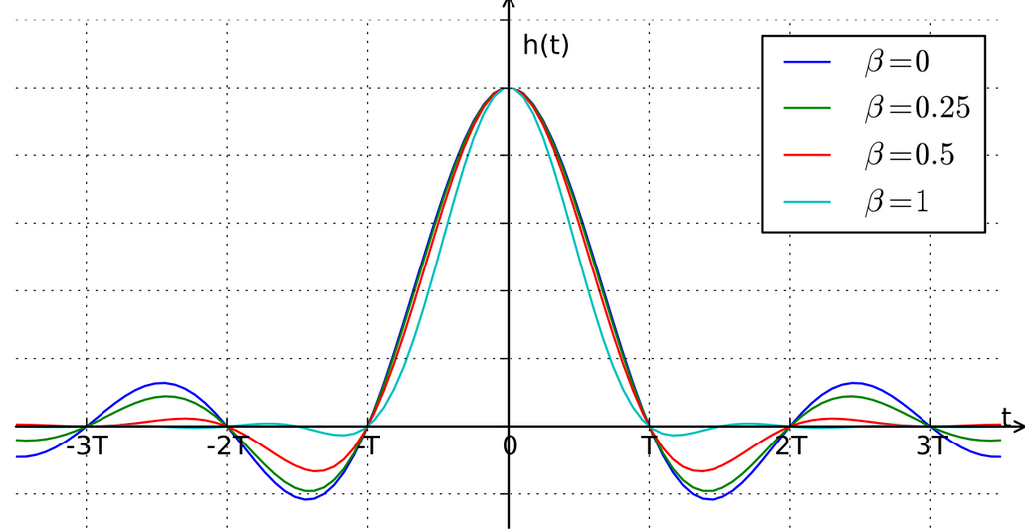

Slide 3
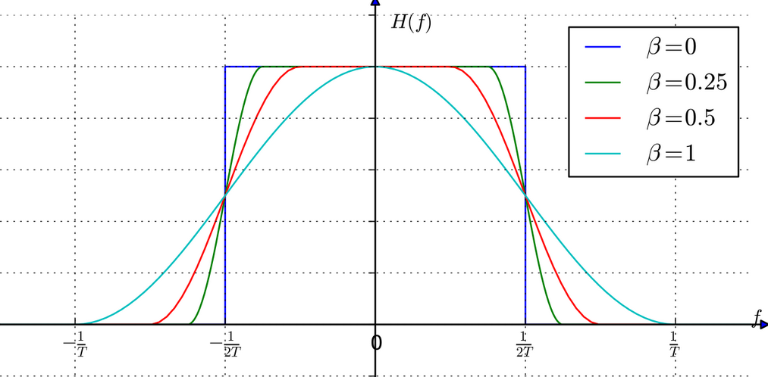
FREQUENCY RESPONSE OF RAISED COSINE FILTER

Slide 4
RC FILTER : 257 taps (duration 2T)
RC FILTER : 384 taps (duration 3T)
Rolloff factor | PAPR (dB)
0 | 2.73
0.1 | 2.72
0.2 | 2.68
0.3 | 2.63
0.4 | 2.54
0.5 | 2.43
0.6 | 2.28
0.7 | 2.11
0.8 | 1.90
0.9 | 1.68
Rolloff factor | PAPR (dB)
0 | 3.873
0.1 | 3.7486
0.2 | 3.6612
0.3 | 3.6145
0.4 | 3.42
0.5 | 3.077
0.6 | 2.9
0.7 | 2.58
0.8 | 2.2685
0.9 | 1.9835

Slide 5
RC FILTER : 513 taps (duration 4T)
Rolloff factor | PAPR (dB)
0 | 4.96
0.1 | 4.913
0.2 | 4.777
0.3 | 4.556
0.4 | 4.25
0.5 | 3.87
0.6 | 3.43
0.7 | 2.94
0.8 | 2.42
0.9 | 2.01

Slide 6
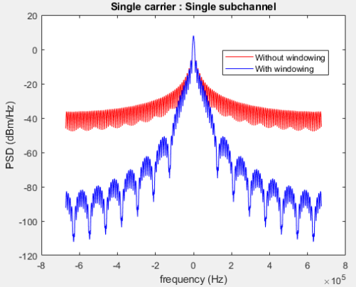
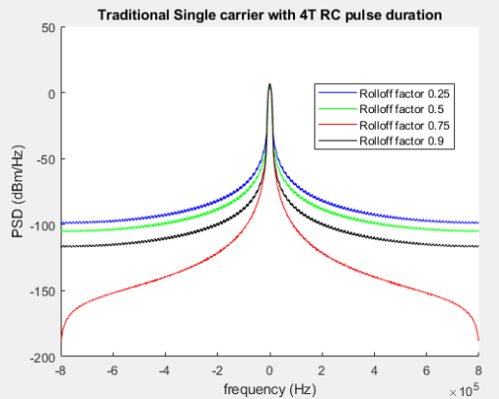
PSD PLOTS FOR TRADITIONAL SINGLE CARRIER AND SINGLE CARRIER WITH OFDM
Single carrier system : single subchannel
Traditional single carrier system

Slide 7
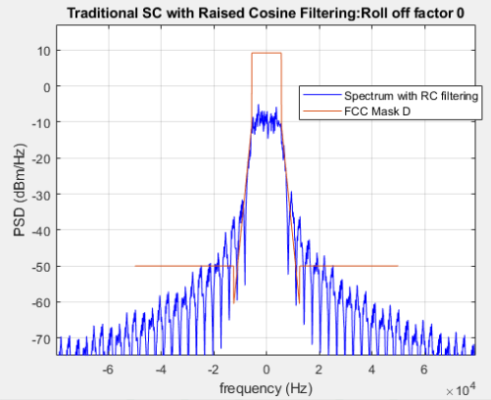
APPLYING FCC PART 90 ( MASK D ) ON TRADITIONAL SINGLE CARRIER
With Raised Cosine filtering of Roll off factor 0

Slide 8
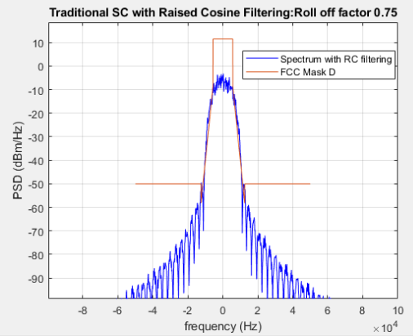
APPLYING FCC PART 90 ( MASK D ) ON TRADITIONAL SINGLE CARRIER
With Raised Cosine filtering of Roll off factor 0.75

Slide 9
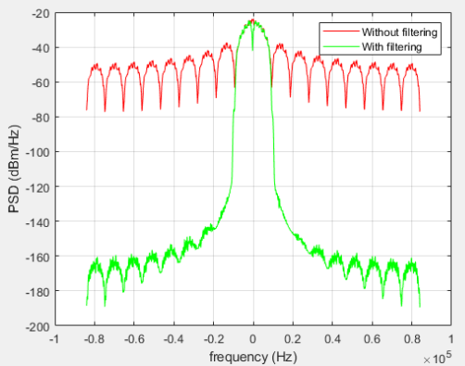
APPLYING IBR FILTER ON SINGLE CARRIER OFDM

Slide 10
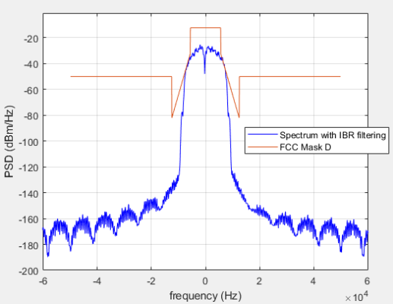
APPLYING FCC PART 90 ( MASK D ) ON IBR FILTERED SINGLE CARRIER OFDM

Slide 11
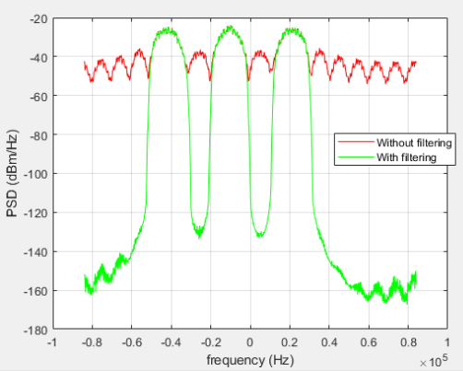
APPLYING IBR FILTER ON SINGLE CARRIER OFDM WITH MULTIPLE SUBCHANNELS ACTIVE

