Slide 1
Project: IEEE P802.15 Working Group for Wireless Personal Area Networks (WPANs)
Submission Title: Time hopping for fragmented UWB transmission in MMS-UWB systems
Date Submitted: May, 2022
Source: Ziyang Guo, Peng Liu, Li Sun, Shimi Shilo, Xun Yang (Huawei Technologies)
Email: guoziyang@huawei.com
Abstract: Enable time hopping for fragmented UWB transmission in MMS-UWB systems to avoid consecutive multi-user interference
Purpose: Enable time hopping for fragmented UWB transmission in MMS-UWB systems to avoid consecutive multi-user interference
Notice: This document has been prepared to assist the IEEE P802.15. It is offered as a basis for discussion and is not binding on the contributing individual(s) or organization(s). The material in this document is subject to change in form and content after further study. The contributor(s) reserve(s) the right to add, amend or withdraw material contained herein.
Release: The contributor acknowledges and accepts that this contribution becomes the property of IEEE and may be made publicly available by P802.15.

Slide 2
PAR Objective | Proposed Solution (how addressed)
Safeguards so that the high throughput data use cases will not cause significant disruption to low duty-cycle ranging use cases | Lower duty-cycle maybe helpful
Interference mitigation techniques to support higher density and higher traffic use cases | Interference mitigation technique to support higher density of fragmented UWB ranging pairs
Other coexistence improvement
Backward compatibility with enhanced ranging capable devices (ERDEVs)
Improved link budget and/or reduced air-time
Additional channels and operating frequencies
Improvements to accuracy / precision / reliability and interoperability for high-integrity ranging
Reduced complexity and power consumption
Hybrid operation with narrowband signaling to assist UWB | Time-hopping for fragment transmission to avoid consecutive interferences
Enhanced native discovery and connection setup mechanisms
Sensing capabilities to support presence detection and environment mapping
Low-power low-latency streaming
Higher data-rate streaming allowing at least 50 Mbit/s of throughput
Support for peer-to-peer, peer-to-multi-peer, and station-to-infrastructure protocols
Infrastructure synchronization mechanisms

Slide 3
MMS-UWB (Recap)
1ms
1ms
Poll
Frag 1
Frag 2
Frag 3
Frag N
Res
1
2
3
N
DATA
t/ms
Time and Freq Sync
Improve ~10*log₁₀N dB link budget by segmenting ranging preamble into N fragments spanning N milliseconds [1, 2]
Interference issues with respect to wideband need to be discussed

Slide 4
MMS-UWB Interference Issues—Cat A
1ms
1ms
SYNC
Packet
Frag 1
Frag 2
Frag 3
Frag N
Time and Freq Sync
1
2
3
N
t/ms
Interference from other UWB transmission
e.g., other ranging pair, other data transmission pair
Cat A: interference between MMS-UWB and other high-PRF data transmissions, e.g., 802.15.4z, or other high-duty cycle UWB activities [3]
Interference from other UWB transmissions may lead to wrong ToA estimation of the fragments, see details in our previous submission [4]
Interference to other UWB transmissions may also degrade their performances, e.g., packet dropout rate or ToA estimation error, depending on their operating scenarios, e.g., data transmission or ranging

Slide 5
MMS-UWB Interference Issues—Cat B
1ms
NB CH i
Poll
Frag 1
Frag 2
Frag 3
Frag N
1st ranging pair
Res
1
2
3
N
DATA
t/ms
1ms
…
NB CH j, j$≠$i
Poll
Frag 1
Frag 2
Frag 3
Frag N
2nd ranging pair
Res
1
2
3
N
DATA
t/ms
1ms
Poll
Frag 1
Frag 2
Frag 3
Frag N
NB CH j
3rd ranging pair
Res
1
2
3
N
DATA
t/ms
Cat B: Interference between multiple non-coordinated MMS-UWB ranging pairs
NBA-MMS-UWB example: Even if Poll packets of different UWB ranging pairs transmit successfully using different NB channels (e.g., the 1st and 2nd pairs) or at different time period (e.g., the 2nd and 3rd pairs), collisions of consecutive UWB fragments may happen in the worst case.

Slide 6
Summary of Related Techniques
Technique | Method | Principle | Cat A | Cat B | Requirement
Time reversal-based [5] | Interference Detection | Detect interference and discard bad ranging measurement | ✔ | ✔ | Time reversal operation
CCA [4] | Interference avoidance | Listen before talk/clear channel assessment before transmission | ✔ | ✘ | CCA support
Mirror channel [6-8] | NB assisted | Channel access on NB | ✘ | ✔ | Extra NB transmission over a common channel during UWB ranging
Time Hopping | Interference mitigation | Mitigate interference via randomization | ✔ | ✔ | Hopping function

Slide 7
Time Hopping for MMS-UWB
Xms
1ms
Xms
1ms
Poll
Frag 1
Frag 2
Frag 3
Frag N
Res
1
2
3
N
DATA
t/ms
Slot 1
Slot 2
Slot 3
…
Slot M
Time and Freq Sync
Enlarge the 1ms to (1+X)ms
Divide Xms into M slots, the UWB fragment hops within M slots
Reduce to NBA-MMS-UWB [1,2] when X=0
Tradeoff between time consumption and collision rate

Slide 8
Time Hopping Function
Xms
1ms
Xms
1ms
Poll
Frag 1
Frag 2
Frag 3
Frag N
Res
1
2
3
N
DATA
t/ms
Slot 1
Slot 2
Slot 3
…
Slot M
Time and Freq Sync
Time hopping function is to generate pseudo-random sequence for each UWB ranging pair:
The sequence needs to be known by both the initiator and the responder
The sequences for different ranging pairs need to have good cross-correlation
Reuse existing time hopping function in 15.4 or design new mechanism

Slide 9
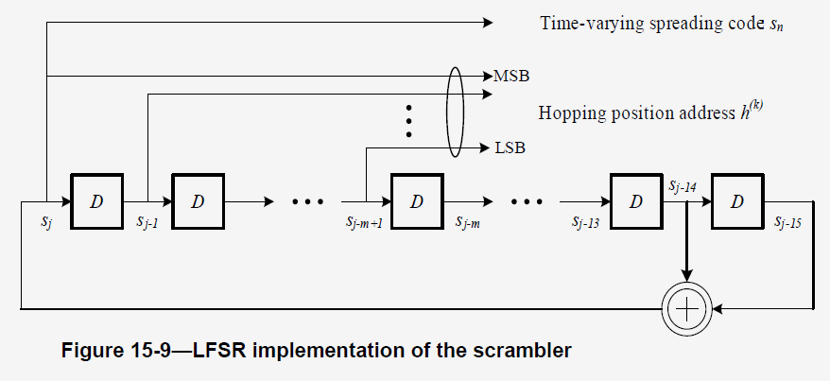
Time Hopping Function -- OPT #1
Time hopping function in IEEE 802.15.4a (section 15.3.2) adopts linear feedback shift register (LFSR) with polynomial $x^{15}+x+1$ and initial state determined by the preamble code to generate pseudo-random sequence
NBA-MMS-UWB example:
Set the initial state of LFSR as a function of NB channel index (suppose frequency hopping in NB) such that different ranging pairs can generate different hopping sequences

Slide 10
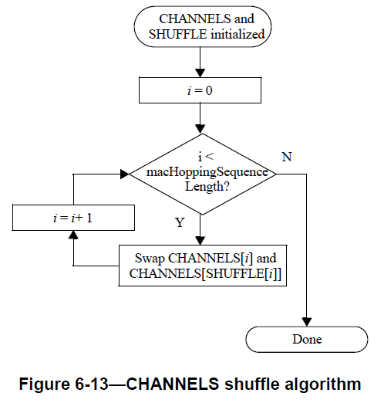
Time Hopping Function -- OPT #2
IEEE 802.15.4 (section 6.2.10) define a channel shuffle algorithm for channel hopping which generates pseudo-random sequence of channel index within the available channel set
Generate SHUFFLE using LFSR with polynomial $x^{9}+x^{5}+1$ and starting seed 255
CHANNELS is initially populated with the monotonically increasing set of available channels
Swap the elements of CHANNELS accordingly to obtain the pseudo-random sequence

Slide 11
Time Hopping Function -- OPT #2
Reuse this algorithm to generate time hopping sequence for different ranging pairs
NBA-MMS-UWB example: set the starting seed of LFSR related to NB channel index when generating SHUFFLE; or initialize CHANNELS according to NB channel index
Could easily enlarge the period of pseudo-random sequence using higher-order polynomials, e.g., $x^{10}+x^{7}+1$

Slide 12
Example of NBA-MMS-UWB with Time Hopping
Suppose that frequency hopping is used in NB [1, 2] to avoid deep fading and interference from other technologies coexisting in the same band
Initial value of time hopping function could be determined by NB channel index so that different UWB systems use different sequences with low cross-correlation
Initial value of time hopping function could be determined by NB channel index
NB ch m
NB ch n
M slots
1ms
M slots
1ms
M slots
1ms
NB ch k
NB ch j
NB
…
NB
NB
…
NB
t(ms)
Slot 1
Slot 2
Slot N

Slide 13
Benefits of Time Hopping in Cat B
Considered scenario: Number of pairs = 4, Number of UWB fragments = 32
Evaluate the worst-case performance with and without time hopping
The worst-case number of collisions for different number of time slots is shown in the Table
The proposed time hopping scheme for MMS-UWB reduce the number of collisions significantly
The number of collisions decrease as the number of time slots increase
Number of time slots | Worst-case number of collisions
 | OPT#1 | OPT#2 | No time hopping
4 | 10 | 10 | 32
8 | 6 | 6
16 | 4 | 3
32 | 3 | 2
*For ranging pair k, the initial states of LFSR is N*NB_Ch(k) + offset, N is the number of UWB fragment, offset is the optimal value among 1000 random search

Slide 14
Systematic Benefits of Time Hopping in Cat B
Considered Scenario: Number of pairs = 4, Number of UWB fragments = 32
Evaluate the ranging performance with and without time hopping
Each pair adopts the proposed time hopping scheme and T1 to T4 are randomly selected in 0-1ms to simulate the starting time of different ranging pairs
Simulation Settings | Descriptions
Fragment Duration | ~128us
Fragment Settings | Peak PRF = 31.20MHz Mean PRF = 16.10MHz; Symbol duration = 993.59ns Random sequence like STS
Preamble symbol repetition | 128
Channel model | CM3，Office LOS
M slots
1ms
M slots
1ms
M slots
1ms
T₁
…
Ranging pair 1
t(ms)
…
M slots
1ms
M slots
1ms
M slots
1ms
T₄
…
Ranging pair 4
t(ms)

Slide 15
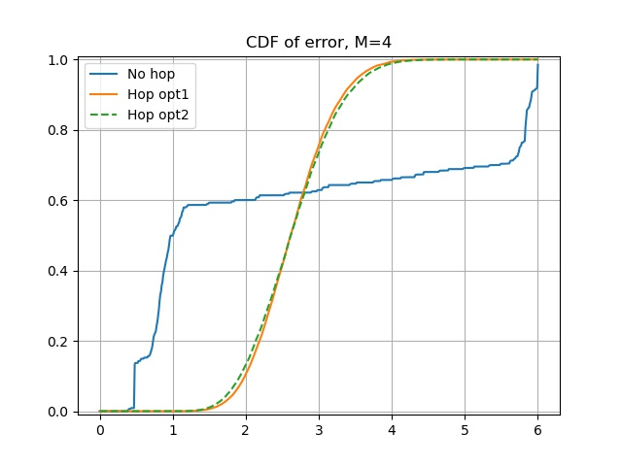
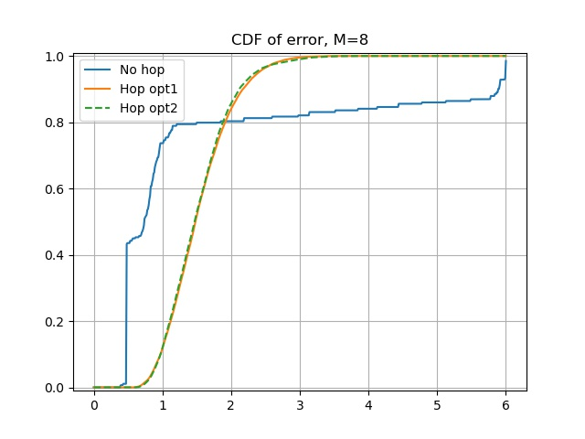
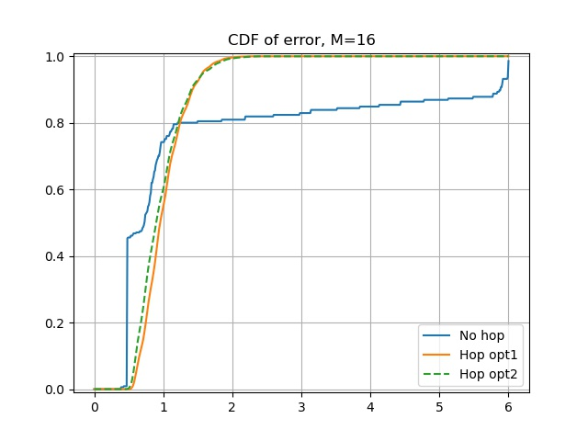
Systematic Benefits of Time Hopping in Cat B
Ranging error(m)
Ranging error(m)
Ranging error(m)
Compared with no hopping [1,2], the proposed time hopping scheme can significantly reduce the probability of large ranging error, i.e., reduce consecutive collision significantly
The ranging performance when using time hopping becomes better as the number of time slots (M) increases
A larger number of time slots may lead to larger latency, which reflects the trade off between ranging latency and ranging accuracy
The number of time slots M can be adjusted according to the interference

Slide 16
Summary
Non-coordinated multi-user interference issue is highlighted for MMS-UWB
Time hopping scheme is proposed to mitigate the consecutive interference for fragmented UWB transmission
The proposed time hopping scheme can work together with other interference detection/avoidance approaches, e.g., the time-reversal based approach [5] and CCA based approach [4]
Time hopping function considerations:
OPT #1 Reuse existing 802.15.4a (section 15.3.2) hopping function (Preferred)
OPT #2 Reuse existing 802.15.4 (section 6.2.10) hopping function (Preferred)
OPT #3 Newly designed time hopping function, but takes time and performance gain is not clear
Example of time hopping in NBA-MMS-UWB is provided, in which the initial value of LFSR could be determined by NB channel index

Slide 17
References
15-21-0605-00-04ab-nba-mms-uwb-mac-considerations, Y. Liu et al.
15-22-0080-00-04ab-nba-mms-uwb-mac-followup, Y. Liu et al.
15-22-0242-00-04ab-review-of-uwb-coex-contributions, S Yang et al.
15-22-0150-01-04ab-channel-access-considerations-on-fragmented-uwb-format, P. Liu et al.
15-22-0072-02-04ab-Interference-detection-for-high-integrity-ranging-in-UWB-systems, L. Sun et al.
15-22-0276-02-04ab-details-of-nb-mirroring-channel, M. Lee et al.
15-22-0065-00-04ab-pilot-nb-radio-for-assisting-uwb-channel-access, H. Li et al.
Proposal of NB PHY assisted CCA for UWB medium access, H. Li et al.

