Slide 1
Project: IEEE P802.15 Working Group for Wireless Speciality Networks (WSN)
Submission Title: New channel plans of terahertz radio for the 3ma after WRC19 – Required Edits
Date Submitted: 16th May 2022
Source: Iwao Hosako, Akifumi Kasamatsu, Norihiko Sekine, and Hiroyo Ogawa, NICT, JAPAN
Address 4-2-1 Nukui-kitamachi, Koganei, Tokyo, 184-8795, Japan
Voice:+81423276508, FAX: +81423276941, E-Mail: hosako@nict.go.jp
Re: n/a
Abstract: The necessary edits and discussion points are highlighted in order to implement New channel plan for 3ma (IEEE 802.15.3d) in response to WRC19 results
Purpose: For discussion and consideration to edit IEEE 802.15.3d Standard
Notice: This document has been prepared to assist the IEEE P802.15. It is offered as a basis for discussion and is not binding on the contributing individual(s) or organization(s). The material in this document is subject to change in form and content after further study. The contributor(s) reserve(s) the right to add, amend or withdraw material contained herein.
Release: The contributor acknowledges and accepts that this contribution becomes the property of IEEE and may be made publicly available by P802.15.

Slide 2
New channel plans of terahertz radio for the 3ma after WRC19 – Required Edits
Iwao Hosako (NICT), et.al.

Slide 3
Basic ideas and exceptions
[Text from doc.: IEEE 802.15-22-0120-01-03ma]
[Basic Ideas]
A simple extension of the 3d channel plan. That is, eight bandwidth channels(2.16 GHz, 4.32 GHz, 8.64 GHz, 12.96 GHz, 17.28 GHz, 25.92 GHz, 51.84 GHz, 69.12 GHz ) will be arranged starting from 321.84 GHz.
Below 450 GHz also includes bands not identified in WRC19 for LMS and FS (296 - 306 GHz, 313 - 318 GHz, 333 - 356 GHz), but they are not considered when considering the 3ma-channel plans because those bands may change in the future.
The channel ID in the 3d channel plan will not change. Newly added channels are assigned a new ID in order of narrowest bandwidth and lowest center frequency.

Slide 4
Basic ideas and Exceptions
[Text from doc.: IEEE 802.15-22-0120-01-03ma]
[Exception-1]
Add a 34.56 GHz-bandwidth channel starting at 252.72 GHz
Therefore, we propose to assign the following five 34.56 GHz-bandwidth channels.
The five channels are 252.72 - 287.28 GHz, 287.28 - 321.84 GHz, 321.84 - 356.40 GHz, 356.40 - 390.96 GHz, and 390.96 - 425.52 GHz.
Reasons for the exception-1
The 3d standard have not assigned channels having 34.56 GHz bandwidth, which is twice as wide as 17.28 GHz.
Furthermore, a bandwidth of 34.56 GHz is suitable for realizing a 50 Gbps transmission rate by QPSK.
A 50 Gbps transmission rate is required for one of the specifications for 8K video transmission (8K60P).

Slide 5
Basic ideas and Exceptions
[Text from doc.: IEEE 802.15-22-0120-01-03ma]
[Exception-2]
Remove a 69.12 GHz-bandwidth channel starting at 321.84 GHz
Add a 69.12 GHz-bandwidth channel starting at 356.40 GHz
Reasons for the exception-2
The 69.12 GHz-bandwidth channels starting at 321.84 GHz overlap with the bands not identified for LMS and FS in WRC19.
In WRC19, 94 GHz width from 356-450 GHz was identified for LSM and FS. Therefore, a 69.12 GHz-bandwidth channel can be configured in it.
At 356.40 GHz, the channel ends are all aligned except for the 69.12 GHz-bandwidth channel.

Slide 6
Re-numbering of Channel IDs
[Text from doc.: IEEE 802.15-22-0120-01-03ma]
[Same content as shown in Basic Ideas]
The channel ID in the 3d channel plan will not change.
Newly added channels are assigned a new ID in order of narrowest bandwidth and lowest center frequency.

Slide 7
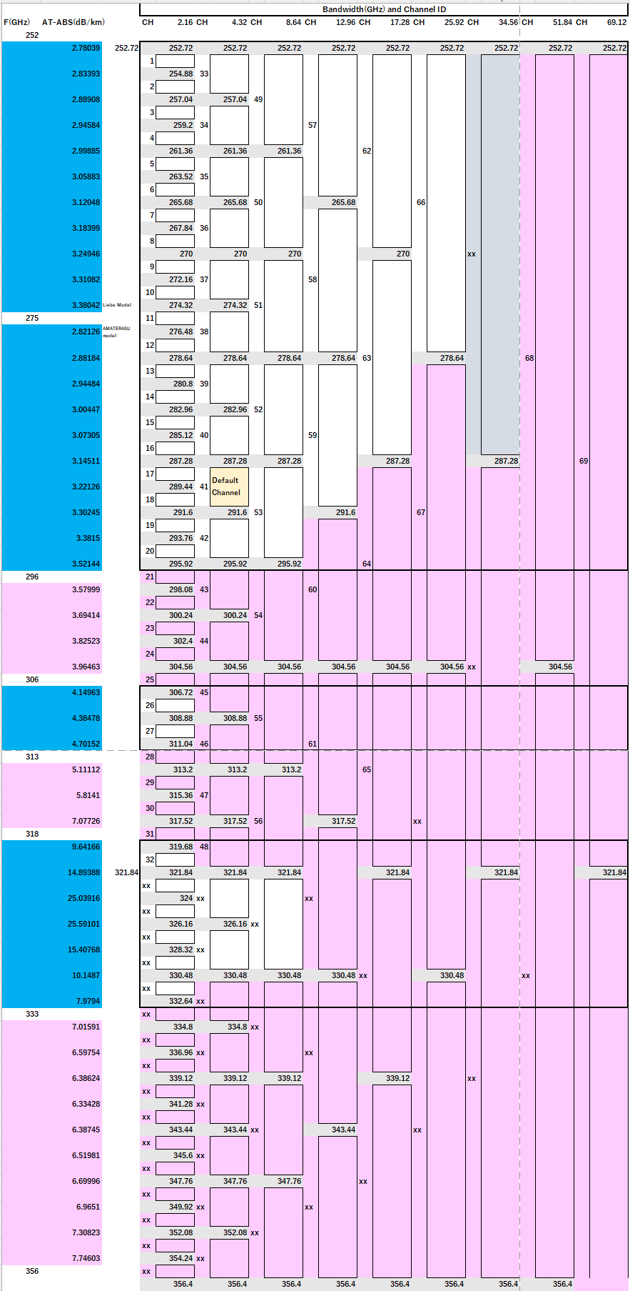
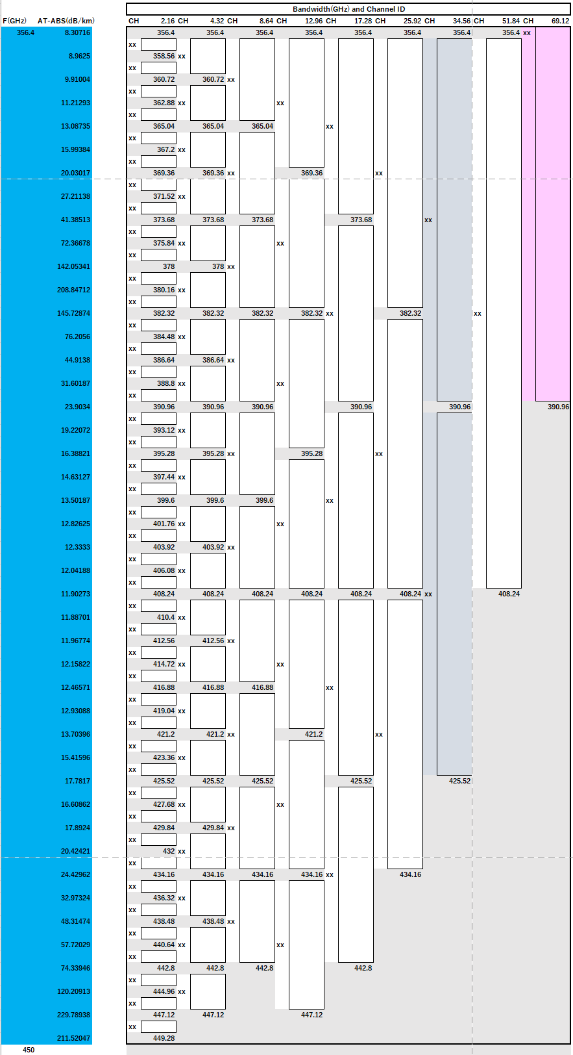
[Proposed channel plan (excluding 69.12GHz width)]
Blue color indicates areas identified as LSM and FS in WRC19.
Pink indicates areas not identified in WRC19 for LSM and FS and the associated affected channels.
Blue-gray indicates the newly proposed 34.56 GHz channels.
[Text from doc.: IEEE 802.15-22-0120-01-03ma]

Slide 8
Identifying where to edit against doc.: IEEE 802.15-22-0120-01-03ma
The following slides show the individual areas where should be edited
In some cases, we proposed the texts and comments for edits

Slide 9
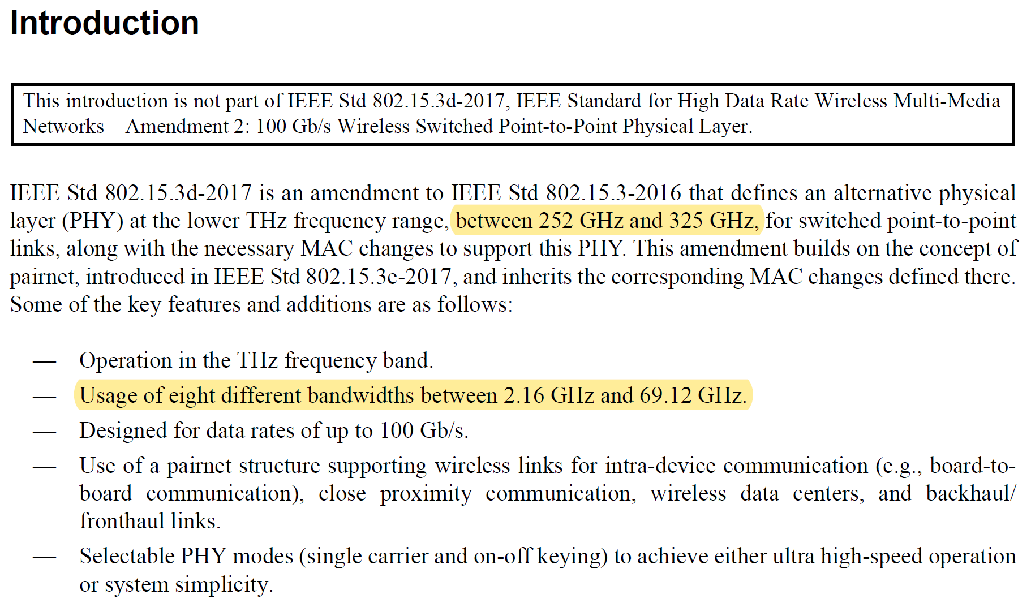
In-Line-Edits @ Page 8, Introduction
Proposed Edit
between 252 and 450 GHz,
Comment
Just leave as it is
In-Line-Edits @ Page 13, 4.5b.1 THz PHY characteristics
Proposed Edit
The frequency band is from 252 to 450 GHz. The THz PHY supports a range of channel bandwidths from 2.16 to 69.12 GHz.

Slide 10
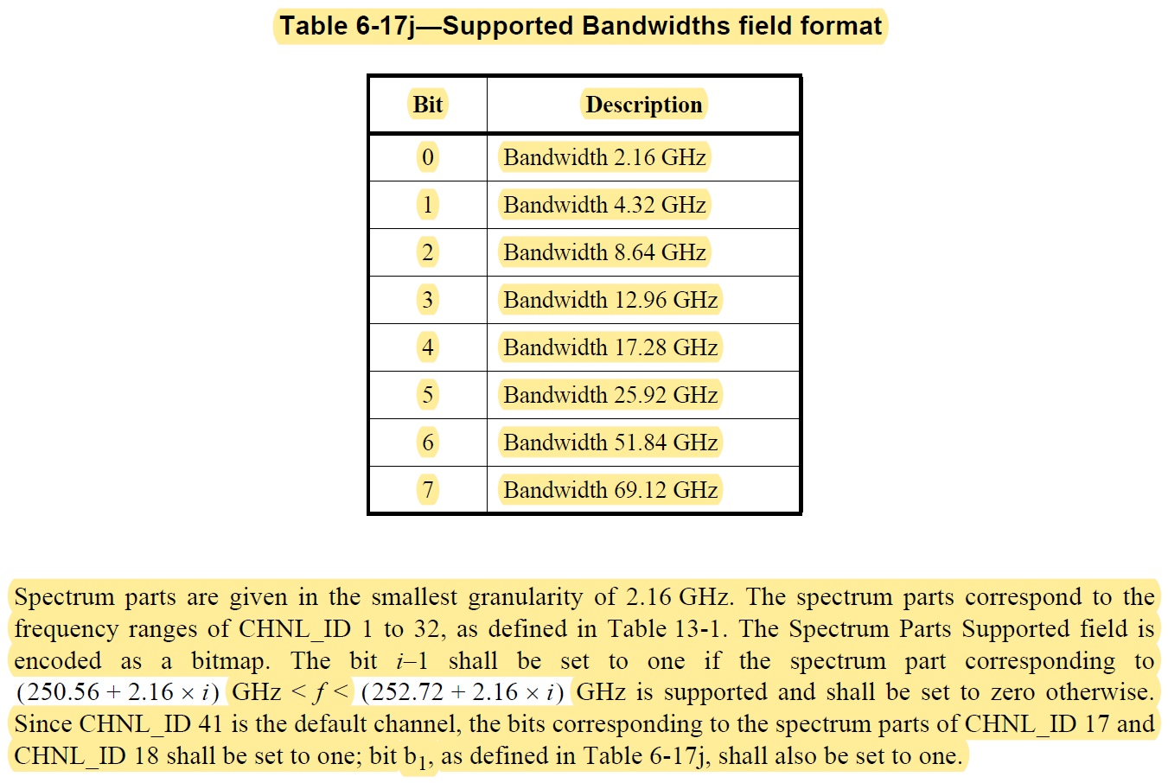
In-Line-Edits @ 6.4.11d THz PRC Capability IE
Page 23, Table 6-17j—Supported Bandwidths field format
Proposed Edit
(Modified to add 34.56 GHz bandwidth channel)
Candidate-1 Candidate-2
Bit | Description
0 | Bandwidth 2.16GHz
1 | Bandwidth 4.32GHz
2 | Bandwidth 8.64GHz
3 | Bandwidth 12.96GHz
4 | Bandwidth 17.28GHz
5 | Bandwidth 25.92GHz
6 | Bandwidth 34.56GHz
7 | Bandwidth 51.84GHz
8 | Bandwidth 69.12GHz
Bit | Description
0 | Bandwidth 2.16GHz
1 | Bandwidth 4.32GHz
2 | Bandwidth 8.64GHz
3 | Bandwidth 12.96GHz
4 | Bandwidth 17.28GHz
5 | Bandwidth 25.92GHz
6 | Bandwidth 51.84GHz
7 | Bandwidth 69.12GHz
8 | Bandwidth 34.56GHz
Comment
These sentences should also be modified to match the above choices.
The above change may affect to Figure 6-87o (6.4.11d THz PRC Capability IE) and Figure 6-87r (6.4.11f THz Pairnet Operation Parameter IE), where Bits:b32-b71 (Spectrum Part Supported)

Slide 11
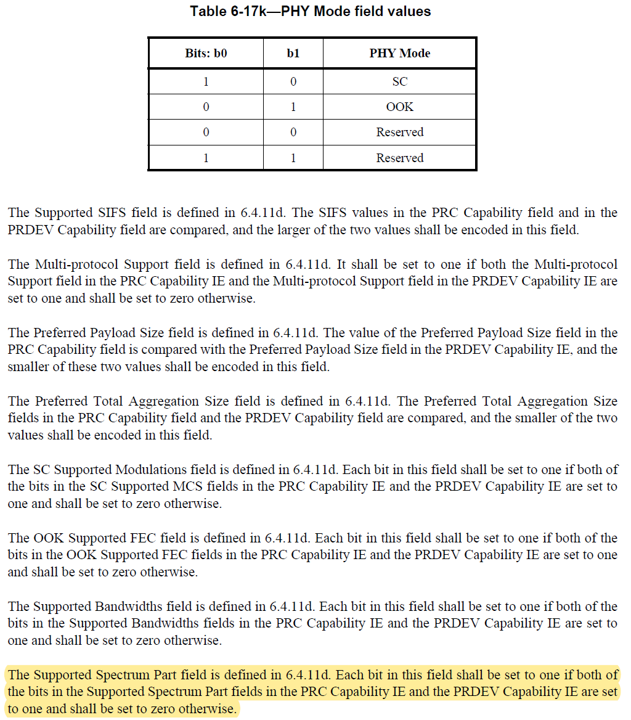
In-Line-Edits @ Page 25, 6.4.11f THz Pairnet Operation Parameter IE
Comment
Need to check if it is OK to keep it as it is.

Slide 12
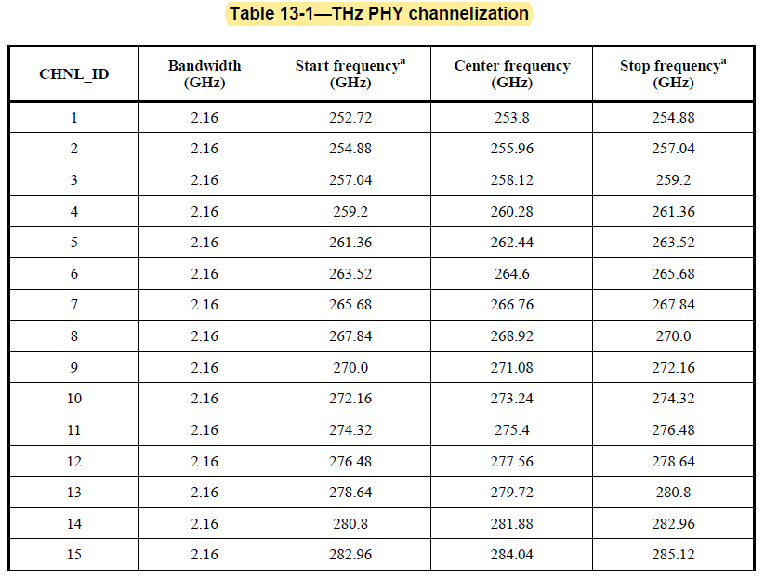
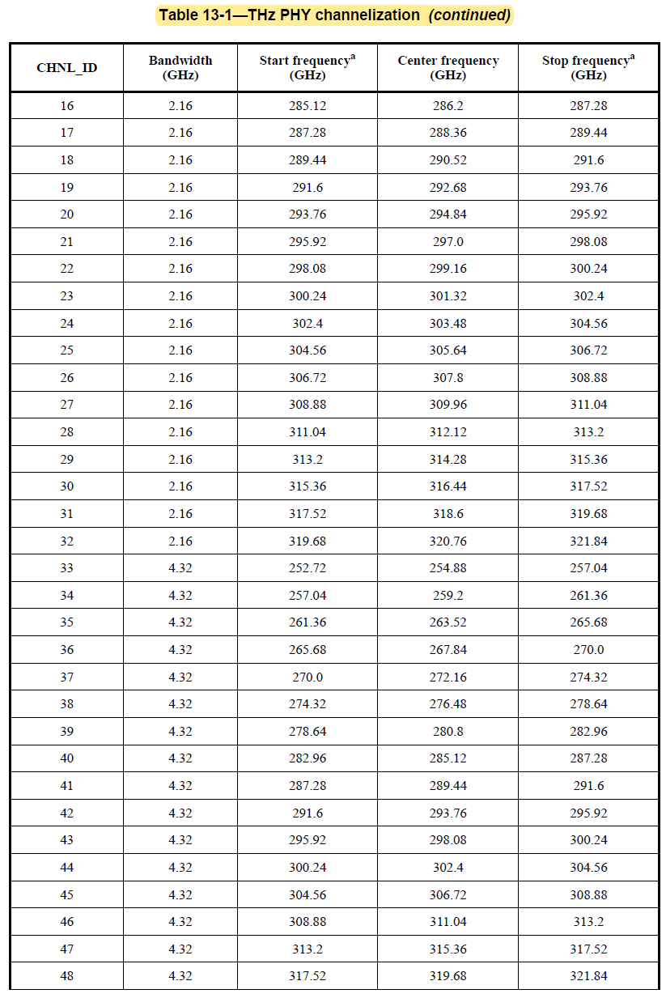
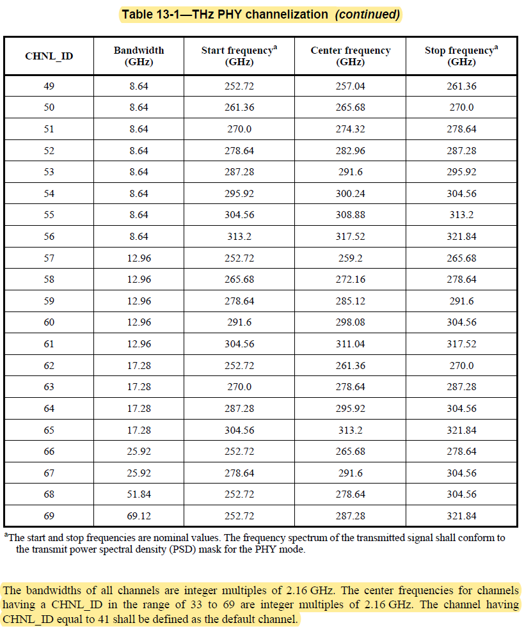
In-Line-Edits @ Page 28-30, 13.1.2 RF channelization,
Table 13-1—THz PHY channelization
Comment
Proposed Edit of the table is in the next slide
Proposed Edit
(Not yet finished, we need to discuss on the default channel.)
The bandwidths of all channels are integer multiples of 2.16 GHz. The center frequencies for channels having a CHNL_ID in the range of 33 to 69 are integer multiples of 2.16 GHz. The channel having CHNL_ID equal to 41 shall be defined as the default channel.

Slide 13
In-Line-Edits @ Page 28-30, 13.1.2 RF channelization,
Table 13-1—THz PHY channelization
(Continued)
Proposed Edit
(Not yet finished)

Slide 14
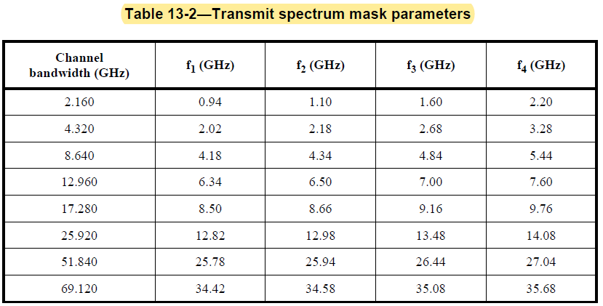
In-Line-Edits @ Page 32, 13.1.3 Transmit PSD mask,
Table 13-2Transmit spectrum mask parameters
Proposed Edit
(Not yet finished)
(Modified to add 34.56 GHz bandwidth channel)
Channel bandwidth (GHz) | f₁ (GHz) | f₂ (GHz) | f₃ (GHz) | f₄ (GHz)
2.160 | 0.94 | 1.10 | 1.60 | 2.20
4.320 | 2.02 | 2.18 | 2.68 | 3.28
8.640 | 4.18 | 4.34 | 4.84 | 5.44
12.960 | 6.34 | 6.50 | 7.00 | 7.60
17.280 | 8.50 | 8.66 | 9.16 | 9.76
25.920 | 12.82 | 12.98 | 13.48 | 14.08
34.560 | ??.?? | ??.?? | ??.?? | ??.??
51.840 | 25.78 | 25.94 | 26.44 | 27.04
69.120 | 34.42 | 34.58 | 35.08 | 35.68

Slide 15
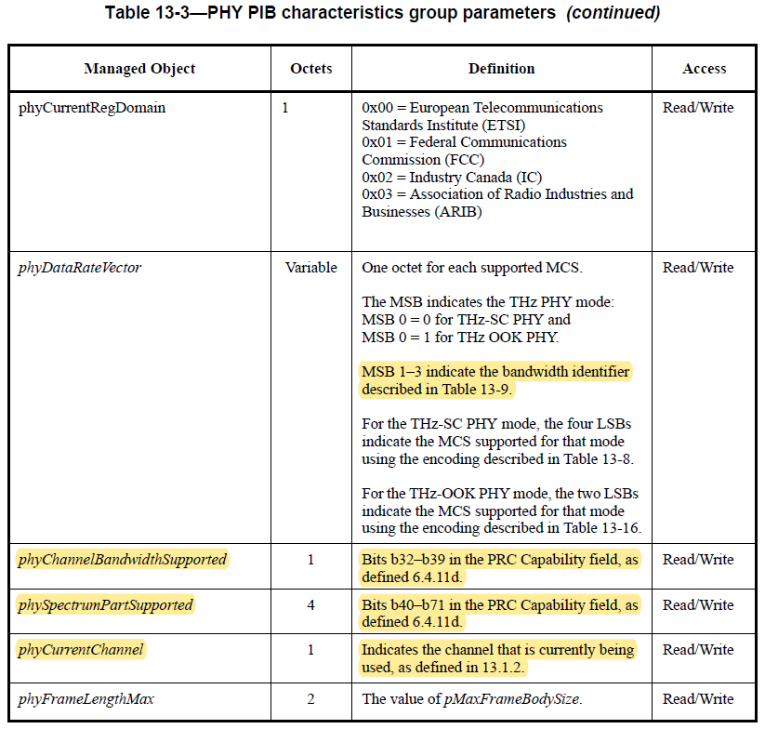
In-Line-Edits @ Page 32-33, 13.1.5.1 THz PHY PIB,
Table 13-3—PHY PIB characteristics group parameters
Proposed Edit
(Not yet finished)
(Modified to add 34.56 GHz bandwidth channel)
Comment
Need to check if it is OK to keep it as it is.

Slide 16
In-Line-Edits @ Page 34, 13.2.1 Channelization of THz-SC PHY,
Proposed Edit
(Not yet finished)
Comment
Need to check if it is OK to keep it as it is.

Slide 17
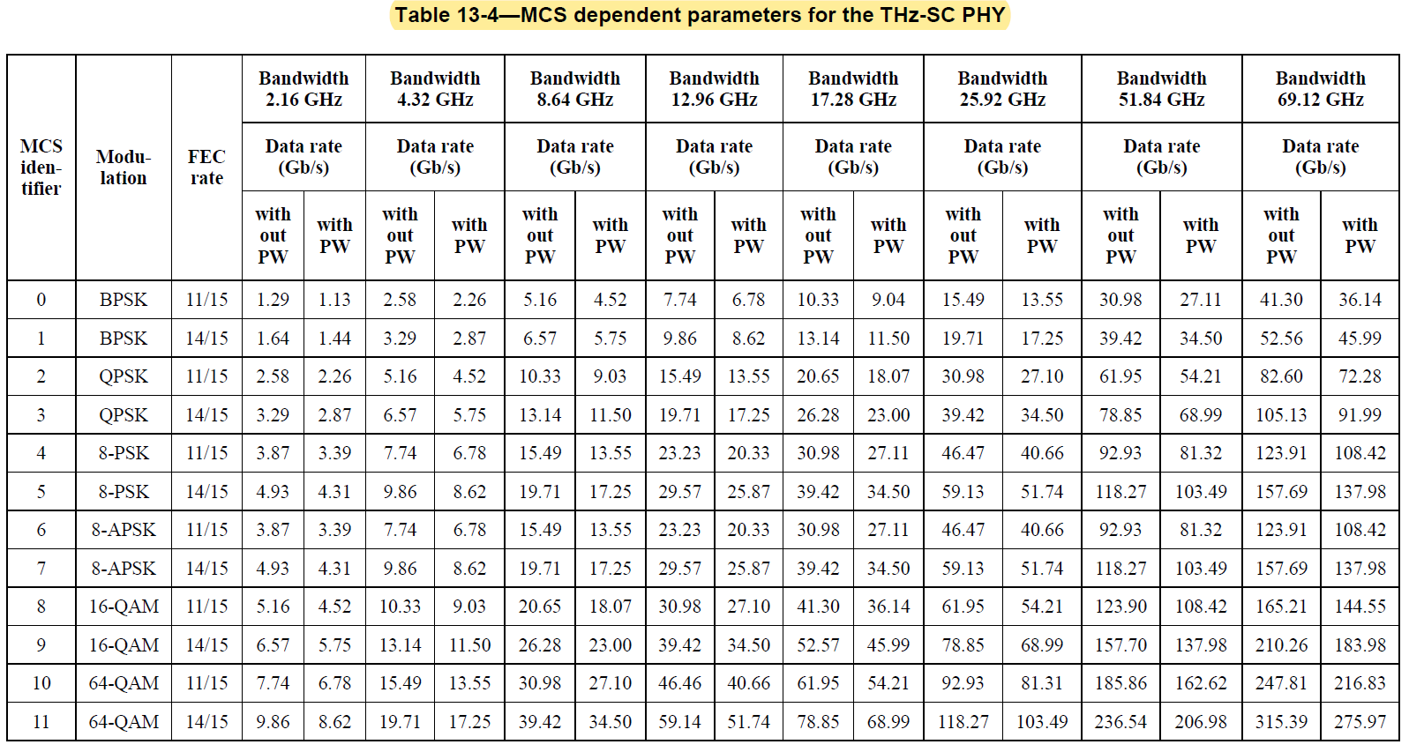
In-Line-Edits @ Page 35-36, 13.2.2.3 MCS dependent parameters
Proposed Edit
(Not yet finished)
(Modified to add 34.56 GHz bandwidth channel)
(Modified to add 16-APSK, 32-APSK,)

Slide 18
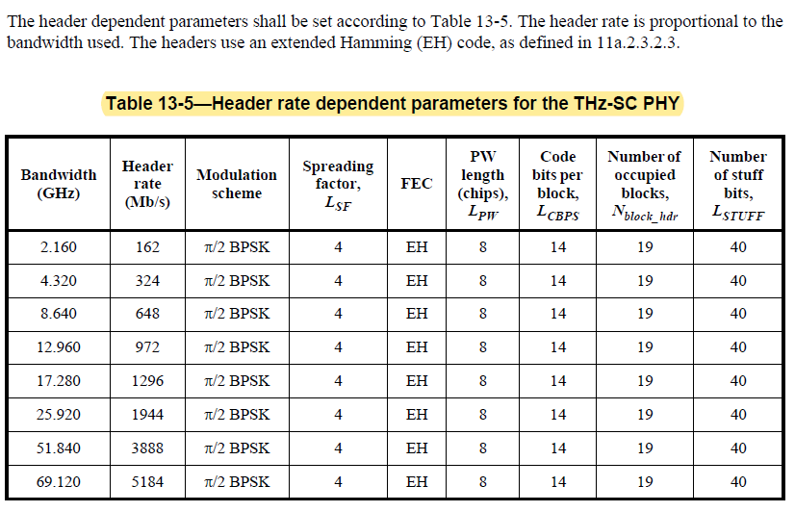
In-Line-Edits @ Page 37, 13.2.2.4 Header dependent parameters,
Table 13-5Header rate dependent parameters for the THz-SC PHY
Proposed Edit
(Not yet finished)
(Modified to add 34.56 GHz bandwidth channel)

Slide 19
In-Line-Edits @ Page 39, 13.2.3.2.1 THz-SC PHY frame header
Proposed Edit
(Not yet finished)
Comment
Need to check if it is OK to keep it as it is.

Slide 20
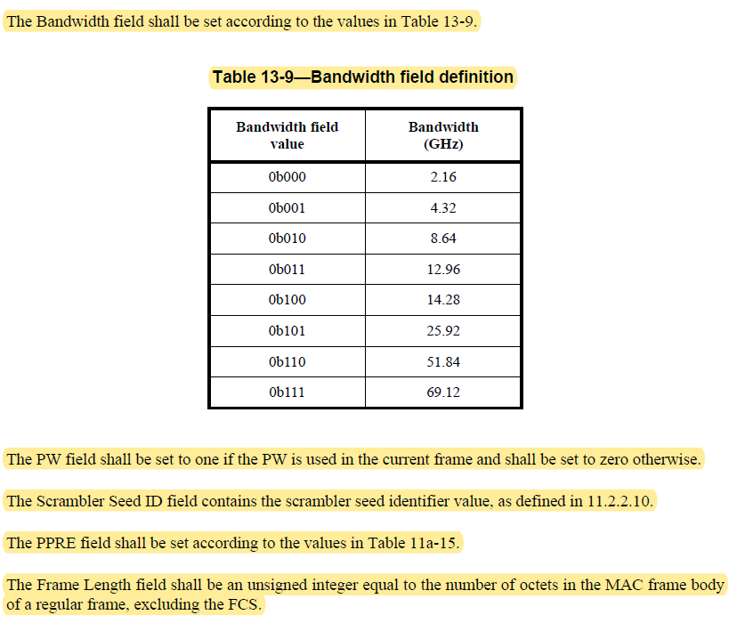
In-Line-Edits @ Page 40, 13.2.3.2.1 THz-SC PHY frame header
Table 13-9Bandwidth field definition
Proposed Edit
(Not yet finished)
(Modified to add 34.56 GHz bandwidth channel)
Comment
Need to check if it is OK to keep it as it is.

Slide 21
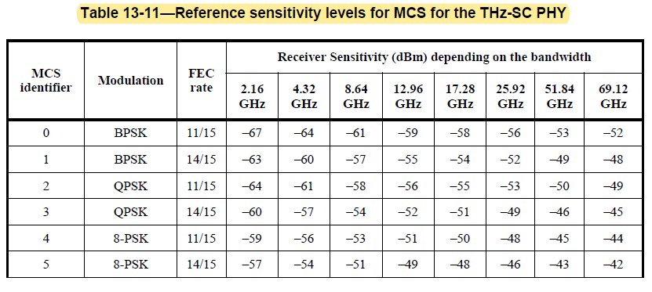
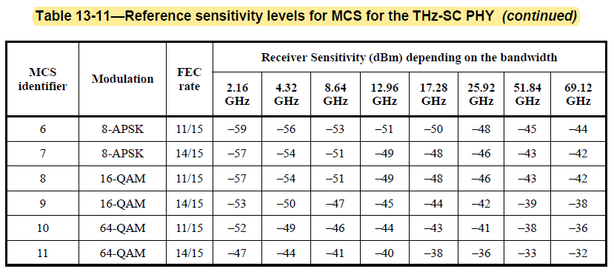
In-Line-Edits @ Page 42-43, 13.2.5.2 Receiver sensitivity
Table 13-11Reference sensitivity levels for MCS for the THz-SC PHY
Proposed Edit
(Not yet finished)
(Modified to add 34.56 GHz bandwidth channel) (Modified to add 16-APSK, 32-APSK,)

Slide 22
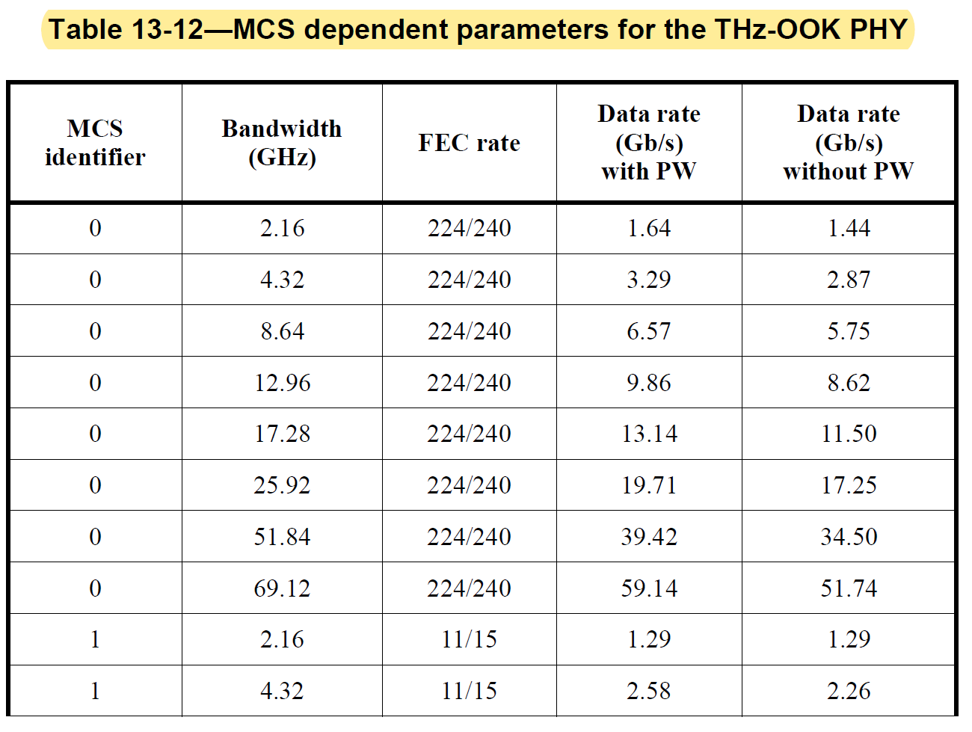
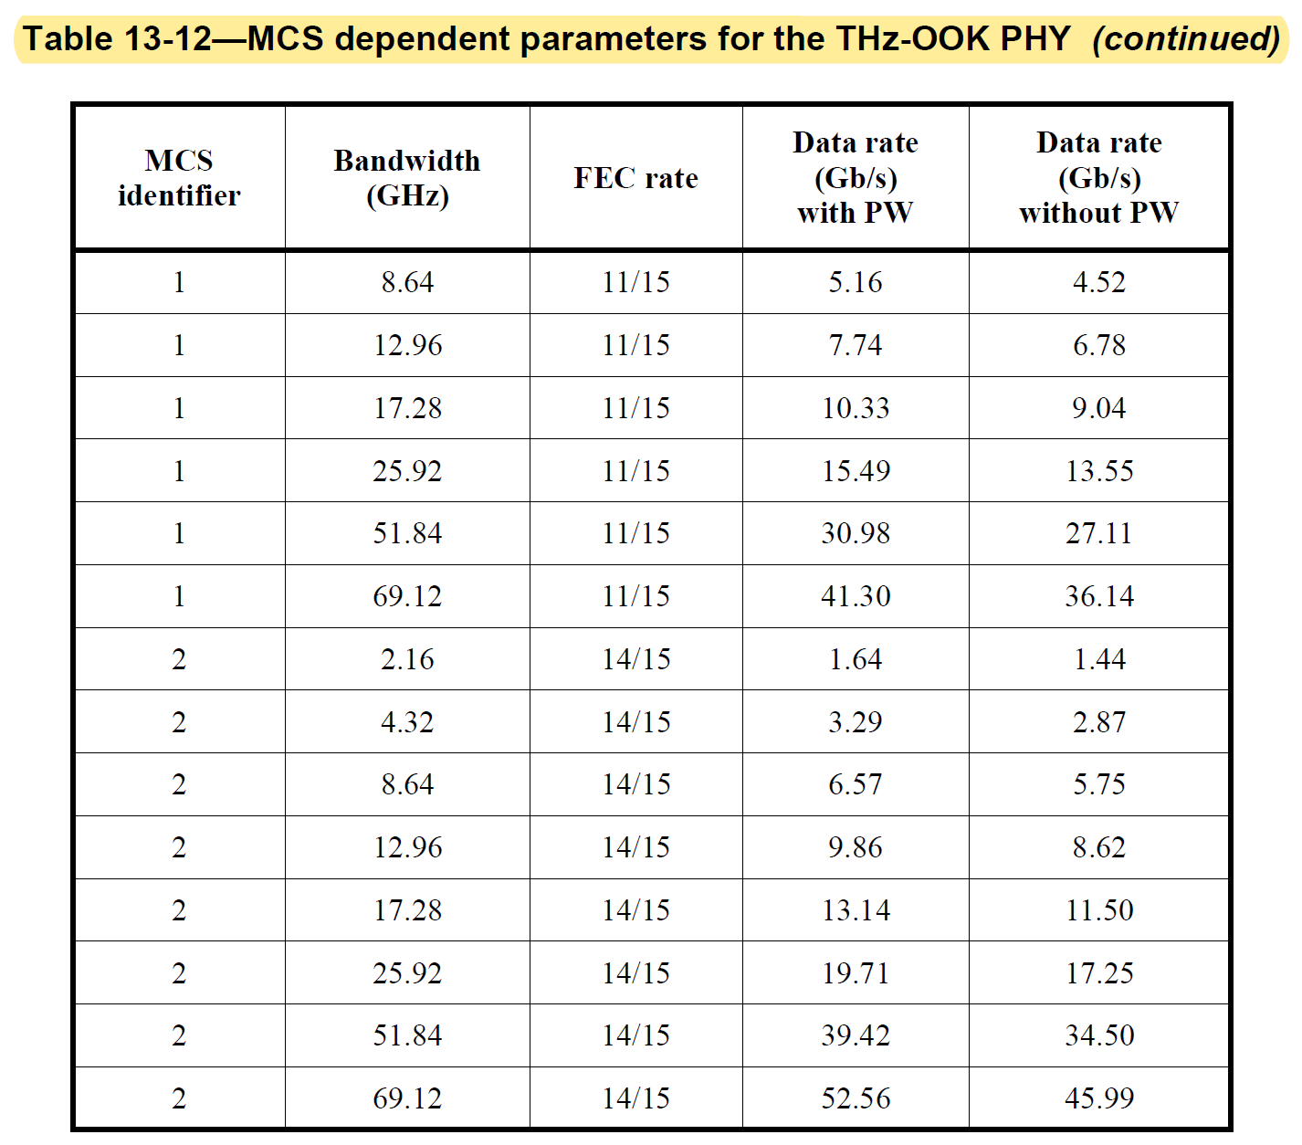
In-Line-Edits @ Page 44-45, 13.3.2.3 MCS dependent parameters
Table 13-12MCS dependent parameters for the THz-OOK PHY
Proposed Edit
(Not yet finished)
(Modified to add 34.56 GHz bandwidth channel)

Slide 23
In-Line-Edits @ Page 44-45, 13.3.2.3 MCS dependent parameters
Table 13-12MCS dependent parameters for the THz-OOK PHY
Proposed Edit
(Not yet finished)
(Modified to add 34.56 GHz bandwidth channel)

Slide 24
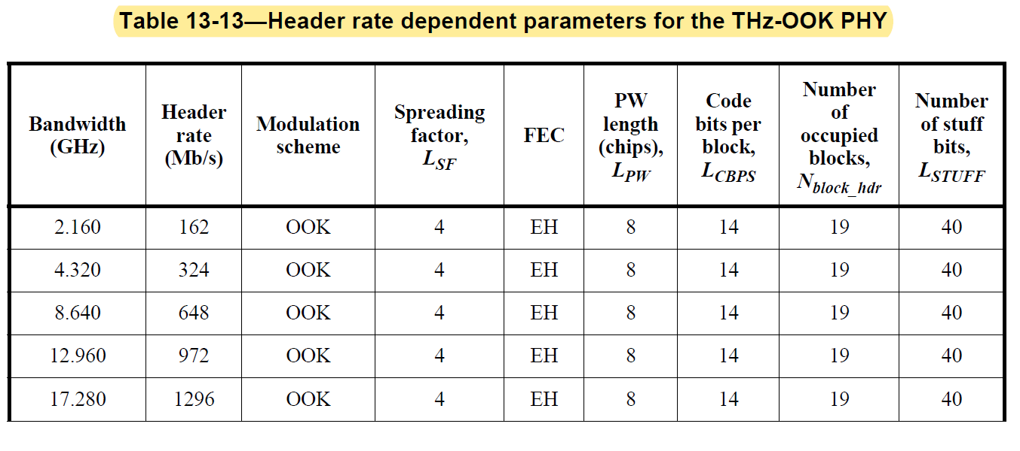
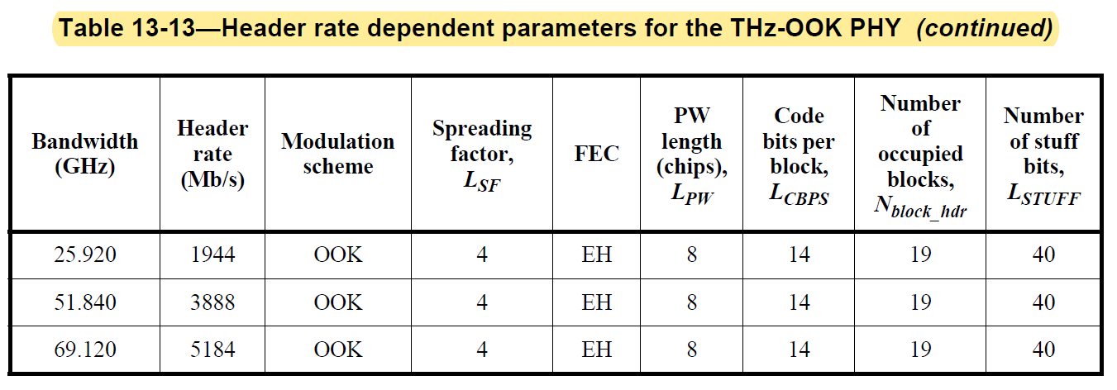
In-Line-Edits @ Page 45-46, 13.3.2.4 Header dependent parameters
Table 13-13Header rate dependent parameters for the THz-OOK PHY
Proposed Edit
(Not yet finished)
(Modified to add 34.56 GHz bandwidth channel)

Slide 25
In-Line-Edits @ Page 48-49, 13.3.5.2 Receiver sensitivity
Table 13-16Reference sensitivity levels for MCS for the THz-OOK PHY
Proposed Edit
(Not yet finished)
(Modified to add 34.56 GHz bandwidth channel)

Slide 26
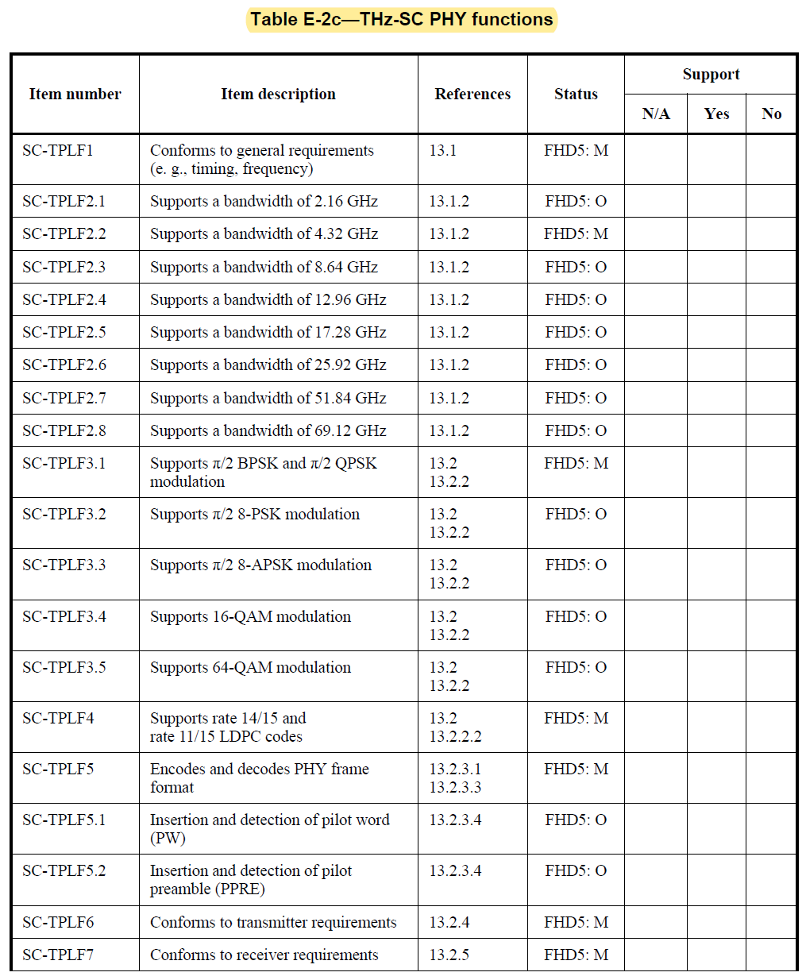
In-Line-Edits @ Page 51-52, E.7.2 PHY functions
Table E-2cTHz-SC PHY functions
Proposed Edit
(Not yet finished)
(Modified to add 34.56 GHz bandwidth channel)
(Modified to add 16-APSK, 32-APSK,)

Slide 27
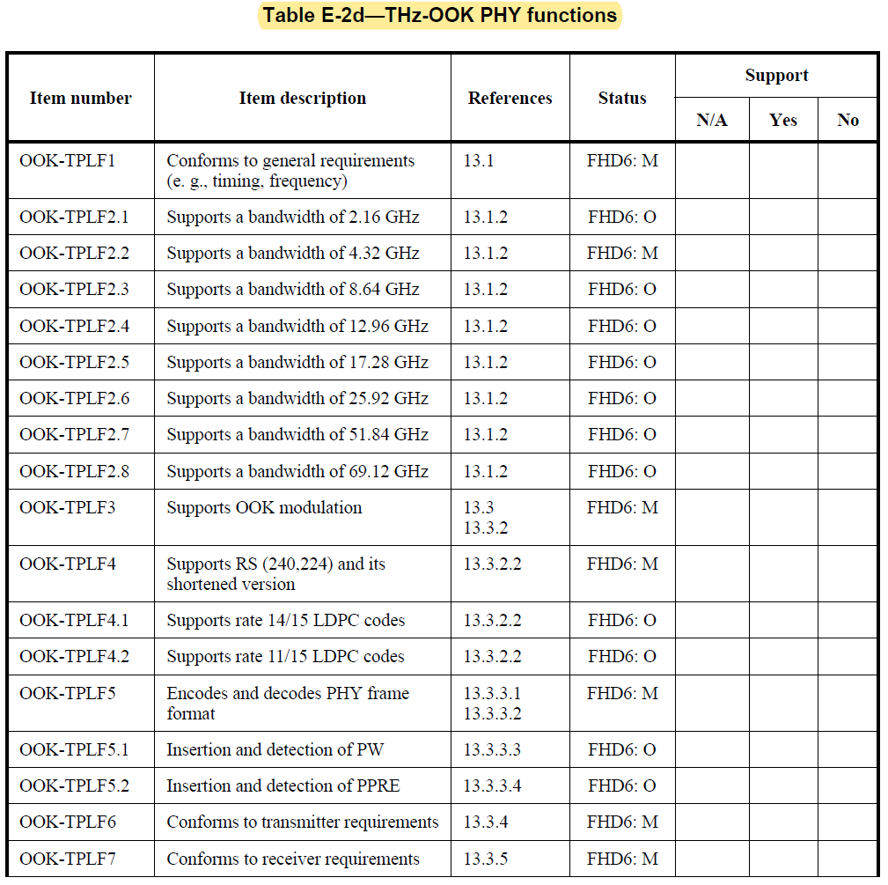
In-Line-Edits @ Page 52-53, E.7.2 PHY functions
Table E-2dTHz-OOK PHY functions
Proposed Edit
(Not yet finished)
(Modified to add 34.56 GHz bandwidth channel)

