Slide 1
Project: IEEE P802.15 Working Group for Wireless Personal Area Networks (WPANs)
Submission Title: [Multi-user interference mitigation]
Date Submitted: [16th May 2022]
Source: [Jarek Niewczas, Billy Verso, Carl Murray, Michael McLaughlin, Igor Dotlic, Ciaran McElroy ] Company [Qorvo, Inc.]
Address [ ]
E-Mail:[billy.verso (at) qorvo.com]
Re: []
Abstract: [Discussion on multi-user interference mitigation]
Purpose: [Discussion on multi-user interference mitigation]
Notice: This document has been prepared to assist the IEEE P802.15. It is offered as a basis for discussion and is not binding on the contributing individual(s) or organization(s). The material in this document is subject to change in form and content after further study. The contributor(s) reserve(s) the right to add, amend or withdraw material contained herein.
Release: The contributor acknowledges and accepts that this contribution becomes the property of IEEE and may be made publicly available by P802.15.

Slide 2
PAR Objective | Proposed Solution (how addressed)
Safeguards so that the high throughput data use cases will not cause significant disruption to low duty-cycle ranging use cases
Interference mitigation techniques to support higher density and higher traffic use cases | Methods to reduce SYNC cross-correlation during collisions
Other coexistence improvement | Fractional sub-channels
Backward compatibility with enhanced ranging capable devices (ERDEVs)
Improved link budget and/or reduced air-time
Additional channels and operating frequencies | Fractional sub-channels
Improvements to accuracy / precision / reliability and interoperability for high-integrity ranging
Reduced complexity and power consumption
Hybrid operation with narrowband signaling to assist UWB
Enhanced native discovery and connection setup mechanisms | Reduced risk of false preamble detections with new sequences
Sensing capabilities to support presence detection and environment mapping
Low-power low-latency streaming
Higher data-rate streaming allowing at least 50 Mbit/s of throughput
Support for peer-to-peer, peer-to-multi-peer, and station-to-infrastructure protocols
Infrastructure synchronization mechanisms

Slide 3
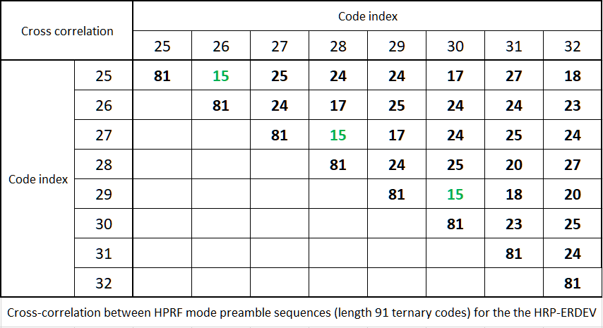
Preamble interference
In 802.15.4z, there is only a limited number of defined preamble sequences and there is a significant cross-correlation between them.
Preamble collisions is a significant concern as the number of UWB deployments increase.
False preamble detection on a sidelobe from another code could lead to increased energy consumption and missing of the true preamble.
High cross-correlations can also inject false correlation peaks resulting in wrong distance estimate.
Several 802.15.4ab contributions have already discussed this issue, for example:
15-21-0590-00-04ab-ranging-qos.pptx proposed chip rate clock changing in 800ppm steps
15-21-0377-02-04ab-preamble-codes-for-data-communications.pptx proposed using longer M-sequences

Slide 4
Fractional (sub-) channels
The (1) proposal keeps the carrier frequency untouched; both chip rate and carrier clocks are derived from same reference (i.e., no change compared to 15.4z). That means that ratio between the carrier and chip rate clocks will be different for each „sub-channel”.
The cross-correlation will be reduced by different symbol drift rates.
However, the proposed step size of 800ppm is too small. At higher SNR, a preamble detection can be accomplished already within 2-8 symbols (~2-6µs in HPRF). In that time-frame, at 800ppm chip rate offset, the colliding preamble will shift in time by only 1.5-5ns, spreading the energy in the narrow window. Considering that the pulse width is ~3-4ns, such slow drift will still introduce high cross-correlation peak. A much higher ppm step size (at least 5-10x) would be needed, but this will reduce the number of available sub-channels.

Slide 5
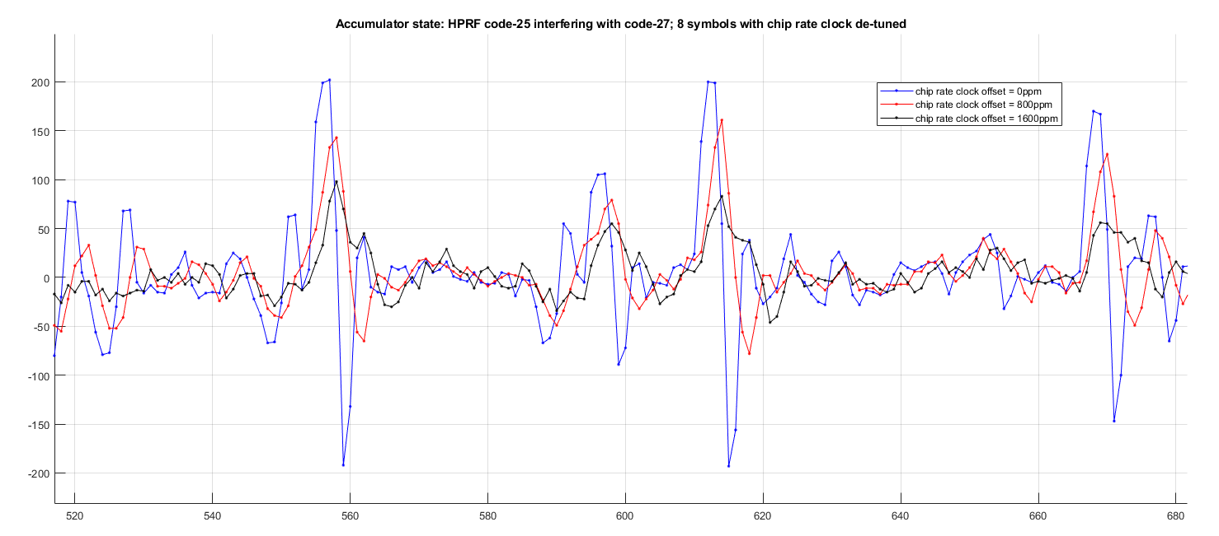
Fractional (sub-) channels

Slide 6
Fractional (sub-) channels
Alternative methods are hereby proposed:
changing both the carrier and chip rate clock (ratio between carrier and chip clocks would be constant)
changing only the carrier clock, leaving the chip clock unchanged
With 800ppm carrier difference (compared to the receiver’s clock), the incoming pulses will change their complex phase so quickly that the energy will average to nearly zero. Example: 120ppm carrier difference causes full 360-degree signal phase rotation within 1µs.

Slide 7
Variable-length random preambles (VRP)
In HRP UWB startup, the SYNC sequence needs to use repetitive symbols, because the receiver does not know the exact signal arrival time and the energy of a single symbol is insufficient for detection.
Due to the repetitions, colliding pulses from other UWB transmitters cause correlation sidelobes peaks at fixed positions.
The problem can be avoided if different users used slightly different symbol lengths, for example, ..,125,126,127,128,129,130,131,132,133,...
The problem is, there are no known flexible-length periodic sequences with good autocorrelation properties.
Let’s check the repetitive pseudo-random symbols

Slide 8
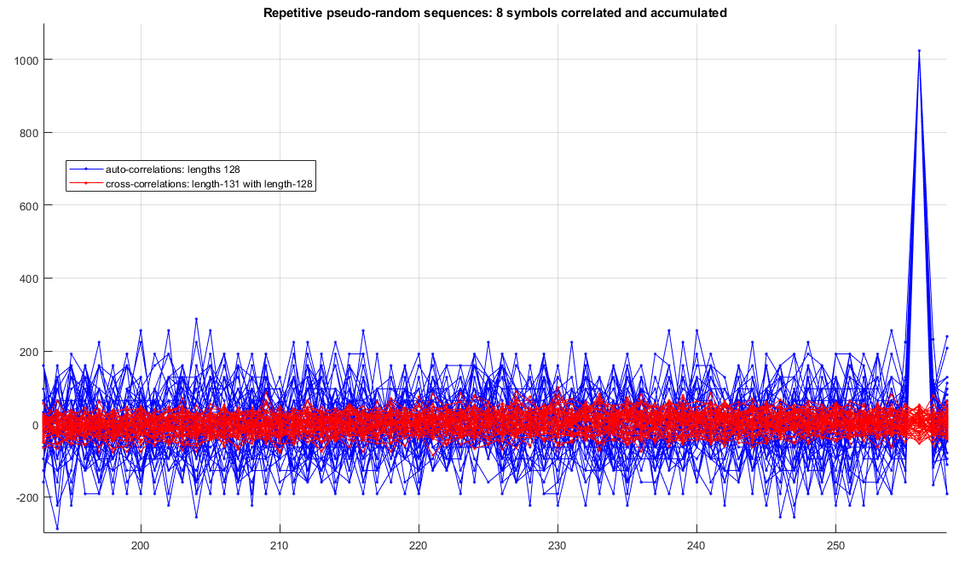
VRP – cross-correlations
Example presents 8 symbols accumulated, but if more symbols were accumulated, cross-correlations’ relative sidelobe amplitude would drop.

Slide 9
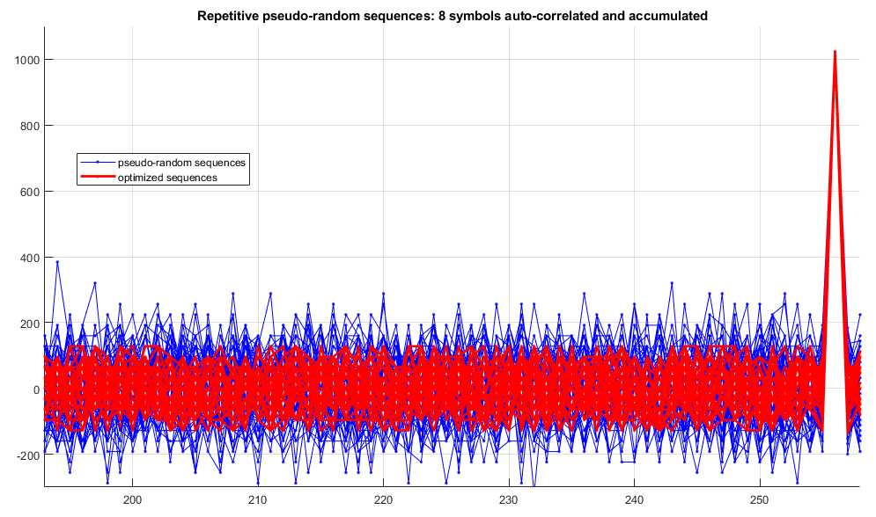
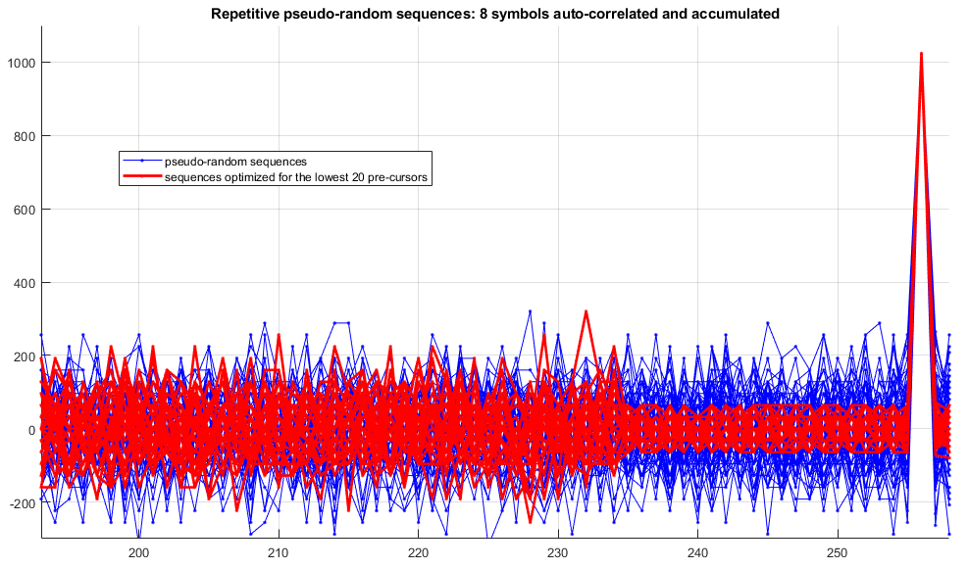
VRP - sidelobes
Pseudo-random sequences, especially the repeated ones, have pretty poor autocorrelation properties (high sidelobes). However, some sequences are better than others and the best sets can be selected.
It is possible to select sequences with relatively low sidelobes across the whole precursor area or concentrate on the immediate precursor region before the main correlation peak.

Slide 10
Variable-length preambles
Pseudo random sequences, even the selected, optimized ones, may still have quite high sidelobes. However, with STS being widely used, importance of very low-sidelobes in the initial SYNC sequence is becoming less important.
As such, pseudo-random sequences could be used for:
initial preamble detection and carrier startup/lock and for SFD detection
in non-ranging data packets. Even with sidelobes, channel estimate is sufficiently good for data demodulation
applications where high 1st path sensitivity from the initial SYNC sequence is not the key requirement (or where highly sensitive 1st path detection is performed based on STS)
In multi-millisecond (MMS) technique to minimize interference from other users.
Alternatively, they could be used as a unique packet detection sequence.
Such wake-up sequence would reduce the rate of false alarms, thus saving energy.

