Slide 1
Project: IEEE P802.15 Working Group for Wireless Specialty Networks (WSN)
Submission Title: [The Advantages of UWB Wakeup]
Date Submitted: [16th May 2022]
Source: [Chitao Goe, Michael Mc Laughlin, Billy Verso, Carl Murray] Affiliation [Qorvo]
Abstract: ​[Input to the technical requirements discussion for the 4ab project]
Purpose: [Highlight the advantages of UWB wakeup radio over NB solutions]
Notice: This document has been prepared to assist the IEEE P802.15. It is offered as a basis for discussion and is not binding on the contributing individual(s) or organization(s). The material in this document is subject to change in form and content after further study. The contributor(s) reserve(s) the right to add, amend or withdraw material contained herein.
Release: The contributor acknowledges and accepts that this contribution becomes the property of IEEE and may be made publicly available by P802.15.
Notes:
Jul 12, 2010
Page 1

Slide 2
PAR Objective
Safeguards so that the high throughput data use cases will not cause significant disruption to low duty-cycle ranging use cases
Interference mitigation techniques to support higher density and higher traffic use cases
Other coexistence improvement
Backward compatibility with enhanced ranging capable devices (ERDEV
Improved link budget and/or reduced air-time
Additional channels and operating frequencies
Improvements to accuracy / precision / reliability and interoperability for high-integrity ranging
Reduced complexity and power consumption | Proposal significantly reduce the power consumption of the companion radio for wakeup
Hybrid operation with narrowband signaling to assist UWB
Enhanced native discovery and connection setup mechanisms | Allows a UWB transmitter to address individual devices and to wake them up
Sensing capabilities to support presence detection and environment mapping
Low-power low-latency streaming
Higher data-rate streaming allowing at least 50 Mbit/s of throughput
Support for peer-to-peer, peer-to-multi-peer, and station-to-infrastructure protocols
Infrastructure synchronization mechanisms

Slide 3
The Advantages of UWB Wakeup
A Low-Power Wake-Up Radio
(LP-WUR)

Slide 4
Introduction
The major aim of UWB wakeup
To initiate communication to battery-powered devices which require years of battery life
UWB wakeup radio can achieve high link margin and very low power
In our previous contribution [1], a design concept backed up by 22nm CMOS circuit simulation has been presented
In this contribution, a review of BLE and Wi-Fi wakeup radio designs from University and Industry is carried out and the advantages of UWB wakeup radio are highlighted.
[1] Michael Mclaughlin et al., “UWB Wakeup Signalling,“, doc.:<15-21-0557-00-04ab>.

Slide 5
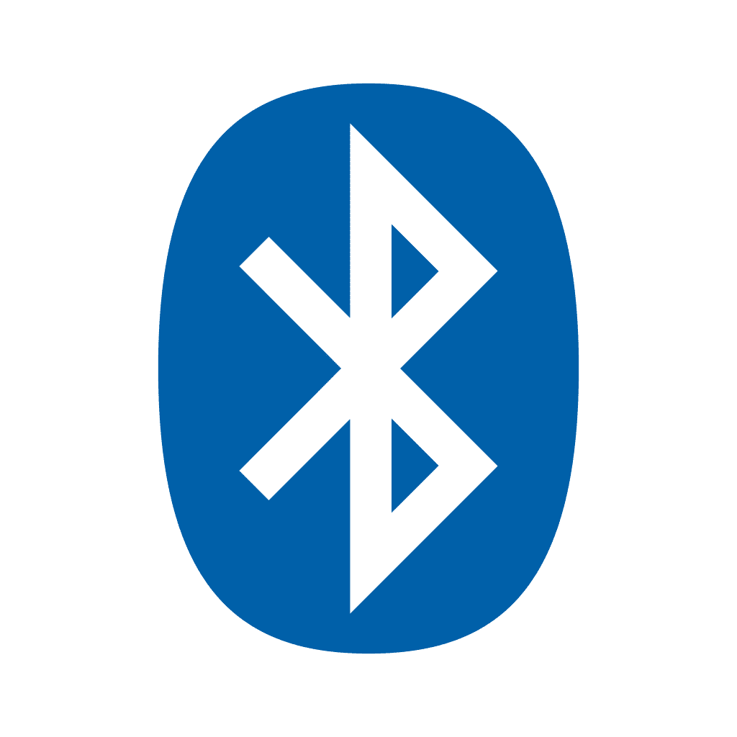
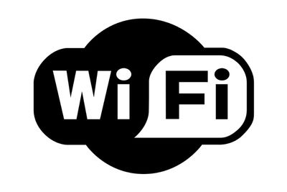
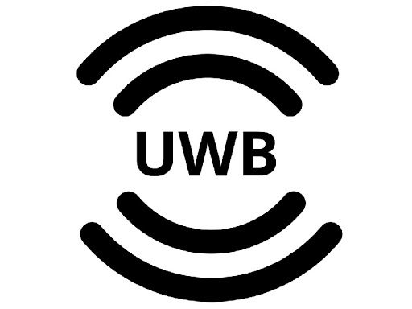
Initiate Comms to Battery-Powered Devices
LP-WUR approach to Escape the Duty-Cycle Trap
Bluetooth Low Energy
Approach: Back-channel (BC) communication
Wi-Fi
Approach: 802.11ba
UWB
Approach: currently lack of LP-WUR, except a proposal [1]
Duty-Cycle Trap [2]
  To increase battery life, a device needs to sleep more → increased latency
  To receive data with low latency, a device needs to sleep less → shorter battery life
[2] M. Park, S. Azizi, R. Stacey, and J. Liu, Low-Power Wake-Up Receiver (LP-WUR) for 802.11, IEEE Standard 802.11-15/1307r1, Nov. 2015.

Slide 6
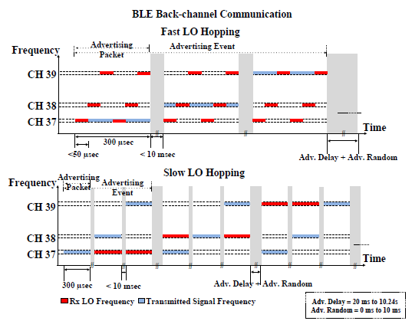
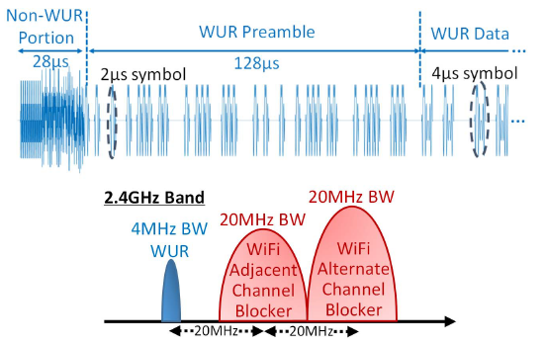
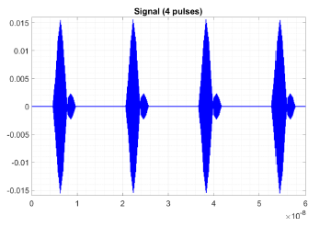
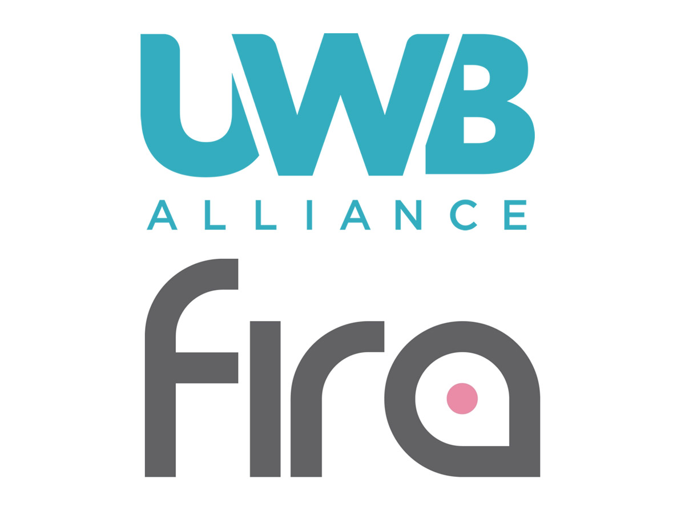
WUR Design Constraints to Achieve Low Power
(1) Standard Compatible Wakeup Signal
UWB wakeup signal enables low power demodulation
Bluetooth Low Energy
Non-standardized wakeup signal
A sub-mW receiver to demodulate the GFSK symbols is not feasible
Back Channel Communication[3]→ Wakeup address encoded into the sequence order of advertising packet, channels and event
Wi-Fi
Standardized wakeup signal
MC-OOK with ¼ rate Manchester coding 64-bit long
WUR LDR frame duration: 920 us
[4]
[5]
UWB
One bit encoded to 4µs of 4z like, STS sequence [1]
Multi-bit preamble and 16-bit address
[3] N. E. Roberts et al., "26.8 A 236nW −56.5dBm-sensitivity bluetooth low-energy wakeup receiver with energy harvesting in 65nm CMOS," 2016 IEEE International Solid-State Circuits Conference (ISSCC), 2016
[4] A. Alghaihab, J. Breiholz, H. Kim, B. Calhoun and D. D. Wentzloff, "A 150 µW −57.5 dBm-Sensitivity Bluetooth Low-Energy Back-Channel Receiver with LO Frequency Hopping," 2018 IEEE Radio Frequency Integrated Circuits Symposium (RFIC), 2018
[5] R. Liu et al., "An 802.11ba-Based Wake-Up Radio Receiver With Wi-Fi Transceiver Integration," in IEEE Journal of Solid-State Circuits, vol. 55, no. 5, pp. 1151-1164, May 2020
[1]

Slide 7
WUR Design Constraints to Achieve Low Power
(2) Interference Resiliency
UWB requires less stringent Interference Resiliency
Bluetooth Low Energy
The 2.4 GHz ISM band is highly congested by multiple wireless standards
Enhance interference resiliency by compromising power consumption
Wi-Fi
In congested 2.4G and 5G channel, it is very restricted to schedule available airtime for wakeup call
Operating in crowded band, LP-WUR has to achieve very good signal-to interference ratio in order to meet sensitivity target by tolerating a very strong adjacent channel Wi-Fi blocker (-40dBm)
UWB
8 GHz band is less congested
Potential narrow-band jammers are in other far away channels

Slide 8
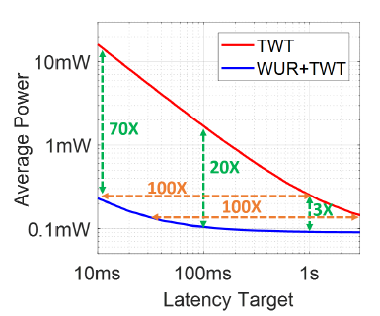
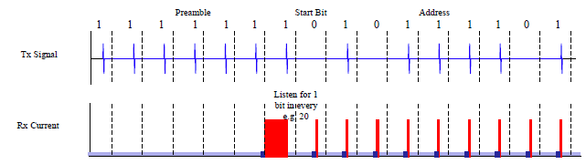
WUR Design Constraints to Achieve Low Power
(3) Duty Cycle Operation
UWB can effectively take advantage of low duty cycle operation
Bluetooth Low Energy
Lack of dedicated protocol to schedule duty cycle for the listen and wakeup time
Crowded channel restricts low duty cycle operation → BLE Tx cannot occupy large portion of airtime to reduce the LP-WUR listen time
Wi-Fi
Coordinated Target Wake Time (TWT) protocol (AP involved) to schedule (not always possible) the listening and wakeup (TWT doesn’t guarantee STA wakes up when the wakeup call arrives)
Constrained air-time prevents low duty cycle operation
UWB
Uncoordinated protocol (suits for event-driven traffic)
TX sends one 4 µs burst for per 1 ms and consecutively for twenty 1’s preamble while WUR listens 1ms in every 20 ms (5% duty cycle)
Sequence length and listening time can be further traded off for latency and power consumption
[4]
[1]

Slide 9
LP-WUR Design Trade-offs
Power, Latency, Sensitivity and Selectivity
Sensitivity
Latency
High
Selectivity
High Power
WiFi
High gain amp
High order filter
Always On
Mixer w/ LO
High order filter
Channel Hopping
BLE
Duty Cycle
Architecture
Building Block
Packet Level
Bit Level
UWB
Low gain amp
Relaxed filter
Low-Power
Envelop Detector
Low Power

Slide 10
Review on BLE and UWB LP-WUR
Publications | Sensitivity (dBm) | Link Margin (dB) | Power Consumption (µW) | Battery Life (year) | Signal to Interference Ratio (dB) | Latency (ms)
UWB - [15-21-0557] | -110 | 96 | 10 | 4 | -31 | 50
CICC’ 2018 - MIT | -80 | 90 | 230 | 0.17 | Not Reported | 0.2
JSSC’ 2019 - UV | -82.2 | 92.2 | 1200 | 0.03 | -10 | 0.2
JSSC’ 2021 - UCSD | -85 | 95 | 220 | 0.18 | -6 | 0.2
JSSC’ 2021 - UCSD | -92 | 102 | 352 | 0.11 | -12.5 | 0.2
Notes: 1) Link Margin for BLE WUR: BLE back-channel communication advertising packet Tx power=+10dBm.
2) Signal to Interference Ratio: Adjacent Channel BLE Jammer@2MHz; For UWB simulated by 20MHz Wi-Fi Jammer@8MHz.
3) Power Consumption: for UWB, calculated by 3% UWB Duty cycle; for BLE WUR 100% duty cycle.
4) Battery Life: details in backup slide 1.
5) Latency: for UWB, 3% duty cycle worse case latency that preamble is detected at the 33ms; for BLE, its 100% duty cycle operation so the latency is only the reception time to demodulate the advertising packet/event.
References
CICC’ 2018 : M. R. Abdelhamid, A. Paidimarri and A. P. Chandrakasan, "A −80dBm BLE-compliant, FSK wake-up receiver with system and within-bit dutycycling for scalable power and latency," 2018 IEEE Custom Integrated Circuits Conference (CICC), 2018.
JSSC’ 2019 : A. Alghaihab, Y. Shi, J. Breiholz, H. Kim, B. H. Calhoun and D. D. Wentzloff, "Enhanced Interference Rejection Bluetooth Low-Energy Back-Channel Receiver With LO Frequency Hopping," in IEEE Journal of Solid-State Circuits, vol. 54, no. 7, pp. 2019-2027, July 2019.
JSSC’ 2021 : P. -H. P. Wang and P. P. Mercier, "An Interference-Resilient BLE-Compatible Wake-Up Receiver Employing Single-Die Multi-Channel FBAR-Based Filtering and a 4-D Wake-Up Signature," in IEEE Journal of Solid-State Circuits, vol. 56, no. 2, pp. 416-426, Feb. 2021.
JSSC’ 2021 : P. -H. P. Wang and P. P. Mercier, "A Dual-Mode Wi-Fi/BLE Wake-Up Receiver," in IEEE Journal of Solid-State Circuits, vol. 56, no. 4, pp. 1288-1298, April 2021.

Slide 11
Review on Wi-Fi and UWB LP-WUR
Publications | Sensitivity (dBm) | Link Margin (dB) | Power Consumption (µW) | Battery Life (year) | Signal to Interference Ratio (dB) | Latency (ms)
UWB - [15-21-0557] | -110 | 96 | 10 | 4 | -33 | 50
VLSI’ 2019 - Intel | -92.4 | 105.4 | 340 | 0.12 | -32.4 | 0.92
TMTT’ 2019 - UM | -83 | 96 | 220 | 0.18 | -20 | 0.92
RFIC’ 2020 - UV | -91.5 | 104.5 | 578 | 0.07 | -45 | 0.92
JSSC’ 2020 - Intel | -92.6 | 105.6 | 495 | 0.08 | -49 | 0.92
Notes: 1) Link Margin: for the 2.4GHz WiFi OFDM Tx max power=5 mW/MHz, the 4MHz WUR max Tx power=+13 dBm.
2) Signal to Interference Ratio: the SIR tested (simulated for UWB) by Wi-Fi Jammer Adjacent Channel @25MHz.
3) Power Consumption: for UWB, calculated by 3% UWB duty cycle; for WiFi WUR 100% duty cycle.
4) Battery Life: details in backup slide 1.
5) Latency: for UWB, 3% duty cycle worse case latency that preamble is detected at the 33ms; for Wi-Fi, it’s 100% duty cycle operation, the latency is only the reception time to demodulate the WUR frame.
References:
VLSI’ 2019 : R. Dorrance et al., "An Ultra-Low Power, Fully Integrated Wake-Up Receiver and Digital Baseband with All-Digital Impairment Correction and -92.4dBm Sensitivity for 802.11ba," 2019 Symposium on VLSI Circuits, 2019.
TMTT’ 2019 : J. Im, H. Kim and D. D. Wentzloff, "A 220- u W −83-dBm 5.8-GHz Third-Harmonic Passive Mixer-First LP-WUR for IEEE 802.11ba," in IEEE Transactions on Microwave Theory and Techniques, vol. 67, no. 7, pp. 2537-2545, July 2019.
RFIC’ 2020 : J. Im, J. Breiholz, S. Li, B. Calhoun and D. D. Wenzloff, "A Fully Integrated 0.2V 802.11ba Wake-Up Receiver with -91.5dBm Sensitivity," 2020 IEEE Radio Frequency Integrated Circuits Symposium (RFIC), 2020.
JSSC’ 2020 : R. Liu et al., "An 802.11ba-Based Wake-Up Radio Receiver With Wi-Fi Transceiver Integration," in IEEE Journal of Solid-State Circuits, vol. 55, no. 5, pp. 1151-1164, May 2020.

Slide 12
Summary
Today’s ubiquitous BLE and Wi-Fi networks adopt LP-WUR to initiate communication to battery-powered devices but make trade-offs between low power consumption, latency and interference resilience
Today’s UWB doesn’t have a wakeup radio solution
The UWB wakeup proposal [1] not only escapes the duty-cycle trap but also achieves very low power consumption (4-years battery life) without compromising the interference resiliency, sensitivity and latency
  Operating in much less congested 8 GHz band facilitates low duty cycle operation
  Simple wakeup signature enables the implementation of low power architecture
The proposal paves the way of applying UWB wakeup as companion radio to wake up BLE, Wi-Fi and UWB devices

Slide 13
Backup Slides

Slide 14
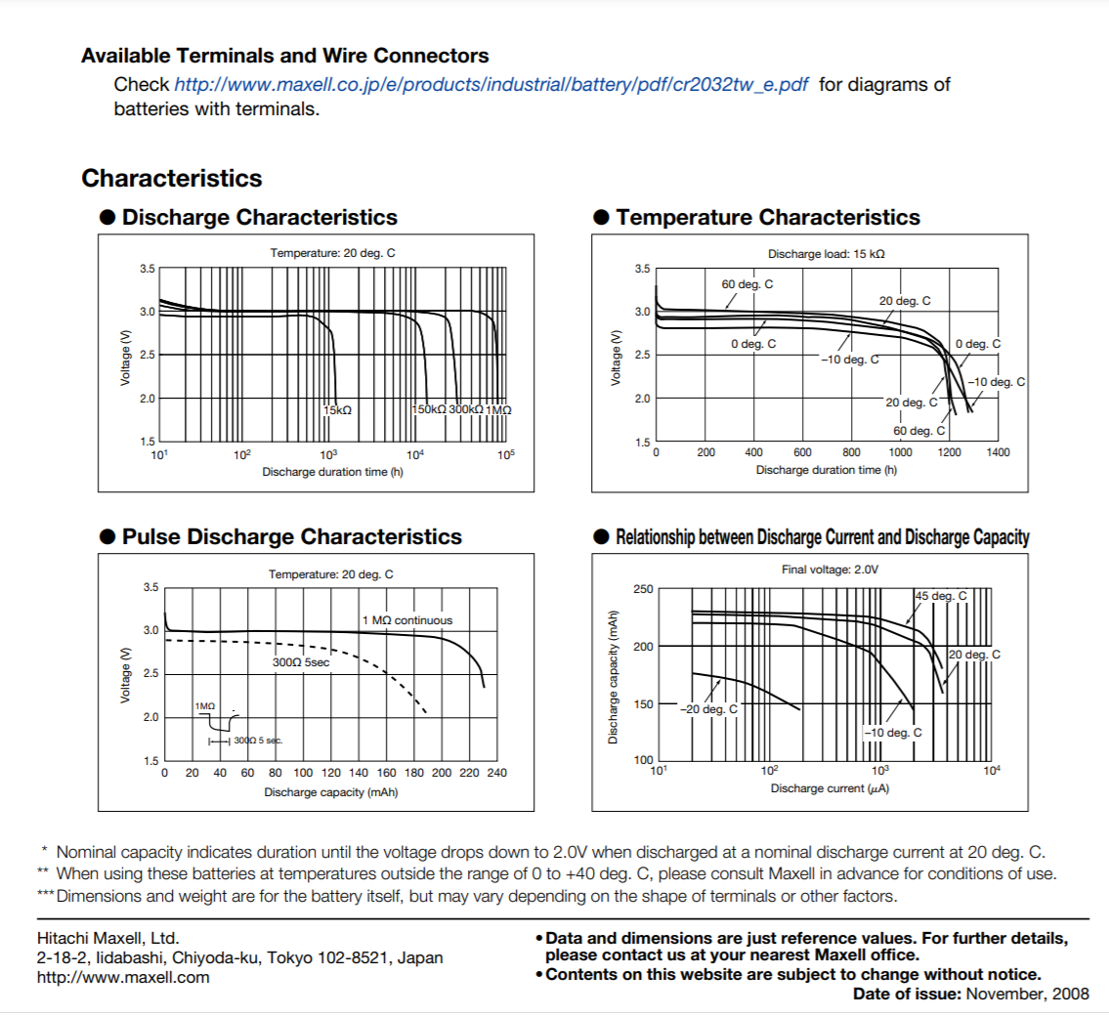
1. How much current can WuRx draw?

