Slide 1
Project: IEEE P802.15 Working Group for Wireless Personal Area Networks (WPANs)
Submission Title: [Deterministic STS Field for Sensing]
Date Submitted: [12 May 2022]
Source: [Igor Dotlic and Michael McLaughlin] Company [Qorvo]
Address [Adelaide Chambers, Peter Street, Dublin 8, Ireland]
E-Mail:[igor(dot)dotlic(at)qorvo(dot)com]
Re: [Study Group 4ab: UWB Next Generation.]
Abstract: [The document introduces supercomplementary zero-sum cross-correlation (SZC) code blocks and describes their properties and benefits for usage as a deterministic STS field.]
Purpose: [To promote usage of SZC code blocks in IEEE 802.15.4ab standard.]
Notice: This document has been prepared to assist the IEEE P802.15. It is offered as a basis for discussion and is not binding on the contributing individual(s) or organization(s). The material in this document is subject to change in form and content after further study. The contributor(s) reserve(s) the right to add, amend or withdraw material contained herein.
Release: The contributor acknowledges and accepts that this contribution becomes the property of IEEE and may be made publicly available by P802.15.

Slide 2
PAR Objective
Safeguards so that the high throughput data use cases will not cause significant disruption to low duty-cycle ranging use cases
Interference mitigation techniques to support higher density and higher traffic use cases | Using fixed aperiodic STS field with a scrambling sequence.
Other coexistence improvement
Backward compatibility with enhanced ranging capable devices (ERDEV | Slight modification of the 4z STS field.
Improved link budget and/or reduced air-time
Additional channels and operating frequencies
Improvements to accuracy / precision / reliability and interoperability for high-integrity ranging | Improves CIR estimation by virtue of the favourable properties of the proposed STS field.
Reduced complexity and power consumption | No need for AES block to run.
Hybrid operation with narrowband signaling to assist UWB
Enhanced native discovery and connection setup mechanisms
Sensing capabilities to support presence detection and environment mapping | Improve CIR estimation under Rx signal deformations.
Low-power low-latency streaming
Higher data-rate streaming allowing at least 50 Mbit/s of throughput
Support for peer-to-peer, peer-to-multi-peer, and station-to-infrastructure protocols
Infrastructure synchronization mechanisms

Slide 3
Deterministic STS Field for Sensing
Why the STS Field Replacement for Sensing should be Deterministic and Aperiodic?

Slide 4
What do we want from our Channel Sounding Sequences for Sensing?
Produce minimal interference to all other devices (sensing / ranging / data).
Have a channel estimate that is maximally valid.
  Targets may produce small changes in the CIR packet-to-packet.
  Be resilient to interference.
    Unwanted receptions should produce minimal artefacts in the channel estimate, not to be mistaken for targets.
  Have minimal correlation artefacts in the presence of systematic Rx signal deformations as:
    Carrier frequency offset (CFO), if not removed before the correlation.
    “Video clipping” – a weak path almost completely shadowed by a stronger path due to the low ADC resolution.

Slide 5
Side Note: CFO Removal after Correlation. Why?
CFO is removed after correlation and before accumulation on per-symbol basis.
This makes needed bit-width in the correlator the same as the input ADC.
Savings in the correlator power and area (one large digital block).
Savings in the CFO removal power and area – the whole symbol is rotated by the same angle.

Slide 6
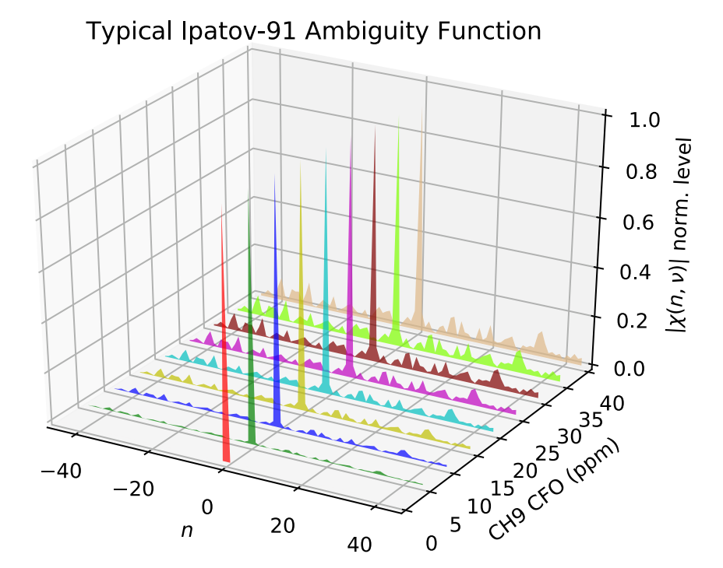
Option 1: Replace STS Field with Repetitive Ipatov Codes.
  Ipatov codes have perfect periodic autocorrelation (PACR).
  The energy of periodic cross-correlation (PCCR) between any two codes from the same family is the same as the energy of PACR:
    Any transmission using the same code family and symbol length has a potential to produce high correlation artefacts.
    If used in the victim SHR, probability of false preamble detections rises.
    Possible mitigation techniques are those in frequency offset: baseband (previously proposed) and carrier.
  Perfect PACR holds only at CFO = 0.
  As CFO rises, so do the correlation sidelobes.
  To remove the edge effects, first symbol pre-cursors and final symbol post-cursors need to be correlated and accumulated.

Slide 7
Option 2: Fixed Aperiodic STS.
Definitions:
  In STS code matrix every row represents a symbol.
  If STS code matrix is transmitted without any gap between symbols (as in 4z), it is called a code block.
If just 4z STS Key and IV are fixed there will be considerable sidelobes.
STS code block should be designed not to produce any sidelobes, i.e., for its symbols to complement completely after correlation.
Moreover, complete complementing should hold under conditions of received code deformation which is consistent from symbol to symbol, e.g., CFO.
Such code matrices, transmitted with a gap longer than the CIR are called supercomplementary sets of sequences (SSS) [1].
Generally, supercomplementarity does not hold when there is no gap between symbols, i.e., when we have a code block.
We have found a way to have supercomplementary code blocks under conditions of the CIR duration being less or equal to the symbol duration.
We call such code blocks supercomplementary zero-sum cross-correlation (SZC) code blocks.
[1] S. Budisin, “Supercomplementary sets of sequences,” Electronics Letters, vol. 23, pp. 504–506, 05 1987.

Slide 8
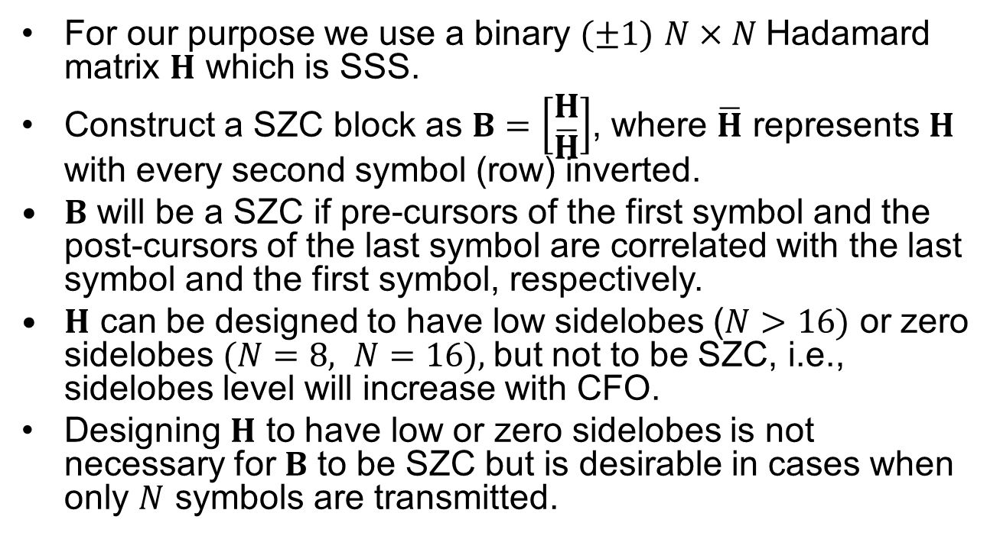
SZC Construction
For our purpose we use a binary $(±1)$ $N×N$Hadamard matrix $H$ which is SSS.
Construct a SZC block as $B=\left[\begin{matrix}H \\ \overline{H}\end{matrix}\right]$, where $\overline{H}$ represents $H$ with every second symbol (row) inverted.
$B$ will be a SZC if pre-cursors of the first symbol and the post-cursors of the last symbol are correlated with the last symbol and the first symbol, respectively.
$H$ can be designed to have low sidelobes ($N>16)$ or zero sidelobes $(N=8, N=16),$but not to be SZC, i.e., sidelobes level will increase with CFO.
Designing $H$ to have low or zero sidelobes is not necessary for $B$ to be SZC but is desirable in cases when only $N$ symbols are transmitted.

Slide 9
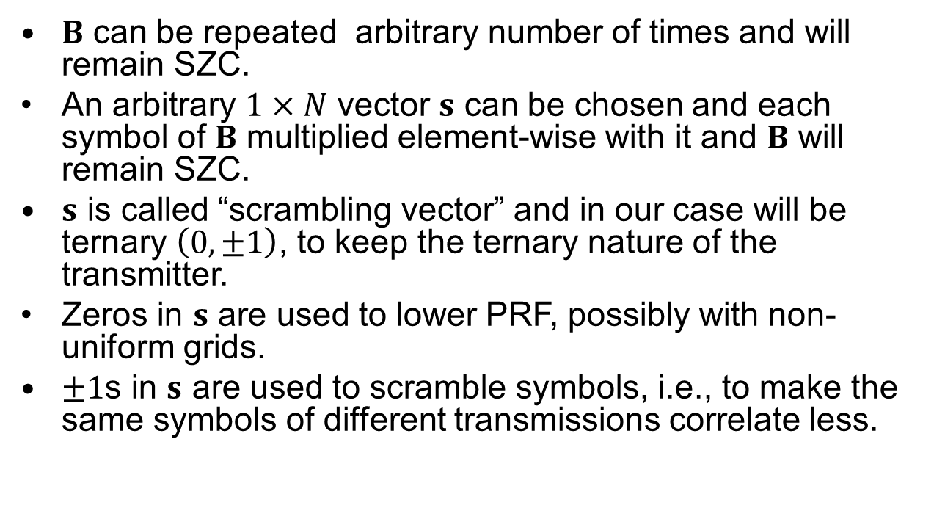
Important SZC Properties
$B$ can be repeated arbitrary number of times and will remain SZC.
An arbitrary $1×N$ vector $s$ can be chosen and each symbol of $B$ multiplied element-wise with it and $B$ will remain SZC.
$s$ is called “scrambling vector” and in our case will be ternary $\left(0, ±1\right)$, to keep the ternary nature of the transmitter.
Zeros in $s$ are used to lower PRF, possibly with non-uniform grids.
$±1$s in $s$ are used to scramble symbols, i.e., to make the same symbols of different transmissions correlate less.

Slide 10
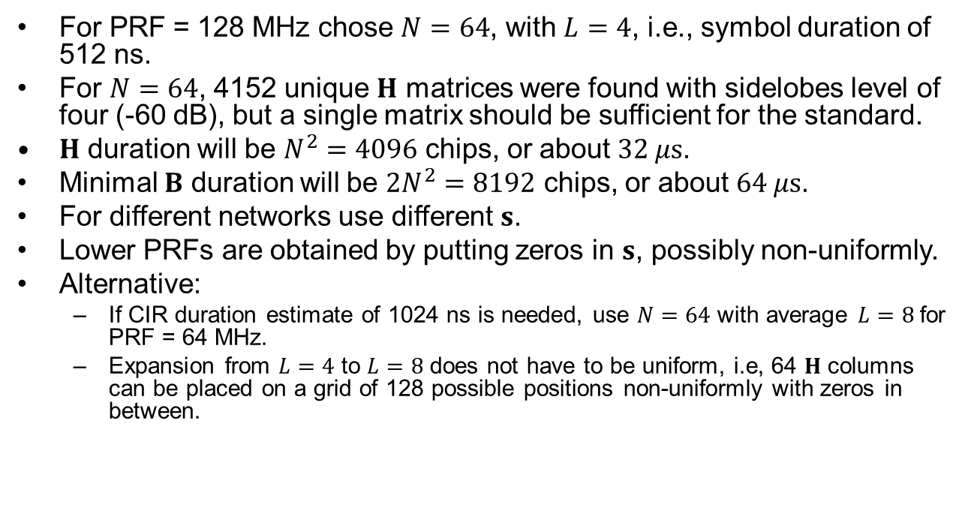
Example Design
For PRF = 128 MHz chose $N=64$, with $L=4$, i.e., symbol duration of 512 ns.
For $N=64$, 4152 unique $H$ matrices were found with sidelobes level of four (-60 dB), but a single matrix should be sufficient for the standard.
$H$ duration will be $N^{2}=4096$ chips, or about $32 μs$.
Minimal $B$ duration will be $2N^{2}=8192$ chips, or about $64 μs$.
For different networks use different $s$.
Lower PRFs are obtained by putting zeros in $s$, possibly non-uniformly.
Alternative:
  If CIR duration estimate of 1024 ns is needed, use $N=64$ with average $L=8$ for PRF = 64 MHz.
  Expansion from $L=4$ to $L=8$ does not have to be uniform, i.e, 64 $H$ columns can be placed on a grid of 128 possible positions non-uniformly with zeros in between.

Slide 11
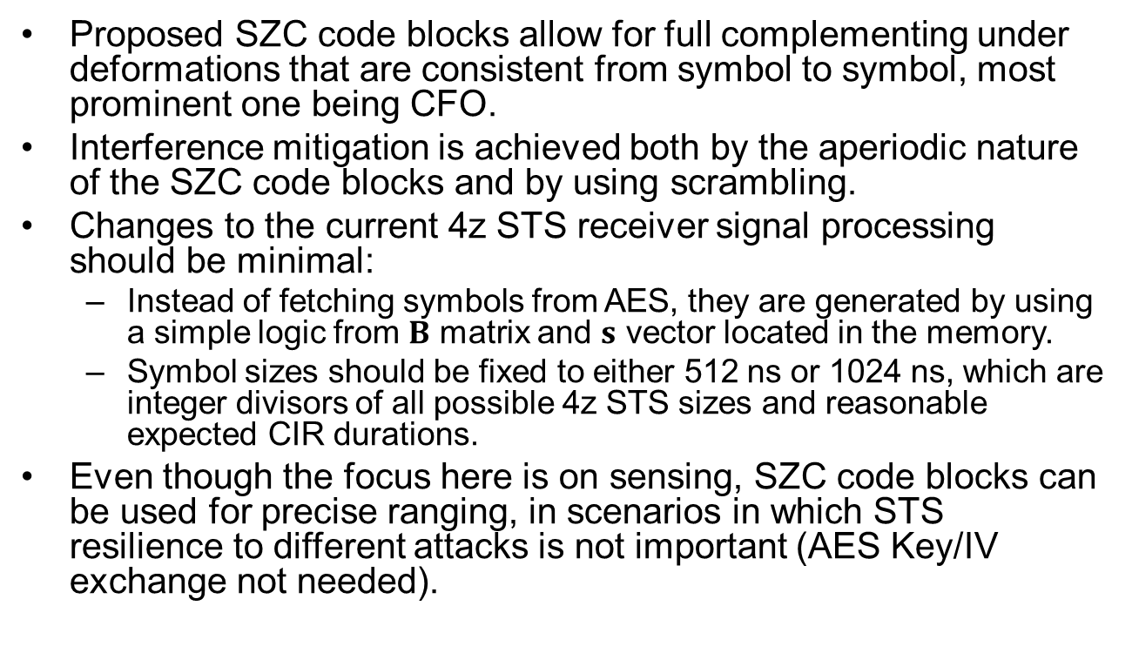
Conclusions
Proposed SZC code blocks allow for full complementing under deformations that are consistent from symbol to symbol, most prominent one being CFO.
Interference mitigation is achieved both by the aperiodic nature of the SZC code blocks and by using scrambling.
Changes to the current 4z STS receiver signal processing should be minimal:
  Instead of fetching symbols from AES, they are generated by using a simple logic from $B$ matrix and $s$ vector located in the memory.
  Symbol sizes should be fixed to either 512 ns or 1024 ns, which are integer divisors of all possible 4z STS sizes and reasonable expected CIR durations.
Even though the focus here is on sensing, SZC code blocks can be used for precise ranging, in scenarios in which STS resilience to different attacks is not important (AES Key/IV exchange not needed).

