Slide 1
Project: IEEE P802.15 Working Group for Wireless Personal Area Networks (WPANs)
Submission Title: [Details of NB Mirroring Channel - Narrowband / UWB Coupling MAC]
Date Submitted: [12 May, 2022]
Source: [Aniruddh Rao Kabbinale, Mingyu Lee, Taeyoung Ha, Junyoung Choi, Karthik Srinivasa Gopalan, Ankur Bansal, Clint Chaplin] Company [Samsung Electronics]
Address: [34, Seongchon-gil, Seocho-gu, Seoul, Korea]
E-Mail: [aniruddh.rao@samsung.com]
Abstract: [Addition of Details on NB mirroring channel - how NB and UWB signaling can cooperate to mirror UWB Channel usage with channel hopping and collision avoidance]
Purpose: [ ]
Notice: This document has been prepared to assist the IEEE P802.15. It is offered as a basis for discussion and is not binding on the authoring individual(s) or organization(s). The material in this document is subject to change in form and content after further study. The authors(s) reserve(s) the right to add, amend or withdraw material contained herein.
Release: The contributor acknowledges and accepts that this contribution becomes the property of IEEE and may be made publicly available by P802.15.

Slide 2
PAR Objective | Proposed Solution (how addressed)
Safeguards so that the high throughput data use cases will not cause significant disruption to low duty-cycle ranging use cases
Interference mitigation techniques to support higher density and higher traffic use cases | Channel hopping to mitigate interference and fading effects in Narrow Band
Other coexistence improvement
Backward compatibility with enhanced ranging capable devices (ERDEVs)
Improved link budget and/or reduced air-time
Additional channels and operating frequencies
Improvements to accuracy / precision / reliability and interoperability for high-integrity ranging
Reduced complexity and power consumption | Off-loading of functionality to lower-complexity/power NB PHY helps reduce complexity of “heavier” UWB sub-system and power consumption of UWB system
Hybrid operation with narrowband signaling to assist UWB | Exploit tightly coupled concurrent operation of NB to help UWB
Enhanced native discovery and connection setup mechanisms | Provide collision avoidance scheme based on the energy detection and CSMA
Sensing capabilities to support presence detection and environment mapping
Low-power low-latency streaming
Higher data-rate streaming allowing at least 50 Mbit/s of throughput
Support for peer-to-peer, peer-to-multi-peer, and station-to-infrastructure protocols
Infrastructure synchronization mechanisms

Slide 3
NB Mirroring Channels
Notations
A : Advertisement
A set of mirroring channels to be defined for each UWB channel (e.g., CH5, CH9). By listening to this set of channels and receiving the advertisement packet, other devices can recognize whether the corresponding UWB channel is occupied or not
There would be one mandatory mirroring channel, while rest would be optional
The set of channels collectively reflect the behavior of corresponding UWB channel

Slide 4
NB Mirroring Channels (contd…)
Notations
A : Advertisement
At a point in time, an advertisement packet can be sent in mandatory mirroring channel OR one of the optional mirroring channels by NB/UWB device which occupies UWB channel at the specific period as controller.
Advertisement packet is used to announce that the specific period of UWB channel is being used and a few characteristics of the NB mirroring channel hopping and UWB transmission.
Advertisement packet is transmitted in NB right before transmission in UWB channel,
We assume data rates such that advertisement size is less than a ranging slot duration to be transmitted fully.

Slide 5
Addressing Interference and Deep Fades
Interference
Is possible from other NB assisted UWB systems and other technology using the same band as proposed
We introduce an LBT mechanism based on one of the CCA modes
The listening time may vary from less than a slot duration to multiple slots duration.
With listening timer duration of multiple ranging slots, this is used during reservation in NB is proposed.
With listening timer duration of less than the size of a ranging slot, the LBT is used before sending Advertisement (post reservation) in NB is proposed.
Channel hopping helps to mitigate the interference caused as well.
Addressing Fading
Mirroring Channels Hopping is introduced to address deep fading effects in proposed band and interference from coexisting systems
The advertiser may decide to hop between within the set of multiple NB mirroring channels.

Slide 6
Hopping within NB Mirroring Channels
Notations
A : Advertisement
Channel Hopping
The controller conveys whether hopping is enabled or not in advertisement
The controller chooses a pattern to hop to other mirroring channels
Among the set of channels available to hop, channels used for hopping and pattern for hopping is also conveyed as part of advertisement
We intend to use hopping only when there is Acknowledgement of failure of Transmission
No response from controlee/ Next higher layer to decide
UWB/NB transmissions colliding even after reservation

Slide 7
Hopping (contd…)
Notations
A : Advertisement
Controller transmits an advertisement packet at every active ranging round in one of the mirroring channels.
The number of mirroring channels per UWB channel would be upto 2.
One strategy: The pattern shall sweep N channels in N ranging blocks. N = Number of NB mirroring channels per UWB channel.
Controller that is scanning is in same channel for N consecutive blocks.
Reservation always happens at Mirroring Channel 0 or Default/mandatory mirroring channel to avoid two controllers reserving same slot, by sending Advertisement in two different mirroring channels.

Slide 8
Collision Avoidance
Notations
A : Advertisement
RAN : Ranging Access Network
Reservation of slots allowed only in default/mandatory mirroring channel
There are chances of two controllers choosing same time slot to be reserved.
To address collision, we define a random delay timer - Reservation Delay Timer (RDT) to expire before the controllers starts advertising for reserving free slots
RDT starts at the beginning of reservation window
RDT can have a maximum value of difference between reservation window size and time duration of advertisement packet. This ensures the advertisement is transmitted completely within the reservation window that the controller wishes to reserve

Slide 9
Collision Avoidance (contd…)
Notations
A : Advertisement
RAN : Ranging Access Network
At any point during running of RDT, if channel is found busy, reservation is aborted in this cycle and attempted in a newly chosen slot in next cycle
From next cycle, post successful reservation, controller sends the advertisement at beginning of reservation window in one of the mirroring channels, after a very small LBT to avoid any collisions.

Slide 10
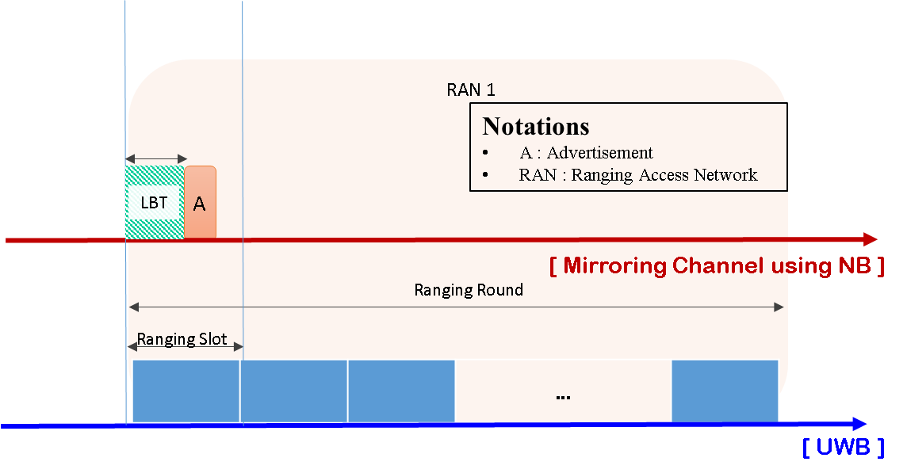
Collision Avoidance (contd…)
Post reservation, for every transmission of advertisement, we propose LBT to address any collisions
The Listening timer of LBT should be less than the slot duration such that after timer expires, the advertisement packet can be transmitted successfully in the slot.
This is in-line with LBT introduced to Poll messages in NB

Slide 11
Complementary Poll messages and Advertisement in NB Mirroring channel
Harmonising Poll message and NB Mirroring channel Advertisement
Use both Advertisement and Poll/Response messages together for setting up ranging
A mirroring channel used to transmit Advertisement
NB channel accompanying a controller session used to do poll/response and report.
Offloading semi-persistent parameters to Advertisement helps in optimising Poll message payload to include only parameters necessary for session setup

Slide 12
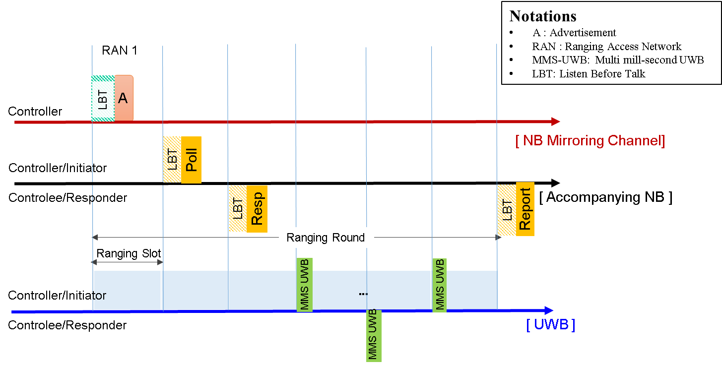
Contd…
Controller sends Advertisement conveying ranging block structure, schedule, LBT and hopping parameters
block size, round size, slot size, number of rounds, round hopping activation, NB mirroring channel hopping details, accompanying NB channel configuration including channel number, modulation and coding etc.

Slide 13
Contd…
Poll message used only to setup session – PHY parameters, roles etc.
Session ID, Ranging round usage, scheduled mode, deferred mode, mini slot length etc.

Slide 14
References
15-21-0504-00-04ab-narrowband-uwb-coupling-mac
15-22-0180-00-04ab-recap-of-narrowband-uwb-coupling-mac
15-22-0262-00-04ab-nba-uwb-technical-framework-proposal
15-22-0275-00-04ab-proposal-of-nb-phy-assisted-cca-for-uwb-medium-access

Slide 15
Thank You

