Slide 1
Project: IEEE P802.15 Working Group for Wireless Personal Area Networks (WPANs)
Submission Title: Follow up on joint discussion between IEEE P802.15.13 and 802.1
Date Submitted: May 11th 2022
Source:
Lennert Bober, Volker Jungnickel, Fraunhofer HHI
Tuncer Baykas, Kadir Has University
Sang-Kyu Lim, ETRI
E-Mail: bober@ieee.org
Abstract: Discussion of open questions on integrating 802.15.13 networks in LANs and enabling TSN via them.
Purpose: Aid development of the P802.15.13 standard
Notice: This document has been prepared to assist the IEEE P802.15. It is offered as a basis for discussion and is not binding on the contributing individual(s) or organization(s). The material in this document is subject to change in form and content after further study. The contributor(s) reserve(s) the right to add, amend or withdraw material contained herein.
Release: The contributor acknowledges and accepts that this contribution becomes the property of IEEE and may be made publicly available by P802.15.

Slide 2
Follow up on joint discussion between IEEE P802.15.13 and 802.1
May 11th 2022

Slide 3
Open topics from the last meeting
Topic #1
  Question raised w.r.t. supporting EtherType only, vs. Length/Type so that an LLC can be encoded re: bridging and routing protocols (e.g. spanning tree, IS-IS) using LLC encoding vs. newer protocols using EtherType encoding. May need to support both encodings vs. only the latter. Bridges may interconnect two 802.15.3 links.
  Will look at changing the use of EtherType only to using a Length/Type field.
  Other changes may be needed as well, e.g. to carry multiple MSDUs in a frame.
  Ethernet frames should be carried transparently, 802.15.3 specifics being carried independently.
Topic #2
  Question raised w.r.t. handling 802.15.4 multicast addresses, if assumed every address is treated as unicast. For inner addresses, suggestion to treat group addresses as broadcast rather than as unicast addresses.
Topic #3
  TSN is a lot of tools - not all are required, many separate tools.
  For 802.1: What minimal set of pieces is needed to be considered to be able to support 802.1 TSN capability? TSN augments 802.1Q bridging. TSN queuing mechanisms originally assume wired links. Wireless links imply new considerations. Time synchronization and multipathing may be useful to 802.15.13. Some TSN tools do not require time synchronization.
  For 802.15.13: What capabilities of TSN are beneficial to 802.15.13? Answering this would help 802.1 participants answer the previous question.
Topic #4
  What in 802.3 TDMA PON have already been addressed, that can be applied - i.e. a solution may already exist.

Slide 4
Topic #1 – EPD, LPD, Length/Type
From last meeting:
  Question raised w.r.t. supporting EtherType only, vs. Length/Type so that an LLC can be encoded re: bridging and routing protocols (e.g. spanning tree, IS-IS) using LLC encoding vs. newer protocols using EtherType encoding. May need to support both encodings vs. only the latter. Bridges may interconnect two 802.15.3 links.
  Will look at changing the use of EtherType only to using a Length/Type field.
  Other changes may be needed as well, e.g. to carry multiple MSDUs in a frame.
  Ethernet frames should be carried transparently, 802.15.3 specifics being carried independently.
P802.15.13:
  Solution: define Length/Type prefix for MSDUs
  Updated description of MSDU in the MD-SAP:
    „The MSDU in EtherType format, i.e., starting with the Length/Type field and ending with the MAC Client Data field as defined in <reference to 802.3>.
  How to refer to 802.3?

Slide 5
Topic #2 – Multicast addresses
From last meeting:
  Question raised w.r.t. handling 802.15.4 multicast addresses, if assumed every address is treated as unicast. For inner addresses, suggestion to treat group addresses as broadcast rather than as unicast addresses.
P802.15.13:
  Broadcast MSDUs with a destination address that has the group bit set
  Text update in 6.2.2:
    „Addresses that have the group bit set shall be treated in the same way as the broadcast address.“
  Change in other locations?

Slide 6
Topic #3 – What TSN standards
From last meeting:
  TSN is a lot of tools - not all are required, many separate tools.
  For 802.1: What minimal set of pieces is needed to be considered to be able to support 802.1 TSN capability? TSN augments 802.1Q bridging. TSN queuing mechanisms originally assume wired links. Wireless links imply new considerations. Time synchronization and multipathing may be useful to 802.15.13. Some TSN tools do not require time synchronization.
  For 802.15.13: What capabilities of TSN are beneficial to 802.15.13? Answering this would help 802.1 participants answer the previous question.
802.15.13:
  Important standards depend on application of a light-network
    Registration of traffic streams between talker and listener (802.1Qcc, 802.1Qat, etc.)
    Time sync (802.1AS)
    Managed objects / YANG?
    Reliability / replication (802.1CB)
    … ?
  It is important to identify the TSN standards that require specific support (or characteristics) from the 802.15.13 network
  Others may work either over the top or by implementing them in a specific product
  Frequency Sync needed („SyncE“)?

Slide 7
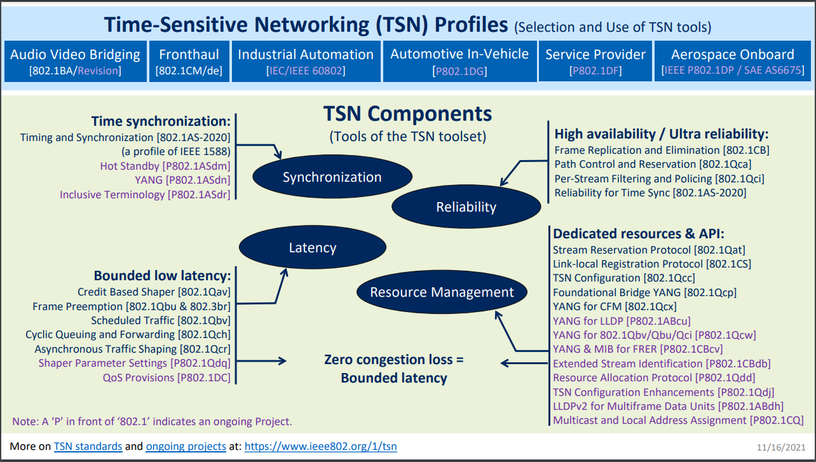
What subset of TSN standards is relevant?
Over
the top?
Over
the top?
Parameter
ranges?
Scheduling?

Slide 8
802.15.13 Networks
MD-SAP
802.15.13 network
Coordinator
Member 1
Member 2
Member 3
MD-SAP
MD-SAP
MD-SAP

Slide 9
Time sync implementation over the top
Grand master
MD-SAP
Acquire transit time based on 802.15.13-
internal synchronization for later correction
in passing frames
802.15.13 network
Coordinator
Timing event frame
Member 1
Member 2
Member 3
MD-SAP
MD-SAP
MD-SAP
Support in 802.15.13 spec needed at all?
Accuracy?
Maximum transit time?
Client

Slide 10
Topic #4 – TDMA PON TSN
From last meeting:
  What in 802.3 TDMA PON have already been addressed, that can be applied - i.e. a solution may already exist.
802.15.13:
  Not yet investigated in depth. IEEE 802.3 is complex…
  Identified one point – transit time through the network may need to be bounded.
  Under further investigation

Slide 11
Assumed networking performance
IEEE P802.15.13 networks, like probably most wireless networks may not be able to reach highest performance characteristics by design
  Frame-based physical layer with fixed length preamble ~ 10s of µs
  PHY frame allows no interruption
  Higher loss rates due to wireless interference
  Changing link capacities due to mobility
  Changing traffic load due to mobility
  … ?

