Slide 1
Project: IEEE P802.15 Working Group for Wireless Specialty Networks
Submission Title: Channel Model for Wearable and Implant BAN in use case of BMI and BCI
Date Submitted: September 12th , 2022
Source: Takumi Kobayashi, Minsoo Kim, Marco Hernandez, Ryuji Kohno
Company: (1)Yokohama National University (2) YRP International Alliance Institute
Address: (1)79-5 Tokiwadai, Hodogaya-ku, Yokohama, 240-8501 Japan,
(2) YRP1 Blg., 3-4 HikarinoOka, Yokosuka-City, Kanagawa, 239-0847 Japan
Voice:[+81-90-5408-0611] E-Mail:[minsoo@minsookim.com, kobayashi-takumi-ch@ynu.ac.jp, marco.hernandez@ieee.org, kohno@ynu.ac.jp, Kohno@yrp-iai.jp]
Re: In response to call for technical contributions
Abstract: This provides draft of channel and environmental model and its classification for vehicle body area network(VBAN) of amendment of IEEE802.15.6-2012 for wireless body area network(BAN) with enhanced dependability.
Purpose: Material for discussion in P802.15.6ma TG corresponding to comments in EC Meeting
Notice: This document has been prepared to assist the IEEE P802.15. It is offered as a basis for discussion and is not binding on the contributing individual(s) or organization(s). The material in this document is subject to change in form and content after further study. The contributor(s) reserve(s) the right to add, amend or withdraw material contained herein.
Release: The contributor acknowledges and accepts that this contribution becomes the property of IEEE and may be made publicly available by P802.15.

Slide 2
Channel Model for Wearable and Implant BAN in use case of BMI and BCI
Takumi Kobayashi ^{(1,2)}, Marco Hernandez ⁽²⁾, Minsoo Kim ⁽²⁾, Ryuji Kohno^{(1,2)}
⁽¹⁾Yokohama National University, ⁽²⁾YRP-International Ariane Institute

Slide 3
Classification of Channel and Environment Models for Human and Vehicle Body Area Networks (HBAN&VBAN)
Channel model
※Covered by IEEE 802.15.6-2012
HBAN model
In-body (Implant)
※
On-body
※
Channel model
With environment
Around body
Outdoor
※Around means;
Desk, WiFi AP in the room etc.
Indoor
※
Home
Implanted BCI model
Office
※
On skull BCI model
Medical (e.g. Hospital)
※
capsule endoscopy
※not covered in 2012
VBAN model
In-vehicle
Engine compartment
Note:
HBAN-model:
-Environment with co-existing systems is not considered.
VBAN model:
Key-less entry system
Localization in-body, on-body
Most dominant model should be defined and separatory defined as Mandatory and Optional.
Cabin
Through Engine compartment and cabin
On-vehicle
Roof
Around vehicle
Side Right/Left/Front/back
Bottom
Static vehicle
Moving vehicle

Slide 4
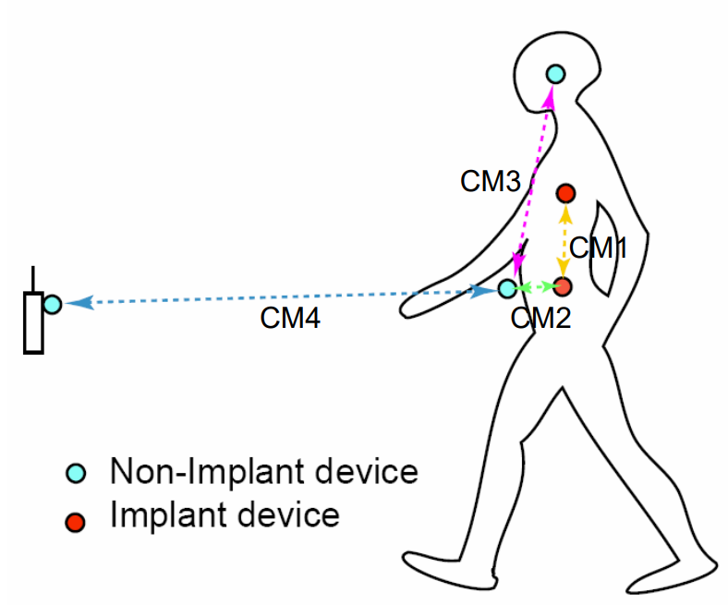
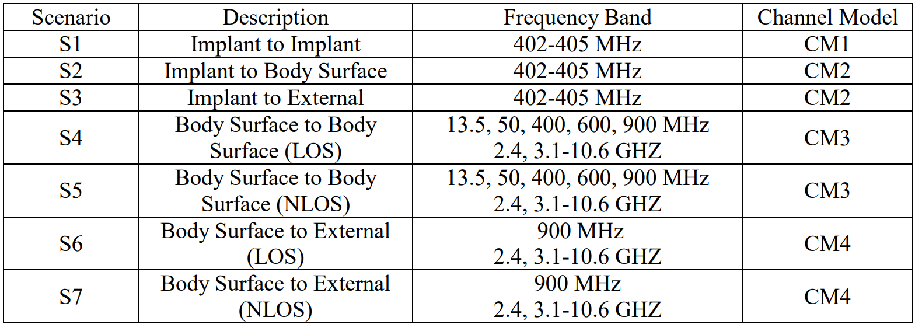
Channel models and scenarios in IEEE802.15.6-2012
IEEE P802.15-08-0780-12-0006-TG6
IEEE 802.15.6-2012 channel models considered
Fading ( Small scale/ large scale)
Path loss
Shadowing
Power delay profile
In-body (implant)
On-body (body surface)
CM1, 2, 3, 4
Scenario 1, to Scenario 7. (S1 – S7)

Slide 5
Channel models and scenarios in IEEE802.15.6ma
Scenario | Description | Frequency Band | Channel Model
S2 | Implant to Body Surface | 402-405 MHz, | CM2
S2.1 | Implant (upper body) to Body Surface | 3.1-10.6 GHz UWB | CM2.1
S2.2 | Implant (head) to Body Surface | 3.1-10.6 GHz UWB | CM2.2
S3 | Implant to External | 402-405 MHz, 3.1-10.6 GHz UWB | CM2
S4 | Body Surface to Body Surface (LOS) | 400, 600, 900 MHz 2.4, 3.1-10.6 GHz | CM3
S4.1 | Body Surface to Body Surface (LOS) | 3.1-10.6 GHz CM4.1 | CM4.1
S5 | Body Surface to Body Surface (NLOS) | 400, 600, 900 MHz 2.4, 3.1-10.6 GHz | CM3
S6 | Body Surface to External (LOS) | 900 MHz 2.4, 3.1-10.6 GHz | CM4
S6.1 | Body Surface (head) to External (LOS) | 3.1-10.6 GHz | CM6.1
S7 | Body Surface to External (NLOS) | 900 MHz 2.4, 3.1-10.6 GHz | CM4
Path loss (Mandatory)
Optional;
Fading ( Small scale/ large scale)
Shadowing
Power delay profile
Specific use cases
Implant to Body Surface for BCI
Implant to External for BCI
Body surface to body surface for BCI
Body Surface to External for BCI
Implant to body surface for capsule endoscopy

Slide 6
Channel models and scenarios in use case of BMI and BCI
Specific use cases
Implant to Body Surface for BCI
Implant to External for BCI
Body surface to body surface for BCI
Body Surface to External for BCI
Implant to body surface for capsule endoscopy
We will define what is BCI and BMI.
Wired connection
Body Surface to Body Surface for BCI
electrode
Future
Future
Arm
Implant to Body Surface for BCI
Body Surface to External on-body surface for BCI
Implant to External for BCI

Slide 7
Suggestion from Prof. Hirata
Implant to implant model for next Gen.
Wired connection
electrode
Future
Arm

Slide 8
1.5 Gen.
Receiver can be placed any where on body like on arm, wrist, neck etc.
Receiver
Device
Transmitter Device
Skin
<10mm
Skull bone
Skull bone
electrodes
Brain

Slide 9
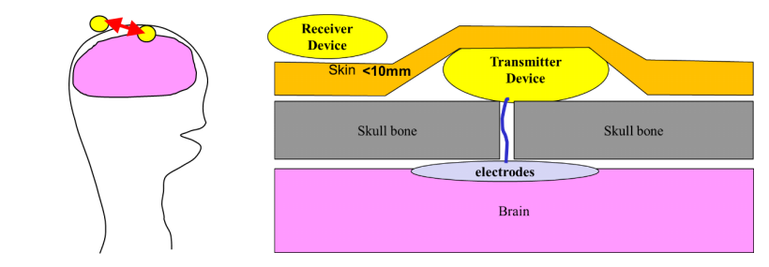
Channel models for BMI and BCI S2.2 (A) implant(head) to on-body
Specific use cases
Implant(head) to on-body for BCI
Implant to External for BCI
Body surface to body surface for BCI
Body Surface to External for BCI
Implant to body surface for capsule endoscopy

Slide 10
Channel models for BMI and BCI S2.2 (B,C) implant(head) to on-body
Specific use cases
Implant(head) to on-body for BCI
Implant to External for BCI
Body surface to body surface for BCI
Body Surface to External for BCI
Implant to body surface for capsule endoscopy
Receiver
Receiver
Skin tissues
Skin tissues
<10mm
<10mm
Tx antenna
Skull bone
Skull bone
Skull bone
electrodes
Tx antenna
electrodes
transmitter
Brain
Brain

Slide 11
Channel models for BMI and BCI S4.1 ― on-body(head) to on-body
Specific use cases
Implant(head) to on-body for BCI
Implant to External for BCI
Body surface to body surface for BCI
Body Surface to External for BCI
Implant to body surface for capsule endoscopy
On-body (head) transmitter device
Receiver
Device

Slide 12
Channel models for BMI and BCI S6.1 ― on-body(head) to external
On-body (head) transmitter device
Specific use cases
Implant(head) to on-body for BCI
Implant to External for BCI
Body surface to body surface for BCI
Body Surface to External for BCI
Implant to body surface for capsule endoscopy
Receiver
Device

Slide 13
Future generation
Receiver
Skin
<10mm
Skull bone
Future
Transmitter
electrodes
Brain

Slide 14
Channel models and scenarios for capsule endoscopy S.2.1
Specific use cases
Implant(head) to on-body for BCI
Implant to External for BCI
Body surface to body surface for BCI
Body Surface to External for BCI
Implant to body surface for capsule endoscopy
Transceiver on body surface
Gastrointestinal tract
capsule endoscopy
Implant to Body Surface for Capsule Endoscopy

Slide 15
Titanium courted implanted device
Non-metallic material
Ant.
Ant.
Ant.
RF
RF
RF
Metal e.g. Titanium
Metal e.g. Titanium
Metal e.g. Titanium
Whole body of an implanted device is covered by metallic material.
Partially non-metallic window is on the surface of the implant devices.
Antenna is outside of metallic chassis

Slide 16
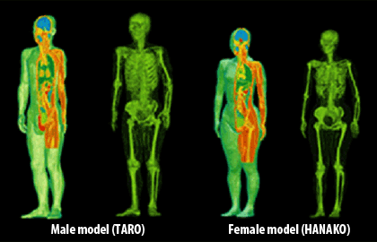
Whole-body voxel human models for numerical simulation
Whole-body voxel human models for numerical simulation is ready to use to develop and analyze channel and environmental model around human brain numerically.
Development of whole-body voxel human models
https://emc.nict.go.jp/bio/model/model01_1_e.html

Slide 17
Thank you for your attention

