Slide 1
Project: IEEE P802.15 Working Group for Wireless Specialty Networks
Submission Title: Channel Model for Wearable and Implant BAN in use case of BMI and BCI
Date Submitted: July 13th , 2022
Source: Takumi Kobayashi, Minsoo Kim, Marco Hernandez, Ryuji Kohno
Company: (1)Yokohama National University (2) YRP International Alliance Institute
Address: (1)79-5 Tokiwadai, Hodogaya-ku, Yokohama, 240-8501 Japan,
(2) YRP1 Blg., 3-4 HikarinoOka, Yokosuka-City, Kanagawa, 239-0847 Japan
Voice:[+81-90-5408-0611] E-Mail:[minsoo@minsookim.com, kobayashi-takumi-ch@ynu.ac.jp, marco.hernandez@ieee.org, kohno@ynu.ac.jp, Kohno@yrp-iai.jp]
Re: In response to call for technical contributions
Abstract: This provides draft of channel and environmental model and its classification for vehicle body area network(VBAN) of amendment of IEEE802.15.6-2012 for wireless body area network(BAN) with enhanced dependability.
Purpose: Material for discussion in P802.15.6ma TG corresponding to comments in EC Meeting
Notice: This document has been prepared to assist the IEEE P802.15. It is offered as a basis for discussion and is not binding on the contributing individual(s) or organization(s). The material in this document is subject to change in form and content after further study. The contributor(s) reserve(s) the right to add, amend or withdraw material contained herein.
Release: The contributor acknowledges and accepts that this contribution becomes the property of IEEE and may be made publicly available by P802.15.

Slide 2
Channel Model for Wearable and Implant BAN in use case of BMI and BCI
Takumi Kobayashi ^{(1,2)}, Marco Hernandez ⁽²⁾, Minsoo Kim ⁽²⁾, Ryuji Kohno^{(1,2)}
⁽¹⁾Yokohama National University,
⁽²⁾YRP-International Ariane Institute

Slide 3
Classification of Channel and Environment Models for Human and Vehicle Body Area Networks (HBAN&VBAN)
Channel model
※Covered by
IEEE 802.15.6-2012
HBAN model
In-body (Implant)
※
On-body
※
Channel model
With environment
Around body
Outdoor
※Around means;
Desk, WiFi AP in the room etc.
Indoor
※
Home
Implanted BCI model
Office
※
On skull BCI model
Medical (e.g. Hospital)
※
capsule endoscopy
※not covered in 2012
VBAN model
In-vehicle
Engine compartment
Note:
HBAN-model:
-Environment with co-existing systems is not considered.
VBAN model:
Key-less entry system
Localization in-body, on-body
Most dominant model should be defined and separatory defined as Mandatory and Optional.
Cabin
Through Engine compartment and cabin
On-vehicle
Roof
Around vehicle
Side Right/Left/Front/back
Bottom
Static vehicle
Moving vehicle

Slide 4
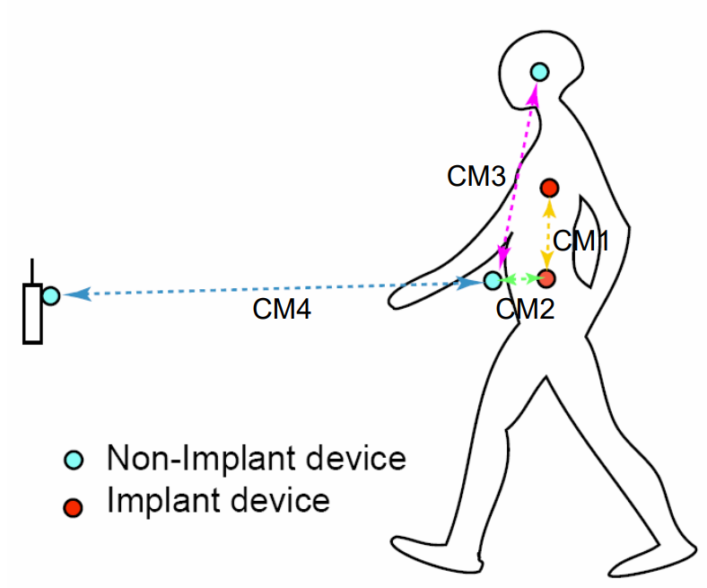
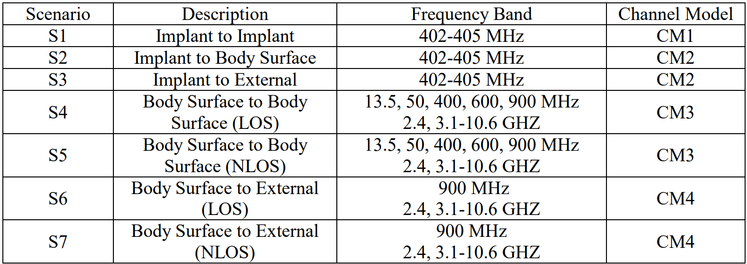
Channel models and scenarios in IEEE802.15.6-2012
IEEE P802.15-08-0780-12-0006-TG6
IEEE 802.15.6-2012 channel models considered
Fading ( Small scale/ large scale)
Path loss
Shadowing
Power delay profile
In-body (implant)
On-body (body surface)
CM1, 2, 3, 4
Scenario 1, to Scenario 7. (S1 – S7)

Slide 5
Channel models and scenarios in IEEE802.15.6ma
Scenario | Description | Frequency Band | Channel Model
S1 | Implant to Implant | 402-405 MHz, 3.1-10.6 GHz UWB | CM1
S2 | Implant to Body Surface | 402-405 MHz, 3.1-10.6 GHz UWB | CM2
S3 | Implant to External | 402-405 MHz, 3.1-10.6 GHz UWB | CM2
S4 | Body Surface to Body Surface (LOS) | 400, 600, 900 MHz 2.4, 3.1-10.6 GHz | CM3
S5 | Body Surface to Body Surface (NLOS) | 400, 600, 900 MHz 2.4, 3.1-10.6 GHz | CM3
S6 | Body Surface to External (LOS) | 900 MHz 2.4, 3.1-10.6 GHz | CM4
S7 | Body Surface to External (NLOS) | 900 MHz 2.4, 3.1-10.6 GHz | CM4
Specific use cases
Implant to Body Surface for BCI | Implant to Body Surface for BCI
Implant to External for BCI | Implant to External for BCI
Body Surface to External for BCI | Body Surface to Body Surface for BCI
Implant to body surface for capsule endoscopy | Implant to External capsule endoscopy
Need to discuss standard antenna issues.
Fading ( Small scale/ large scale)
Path loss
Shadowing
Power delay profile
In-body (implant)
On-body (body surface)
In-body (BCI)
On-body (BCI)
capsule endoscopy

Slide 6
Channel models and scenarios in use case of BMI and BCI
Specific use cases
Implant to Body Surface for BCI
Implant to External for BCI
Body Surface to External for BCI
Implant to Body surface for capsule endoscopy
We will define what is BCI and BMI.
Wired connection
Body Surface to Body Surface for BCI
Implant to Body Surface for BCI
Body Surface to External for BCI
Implant to External for BCI

Slide 7
Suggestion from Prof. Hirata
Implant to implant model for next Gen.
Arm

Slide 8
BCI implanted device configuration
Skin
Skull bone
<10mm
Brain
Skin
Skull bone
Device
Skull bone
electrodes
Brain
Skin
Device
Skull bone
Skin
Skull bone
Device
Brain
Brain
Brain

Slide 9
1st generation
Receiver
Device
Skin
<10mm
Skull bone
Transmitter Device
Skull bone
electrodes
Brain
Wired connection

Slide 10
1.5 Gen.
Receiver can be placed any where on body like on arm, wrist, neck etc.
Receiver
Device
Transmitter Device
Skin
<10mm
Skull bone
Skull bone
electrodes
Brain

Slide 11
1.5 Gen.
Receiver can be placed any where on body like on arm, wrist, neck etc.
Receiver
Device
Receiver
Device
Transmitter Device
Skin
<10mm
Skull bone
Skull bone
electrodes
Brain

Slide 12
Ideal 2nd generation
Receiver
Skin
<10mm
Skull bone
Skull bone
Transmitter
electrodes
Brain

Slide 13
Titanium courted implanted device
Non-metallic material
Ant.
Ant.
Ant.
RF
RF
RF
Metal e.g. Titanium
Metal e.g. Titanium
Metal e.g. Titanium
Whole body of an implanted device is covered by metallic material.
Partially non-metallic window is on the surface of the implant devices.
Antenna is outside of metallic chassis

Slide 14
Channel models and scenarios in use case of capsule endoscopy
Specific use cases
Implant to Body Surface for BCI
Implant to External for BCI
Body Surface to External for BCI
Implant to body surface for capsule endoscopy
Transceiver on body surface
Gastrointestinal tract
capsule endoscopy
Implant to Body Surface for Capsule Endoscopy

Slide 15
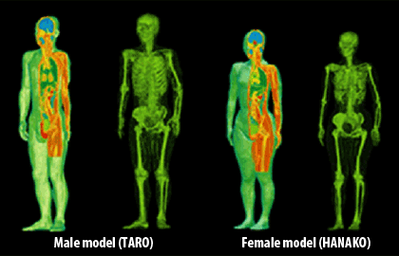
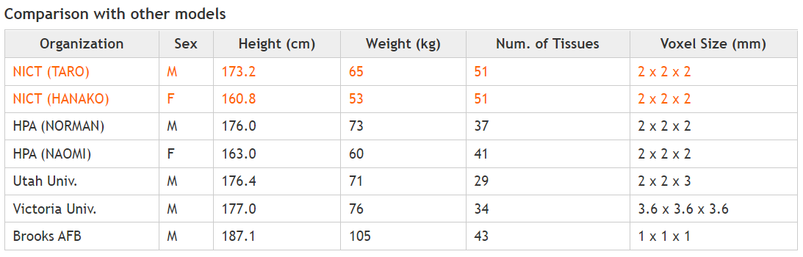
Whole-body voxel human models for numerical simulation
Whole-body voxel human models for numerical simulation is ready to use to develop and analyze channel and environmental model around human brain numerically.
Development of whole-body voxel human models
https://emc.nict.go.jp/bio/model/model01_1_e.html

Slide 16
From 15.6-2012
From 15.4a
From 15.4ab
Channel model
Marco san provided
15.8
Large scale fading
Small scale fading
Path loss
UWB Channel model
15.4 Indoor residential
Shadowing
15.4a Indoor residential
Simulation methodology
HBAN
Channel model
VBAN
Channel model
HBAN
Channel model
VBAN
Channel model
In-body
In-vehicle
On-body
On-vehicle
Surrounding body
Surrounding vehicle
In-body
In-vehicle
On-body
On-vehicle
15.4 outdoor
Surrounding body
Surrounding vehicle
15.4 outdoor

Slide 17
Channel and Environmental Models
Environment model
※will be defined in this amendment
Channel model
Environment model
Channel model
Path loss
Reflection
Multipath
Fading
LOS / NLOS model
White Gaussian noise
Interference from co-existing wireless systems
e.g. Bluetooth, IEEE 802.11, IEEE 802.15.4 etc.
Interference from the other BANs.
Interference from the other electric systems, devices and components (Electro-magnetic interference; EMI from electric motors, spark plugs in vehicles, etc.
Electro-magnetic compatibility; EMC. Possibility to affect to the other systems and human body.
VBAN ⬄ HBAN interference
VBAN and HBAN ⬄ Vehicle control and human body impacts.
Colored noise (Impulse noise, spike noise, ignition noise etc.)
Time-varying channel and interference modeling (Statistic, non-static, pseudo static model)
※IEEE802.15.6-2012
Other wireless systems
EMI EMC
Colored noise
Time-varying modeling
※mandatory
※optional
※mandatory
※mandatory
※Comments in May 2021.
※optional
or
?
※mandatory
or
?
※optional
※mandatory
※mandatory
※optional

Slide 18
Environmental model
EMI from vehicle system
Colored noise
EV Switching noise
Ignition noise
etc…
Standard antenna
Standard antenna
Channel model
Propagation Model （based on S-V Model）
RF
ANT
+
ANT
RF
Distance dependent function
Interference from the other Wireless systems
Interference from the other BAN
Interference from the other UWB (not BAN)
Distance dependent function
We propose to define environmental models including antenna effect. Parameter measurements will be performed by using standard antennas which will be defined separately.

Slide 19
HBAN coordinator to HBAN coordinator
Body surface to ANOTHER body surface
Cannot be considered similar
Need to consider SAR issues
Body surface to body surface
Body surface to body surface

Slide 20
Thank you for your attention

