Slide 1
Project: IEEE P802.15 Working Group for Wireless Personal Area Networks (WPANs)
Submission Title: [Preamble only packet for UWB]
Date Submitted: [6 May, 2022]
Source: [Chenchen Liu, Bin Qian , David Xun Yang] Company [Huawei]
Address [Huawei Base, Shenzhen, CHINA]
E-Mail:[liuchenchen1@Huawei.com]
Re: [Study Group 4ab: UWB Next Generation]
Abstract: [Propose preamble only packet for UWB ranging and sensing application]
Purpose: [ ]
Notice: This document has been prepared to assist the IEEE P802.15. It is offered as a basis for discussion and is not binding on the contributing individual(s) or organization(s). The material in this document is subject to change in form and content after further study. The contributor(s) reserve(s) the right to add, amend or withdraw material contained herein.
Release: The contributor acknowledges and accepts that this contribution becomes the property of IEEE and may be made publicly available by P802.15.

Slide 2
Technical Guidance
PAR Objective | Proposed Solution (how addressed)
Safeguards so that the high throughput data use cases will not cause significant disruption to low duty-cycle ranging use cases
Interference mitigation techniques to support higher density and higher traffic use cases
Other coexistence improvement
Backward compatibility with enhanced ranging capable devices (ERDEVs)
Improved link budget and/or reduced air-time | Propose a preamble only packet to reduce the airtime
Additional channels and operating frequencies
Improvements to accuracy / precision / reliability and interoperability for high-integrity ranging | Ipatov sequence with enough pulses to fully make use of the transmission power, thus improve the accuracy and reliability
Reduced complexity and power consumption
Hybrid operation with narrowband signaling to assist UWB
Enhanced native discovery and connection setup mechanisms
Sensing capabilities to support presence detection and environment mapping
Low-power low-latency streaming
Higher data-rate streaming allowing at least 50 Mbit/s of throughput
Support for peer-to-peer, peer-to-multi-peer, and station-to-infrastructure protocols
Infrastructure synchronization mechanisms

Slide 3
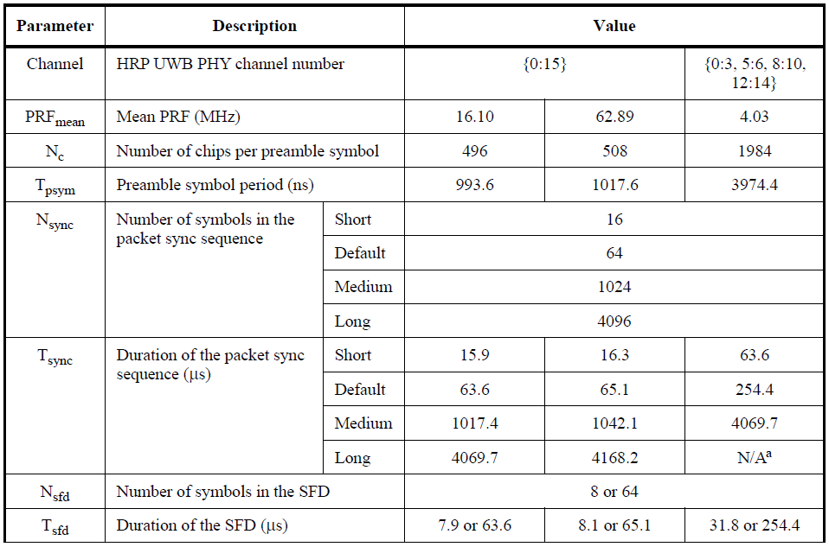
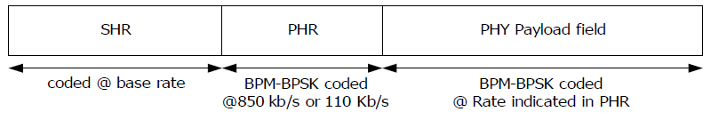
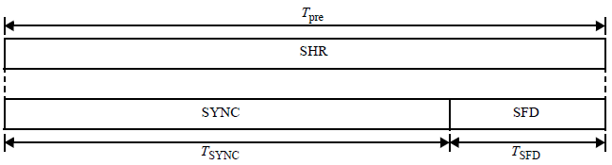
Background and Motivations
The typical PPDU structure of 15.4z.
The preamble sequence is repeated many times, which may cause the spectral line problem. It will limit the maximum transmission power.
The sensing/ranging can be performed on the preamble sequence , where the larger the transmission power, the better sensing/ranging performance.
Even the short packet of 15.4z is too long, which leads to a large overhead

Slide 4
Background and Motivations
UWB Regulatory restrictions：
  Must not violate -41.3dBm mean power in any 1MHz RBW bin averaged over 1ms
  Must not violate 0dBm at any time in any 50MHz bin (For the Peak EIRP limit , it is acceptable to use a different resolution bandwidth, in which case the EIRP limit shall be 20log10(RBW/50) dBm where RBW is the used resolution bandwidth in MHz, which lead to minimum of 186 pulses)

Slide 5
Restrictions on the preamble only frame
To avoid the spectral lines problem caused by the repetition of preamble sequence when measured with a 1MHz RBW, the sequence shall last at least 1us.
To fully make use of the transmission power, the preamble only packet shall contain at least 186 pulses.
To have an ideal autocorrelation for the preamble sequence, an Ipatov sequence is preferred for the preamble only packet

Slide 6
Proposed preamble only packet structure
Based on the restrictions, we propose the following preamble only packet structure, which has a similar structure as the 15.4z preamble
This preamble only packet can be duplicated for multiple milliseconds

Slide 7
Conclusions
A preamble only packet structure is proposed.
The proposed packet structure can avoid the spectral lines problems when measured within a 1MHz RBW.
The proposed packet structure can make full use of the transmission power.
The proposed packet structure can have an ideal autocorrelation by using an Ipatov sequence.

Slide 8
References
[1] P802.15.4z, Draft Standard for Low-Rate Wireless Networks
[2] 15-22-0243-00-04ab-golay-complementary-sequences-preamble-construction-for-uwb-ranging-beyond-4z-ipatov(Xiliang (Apple))
[3] 15-22-0178-00-04ab-a-novel-channel-sounding-sequence(McLaughlin (Qorvo))

