Slide 1
Project: IEEE P802.15 Working Group for Wireless Personal Area Networks (WPANs)
Submission Title: Discussion on NB Assisted UWB Message Sequence and Synchronization
Date Submitted: May 12, 2022
Source: Pooria Pakrooh, Bin Tian, Steve Shellhammer and Koorosh Akhavan (Qualcomm)
E-Mail:{ppakrooh, btian, sshellha, kakhavan}@qti.qualcomm.com
Abstract: Discussion on NBA UWB message sequence and time/frequency synchronization schemes
Notice: This document has been prepared to assist the IEEE P802.15. It is offered as a basis for discussion and is not binding on the authoring individual(s) or organization(s). The material in this document is subject to change in form and content after further study. The authors(s) reserve(s) the right to add, amend or withdraw material contained herein.

Slide 2
PAR Objective | Proposed Solution (how addressed)
Safeguards so that the high throughput data use cases will not cause significant disruption to low duty-cycle ranging use cases
Interference mitigation techniques to support higher density and higher traffic use cases
Other coexistence improvement
Backward compatibility with enhanced ranging capable devices (ERDEVs)
Improved link budget and/or reduced air-time
Additional channels and operating frequencies
Improvements to accuracy / precision / reliability and interoperability for high-integrity ranging
Reduced complexity and power consumption
Hybrid operation with narrowband signaling to assist UWB | Discussion on NBA UWB message sequence, slot structure, and time/frequency synchronization schemes
Enhanced native discovery and connection setup mechanisms
Sensing capabilities to support presence detection and environment mapping
Low-power low-latency streaming
Higher data-rate streaming allowing at least 50 Mbit/s of throughput
Support for peer-to-peer, peer-to-multi-peer, and station-to-infrastructure protocols
Infrastructure synchronization mechanisms

Slide 3
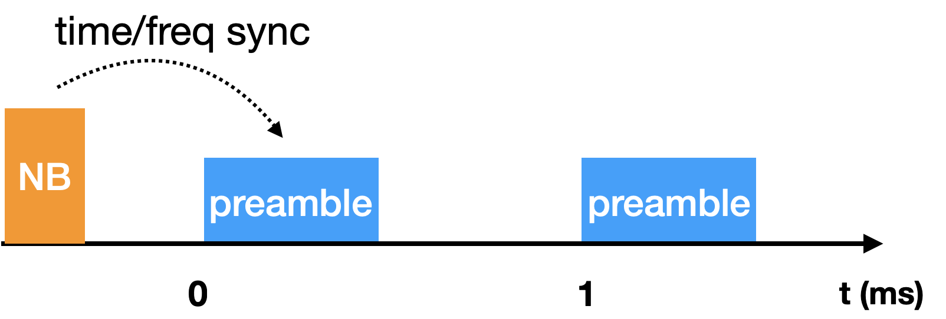
Introduction
Narrow Band (NB) assisted multi-millisecond UWB has been proposed in [1-5] to improve link budget
  NB and UWB PHY share the clock source. NB provides initial time and frequency synchronization for UWB, enabling UWB to combine over multiple 1ms fragments to enhance limit budget.
An open interface is recommended in [6] for initial synchronization phase to enable different technologies which shares the same clock source as UWB
In this contribution, we discuss message sequence and the slot structure for NBA-UWB, as well as options for time/frequency initial synchronization.

Slide 4
NBA-UWB Sequence for SS-TWR
NBA-UWB message sequence has been discussed in [7-8].
The message sequence can be separated into three phases
  Initial synchronization: NB message exchange
  Multi-fragment UWB measurement phase
  Measurement report
Initiator
NB
Preamble
UWB
UWB
Responder
NB
0
UWB
1
UWB
2
NB
T(ms)
NB synchronization messages
UWB first fragment
UWB second fragment
Measurement report
Two messages in each slot for SS-TWR: Two fragments

Slide 5
NBA-UWB Sequence for SS-TWR
Phase 1) Initial synchronization: NB message exchange
    If needed, NB message exchange can provide scheduling and capability information
    Initiator’s NB message provides
      Ranging configuration information if needed
      Initial time/frequency synchronization to the responder
    Responder’s NB message can help with
      Two-way handshaking
      Received frequency synchronization (will be discussed in the following slides)
      Signaling required number of fragments from responder to initiator
        Based on poll NB message received power, and the difference between NB and UWB link budget, it can be roughly computed that how many UWB fragments are need.
Phase 2) Multi-fragment UWB measurement phase
    To reduce latency, UWB measurements can be interleaved in each fragment
    Responder’s UWB transmission is staggered by fixed offset (e.g., 0.5 ms) to the initiator’s UWB transmission

Slide 6
NBA-UWB Sequence for SS-TWR
Phase 3) Report: NB message to carry measurement report
    Different variations of the report message, depending on which side performs ranging computation
      Initiator performs computation: Measurement report from responder to initiator → Shown in Slide 4.
      Another variation (responder computes range), initiator sends the report to responder.
    Initiator/responder may send an ack for the NB report in the last phase
      Retransmission can be done in the next round
      If NB report delivery has already succeeded, this helps with releasing memory for the measurement report until next block

Slide 7
Message Sequence: Multiple Rounds
For the next ranging round, NB synchronization can be skipped
  The need for NB in the subsequent rounds could be negotiated
  If the next round is close in time, time/frequency do not change significantly between rounds
  Time and frequency can be further refined during UWB fragments of the previous round and used for the subsequent rounds.
  NB can be used to retransmit measurement report from previous round, in case of report failure in previous round.

Slide 8
Existing Ranging Session Structure
Assuming discovery and UWB ranging session have been setup (phase 0 in [9]), for example via BLE
  UWB channel to use
  Slot, Round, and Block durations (constraints: one UWB message per slot, one ranging measurement per round)
UWB_Time_T0 is the time information passed to UWB to mark the beginning of the ranging session
Only one measurement per Round, and only one Round is used per Block
  If Round hoping is enabled, from one Block to another Block, the Round index is selected based on a specified function
  Block duration determines frequency of measurement

Slide 9
NBA-UWB Slot Structure for SS-TWR
Interleave NB messages and UWB fragments to avoid latency
  Multiple Slots for NB messages for more flexibility: Slots 0→N-1
    NB messages may need more than one slot: NB message duration could be longer. Additionally, offset between NB and UWB may need to be configurable based on negotiation to accommodate turn-around between NB and UWB.
  One fragment of UWB messages for each side per slot
Another option: NB synchronization can be done before going to the slot structure for UWB
  It could be challenging to fit NB transmissions in a fixed number of slots, as it requires fast turn-around time between NB and UWB
Initiator
Initiator
NB
Preamble
UWB
UWB
Responder
NB
0
UWB
1
UWB
2
NB
T (ms)
Responder
Slot 0 → N-1:
Phase 1 NB sync
Slot N:
UWB first fragments
Slot N+1:
UWB second fragment
Multiple slots N+2→2N+1:
Phase 3, Measurement report
Two messages in each slot for SS-TWR: Two fragments

Slide 10
NBA-UWB Time/Frequency Synchronization
Reference for time and frequency of UWB measurement sequence. Three options:
  1. Initiator is the reference for time and frequency. Responder’s transmission time and frequency are based on initiator’s clock. Responder pre-corrects time and frequency based on initial NB synchronization.
    Requires additional complexity in Tx side to do frequency pre-correction.
  2. (Preferred) Initiator is the reference for the time. Responder’s transmission time is corrected based on initial NB synchronization to align with initiator clock. Each side’s transmission frequency is based on its own clock with no precorrection (Responder’s NB is needed).
  3. Transmitter’s time and frequency are based on its own clock. No pre-correction in frequency or transmission time. Time and frequency correction are done at the receiver.
    Initiator and responder timings are based on different clocks, difficult for ranging computation.

Slide 11
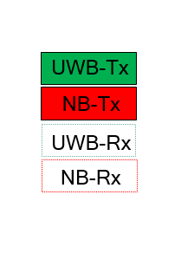





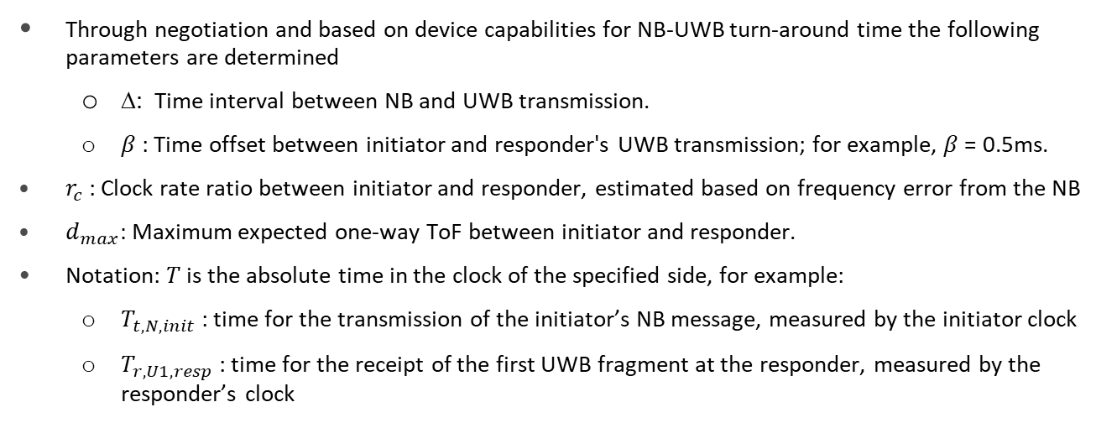





Notation for Timing Synchronization
$$\text{Δ}$$
$$T_{t,N,init}$$
$$T_{r,N,init}$$
$$T_{t,U1,init}$$
$$T_{r,U1,init}$$
Initiator
Responder
$$T_{r,U1,resp}$$
$$T_{r,N,resp}$$
$$T_{t,N,resp}$$
$$T_{t,U1,resp}$$
$$\frac{β}{r_{c}}$$
Through negotiation and based on device capabilities for NB-UWB turn-around time the following parameters are determined
  ∆: Time interval between NB and UWB transmission.
  $β$: Time offset between initiator and responder's UWB transmission; for example, $β$= 0.5ms.
$r_{c}$: Clock rate ratio between initiator and responder, estimated based on frequency error from the NB
$d_{max}:$ Maximum expected one-way ToF between initiator and responder.
Notation: $T$ is the absolute time in the clock of the specified side, for example:
  $T_{t,N,init}$: time for the transmission of the initiator’s NB message, measured by the initiator clock
  $T_{r,U1,resp}$: time for the receipt of the first UWB fragment at the responder, measured by the responder’s clock

Slide 12

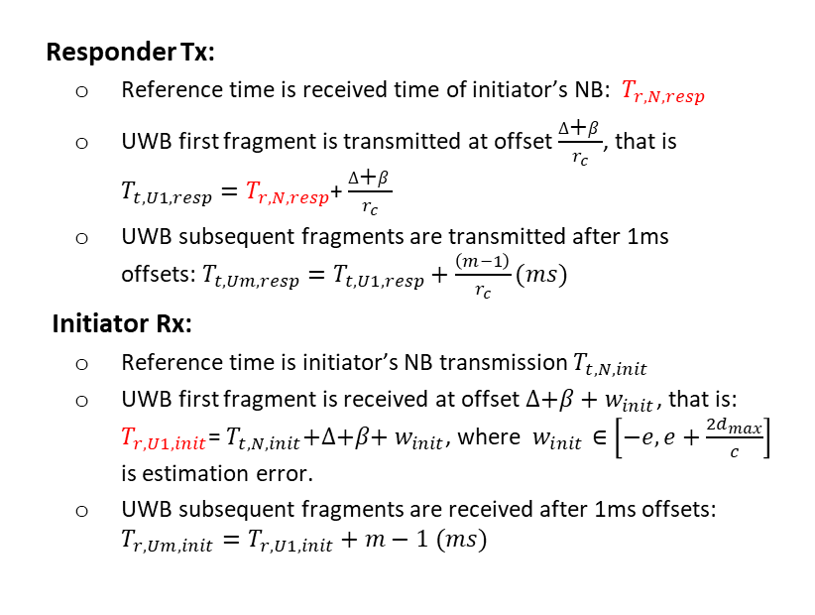







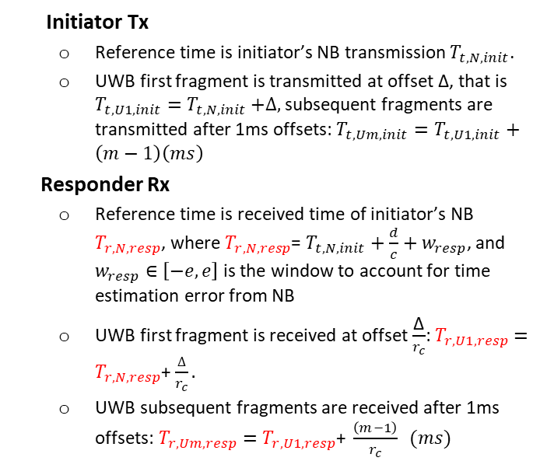


Timing Synchronization
$$\text{Δ}$$
$$T_{t,N,init}$$
$$T_{r,N,init}$$
$$T_{t,U1,init}$$
$$T_{r,U1,init}$$
Initiator
No clock correction at the initiator
Responder’s clock is corrected
Responder
$$T_{r,U1,resp}$$
$$T_{r,N,resp}$$
$$T_{t,N,resp}$$
$$T_{t,U1,resp}$$
$$\frac{β}{r_{c}}$$
Initiator Tx
  Reference time is initiator’s NB transmission $T_{t,N,init}$.
  UWB first fragment is transmitted at offset Δ, that is $T_{t,U1,init}=$ $T_{t,N,init}$ $+∆,$subsequent fragments are transmitted after 1ms offsets: $T_{t,Um,init}=T_{t,U1,init}+\left(m−1\right)\left(ms\right)$
Responder Rx
  Reference time is received time of initiator’s NB $T_{r,N,resp}$, where $T_{r,N,resp}$= $T_{t,N,init}+\frac{d}{c}+w_{resp}$, and $w_{resp}∈\left[−e,e\right]$ is the window to account for time estimation error from NB
  UWB first fragment is received at offset $\frac{\text{Δ}}{r_{c}}$: $T_{r,U1,resp}=T_{r,N,resp}$+ $\frac{∆}{r_{c}}.$
  UWB subsequent fragments are received after 1ms offsets:$T_{r,Um,resp}=T_{r,U1,resp}\text{+ }\frac{\left(m−1\right)}{r_{c}} (ms)$
Responder Tx:
  Reference time is received time of initiator’s NB: $T_{r,N,resp}$
  UWB first fragment is transmitted at offset $\frac{∆\text{+}β}{r_{c}}$, that is $T_{t,U1,resp}=T_{r,N,resp}$+ $\frac{∆\text{+}β}{r_{c}}$
  UWB subsequent fragments are transmitted after 1ms offsets:$T_{t,Um,resp}=T_{t,U1,resp}+\frac{\left(m−1\right)}{r_{c}}(ms)$
Initiator Rx:
  Reference time is initiator’s NB transmission $T_{t,N,init}$
  UWB first fragment is received at offset $∆\text{+}β+w_{init}$, that is: $T_{r,U1,init}$= $T_{t,N,init}\text{+}∆\text{+}β\text{+} w_{init}$, where $w_{init}∈\left[−e,e+\frac{{2d}_{max}}{c}\right]$ is estimation error.
  UWB subsequent fragments are received after 1ms offsets: $T_{r,Um,init}=T_{r,U1,init}+m−1 (ms)$

Slide 13
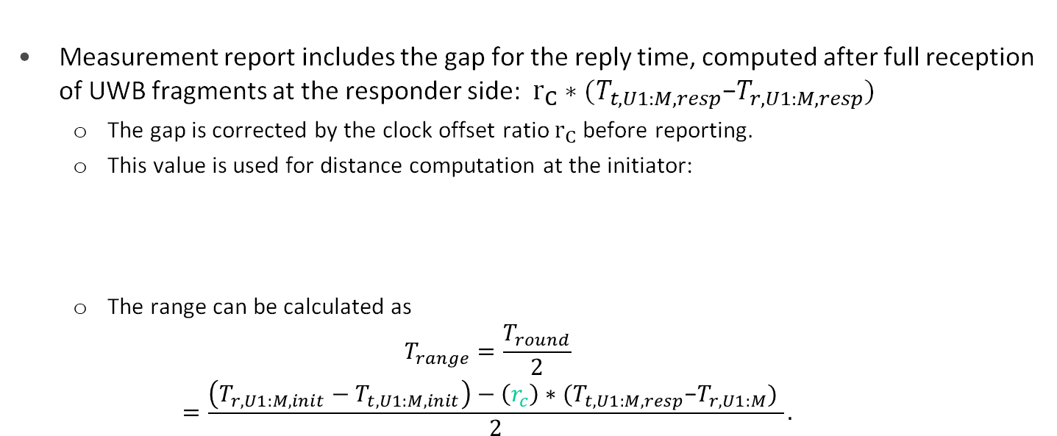
Measurement Report
Measurement report includes the gap for the reply time, computed after full reception of UWB fragments at the responder side: $r_{C}∗(T_{t,U1:M,resp}\text{−}T_{r,U1:M,resp}\text{)}$
  The gap is corrected by the clock offset ratio $r_{C}$before reporting.
  This value is used for distance computation at the initiator:
  The range can be calculated as
    $$T_{range}=\frac{T_{round}}{2}$$
    $$=\frac{\left(T_{r,U1:M,init}−T_{t,U1:M,init}\right)−\left(r_{c}\right)∗(T_{t,U1:M,resp}\text{−}T_{r,U1:M}\text{)} }{2}.$$
    $({ T}_{r,U1:M,init}−T_{t,U1:M,init})=T_{round}+r_{c}∗{(T}_{t,U1:M,resp}$-$T_{r,U1:M,resp}$).

Slide 14
References
[1] 15-22-0064-04ab Potentials of narrowband assisted UWB
[2] 15-22-0074-04ab Link budget analysis for NBA-MMS
[3] 15-21-0593-04ab More on NBA-MMS
[4] 15-21-0409-04ab Narrowband assisted multi-millisecond UWB
[5] 15-22-0192-04ab NBA UWB technical framework proposal
[6] 15-22-0156-04ab Discussion on NB Assisted NB
[7] 15-21-0605-04ab NBA-MMS-UWB MAC Considerations
[8] 15-22-0080-04ab NBA-MMS-UWB MAC Follow-up
[9] 15-22-0214-04ab Long-range Ranging

