Slide 1
Project: IEEE P802.15 Working Group for Wireless Personal Area Networks (WPANs)
Submission Title: Coexistence discussion on narrowband assisted UWB
Date Submitted: May 10, 2022
Source: Bin Tian, Pooria Pakrooh and Koorosh Akhavan (Qualcomm), Jonathan Segev (Intel)
E-Mail:{btian, ppakrooh, kakhavan}@qti.qualcomm.com, jonathan.segev@intel.com
Abstract: Discuss coexistence challenges and solutions for the narrowband assisted UWB .
Purpose: .
Notice: This document has been prepared to assist the IEEE P802.15. It is offered as a basis for discussion and is not binding on the authoring individual(s) or organization(s). The material in this document is subject to change in form and content after further study. The authors(s) reserve(s) the right to add, amend or withdraw material contained herein.

Slide 2
PAR Objective | Proposed Solution (how addressed)
Safeguards so that the high throughput data use cases will not cause significant disruption to low duty-cycle ranging use cases
Interference mitigation techniques to support higher density and higher traffic use cases
Other coexistence improvement | Coexistence for NB+UWB operation
Backward compatibility with enhanced ranging capable devices (ERDEVs)
Improved link budget and/or reduced air-time
Additional channels and operating frequencies
Improvements to accuracy / precision / reliability and interoperability for high-integrity ranging
Reduced complexity and power consumption
Hybrid operation with narrowband signaling to assist UWB | Discuss coexistence solutions of NB assisted UWB
Enhanced native discovery and connection setup mechanisms
Sensing capabilities to support presence detection and environment mapping
Low-power low-latency streaming
Higher data-rate streaming allowing at least 50 Mbit/s of throughput
Support for peer-to-peer, peer-to-multi-peer, and station-to-infrastructure protocols
Infrastructure synchronization mechanisms

Slide 3
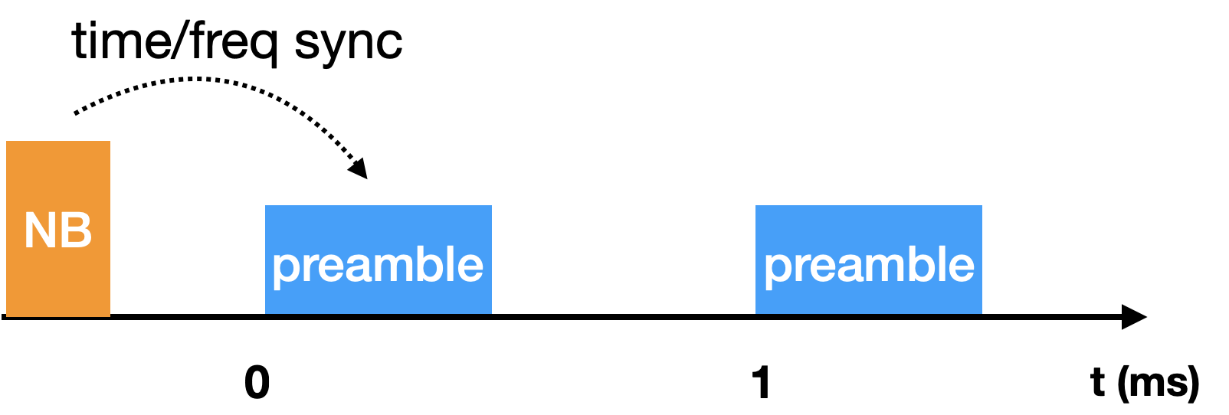
Overview
NB assisted UWB have been proposed in [1-4] to improve link budget
NB: O-QPSK (15.4 PHY) operating in UNII-3 and UNII-5 [5]
In our previous contribution [6], we
recommend open interface for initial synchronization phase to enable different technologies which shares the same clock source as UWB to provide initial frequency and time synchronization to UWB
highlight potential coexistence challenges of NB

Slide 4
Recap of Coexistence Challenges of NB
Inter device coexistence: between different devices and/or technologies
UNII-3 and UNII-5 band is used by many technologies and can get crowded.
Without Listen before talk (LBT), NB transmission may collide with ongoing transmission from NB or other technology (e.g., WiFi) and cause failure to both transmissions
In-device coexistence
Many devices e.g., phones already operate WiFi in UNII-3 and UNII-5
Interference and blocking between WiFi and NB PHY Tx and Rx
Tx/Rx concurrency likely not possible
Time sharing is needed between WiFi and NB PHY
Hopping and arbitrary message arrival time of NB PHY make arbitration very difficult

Slide 5
Coexistence Methods of NB
Listen Before Talk (LBT)
Agile frequency hopping (channel selection)
Channelization
Frequency hopping
Blocked channel list channel
Duty cycle control

Slide 6
LBT for NB
Clear channel assessment (CCA): propose energy based detection (ED) with level of -62dBm/20MHz
Back off scheme:
Random back off: e.g. Exponential back off
Brings uncertainty to the receive time window. More power consumption at the receiver and makes in device WiFi-NB arbitration more challenging
Not a good direction
Frame based LBT: cancel the transmission if channel is assessed as busy. Retry at the next fixed time
No impact to receiver timing since retransmission timing is known
Recommend frame based LBT
Transmitting when the channel is known busy doesn’t help
UNII-5 regulatory rule also requires LBT

Slide 7
Example of Frame Based LBT Sequence
When NB channel is busy, stop transmission and wait for the next round after a deterministic interval
When to transmit NB again?
Option 1: UWB Tx slots are scheduled together with the NB Tx slot in each ranging round. Abort all NB and UWB transmission after NB CCA busy. Wait for the next round of ranging (as shown above)
Option 2: Abort NB transmission after NB CCA busy. Retry NB CCA in the next slot. Schedule UWB Tx slots after NB Tx. If the NB CCA busy exceeds a limit, skip the current round and wait for the next round
Ch is busy
No NB Tx
No
UWB Tx
No
UWB Tx
Chan idle
NB Tx
UWB Tx
UWB Tx
NB
UWB
Preamble
UWB
Preamble
Preamble
UWB
Preamble
UWB
Preamble
NB
NB
0
1
T(ms)
NB
Ch is busy
No NB Tx
Ch busy
No NB Tx
Chan idle
NB Tx
UWB Tx
UWB Tx
NB
NB
UWB
Preamble
UWB
Preamble
NB
Preamble
T(ms)
NB
NB

Slide 8
Agile Frequency Hopping
Support high level ideas on agile frequency hopping [5]
Multiple NB channels: define prioritized channels
Hopping
Maintain blocked channel list and skipped those channels in hopping
Blocked channel list is part of capability exchange and mandated to be followed
Define prioritized NB channel spectrum. For example, in UNII-3,
5730-5735MHz: 5MHz
5725-5730MHz (part of Ch#144): 5MHz

Slide 9
Duty Cycle Limit
Predictability and duty cycle limit of NB operation is the key for WiFi-NB arbitration required for in device coexistence and power savings
Suggest to limit the NB usage in UNII-3 and UNII-5 mainly for synchronization and define duty cycle limit
Better coexistence and power saving
Other proposed NB function like discovery/association can be offloaded to existing solutions like BLE etc.

Slide 10
References
[1] 15-22-0064-04ab Potentials of narrowband assisted UWB
[2] 15-22-0074-04ab Link budget analysis for NBA-MMS
[3] 15-21-0593-04ab More on NBA-MMS
[4] 15-21-0409-04ab Narrowband assisted multi-millisecond UWB
[5] 15-22-0192-04ab NBA UWB technical framework proposal
[6] 15-22-0156-04ab Discussion on NB Assisted NB

