Slide 1
Project: IEEE P802.15 Working Group for Wireless Specialty Networks (WSN)
Submission Title: TG4ab May 2022 Meeting Slides
Date Submitted: May 10, 2022
Source: Benjamin A. Rolfe (Blind Creek Associates)
Contact:
Voice: +1 408 395 7207, E-Mail: ben.rolfe @ ieee.org
Re: Task Group 4ab: UWB Next Generation for 802.15.4
Abstract: Plenary Session Slides
Purpose: Continue to progress the project
Notice: This document has been prepared to assist the IEEE P802.15. It is offered as a basis for discussion and is not binding on the contributing individual(s) or organization(s). The material in this document is subject to change in form and content after further study. The contributor(s) reserve(s) the right to add, amend or withdraw material contained herein.
Release: The contributor acknowledges and accepts that this contribution becomes the property of IEEE and may be made publicly available by P802.15.
Notes:
Jul 12, 2010
Page 1

Slide 2
Task Group 15.4ab Next Generation UWB Amendment
Objective: enhancements to 802.15.4 Ultra Wideband (UWB) physical layers (PHYs) medium access control (MAC) and associated ranging techniques while retaining backward compatibility with enhanced ranging capable devices (ERDEVs).
Meeting will begin at 10 after the hour

Slide 3
Registration for 802 LMSC Plenaries and 802 Wireless Interims
This 802.15 meeting is part of a IEEE 802 Wireless Interim session
You must pay the registration fee in order to attend
If you have not already done so please register:
Registration Link: https://touchpoint.eventsair.com/2022-may-ieee-802-wireless-interim-session
If you do not intend to register for this session you must leave this meeting and, if you have logged attendance on IMAT, email the appropriate WG chair or vice chairs to have your attendance cancelled

Slide 4
Deadbeat Consequences (Deadbeat: in default of paying registration fee for a prior mtg.)
No participation credit will be granted for said session.
Any participation credit acquired before said session toward membership in any IEEE 802 LMSC group is revoked.
Membership in any IEEE 802 LMSC group is terminated.
No participation credit will be granted for attendance at any subsequent IEEE 802 LMSC session until the individual has complied with the registration requirements for all previously attended IEEE 802 LMSC sessions by the start of said subsequent session.

Slide 5
Registration Reminder
If you are not yet registered and paid the meeting fee please do so now.
Late Registration:
$800 after After Friday April 29, 2022
Registration Link: https://touchpoint.eventsair.com/2022-may-ieee-802-wireless-interim-session

Slide 6
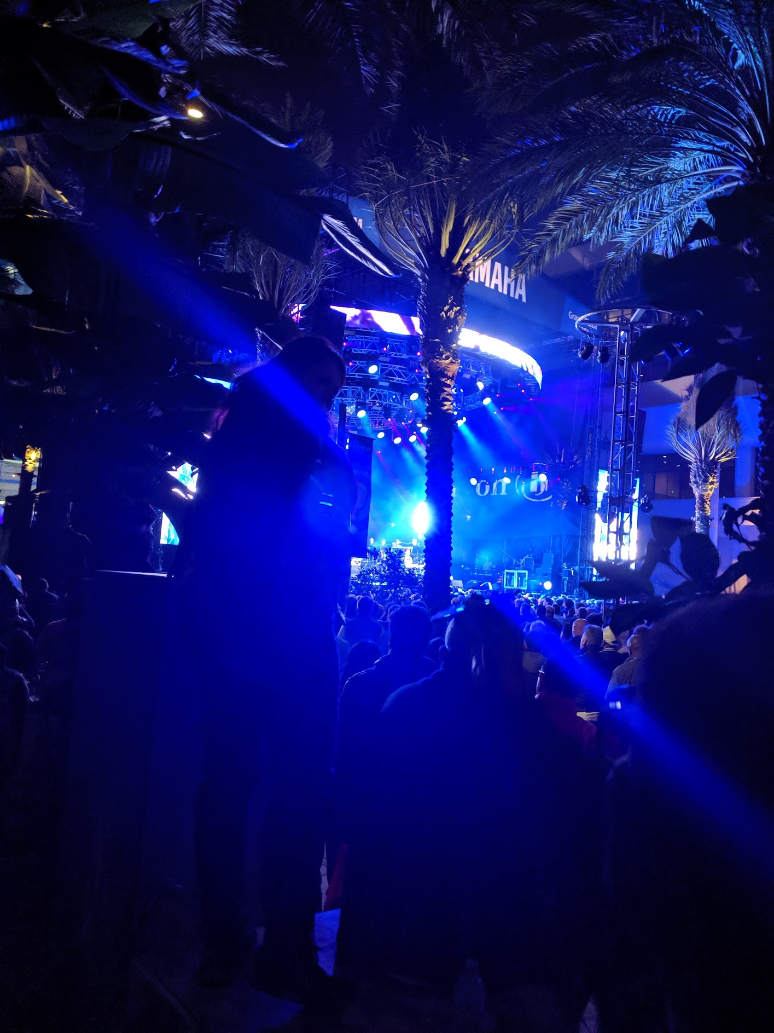
Task Group 15.4ab Virtual Interim May 2022
May 10th through May 17th

Slide 7
Task Group Rules
Discussion: Everyone present is welcome
Straw polls: Everyone present may vote
Formal motions: WG voters
To make, second and vote
Patent policy for PAR activities applies
All the usual rules of conduct
Please identify yourself on first contact with name and affiliation

Slide 8
IEEE-SA Patent, Copyright, and Participation Policies
See: https://grouper.ieee.org/groups/802/sapolicies.shtml
IEEE-SA Patent Slides for Standards Development Meetings (.pdf)
https://development.standards.ieee.org/myproject/Public/mytools/mob/slideset.pdf
IEEE-SA Standards Board Patent Committee (PatCom) home page
https://standards.ieee.org/content/ieee-standards/en/about/sasb/patcom/index.html
IEEE-SA Participation Policy meeting slide set - individual method (.pdf)
https://standards.ieee.org/content/dam/ieee-standards/standards/web/documents/other/Participant-Behavior-Individual-Method.pdf
Working Group Copyright Materials
https://standards.ieee.org/ipr/copyright-materials.html
https://standards.ieee.org/content/dam/ieee-standards/standards/web/documents/other/ieee-sa-copyright-policy-2019.pdf

Slide 9
IEEE 802 Ground Rules
Respect … give it, get it
NO product pitches
NO corporate pitches
NO prices
NO restrictive notices – (no confidentially notices in email)
Presentations must be openly available

Slide 10
MAY Agenda
https://mentor.ieee.org/802.15/dcn/22/15-22-0216-06-04ab-tg-agenda-may-2022.xlsx
 |  |  |  | Wednesday | Friday | Tuesday |  | Wednesday |  | Thursday |  | Friday |  | Sunday |  |  | Monday |  | Tuesday |  | Wednesday
EST | PST | UTC | JST | 4-May | 6-May | 10-May |  | 11-May |  | 12-May |  | 13-May |  | 15-May | UTC | JST | 16-May |  | 17-May |  | 18-May
5:00 | 2:00 | 10:00 | 19:00 |  |  |  |  |  |  |  |  |  |  |  | 9:00 | 18:00
6:00 | 3:00 | 11:00 | 20:00 |  |  |  |  |  |  |  |  |  |  |  | 10:00 | 19:00
7:00 | 4:00 | 12:00 | 21:00 |  |  |  |  | TG7a | TG13 | TG7a | TG13 | SC THz | AM0 |  | 11:00 | 20:00 | TG7a | TG13 | TG7a | TG13
8:00 | 5:00 | 13:00 | 22:00 |  |  |  |  |  |  |  |  |  |  |  | 12:00 | 21:00
9:00 | 6:00 | 14:00 | 23:00 |  |  | WG Opening Meeting |  | TG6a | TG3ma | TG6a | TG4ab | TG3ma | Joint 6a/4ab/14 |  | 13:00 | 22:00 | TG3ma | TG4ab | TG6a | TG4ab | WG Closing Meeting
10:00 | 7:00 | 15:00 | 0:00 | 802.15 CAC |  |  |  |  |  |  |  |  |  |  | 14:00 | 23:00
11:00 | 8:00 | 16:00 | 1:00 |  |  | SC Maint |  | Joint 802.15/802.1 |  | SC Maint |  | SC IETF |  |  | 15:00 | 0:00 | SC Maint |  | SC WNG
12:00 | 9:00 | 17:00 | 2:00 |  |  |  |  |  |  |  |  |  |  |  | 16:00 | 1:00
13:00 | 10:00 | 18:00 | 3:00 |  |  | TG16t | Joint 14/15/4ab | TG15 | PM1 | TG4ab (TBC) | PM1 | PM1 | PM1 |  | 17:00 | 2:00 | TG16t | PM1 | TG15 | PM1
14:00 | 11:00 | 19:00 | 4:00 |  |  |  |  |  |  |  |  |  |  |  | 18:00 | 3:00
15:00 | 12:00 | 20:00 | 5:00 |  |  | PM2 | PM2 | TG4cor1 | PM2 | PM2 | PM2 | PM2 | PM2 |  | 19:00 | 4:00 | TG4cor1 | PM2 | PM2 | PM2
16:00 | 13:00 | 21:00 | 6:00 |  |  |  |  |  |  |  |  |  |  |  | 20:00 | 5:00
17:00 | 14:00 | 22:00 | 7:00 |  |  | TG4ab | EV1 | TG4ab | EV1 | TG4ab | EV1 | EV1 | EV1 |  | 21:00 | 6:00 | TG4ab | EV1 | TG4ab | EV1
18:00 | 15:00 | 23:00 | 8:00 |  |  |  |  |  |  |  |  |  |  |  | 22:00 | 7:00
19:00 | 16:00 | 0:00 | 9:00 |  |  | EV2 | EV2 | EV2 | EV2 | EV2 | EV2 | EV2 | EV2 |  | 23:00 | 8:00 | EV2 | EV2 | EV2 | EV2
20:00 | 17:00 | 1:00 | 10:00 |  |  |  |  |  |  |  |  |  |  |  | 0:00 | 9:00
21:00 | 18:00 | 2:00 | 11:00 |  |  |  |  |  |  |  |  |  |  |  | 1:00 | 10:00
22:00 | 19:00 | 3:00 | 12:00 |  |  |  |  |  |  |  |  |  |  |  | 2:00 | 11:00
23:00 | 20:00 | 4:00 | 13:00 |  |  |  |  |  |  |  |  |  |  |  | 3:00 | 12:00
15.4ab
 | TG4ab Meeting slots
Joint
 | Joint meetings with TG4ab

Slide 11
Agenda
Discussion:
Requests for allocation (not in yet)
Adding a meeting slot
PM1 Thursday is available
All other options are PM1 or PM2
Rather painful day for or VC/RS
Horse-trading:
Requests for different time slots:
We have on PM1 session which not good for time zones in Asia
Offers to trade time slots – someone in PT or ET willing?
We may have some consolidation of time slots?
E.g. need less time than has been allocated (consider also discussion)
Motion: Approve Agenda in 15-22-0216-07
Moved/Second:

Slide 12
Approval of Minutes
Motion to approve March plenary session minutes, document # 15-22-0202-00, and Conference Call minutes (March through May 2022) document # 15-22-0239-00
Moved by: David Xun Yang (Huawei)
Second by: Clint Powell (Meta)
Links:
https://mentor.ieee.org/802.15/dcn/22/15-22-0202-00-04ab-tg4ab-mar-plenary-mins.docx
https://mentor.ieee.org/802.15/dcn/22/15-22-0239-00-04ab-tg4ab-conf-call-mins-mar-to-may-2022.docx

Slide 13
Session Objectives
Hear technical contributions and develop technical content
Continue collaborations and convergence
Commit to PHY feature set

Slide 14
General Announcements
DO NOT FORGET
REGISTRATION (and the meeting fee) is REQUIRED TO PARTICPATE in any meeting during the plenary session.
Did we mention this?
Bad things happen if you fail to register and pay the fee. Please don’t let that happen to you!

Slide 15
Recap and TG Operation

Slide 16
5.2.b Scope of the project (As approved):
This amendment enhances the Ultra Wideband (UWB) physical layers (PHYs) medium access control (MAC), and associated ranging techniques while retaining backward compatibility with enhanced ranging capable devices (ERDEVs). Areas of enhancement include:
additional coding, preamble and modulation schemes to additional coding, preamble and modulation schemes to support improved link budget and/or reduced air-time relative to IEEE Std 802.15.4 UWB;
additional channels and operating frequencies;
interference mitigation techniques to support greater device density and higher traffic use cases relative to the IEEE Std 802.15.4 UWB;
improvements to accuracy, precision and reliability and interoperability for high-integrity ranging; schemes to reduce complexity and power consumption;
definitions for tightly coupled hybrid operation with narrowband signaling to assist UWB;
enhanced native discovery and connection setup mechanisms;
sensing capabilities to support presence detection and environment mapping;
and mechanisms supporting low-power low-latency streaming as well as high data-rate streaming allowing at least 50 Mb/s of throughput.
Support for peer-to-peer, peer-to-multi-peer, and station-to-infrastructure protocols are in scope, as are infrastructure synchronization mechanisms. This amendment includes safeguards so that the high throughput data use cases do not cause significant disruption to low duty-cycle ranging use cases.
https://development.standards.ieee.org/myproject-web/app#viewpar/9081

Slide 17
Task Group Organization
Chair: Benjamin Rolfe (BCA)¹
Vice Chair and Recording Secretary: David Xun Yang (Huawei)
Vice Chair: Clint Powell (Meta)
Vice Chair: Clint Chaplin (SRA)
Lead Technical Editor: Billy Verso
Thank you to all the volunteers!
¹ Affiliation Details here: https://mentor.ieee.org/802-ec/dcn/22/ec-22-0061-00-00EC-rolfe-affiliations-by-802-activity.pdf

Slide 18
Project Schedule (working baseline)
Proposed project schedule | Nov-21 | Dec-21 | Jan-22 | Feb-22 | Mar-22 | Apr-22 | May-22 | Jun-22 | Jul-22 | Aug-22 | Sep-22 | Oct-22 | Nov-22 | Dec-22 | Jan-23 | Feb-23 | Mar-23 | Apr-23 | May-23 | Jun-23 | Jul-23 | Aug-23 | Sep-23 | Oct-23 | Nov-23 | Dec-23 | Jan-24 | Feb-24 | Mar-24 | Apr-24 | May-24 | Jun-24 | Jul-24 | Aug-24 | Sep-24 | Oct-24 | Nov-24
Call for proposals
Hear and evaluate proposals
Cut-off for new proposals, PHY
Cut-off for new proposals, MAC
Integrate poposals/contributions into TFD
Develop draft from TFD
Draft 0
TG draft review and revision
Working group pre-ballot review
Pre-ballot review and comment resolution
First letter ballot |  |  |  |  |  |  |  |  |  |  |  |  |  |  |  |  | LB
LB Comment Resolution
WG Recirculatoin |  |  |  |  |  |  |  |  |  |  |  |  |  |  |  |  |  |  |  |  | LB-R
Comment resolution, 1st recirc
Conditional approval for SA ballot
WG Recirculatoin |  |  |  |  |  |  |  |  |  |  |  |  |  |  |  |  |  |  |  |  |  |  | LB-R
Comment resolution, 2nd recirc and final recirc
First SA ballot |  |  |  |  |  |  |  |  |  |  |  |  |  |  |  |  |  |  |  |  |  |  |  |  | SA
Comment resolution, first SA ballot
SA Resirculation |  |  |  |  |  |  |  |  |  |  |  |  |  |  |  |  |  |  |  |  |  |  |  |  |  |  |  | SA-R
Comment resolution, SA recirculation
SA Resirculation |  |  |  |  |  |  |  |  |  |  |  |  |  |  |  |  |  |  |  |  |  |  |  |  |  |  |  |  |  |  | SA-R
Comment resolution, 2nd SA recirc
Conditional or unconditional approval to RevCom |  |  |  |  |  |  |  |  |  |  |  |  |  |  |  |  |  |  |  |  |  |  |  |  |  |  |  |  | ?? |  |  |  | ??
Optional 3rd SA recirc if needed |  |  |  |  |  |  |  |  |  |  |  |  |  |  |  |  |  |  |  |  |  |  |  |  |  |  |  |  |  |  |  |  | SA-R
RevCom meets |  |  |  |  |  |  |  |  |  |  |  |  |  |  |  |  |  |  |  |  |  |  |  |  |  |  |  |  |  |  |  |  |  | ` |  |  |  | `
You are Here >
Notes: SASB/RevCom schdule for 2024 a guess

Slide 19
Schedule Major Milestones
Near Term Working Milestones
Call for proposals | November 2021
Cut-off for new features (high level feature set), PHY | May 2022
Cut-off for new features (high level feature set), MAC | July 2022
Draft 0 | September 2022
TG draft review and revision complete | November 2022
Working group pre-ballot review complete | January 2022 (before meeting)
First letter ballot | March 2023 (following meeting)
…

Slide 20
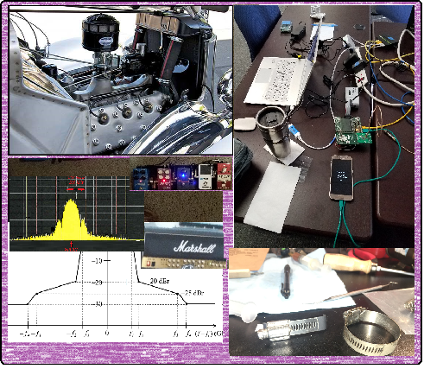
Technical Contributions

Slide 21
List of Technical Presentations
So Far, posted:
https://mentor.ieee.org/802.15/dcn/22/15-22-0242-00-04ab-review-of-uwb-coex-contributions.pptx
https://mentor.ieee.org/802.15/dcn/22/15-22-0256-00-04ab-simultaneous-ranging-solutions.pptx
https://mentor.ieee.org/802.15/dcn/22/15-22-0257-00-04ab-cir-feedback-scheme-for-uwb-sensing-continue.pptx
https://mentor.ieee.org/802.15/dcn/22/15-22-0255-00-04ab-mac-considerations-on-unified-control-for-uwb-sensing-and-ranging.pptx
https://mentor.ieee.org/802.15/dcn/22/15-22-0248-00-04ab-privacy-preserving-and-performance-enhancement-for-uwb-sensing.pptx
https://mentor.ieee.org/802.15/dcn/22/15-22-0243-00-04ab-golay-complementary-sequences-preamble-construction-for-uwb-ranging-beyond-4z-ipatov.pptx

Slide 22
Next Steps

Slide 23
Interim TC planning
Call frequency and phase:
Call organization:
Topics:

Slide 24
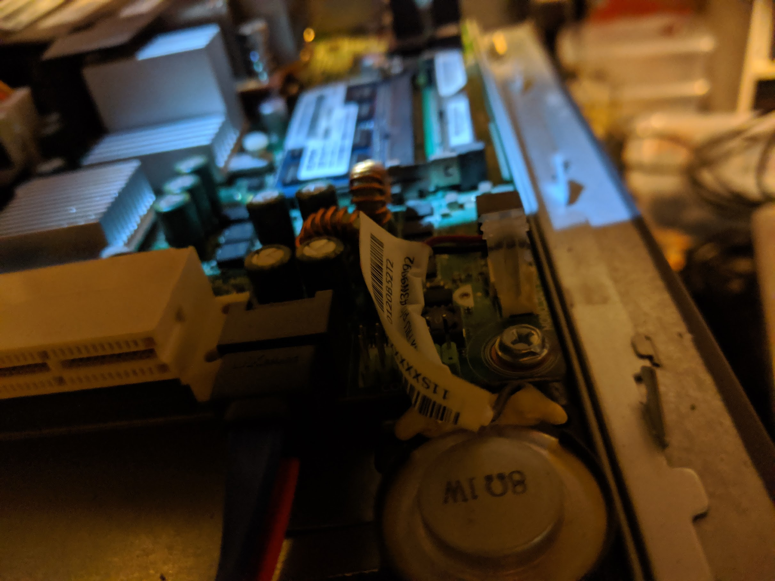
Task Group Closing

Slide 25
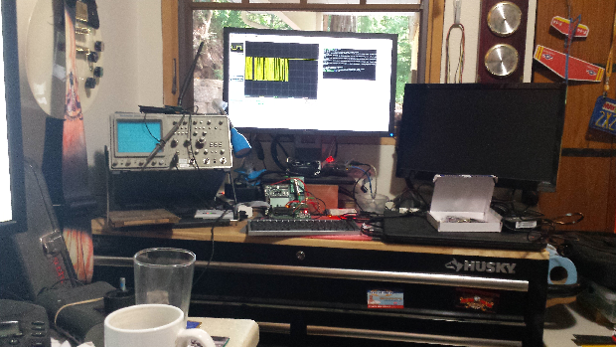
Other Business

Slide 26
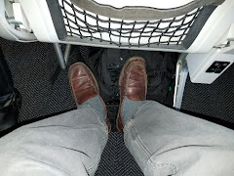
Adjourned Thanks

