Slide 1
Project: IEEE P802.15 Working Group for Wireless Personal Area Networks (WPANs)
Submission Title: [MAC considerations on unified control for UWB sensing and ranging]
Date Submitted: [May 10, 2022]
Source: [Kuan Wu, Xiaohui Peng, Bin Qian , David Xun Yang] Company [Huawei Technologies]
Contact: wukuan2@huawei.com
Abstract: [UWB sensing and ranging, MAC control support, Information Element Design]
Purpose: [Discussion on MAC considerations on unified control for UWB sensing and ranging in 802.15.4ab]
Notice: This document has been prepared to assist the IEEE P802.15. It is offered as a basis for discussion and is not binding on the contributing individual(s) or organization(s). The material in this document is subject to change in form and content after further study. The contributor(s) reserve(s) the right to add, amend or withdraw material contained herein.
Release: The contributor acknowledges and accepts that this contribution becomes the property of IEEE and may be made publicly available by P802.15.

Slide 2
PAR Objective | Proposed Solution (how addressed)
Safeguards so that the high throughput data use cases will not cause significant disruption to low duty-cycle ranging use cases
Interference mitigation techniques to support higher density and higher traffic use cases
Other coexistence improvement
Backward compatibility with enhanced ranging capable devices (ERDEVs) | A unified MAC control support for sensing systems piggy-backing on ranging protocols
Improved link budget and/or reduced air-time
Additional channels and operating frequencies
Improvements to accuracy / precision / reliability and interoperability for high-integrity ranging
Reduced complexity and power consumption
Hybrid operation with narrowband signaling to assist UWB
Enhanced native discovery and connection setup mechanisms
Sensing capabilities to support presence detection and environment mapping | MAC control support for UWB sensing session control and configuration
Low-power low-latency streaming
Higher data-rate streaming allowing at least 50 Mbit/s of throughput
Support for peer-to-peer, peer-to-multi-peer, and station-to-infrastructure protocols
Infrastructure synchronization mechanisms

Slide 3
Related submission
IEEE Standard for Low-Rate Wireless Networks–Amendment 1: Enhanced Ultra Wideband (UWB) Physical Layers (PHYs) and Associated Ranging Techniques, IEEE Standard 802.15.4z-2020 (Amendment to IEEE Standard 802.15.4-2020), IEEE SA, pp. 1–174, Aug. 25, 2020
15-21-0530-00-04ab-dl-tdoa-positioning-tdma-scheme (Oct. 2021) , Jean-Marie André et al.
15-21-0616-01-04ab-beacon-and-ranging-frames-to-support-downlink-tdoa-dl-tdoa-location-service-in-802-15 (Nov. 2021), Yongsen Ma et al.
15-22-0040-04-04ab-waveform-design-for-uwb-sensing (Jan. 2022) , Xiaohui Peng et al.
15-22-0155-00-04ab-cir-feedback-scheme-for-uwb-sensing (Mar. 2022) , Bin Qian et al.
15-22-0175-00-04ab-sensing-device (Mar. 2022) , Dag T. Wisland et al.
15-22-0012-02-04ab-uwb-sensing-scenarios-for-802-15-4ab (Jan. 2022) , Pooria Pakrooh et al.
15-21-0399-00-04ab-uwb-sensing-in-802-15 (Jul. 2021) , Frank Leong et al.
15-22-0061-00-04ab-sensing-continued (Jan. 2022) , Frank Leong et al.
15-22-0083-01-04ab-uwb-sensing-concepts (Jan. 2022) , Dag T. Wisland et al.

Slide 4
Introduction
In this contribution, we provided a preliminary study on a unified MAC control for sensing and ranging
  Advanced Ranging Control IE (ARC IE) [1] is reused to extend the round usage definitions
  A newly designed sensing device management IE (SDM IE) derived from ranging device management IE (RDM IE) [1] is introduced

Slide 5
Recap of DL-TDOA
Anchor
Anchor
OWR
TWR
Anchor
Tag
Ranging packet
One-way ranging (OWR) between anchors and tags is used for DL-TDOA services [1]-[3]
In the DL-TDOA scenarios, inter-anchors can act in a two-way ranging (TWR) manner [3]
Remark: TWR services between anchors can piggy-back on OWR/DL-TDOA services, or vice versa.

Slide 6
Recap of UWB sensing pulse shape
A preliminary study is proposed on sensing waveform design and requirements considerations [4]
An example sensing pulse shape is the 8th order Butterworth pulse multiplied by Gaussian window [4], with low post-ring (left figure above), meanwhile complying with the power spectral density (PSD) mask (right figure above)
Remark: A well-designed unified pulse shape may have the potentials to perform simultaneous sensing and ranging.

Slide 7
Recap of UWB sensing session
Legacy 4z round/block structure is employed for UWB sensing session [5]
Sensing shares a similar round timing structure with ranging in terms of a control phase, a measurement phase and a reporting phase [5]
Deriving sensing system from ranging protocol is suggested in [6]
Remark: A unified MAC control signaling can be considered for sensing and ranging.

Slide 8
Observation and Motivation
Controller/Requesting
device
Sensing/Ranging
device
Sensing/Ranging
device
OWR
Sensing
Tag
TWR
Object
Sensing/Ranging device
Sensing/Ranging device
Control/Request
Sensing/Ranging packet
Measurement related report
FIG 1. A generalized/unified UWB role structure
Regardless of sensing/ranging [1-10], all these services can be depicted by a generalized/unified UWB role structure model
In this contribution, we propose a unified MAC control support for sensing and ranging. Specifically, round usage definition and device role management are studied via ARC IE and RDM IE, respectively

Slide 9
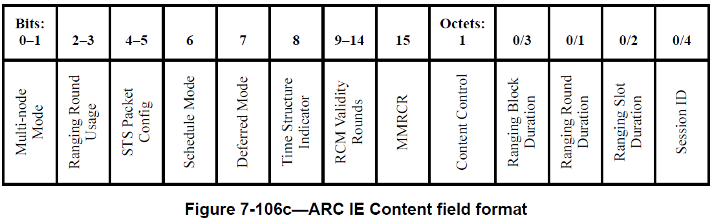
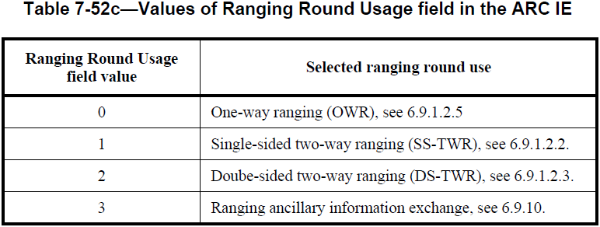
Re-using ARC IE for extended round usage definition
Bits: 0 | 1 | 2 | 3 | 4-7
RBDP | RRDP | RSDP | SIP | Reserved
Figure 7-106d—Content Control field of the ARC IE
Ranging Round Usage field in ARC IE in 802.15.4z [1] only configurates ranging services
Utilizing some of the reserved bits in Content Control field to extend round usage to include sensing services and various services piggy-backing
In many-to-many scenarios, legacy devices can still recognize its round usage via ARC IE

Slide 10
Re-using ARC IE for extended round usage definition (cont.)
An example list of extended round usage definitions
Extended round usage value | Extended round usage definition | Remark
0 | One-way ranging (OWR) | Legacy round usage definitions in ARC IE
1 | Single-sided two-way ranging (SS-TWR)
2 | Double-sided two-way ranging (DS-TWR)
3 | SS-TWR piggybacking OWR | Newly introduced round usage definitions in ARC IE
4 | DS-TWR piggybacking OWR
5 | One-way sensing (OWS)
6 | Two-way sensing (TWS)
7 | OWS piggybacking OWR
8 | TWS piggybacking SS-TWR
9 | TWS piggybacking DS-TWR
10 | TWS piggybacking SS-TWR and OWR
11 | TWS piggybacking DS-TWR and OWR

Slide 11
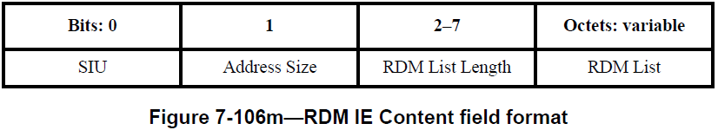
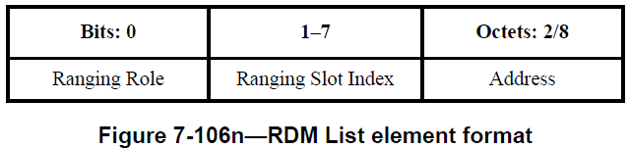
Thoughts on sensing device management
Since sensing and ranging share many similarities in slotted round structure [5], the sensing device management IE (SDM IE) can be derived from RDM IE
Apart from the functions already supported by RDM IE, the SDM IE should at least add the following functions as:
  Sensing mode indication: active sensing or passive sensing [7]
  Device role determination according to the sensing mode and extended round usage on services piggy-backing modes specified by ARC IE

Slide 12
Thoughts on sensing device management design (cont.)
Example format of SDM IE content field format
Bits: 0 | 1 | 2-7 | Octets: variable
SIU | Address Size | SDM List Length | SDM List
Bits: 0 | 1 | 2-8 | 9-15 | Octets: 2/8
Sensing Role | Sensing Mode | Sensing Slot Index | Reserved | Address
 | Sensing Mode=0 | Sensing Mode=1
Sensing Role=0 | Passive sensing, the selected device is the sensing transmitter In case of simultaneous sensing and ranging, the selected device is also the ranging responder | Active sensing, the selected device is the receiver In case of simultaneous sensing and ranging, the selected device is also the ranging responder
Sensing Role=1 | Passive sensing, the selected device is the receiver In case of simultaneous sensing and ranging, the selected device is also the ranging initiator | Active sensing, the selected device is the transmitter In case of simultaneous sensing and ranging, the selected device is also the ranging initiator
‘Simultaneous sensing and ranging’ refers to round usages provided in the aforementioned list of extended round usage definitions

Slide 13
Summary and suggestions
In this contribution, we proposed a preliminary study on unified MAC control support for sensing and ranging
  The ARC IE can be reused to configurate the extended round usage, providing some backward compatibility with legacy ranging devices
  The SDM IE can be derived from RDM IE to support sensing device management
More design considerations on unified MAC for sensing and ranging should be further discussed

Slide 14
Appendix
Passive sensing [6]: Initiator is the sensing receiver, responders are sensing transmitters
Active sensing [6]: Initiator is the sensing transmitter, responders are sensing receivers
Initiator/Rx
Responder/Tx
Initiator/Tx
Responder/Rx
Object
Object
    Passive sensing
    Active sensing
Sensing request
Sensing packet
Sensing measurement related reports

Slide 15
Appendix
Illustration of OWS and TWS proposed in [7]
Initiator/Rx
Responder/Tx
Initiator/Tx
Responder/Rx
Object
Object
    One-way Sensing (OWS)
    Two-way Sensing (TWS)
Sensing packet 1
Sensing packet 2

