Slide 1
Project: IEEE P802.15 Working Group for Wireless Specialty Networks (WSN)
Submission Title: Simultaneous ranging solutions
Source: Bin Qian, ChenchenLiu, Kuan Wu, David Xun Yang, Peng Liu (Huawei Technologies)
Address : [Huawei Bantian Base, Longgang District, Shenzhen, 518129 China]
E-Mail: [qianbin14@huawei.com]
Re: Task Group 4ab: UWB Next Generation for 802.15.4
Abstract: [simultaneous ranging, preamble shift, MMS-UWB]
Purpose:
Notice: This document has been prepared to assist the IEEE P802.15. It is offered as a basis for discussion and is not binding on the contributing individual(s) or organization(s). The material in this document is subject to change in form and content after further study. The contributor(s) reserve(s) the right to add, amend or withdraw material contained herein.
Release: The contributor acknowledges and accepts that this contribution becomes the property of IEEE and may be made publicly available by P802.15.
Notes:
Jul 12, 2010
Page 1

Slide 2
PAR Objective | Proposed Solution (how addressed)
Safeguards so that the high throughput data use cases will not cause significant disruption to low duty-cycle ranging use cases
Interference mitigation techniques to support higher density and higher traffic use cases | Proper preamble cyclic shift mitigates the interference among different responders
Other coexistence improvement
Backward compatibility with enhanced ranging capable devices (ERDEVs)
Improved link budget and/or reduced air-time
Additional channels and operating frequencies
Improvements to accuracy / precision / reliability and interoperability for high-integrity ranging | Solutions to enable simultaneous ranging
Reduced complexity and power consumption | The time of correlation operation is reduced at the receiver to save power by simultaneous ranging
Hybrid operation with narrowband signaling to assist UWB
Enhanced native discovery and connection setup mechanisms
Sensing capabilities to support presence detection and environment mapping
Low-power low-latency streaming
Higher data-rate streaming allowing at least 50 Mbit/s of throughput
Support for peer-to-peer, peer-to-multi-peer, and station-to-infrastructure protocols
Infrastructure synchronization mechanisms

Slide 3
Simultaneous ranging solutions

Slide 4
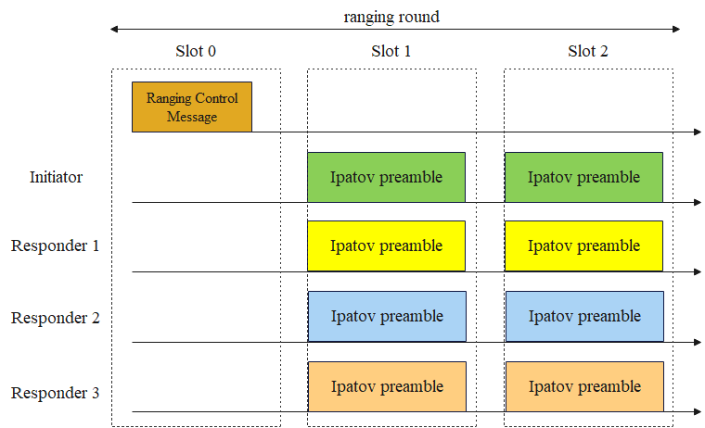
Recap - Multiple Transmissions in One Slot
In [1], the concepts of multiple transmissions in one ranging slot is introduced in the DL-TDOA scenario
Multiple devices transmit different Ipatov preambles at the same time
Challenge: the receiver is required to perform multiple correlation operations which may increase the complexity

Slide 5
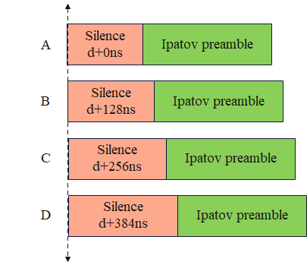
Simultaneous Ranging – Time Shift
An enhancement to the ranging is the so-called simultaneous ranging [2], which enables multiple devices to respond at almost the same time with overlapping frames.
Each responding device has a different delay and applies the same Ipatov preamble sequence such that the receiver only needs to perform the correlation operation once. By time shift, the correlation duration is roughly equal to the Ipatov preamble length instead of the Ipatov preamble length times the number of responders, which reduces the complexity. Note that the Ipatov preamble here is a sequence that can differ from the existing sequences used in 15.4z

Slide 6
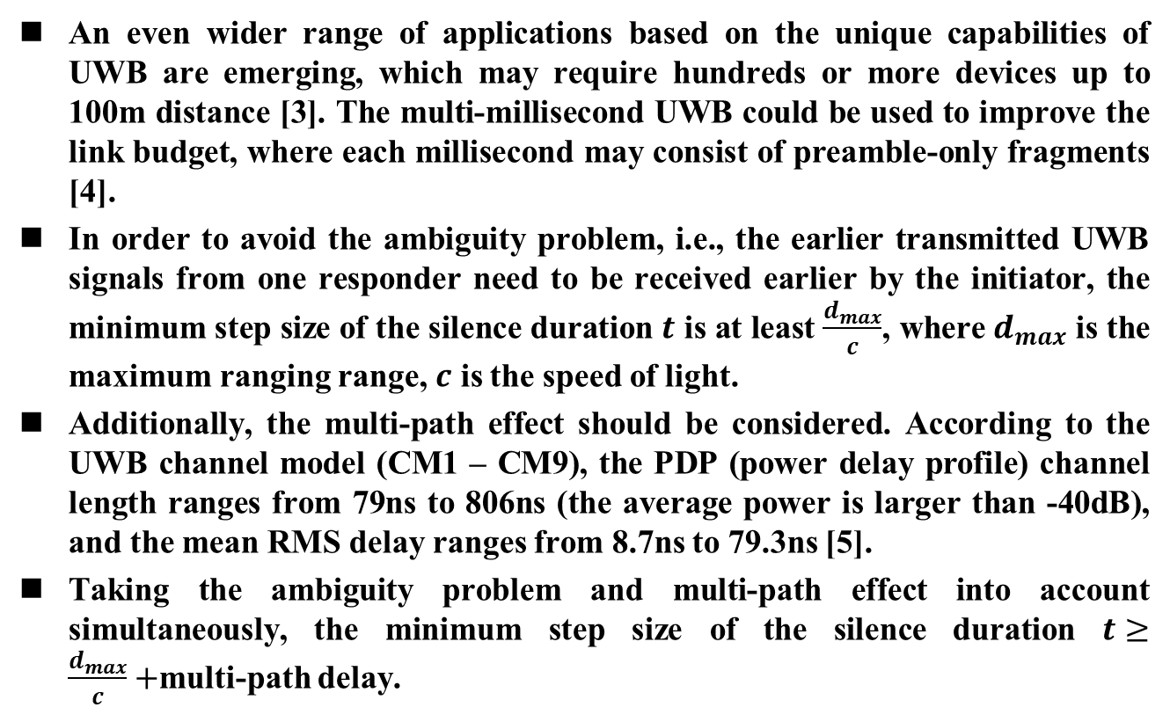
Practical Issues of Time Shift Solution
An even wider range of applications based on the unique capabilities of UWB are emerging, which may require hundreds or more devices up to 100m distance [3]. The multi-millisecond UWB could be used to improve the link budget, where each millisecond may consist of preamble-only fragments [4].
In order to avoid the ambiguity problem, i.e., the earlier transmitted UWB signals from one responder need to be received earlier by the initiator, the minimum step size of the silence duration $t$ is at least $\frac{d_{max}}{c}$, where $d_{max}$ is the maximum ranging range, $c$ is the speed of light.
Additionally, the multi-path effect should be considered. According to the UWB channel model (CM1 – CM9), the PDP (power delay profile) channel length ranges from 79ns to 806ns (the average power is larger than -40dB), and the mean RMS delay ranges from 8.7ns to 79.3ns [5].
Taking the ambiguity problem and multi-path effect into account simultaneously, the minimum step size of the silence duration $t≥\frac{d_{max}}{c}+$multi-path delay.

Slide 7
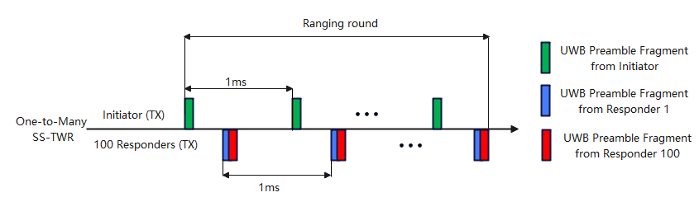
Practical Issues of Time Shift Solution
In the SS-TWR scheme, the measurement error caused by clock offset between the initiator and the responders is proportional to the reply time of the responders
Time shift solution may increase the reply time. For example, let’s consider the MMS-UWB case where there are 32 fragments, each lasts about 30us. Assume there are 100 responders and the silence delay step size is 250ns, the largest silence delay would be about 25us
The larger reply time results in larger measurement error

Slide 8
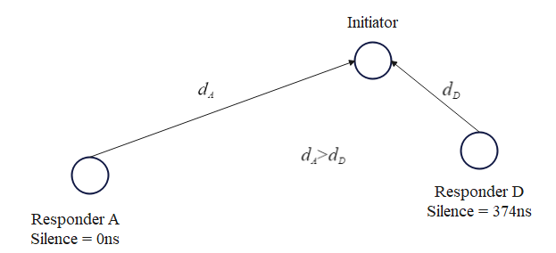
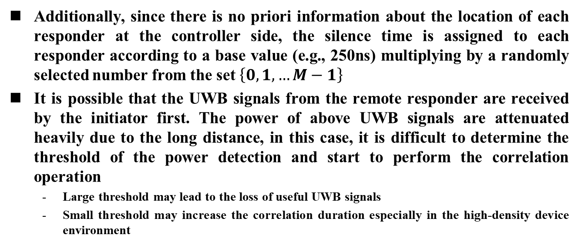
Practical Issues of Time Shift Solution
Additionally, since there is no priori information about the location of each responder at the controller side, the silence time is assigned to each responder according to a base value (e.g., 250ns) multiplying by a randomly selected number from the set $\left\{0, 1, …M−1\right\}$
It is possible that the UWB signals from the remote responder are received by the initiator first. The power of above UWB signals are attenuated heavily due to the long distance, in this case, it is difficult to determine the threshold of the power detection and start to perform the correlation operation
  Large threshold may lead to the loss of useful UWB signals
  Small threshold may increase the correlation duration especially in the high-density device environment

Slide 9
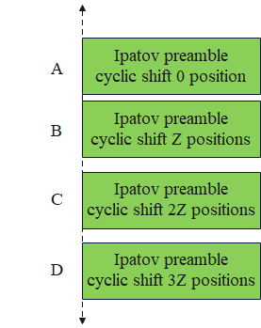
Simultaneous Ranging – Preamble Shift
Actually, the simultaneous ranging could be also achieved by shifting the preamble sequence instead of staggering the transmission start time
In this scheme, each responder generates its own preamble sequence based on an identical base Ipatov sequence by cyclic shifting the above base sequence with proper positions in one direction respectively. The shifted preamble sequences from responders are aligned to start at the same time

Slide 10
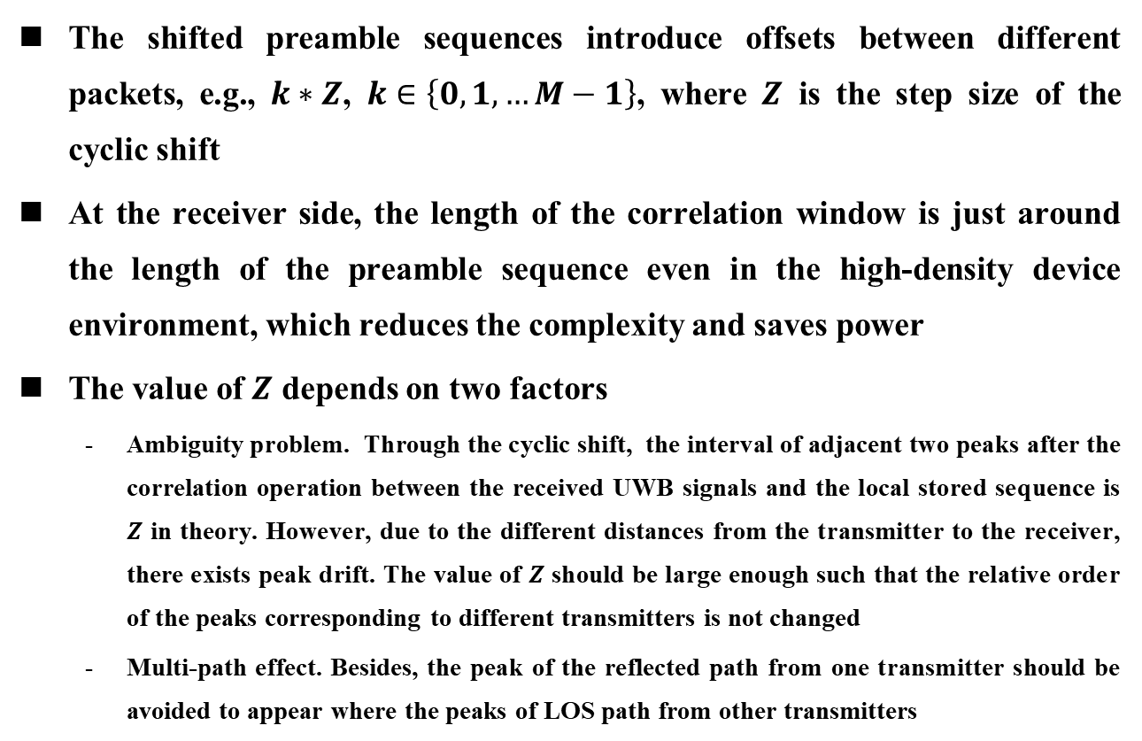
Simultaneous Ranging – Preamble Shift
The shifted preamble sequences introduce offsets between different packets, e.g., $k∗Z$, $k∈\left\{0, 1, …M−1\right\}$, where $Z$ is the step size of the cyclic shift
At the receiver side, the length of the correlation window is just around the length of the preamble sequence even in the high-density device environment, which reduces the complexity and saves power
The value of $Z$ depends on two factors
  Ambiguity problem. Through the cyclic shift, the interval of adjacent two peaks after the correlation operation between the received UWB signals and the local stored sequence is $Z$ in theory. However, due to the different distances from the transmitter to the receiver, there exists peak drift. The value of $Z$ should be large enough such that the relative order of the peaks corresponding to different transmitters is not changed
  Multi-path effect. Besides, the peak of the reflected path from one transmitter should be avoided to appear where the peaks of LOS path from other transmitters

Slide 11
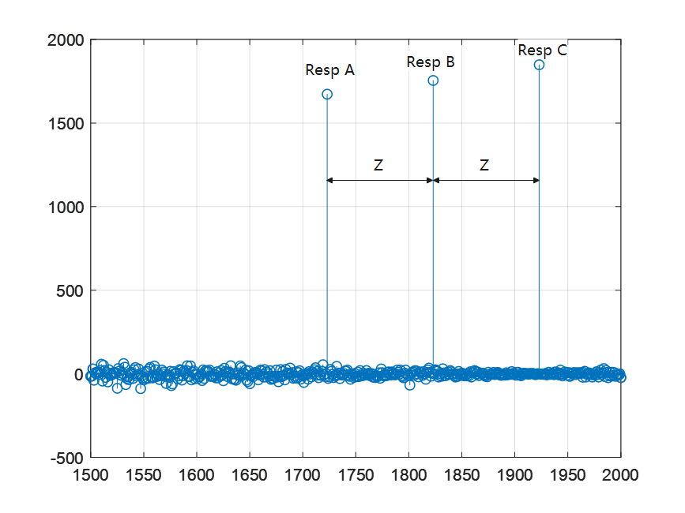
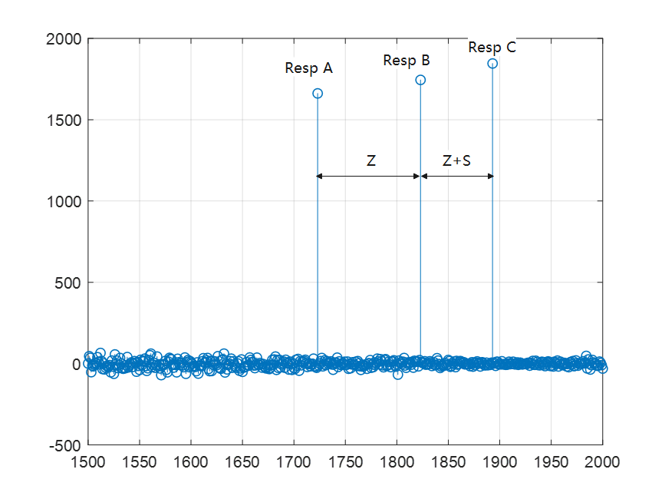
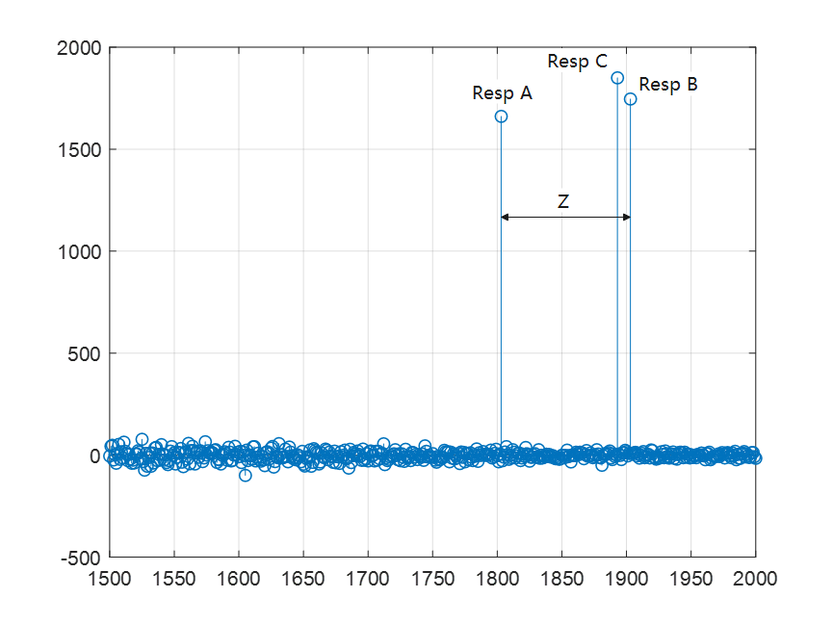
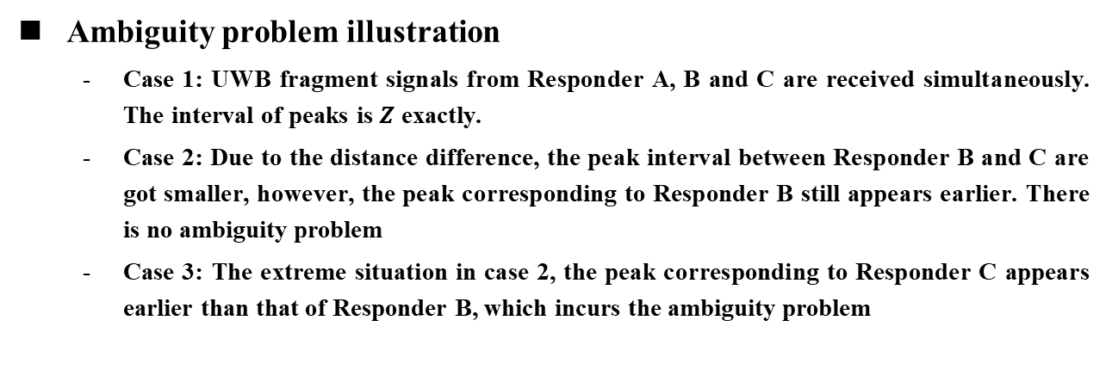
Simultaneous Ranging – Preamble Shift
Ambiguity problem illustration
  Case 1: UWB fragment signals from Responder A, B and C are received simultaneously. The interval of peaks is $Z$ exactly.
  Case 2: Due to the distance difference, the peak interval between Responder B and C are got smaller, however, the peak corresponding to Responder B still appears earlier. There is no ambiguity problem
  Case 3: The extreme situation in case 2, the peak corresponding to Responder C appears earlier than that of Responder B, which incurs the ambiguity problem
Case 1
Case 2
Case 3

Slide 12
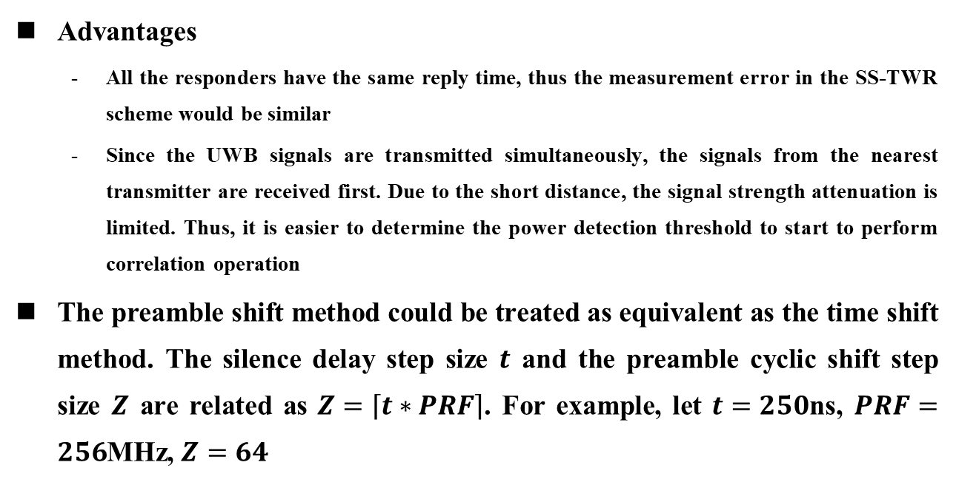
Preamble Shift - Implementation Advantages
Advantages
  All the responders have the same reply time, thus the measurement error in the SS-TWR scheme would be similar
  Since the UWB signals are transmitted simultaneously, the signals from the nearest transmitter are received first. Due to the short distance, the signal strength attenuation is limited. Thus, it is easier to determine the power detection threshold to start to perform correlation operation
The preamble shift method could be treated as equivalent as the time shift method. The silence delay step size $t$ and the preamble cyclic shift step size $Z$ are related as $Z=\left\lceil t∗PRF\right\rceil$. For example, let $t=250$ns, $PRF=256$MHz, $Z=64$

Slide 13
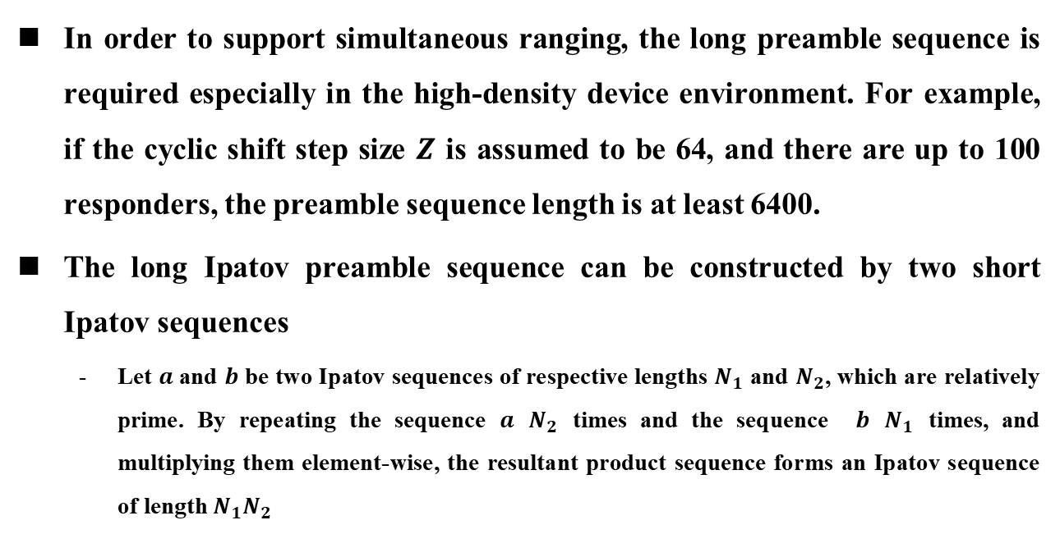
Preamble Construction
In order to support simultaneous ranging, the long preamble sequence is required especially in the high-density device environment. For example, if the cyclic shift step size $Z$ is assumed to be 64, and there are up to 100 responders, the preamble sequence length is at least 6400.
The long Ipatov preamble sequence can be constructed by two short Ipatov sequences
  Let $a$ and $b$ be two Ipatov sequences of respective lengths $N_{1}$ and $N_{2}$, which are relatively prime. By repeating the sequence $a$ $N_{2}$ times and the sequence $b$ $N_{1}$ times, and multiplying them element-wise, the resultant product sequence forms an Ipatov sequence of length $N_{1}N_{2}$

Slide 14
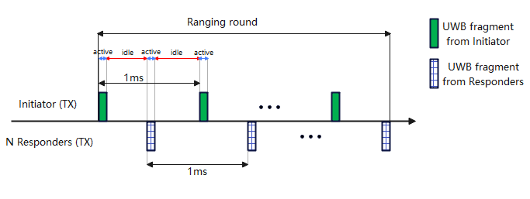
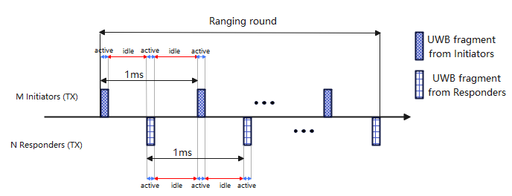
Use Cases
One-to-many SS-TWR
Many-to-many SS-TWR

Slide 15
Summary
In this presentation, some aspects of the simultaneous ranging are introduced:
  A time shift and a preamble shift based simultaneous ranging solutions are compared
  Compared with the time shift solution, the preamble shift solution has two implementation advantages
    The reply time of all responders are same
    It is easier to determine the start of the correlation window
  The simultaneous ranging solutions could be used in the one-to-many and many-to-many ranging scenarios

Slide 16
References
Mingyu Lee, Taeyoung Ha, Jungyoung Choi, Karthik Srinivasa Gopalan, Aniruddh Rao Kabbinale, Ankur Bansal, Clint Chaplin, “Multiple transmissions in a ranging slot,” IEEE 802.15-22-0179-00-04ab, March, 2022.
Petr Sedlacek, Martin Slanina, and Pavel Masek, “An overview of the IEEE 802.15.4z standard and its comparison to the existing UWB standard”, 29th International Conference on Radioelektronika, April, 2019.
Dieter Coppens, Eli De Poorter, Adnan Shahid, Sam Lemey and Chris Marshall, “An overview of ultra-wideband (UWB) standards (IEEE 802.15.4, FiRa, Apple): interoperability aspects and future research directions”, arXiv:2202.02190
Ersen Ekrem, Ido Bettesh, and Moche Cohen, “More on narrowband assisted multi-millisecond UWB”, IEEE 802.15-21-0593-01-04ab, Nov, 2021.
Carlos Aldana, Qiyue Zou, “Preamble codes for data communications in 802.15.4ab”, IEEE 802.15-21-0377-02-04ab, Sep, 2021.

