Slide 1
Project: IEEE P802.15 Working Group for Wireless Specialty Networks (WSN)
Submission Title: Privacy Preserving and Performance Enhancement for UWB Sensing
Source: Li Sun, Peng Liu, Yuwei Wang, Kuan Wu, Bin Qian, and David Xun Yang
Address : [Huawei Bantian Base, Longgang District, Shenzhen, 518129 China]
E-Mail: [sunli50@huawei.com]
Re: Task Group 4ab: UWB Next Generation for 802.15.4
Abstract: [Sensing, privacy, performance enhancement, UWB]
Purpose:
Notice: This document has been prepared to assist the IEEE P802.15. It is offered as a basis for discussion and is not binding on the contributing individual(s) or organization(s). The material in this document is subject to change in form and content after further study. The contributor(s) reserve(s) the right to add, amend or withdraw material contained herein.
Release: The contributor acknowledges and accepts that this contribution becomes the property of IEEE and may be made publicly available by P802.15.
Notes:
Jul 12, 2010
Page 1

Slide 2
PAR Objective | Proposed Solution (how addressed)
Safeguards so that the high throughput data use cases will not cause significant disruption to low duty-cycle ranging use cases
Interference mitigation techniques to support higher density and higher traffic use cases
Other coexistence improvement
Backward compatibility with enhanced ranging capable devices (ERDEVs)
Improved link budget and/or reduced air-time
Additional channels and operating frequencies
Improvements to accuracy / precision / reliability and interoperability for high-integrity ranging
Reduced complexity and power consumption
Hybrid operation with narrowband signaling to assist UWB
Enhanced native discovery and connection setup mechanisms
Sensing capabilities to support presence detection and environment mapping | This contribution proposes a novel sensing mode called collaborative sensing, which can preserve user privacy and improve sensing performance as well.
Low-power low-latency streaming
Higher data-rate streaming allowing at least 50 Mbit/s of throughput
Support for peer-to-peer, peer-to-multi-peer, and station-to-infrastructure protocols
Infrastructure synchronization mechanisms

Slide 3
Related Contributions
UWB sensing in 802.15 <15-21-0399-00-04ab>, Jul. 2021, Frank Leong, et. al.
UWB sensing scenarios for 802.15.4ab <15-22-0012-01-04ab>, Jan. 2022, Pooria Pakrooh, et. al.
Sensing – continued <15-22-0061-00-04ab>, Jan. 2022, Frank Leong, et. al.
Sensing device <15-22-0175-00-04ab>, March. 2022, Dag T. Wisland, et al.
Privacy issues in UWB sensing <15-22-0177-00-04ab>, Mar. 2022, Li Sun, et al.

Slide 4
Privacy Issues in Sensing (Recap)
Two privacy issues in UWB sensing have been identified in [1].
Privacy issue #1: CIR report fed back from receiver to transmitter may be overheard by unauthorized or malicious users, which incurs privacy concerns —— This issue can be easily dealt with using encryption approaches
Privacy issue #2: Sensing packets/preamble can be received and decoded by anyone. By capturing legitimate transmitter’s sensing packets/preamble and measuring CIR, unauthorized entities can infer the presence and locations of the objects, analyze the behaviors of users, do environmental mapping, etc., which violates users’ privacy requirement —— This issue is more challenging than issue #1, because it cannot be solved by simply using encryption techniques.
[1] Privacy issues in UWB sensing <15-22-0177-00-04ab>, Mar. 2022, Li Sun, et al.

Slide 5
Collaborative Sensing: Framework
Basic Idea:
Each sensing round is divided into two slots
In each slot, two responders transmit sensing packets collaboratively, where the sensing packets are generated from a public sequence and a secret codeword
The initiator combines the received signals from two slots to produce the sensing result
Due to the ignorance of the codewords, the unauthorized users are unable to infer the correct CIRs
Responder1
Responder2
TX1
TX2
Slot1: +s[n]
Slot2: +s[n]
Slot1: +s[n]
Slot2: -s[n]
h
Object
g
Initiator
RX
Round 1
Round 2
Initialization
Slot1
Slot2
Slot1
Slot2
...
Sensing Procedure

Slide 6
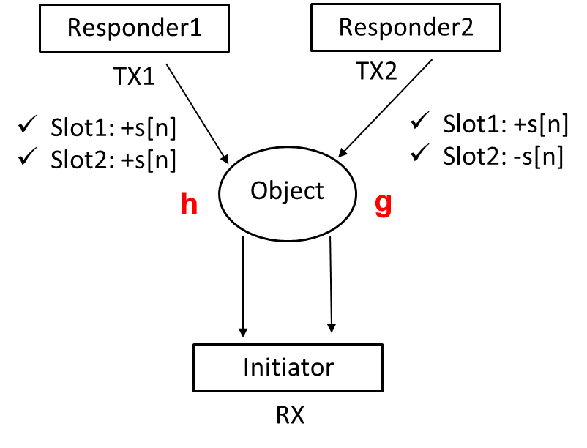
Collaborative Sensing: Implementation
Step 1: Initialization and synchronization setup (details will be discussed later)
Step 2: Sensing protocol within any round $m$:
Slot 1: TX1: $a_{m}s\left[n\right]$, TX2: $b_{m}s\left[n\right]$
Slot 2: TX1: $c_{m}s\left[n\right]$, TX2: $d_{m}s\left[n\right]$
s[n] is a public sequence known by everyone (e.g., Ipatov preamble)
{{$a_{m}$, $c_{m}$}, {$b_{m}$, $d_{m}$}} constitutes the codeword used for round m, which is chosen randomly from the following codebook: {{+1,+1},{+1,-1}}, {{+1,-1},{+1,+1}}, {{+1,+1},{-1,+1}}, {{+1,-1},{-1,-1}}, {{-1,+1},{+1,+1}}, {{-1,-1},{+1,-1}}, {{-1,+1},{-1,-1}}, {{-1,-1},{-1,+1}}
The codeword indices (i.e., 1~8) used for each round are only shared among the legitimate parties during Step 1 and are unknown to other devices (many approaches can be utilized to realize this, such as encryption)

Slide 7
Collaborative Sensing: Implementation
Step 3: CIR estimation by joint processing
Slot 1:
Slot 2:
$$y_{m,1}\left[n\right]=s\left[n\right]∗h_{m}\left[n\right]+s\left[n\right]∗g_{m}\left[n\right]+w_{m,1}[n]$$
$$y_{m,2}\left[n\right]=s\left[n\right]∗h_{m}\left[n\right]−s\left[n\right]∗g_{m}\left[n\right]+w_{m,2}[n]$$
where m is the round index and the codeword is assumed to be {{+1,+1},{+1,-1}}. Here, perfect synchronization is assumed between the two responders (how to realize this will be discussed later)
CIR estimate:
$z_{1}\left[n\right]=y_{m,1}\left[n\right]$+$y_{m,2}\left[n\right]$
$=2s\left[n\right]∗h_{m}\left[n\right]$+$w_{m,1}\left[n\right]+w_{m,2}[n]$
$$\hat{h_{m}\left[n\right]}$$
$z_{2}\left[n\right]=y_{m,1}\left[n\right]$-$y_{m,2}\left[n\right]$
$=2s\left[n\right]∗g_{m}\left[n\right]$+$w_{m,1}\left[n\right]−w_{m,2}[n]$
$$\hat{g_{m}\left[n\right]}$$

Slide 8
Collaborative Sensing: Implementation
Benefits of Collaborative Sensing
Privacy preserving capability: Based on the received signals within each round, the unauthorized user is only able to estimate the linear combinations of $h_{m}\left[n\right]$ and $g_{m}\left[n\right]$, where the combination coefficients are determined by the codewords. Thus, it is very difficult for the unauthorized user to estimate the CIR correctly, thereby protecting user privacy
Within any round $m$, the received signals at the unauthorized user:
$$y_{u,m,1}\left[n\right]=a_{m}s\left[n\right]∗h_{u,m}\left[n\right]+b_{m}s\left[n\right]∗g_{u,m}\left[n\right]+w_{u,m,1}[n]$$
$$a_{m}h_{u,m}\left[n\right]+b_{m}g_{u,m}\left[n\right]$$
$$y_{u,m,2}\left[n\right]=c_{m}s\left[n\right]∗h_{u,m}\left[n\right]+d_{m}s\left[n\right]∗g_{u,m}\left[n\right]+w_{u,m,2}[n]$$
$$c_{m}h_{u,m}\left[n\right]+d_{m}g_{u,m}\left[n\right]$$
The CIRs available at the unauthorized user:
$a_{1}h_{u,1}+b_{1}g_{u,1}$,
$c_{1}h_{u,1}+d_{1}g_{u,1}$,
$a_{2}h_{u,2}+b_{2}g_{u,2}$,
$c_{2}h_{u,2}+d_{2}g_{u,2}$,
$$⋯$$

Slide 9
Collaborative Sensing: Implementation
Benefits of Collaborative Sensing
Privacy preserving capability: Based on the received signals within each round, the unauthorized user is only able to estimate the linear combinations of $h_{m}\left[n\right]$ and $g_{m}\left[n\right]$, where the combination coefficients are determined by the codewords. Thus, it is very difficult for the unauthorized user to estimate the CIR correctly, thereby protecting user privacy
Improved sensing accuracy: 3dB SNR boost in CIR estimates
$z_{1}\left[n\right]=y_{m,1}\left[n\right]$+$y_{m,2}\left[n\right]$
$=2s\left[n\right]∗h_{m}\left[n\right]$+$w_{m,1}\left[n\right]+w_{m,2}[n]$
$$\hat{h_{m}\left[n\right]}$$
$z_{2}\left[n\right]=y_{m,1}\left[n\right]$-$y_{m,2}\left[n\right]$
$=2s\left[n\right]∗g_{m}\left[n\right]$+$w_{m,1}\left[n\right]−w_{m,2}[n]$
$$\hat{g_{m}\left[n\right]}$$
Both $h_{m}\left[n\right]$ and $g_{m}\left[n\right]$ can be estimated, thus obtaining a more accurate and complete characterization of the object being sensed

Slide 10
Details of Initialization Step
Initiator transmits sensing request
Responder 1 & 2 responds to the initiator by sending sensing request confirmation
Initiator estimates the round-trip time between the two responders and itself, denoted by TRT₁ and TRT₂
Initiator broadcasts an activation packet to start the sensing procedure.
The activation packet, sent at $t_{start}$, includes the following:
Timing information: a fixed delay $∆$, TRT₁, TRT₂
Codeword indices for each round (encryption is applied prior to transmission)
Responders determine the time instants to transmit sensing packets:
Responder 1: t₁+ $∆$ (t₁ is the time inst. at which activation packet is received by resp. 1)
Responder 2: t₂+ $∆$+TRT₁-TRT₂ $\text{(}\text{t}\text{2}$ $\text{is} \text{the} \text{time} \text{inst}\text{. }\text{at} \text{which} \text{activation} \text{packet} \text{is} \text{received} \text{by} \text{resp}\text{. 2)}$
The time instant of receiving sensing packet 1 at the initiator:
$t=t_{start}+\frac{TRT1}{2}+∆$ + $\frac{TRT1}{2}$ = $t_{start}+TRT1+∆$
The time instant of receiving sensing packet 2 at the initiator:
$t′=t_{start}+\frac{TRT2}{2}+∆$ + $TRT1$- $TRT2$ + $\frac{TRT2}{2}$ = $t_{start}+TRT1+∆$

Slide 11
Summary
A new sensing paradigm called collaborative sensing is proposed, where two responders perform joint sensing in a collaborative way
A coding method is developed at TX sides to pre-process the sensing signals, and a low-complexity signal combining approach is applied at RX side
The proposed method prevents the unauthorized users deciphering the CIR from its received sensing packets, thus protecting user privacy
Moreover, by using the proposed method, the CIR can be estimated with higher accuracy, and a more complete characterization of the object can be obtained

