Slide 1
Project: IEEE P802.15 Working Group for Wireless Personal Area Networks (WPANs)
Submission Title: Golay Complementary Sequences: Preamble Construction for UWB Ranging beyond 4z Ipatov
Date Submitted: 9 May, 2022
Source: Xiliang Luo and Moche Cohen (Apple Inc.)
Address: One Apple Park Way, Cupertino, CA 95104, USA
E-Mail: luoxiliang@ieee.org
Abstract: Review the benefits of preamble sequences based on Golay complementary pairs.
Purpose: Recommend a preamble sequence construction scheme for ranging beyond 4z.
Notice: This document has been prepared to assist the IEEE P802.15. It is offered as a basis for discussion and is not binding on the contributing individual(s) or organization(s). The material in this document is subject to change in form and content after further study. The contributor(s) reserve(s) the right to add, amend or withdraw material contained herein.
Release: The contributor acknowledges and accepts that this contribution becomes the property of IEEE and may be made publicly available by P802.15.

Slide 2
PAR Objective | Proposed Solution (how addressed)
Safeguards so that the high throughput data use cases will not cause significant disruption to low duty-cycle ranging use cases
Interference mitigation techniques to support higher density and higher traffic use cases | Proposed sequences offer flexible multi-user interference mitigation
Other coexistence improvement
Backward compatibility with enhanced ranging capable devices (ERDEVs)
Improved link budget and/or reduced air-time
Additional channels and operating frequencies
Improvements to accuracy / precision / reliability and interoperability for high-integrity ranging
Reduced complexity and power consumption | Proposed sequences allows efficient construction
Hybrid operation with narrowband signaling to assist UWB
Enhanced native discovery and connection setup mechanisms
Sensing capabilities to support presence detection and environment mapping
Low-power low-latency streaming
Higher data-rate streaming allowing at least 50 Mbit/s of throughput
Support for peer-to-peer, peer-to-multi-peer, and station-to-infrastructure protocols
Infrastructure synchronization mechanisms

Slide 3
Golay Complementary Sequences
Preamble Construction for UWB Ranging beyond 4z Ipatov

Slide 4
Golay Complementary Pair
Two sequences (a, b) form a Golay complementary pair (a.k.a. Golay sequences) when
  sum of the aperiodic autocorrelation functions of the two sequences is zero for any nonzero time shift
Preambles can be formed by concatenating the two sequences in a Golay pair
  a gap can be appended after each sequence
    a zero-autocorrelation zone (ZACZ) is obtained
    the size of the gap facilitates multi-user interference mitigation
  the concatenated sequence can be repeated for a number of times
a
0
b
0
a
0
b
gap

Slide 5
Golay Complementary Pair: Desirable Properties
Golay sequences are ideal for preambles beyond Ipatov in 4z
  a much larger set of sequences
  flat spectrum
    comparable to or even better than Ipatov sequences
  flexible interference mitigation in the presence of multi-user ranging
  efficient construction is available

Slide 6
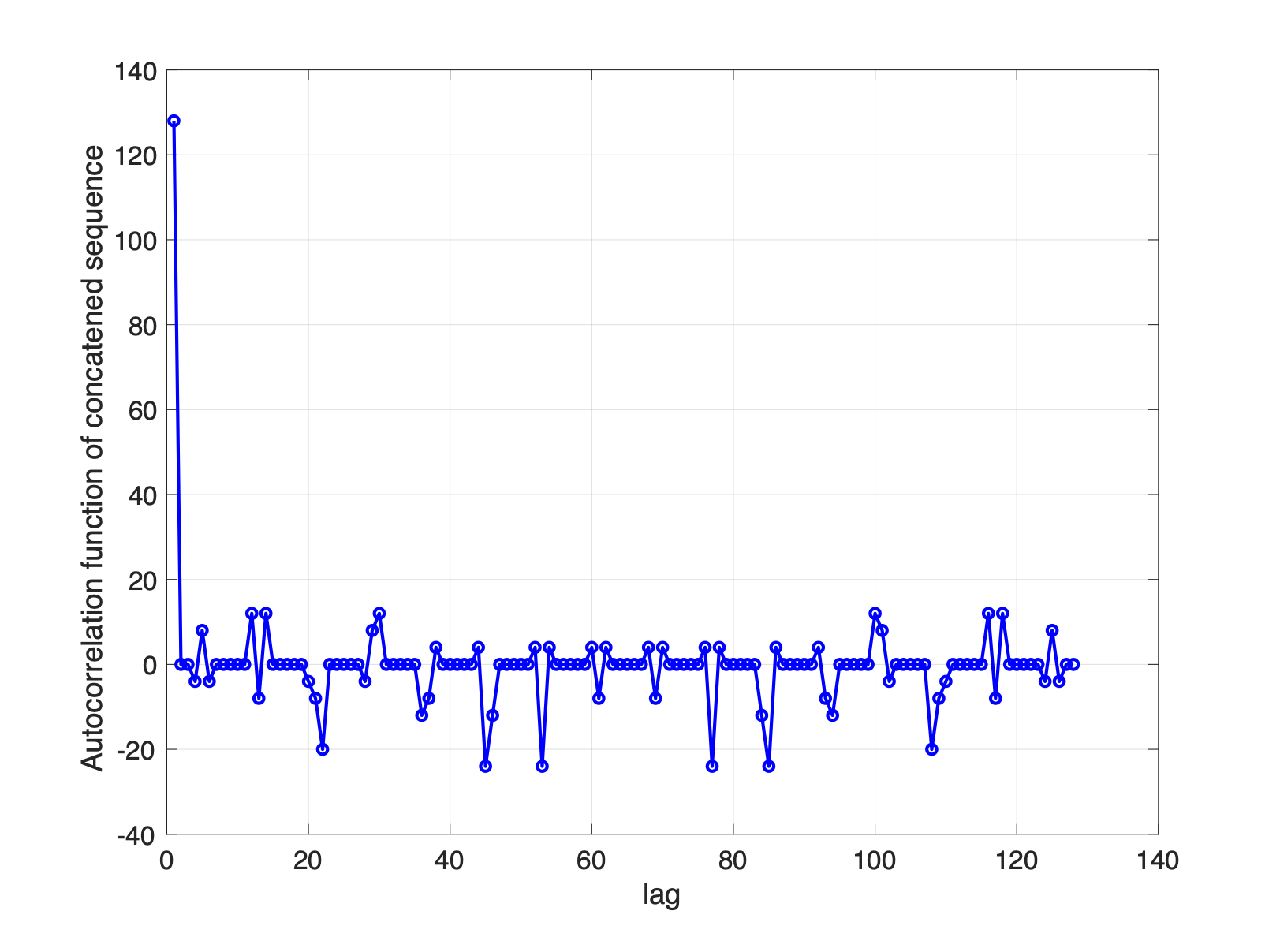
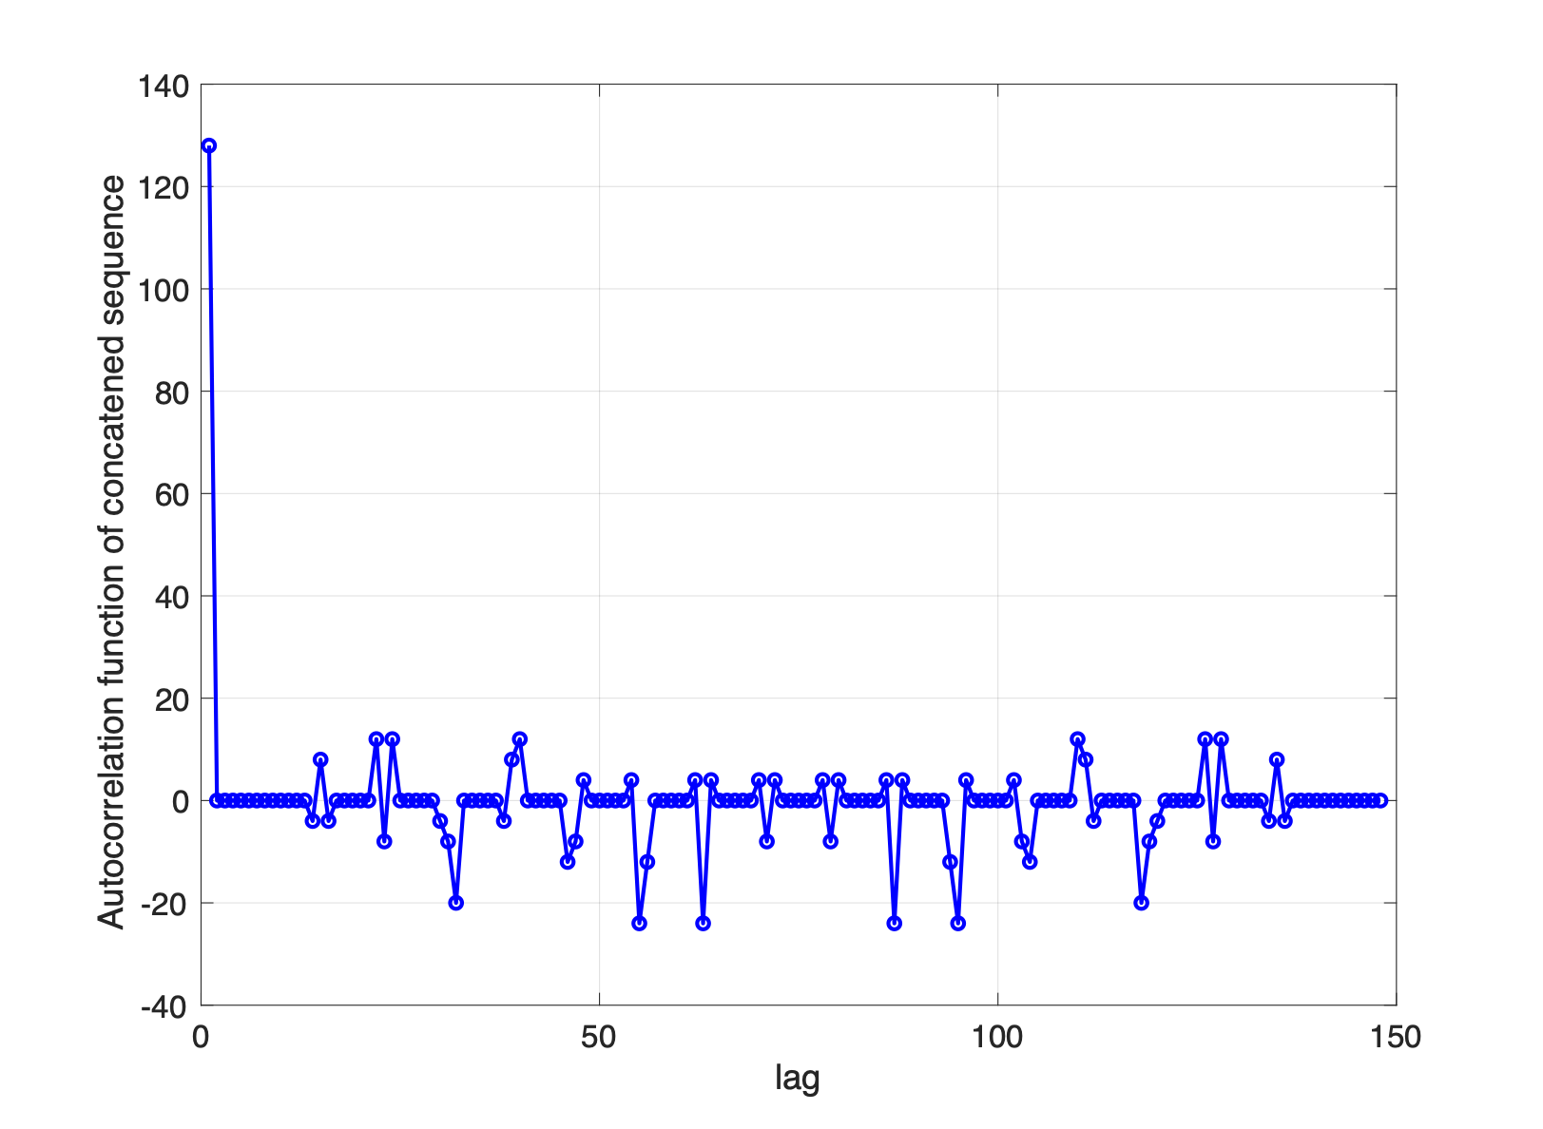
Example: Length(a) = Length(b) = 64
Gaps Enables ZACZ
Periodic ACF of concatenated sequence of a Golay 64 without any gaps
Periodic ACF of concatenated sequence of a Golay
64 with a gap of 10 after each sequence
a
b
a
b
a
0
b
0
a
0
b

Slide 7
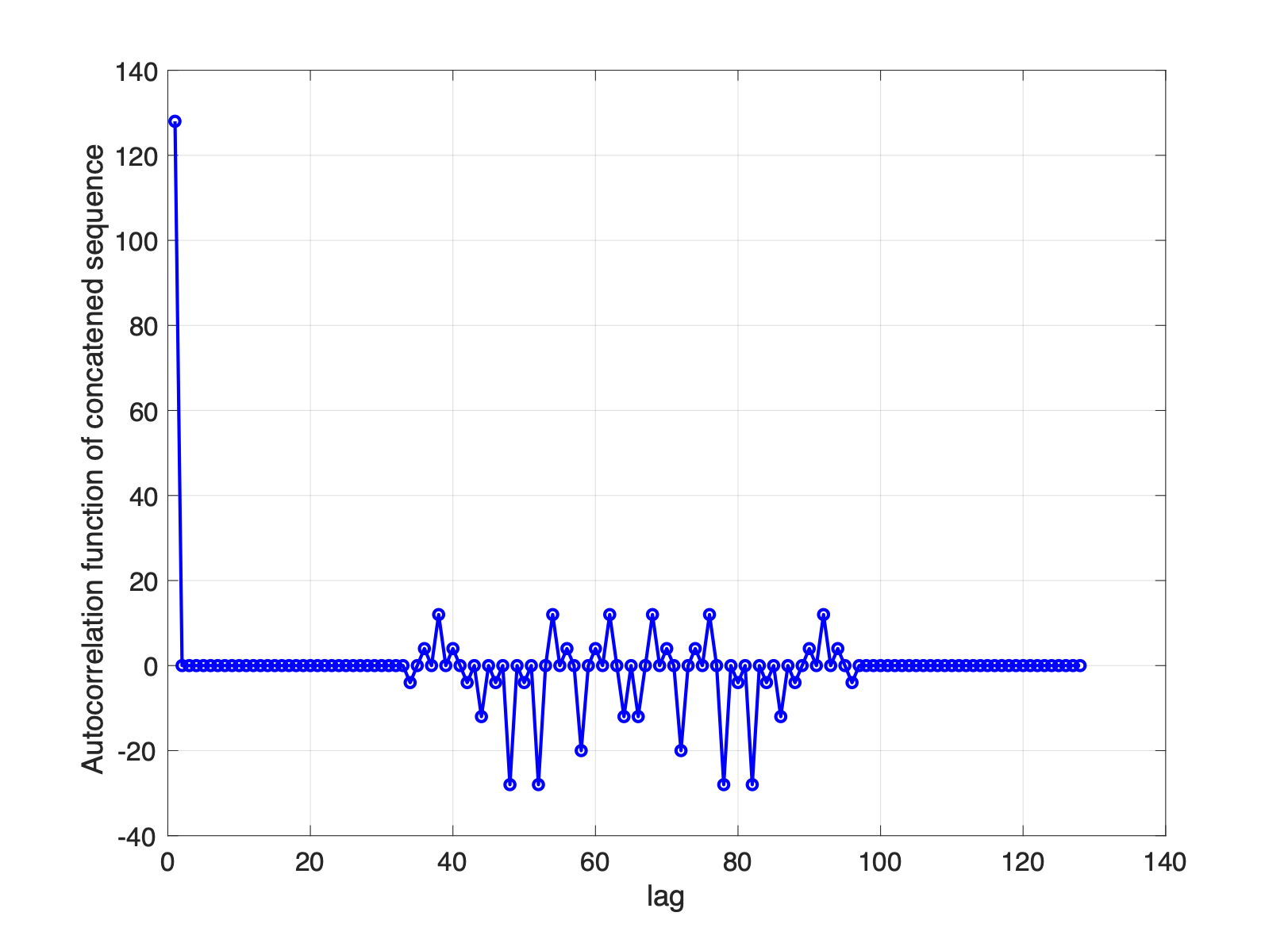
Example: Length(a) = Length(b) = 64
ZACZ is Feasible Without Gaps
ZACZ is possible when certain Golay complementary pairs are concatenated directly without any gaps
Periodic ACF of concatenated sequence of a special Golay 64 without any gap
The number of these type of Golay pairs is large, e.g., O(1000) for Golay length 64
a
b
a
b

Slide 8
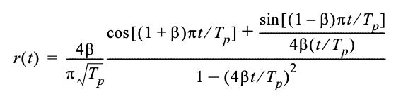
Spectrum of Golay Sequences
Comparable with Ipatov
Golay = [a, b], length=32, gap length=32
Ipatov_9 = [1, 0, 0, 1, 0, 0, 0, -1, 0, -1, -1, 0, 0, -1, -1, 1, 0, 1, 0, 1, 0, 0, -1, 1, -1, 1, 1, 0, 1, 0, 0, 0, 0, 1, 1, -1, 0, 0, 0, 1, 0, 0, -1, 0, 0, -1, -1, 0, -1, 1, 0, 1, 0, -1, -1, 0, -1, 1, 1, 1, 0, 1, 1, 0, 0, 0, 1, -1, 0, 1, 0, 0, -1, 0, 1, 1, -1, 0, 1, 1, 1, 0, 0, -1, 1, 0, 0, 1, 0, 1, 0, -1, 0, 1, 1, -1, 1, -1, -1, 1, 0, 0, 0, 0, 0, 0, 1, 0, 0, 0, 0, 0, -1, 1, 0, 0, 0, 0, -1, 0, -1, 0, 0, 0, -1, -1, 1]
Pulse Shape: SRRC
SF: 4

Slide 9
Cross-Correlation of Golay Sequences
Flexible Multi-User Interference Mitigation
Different gap sizes for different users improve the cross-correlation performance significantly
User-1
a
0
b
0
a
0
b
User-2
c
0
d
0
c
0
d
0
User-3
e
0
f
0
e
0

Slide 10
Example: Golay (32, 32) vs. Ipatov 127
Cross Correlations
Two Ipatov 127 sequences x 16
Preamble 1: Golay (32, 32) sequences with gap size of 32, repeat 16 times
Preamble 2: Golay (32, 32) sequences with gap size of 32, repeat 16 times
64 → 32
avg
64 → 8
(18dB)

Slide 11
Example: Golay (32, 32) vs. Ipatov 127
Cross Correlations
Two Ipatov 127 sequences x 16
Preamble 1: Golay (32, 32) sequences with gap size of 32, repeat 16 times
Preamble 2: Golay (32, 32) sequences with gap size of 33, repeat 16 times
64 → 4
(24dB)
avg
64 → 8
(18dB)
Different period length → More effective averaging & intf suppression

Slide 12





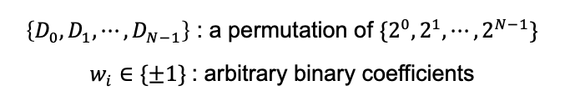







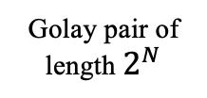
Construction of Golay Sequences
Well-Known Efficient Schemes
Golay pairs of length 2^N can be generated using the following recursive structure:
+
+
$$⋯$$
+
$$a_{k}^{[N]}$$
Golay pair of length $2^{N}$
$$δ_{k}$$
+
+
+
$$b_{k}^{[N]}$$
$$D_{0}$$
X
-
+
$$D_{1}$$
X
-
+
$$⋯$$
$$D_{N−1}$$
X
-
+
$$w_{0}$$
$$w_{1}$$
$$w_{N−1}$$
$\left\{D_{0},D_{1},⋯,D_{N−1}\right\}$ : a permutation of $\{2^{0},2^{1},⋯,2^{N−1}\}$
$w_{i}∈\{±1\}$: arbitrary binary coefficients
Total $2^{N}⋅N!$ Golay pairs of length $2^{N}$ can be constructed!

Slide 13
Conclusion
Preambles beyond 4z Ipatov can be constructed by concatenating the two sequences in a Golay pair
  Golay pair can be chosen to exhibit large ZACZs
  gap can be appended after each sequence
  concatenation is repeated in time for multiple times
Desirable properties for Golay complementary sequences based construction
  a large family of sequences with good auto-/cross-correlation properties
  flat spectrum
  flexible multi-user interference mitigation
  allows efficient construction

Slide 14
More Information

Slide 15
Golay sequences assumed, length=32

Slide 16
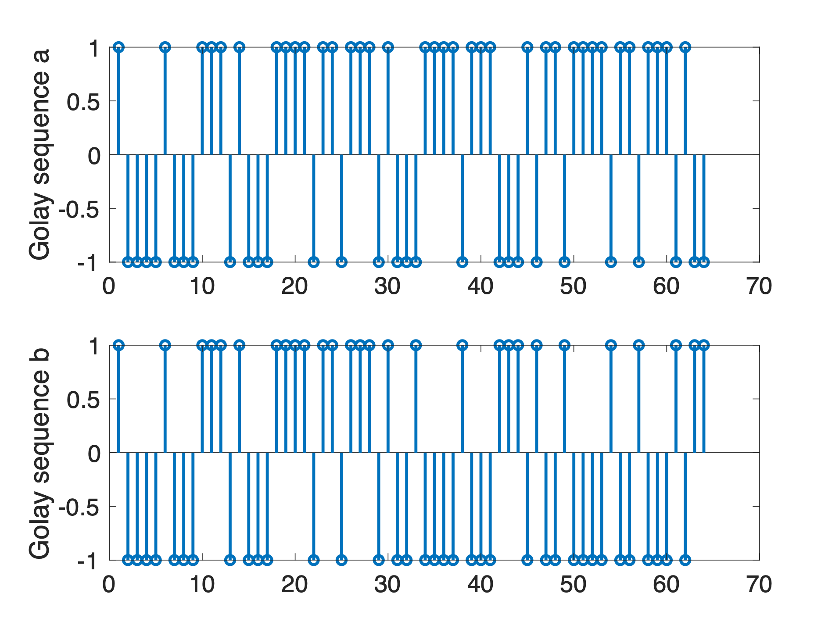
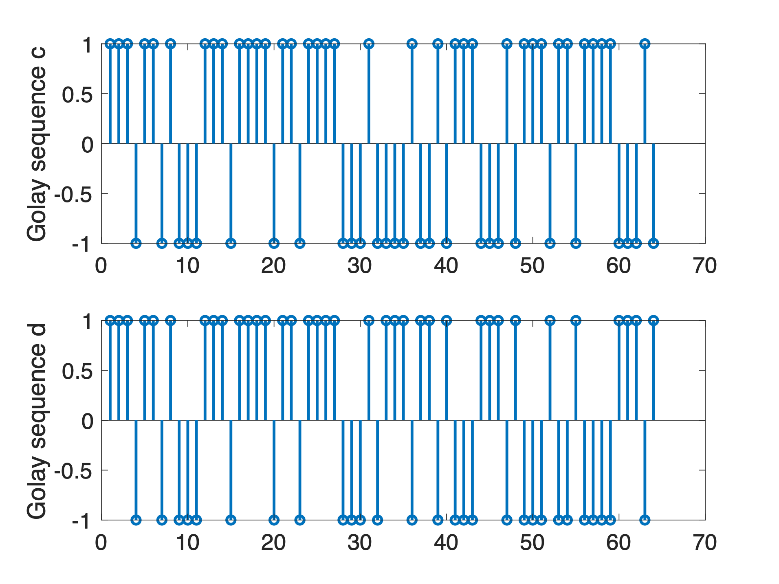
Golay sequences assumed, length = 64

Slide 17
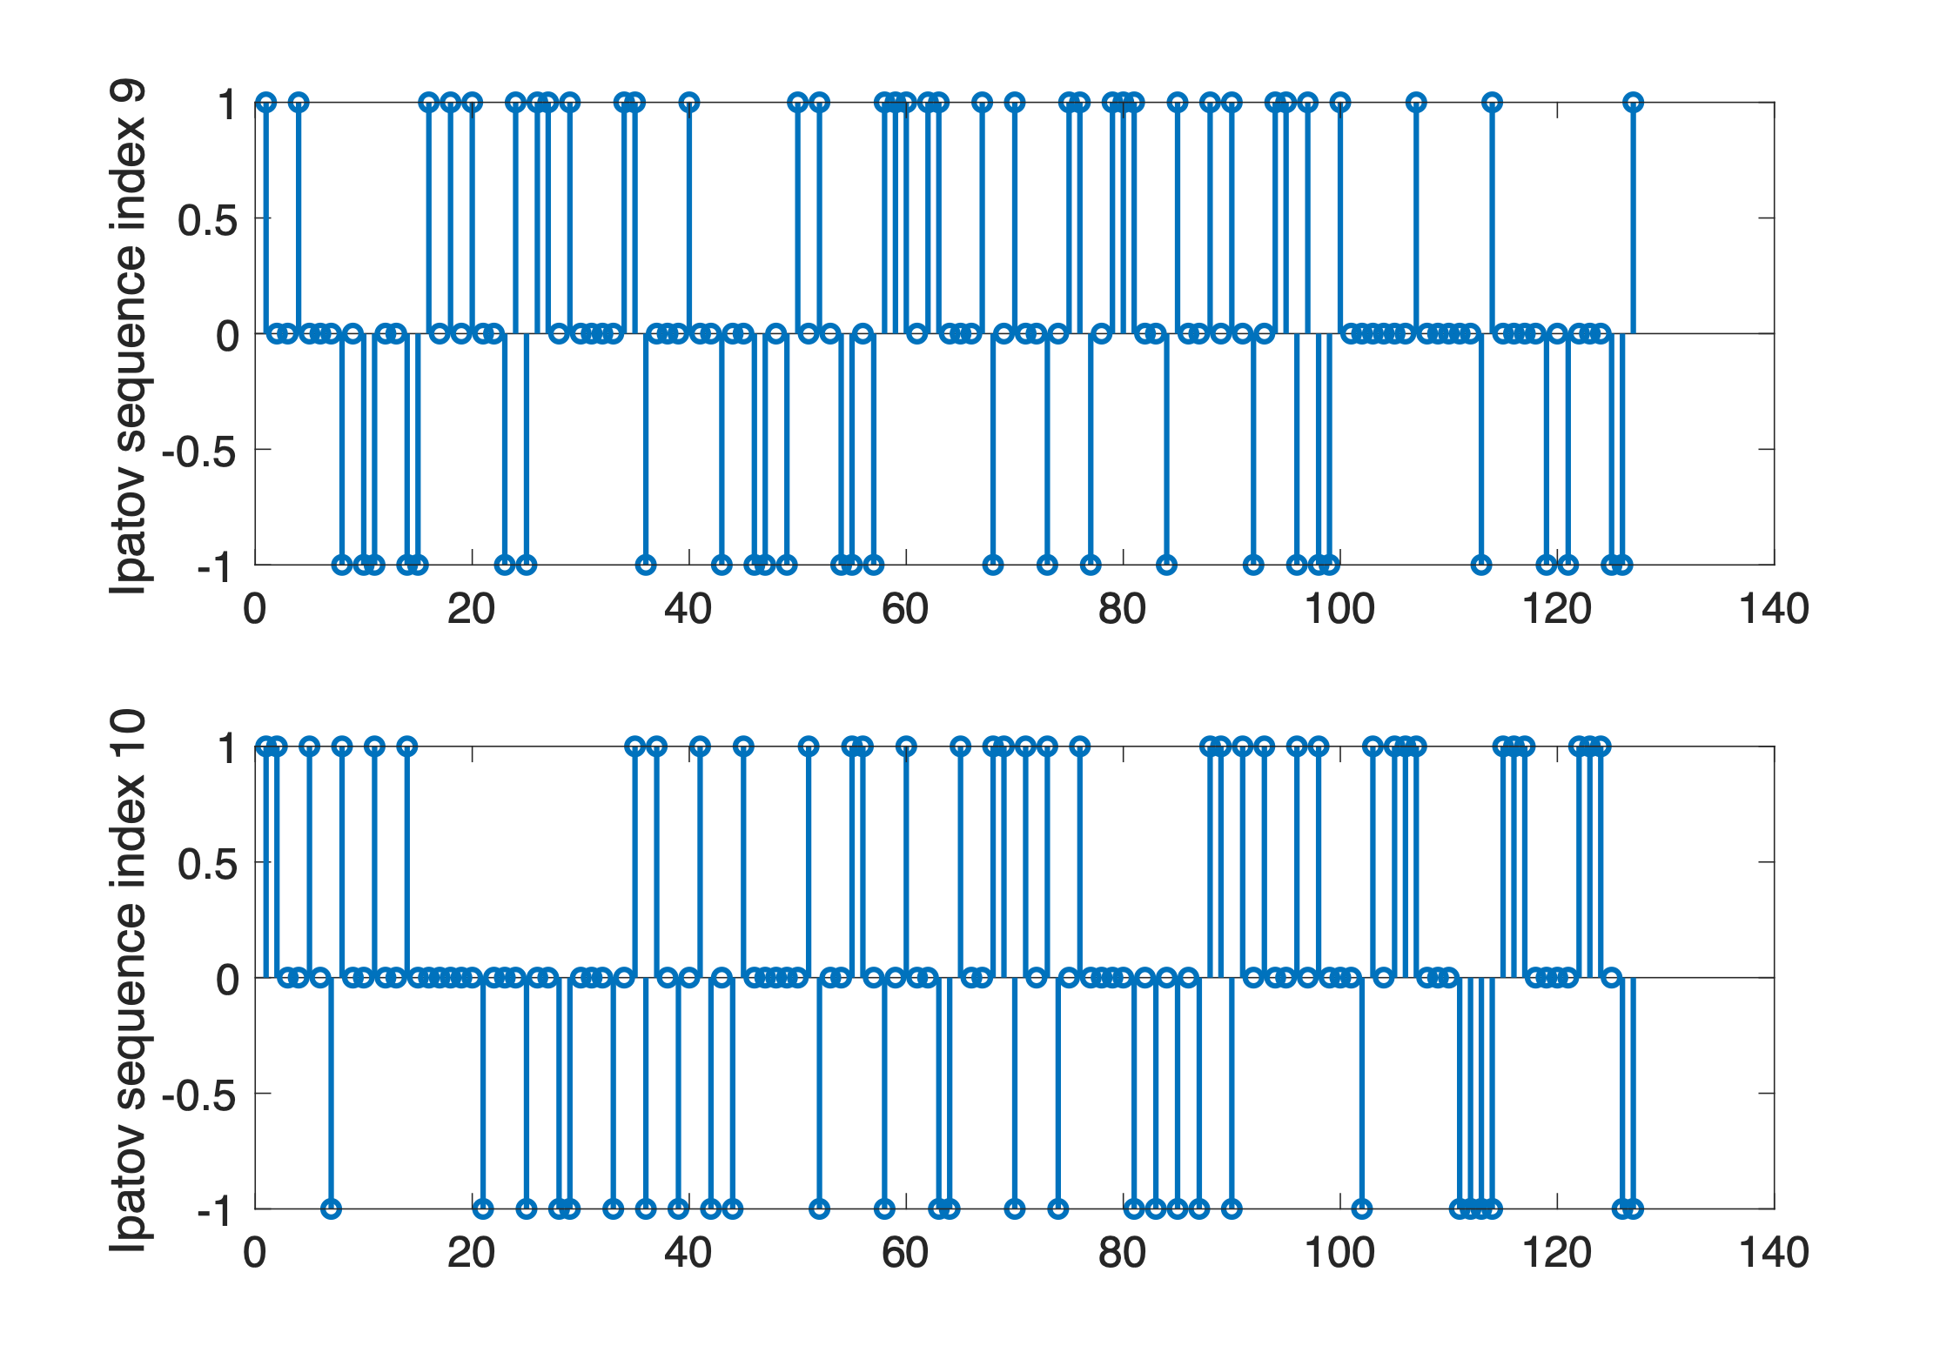
Ipatov sequences assumed

Slide 18
Example: Golay (64, 64) vs. Ipatov 127
Cross Correlations
Two Ipatov 127 perfect sequences
Two Golay (64, 64) sequences with the same gap
Two Golay (64, 64) sequences with different gaps
18dB
29dB
Concatenate using Gap = 3
One Gap = 3 and One Gap = 5

