Slide 1
Project: IEEE P802.15 Working Group for Wireless Personal Area Networks (WPANs)
Submission Title: Issues on Doc. 15-22-0146/r0 and Doc. 15-22-0147/r0
Date Submitted: 09 May 2022
Source: Sang-Kyu Lim [ETRI] and Vinayagam Mariappan [SMR Automotive Modules Korea]
Address: 218 Gajeong-ro, Yuseong-gu, Daejeon, 34129, Korea
Voice:[+82-42-860-1573], FAX: [+82-42-860-5218], E-Mail:[sklim@etri.re.kr]
Re:
Abstract: This document is to give some comments on doc. 15-22-0146/r0 and doc. 15-22-0147/r0
Purpose: Contribution to IEEE P802.15.7a
Notice: This document has been prepared to assist the IEEE P802.15. It is offered as a basis for discussion and is not binding on the contributing individual(s) or organization(s). The material in this document is subject to change in form and content after further study. The contributor(s) reserve(s) the right to add, amend or withdraw material contained herein.
Release: The contributor acknowledges and accepts that this contribution becomes the property of IEEE and may be made publicly available by P802.15.

Slide 2
Issues on Doc. 15-22-0146/r0
and Doc. 15-22-0147/r0
Sang-Kyu Lim [ETRI]
Vinayagam Mariappan [SMR Automotive Modules Korea]

Slide 3
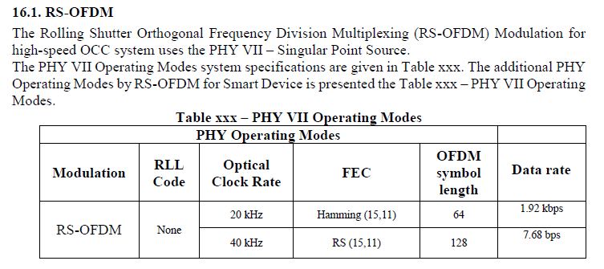
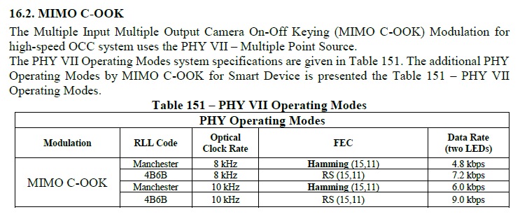
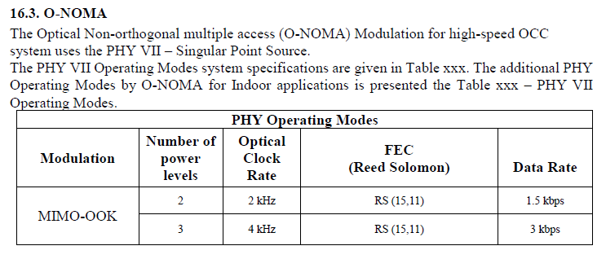
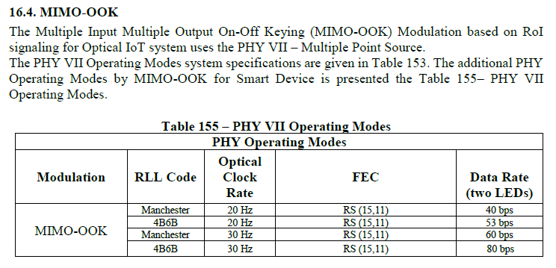
Issue No.1 – Tables on PHY VII Operating Modes
Too many tables showing PHY VII Operating Modes in doc. 15-22-0146/r0
It’s better to reorganize the tables so that all of PHY VII Operating Modes are shown in a table.

Slide 4
Issue No.2 – Tables on PHY PIB Attributes
Too many tables showing PHY PIB attributes for PHY VII in doc. 15-22-0146/r0
It’s better to reorganize the tables so that all of PHY PIB attribute for PHY VII are shown in a table.

Slide 5
Issue No.3 – Sub-section Numbering in 16.1
In Rolling Shutter OFDM block diagram of doc. 15-22-0146/r0, the first step in terms of signal flow is Sequence Number inserting, and then FEC, QAM constellation mapping, and so on.
However, 16.1.4. is Sequence Number inserting, 16.1.5. is FEC, and 16.1.3. is Hermitian Mapping.
It’s better to rearrange the sub-section numbering in accordance with the Signal Flow.

Slide 6
Issue No.4 – Missing Sub-sections in 16.1
In Section 16.1 describing RS-OFDM specifications, the sub-sections describing QAM constellation mapping, IDFT, and Cyclic-Prefix are not found in doc. 15-22-0146/r0.
Add the sub-sections describing QAM constellation mapping, IDFT, and Cyclic-Prefix to Section 16.1 in doc. 15-22-0146/r0.

Slide 7
Issue No.5 – Missing Information on QAM level
In Rolling Shutter OFDM block diagram of doc. 15-22-0146/r0, there is not any information about what kind of QAM level is used, for example, 16-QAM, 64-QAM or 256-QAM.
Definitely define the specifications on QAM level for RS-OFDM in doc. 15-22-0146/r0.

Slide 8
Issue No.6 – Sub-section Numbering in 16.2
In MIMO C-OOK block diagram of doc. 15-22-0146/r0, the first step in terms of signal flow is FEC, and then Sequence Number inserting, RLL encoder, and so on.
It’s better to rearrange the sub-section numbering in accordance with the Signal Flow.

Slide 9
Issue No.7 – Missing Sub-sections in 16.2
In Section 16.2 describing MIMO C-OOK specifications, the sub-sections describing Sequence Number inserting, Preamble inserting, and OOK mapping are not found in doc. 15-22-0146/r0.
Add the sub-sections describing Sequence Number inserting, Preamble inserting, and OOK mapping to Section 16.2 in doc. 15-22-0146/r0.

Slide 10
Issue No.8 – Sub-section Numbering in 16.4
In MIMO OOK block diagram of doc. 15-22-0146/r0, the first step in terms of signal flow is Outer FEC, and then LED-ID inserting, Inner FEC, RLL encoder, and so on.
It’s better to rearrange the sub-section numbering in accordance with the Signal Flow.

Slide 11
Issue No.9 – Missing Sub-sections in 16.4
In Section 16.4 describing MIMO OOK specifications, the sub-sections describing LED-ID inserting, Preamble inserting, and OOK mapping are not found in doc. 15-22-0146/r0.
Add the sub-sections describing LED-ID inserting, Preamble inserting, and OOK mapping to Section 16.4 in doc. 15-22-0146/r0.

Slide 12
Issue No.10 – Data Rates supported by PHY VIII
Doc. 15-22-0147/r0 describes the specifications on HOOK-OFDM, HS2PSK-OFDM, and BPPM in PHY VIII.
However, any specifications on data rates supported by HOOK-OFDM, HS2PSK-OFDM, and BPPM in PHY VIII is not found.
Add the specifications on data rates supported by HOOK-OFDM, HS2PSK-OFDM, and BPPM in PHY VIII to doc. 15-22-0147/r0.

Slide 13
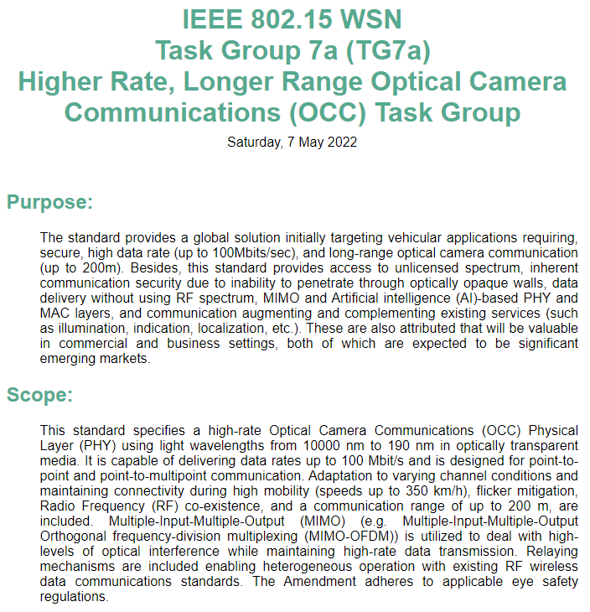
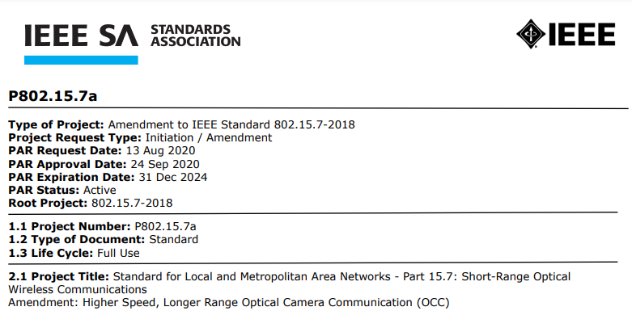
Issue No.11 – What is the difference between 802.15.7-2018
and the current draft discussed in TG7a
TG7a is pursuing the higher data rates, longer range OCC, as shown on the Homepage for TG7a and in the PAR document for P802.15.7a. However, compared to the published standard IEEE 802.15.7-2018, the data rates supported by PHY VII and PHY VIII are never higher than that of specifications defined in IEEE 802.15.7-2018.
So, the question is; What do the PHY VII and PHY VIII support for the higher data rates, longer range OCC ?

