Slide 1
Project: IEEE P802.15 Working Group for Wireless Personal Area Networks (WPANs)
Submission Title: [ETSI SmartBAN in Medical/Wellbeing IoT]
Date Submitted: [5th May 2022]
Source: [1: Lorenzo Mucchi] [Dept. of Information Engineering, University of Florence, Italy]
[2: Matti Hämäläinen] [Centre for Wireless Communications – University of Oulu, Finland]
Address [1; via di S. Marta 3, I-50139, Firenze, Italy
2; P.O. Box 4500, FI-90014 University of Oulu, Finland]
Voice:[1; + 39 055 275 8539], FAX: +458-40-5243813],
Email:[1: lorenzo.mucchichi@unifi.it, 2: matti.hamalainen@oulu.fi] Re: []
Re: []
Abstract: [This document contains latest overview of ETSI SmartBAN in Medical and Wellbeing IoT.]
Purpose: [information]
Notice: This document has been prepared to assist the IEEE P802.15. It is offered as a basis for discussion and is not binding on the contributing individual(s) or organization(s). The material in this document is subject to change in form and content after further study. The contributor(s) reserve(s) the right to add, amend or withdraw material contained herein.
Release: The contributor acknowledges and accepts that this contribution becomes the property of IEEE and may be made publicly available by P802.15.

Slide 2
ETSI SmartBAN in Medical/Wellbeing IoT
Prof. Lorenzo Mucchi
Dept. of Information Engineering, University of Florence, Italy
Prof. Matti Hämäläinen
Centre for Wireless Communications – University of Oulu, Finland

Slide 3
Content
Motivation
SmartBAN in brief
  Use-cases
  Summary
  List of published ETSI documents

Slide 4
Motivation
IoT utilization is spreading fast in modern home and industrial automation, but it can also be utilized in healthcare domain.
  Wearables and other health and wellbeing related personal devices carried by humans, or even implanted inside a human, are being more popular in healthcare.
  Low power consumption devices could enable seamless 24/7 monitoring, control and actuation functions for various use-cases to assist healthcare professionals and patients.

Slide 5
Motivation
The ETSI SmartBAN is a European initiative towards wider wireless body area networks (WBAN) utilization.
This presentation summaries shortly the SmartBAN standard and its utilization in medical IoT (mIoT) applications in heterogeneous radio environment.
The ETSI SmartBAN standard is defining physical and medium access control layers (PHY/MAC), as well as semantic interoperability mechanisms, heterogeneity management and security for smart WBAN.

Slide 6
Motivation
The work towards smart BAN standardization under the ETSI Technical Committee (TC) SmartBAN started in 2013.
Our goal is to have a reliable, low-power and interoperable standard to boost WBAN technology development and adaptation to global mIoT markets

Slide 7
SmartBAN in brief – Architecture
The SmartBAN network is controlled by the network coordinator, called as a Hub, which is the most powerful device associated to the network.
The SmartBAN sensor nodes connected to the Hub can consist of reduced functionalities and thus they could consume much less energy and be cheaper.
  Maximum number of nodes is 16, being typically < 8
The maximum range is less than 2 m.
  Based on the human’s dimensions

Slide 8
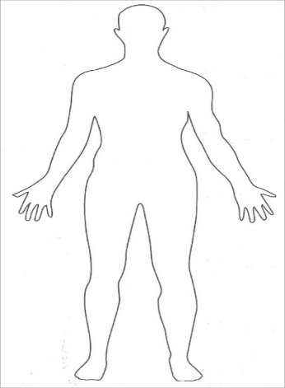
SmartBAN in brief – Architecture
The current SmartBAN system model is based on a one-hop star network topology.
  Ongoing revision work to support relay functionality
  and Hub-to-Hub (H2H) communications
e.g.,
patient <−> doctor
patient <-> medical device
Node
Node
Hub
Hub2Hub
Hub
Node
Node
Node
Node
Relay
Node

Slide 9
SmartBAN in brief – Operational assumptions
SmartBAN devices need to be energy efficient.
They need to co-exist with the other radio systems sharing the same space and frequency band.
System needs to fulfil pre-defined quality of service (QoS) requirements. Smart Body Area Networks (SmartBAN); System Description. ETSI TR 103 394.
SmartBAN is providing fast channel access mechanism and supports prioritized traffic for nodes to communicate with the hub.

Slide 10
SmartBAN in brief – Physical layer
May 2022
SmartBAN is operating at unlicensed 2.4 GHz ISM band consisting of forty 2 MHz physical channels at the frequency band from 2401 MHz to 2481 MHz with center frequencies of
  f_{c} = 2402 MHz + 2*n MHz, n = 0 ... 39.
  Channels Ch0, Ch12 and Ch39 are dedicated to control information, and they are named as Control Channels (CCH).
  The other 37 channels are reserved for data payload and those are called as Data Channels (DCH).

Slide 11
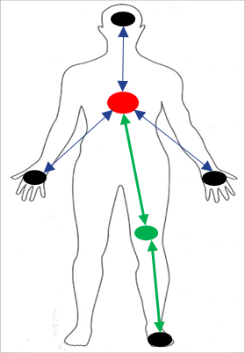
SmartBAN in brief – Physical layer
May 2022
Hub is using CCH to broadcast control channel beacon (C-Beacon) with essential network information.
hub address, slot length, time slots, interference mitigation mechanism, duty cycling, DCH channel number, initial state for scrambling, and time stamp
All data, as well as control and management information, is transmitted using bidirectional DCH.
One established SmartBAN is using only one CCH and DCH.
  frequency hopping, like BLE does, is not supported
  hub decides the channels to be used
Interference mitigation and coexistence managements with adjacent SmartBAN networks are handled using different CCHs and DCHs per each network.
DCH3
CCH12
DCH14
CCH0
DCH23
CCH39

Slide 12
SmartBAN in brief – Physical layer
May 2022
Data modulation is Gaussian frequency shift keying (GFSK)
  modulation index h = 0.5 and bandwidth-bit period product BT = 0.5.
Data rate is nominally 1 kbps to 100 kbps, but it is scalable up to 1 Mbps.
Forward error control (FEC) and repetition coding are used to improve a transmission quality.
  instead of using bit-vice repetition coding (e.g., IEEE802.15.6), repetition is done packet-vice by sending Physical Layer Protocol Data Unit (PPDU) either 2 or 4 times, or just only once.

Slide 13
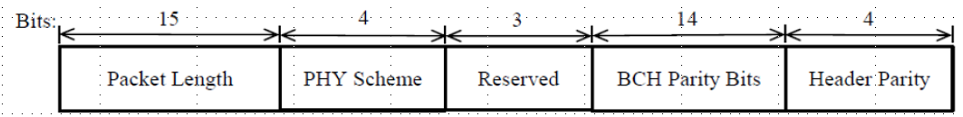
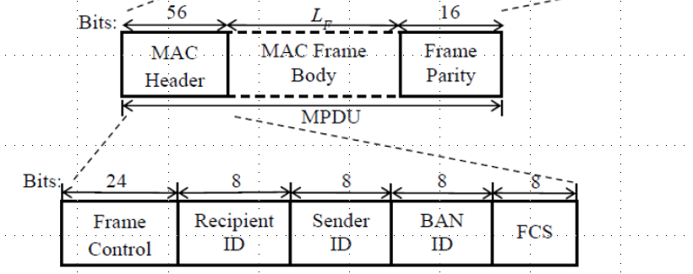
SmartBAN in brief – Physical layer
May 2022
Source: Smart Body Area Network (SmartBAN);
Enhanced Ultra-Low Power Physical Layer. ETSI TS 103 326.
PPDU – Physical Layer Protocol Data Unit
Bits: 16 40 L_{PSDU}
Preamble
PLCP Header
PSDU
1010101010101010
Physical Layer Service Data Unit
Physical Layer Convergence Protocol Header
MAC Protocol Data Unit
Source: Smart Body Area Network (SmartBAN);
Low Complexity Medium Access Control (MAC) for SmartBAN. ETSI TS 103 325.

Slide 14
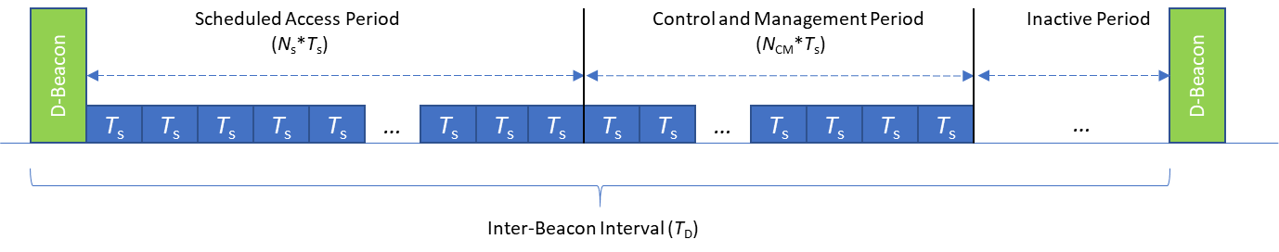

SmartBAN in brief – MAC layer
May 2022
One of the goals in SmartBAN was to define a simple MAC, which still enables efficient functionalities.
The main block in MAC layer is a superframe called as an Inter-Beacon Interval (IBI).
IBI is divided into three parts: scheduled access period (SAP), control and management period (C/M) and inactive period.
C/M | Any device wishing to transmit data or management frames. Slotted-Aloha, if enough resources were not granted during SAP.
SAP | For data transmission. Each node has its own reserved slot

Slide 15
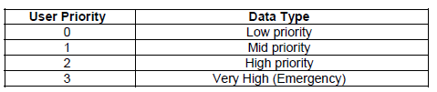
SmartBAN in brief – MAC layer
May 2022
SmartBAN introduces a novel channel access method called as a Multi-use Channel Access (MCA).
Very-low latency (about ms) emergency/highest priority transmissions using Priority Channel Access (PCA).
  order of slot time instead of frame as typically in other Standards
  4 user priority classes
Can be used in both Scheduled Access, and Control and Management Periods
Utilization of scheduled but unused time slots by secondary users is to improve channel usage.

Slide 16
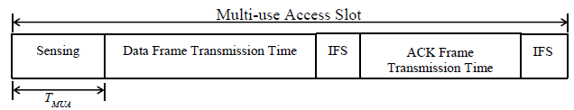
SmartBAN in brief – MAC layer
May 2022
Multi-use Channel Access is an optional feature.
  Mandatory: Hubs need always to support MCA!
  Nodes, on the other hand, shall always support Scheduled Channel Access and Slotted Aloha Channel Access, and they may support MCA.
  MCA may only be used when every node in the network supports it
Nodes need to perform two clear channel assessments (CCA) to detect a) possible emergency or b) slot owner transmissions.
Source: Smart Body Area Network (SmartBAN);
Low Complexity Medium Access Control (MAC) for SmartBAN. ETSI TS 103 325.

Slide 17
SmartBAN in brief – Interoperability
May 2022
TC SmartBAN has defined mechanisms for interoperability and heterogeneity management.
  SmartBAN is providing data-level, semantic and technical interoperability
SmartBAN utilizes an open data reference semantic model, which can be associated with metadata.
  The functionalities are supporting both measurements and control
Due to the harmonized data presentation, SmartBAN provides also semantic analysis, which enables automated monitoring and controlling.
SmartBAN is able to coexist and share data between multi-technology wireless medical devices independently of vendors!

Slide 18
SmartBAN in brief – Use-cases
May 2022
The potential use-cases are dealing with person’s safety and health monitoring, when vital signs can be automatically collected, analyzed and transmitted to electrical health records from where the data can be accessed by the authorized health professionals.
  uses-cases are such as stress, sleep, safety, and fall monitoring, etc.
As WBANs support mobility and wearables, SmartBAN is also suitable for various sports and welfare applications to collect human’s physical information during their daily activities.
* Smart Body Area Networks (SmartBAN); System Description. ETSI TR 103 394.
* Smart Body Area Network (SmartBAN); Applying SmartBAN MAC (ETSI TS 103 325)
for various use-cases. ETSI TR 103 711.
Notes:
Smart Body Area Networks (SmartBAN); System Description. ETSI TR 103 394.

Slide 19
SmartBAN in brief – Use-cases
May 2022
In assisted living environments, SmartBAN is a potential technology for smart living and smart home solutions to provide additional information of the person’s wellbeing and lifestyle.
Due to the various needs for quality-of-service different applications have, the SmartBAN system is scalable in the means of data rates, latency requirements, allowed errors, and so on.
SmartBAN is also future-proof WBAN technology.
  Smart Coordinator will be a bridge outside of SmartBAN
Notes:
Smart Body Area Networks (SmartBAN); System Description. ETSI TR 103 394.

Slide 20
Smart Coordinator
We envision that Smart Coordinator (SC) can act as a bridge between the human centric measurements and a wider, ubiquitous medical access network.
    Security and heterogeneity management
    Smart Coordinator specifications will be defined
    by ETSI TC SmartBAN!
Smart Coordinator enables future proof
operation as the smartness is in the Smart Coordinator, not in the nodes.
  New functionalities can be adopted via SC
WiFi
BLE
4G
5G
6G
etc.

Slide 21
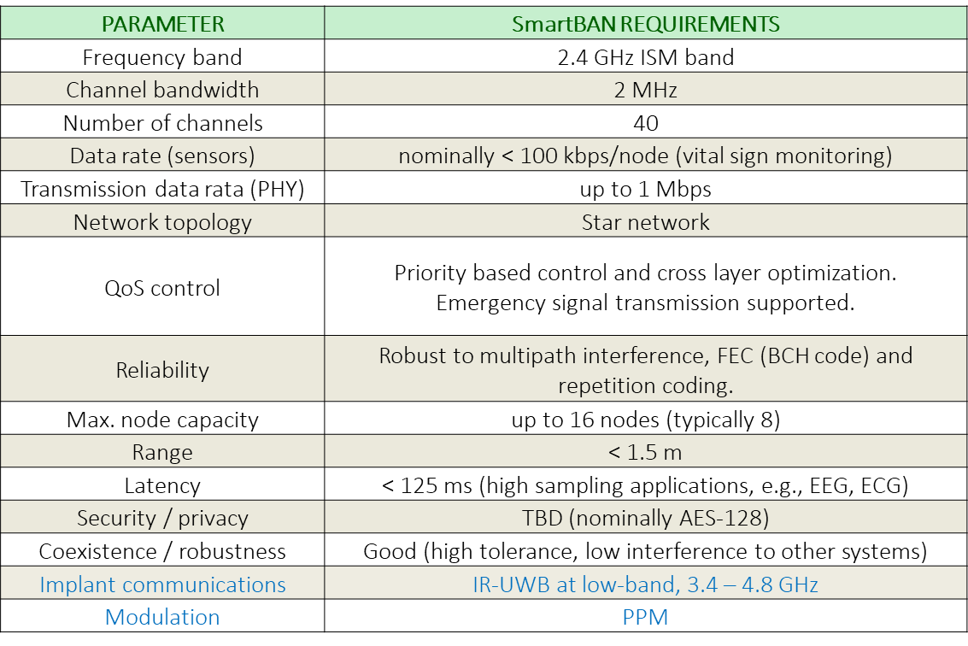
Conclusion
May 2022
amendments to relay and H2H are coming
Notes:
Smart Body Area Networks (SmartBAN); Implant communications. ETSI TR 103 751.
Smart Body Area Network (SmartBAN); Measurements and modelling of SmartBAN Radio Frequency (RF) environment. ETSI TR 103 395.

Slide 22
List of published TS
May 2022
Smart Body Area Network (SmartBAN); Enhanced Ultra-Low Power Physical Layer. ETSI TS 103 326.
Smart Body Area Network (SmartBAN); Low Complexity Medium Access Control (MAC) for SmartBAN. ETSI TS 103 325.
Smart Body Area Networks (SmartBAN); Unified data representation formats, semantic and open data model. ETSI TS 103 378.
Smart Body Area Networks (SmartBAN); Service and application standardized enablers and interfaces, APIs and infrastructure for interoperability management. ETSI TS 103 327.
https://www.etsi.org/committee/1413-smartban

Slide 23
List of published TR
May 2022
Smart Body Area Networks (SmartBAN); System Description. ETSI TR 103 394.
Smart Body Area Network (SmartBAN); Measurements and modelling of SmartBAN Radio Frequency (RF) environment. ETSI TR 103 395.
Smart Body Area Networks (SmartBAN); Implant communications. ETSI TR 103 751.
Smart Body Area Network (SmartBAN); Applying SmartBAN MAC (ETSI TS 103 325) for various use-cases. ETSI TR 103 711.
Summary article:
M. Hämäläinen, L. Mucchi, M. Girod-Genet, T. Paso, J. Farserotu, H. Tanaka, D. Anzai, L. Pierucci, R. Khan, Md M. Alam, P. Dallemagne, "ETSI SmartBAN Architecture: the Global Vision for Smart Body Area Networks", IEEE Access, Vol. 8, pp. 150611 - 150625, 2020.

Slide 24
May 2022
Thank You!
Contact:
lorenzo.mucchi@unifi.it
matti.hamalainen@oulu.fi

