Slide 1
Project: IEEE P802.15 Working Group for Wireless Personal Area Networks (WPANs)
Submission Title: [Long-range Ranging]
Date Submitted: [19th April 2022]
Source: [Billy Verso, Carl Murray, Michael McLaughlin, Jarek Niewczas, Igor Dotlic, Ciaran McElroy ] Company [Qorvo, Inc.]
Address [ ]
E-Mail:[billy.verso (at) qorvo.com]
Re: [Long-range two-way ranging for the TG4ab next generation UWB project]
Abstract: [Discussion on long-range ranging.]
Purpose: [To prompt discussion on system considerations for long range ranging.]
Notice: This document has been prepared to assist the IEEE P802.15. It is offered as a basis for discussion and is not binding on the contributing individual(s) or organization(s). The material in this document is subject to change in form and content after further study. The contributor(s) reserve(s) the right to add, amend or withdraw material contained herein.
Release: The contributor acknowledges and accepts that this contribution becomes the property of IEEE and may be made publicly available by P802.15.

Slide 2
Long-range ranging
Multi-fragment / multi-millisecond schemes have been proposed to give longer range UWB ranging. These schemes being designed to overcome the sensitivity bottleneck imposed by the very low transmit level permitted by regulation
  37 nJ per millisecond per 500 MHz
The aim of this submission is to examine the system features of some use cases and consider in more detail the requirements for those uses cases especially in terms of energy consumption and link budgets.
Long-range ranging scenarios considered here are:
  Ranging to a UWB tag where the tag receives first
  Ranging to a UWB tag where the tag transmits first

Slide 3
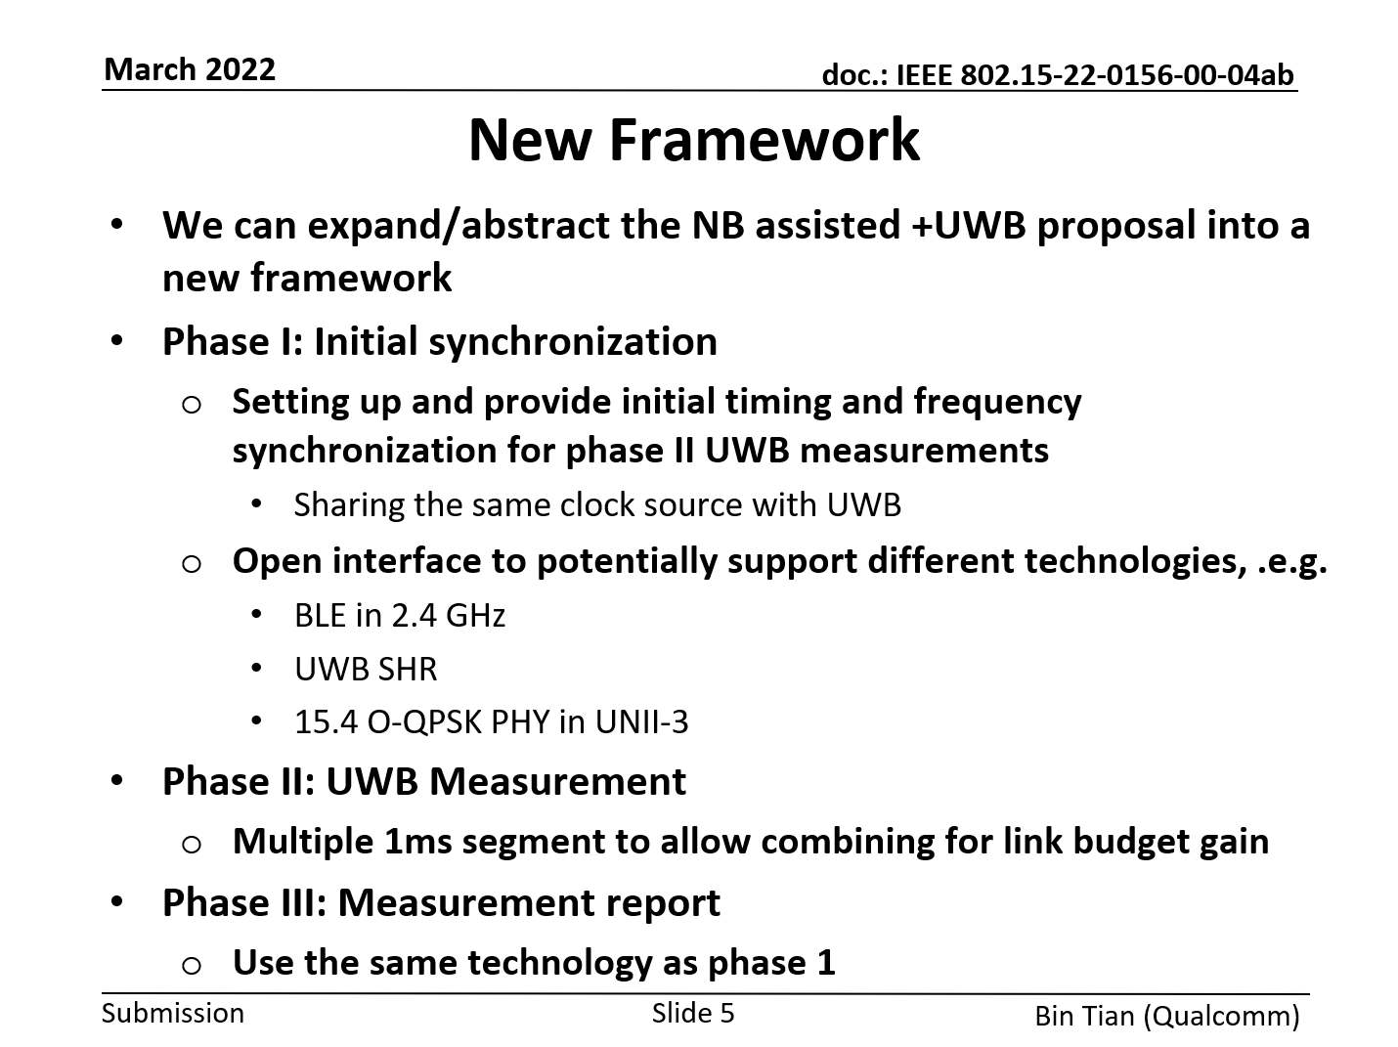
Long-range ranging - Phases
Submission 15-22-0156 from Bin Tian introduced the idea of a framework with phases, but this omitted the phase(s) that get things going, e.g., a wake-up phase.
Phase zero: Wake-up
  Turn on and set up radio receiver ready for initial sync phase

Slide 4
Long-range ranging – where the tag receives first
In this case the tag listens for the ranging message, but to save the power drain associated with constantly listening, we assume that the system designer will employ wake-up radio techniques.
The wake-up primes full RX turn on to acquire timing info T0, either from a narrowband radio or from a first CZC fragment, then additional fragments give improved range/sensitivity on TOA.
The operating range of the wakeup rather than the multi-frag UWB is the range limiting factor.
Shorter range attenuated first path scenarios still work once strong secondary paths exist to allow the wakeup be seen. Data (D0) sensitivity does not need to be greater than that of the wake-up.

Slide 5
Long-range ranging – where the tag sends first
In this case the tag periodically sends message Ax and opens its receiver to receive a response message Bx to indicate that the initiator (phone?) wants to performing ranging.
To find the tag, the phone opens its receiver to wait for Ax and then responds to kick off the TWR
Response Bx might be same as F0/T0, as shown on next slide.

Slide 6
Long-range ranging – where the tag sends first
Should tag’s periodic Ax be sent with narrowband or with UWB? Generally, UWB energy per bit is superior to narrowband, so it might be the better choice, but what about operating range?
Ax cannot be a high-powered NB transmission as this would drain the tag battery too much.
And, what about LBT requirements or performance when messages collide?
Need to consider whether NB or UWB has the better properties here.

Slide 7
Conclusion
We should consider the complete system approach to ranging to tags with limited battery capacity:
  For reasonable battery life TX power will be limited, and/or, low-power RX wake-up radio techniques are needed.
  If this limits communications range, then perhaps we are really looking at scenarios where the channels have strong (reflected) signal paths for communications but attenuated direct paths needing high sensitivity TOA determination.
And then ask ourselves:
  Is UWB sufficient on its own when the complete system is examined in detail?
  What are the scenarios where narrowband benefits ranging performance?
  Before deciding…. what other UWB / RTLS use cases should we also consider from a more complete system perspective?

Slide 8
THE END

