Slide 1
PHY Layer Design Considerations for ieee802.16t
April 14-2022
DCN 15-22-0211-00-016t

Slide 2
Key SRD PHY Layer Requirements
Support operation in paired and unpaired continuous/non continuous licensed bands:
  Paired spectrum example: AAR- 900 MHz
  Paired spectrum with small separation example: AMTS band
  Unpaired spectrum example: AAR-160 MHz
  Non continuous spectrum example: ATCS band
Support partition of continuous licensed bands into multiple channels:
  Partitioning of the bands between multiple organizations
  Smooth migration of legacy deployments
  Frequency reuse
  Link budget/coverage considerations
Support operation in Private Land Mobile Radio (PLMR) bands (e.g., RR160 MHz) is required. This includes:
  Support of common PLMR channel bandwidth: 6.25, 12.5, 25 and 50 kHz
  Support special PLMR channel bandwidth: 5, 7.5 and 15 kHz
  Support aggregation of multiple adjacent and non-adjacent PLMR channels to enable higher throughput services.
The specification will support simultaneous remote operation over one or more aggregated (adjacent or non-adjacent) subchannels of bandwidth as low as 5 kHz.
The specification will support base station operation over any one or more sub-channels. The base station may support aggregation of multiple subchannels such that the total bandwidth in the sector is not limited to 100 KHz.

Slide 3
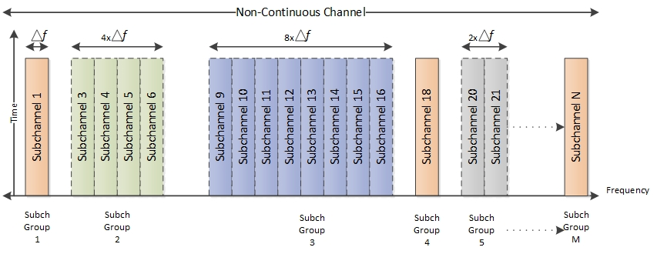
Partitioning of a Non-Continuous Channel into Continuous Sub-Channel Groups

Slide 4
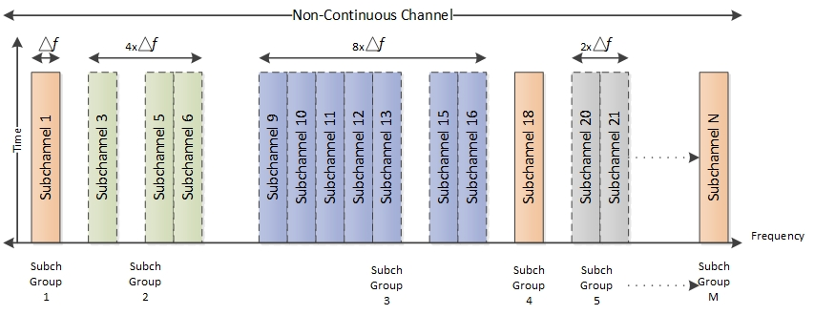
Partitioning of a Non-Continuous Channel into Continuous and Non-Continuous Sub-Channel Groups

Slide 5
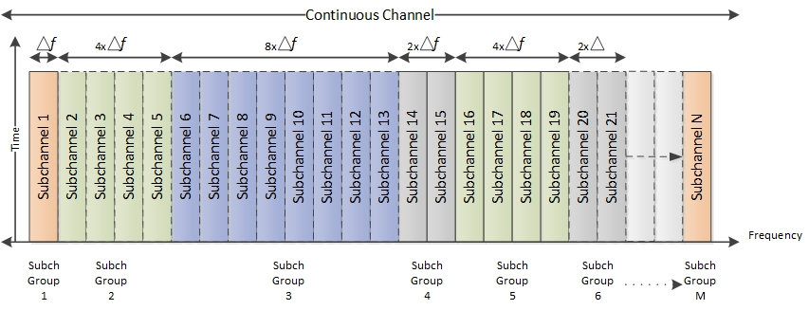
Partitioning of a Continuous Channel

Slide 6
Self Sufficiency
Subchannel groups are self-sufficient in terms of supporting communication between the base station and remote stations including DL & UL synchronization, ranging, bandwidth allocation and network entry. The remotes send and receive the data over one subchannel group. The remote does not need to listen to any other subchannel outside the subchannel group to support its communication with the base station.
Self-sufficiency advantages:
  a. Multiple types of remotes can be developed depending on the application. For example, the system may employ a low-end remote designed to operate on a single subchannel and a high-end remote designed to operate on multiple subchannels.
  b. A remote transmitting on one subchannel does not need as much power as a remote transmitting on multiple subchannels.
  c. By receiving on one subchannel, a remote may be able to better mitigate interference caused by other subchannel signals.
  d. Low end remote can be cost effective and will have better battery life.
  e. Partitioning of channel can be done based on the application needs.

Slide 7
PHY Layer Differences Relative to IEEE802.16 -2017
Single subcarrier per sub-channel
New definition of bin and slot
Optional multiple subcarrier spacing
SC-FDMA waveform for adjacent/non-adjacent subchannel aggregation in uplink
Decoupling of preamble and MAPs from the frame structure with configurable periodicity for per frame overhead reduction
Pilots are time multiplexed with data symbols
QAM256 with CTC rate 7/8 added as a high frequency utilization FEC. This can leverage low noise floor in narrow channels.
Improved codeword repetition scheme for robust communication.
New preamble and ranging sequences.

Slide 8
Waveform
Downlink
  Transmission in the downlink direction employs OFDM with a single subcarrier per subchannel. FFT sizes of 16, 32, …. through 512 are proposed to support up to 512 subchannels. A subchannel bit map is used to turn off any unused subchannel.
Uplink
  Transmission in the uplink direction employs Single Carrier FDMA (SC-FDMA).

Slide 9
De-coupling Preamble and Maps per frame
The preamble is sent over a single subchannel within a subchannel group based on the periodicity time configuration. Periodicity of the preamble is configured in terms of the number of frames e.g., periodicity of 5 means every 5th frame preamble will be present, and other frames data will be sent in the place of the preamble below figure shows the same.
IOT-MAP carries information about DL and UL allocation. IoT Map will be transmitted based on need and can contain the allocation information across the frames.

Slide 10
Modulation and coding
Preamble and Pilots will be BPSK modulated.
Data shall use Convolutional Coding (CC) or convolutional Turbo codes (CTC).
Below table shows the combination
Modulation | FEC rate
QPSK | 1/2
QPSK | 3/4
QAM16 | 1/2
QAM16 | 3/4
QAM64 | 3/4
QAM64 | 5/6
QAM256 | 7/8

Slide 11
Resource allocation
Bins and slots
a. The minimum air interface resource allocation in the downlink and in the uplink is the slot. It is constructed using configurable bins such that one slot contains 48 data symbols.
b. A bin spans over one subcarrier/tone across multiple symbols in time, e.g., 9 symbols shown below
c. the spectral efficiency by increasing the data symbols to pilot ratio
d. A slot is formed such that it contains the 48 data symbols, e.g., 6 bins each carrying 8 data symbols.

Slide 12
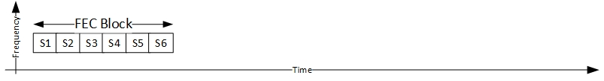
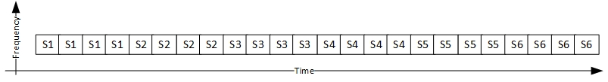
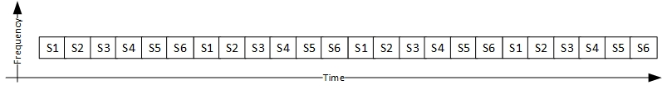
Repetitions
Repetitions will be used to improve the receiver sensitivity in both DL and UL. Up to 128 repetitions will be supported. The repetition will reduce the channels data capacity by a repetition factor. This repetition scheme is applied only to the QPSK modulation with all coding schemes.
The 802.16-2017 repetition scheme is done for bits within slot first while the improved scheme repeats the entire FEC block. This provides a significant time diversity benefit.

Slide 13
Items to be added for completeness
Review all the references given to 802.16-2017.
For various FFT sizes guard band allocations need to define.
256 QAM modulation and coding details.
For Peer-to-peer communication if any changes needed in PHY
Mixed subcarrier spacing how we’re going to introduce ?

Slide 14
Performance analysis to be done
DL Preamble codes
a. Gold sequence is proposed, need to perform comparative analysis with 802.16 2017 preamble codes and other possible codes.
b. Preamble code length selection.
Ranging codes
a. Zadoff-Chu sequence is proposed, need to perform comparative analysis with 802.16 2017 ranging codes and other possible sequences.
b. Ranging code length selection.
Repetition
a. Analysis of the gain due to time diversity.
b. Analysis of the changes needed to meet the maximum gain achieved by repetition factor 128.

