Slide 1
Project: IEEE P802.15 Working Group for Wireless Personal Area Networks (WPANs)
Submission Title: IEEE P802.15.13 compatibility with IEEE 802.1
Date Submitted: April 11th 2022
Source:
Lennert Bober, Volker Jungnickel, Fraunhofer HHI
Tuncer Baykas, Kadir Has University
Sang-Kyu Lim, ETRI
E-Mail: bober@ieee.org
Abstract: Relevant details from the P802.15.13 draft 6.0 for the support of 802.1 architecture and TSN features.
Purpose: Aid development of the P802.15.13 standard
Notice: This document has been prepared to assist the IEEE P802.15. It is offered as a basis for discussion and is not binding on the contributing individual(s) or organization(s). The material in this document is subject to change in form and content after further study. The contributor(s) reserve(s) the right to add, amend or withdraw material contained herein.
Release: The contributor acknowledges and accepts that this contribution becomes the property of IEEE and may be made publicly available by P802.15.

Slide 2
IEEE P802.15.13 compatibility with IEEE 802.1
Basis for discussion on
April 11 2022

Slide 3
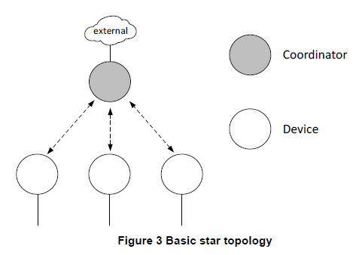
P802.15.13 network topology
Concept
Star topology where the coordinator is connected to a LAN („external“).
Devices are peers in the integrated LAN.
Coordinator provides bridging interface.
(= IEEE 802.1 LAN)
(member)

Slide 4
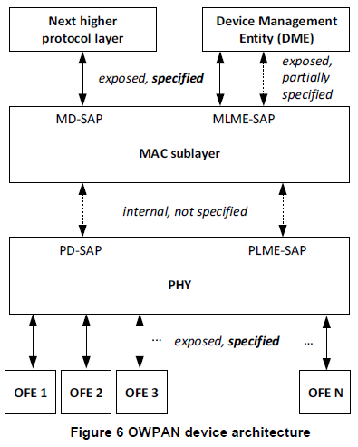
General device architecture
Every „node“ in the network is a device.
  Coordinators = devices that run a network
  Members = devices that participate in a network
802.1AC ?

Slide 5
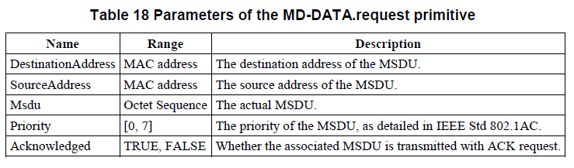
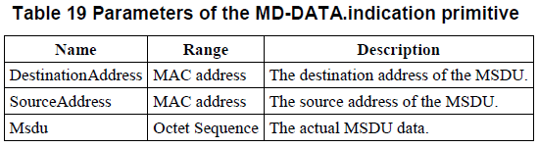
The MAC data SAP (MD-SAP)
MD-SAP to support 802.1AC
  MSDUs
  EUI-48 MAC addresses
  More needed?
Other SAPs not relevant?
“MSDUs shall be in EtherType protocol discrimination format, described in IEEE Std 802 Thus, the two octet wide EtherType shall be prepended to the MSDU in big endian byte order. “

Slide 6
Addresses
EUI-48 addresses
FF-FF-FF-FF-FF-FF is broadcast address
No multicast addresses yet
MAC frame / MPDU carries three addresses
  Only one address per device supported / devices cannot bridge

Slide 7
MAC layer characteristics
„Deterministic“ TDMA medium access
  Queueing delay
Retransmissions, reordering and frame loss possible
  More delay sources
  Possible violation of some Ethernet / LAN invariants

Slide 8
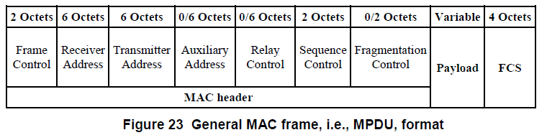
MAC frames
Proposed lately: Have just two addresses in MPDU header; put „complete“ Ethernet frame in payload (having also two addresses).
How to correctly specify the MSDU format?
VLAN tag needed?

Slide 9
Towards TSN
Scheduling is implementation specific
Time synchronization possible at MAC layer (not yet specified)
  It is synchronized for TDMA anyway (~ few µs error)
No Frame preemption
  PHY frames can be long (multiple ms)

Slide 10
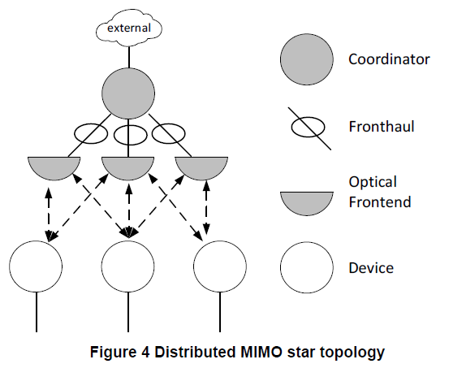
Towards TSN (2)
Due to distributed MIMO, delay through propagation over fronthaul exists
  Virtual high physical propagation delay
  Implications?

Slide 11
Security
Currently, no encryption, authentication
Goal is to reuse standards defined in 802.1
  802.1AE: MACsec
  802.1AR: Secure Device Identity
  Key exchange?

Slide 12
Goals and status
Currently in SA-Ballot
No TSN-compatibility for the base standard
Future amendments possible; try to find a good basis for TSN amendment now
Security will be added in amendment

Slide 13
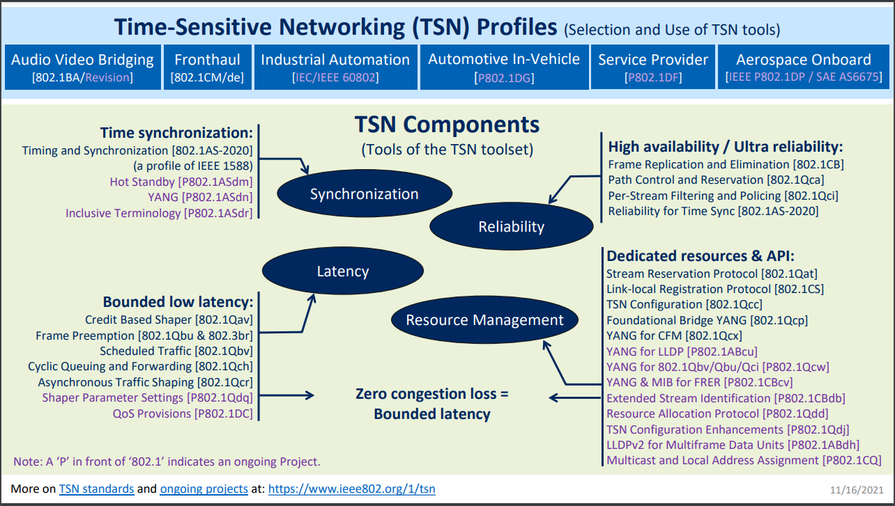
What to support for TSN

