Slide 1
Project: IEEE P802.15 Working Group for Wireless Specialty Networks (WSN)
Submission Title: TG 15.4ab Agenda and Meeting Slides
Date Submitted: Mach 29th, 2022
Source: Benjamin A. Rolfe (Blind Creek Associates)
Contact:
Voice: +1 408 395 7207, E-Mail: ben.rolfe @ ieee.org
Re: Task Group 4ab: 802.15.4 UWB Next Generation
Abstract: Teleconference (WebEx) Agenda and Meeting Slides
Purpose: Emulate organization, encourage participation and make further progress
Notice: This document has been prepared to assist the IEEE P802.15. It is offered as a basis for discussion and is not binding on the contributing individual(s) or organization(s). The material in this document is subject to change in form and content after further study. The contributor(s) reserve(s) the right to add, amend or withdraw material contained herein.
Release: The contributor acknowledges and accepts that this contribution becomes the property of IEEE and may be made publicly available by P802.15.
Notes:
Jul 12, 2010
Page 1

Slide 2
Task Group 15.4ab Next Generation UWB Amendment
Teleconference / Virtual Meeting
March 29th, 2022

Slide 3
Task Group Rules
Discussion: Everyone present is welcome
Straw polls: Everyone present may vote
Formal motions: WG voters
To make, second and vote
Patent policy for PAR activities applies
All the usual rules of conduct
Please identify yourself on first contact with name and affiliation

Slide 4
IEEE-SA Patent, Copyright, and Participation Policies
See: https://grouper.ieee.org/groups/802/sapolicies.shtml
IEEE-SA Patent Slides for Standards Development Meetings (.pdf)
https://development.standards.ieee.org/myproject/Public/mytools/mob/slideset.pdf
IEEE-SA Standards Board Patent Committee (PatCom) home page
https://standards.ieee.org/content/ieee-standards/en/about/sasb/patcom/index.html
IEEE-SA Participation Policy meeting slide set - individual method (.pdf)
https://standards.ieee.org/content/dam/ieee-standards/standards/web/documents/other/Participant-Behavior-Individual-Method.pdf
Working Group Copyright Materials
https://standards.ieee.org/ipr/copyright-materials.html
https://standards.ieee.org/content/dam/ieee-standards/standards/web/documents/other/ieee-sa-copyright-policy-2019.pdf

Slide 5
Ways to inform ieee
Cause an LOA to be submitted to the IEEE SA (patcom@ieee.org); or
Provide the chair of this group with the identity of the holder(s) of any and all such claims as soon as possible; or
Speak up now and respond to this Call for Potentially Essential Patents
If anyone in this meeting is personally aware of the holder of any patent claims that are potentially essential to implementation of the proposed standard(s) under consideration by this group and that are not already the subject of an Accepted Letter of Assurance, please respond at this time by providing relevant information to the WG Chair
08 June 2021 – Slide 2

Slide 6
IEEE 802 Ground Rules
Respect … give it, get it
NO product pitches
NO corporate pitches
NO prices
NO restrictive notices – (no confidentially notices in email)
Presentations must be openly available

Slide 7
Proposed Agenda
Opening and meeting preamble
Recap and Reminders
Technical discussions
Update: New Data Rates (15-22-0181-01)
Channel Sounding (continue discussion)
Next steps
Telecons
May Agenda Discussion
Any other Business

Slide 8
Recap

Slide 9
5.2.b Scope of the project (As approved):
This amendment enhances the Ultra Wideband (UWB) physical layers (PHYs) medium access control (MAC), and associated ranging techniques while retaining backward compatibility with enhanced ranging capable devices (ERDEVs). Areas of enhancement include:
additional coding, preamble and modulation schemes to additional coding, preamble and modulation schemes to support improved link budget and/or reduced air-time relative to IEEE Std 802.15.4 UWB;
additional channels and operating frequencies;
interference mitigation techniques to support greater device density and higher traffic use cases relative to the IEEE Std 802.15.4 UWB;
improvements to accuracy, precision and reliability and interoperability for high-integrity ranging; schemes to reduce complexity and power consumption;
definitions for tightly coupled hybrid operation with narrowband signaling to assist UWB;
enhanced native discovery and connection setup mechanisms;
sensing capabilities to support presence detection and environment mapping;
and mechanisms supporting low-power low-latency streaming as well as high data-rate streaming allowing at least 50 Mb/s of throughput.
Support for peer-to-peer, peer-to-multi-peer, and station-to-infrastructure protocols are in scope, as are infrastructure synchronization mechanisms. This amendment includes safeguards so that the high throughput data use cases do not cause significant disruption to low duty-cycle ranging use cases.
https://development.standards.ieee.org/myproject-web/app#viewpar/9081

Slide 10
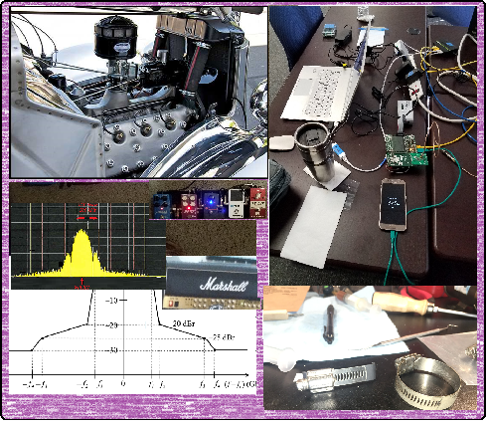
Technical Discussion

Slide 11
Next Steps

Slide 12
Collaboration Potential
Areas for collaboration and convergence based on discussions and presentations:
Enhanced location and navigation support
DL-TDOA
Sensing
NB-UWB hybrid
UWB power saving
Improved integrity mechanisms
Enhanced data communications
Coexistence considerations and mechanisms (including channel access)

Slide 13
Interim TC planning
Call frequency and phase: Weekly on Tuesday 6am PT Commencing 29-March-2022
Call organization: Will cancel if no agenda items received 24 hours prior
Next Call: April 5th

Slide 14
May Plenary
Interim meeting is Virtual Only
Registration is open
Register early for the best rate
Early Registration: Until 23:59 PM Eastern Time, Friday April 8, 2022: US$400.00 (All attendees)
Standard Registration: After early, until 23:59 PM Eastern Time, Friday April 29, 2022: US$600.00 (All attendees)
Late Registration: After 23:59 PM Eastern Time, Friday April 29, 2022: US$800.00 (All attendees)
https://touchpoint.eventsair.com/2022-may-ieee-802-wireless-interim-session
Agenda: No requests so far
Reminder: get your requests in early for the best timeslots!

Slide 15
July Plenar
From the meeting planners:
Hotel reservation is open
Early bird rate is limited
July is a busy time for Montreal and rooms expected to fill up / sell out

Slide 16
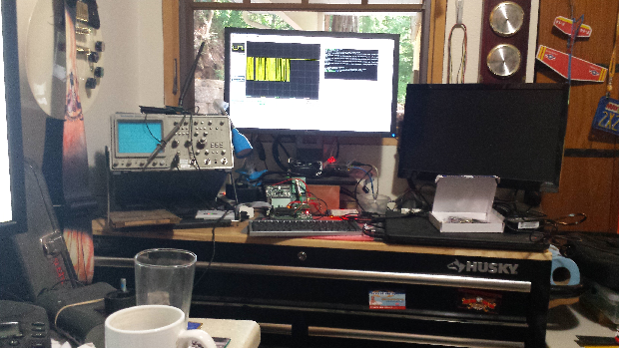
Other Business

Slide 17
Adjourned Thanks

