Slide 1
Project: IEEE P802.15 Working Group for Wireless Specialty Networks (WSN)
Submission Title: TG4ab March 2022 Meeting Slides
Date Submitted: March 8, 2022
Source: Benjamin A. Rolfe (Blind Creek Associates)
Contact:
Voice: +1 408 395 7207, E-Mail: ben.rolfe @ ieee.org
Re: Task Group 4ab: UWB Next Generation for 802.15.4
Abstract: Plenary Session Slides
Purpose: Continue to progress the project
Notice: This document has been prepared to assist the IEEE P802.15. It is offered as a basis for discussion and is not binding on the contributing individual(s) or organization(s). The material in this document is subject to change in form and content after further study. The contributor(s) reserve(s) the right to add, amend or withdraw material contained herein.
Release: The contributor acknowledges and accepts that this contribution becomes the property of IEEE and may be made publicly available by P802.15.
Notes:
Jul 12, 2010
Page 1

Slide 2
Task Group 15.4ab Next Generation UWB Amendment
Objective: enhancements to 802.15.4 Ultra Wideband (UWB) physical layers (PHYs) medium access control (MAC) and associated ranging techniques while retaining backward compatibility with enhanced ranging capable devices (ERDEVs).

Slide 3
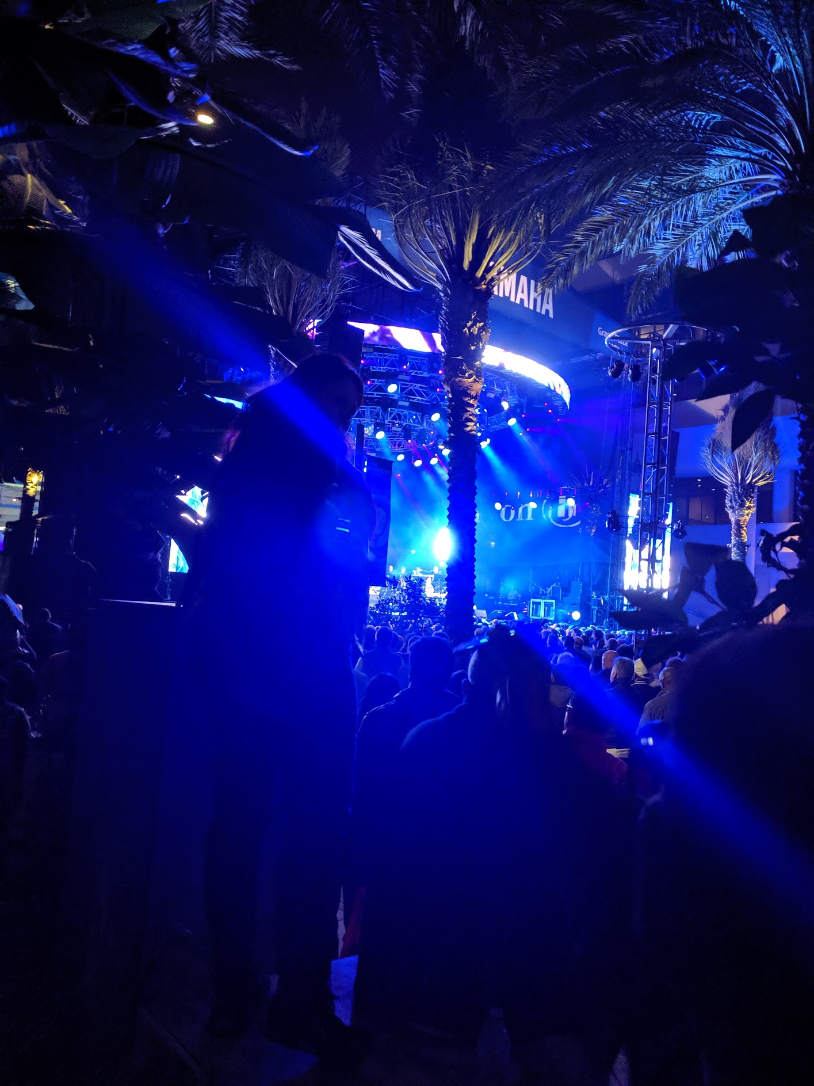
Task Group 15.4ab Virtual Plenary March 2022
March 8th through March 16th 2022

Slide 4
March Agenda
https://mentor.ieee.org/802.15/dcn/22/15-22-0114-08-04ab-tg-4ab-agenda-march-2022.xlsx
 |  |  |  | Wednesday | Friday | Tuesday |  | Wednesday |  | Thursday |  | Friday |  | Sunday |  |  | Monday |  | Tuesday |  | Wednesday
EST | PST | UTC | JST | 2-Mar | 4-Mar | 8-Mar |  | 9-Mar |  | 10-Mar |  | 11-Mar |  | 13-Mar | UTC | JST | 14-Mar |  | 15-Mar |  | 16-Mar
5:00 | 2:00 | 10:00 | 19:00 |  |  |  |  |  |  |  |  |  |  |  | 9:00 | 18:00
6:00 | 3:00 | 11:00 | 20:00 |  |  |  |  |  |  |  |  |  |  |  | 10:00 | 19:00
7:00 | 4:00 | 12:00 | 21:00 |  |  |  |  | TG7a | AM0 | TG7a | AM0 | SC THz | AM0 |  | 11:00 | 20:00 | TG7a | TG13 | TG7a | TG13
8:00 | 5:00 | 13:00 | 22:00 |  |  |  |  |  |  |  |  |  |  |  | 12:00 | 21:00
9:00 | 6:00 | 14:00 | 23:00 |  |  | WG Opening Meeting |  | TG13 | TG6a | TG13 | TG6a | TG3ma | Joint 6a/4ab/14 |  | 13:00 | 22:00 | TG3ma | TG4ab | TG6a | AM1 | WG Closing Meeting
10:00 | 7:00 | 15:00 | 0:00 | 802.15 CAC |  |  |  |  |  |  |  |  |  |  | 14:00 | 23:00
11:00 | 8:00 | 16:00 | 1:00 |  |  | SC Maint |  | SC WNG |  | SC IETF |  | TG4ab | AM2 |  | 15:00 | 0:00 | Joint 802.15/802.1 |  | SC Maint
12:00 | 9:00 | 17:00 | 2:00 |  |  |  |  |  |  |  |  |  |  |  | 16:00 | 1:00
13:00 | 10:00 | 18:00 | 3:00 |  |  | TG16t | PM1 | TG15 | PM1 | Joint 14/15/4ab | PM1 | PM1 | PM1 |  | 17:00 | 2:00 | TG15 | PM1 | TG16t | TG4ab
14:00 | 11:00 | 19:00 | 4:00 |  |  |  |  |  |  |  |  |  |  |  | 18:00 | 3:00
15:00 | 12:00 | 20:00 | 5:00 |  |  | PM2 | PM2 | TG4cor1 | PM2 | TG14 | PM2 | PM2 | PM2 |  | 19:00 | 4:00 | TG4cor1 | PM2 | PM2 | PM2
16:00 | 13:00 | 21:00 | 6:00 |  |  |  |  |  |  |  |  |  |  |  | 20:00 | 5:00
17:00 | 14:00 | 22:00 | 7:00 |  |  | TG4ab | EV1 | TG4ab | EV1 | TG4ab | EV1 | EV1 | EV1 |  | 21:00 | 6:00 | TG4ab | EV1 | TG4ab | EV1
18:00 | 15:00 | 23:00 | 8:00 |  |  |  |  |  |  |  |  |  |  |  | 22:00 | 7:00
19:00 | 16:00 | 0:00 | 9:00 |  |  | EV2 | EV2 | EV2 | EV2 | EV2 | EV2 | EV2 | EV2 |  | 23:00 | 8:00 | EV2 | EV2 | EV2 | EV2
20:00 | 17:00 | 1:00 | 10:00 |  |  |  |  |  |  |  |  |  |  |  | 0:00 | 9:00
21:00 | 18:00 | 2:00 | 11:00 |  |  |  |  |  |  |  |  |  |  |  | 1:00 | 10:00
22:00 | 19:00 | 3:00 | 12:00 |  |  |  |  |  |  |  |  |  |  |  | 2:00 | 11:00
23:00 | 20:00 | 4:00 | 13:00 |  |  |  |  |  |  |  |  |  |  |  | 3:00 | 12:00
15.4ab
 | TG4ab Meeting slots
Joint
 | Joint meetings with TG4ab

Slide 5
5.2.b Scope of the project (As approved):
This amendment enhances the Ultra Wideband (UWB) physical layers (PHYs) medium access control (MAC), and associated ranging techniques while retaining backward compatibility with enhanced ranging capable devices (ERDEVs). Areas of enhancement include:
additional coding, preamble and modulation schemes to additional coding, preamble and modulation schemes to support improved link budget and/or reduced air-time relative to IEEE Std 802.15.4 UWB;
additional channels and operating frequencies;
interference mitigation techniques to support greater device density and higher traffic use cases relative to the IEEE Std 802.15.4 UWB;
improvements to accuracy, precision and reliability and interoperability for high-integrity ranging; schemes to reduce complexity and power consumption;
definitions for tightly coupled hybrid operation with narrowband signaling to assist UWB;
enhanced native discovery and connection setup mechanisms;
sensing capabilities to support presence detection and environment mapping;
and mechanisms supporting low-power low-latency streaming as well as high data-rate streaming allowing at least 50 Mb/s of throughput.
Support for peer-to-peer, peer-to-multi-peer, and station-to-infrastructure protocols are in scope, as are infrastructure synchronization mechanisms. This amendment includes safeguards so that the high throughput data use cases do not cause significant disruption to low duty-cycle ranging use cases.
https://development.standards.ieee.org/myproject-web/app#viewpar/9081

Slide 6
Task Group Organization
Chair: Benjamin Rolfe (BCA)¹
Vice Chair and Recording Secretary: David Xun Yang (Huawei)
Vice Chair: Clint Powell (Meta)
Vice Chair: Clint Chaplin (SRA)
Lead Technical Editor: Billy Verso
Thank you to all the volunteers!
¹ Affiliation Details here: https://mentor.ieee.org/802-ec/dcn/22/ec-22-0061-00-00EC-rolfe-affiliations-by-802-activity.pdf

Slide 7
Project Schedule (working baseline)
Proposed project schedule | Nov-21 | Dec-21 | Jan-22 | Feb-22 | Mar-22 | Apr-22 | May-22 | Jun-22 | Jul-22 | Aug-22 | Sep-22 | Oct-22 | Nov-22 | Dec-22 | Jan-23 | Feb-23 | Mar-23 | Apr-23 | May-23 | Jun-23 | Jul-23 | Aug-23 | Sep-23 | Oct-23 | Nov-23 | Dec-23 | Jan-24 | Feb-24 | Mar-24 | Apr-24 | May-24 | Jun-24 | Jul-24 | Aug-24 | Sep-24 | Oct-24 | Nov-24
Call for proposals
Hear and evaluate proposals
Cut-off for new proposals, PHY
Cut-off for new proposals, MAC
Integrate poposals/contributions into TFD
Develop draft from TFD
Draft 0
TG draft review and revision
Working group pre-ballot review
Pre-ballot review and comment resolution
First letter ballot |  |  |  |  |  |  |  |  |  |  |  |  |  |  |  |  | LB
LB Comment Resolution
WG Recirculatoin |  |  |  |  |  |  |  |  |  |  |  |  |  |  |  |  |  |  |  |  | LB-R
Comment resolution, 1st recirc
Conditional approval for SA ballot
WG Recirculatoin |  |  |  |  |  |  |  |  |  |  |  |  |  |  |  |  |  |  |  |  |  |  | LB-R
Comment resolution, 2nd recirc and final recirc
First SA ballot |  |  |  |  |  |  |  |  |  |  |  |  |  |  |  |  |  |  |  |  |  |  |  |  | SA
Comment resolution, first SA ballot
SA Resirculation |  |  |  |  |  |  |  |  |  |  |  |  |  |  |  |  |  |  |  |  |  |  |  |  |  |  |  | SA-R
Comment resolution, SA recirculation
SA Resirculation |  |  |  |  |  |  |  |  |  |  |  |  |  |  |  |  |  |  |  |  |  |  |  |  |  |  |  |  |  |  | SA-R
Comment resolution, 2nd SA recirc
Conditional or unconditional approval to RevCom |  |  |  |  |  |  |  |  |  |  |  |  |  |  |  |  |  |  |  |  |  |  |  |  |  |  |  |  | ?? |  |  |  | ??
Optional 3rd SA recirc if needed |  |  |  |  |  |  |  |  |  |  |  |  |  |  |  |  |  |  |  |  |  |  |  |  |  |  |  |  |  |  |  |  | SA-R
RevCom meets |  |  |  |  |  |  |  |  |  |  |  |  |  |  |  |  |  |  |  |  |  |  |  |  |  |  |  |  |  |  |  |  |  | ` |  |  |  | `
You are Here >
Notes: SASB/RevCom schdule for 2024 a guess

Slide 8
Schedule Major Milestones
Near Term Working Milestones
Call for proposals | November 2021
Cut-off for new features (high level feature set), PHY | May 2022
Cut-off for new features (high level feature set), MAC | July 2022
Draft 0 | September 2022
TG draft review and revision complete | November 2022
Working group pre-ballot review complete | January 2022 (before meeting)
First letter ballot | March 2023 (following meeting)
…

Slide 9
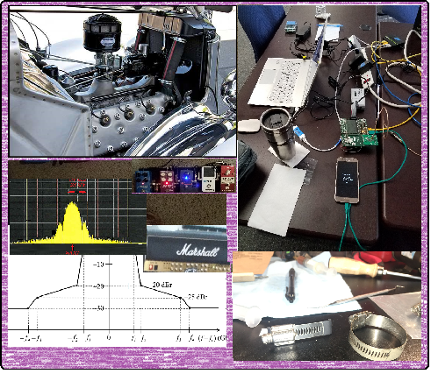
Technical Contributions

Slide 10
List of Technical Presentations
https://mentor.ieee.org/802.15/dcn/22/15-22-0073-01-04ab-a-method-to-evaluate-the-quality-of-tof-measurement-for-ir-uwb.pptx
https://mentor.ieee.org/802.15/dcn/22/15-22-0144-01-04ab-use-cases-of-uwb-sensing-proxy-application-in-802-15-4ab.pptx
https://mentor.ieee.org/802.15/dcn/22/15-22-0150-01-04ab-channel-access-considerations-on-fragmented-uwb-format.pptx
https://mentor.ieee.org/802.15/dcn/22/15-22-0155-00-04ab-cir-feedback-scheme-for-uwb-sensing.pptx
https://mentor.ieee.org/802.15/dcn/https://mentor.ieee.org/802.15/dcn/22/15-22-0156-00-04ab-discussion-on-nb-assisted-uwb.pptx
https://mentor.ieee.org/802.15/dcn/22/15-22-0169-00-04ab-measurement-based-ban-channel-model-for-xr-applications-part-ii.pptx
https://mentor.ieee.org/802.15/dcn/22/15-22-0170-00-04ab-discussion-on-uwb-sensing-report.pptx
https://mentor.ieee.org/802.15/dcn/22/15-22-0072-02-04ab-integrity-protection-to-support-secure-ranging-in-ir-uwb.pptx
https://mentor.ieee.org/802.15/dcn/22/15-22-0173-00-04ab-ack-for-data-communication.pptx
https://mentor.ieee.org/802.15/dcn/22/15-22-0174-01-04ab-u-nii-band-status-of-japan-for-consideration-to-nb-assisted-uwb.pptx
https://mentor.ieee.org/802.15/dcn/22/15-22-0175-00-04ab-sensing-device.pptx
https://mentor.ieee.org/802.15/dcn/22/15-22-0177-01-04ab-privacy-issues-in-uwb-sensing.pptx
https://mentor.ieee.org/802.15/dcn/22/15-22-0178-00-04ab-a-novel-channel-sounding-sequence.pptx
https://mentor.ieee.org/802.15/dcn/22/15-22-0179-00-04ab-multiple-transmissions-in-a-ranging-slot.ppt
https://mentor.ieee.org/802.15/dcn/22/15-22-0180-00-04ab-recap-of-narrowband-uwb-coupling-mac.pptx
https://mentor.ieee.org/802.15/dcn/22/15-22-0181-00-04ab-new-data-rates.pptx
https://mentor.ieee.org/802.15/dcn/22/15-22-0192-00-04ab-nba-uwb-technical-framework-proposal.docx
https://mentor.ieee.org/802.15/dcn/22/15-22-0193-00-04ab-tg4ab-drafting-process.docx

Slide 11
Next Steps

Slide 12
Interim TC planning
Call frequency and phase: Weekly on Tuesday 6am PT Commencing 29-March-2022
Call organization: Will cancel if no agenda items received 24 hours prior

Slide 13
Thanks

