Slide 1
Project: IEEE P802.15 Working Group for Wireless Personal Area Networks (WPANs)
Submission Title: [A Novel Channel Sounding Sequence for 15.4ab]
Date Submitted: [15th March 2022]
Source: [Michael McLaughlin, Igor Dotlic] [Qorvo]
Address [Adelaide Chambers, Peter Street, Dublin 8, Ireland]
E-Mail:[michael.mclaughlin at qorvo.com]
Re: [Study Group 4ab: UWB Next Generation]
Abstract: [A proposal for a channel sounding sequence for 15.4ab]
Purpose: [To increase the range of the 802.15.4ab PHY by up to 20dB]
Notice: This document has been prepared to assist the IEEE P802.15. It is offered as a basis for discussion and is not binding on the contributing individual(s) or organization(s). The material in this document is subject to change in form and content after further study. The contributor(s) reserve(s) the right to add, amend or withdraw material contained herein.
Release: The contributor acknowledges and accepts that this contribution becomes the property of IEEE and may be made publicly available by P802.15.

Slide 2
Technical Guidance
PAR Objective | Proposed Solution (how addressed)
Safeguards so that the high throughput data use cases will not cause significant disruption to low duty-cycle ranging use cases.
Interference mitigation techniques to support higher density and higher traffic use cases | This proposal reduces airtime by a factor of 16 or more thus reducing the probability of collisions by the same factor.
Other coexistence improvement | In contrast to, for example, m-sequences, Ipatov sequences, there are, literally, millions of CZC sequences of length 64. This means that many different logical channels can be supported
Backward compatibility with enhanced ranging capable devices (ERDEVs).
Improved link budget and/or reduced air-time | This proposal reduces airtime by a factor of 16 or more and improves link budget by up to 20dB
Additional channels and operating frequencies
Improvements to accuracy / precision / reliability and interoperability for high-integrity ranging;
Reduce complexity and power consumption; | This proposal reduces airtime by a factor of 16 or more and in that way reduces transmitter and receiver power consumption by approximately the same factor
Hybrid operation with narrowband signaling to assist UWB; | This proposal removes the need for narrowband assistance
Enhanced native discovery and connection setup mechanisms; | This sequence, by virtue of its extremely short duration, enables a wake-up radio with a similar link budget to current 802.15.4z devices
Sensing capabilities to support presence detection and environment mapping; | The lower PRF proposed here enhances sensing operation
Low-power low-latency streaming
higher data-rate streaming allowing at least 50 Mbit/s of throughput.
Support for peer-to-peer, peer-to-multi-peer, and station-to-infrastructure protocols; | In contrast to, for example, m-sequences, Ipatov sequences, there are, literally, millions of CZC sequences of length 64. This means that many different logical channels can be supported
Infrastructure synchronization mechanisms. | This sequence, by virtue of its extremely short duration, enhances synchronisation mechanisms

Slide 3
A Novel Channel Sounding Sequence
This contribution proposes a Channel Sounding Sequence that allows a UWB transceiver to do ranging with a link margin of at least 110dB

Slide 4
Seemingly unresolvable conflict
Channel sounding sequences have two conflicting requirements
Requirement 1
A repeating sequence has spectral lines at the repetition frequency with nulls in between
UWB spectrum must have no nulls when measured with a 1MHz RBW
=> Sequence must be > than 0.5µs long, preferably 1µs long
Requirement 2
A 40ppm CFO at 8GHz is 320kHz offset
Over 1µs the phase drifts by ~120˚
The CIR estimate from 3 symbols accumulated will completely cancel each other out
To get a channel estimate, many symbols need to be accumulated
=> Symbols need to be MUCH shorter than 1µs
=

Slide 5
Enter CZC codes
History of some useful channel sounding sequences
Golay introduced Complementary Pairs in 1961. These are pairs of sequences the sum of whose autocorrelation sidelobes are zero.
Complementary Sets were introduced in 1972 by Tseng and Liu. These are sets of sequences the sum of whose autocorrelation sidelobes are zero.
Ipatov introduced ternary codes in 1980 which have perfect periodic auto-correlation.
Igor Dotlic (Qorvo) took these Complementary Sets and added the property whereby neighbouring codes in a set have zero-sum cross correlation. We call these Complementary Zero-sum Cross-correlation Code Blocks or CZC codes
This allows codes to be sent consecutively, with no gap, and they don’t interfere with each other

Slide 6
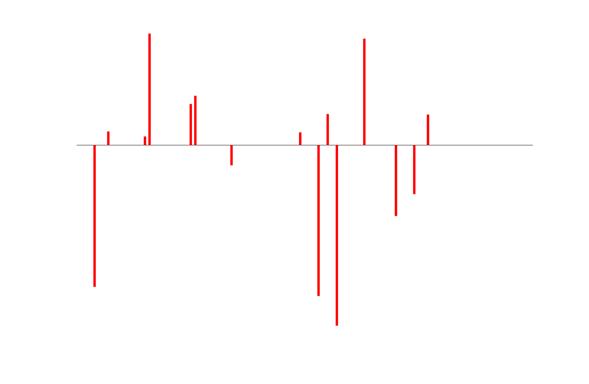
Channel Sounding
What we would like to do (But we can’t)
Infinitely Tall
I → ∞
Channel (i.e. CIR)
Received signal
→
→
.
.
.
Where (I x ∆t) is some finite charge
Infinitely Narrow
∆t → 0
T₀

Slide 7
Channel Sounding
Next best thing… (But we are not allowed)
Very Tall
I → lots of mA
Channel (i.e. CIR)
Received signal
→
→
.
.
.
Very Narrow
∆t < 1ps
T₀

Slide 8
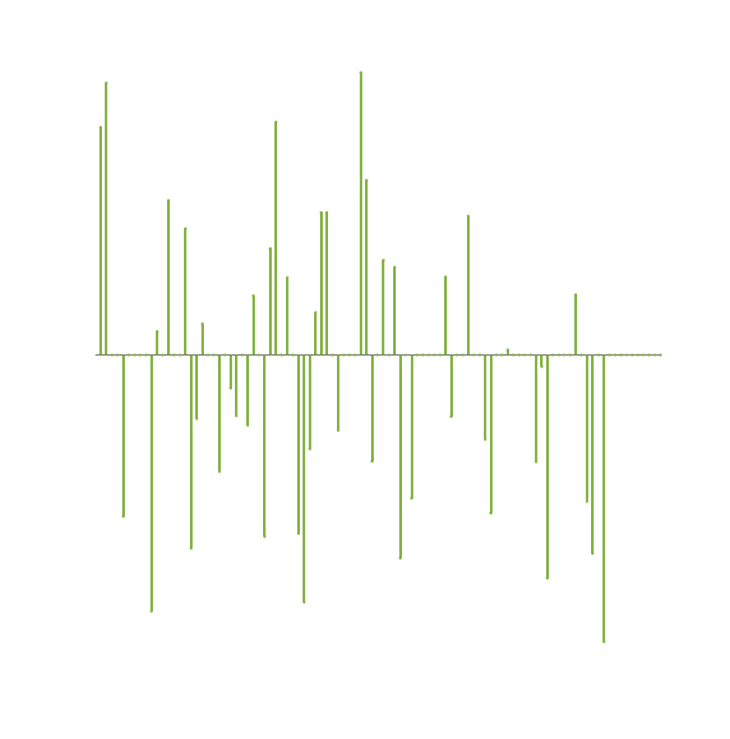
Channel Sounding
A perfect solution?
Correlated signal is CIR estimate
Quite Narrow
∆t ~ 2ns
Channel (i.e. CIR)
→
→
→
→
Not too tall, modest I
T₀

Slide 9
Channel Sounding
A perfect solution?
Correlated signal is CIR estimate
Quite Narrow
∆t ~ 2ns
Channel (i.e. CIR)
→
→
→
→
Not too tall
I ~ modest
T₀

Slide 10
Channel Sounding
We can analyse this more easily like this
A sequence with perfect Autocorrelation
Channel (i.e. CIR)
Correlated signal is CIR estimate
Quite Narrow
∆t ~ 2ns
→
→
→
→
T₀
Not too tall
I ~ modest
T₀

Slide 11
Channel Sounding
A perfect solution?
A sequence with perfect Autocorrelation
Channel (i.e. CIR)
Correlated signal
Quite Narrow
∆t ~ 2ns
→
→
→
→
T₀
Not too tall
I ~ modest
T₀

Slide 12
Channel Sounding: Golay Pairs
1st of a pair with perfect Autocorrelation sum
2nd of a pair with perfect Autocorrelation sum
Quite Narrow
∆t ~ 2ns
Quite Narrow
∆t ~ 2ns
→
→
→
→
Not too tall
I ~ modest
+
=

Slide 13
Channel Sounding: Ipatov Sequences
Ipatov sequences have perfect “periodic” autocorrelation

Slide 14
Complementary Sets
By adding together all the impulse responses a perfect CIR estimate is found
-----+++
++++-+++
-+-+++-+
+-+-++-+
-++----+
++---+--
-++-+++-
++--+-++
Example 8 x 8 complementary set
A drawback is that the codes need to be sent with a gap between them to allow the multipath for each code to die away

Slide 15
Complementary Zerosum Cross-correlation Blocks
By adding together all the impulse responses a perfect CIR estimate is found even when the codes are sent directly following each other
-----+++
++++-+++
-+-+++-+
+-+-++-+
-++----+
++---+--
-++-+++-
++--+-++
Example 8 x 8 CZC code block
If the CZC block has this property, then provided the multipath has a delay of less than or equal to the code length, all the cross correlations will cancel each other out

Slide 16
CZC Blocks with “Double Protection”
We can also ensure a zero sum of the cross correlations of the next nearest neighbour
If the CZC block has this property, then provided the multipath has a delay of less than or equal to twice the code length, all the cross correlations will cancel each other out. Of course we can extend this concept to more neighbours if needed
+++-
+-++
++-+
+---
+++-
+-++
++-+
+---
---+
+-++
--+-
+---
+++-
-+--
++-+
-+++
Example16 x 4 CZC code block with “double cc protection”

Slide 17
Why CZCs solve the length conflict problem:
CZCs combine the virtues of both long and short codes
-----+++
++++-+++
-+-+++-+
+-+-++-+
-++----+
++---+--
-++-+++-
++--+-++
An 16 x 4 CZC block sent at 64MHz PRF has 64 pulses so it is 1µs long => No spectral lines
When the receiver correlates with the same set and adds the correlation results together there are no auto correlation or cross correlation sidelobes, so a perfect channel estimate is obtained for each and every 1µs block
Each individual 4 pulse code only lasts 64ns so have negligible rotation, 7.5˚
Over the 16 codes whose correlations are summed, the worst case (40ppm) rotation averages to 60˚
This is a small enough rotation to get a good channel estimate which can give a good estimate of the rotation of the channel caused by the carrier offset.
Example 8 x 8 CZC code block
+++-
+-++
++-+
+---
+++-
+-++
++-+
+---
---+
-+--
++-+
+---
+++-
+-++
--+-
-+++
Example 16 x 4 CZC code block

Slide 18
A new channel estimate is found every 64ns
After the first 1µs 16 codes have been received
This forms a perfect channel estimation block
Each 64ns a new code is received
which also forms a perfect block
So, e.g., a 4µs block, 64 x 4 pulse symbols gives us 48 different CIR estimates
Each with zero auto-correlation and cross-correlation sidelobes

Slide 19
Further Advantages of the short CZC sequence (1)
A UWB signal with exactly one pulse every 16ns has the same peak power as mean power in 50MHz RBW. This allows 24dBs of gain to be applied and for the signal to be as short as 4µs which is 4 CZC code blocks sent consecutively
This boosts the Link Margin by 24dB for the duration of the sequence
Very low average Transmitter power consumption (6% duty cycle vs shortest 4z packet)
Very low Receiver power consumption (6% of power required vs shortest 4z packet)
After the position of the burst is determined, the receiver, in e.g. the tag, can be turned off for most of the 1ms containing the burst

Slide 20
Further Advantages of the short CZC sequence (2)
Very low (0.4%) duty cycle makes collisions with other UWB packets very unlikely
Correlator outputs can be stored in memory and processed serially during next 1ms to search for best CFO estimate, e.g. by finding optimum rotation.
For transmitters with limited Tx gain capability, e.g. the tag, a much longer sequence can be transmitted, e.g. 32µs
There are millions of CZC sequences of size 16 x 4
(I have found over 3,500,000 unique sequences in < 10⁻⁸ of search space)

Slide 21
1ms Fragments: Qorvo View
Initial TOA, CIR and CFO estimate
Refined CIR, TOA
Further Refinement
Possible Data packet
Possible Data packet
UWB
CZC
frag1
UWB
CZC
frag2
UWB
CZC
frag3
. . .
UWB
data
fragM
. . .
UWB
data
fragN
1ms
2ms
3ms
. . .
Mms
. . .
Nms

Slide 22
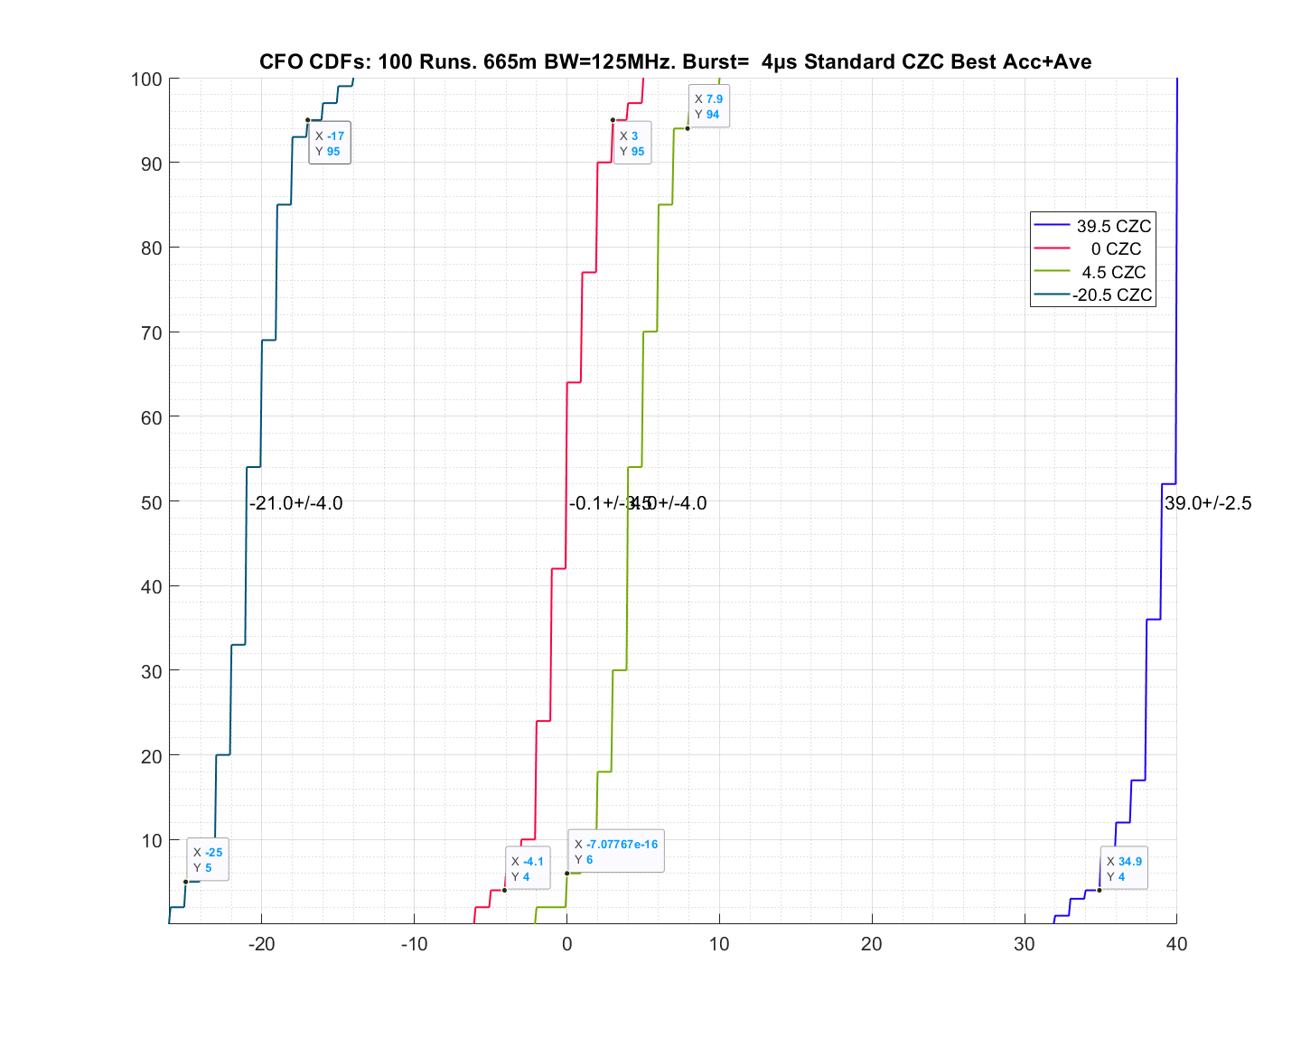
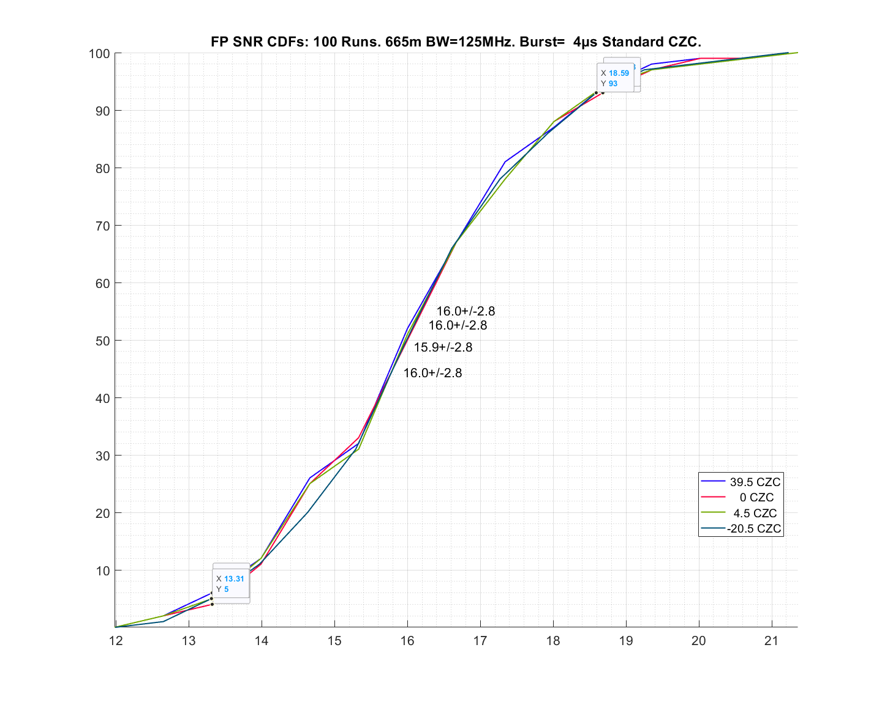
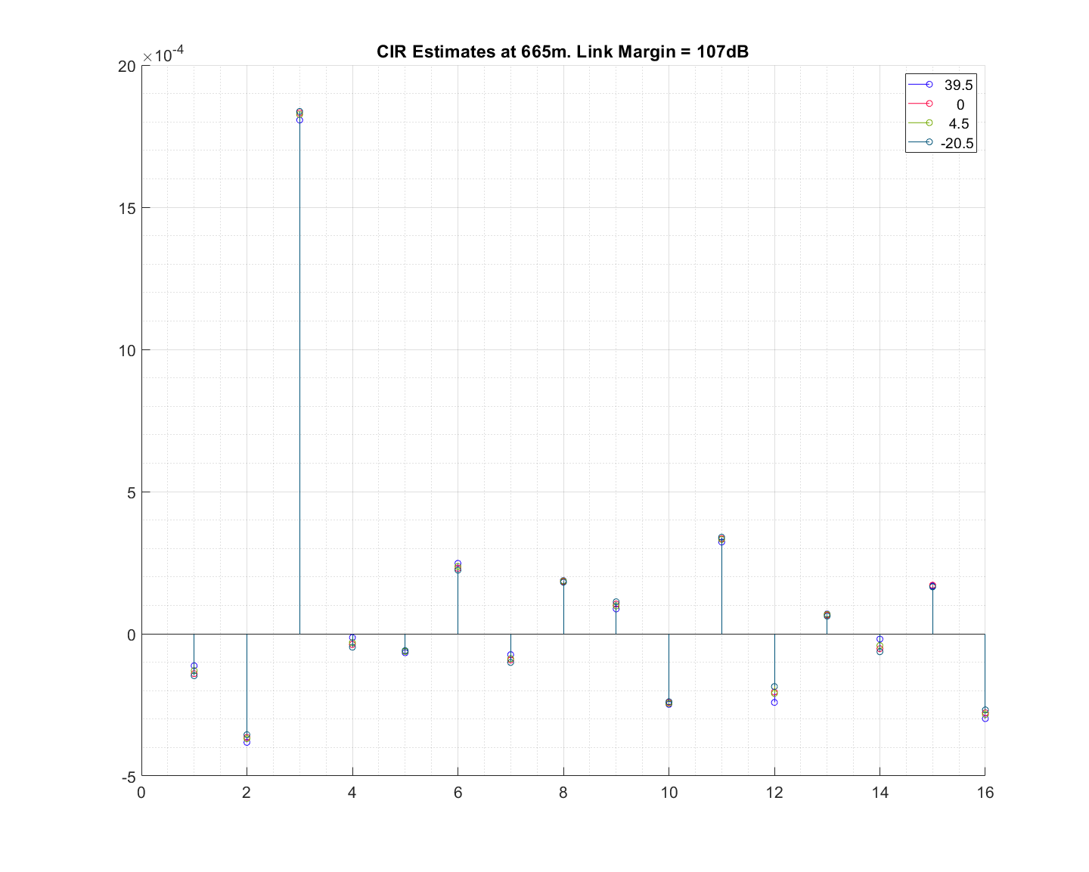
Performance at 107dB Link Margin
Detection rate: 100% in each 1ms using 1µs (64 pulse) correlator
The CFO here is estimated by doing a serial search for the best rotation

Slide 23
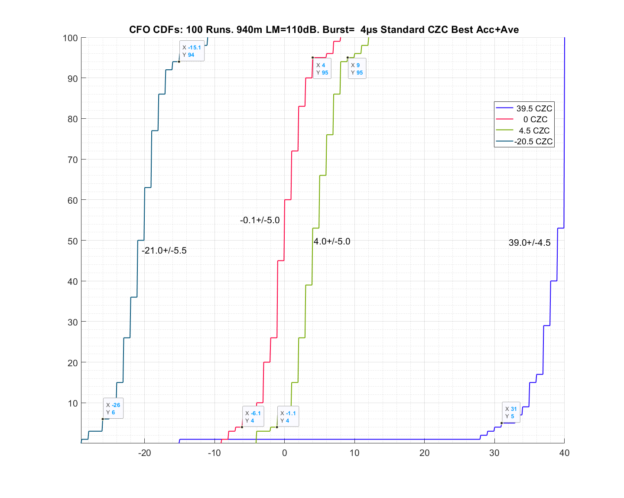
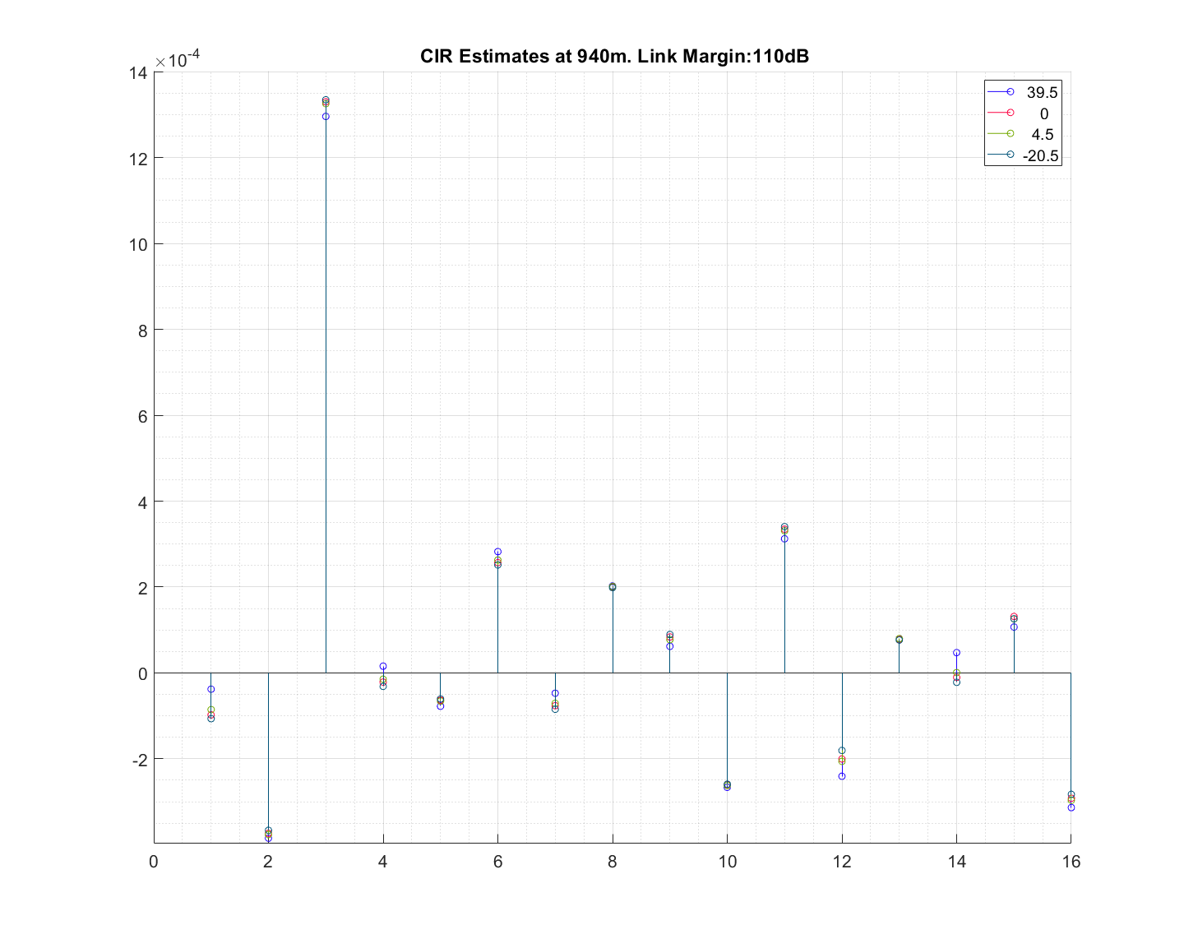
Performance at 110dB Link Margin
Detection rate: 86% in each 1ms using 1µs (64 pulse) correlator
The CFO here is estimated by doing a serial search for the best rotation

Slide 24
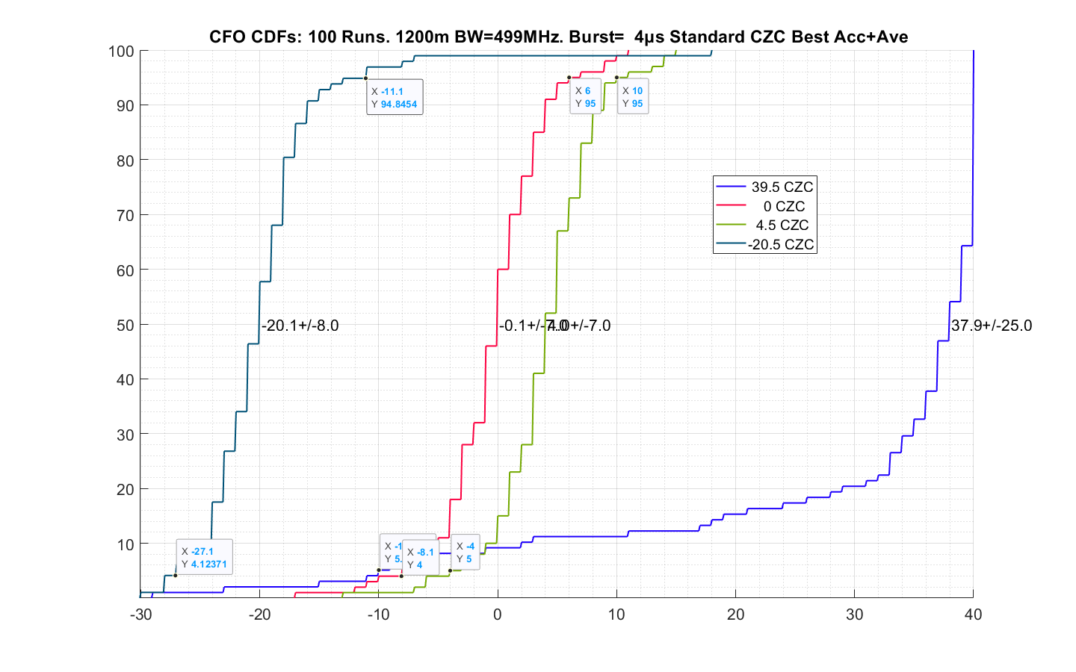
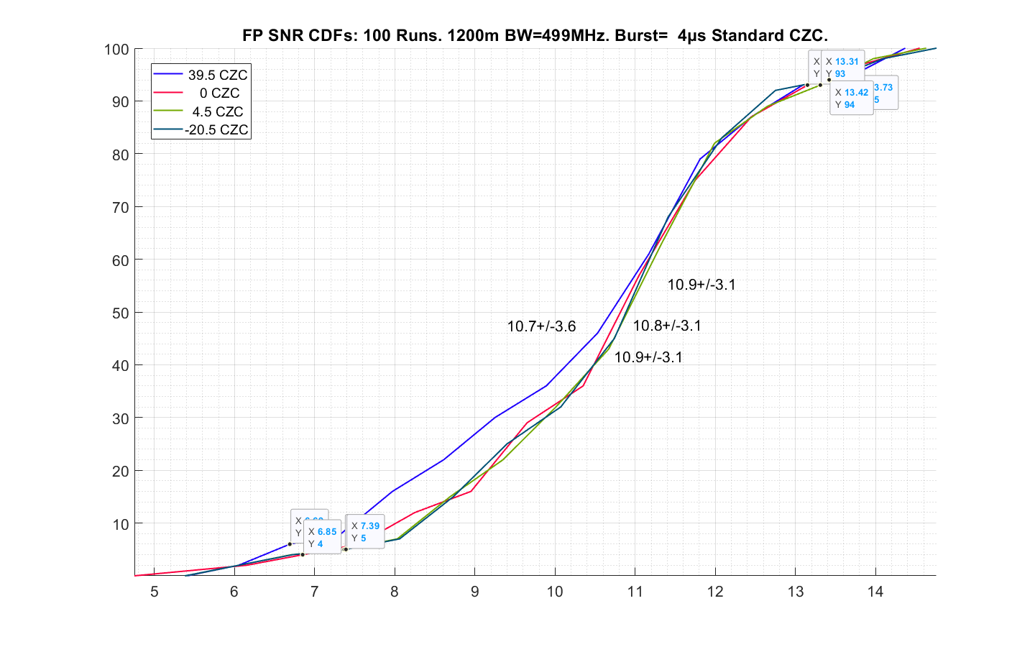
Performance at 112dB Link Margin
Detection rate: Currently 25% in each 1ms using 1µs (64 pulse) correlator

Slide 25
Very long range ranging measurement
Fixed response delay does not require data transfer
At very high link margins, data transfer may be challenging.
Unless multi-ms data fragments are used
For this situation, a fixed response delay can be used
E.g. say a tag is being searched for by someone with a phone. A fixed response delay can be used until the phone gets closer to the tag
A unique CZC code could have been previously chosen to avoid collisions
Extremely weak direct paths can be found with multi-ms fragments if a weak, but stronger, reflected path is present.

Slide 26
How accurately does the CFO need to be estimated?
The better the accuracy, the less uncertainty there is in the TOA of the next burst
1ppm drift error over 1ms is a 1ns drift in time
The 5ppm accuracy achieved here, with one fragment, at a link margin of 110dB allows the TOA of the next fragment to be predicted to within 5ns
As the CFO accuracy is refined, even better fragment arrival time can be achieved

