Slide 1
Project: IEEE P802.15 Working Group for Wireless Specialty Networks (WSN)
Submission Title: Privacy issues in UWB sensing
Source: Li Sun, Peng Liu, David Xun Yang (Huawei Technologies)
Address : [Huawei Bantian Base, Longgang District, Shenzhen, 518129 China]
E-Mail: [sunli50@huawei.com]
Re: Task Group 4ab: UWB Next Generation for 802.15.4
Abstract: [Privacy, sensing, UWB]
Purpose:
Notice: This document has been prepared to assist the IEEE P802.15. It is offered as a basis for discussion and is not binding on the contributing individual(s) or organization(s). The material in this document is subject to change in form and content after further study. The contributor(s) reserve(s) the right to add, amend or withdraw material contained herein.
Release: The contributor acknowledges and accepts that this contribution becomes the property of IEEE and may be made publicly available by P802.15.
Notes:
Jul 12, 2010
Page 1

Slide 2
PAR Objective | Proposed Solution (how addressed)
Safeguards so that the high throughput data use cases will not cause significant disruption to low duty-cycle ranging use cases
Interference mitigation techniques to support higher density and higher traffic use cases
Other coexistence improvement
Backward compatibility with enhanced ranging capable devices (ERDEVs)
Improved link budget and/or reduced air-time
Additional channels and operating frequencies
Improvements to accuracy / precision / reliability and interoperability for high-integrity ranging
Reduced complexity and power consumption
Hybrid operation with narrowband signaling to assist UWB
Enhanced native discovery and connection setup mechanisms
Sensing capabilities to support presence detection and environment mapping | This contribution proposes several privacy concerns that should be considered in designing UWB sensing solutions
Low-power low-latency streaming
Higher data-rate streaming allowing at least 50 Mbit/s of throughput
Support for peer-to-peer, peer-to-multi-peer, and station-to-infrastructure protocols
Infrastructure synchronization mechanisms

Slide 3
Related Contributions
UWB sensing in 802.15 <15-21-0399-00-04ab>, Jul. 2021, Frank Leong, et. al.
UWB sensing methods and KPIs in 802.15 <15-21-0505-00-04ab>, Sep. 2021, Xiaohui Peng et. al.
CIR feedback for UWB sensing <15-21-0570-00-04ab>, Nov. 2021, Xiaohui Peng, et. al.
Waveform design for UWB sensing <15-22-0040-00-04ab>, Jan. 2022, Xiaohui Peng, et. al.
UWB sensing scenarios for 802.15.4ab <15-22-0012-01-04ab>, Jan. 2022, Pooria Pakrooh, et. al.
Sensing – continued <15-22-0061-00-04ab>, Jan. 2022, Frank Leong, et. al.
Link budget analysis and CIR reporting for UWB RF sensing <15-22-0066-02-04ab>, Jan. 2022, Pooria Pakrooh, et. al.
UWB sensing concepts <15-22-0083-00-4ab>, Jan. 2022, Dag T. Wisland, et. al.
An increasing interest is observed in the sensing related topics

Slide 4
Major Topics under Discussion
Application scenarios/use cases (presence detection, environmental mapping, etc.)
Operational modes for UWB sensing (monostatic, multistatic, one-way, two-way, proxy, etc.)
Sensing methods (RSS, DOA, reflection, etc.) and KPIs
CIR compression and feedback
Waveform design
Link budget analysis for UWB sensing
Interference Management (not fully discussed)
Privacy issue is not discussed yet, but it’s important to take privacy into account when designing a sensing protocol.

Slide 5
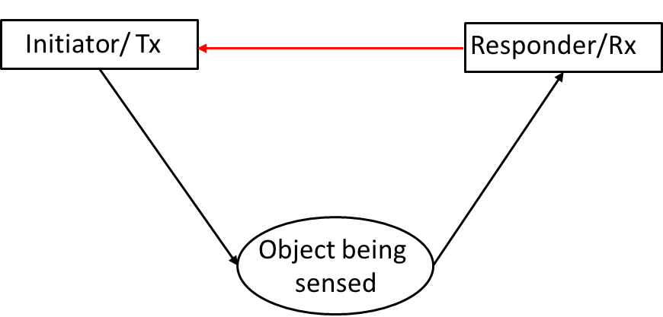
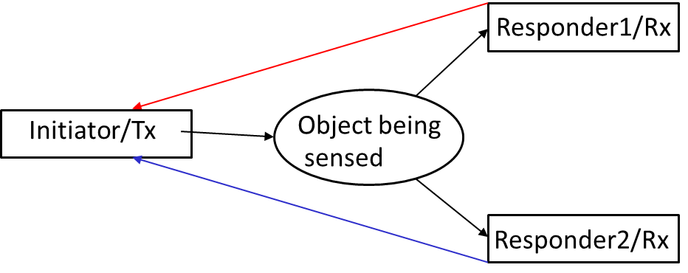
Privacy Issue #1
CIR feedback is required for some sensing modes
Bi-static sensing Mode B
Multi-static sensing Mode B
Figure Source: UWB sensing scenarios for 802.15.4ab <15-22-0012-01-04ab>, Jan. 2022, Pooria Pakrooh, et. al.
The CIR transmitted over the air may be overheard by unauthorized or even malicious entities
By collecting the CIR reports, the unauthorized parties can infer the presence and locations of the objects, analyze the behaviors of users, and do environmental mapping, which incurs privacy concerns

Slide 6
Privacy Issue #1
Possible Technical Solutions
Cryptographic approaches: Transmit encrypted CIR reports
Physical layer security approaches: Use signal processing methods to significantly degrade the received signal quality at unauthorized users
Differential-privacy like approaches: Mask a user’s individual CIR report before it is shared. If multiple copies of a CIR report are collected from a device, the noises that have been added can average out at the receiver, and the sensing performance is not degraded. However, it might be difficult for the unauthorized parties to collect all these copies to cancel out the noises.
Other candidate solutions?

Slide 7
Privacy Issue #2
Even without explicit CIR sharing, the unauthorized parties can still overhear the sensing packets or preamble from the legitimate transmitter due to the openness of wireless medium.
By capturing legitimate transmitter’s sensing packets or preamble and measuring CIR, the unauthorized entities can perform sensing as the legitimate receiver does, thus violating user privacy.
While the payload (such as CIR reports) can be encrypted, the preamble is publicly known to everyone. Encryption of the preamble will impact the auto-correlation property of the preamble sequence, which degrades the synchronization performance of the system.
Thus, privacy issue #2 is more difficult to solve compared to privacy issue #1, because higher-layer approaches like encryption does not help.

Slide 8
Privacy Issue #2
Possible Technical Solutions
Physical layer security approaches: Manipulate the transmitted signal in a controlled manner such that the eavesdropper obtains an incorrect CIR estimate but the legitimate receiver is still able to estimate CIR correctly
Some works have already been done to protect privacy in WiFi sensing (but the existing schemes cannot be directly applied to UWB systems):
CSI fuzzer [1]: The CSI fuzzer imposes an artificial channel response to the signal prior to transmission. Only the authorized receiver that knows the artificial response can calculate the actual channel response and perform CSI sensing
Waveform-defined privacy [2]: The transmitter tunes the waveform characteristics by changing the sign of modulated symbols on some sub-carriers. In this way, the phase information of some CSI coefficients is manipulated, which efficiently hides private user behaviors.
Other candidate solutions?

Slide 9
Summary
It is necessary to take privacy protection into account when designing sensing protocols
Two privacy issues are identified in this contribution. Maybe there are more privacy concerns?
Some candidate solutions are briefly introduced to address the privacy challenges. Which one do you prefer? Any other suggestions?
Detailed algorithm design is yet to be done. More work is needed.

Slide 10
References
[1] X. Jiao, M. Mehari, W. Liu, M. Aslam, and I. Moerman, “Openwifi CSI Fuzzer for Authorized Sensing and Covert Channels,” in Proc., ACM Conference on Security and Privacy in Wireless and Mobile Networks (WiSec), NY, USA, pp. 377–379, Jun. 2021.
[2] Tongyang Xu, “Waveform-Defined Privacy: A Signal Solution to Protect Wireless Sensing,” in Proc. IEEE 94th Vehicular Technology Conference (VTC2021-Fall), Norman, OK, USA, Sept. 2021.

