Slide 1
Project: IEEE P802.15 Working Group for Wireless Personal Area Networks (WPANs)
Submission Title: [Sensing Device]
Date Submitted: [11 March, 2022]
Source: [Dag T. Wisland (Novelda AS), Frank Leong (NXP Semiconductors), Kristian Granhaug, Dries Neirynck, Nikolaj Andersen (Novelda AS), Wolfgang Küchler, Riku Pirhonen (NXP Semiconductors)]
Re: [Input to the Working Group]
Abstract: [Presentation, UWB in 802.15, sensing]
Purpose: []
Notice: This document has been prepared to assist the IEEE P802.15. It is offered as a basis for discussion and is not binding on the contributing individual(s) or organization(s). The material in this document is subject to change in form and content after further study. The contributor(s) reserve(s) the right to add, amend or withdraw material contained herein.
Release: The contributor acknowledges and accepts that this contribution becomes the property of IEEE and may be made publicly available by P802.15.

Slide 2
PAR Objective | Proposed Solution (how addressed)
Safeguards so that the high throughput data use cases will not cause significant disruption to low duty-cycle ranging use cases
Interference mitigation techniques to support higher density and higher traffic use cases
Other coexistence improvement
Backward compatibility with enhanced ranging capable devices (ERDEVs) | Re-use of existing PHY elements
Improved link budget and/or reduced air-time
Additional channels and operating frequencies | Specification of carrier frequencies for Sensing
Improvements to accuracy / precision / reliability and interoperability for high-integrity ranging
Reduced complexity and power consumption
Hybrid operation with narrowband signaling to assist UWB
Enhanced native discovery and connection setup mechanisms
Sensing capabilities to support presence detection and environment mapping | Outlining key Sensing PHY and MAC aspects
Low-power low-latency streaming
Higher data-rate streaming allowing at least 50 Mbit/s of throughput
Support for peer-to-peer, peer-to-multi-peer, and station-to-infrastructure protocols
Infrastructure synchronization mechanisms

Slide 3
Sensing Device

Slide 4
UWB Sensing in 802.15.4ab
UWB is positioned to enable large-scale deployment of uniquely high-performant standardized Sensing functionality, when provided as part of a Ranging+Sensing radio concept
Address new Sensing-based applications
Leverage Sensing to accelerate adoption of UWB technology
Define the Sensing Device (SDEV)
Specify a conditionally mandatory basic feature set, enabling high-performance UWB Sensing @ ~500 MHz BW
Specify SDEV as an extension of ERDEV capabilities
SDEVs using ERDEV capabilities are good spectrum citizens
Specify options beyond the SDEV to support up to ≥1.5 GHz BW
Support Sensing Networks
Distributed Sensing systems
Coexistence management
Networks using both Multistatic and Monostatic Sensing results

Slide 5
UWB Sensing – Terminology
Align Sensing terminology with IEEE Std 686-2017
Extend with additional (e.g., Monostatic Sensing) terminology where applicable, e.g.: tap, (range) bin, resolution cell

Slide 6
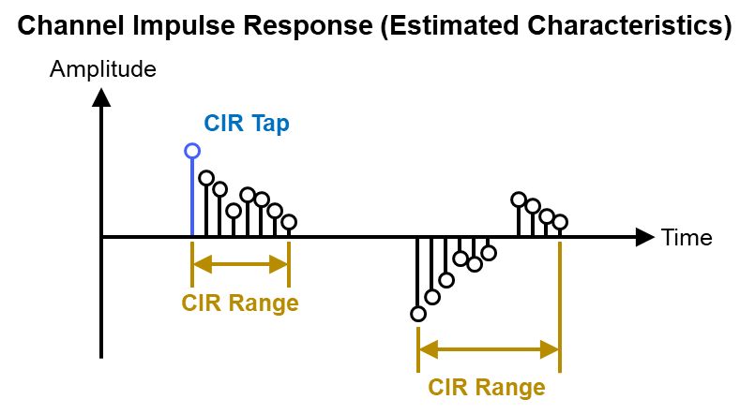
UWB Sensing – More Terminology
Illuminating Signal (from Sensing Transmitter/Initiator)
Echo Signal (to Sensing Receiver/Responder):
Sensing Processor creates Sensing Result from Sensing Measurement

Slide 7
Use of Multiple Antennas per Station
Specify periodic (e.g., existing Ipatov) sequences to be used for Sensing as drop-in replacement for STS segments (i.e., support multiple segments separated by gaps)
This could support per-segment assignment of (virtual) TX antennas
Support multiple spreading factors {1, ..., 128} (i.e., PRFs {499, ..., 4} MHz)
Dynamically adjustable per-segment parameters
Consider explicit signaling to indicate intention to use a packet for Sensing (e.g., setting a PHR bit)

Slide 8
UWB Sensing – Pulse Shape (I)
Specify a tight bound for Sensing pulse shape fidelity
Sensing performance depends more strongly on pulse shape than Ranging performance does
Specify the Sensing pulse such that it complies with Ranging requirements
Enable mode switching without change of pulse shape
Enable Sensing systems piggy-backing on Ranging protocols

Slide 9
UWB Sensing – Pulse Shape (II)
Avoid pre-ringing and post-ringing, strictly time-bound the pulse
Approximate a Gaussian pulse shape to be used for Sensing
For Sensing, specify a smooth Kaiser window (time-bounded) with L equivalent to 3 chips and β = πα = 10 as reference shape

Slide 10
UWB Sensing – Carrier Grid Spacing
Performing Sensing at multiple carrier frequencies allows to achieve large effective total bandwidth
In order to avoid artifacts, some overlap may be desirable
Overlap somewhere between 25-75% may be desirable
Carrier grid spacing of 124.8 MHz allows to choose between 124.8 MHz (N+1, i.e., ~75% overlap), 249.6 MHz (N+2, i.e., ~50% overlap), and 374.4 MHz (N+3, i.e., ~25% overlap) configurations

Slide 11
UWB Sensing – CIR Sharing (I)
CIR Reports are central to Sensing Networks
Frequently transmitted together with the Sensing waveform, therefore representing a high-priority specification item
Static IEs and dependent IEs can be specified in a next step
Essentially, we propose two types of CIR representation:
I/Q Amplitude Pairs
Range-Velocity Pairs with optional AoA (Azimuth) and EoA (Elevation) support
Support both Multistatic and Monostatic Sensing Measurements
Facilitate Distributed/Collaborative/Remote/Proxy Sensing
Enable simultaneous tracking of multiple targets
Higher sampling rates to facilitate optional “Large BW” modes

Slide 12
UWB Sensing – CIR Sharing (II)
Dedicated Information Element for CIR sharing
Facilitate centralized processing (i.e., support the use of “dumb” edge nodes)
Support transmission of selected ranges of CIR taps (referred to 0 meters)
Support complex CIR tap sizes of 2*{8,12,16,24} bits
CIR tap I&Q amplitudes encoded in linear scale, with sampling rate ({1,2,4,8} times the chip rate), reference level and tap size (I&Q always of same size) to be set via dedicated IE or OOB means
Structure / Order of Transmission:
Main Header
Range Header 1
Range Body 1
Range Header 2
Range Body 2
...
Range Header N
Range Body N

Slide 13
UWB Sensing – CIR Sharing (III)
Main Header (transmitted 1x)
Field Name | Field Length (Bits) | Description
Compression | 1 | Set when using DEFLATE (i.e., Zip) compression of fields beyond the first octet
Reserved | 7 | Reserved
Number of Ranges | 8 | Number of CIR ranges transmitted

Slide 14
UWB Sensing – CIR Sharing (IV)
Range Header (transmitted for each range)
Field Name | Field Length (Bits) | Description
Local Antenna Number | 5 | Antenna associated with current CIR range
Timeslot Number | 3 | Transmitted (Ipatov) segment associated with current CIR range, i.e., (virtual) TX antenna; all 1s means the current CIR range is associated with the preamble
Line-Of-Sight Available | 2 | Signals whether (slow-moving/stationary) LOS path has been searched for (MSB) and whether it has been found (LSB)
Reserved | 1 | Reserved
Target Mode | 1 | Enabled if current CIR range contains target distance-velocity pairs instead of CIR tap amplitudes
Target AoA | 1 | Enabled if AoA field is transmitted
Target EoA | 1 | Enabled if EoA field is transmitted
Range Start Index | 16 | Starting index (sample) of current range; also applies to Target Mode
Length of Range (LoR) | 10 | Number of taps/elements in current range; in Target Mode, contains the number of targets

Slide 15
UWB Sensing – CIR Sharing (V)
Range Body (transmitted LoR times for each range,
i.e., I&Q amplitude pairs for each tap or delay velocity pairs for each element)
Field Name | Field Length (Bits) | Description
In-Phase Amplitude | {8,12,16,24} | Amplitude scaled to pre-agreed level, encoded as signed integer (not transmitted in Target Mode)
Quadrature Amplitude | {8,12,16,24} | Amplitude scaled to pre-agreed level, encoded as signed integer (not transmitted in Target Mode)
Target Delay | 12 | Estimated distance of the current target, expressed in number of samples (only transmitted in Target Mode)
Target Velocity | 12 | Estimated target velocity as signed integer multiple of 2.5e-3 m/s (only transmitted in Target Mode)
Target AoA | 12 | Estimated azimuth of the current target, range -π to +π (optional; only transmitted in Target Mode)
Target EoA | 12 | Estimated elevation of the current target, range -π to +π (optional; only transmitted in Target Mode)

Slide 16
References
https://mentor.ieee.org/802.15/dcn/21/15-21-0399-00-04ab-uwb-sensing-in-802-15.pptx https://mentor.ieee.org/802.15/dcn/21/15-21-0570-00-04ab-cir-feedback-for-uwb-sensing.pptx https://mentor.ieee.org/802.15/dcn/22/15-22-0040-04-04ab-waveform-design-for-uwb-sensing.pptx https://mentor.ieee.org/802.15/dcn/22/15-22-0061-00-04ab-sensing-continued.pptx https://mentor.ieee.org/802.15/dcn/22/15-22-0066-02-04ab-link-budget-analysis-and-cir-reporting-for-uwb-rf-sensing.pptx https://mentor.ieee.org/802.15/dcn/22/15-22-0012-02-04ab-uwb-sensing-scenarios-for-802-15-4ab.pptx https://mentor.ieee.org/802.15/dcn/22/15-22-0083-01-04ab-uwb-sensing-concepts.pptx https://mentor.ieee.org/802.15/dcn/22/15-22-0144-03-04ab-use-cases-of-uwb-sensing-proxy-application-in-802-15-4ab.pptx https://mentor.ieee.org/802.15/dcn/22/15-22-0170-00-04ab-discussion-on-uwb-sensing-report.pptx

