Slide 1
Project: IEEE P802.15 Working Group for Wireless Personal Area Networks (WPANs)
Submission Title: U-NII band status of Japan for consideration to NB-assisted UWB
Date Submitted: March xx 2022
Source: Huan-Bang Li, Homare Murakami, Takeshi Matsumura (NICT, Japan)
Address: 3-4 Hikarino-oka, Yokosuka-shi, Kanagawa, 239-0847 Japan
E-Mail: {lee, homa, matsumura}@nict.go.jp
Abstract: Show UNII band status and proposed future plan in Japan as reference for discussing NB assisted UWB.
Purpose: To improve coexistence among UWB systems.
Notice: This document has been prepared to assist the IEEE P802.15. It is offered as a basis for discussion and is not binding on the authoring individual(s) or organization(s). The material in this document is subject to change in form and content after further study. The authors(s) reserve(s) the right to add, amend or withdraw material contained herein.

Slide 2
PAR Objective | Proposed Solution (how addressed)
Safeguards so that the high throughput data use cases will not cause significant disruption to low duty-cycle ranging use cases | Effective and efficient CCA reduce disruption between UWB devices
Interference mitigation techniques to support higher density and higher traffic use cases | Use pilot NB radio as pilot to facilitate CCA so as to improve coexistence.
Other coexistence improvement | Use pilot NB radio to improve coexistence among UWB devices.
Backward compatibility with enhanced ranging capable devices (ERDEVs)
Improved link budget and/or reduced air-time
Additional channels and operating frequencies
Improvements to accuracy / precision / reliability and interoperability for high-integrity ranging
Reduced complexity and power consumption
Hybrid operation with narrowband signaling to assist UWB | Exploiting pilot NB PHY and concurrent operation with UWB to assist UWB channel access
Enhanced native discovery and connection setup mechanisms
Sensing capabilities to support presence detection and environment mapping
Low-power low-latency streaming
Higher data-rate streaming allowing at least 50 Mbit/s of throughput
Support for peer-to-peer, peer-to-multi-peer, and station-to-infrastructure protocols
Infrastructure synchronization mechanisms

Slide 3
Contents
Background
Purpose
Current status of U-NII band for WLAN in Japan
Public comments are solicited for the plan of using U-NII-5 band
Summary

Slide 4
Background
Within IEEE 802.15.4ab, narrowband assisted UWB (concurrent operation of UWB and narrowband radio) is considered of significant potentials. Proposed examples include but not limited to the followings.
- clear channel assessment / channel access.
- link budget improvement.
- efficient wake-up /discovery.
- offloading status signaling.
- reduce UWB airtime
NICT showed examples of using sub-GHz band available in Japan (15-22-0065-00-04ab)
Apple, etc. proposed U-NII-3 as narrowband candidate (15-22-0064-00-04ab)
Qualcomm suggests to use open interface including U-NII-3, BLE, etc. (15-22-0156-00-04ab)

Slide 5
Purpose
Present U-NII band status in Japan
  Review current usage of U-NII-1, 2 bands for WLAN
  Show proposed future plan of U-NII-5 band in comparison with USA and EU
Provide reference for discussion on narrowband-assisted UWB

Slide 6
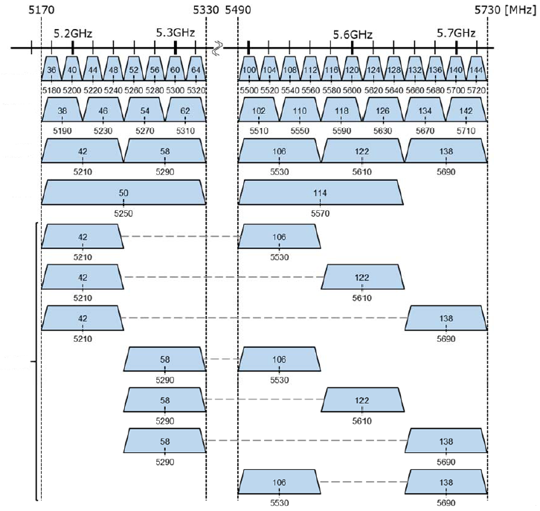
Current Status
BW=20MHz
BW=40MHz
BW=80MHz
BW=160MHz
Can be used outdoor.
DFS, TPC required
80MHz & 80MHz
DFS, TPC required

Slide 7
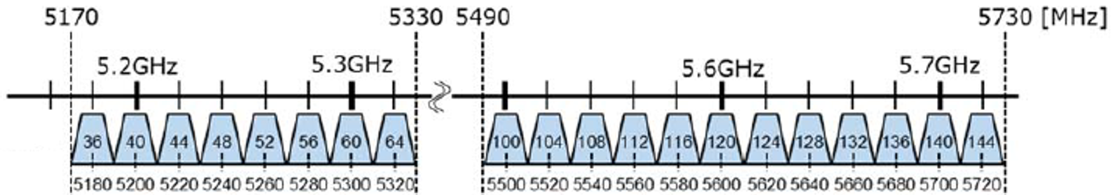
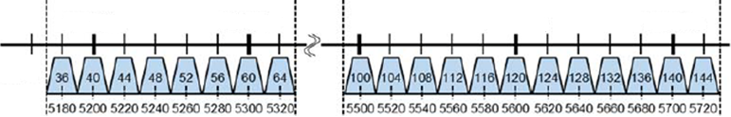
Revision Continues
Revision
May 2005
(U-NII-1)
(U-NII-2A)
Revision
Jan. 2007
(U-NII-2C)
Revision
July 2019
(U-NII-2C+)
When will be the next revision?
How about U-NII 3 and above

Slide 8
Proposed Future Plan
MIC issued a report on March 2, 2022. In this report, U-NII-5 is newly proposed for WLAN operation.
Public comments are solicited for the proposed new plan on U-NII-5 until April 1.
Further steps are expected to enable the proposed new plan in near future.
MIC: Ministry of Internal Affair and Communications, which is in charge of radio regulation of Japan

Slide 9
Proposed New Plan on U-NII-5
 |  | USA ready | EU ready | Japan under-plan
Standard Power | frequency (MHz) | 5925-6425 6525-6875
 | access point | e.i.r.p.= 36dBm PSD = 23dBm/MHz
 | client | e.i.r.p.= 30dBm PSD = 17dBm/MHz
Low power indoor | Frequency (MHz) | 5925-7125 | 5925-6425 | 5925-6425
 | access point | e.i.r.p.= 30dBm PSD = 5dBm/MHz | e.i.r.p.= 23dBm PSD = 10dBm/MHz | e.i.r.p.= 23dBm PSD = 10dBm/MHz
 | client | e.i.r.p.= 24dBm PSD = -1dBm/MHz
Very Low power | Frequency (MHz) |  | 5925-6425 | 5925-6425
 | access point |  | e.i.r.p.= 14dBm PSD = 1dBm/MHz | e.i.r.p.= 14dBm PSD = 1dBm/MHz
 | client

Slide 10
Summary
Name | Freq. range (GHz) | Availability in Japan
U-NII-1 | 5.15-5.25 | Ready (5.17-5.25)
U-NII-2A | 5.25-5.35 | Ready (5.25-5.33)
U-NII-2C | 5.47-5.725 | Ready (5.49-5.73)
U-NII-3 | 5.725-5.85 | allocated to ITS/DSRC
U-NII-5 | 5.925-6.425 | Under plan

