Slide 1
Project: IEEE P802.15 Working Group for Wireless Personal Area Networks (WPANs)
Submission Title: Ack for data communication
Date Submitted: March 2022
Source: Kangjin Yoon, Chunyu Hu, Clint Powell, Carlos Aldana, Claudio Da Silva (Meta Platforms, Inc)
Email: kyoon@fb.com
Abstract: Existing Ack mechanisms can be used for data communication
Purpose: To see what Ack mechanisms we have in the existing specifications and see if those are applicable to data communication use-cases
Notice: This document has been prepared to assist the IEEE P802.15. It is offered as a basis for discussion and is not binding on the contributing individual(s) or organization(s). The material in this document is subject to change in form and content after further study. The contributor(s) reserve(s) the right to add, amend or withdraw material contained herein.
Release: The contributor acknowledges and accepts that this contribution becomes the property of IEEE and may be made publicly available by P802.15.

Slide 2
PAR Objective | Proposed Solution (how addressed)
Safeguards so that the high throughput data use cases will not cause significant disruption to low duty-cycle ranging use cases
Interference mitigation techniques to support higher density and higher traffic use cases
Other coexistence improvement
Backward compatibility with enhanced ranging capable devices (ERDEVs)
Improved link budget and/or reduced air-time | RMMRC IE can reduce air-time by reducing the number of Ack frames
Additional channels and operating frequencies
Improvements to accuracy / precision / reliability and interoperability for high-integrity ranging
Reduced complexity and power consumption
Hybrid operation with narrowband signaling to assist UWB
Enhanced native discovery and connection setup mechanisms
Sensing capabilities to support presence detection and environment mapping
Low-power low-latency streaming | RMMRC IE can reduce power by reducing the number of Ack frames
Higher data-rate streaming allowing at least 50 Mbit/s of throughput | Ack mechanism for higher data-rate use-case
Support for peer-to-peer, peer-to-multi-peer, and station-to-infrastructure protocols | Peer-to-peer and peer-to-multi-peer Ack mechanism
Infrastructure synchronization mechanisms

Slide 3
Introduction
Most ranging applications are not using explicit Ack
802.15.4-2020 and 802.15.4z-2020 both define explicit Ack mechanisms
Explicit Ack is an important building block for reliability, which is a common requirement for data communication
Explicit Ack as an optional feature
In this presentation, we will revisit existing Ack mechanisms and see how these can be used for data communication

Slide 4
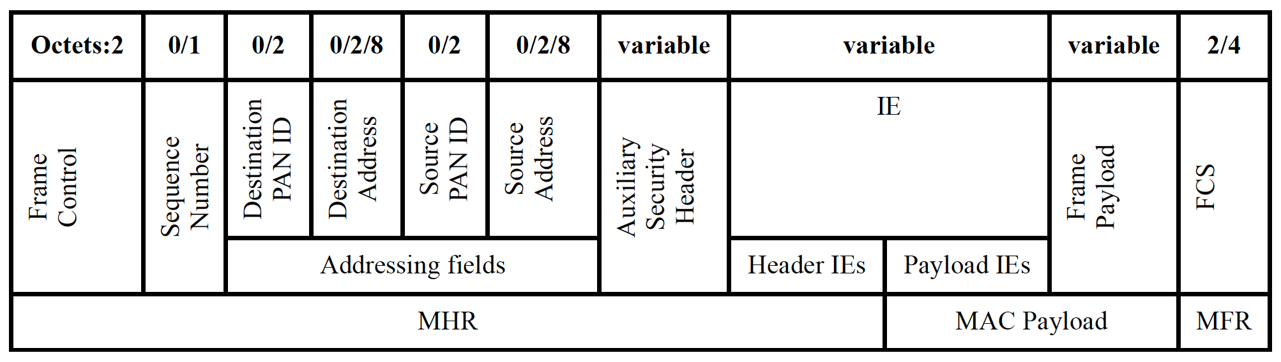
Enhanced-Ack (Enh-Ack)
Enh-Ack can be transmitted right after AIFS^{[1]} from the end of reception
Requested by Ack Request (AR) field in MHR
Frame Control field indicates the presence of each field (i.e., Sequence Number, destination address, source address, IE, etc.)
[1] AIFS: Ack Interframe Spacing
[2] Enh-Ack can be used for 15.4-2003/2006 version frame only

Slide 5
Example of Enh-Ack
Sequence Number and Destination Address
Octets: 2
1
2
2
Frame Control
Sequence Number
Destination Address
FCS
MHR
MFR

Slide 6
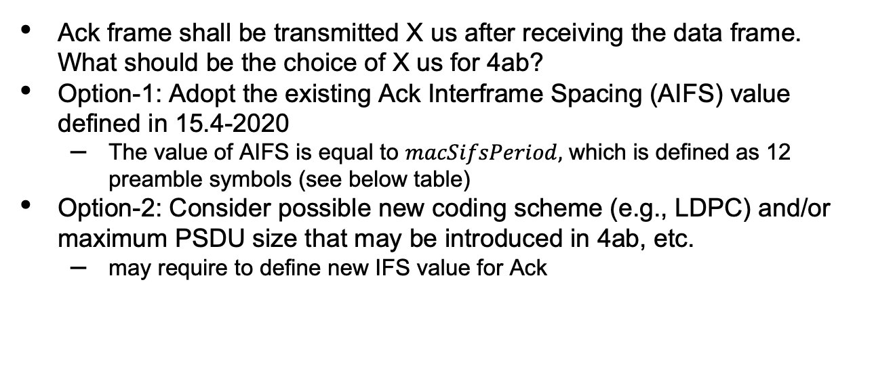
Data-Ack Interframe Spacing
Ack frame shall be transmitted X us after receiving the data frame. What should be the choice of X us for 4ab?
Option-1: Adopt the existing Ack Interframe Spacing (AIFS) value defined in 15.4-2020
  The value of AIFS is equal to $macSifsPeriod,$ which is defined as 12 preamble symbols (see below table)
Option-2: Consider possible new coding scheme (e.g., LDPC) and/or maximum PSDU size that may be introduced in 4ab, etc.
  may require to define new IFS value for Ack
Ranging Slot
 | Symbol duration (ns) | AIFS (us)
HPRF | 729.17 | 8.75
BPRF | 993.6 | 11.92
 | 1017.6 | 12.21
Control
ACK
Data
ACK
…
AIFS
AIFS

Slide 7
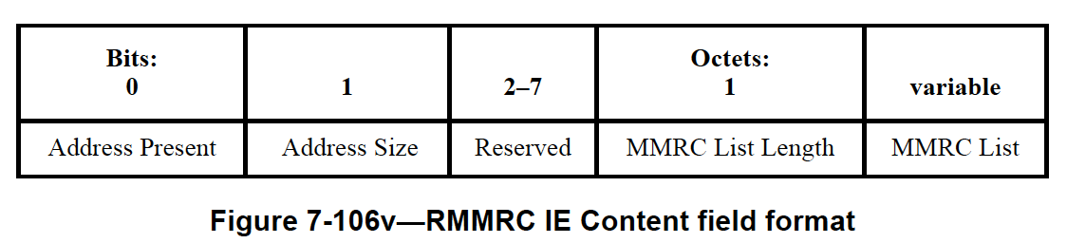
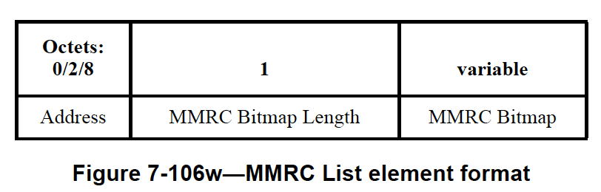
Ranging Multiple Message Receipt Confirmation IE (RMMRC IE)
Introduced in 4z-2020
Ack for multiple messages
Multiple Message Receipt Confirmation (MMRC) List field can have multiple MMRC List elements
MMRC Bitmap field: Each bit maps to the slots in the ranging round and confirms the receipt of a message in the slot

Slide 8
Ranging Multiple Message Receipt Confirmation IE (RMMRC IE)
Control Message can allocate a slot for RMMRC IE transmission
Ranging Slot
Control
Data
Data
RMMRC IE
Ranging Round

Slide 9
RMMRC IE: Ack for Broadcast frames
Controller may assign multiple slots/frames for broadcasting to multiple devices.
Receiver can use RMMRC IE to Ack them
Ranging Slot
Control
Broadcast Data
Broadcast Data
RMMRC IE from Device A
RMMRC IE from Device B
Ranging Round

Slide 10
Comparison Between Enh-Ack and RMMRC IE
 | Enh-Ack | RMMRC IE
Transmission timing | AIFS after receiving the Data frame | Scheduled slot
Frame Type | Ack Frame | Data Frame
Pros | Immediate confirmation | Ack for multiple data (less overhead), Ack for broadcast data frame(s)

Slide 11
Summary
We can utilize both Enh-Ack and/or RMMRC IE for Ack for data frame(s) wherever applicable
  Enh-Ack is the fastest way to let the data frame transmitter knows the successful reception
  RMMRC IE can reduce overhead if used to acknowledge multiple frames and/or broadcast frames

Slide 12
Appendix

Slide 13
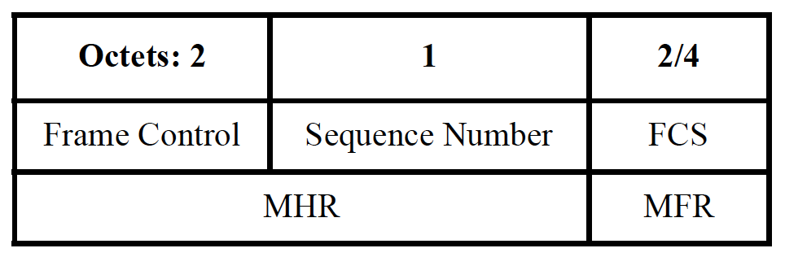
Immediate-Ack (Imm-Ack)
Ack for 15.4-2003/2006 version frame
Requested by Ack Request (AR) field in MHR
Sequence number only
15.4-2003/2006 version frame cannot have IE 🡪 Not applicable for 4z or 4ab frames

