Slide 1
Project: IEEE P802.15 Working Group for Wireless Personal Area Networks (WPANs)
Submission Title: MAC considerations for data communication
Date Submitted: March 2022
Source: Kangjin Yoon, Chunyu Hu, Carlos Aldana, Claudio Da Silva, (Meta Platforms, Inc)
Email: kyoon@fb.com
Abstract: High level overview and proposals about UWB data communication
Purpose: To discuss general direction for enhanced UWB data communication
Notice: This document has been prepared to assist the IEEE P802.15. It is offered as a basis for discussion and is not binding on the contributing individual(s) or organization(s). The material in this document is subject to change in form and content after further study. The contributor(s) reserve(s) the right to add, amend or withdraw material contained herein.
Release: The contributor acknowledges and accepts that this contribution becomes the property of IEEE and may be made publicly available by P802.15.

Slide 2
PAR Objective | Proposed Solution (how addressed)
Safeguards so that the high throughput data use cases will not cause significant disruption to low duty-cycle ranging use cases | Keeping slotted structure may help to make less impact to the coexisting ranging use-case
Interference mitigation techniques to support higher density and higher traffic use cases
Other coexistence improvement
Backward compatibility with enhanced ranging capable devices (ERDEVs)
Improved link budget and/or reduced air-time
Additional channels and operating frequencies
Improvements to accuracy / precision / reliability and interoperability for high-integrity ranging
Reduced complexity and power consumption
Hybrid operation with narrowband signaling to assist UWB
Enhanced native discovery and connection setup mechanisms
Sensing capabilities to support presence detection and environment mapping
Low-power low-latency streaming | Scheduling can be used for data communication to save power
Higher data-rate streaming allowing at least 50 Mbit/s of throughput | Scheduling mechanism for general data comm
Support for peer-to-peer, peer-to-multi-peer, and station-to-infrastructure protocols | Scheduling mechanism for general data comm, applicable to all described cases
Infrastructure synchronization mechanisms

Slide 3
Previous Contributions for Data Communication
DCN 222r0 (Apr. 2021) “Data Communication enhancements”
Introduced essential requirements for data communication in PHY perspective
DCN 501r0 (Sept. 2021) “Ways to achieve higher data rate for the HRP-UWB PHY”
Shared options for achieving higher data rate
DCN 047r1 (Jan. 2022) “MAC layer considerations for UWB data streaming”
Proposed channel access with energy detection sensing to improve coexistence performance

Slide 4
UWB for Data Communication
UWB has low latency and relatively high PHY rate
 | BT Classic/LE | 802.15.4z UWB | 802.11 Wi-Fi
Latency | Low (No LBT ^{[1]}) | Low (No LBT) | High (LBT)
PHY rate | 3 Mbps | 31.2 Mbps | 100+ Mbps
Range | 10 m | 10 m (much shorter in NLOS) | 100 m
UWB is a good candidate for some type of time-sensitive traffic that requires higher PHY rate/throughput than BT Classic/LE can provide
In 4ab, we can enhance PHY rate and communication range while keeping low latency
[1] LBT: Listen-before-talk

Slide 5
Target Network Topology
Star topology: One controller, one or more controlees
Controller
Controlee 1
Controlee 3
Controlee 2

Slide 6
MAC Considerations for Data Comm.
To use UWB for data communication, we have following high level design questions as first step:
Slotted structure vs. unslotted structure
Contention-based vs. scheduling-based
Control, scheduling mechanisms for data communication
Ack mechanism for data frame (in separate contribution)

Slide 7
Slotted Structure vs. Unslotted Structure
4z enhanced ranging utilizes slotted structure
 | Slotted Structure | Unslotted structure
Pros | Facilitate efficient scheduling Reuses 4z design Coex with ranging natively | More flexibility
Propose to focus on the slotted structure

Slide 8
Contention-based vs. Scheduling-based
4z has both modes, while most of ranging applications utilize scheduling-based mode
 | Contention-based mode | Scheduling-based mode
Pros | Can support more devices than the number of slots No scheduling negotiation | Well defined in 4z-2020 Efficient channel usage thanks to no collision in intra-session Power saving
Fit | Bursty and unpredictable traffic per device | Recurring traffic pattern

Slide 9
Scheduling-based Mode
Scheduling-based mode is preferred due to following reasons:
Minimal change from 4z-2020
More predictable latency if reliability can be maintained by link budget and retransmission
Contention-based mode might be still useful in some cases but probably limited and not always needed

Slide 10
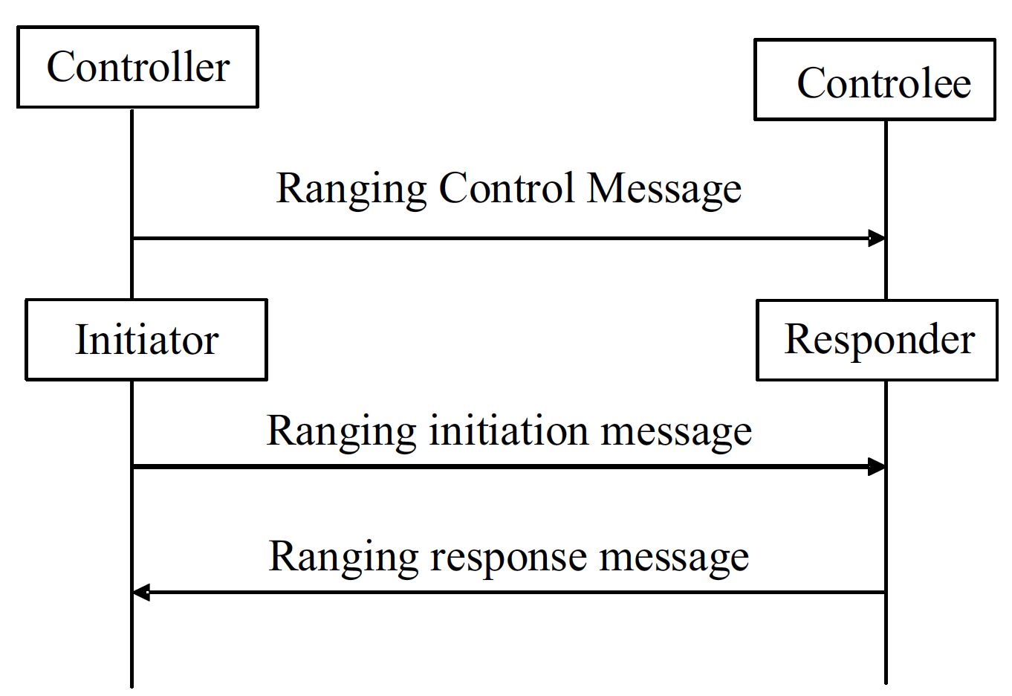
Control and Scheduling for Ranging
Controller sends Ranging Control Message (RCM) in the first slot of the Ranging Round
RCM contains:
Advanced Ranging Control IE (ARC IE) for ranging control
Which ranging method will be used (SS-TWR / DS-TWR)
Which STS type will be used (SP0 / SP1 / SP2 / SP3)
Which schedule mode will be used (Scheduling-based mode / Contention-based mode)
Block duration, round duration, slot duration
Etc.
Ranging Device Management IE (RDM IE) for scheduling
One or more RDM List elements
Each RDM List element shows how the slot will be used
Which device will use the slot
What ranging role the device will take (Initiator or responder)

Slide 11
Thoughts on Control and Scheduling for Data Comm
Controller can send Control Message similar to RCM
Control Message may contain:
Existing IE for ranging
Ranging and data communication can be performed in a single Ranging Round
New IE for data session control
Safeguards for ranging use-cases
Interference mitigation
Coexistence improvement
Native discovery and connection setup
Etc.
New IE for scheduling signaling
Efficient scheduling for data communication
Controller
Controlee
Control Message
Ack
Data
Ack
.
.
.

Slide 12
Summary
Slotted structure is preferred over unslotted structure
Scheduling-based mode is preferred over contention-based mode
We need to define new IEs for control and scheduling for data communication

Slide 13
Appendix

Slide 14
Control Mechanism for Data Communication Session
In 4z-2020, Advanced Ranging Control IE (ARC IE) is used for Ranging Control information
Controller sends Ranging Control Message (RCM) which has ARC IE at the beginning of Ranging Round
Ranging Slot
RCM
RIM ^{[1]}
RRM ^{[2]}
RFM ^{[3]}
MRM ^{[4]}
Ranging Round
[1] RIM: Ranging Initiation Message
[2] RRM: Ranging Response Message
[3] RFM: Ranging Final Message
[4] MRM: Measurement Report Message

Slide 15
Background: ARC IE ^{[1]}
Ranging configuration information
Ranging specific configurations
Multi-node Mode, Ranging Round Usage, STS Packet Config, etc.
General configurations
Schedule Mode, Ranging Block Duration, etc.
[1] IEEE 802.15.4z-2020, p. 78

Slide 16
Background: RDM IE ^{[1]}
Controller sends Ranging Control Message (RCM) in the first slot
RCM includes Ranging Device Management IE (RDM IE), which is used for slot scheduling
By reading RDM List elements, controlees can figure out how slots will be used
[1] IEEE 802.15.4z-2020, p. 87

