Slide 1
Project: IEEE P802.15 Working Group for Wireless Personal Area Networks (WPANs)
Submission Title: Discussion on UWB sensing report
Date Submitted: March 8, 2022
Source: Pooria Pakrooh, Bin Tian, Steve Shellhammer and Koorosh Akhavan (Qualcomm)
E-Mail:{ppakrooh, btian, sshellha, kakhavan}@qti.qualcomm.com
Abstract: Follow-up discussion on UWB sensing capabilities support and report.
Notice: This document has been prepared to assist the IEEE P802.15. It is offered as a basis for discussion and is not binding on the authoring individual(s) or organization(s). The material in this document is subject to change in form and content after further study. The authors(s) reserve(s) the right to add, amend or withdraw material contained herein.

Slide 2
PAR Objective | Proposed Solution (how addressed)
Safeguards so that the high throughput data use cases will not cause significant disruption to low duty-cycle ranging use cases
Interference mitigation techniques to support higher density and higher traffic use cases
Other coexistence improvement
Backward compatibility with enhanced ranging capable devices (ERDEVs)
Improved link budget and/or reduced air-time
Additional channels and operating frequencies
Improvements to accuracy / precision / reliability and interoperability for high-integrity ranging
Reduced complexity and power consumption
Hybrid operation with narrowband signaling to assist UWB
Enhanced native discovery and connection setup mechanisms
Sensing capabilities to support presence detection and environment mapping | We discuss design parameters for the window-based Channel Impulse Response (CIR) sensing approach and discuss CIR report format for it.
Low-power low-latency streaming
Higher data-rate streaming allowing at least 50 Mbit/s of throughput
Support for peer-to-peer, peer-to-multi-peer, and station-to-infrastructure protocols
Infrastructure synchronization mechanisms

Slide 3
Introduction
We have proposed a window-based solution for CIR sensing report [1].
Window-based CIR design is convenient because it addresses the following challenges in RF sensing
Large dynamic range in CIR taps
Consistency in CIR report for multiple CIR measurements to identify changes in the environment
Earliest detected tap
Strongest detected tap
Noise Threshold
Noise Threshold
$t_{0}$- $t_{lead}$
$t_{0}$- $t_{lead}$
$$t_{0}\text{+} t_{lag}$$
$$t_{0}$$
$$t_{0}\text{+} t_{lag}$$
$$t_{0}$$
Fixed window around the earliest detected tap
Fixed window around the strongest detected tap

Slide 4
CIR Window Parameters
In the window-based CIR report approach, there are CIR window parameters that need to be determined and included in the CIR report:
Reference point for the CIR window
Window offset
Window length
Number of windows
CIR report sampling rate
Number of bits for I/Q values in CIR report
Additional parameters could be needed in the CIR report for multiple Rx antenna sensing scenario.
Reference Point: Earliest detected tap
Noise Threshold
$$t_{0}$$
$$t_{0}+W_{offset}$$
$t_{0}+W_{offset}$+ $W_{length}$
$$W_{offset}$$
$$W_{length}$$
Sensing window parameters defined relative to the earliest detected tap

Slide 5
CIR Window: Reference and Number of Windows
The reference point for the CIR window can be based on the earliest arrival tap of the estimated CIR.
Other methods are possible for specifying the reference points for synchronized scenarios.
One window is simple and may be sufficient.
The duration and position of the window could be configurable to cover a large sensing area.
Multiple windows increase complexity and potentially payload CIR feedback size. Its need requires to be discussed.

Slide 6
CIR Window Length and Offset
Through negotiation, and based on receiver’s capability, possible window length ($W_{length}$), and initial offset of the window from the reference point ($W_{offset}$) could be determined.
Depending on the range of interest in a sensing application, specific window length and offset can be selected.
Reference Point: Earliest detected tap
Noise Threshold
$$t_{0}$$
$$t_{0}+W_{offset}$$
$t_{0}+W_{offset}$+ $W_{length}$
$$W_{offset}$$
$$W_{length}$$
Sensing window parameters defined relative to the earliest detected tap

Slide 7
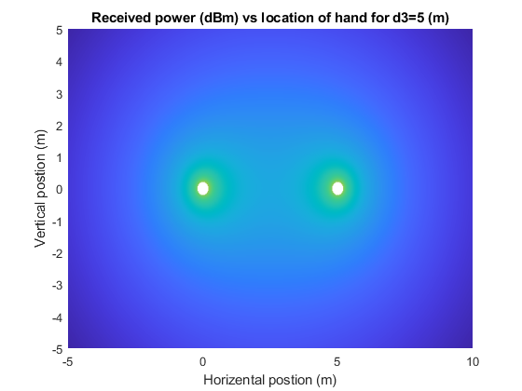
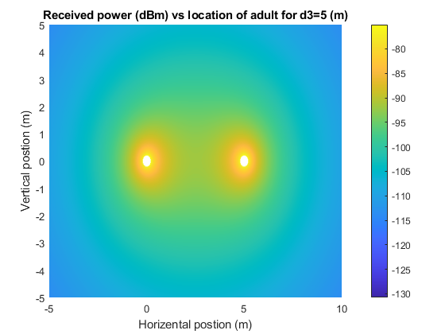
CIR Window Size
Options for the duration of CIR window need to be specified in the standard so that so that HW implementation has a bounded complexity
The window duration is determined by the delay spread in the sensing region, defined as $d_{spread}$= $d_{1}+d_{2}$- $d_{3}$
The window size of around $32 ns$ (32 taps at chipx2 sampling rate), can cover around 10m of sensing range spread. Sensing at farther range provides very low reflected power for most of sensing cases.
UWB Tx
UWB Rx
$$d_{3}$$
Initiator/ Tx
Responder/Rx
$$d_{1}$$
$$d_{2}$$
Object being
sensed

Slide 8
Report of CIR values
When window offset is zero, the CIR can be reported according the following approaches
Approach 1: The CIR values can be interpolated and reported at sampling grid points relative to the interpolated first arrival path (Fig. 1). (At points $t_{0}^{int},t_{0}^{int}+T,t_{0}^{int}+2T, … )$, increases responder complexity
Approach 2: [Preferred approach] To limit the complexity at the responder side Interpolation across CIR before reporting can be avoided (Fig. 2). (At points $t_{0},t_{0}+T,t_{0}+2T, … )$
However, the earliest tap could be based on interpolation for ranging purpose.
The CIR report includes the interpolated earliest tap offset from the grid (${Δt}_{0}$)
When window offset is nonzero ($W_{offset}$) then the sampling points in the above approaches would be shifted by $W_{offset}$
Earliest detected tap before interpolation
Second tap after interpolation
Second tap before interpolation
Earliest detected tap after interpolation
…
$$t_{0}$$
$$t_{0}^{int}$$
$$t_{0}+T$$
$$t_{0}^{int}+T$$
$t_{0}$+2T
Fig. 1: CIR is interpolated before reporting (Green points are reported)
…
$$t_{0}$$
$$t_{0}^{int}$$
$$t_{0}+T$$
$t_{0}$+2T
$${Δt}_{0}$$
Fig. 2: CIR is reported at the grid point. Offset of earliest arrival path and grid point is contained in the report (Blue instances are reported), along with ${Δt}_{0}$

Slide 9
CIR Sensing Report: CIR Sampling Rate
Higher receiver sampling rate increases receiver complexity, and report overhead.
The payload size limit also need to be considered for CIR report.
Reported sampling rate: Chip ratex2 to provide a reasonable balance between accuracy and complexity, where chip rate is equal to the sensing bandwidth. Chip ratex1 may also be considered if feedback overhead is a concern.
For single UWB channel, the sensing bandwidth is 499.2 MHz
Sensing at multiple frequency segments is ongoing discussion. If adopted, chip rate is equal to the aggregated bandwidth, leading to larger sampling rates.

Slide 10
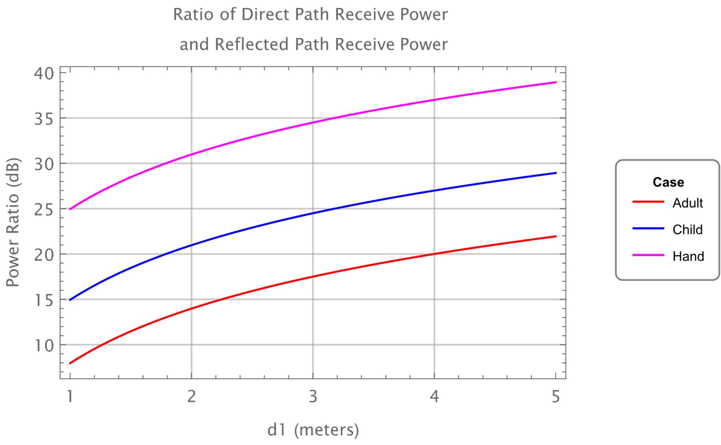
CIR IQ Bit-width
Number of bits in the report need to be limited
Using large number of bits increases the report overhead
Suggesting 12 bits for encoding signed I/Q each
Even for dynamic range of around 48 dB, SQNR of 29 dB can be achieved
The I/Q values can be normalized. The normalization (scaling) factor can be included in the report.
Full Scale
8 bits ≃ 48 dB dynamic range
Smallest bit expected
Quantization noise is 29dB below LSB
Quantization noise level ≃ -77 dBFs

Slide 11
Multiple Rx Antennas
Report of each antenna CIR, if requested, needs to be supported through negotiation.
In the presence of multiple Rx antennas, Rx antennas can be reported sequentially.
CIR report window for multiple antennas should be aligned
The offset of grid points for the antennas relative to the common timing could be contained in the report
For AoA analysis, Rx chain angle/latency calibration results can be included in the CIR report for compensation by initiator’s upper layer.
It could be too cumbersome to compensate for the angle/latency at the responder side, as it requires interpolation over the antenna CIRs

Slide 12
Content of the CIR Report
Field | Field length (bits) | Comments
Common Fields
Number of Rx antennas | TBD
Window duration ($W_{length}$) | 5 bits
Window offset ($W_{offset}$) | 6 bits | offset from the reference point.
For Each Rx Chain
RF Chain Phase Calibration | TBD | One real value per Rx chain
RF Chain Latency Calibration | 7 bits | One real value per Rx chain; Like Ranging counter time unit, could be in units of $2^{−7}$of chipping period.
Timing Offset (${Δt}_{0}$) | 7 bits | Offset of estimated EAP from grid points to assist with interpolation at initiator; Could be in units of $2^{−7}$of chipping period.
Normalization factor for I/Q | TBD | Common normalization value for In-phase and Quadrature CIR values
CIR In-Phase report | 12 bits | Per tap; normalized
CIR Quadrature report | 12 bits | Per tap; normalized

Slide 13
References
[1] Pooria Pakrooh, Bin Tian, Steve Shellhammer, and Koorosh Akhavan “Link budget analysis and CIR reporting for UWB RF sensing”, IEEE 802.15-22-0066-01-4ab, January 2022
[2] Frank Leong, Wolfgang Küchler, Riku Pirhonen, “Sensing - Continued” January 2022

