Slide 1
Project: IEEE P802.15 Working Group for Wireless Personal Area Networks (WPANs)
Submission Title: Measurement based BAN channel model for XR applications: Part II
Source: Carlos Aldana (Meta), Andreas Molisch (USC), Morteza Mehrnoush (Meta), Chunyu Hu (Meta), Qiyue Zou (Meta)
Address : [1 Hacker Way, Menlo Park, CA 94025]
E-Mail: [caldana (at) fb.com]
Re: Task Group 4ab: UWB Next Generation
Abstract: [Measurement based channel model for body area networks: Part II]
Purpose:
Notice: This document has been prepared to assist the IEEE P802.15. It is offered as a basis for discussion and is not binding on the contributing individual(s) or organization(s). The material in this document is subject to change in form and content after further study. The contributor(s) reserve(s) the right to add, amend or withdraw material contained herein.
Release: The contributor acknowledges and accepts that this contribution becomes the property of IEEE and may be made publicly available by P802.15.
Notes:
Jul 12, 2010
Page 1

Slide 2
Technical Guidance [1]
PAR Objective | Proposed Solution (how addressed)
Safeguards so that the high throughput data use cases will not cause significant disruption to low duty-cycle ranging use cases.
Interference mitigation techniques to support higher density and higher traffic use cases
Other coexistence improvement
Backward compatibility with enhanced ranging capable devices (ERDEVs).
Improved link budget and/or reduced air-time | Channel model for body area networks applies here
Additional channels and operating frequencies
Improvements to accuracy / precision / reliability and interoperability for high-integrity ranging; | Channel model for body area networks applies here
Reduce complexity and power consumption;
Hybrid operation with narrowband signaling to assist UWB;
Enhanced native discovery and connection setup mechanisms;
Sensing capabilities to support presence detection and environment mapping;
Low-power low-latency streaming | Channel model for body area networks applies here
higher data-rate streaming allowing at least 50 Mbit/s of throughput. | Chanel model for body area networks applies here
Support for peer-to-peer, peer-to-multi-peer, and station-to-infrastructure protocols;
Infrastructure synchronization mechanisms.

Slide 3
Background
BAN channel model Part I (15-22-62-01) [1]
Link Gain based on measurements taken in 4.5-8.5 GHz from antennas on HMD (head-mounted display) to antennas on body.
IEEE 802.15.4a Channel Models
[2] 15-04-0662 “IEEE 802.15.4a channel model – final report”
Saleh-Valenzuela
[3] Saleh, Valenzuela, “A statistical model for indoor multipath propagation”, IEEE J. Sel. Areas in Comm., vol.5, pp.128-137, Feb. 1987.

Slide 4
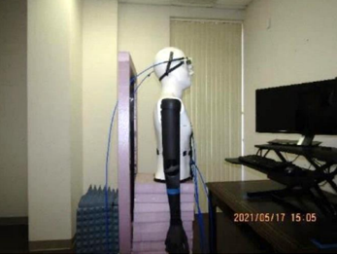
Background : Link Gain Parameters [1]
Link gain formula that takes both vertical distance and angle into account
Equation 1 1
d₀ = 1m; S, for shadowing, is zero-mean Gaussian distributed random variable with standard deviation sigma (dB)
 | on_body | screen | environment (env)
sigma (dB) | 8.1 | 9.4 | 1.85
When combining effect of all 3, Path loss = 10log₁₀(10^(on_body/10) + 10 ^(screen/10) + 10 ^ (env/10))

Slide 5
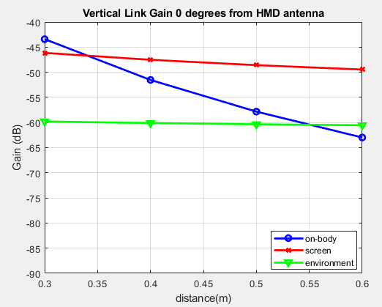
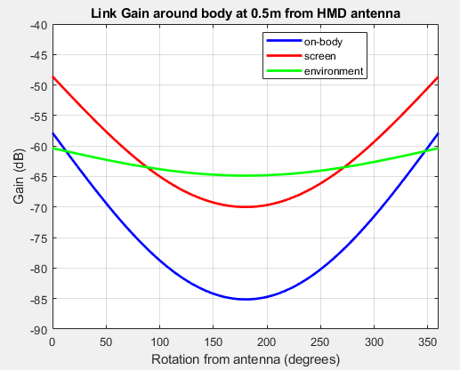
Background: A closer look at model in [1]
Vertical Gain Around Body
For comparison, FSPL (free space path loss) at 0.3/0.5m at 6.5GHz is 38.2/42.7 dB

Slide 6
Background: IEEE 802.15.4a Channel Model [2]
Accepted by the IEEE 802.15.4a Task Group as standard model for evaluation of UWB proposals
A statistical model for frequency range 2–10 GHz and multiple environments (indoor residential, office, outdoor, industrial, etc.)
It includes a frequency-dependent path gain and a Saleh–Valenzuela (SV) multipath model
Path gain is frequency-dependent:
$G\left(d,f\right)=\frac{1}{2}G_{0}η_{TX−ant}\left(f\right)η_{RX−ant}(f)\frac{{\left(f/{f_{c}}\right)}^{−2(κ+1)}}{{\left(d/{d_{0}}\right)}^{n}}$
Baseband impulse response SV model:
$$h\left(t\right)=\sum_{l=0}^{N−1}{\sum_{k=0}^{K−1}{\underset{multipath component}{\underbrace{a_{k,l}e^{jφ_{k,l}}δ(t−T_{l}−τ_{k,l})}}}}$$
Tx Baseband Signal
Path Gain $G(d,f)$
Impulse Response $h(t)$
Rx Baseband Signal
Rx antenna efficiency
reference frequency $f_{c}$ = 5GHz
$n, κ$ are environment-dependent parameters
path gain at reference distance 1m
Tx antenna efficiency
$d_{0}$ = 1m
tap weight
tap phase
cluster delay
component delay
$N$ clusters
each cluster has $K$ components

Slide 7
Background: Review of SV model [3]
First cluster is formed by “direct” path to receiver
Subsequent cluster result from reflections from the building walls/doors
Cluster arrival times (the arrival times of the first rays of the clusters) are modeled as Poisson arrival process with some rate Γ
Within each cluster, subsequent rays also arrive according to a Poisson process with another rate γ. Note all clusters use same γ.
τ
PDP( )P
e ^{-τ/ Γ}
e ^{-τ/ γ}
τ

Slide 8
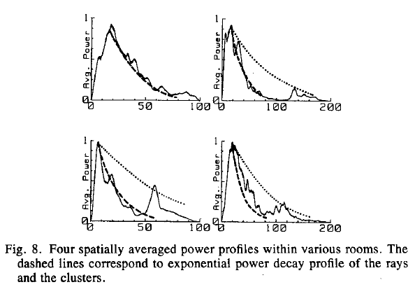
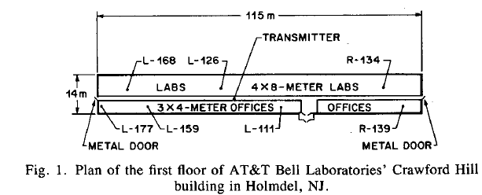
Background: Measurements in [3]
Medium size 2 story office building, fc = 1.5 GHz
8 rooms measured with 25 locations within each room
Found that 4 rooms only had 1 cluster and 4 other rooms had 2 clusters.
Note that 3m x 4m office is similar to the office where the measurements were made with size of 3.9m x 3.45m

Slide 9
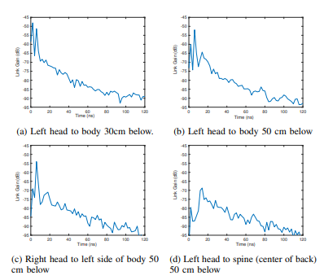
Measurements in office with desk
Monitor is 0.9 meters away from Popeye
In top left, there is a strong peak at 2ns with a second peak at 6ns, corresponding to reflection from monitor
There is an exponentially decaying component starting at around 12ns, which is due to the environment
In the top right, the strong peak at 2ns has decreased by more than 10dB (due to shadowing from the chest) while the screen reflected component remains largely unchanged.
In the bottom left, the strong peak at 2ns has decreased even more due to the propagation across the body.
In the bottom right, the propagation is mostly due to environment and is happening via back and sidewall reflections.

Slide 10
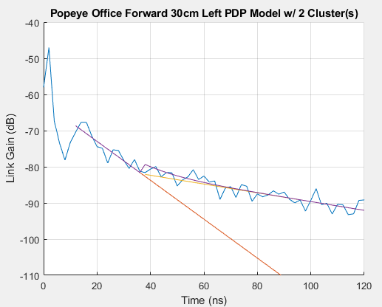
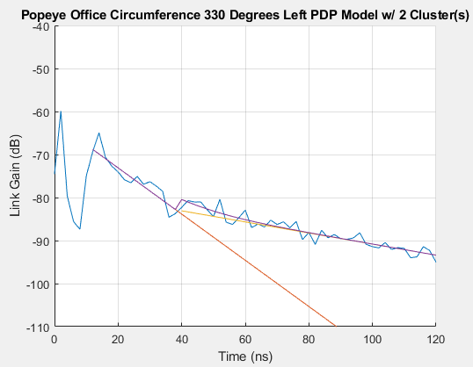
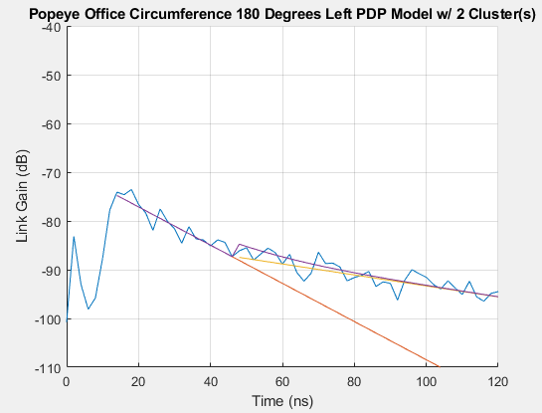
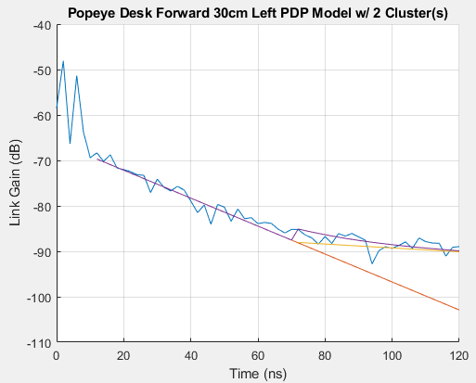
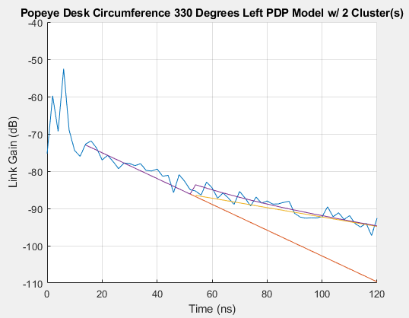
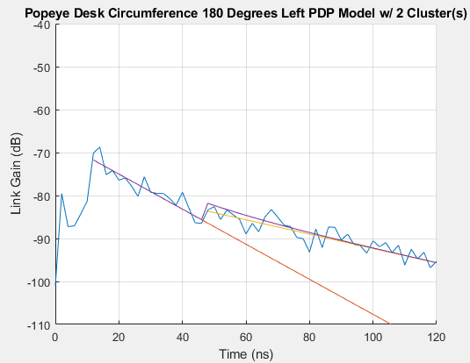
Example PDPs with and without screen
no screen, 0 degrees, LOS
no screen, 30 degree offset
no screen, behind body
on-bodyy
environment
with screen, 0 degrees, LOS
with screen, 30 degree offset
with screen, behind body
on-bodyy
environment
screeny
Red line is the first cluster. Yellow line is the second cluster. Purple line is the sum of both clusters
In all measurements so far, 2 clusters provided a good fit.

Slide 11
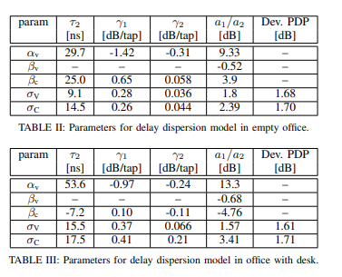
PDP Delay Model
Power delay profile can be modeled as:
where I(x) is the indicator function, which is 1 if the argument is true, and 0 otherwise. In addition, N_{cluster} = 2.
Equation 2 1
τ
PDP( )P
a_{on-body}
a₁
a_{screen}
a₂
τ_{LOS}=s
2nss
τ₁=s
12nss
τ₂s
τ
τ_{screen}=s
6nss

Slide 12
Additional details on parameters
τ₂
Parameter | ,γ_{1,} γ₂ | Ratio of a₁/a₂ (dB) | Deviation of PDP in each tap from exponential
 | Distance-independent α_{v} + S_{v} along vertical and α_{v} + β_{c} sin(φ/2) +S_{c} along circumference. Deviations from mean are uniformly distributed | Follows α_{v} + β_{c} sin(φ/2) +10β_{v}log(d/d₀)+S_{c} +S_{v} Deviations from mean are uniformly distributed | Follows Equation 2. Deviations are log normal (like SV model)
S_{v} is a zero-mean uniform RV with std σ_{v}. S_{c} is a zero-mean uniform RV with std σ_{c}.

Slide 13
How does this PDP model compare with SV?
 | This work | SV
γ_{1,} γ₂ | Allowed to be different | same
Arrival time of cluster | uniform | Poisson
Envelope of clusters | Depends on a1/a2 ratio | Follows exponential distribution
Deviation of PDP | Log normal | Log normal

Slide 14
Simulating the BAN channel
Determine path gain of on-body (a_{on-body}), screen (a_{screen}), per Eq.1 in Slide 4.
For PDP, the on-body contribution is a delta pulse at 2ns and the screen contribution is a delta pulse at 6ns.
The starting point of cluster 1 is 12ns; starting point of second cluster is chosen using a uniform distribution according to Tables II and III in Slide 11.
The decay time constant for first and second cluster as well as the ratio of first to second peak is chosen using a uniform distribution according to Tables II and III in Slide 11.
Compute the power sum of the first and second cluster in the interval [12,…120ns] and normalize so that the total power is same as the environment path gain in Equation 1 in Slide 4.
The PDP at each delay is computed by adding a normally distributed (on a dB) scale statistical variation according to parameters in Table II and III in slide 11.
Finally, add uniform RV with [0,2 π] to the phase of each tap.

Slide 15
Conclusions
Part I presented a measurement-based link gain model as a function of the mounting position of the antennas on head and torso.
Part II presented a measurement-based PDP model as well as channel generation procedure as a function of the mounting position of the antennas on head and torso.
The channel model splits the contributions from the body, the screen (if present), and the environment for XR applications.

Slide 16
Strawpoll
The task group agrees to add the BAN channel model for evaluation of different PHY proposals addressing data communications.
Vote: Y/N/A

Slide 17
Appendix

Slide 18
CM1 Channel Statistics

Slide 19
CM1 Channel Statistics

