Slide 1
March 2022
Doc: IEEE P802.15-22-0166-00-6a
Project: P802.15 Working Group for Wireless Specialty Networks
Submission Title: Improving the Security of the IEEE 802.15.6 Standard for Medical BANs.
Date Submitted: March 10th, 2022
Source: Muhammad Ali, Georg Hahn, Said Hamdioui, Wouter Serdijn, Christos Strydis.
Company: Delft University of Technology, Erasmus Medical Center.
Address: Wytemaweg 80, 3015 CN, Rotterdam, The Netherlands.
E-Mail: c.strydis@erasmusmc.nl
Abstract: Security enhancements for IEEE 802.15.6 Std.
Purpose: Material for discussion.
Notice: This document has been prepared to assist P802.15.6a. It is offered as a basis for discussion and is not binding on the contributing individual(s) or organization(s). The material in this document is subject to change in form and content after further study. The contributor(s) reserve(s) the right to add, amend or withdraw material contained herein.
Release: The contributor acknowledges and accepts that this contribution becomes the property of IEEE and may be made publicly available by P802.15.6a.
Submission
Slide 1
Muhammad Ali, et.al.

Slide 2


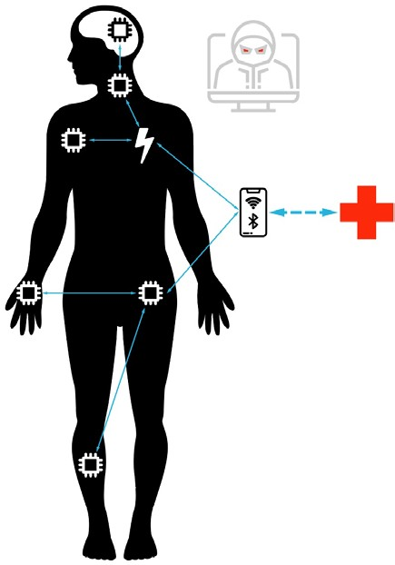
Improving the Security of the IEEE 802.15.6 Standard for Medical BANs
M u h a mma d A l i S i d d i q i G e o r g H ah n
S a id H a md i o u i , S e n i o r M e m b e r, I EEE Wo u t e r A . S e r d ij n , F e l l o w, I EEE
C h ris t o s S t r y d is , S e n i o r M e m b e r, I EEE

Slide 3
Agenda
Motivation & problem statement
Explaining Medical Body Area Networks (MBANs)
IEEE 802.15.6 security
MBAN threat landscape and security requirements
Security-analysis & -assessment methodology
Security recommendations (Highlights)
Methodology benefits & drawbacks
Next steps

Slide 4


Security lagging behind
Motivation and problem statement
Motivation
Technology
Security
IEEE 802.15.6 security
Medical applications are becoming increasingly wireless
Medical data is extremely sensitive and private
Medical devices often have a critical functionality
Cyber incidents involving medical devices are getting more prominent
Only secure applications will be adopted by broader population
The research question
How can the IEEE
802.15.6 standard’s security posture be improved in order to
provide a secure framework for future MBAN applications?
IoT and IoMT are disrupting traditional healthcare
Vulnerabilities in association and disassociation protocols have been found recently
There is still room for improvement in terms of security
Many new medical applications (such as Neural Dust), do not exactly fit within the framework set by 802.15.6.
Devices get increasingly more functionality
Lack of standardisation for wireless medical sensors and actuators
Rapid advances in wireless technology for interconnected devices in the medical space are accompanied by a lack of proper security measures
2

Slide 5
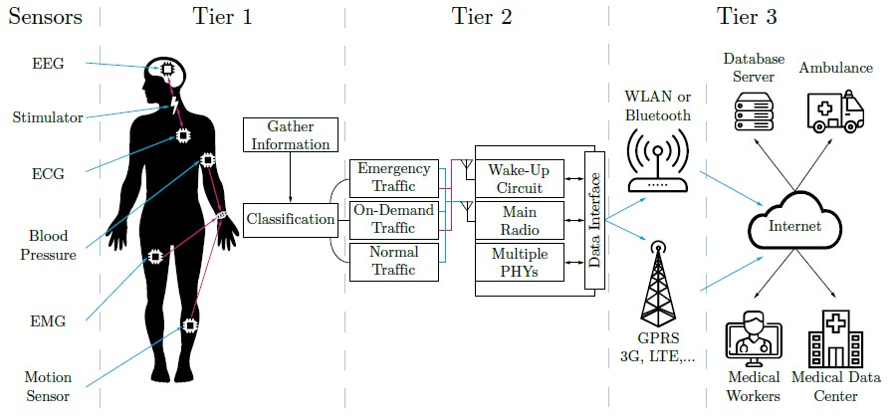
MBAN taxonomies
Explaining Medical Body Area Networks (MBANs)
Disclaimer: In this presentation, MBANs and WBANs will be used interchangeably
Functionality
Implementation
Role
Sensor
Actuator
Hybrid
Central Control Unit (CCU)
Invasive
Semi-Invasive
Wearable
Ambient
End node
Relay node
Coordinator node
Tree
Star
Peer-to-peer
Node types
MBAN
Topologies
Architecture
Applications
MBAN 3-tier architecture
Invasive
Semi-Invasive
Wearable
Remote Control
Leadless Cardiac Pacemakers
Cancer detection
Body dust
…
Diabetes control
Remote hearing aids
…
Epileptic seizure detection
Mental status monitoring
Sleep analysis
…
Ambient Assisted
Living (AAL)
…
3

Slide 6

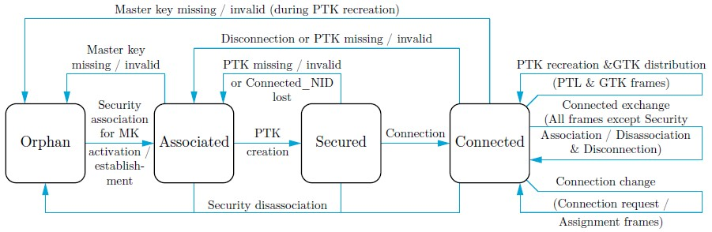

IEEE 802.15.6 security
The IEEE 802.15.6 standard security
Security is offered in three levels
Unsecured communication | Authentication without encryption | Authentication with encryption
Association / Disassociation protocols
Master-key pre-shared association
Unauthenticated association
The network’s central coordinator (hub) must choose a security level before initiating a connection
Public-key hidden association
Password authenticated association
Which other security flaws does the standard have and how can we identify them?
Display authenticated association
Security state diagram
PTK creation and GTK distribution
Disassociation
Several vulnerabilities in the association and disassociation protocols provided by IEEE
802.15.6 have been found by Toorani et al.
4

Slide 7
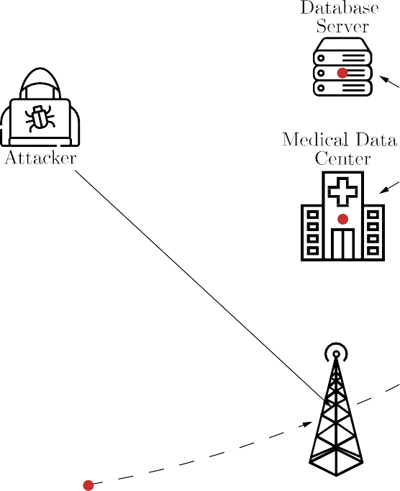
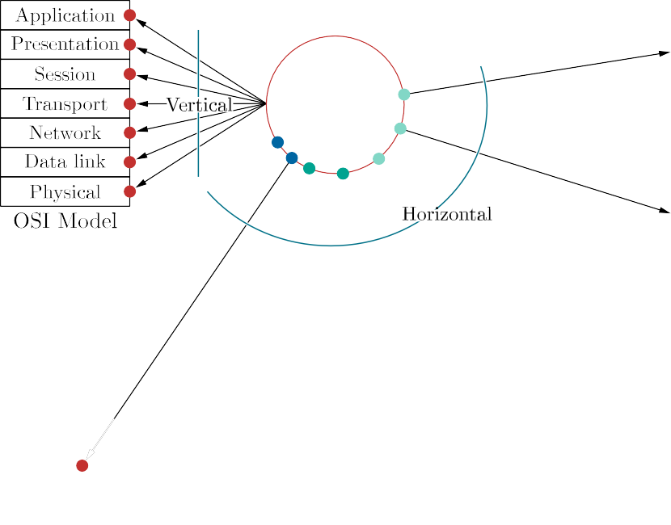
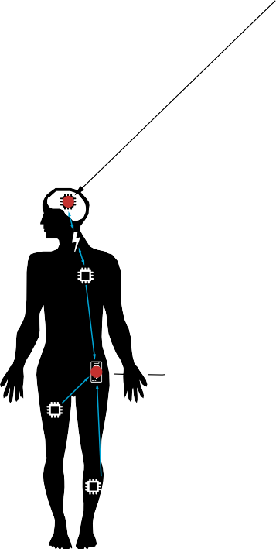

Attack surface constantly increasing
MBAN threat landscape and security requirements
New applications are leading to a rapid expansion of the attach surface
Security attributes need to be addressed in a structured and complete manner:
Confidentiality
Integrity
Availability
Authentication
Authorization
Data freshness
Secure-key management
Accountability
Dependability
Flexibility
Robustness

Slide 8
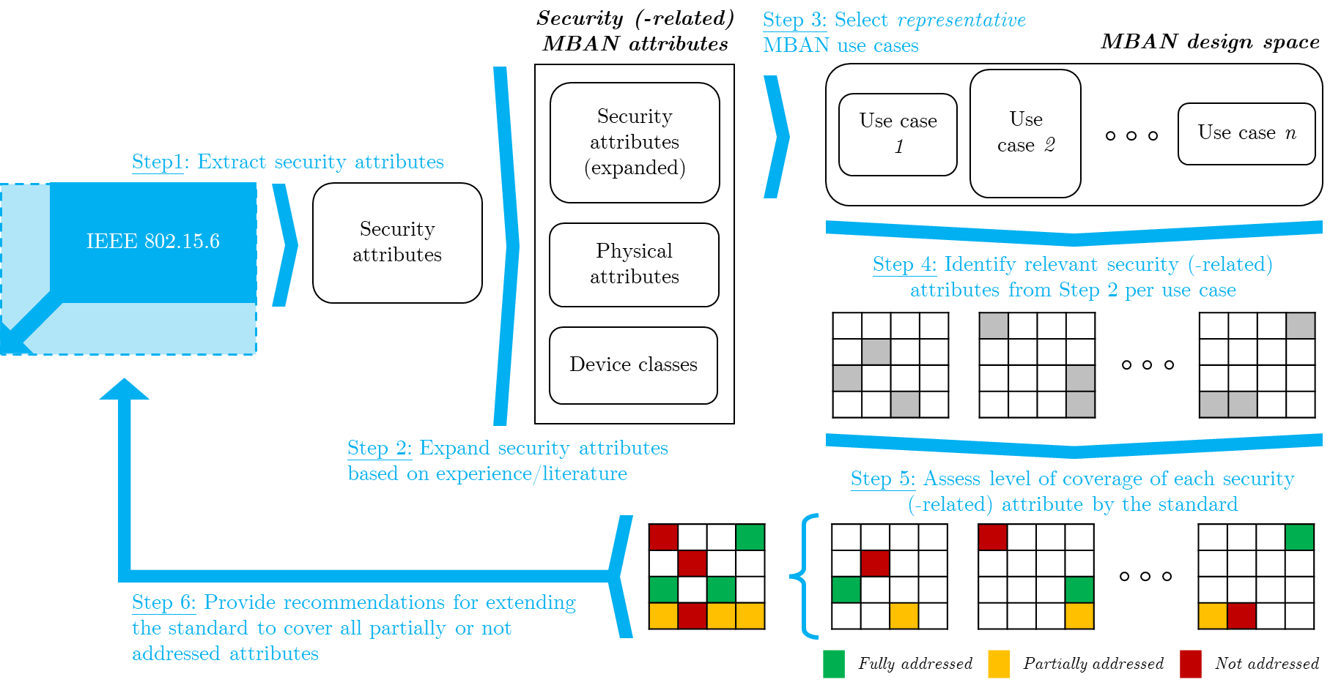
Our assessment methodology
A heuristic, iterative and scalable approach
A structured procedure to analyse the standard in terms of security

Slide 9
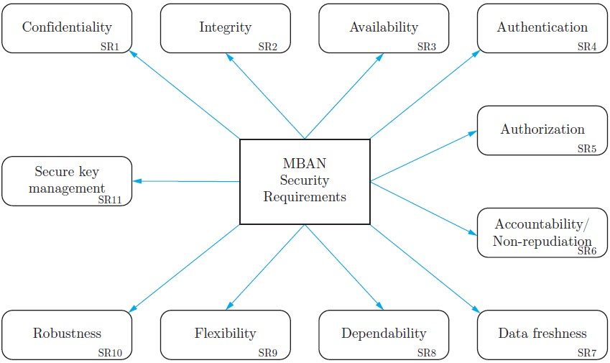
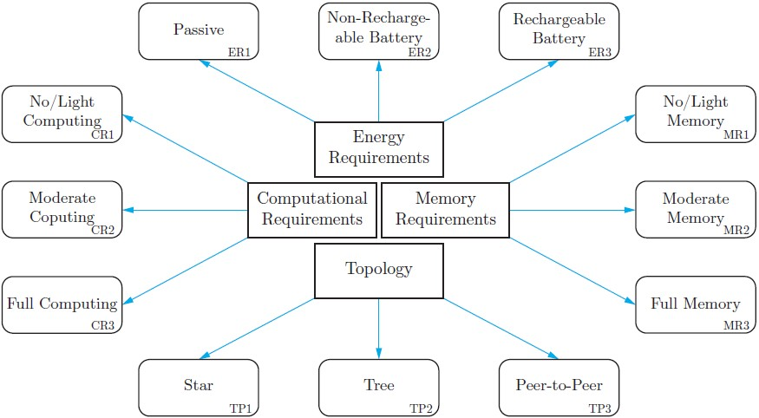
Introduced security (-related) attributes
A structured procedure to analyse the standard in terms of security
Security attributes (Sx)
Physical attributes (Px)
Recall the taxonomies introduced!
Device classes (Dx)
Invasive
Semi-invasive
Wearable
Ambient

Slide 10
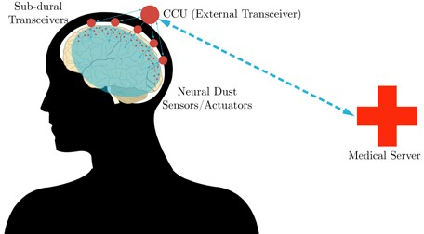
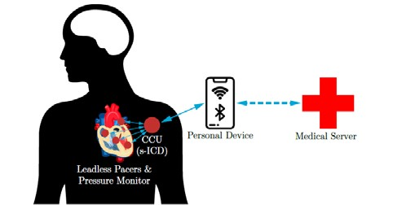
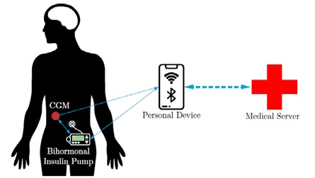
Representative MBAN use cases
A structured procedure to analyse the standard in terms of security
Scenario 1 – „Neural Dust“
Scenario 2 – „Leadless Cardiac Pacemaker“
Scenario 3 – „Artificial Pancreas“
Description
Key-Facts
Description
Key-Facts
Description
Key-Facts
Cortically and sub-cortically implanted untethered, micron-sized sensors and actuators, communicating
with sub-dural transceivers via ultrasound and back- scattering that relay data to a wearable external transceiver
Capable of recording EMG and extracellular signals and deep brain stimulation
Sub-dural transceivers relay signal to CCU
US channel of neural dust nodes are considered as inherently secure
Leadless cardiac pacemaker network capable of CRT and bradycardia pacing therapy, combined with an s-ICD. The device generator acts as the CCU that collects and processes data & instructions from implanted nodes and relays it to a personal device
Implanted nodes directly communicate with sub- cutaneous CCU via RF communication
If a connection can be established, the personal device relays data to medical server
Artificial pancreas system with a CGM transmitting blood glucose levels to a bihormonal insulin pump as well as a personal device. The pump acts as the network’s CCU and coordinates the peer-to-peer connection between nodes
Bihormonal insulin pump can autonomously regulate blood glucose levels
CGM system records real- time blood sugar and transmits data to pump and PDA
Personal device for convenience
Pump is CCU

Slide 11
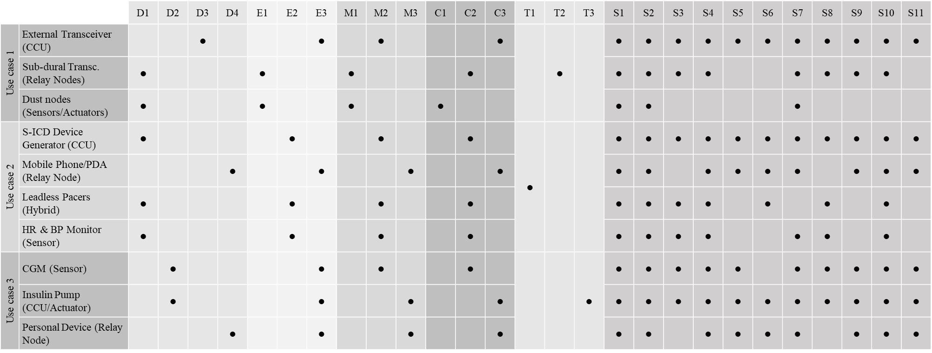
How use cases are linked to security(-related) attributes
A structured procedure to analyse the standard in terms of security
This matrix links device classes, physical and security requirements with the use cases

Slide 12
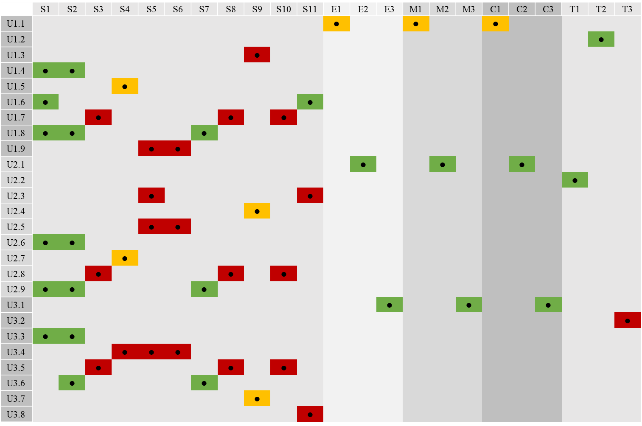
Use-case specifications vs. Security(-related) attributes: Gaps Identified
Analysing the IEEE 802.15.6 standard
We cover each security(-related) attribute at least once due to employing 3 separate use cases
Looking at the resulting coverage map, we are able to identify gaps
satisfied
partly satisfied
not satisfied

Slide 13
Security(-related) recommendations – A few highlights
Physical & Organizational recommendations
  PO.R3: An explanation of the mMaxBANSize limit needs to be added in Chapter 4.2: Network topology or as an addition to Table 24 - MAC sublayer parameters. More importantly, this limit is not sufficient for future applications (e.g., Neural Dust).
Cryptography, Confidentiality & Integrity recommendations
  CC.R3: In Chapter 7: Security services, a paragraph needs to be added stating that, for devices unable to support conventional cryptography, the developer needs to ensure the inherent security of the link (security by design). For example, in Neural Dust, a MHz-range ultrasound channel can be employed to achieve inherently secure communication.
Authentication & Authorization recommendations
  AA.R1: In Chapter 7.1.1: Master key pre-shared association, it is mentioned that the hub and the node perform mutual authentication with each other, while simultaneously advancing to the PTK-creation procedure. Here, a paragraph explaining the inner workings of the mutual authentication procedure has to be added.
Other recommendations
  O.R2: In Chapter 7: Security services, best practices and recommendations on how to harden a BAN against DoS attacks need to be introduced in a separate sub-chapter.

Slide 14
What our methodology offers
Taxonomies against which the standard can reflect itself
  Taxonomies: Node functionality, node implementation, node role, MBAN security tiers, security attributes
  A standard needs to be very clear, especially with the advent of new applications (e.g., Neural Dust)
A tractable method by which to assess the (security) provisions of the IEEE standard
  An exhaustive search of the whole MBAN design space would be impractical or infeasible
An iterative, scalable method that can be adjusted to:
  More use cases
  New security vulnerabilities
  More or finer-grain security(-related) attributes
A “forensics”, reversible method → allows tracking new IEEE-standard additions back to respective findings

Slide 15
What is currently not there
Updated, end-to-end security protocols addressing MBANs
  Essentially, we currently provide recommendations on the vocabulary
  Can we also extend the grammar?
  Can this, in fact, be achieved in a general way (i.e., as part of a standard?)

Slide 17





Thank you for listening
15
https://neurocomputinglab.com

