Slide 1
Project: IEEE P802.15 Working Group for Wireless Personal Area Networks (WPANs)
Submission Title: Discussion on narrowband assisted UWB
Date Submitted: March 8, 2022
Source: Bin Tian, Pooria Pakrooh and Koorosh Akhavan (Qualcomm)
E-Mail:{btian, ppakrooh, kakhavan}@qti.qualcomm.com
Abstract: Discuss the challenges and framework of the narrowband assisted UWB .
Purpose: .
Notice: This document has been prepared to assist the IEEE P802.15. It is offered as a basis for discussion and is not binding on the authoring individual(s) or organization(s). The material in this document is subject to change in form and content after further study. The authors(s) reserve(s) the right to add, amend or withdraw material contained herein.

Slide 2
PAR Objective | Proposed Solution (how addressed)
Safeguards so that the high throughput data use cases will not cause significant disruption to low duty-cycle ranging use cases
Interference mitigation techniques to support higher density and higher traffic use cases
Other coexistence improvement | Coexistence for NB+UWB operation
Backward compatibility with enhanced ranging capable devices (ERDEVs)
Improved link budget and/or reduced air-time
Additional channels and operating frequencies
Improvements to accuracy / precision / reliability and interoperability for high-integrity ranging
Reduced complexity and power consumption
Hybrid operation with narrowband signaling to assist UWB | Discuss issues and framework of NB assisted UWB
Enhanced native discovery and connection setup mechanisms
Sensing capabilities to support presence detection and environment mapping
Low-power low-latency streaming
Higher data-rate streaming allowing at least 50 Mbit/s of throughput
Support for peer-to-peer, peer-to-multi-peer, and station-to-infrastructure protocols
Infrastructure synchronization mechanisms

Slide 3
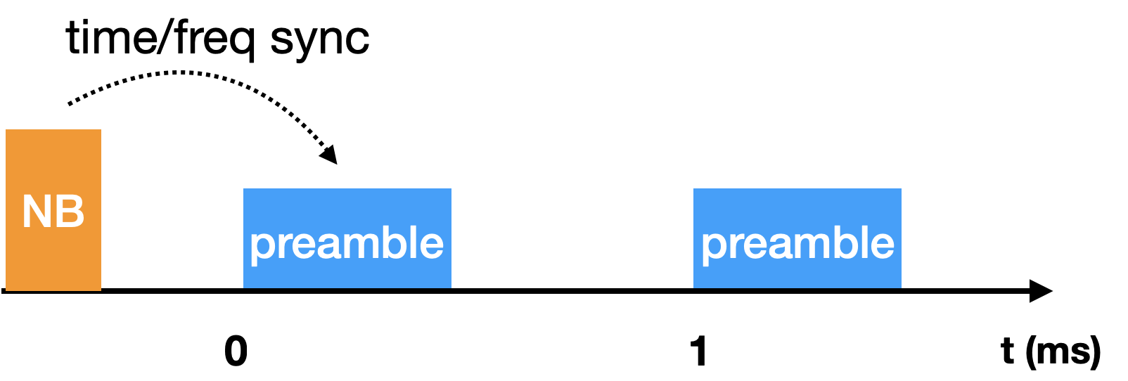
Overview
NB assisted UWB has been proposed in [1-4]
  NB: O-QPSK (15.4 PHY) operating in UNII-3
Main benefit: improve link budget
  Leverage NB higher Tx power to provide initial time and frequency synchronization
  UWB: combining over multiple 1ms period to enhance link budget

Slide 4
Discussion on 15.4 O-QPSK NB in UNII-3
Yet another radio to support
  Many products already support UWB+BLE
Coexistence challenges
  UNII-3 is used by many technologies, and it can get crowded
  LBT is needed to avoid collision and better coexistence
  In device coexistence
    Many devices e.g. phones already operate WiFi in UNII-3
    Interference and blocking between WiFi and NB PHY Tx and Rx
      Tx/Rx concurrency likely not possible
    Time sharing needed between WiFi and NB PHY
      Hopping and arbitrary message arrival time of NB PHY make arbitration very difficult
Unavailable in some regions (e.g. Japan)
In summary, NB in UNII-3 may not be a good choice for many products, applications and/or in certain regions

Slide 5
New Framework
We can expand/abstract the NB assisted +UWB proposal into a new framework
Phase I: Initial synchronization
  Setting up and provide initial timing and frequency synchronization for phase II UWB measurements
    Sharing the same clock source with UWB
  Open interface to potentially support different technologies, .e.g.
    BLE in 2.4 GHz
    UWB SHR
    15.4 O-QPSK PHY in UNII-3
Phase II: UWB Measurement
  Multiple 1ms segment to allow combining for link budget gain
Phase III: Measurement report
  Use the same technology as phase 1

Slide 6

Example of UWB-based Initial Synchronization
-5.8 dBm
UWB
UWB
SHR
Preamble
-14.3 dBm
-74 dBJ
-74 dBJ
time
139.4 us
139.4 us
-5.8 dBm
UWB
UWB
Preamble
Preamble
-14.3 dBm
UWB
$$⋯$$
Long SHR
-74 dBJ
-74 dBJ
time
1 ms
1 ms
Initial Sync Phase
UWB Measurement Phase
Transmit a short SHR when only one “Preamble” be sent
When more than one “Preamble” be sent, the length of SHR in millisecond matches with the number of “Preamble”

Slide 7
Suggestions
15.4ab defines an open interface to enable different technologies for phase 1 initial synchronization
  Interface can define the parameters needed to support the following UWB measurement and specify the timing and frequency synchronization accuracy requirements
  May define an UWB option for initial sync
  For 15.4 NB PHY in UNII-3 band, need to define coexistence rules (LBT) and potential operating parameters (periodicity, duty cycle etc) to help in-device coexistence
For phase II UWB measurement, need to discuss on more details, .e.g.
  Duration range of UWB segment in each 1ms
  Need of security: current proposal in [1-4] doesn’t include security
    Any use cases that do not require security?
  Impact of clock/frequency/phase drift to the combining over multiple 1ms

Slide 8
References
[1] 15-22-0064-04ab Potentials of narrowband assisted UWB
[2] 15-22-0074-04ab Link budget analysis for NBA-MMS
[3] 15-21-0593-04ab More on NBA-MMS
[4] 15-21-0409-04ab Narrowband assisted multi-millisecond UWB

